Slide 1




Exploring deep Mesozoic reservoirs in the Lower Kura Basin: neotectonic controls and fluid behavior in the Yevlakh-Agjabadi Depression, Azerbaijan
Fidan Aslanzade(1), Beyler Aslanov(2),
Shakhzod Umarov(3), Rahimjan Umurzakov (4)
(1) French-Azerbaijani University (UFAZ/ASOIU), Baku, Azerbaijan (fidan.aslanzada@ufaz.az) (2) Institute of Geotechnological Problems of Oil, Gas and Chemistry, Azerbaijan State Oil and Industry University (ASOIU), Baku, Azerbaijan (beyler@inbox.ru) (3) Uzbek Institute of Standards, Tashkent, Uzbekistan (shakhumarov@gmail.com)
(4) Tashkent State Technical University named after Islam Karimov, Tashkent, Uzbekistan (umruzok54@gmail.com)

Slide 2
The aim of the study is:
The aim of the study is: to study the structural and geodynamic features and substantiate the oil and gas potential prospects of the deep Mesozoic complexes in the central part of the Yevlakh-Agjabedi depression, Azerbaijan.
Research objectives :
to analyze the deep geological structure and formation history of the Yevlakh-Agjabedi depression;
to provide a detailed lithological and stratigraphic characterization of the Mesozoic section, including the determination and refinement of petrophysical properties of reservoir rocks;
to improve the methodology for identifying structural elements controlling oil and gas potential, based on the classification of local structures using geophysical data and drilling information;
to perform paleostructural reconstructions and develop a geodynamic model of the studied region, determining the role of fault zones in hydrocarbon migration and trap emplacement.

Slide 3
The scientific novelty lies in
1
Identified structural patterns of Mesozoic complexes in the Yevlakh-Agjabedi Depression, confirming a >5 km thick Jurassic volcanic sequence.
First substantiation of fundamental trap differences: tectonically shielded and structural-block traps dominate in Mesozoic vs. stratigraphic/lithologic in Cenozoic.
Established genetic link between Naftalan–Gedekboz–Duzdag meridional uplift belt and a deep horst-like structure; proposed two alternative HC migration models.
Developed a geodynamic model explaining the role of fault zones in HC migration and trap emplacement, reconciling deep generation source concepts with existing geophysical data.
2
3
4

Slide 4
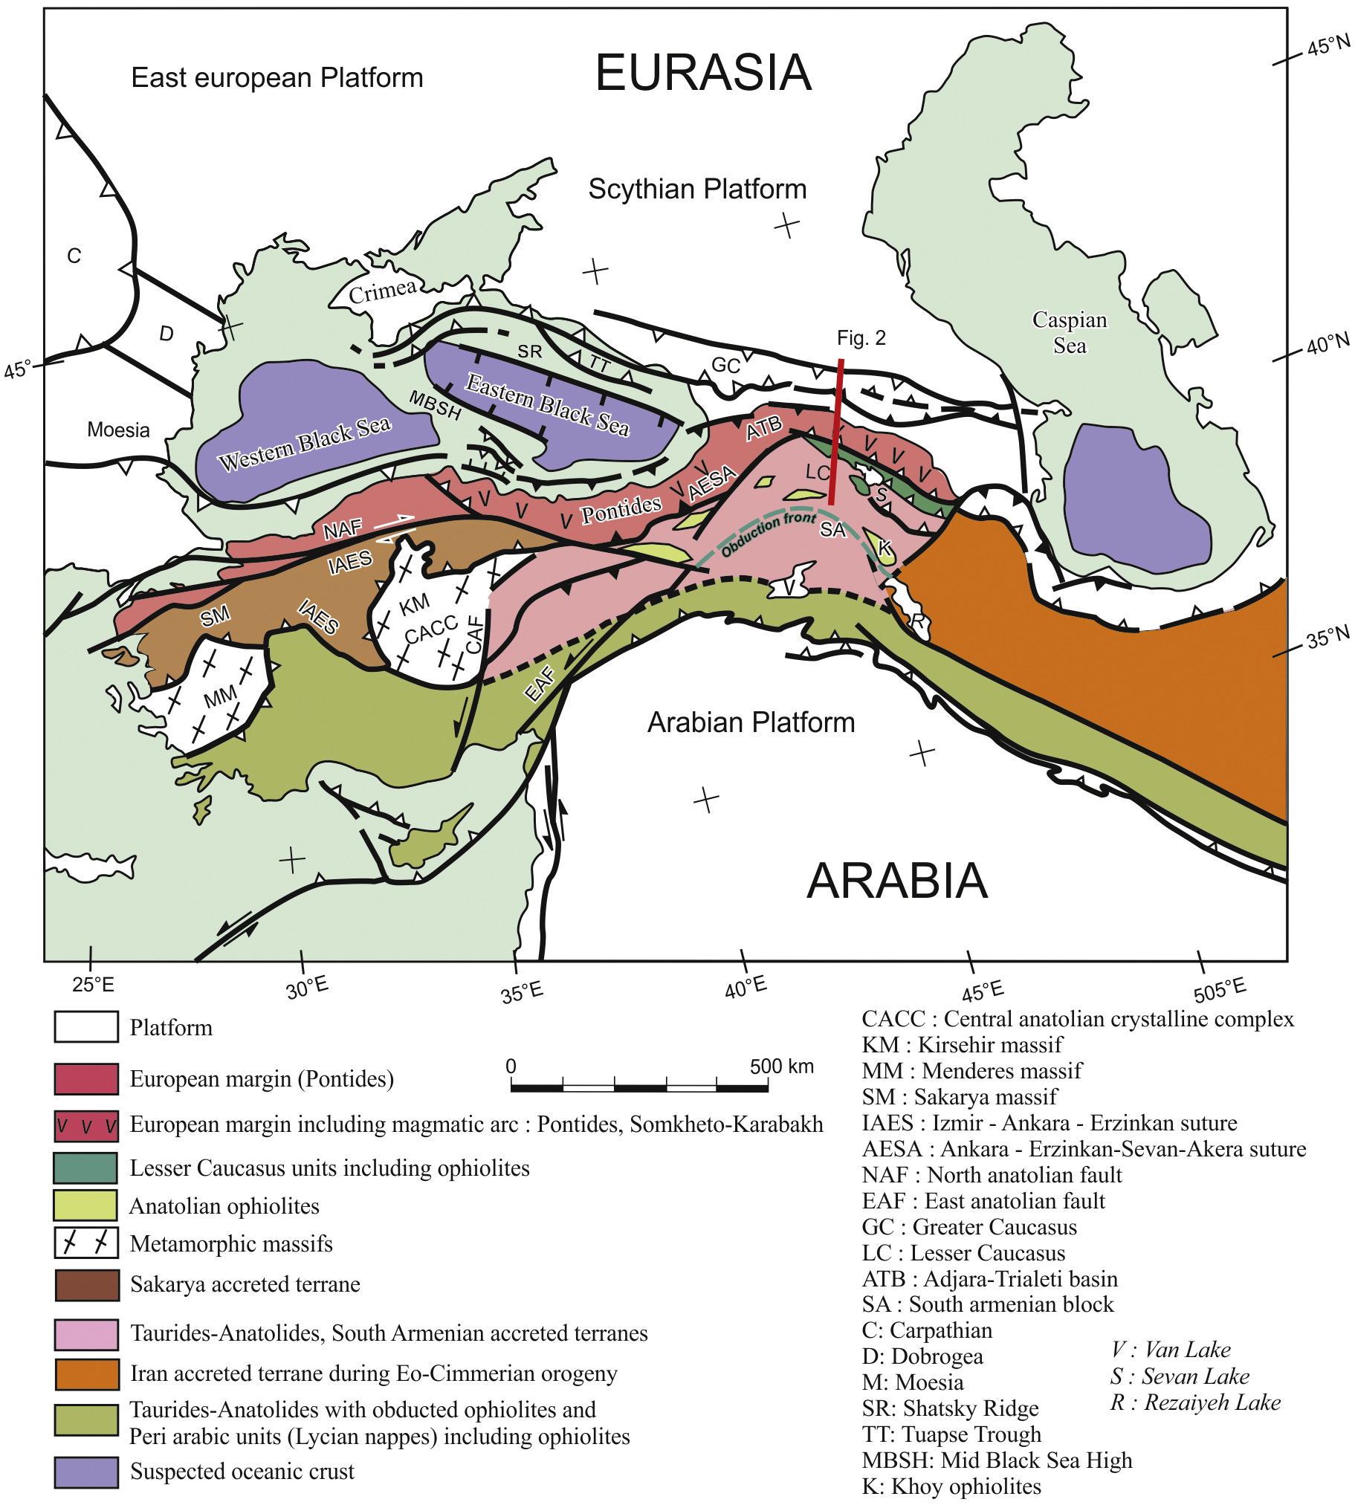
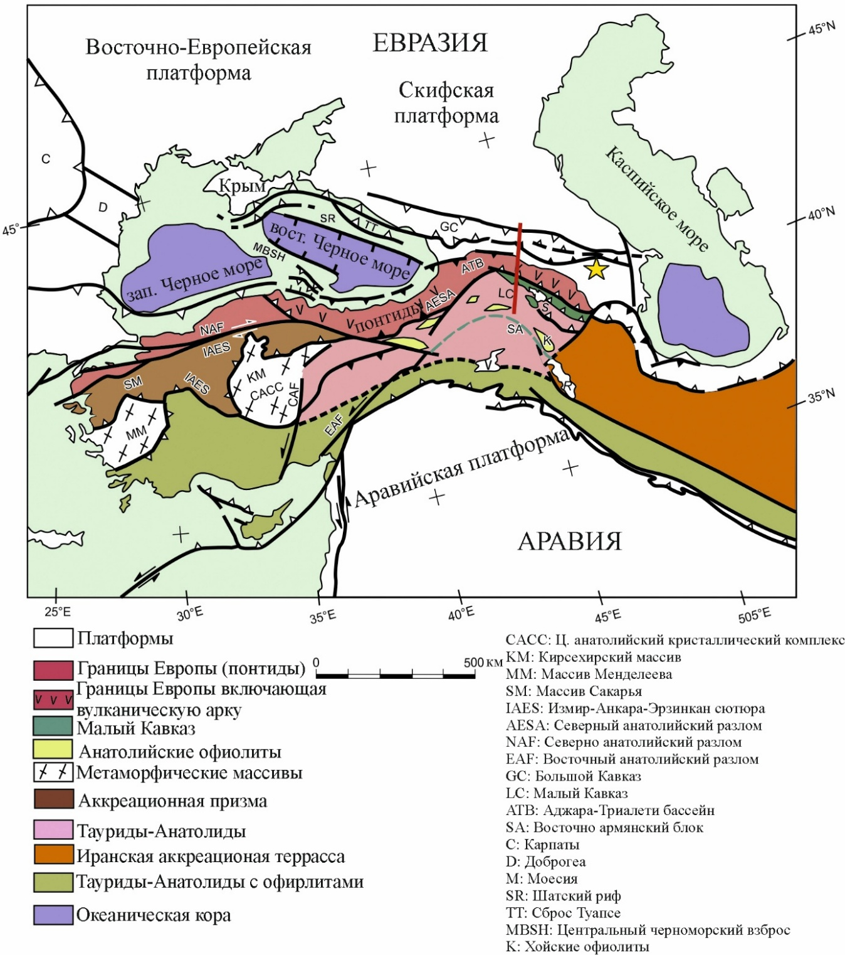
Tectonodynamics of the Black Sea-Caspian region
1
Sosson et al., 2010 и 2014

Slide 5
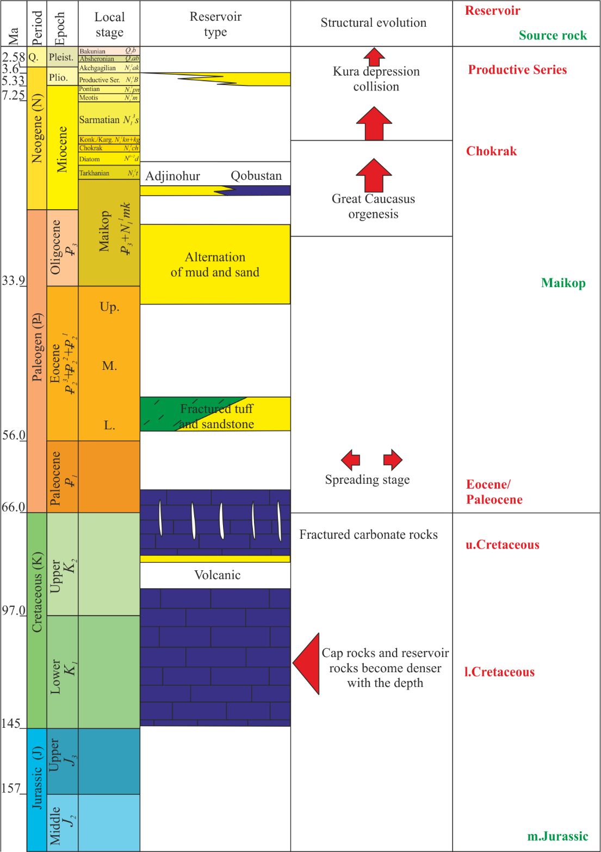
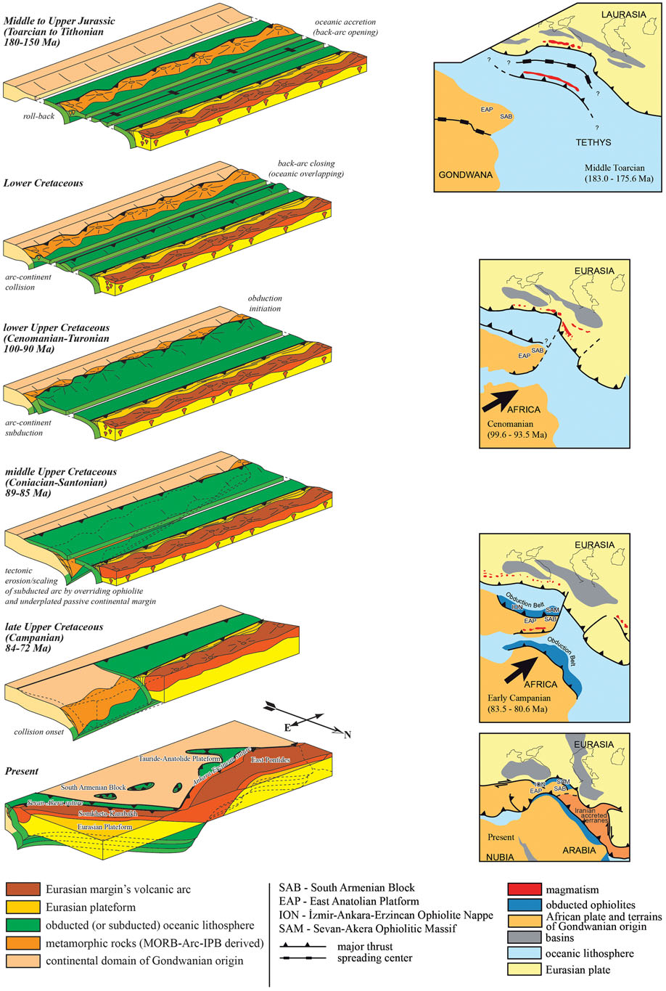
Composite stratigraphic column of the YAD
Paleotectonic evolution of the subduction process of the Eurasian and Arabian plates
1
J ₂ – J ₃
K ₁
K ₁ - K ₂
K ₂
K ₂ - P
P - Q
Barrier & Vrielynck, 2008
Forte 2010; Nemčok, 2013

Slide 6
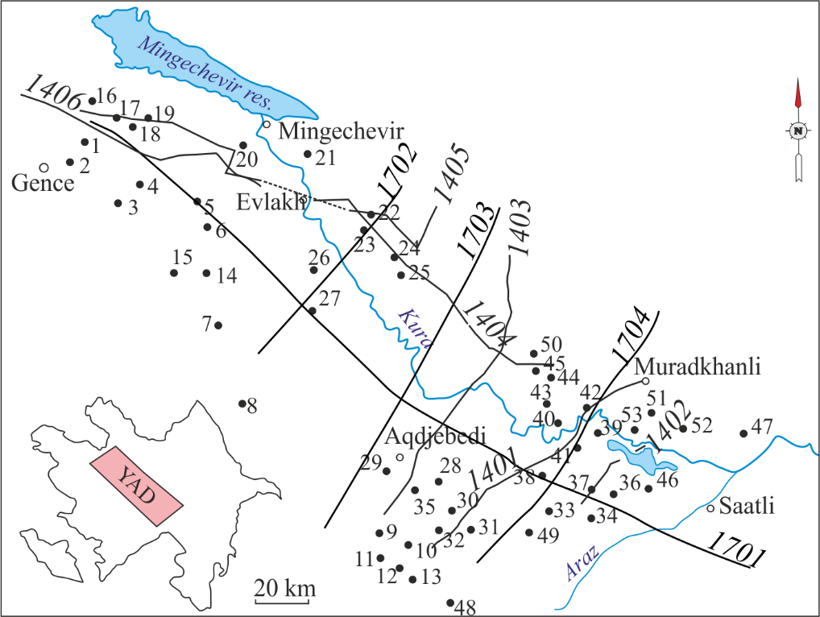
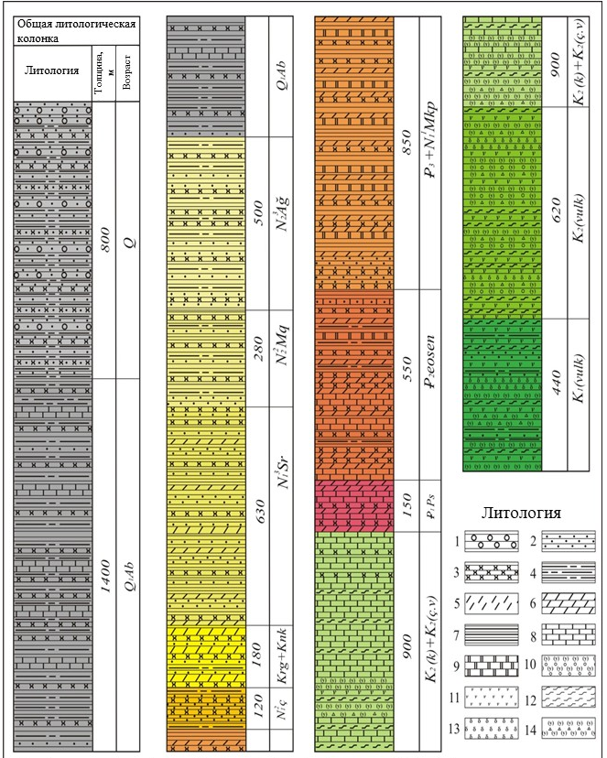
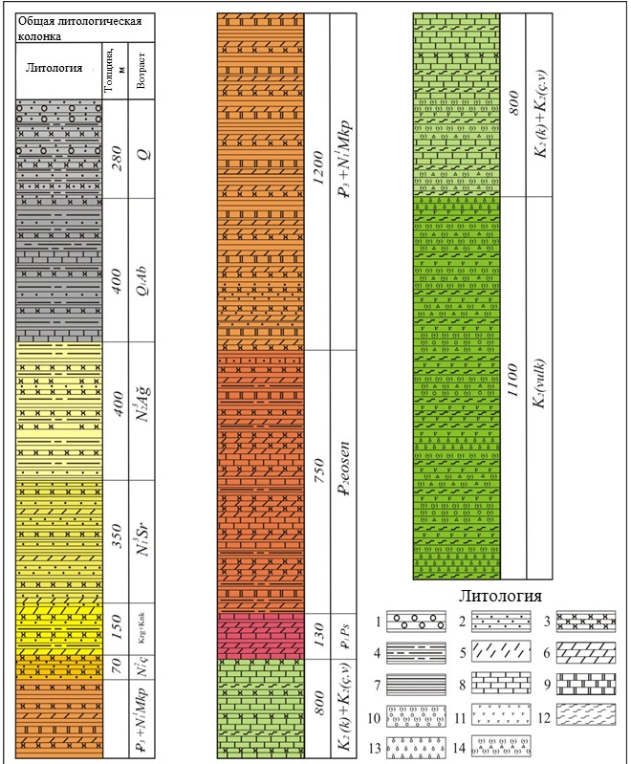
Map showing the location of regional seismic profiles and structures of the YAD
Generalized lithological-stratigraphic section of the northeastern slope of the YAD
2
1 – conglomerate, 2 – sand, 3 – sandstone, 4 – clay, 5 – calcareous clay, 6 – marl, 7 – mudstone, 8 – limestone, 9 – dolomite, 10 – tuffaceous sandstone, 11 – porphyrite and basalt, 12 – tuffaceous gravelite, 13 – andesite, 14 – tuff and tuffite

Slide 7
Indicators of local uplifts in the Mesozoic deposits of the Yevlakh-Agjabedi oil and gas region
2
№ | Structure | Well stratigraphic control | Amplitude, m | Depth, м
1 | Zardab | Mz | 50 | 4350
2 | Djafarli | Mz | 100–110 | 4400
3 | Djarli | Mz | 100–120 | 3000
4 | Sorsor | Mz | 80–100 | 3100
5 | Karabudjak | Mz | 50–70 | 3800
6 | Karabat | Mz | 50–60 | 3750
7 | Mid. Mugan | Mz | 80–100 | 3800
8 | Garali | Mz | 40–50 | 4000
9 | Mammedli | Mz | 80–90 | 3700
10 | Shikhbaghi | Mz | 100–110 | 4300
11 | Karakali | Mz | 50–70 | 3800
12 | Gellyu | Mz | 80–90 | 3700
13 | Beyimli | Mz | 40–50 | 4100
14 | Gishlaq | Mz | 70–90 | 4000
15 | East. Shikhbaghi | Mz | 50–60 | 4150

Slide 8
Reservoir properties of Cretaceous rocks
2
Reservoir properties of Upper Cretaceous carbonate rocks
Reservoir properties of Upper Cretaceous volcanic rocks
Lithology | Porosity, % | Permeability, 10⁻¹⁵ m² | Fracture density, m⁻¹
Limestone | 1,5 - 19,0 | 2,1 - 42,2 | 1,7 - 233,0
Marl | 1,2 - 21,3 | 1,61 - 13,2 | 1,2 - 230,0
Dolomite | 1,0 - 6,4 | 0,001 - 70,2 | 40,0 - 140,0
Field | Porosity, % | Permeability, 10⁻¹⁵ m² | Fracture density, m⁻¹
Muradkhanly | 0.6-28.8 | <0.001-527.1 | 1.1-126.0
Duzdag,Terter,Mil,Sorsor, Carli | 0.6-21.9 | <0.01-15.2 | 1.2-9.8
Reservoir properties of Lower Cretaceous rocks
Field | Rock types | Porosity, % | Permeability, 10⁻¹⁵ m² | Fracture density, m⁻¹
Carli | Volcanic | 3.6-13.3 | - | 0.0-98.0
Sorsor | Volcanic sedimentary | 10.1-26.2 | 1.2-16.5 | 0.0-59.0

Slide 9
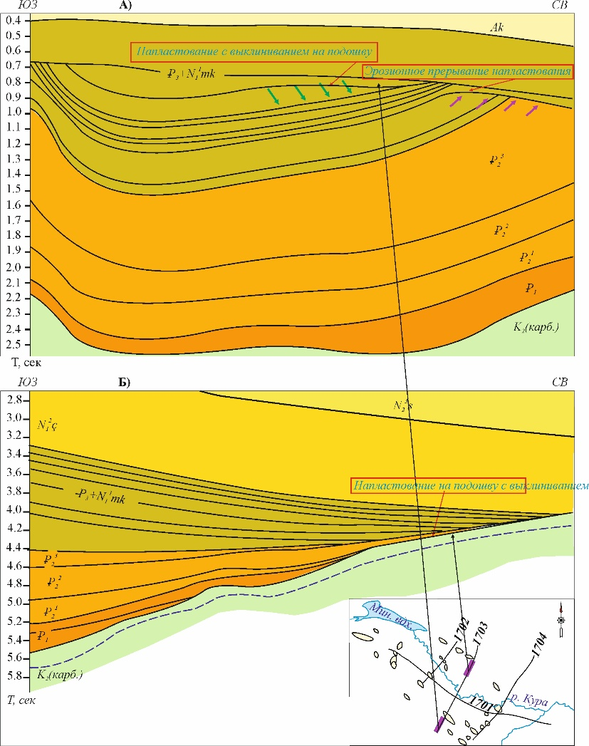
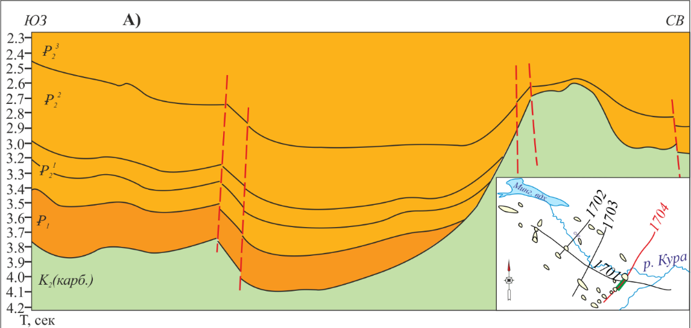
Structural and tectonic differentiation of pinch-out zones
2
SW
NE
SW
B)
NE
№1703 profile
PINCH OUT TO THE TOP
EROSION SURFACE
PINCH OUT TO THE BOTTOM
№1704 profile
SW
NE

Slide 10
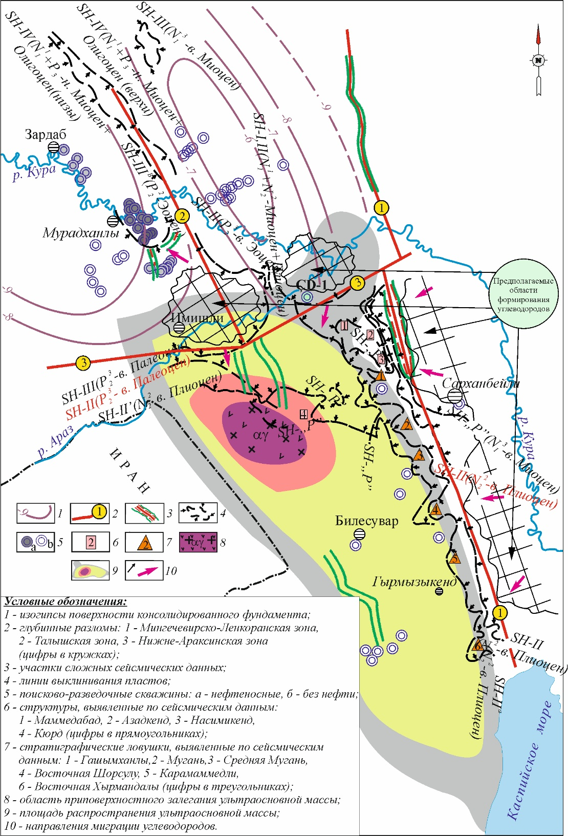
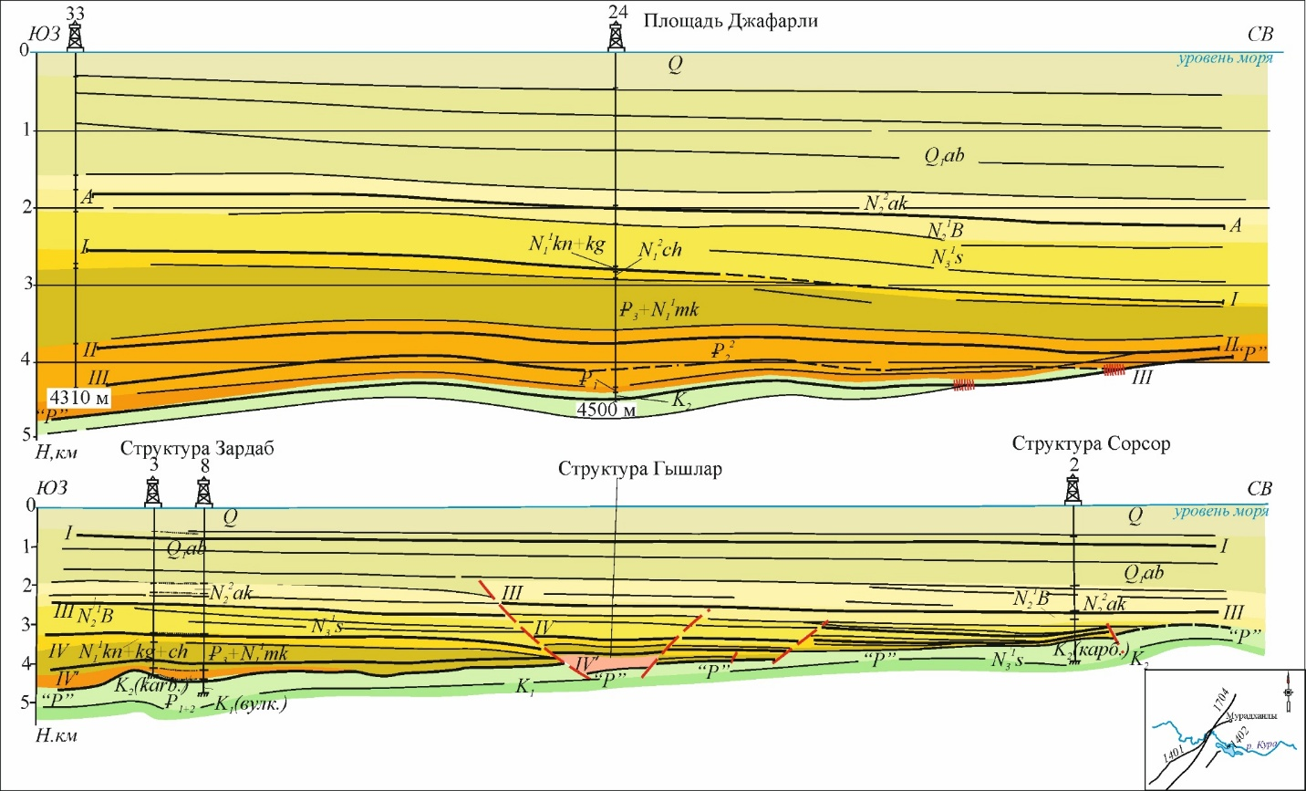
Structural-tectonic differentiation of pinch-out zones
2
Structural-lithological scheme of pinch-out zones and hydrocarbon migration pathways of the Saatly-Göychay-Lankaran zone
SW
DJAFARLI
NE
POSSIBLE HC FORMATION
ZONE
ZARDAB
QISHLAR
SORSOR
SW
NE
Legend: 1 – seismic horizon (I – Productive sequence, III – Miocene, IV – top of Maykop); 2 – seismic reflections corresponding to the boundary of the Mesozoic complex; 3 – exploration wells.
Source: Aslanov, Aslanzadə (2022)
Aslanov, Aslanzadə (2022)

Slide 11
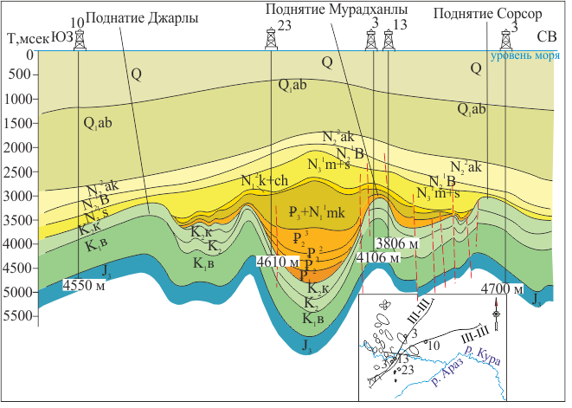
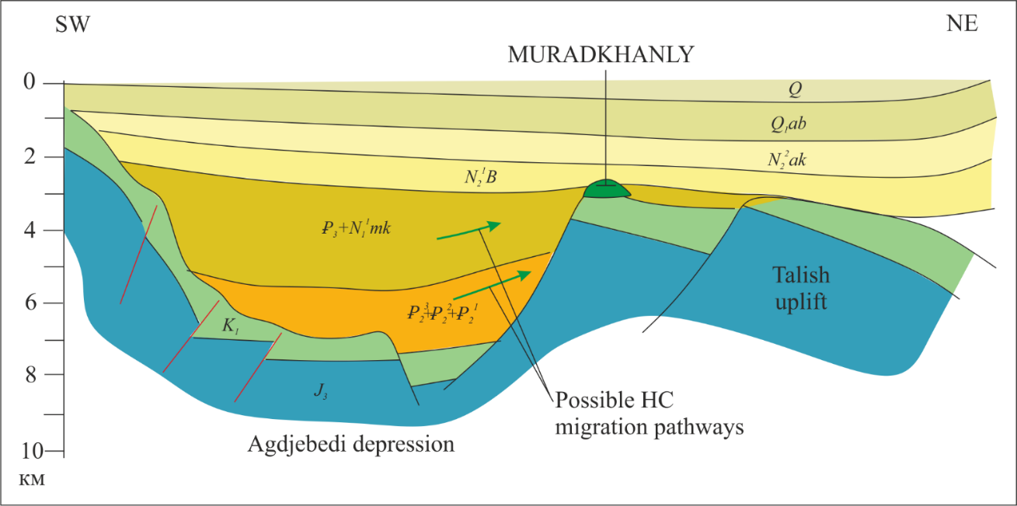
The Muradkhanly uplift as a model of a structural trap
3
DJARLI
MURADKHALY
SORSOR
SW
NE
SEA LEVEL
Scheme of hydrocarbon migration and formation of hydrocarbon potential of the Muradkhanly field (based on SOCAR materials). In the structural-tectonic framework of the Agjabedi trough and the Talysh uplift.
Kura
Araz
Djarly–Muradkhanly–Sorsor uplift group

Slide 12
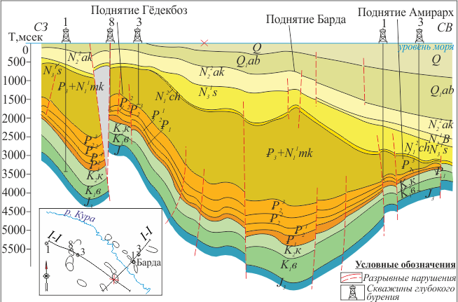
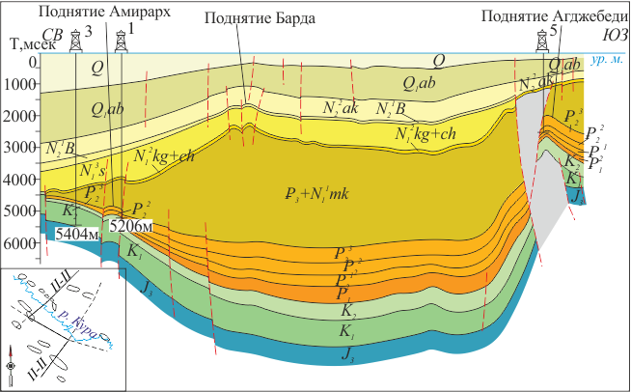
Trap types based on seismotectonic analysis
3
GEDEKBOZ
BARDA
AMIRARKH
AMIRARKH
BARDA
AGDJEBEDI
NW
NE
SW
Gedekboz–Barda–Amirarkh uplift group
Amirarkh–Barda–Agjabedi uplift group

Slide 13
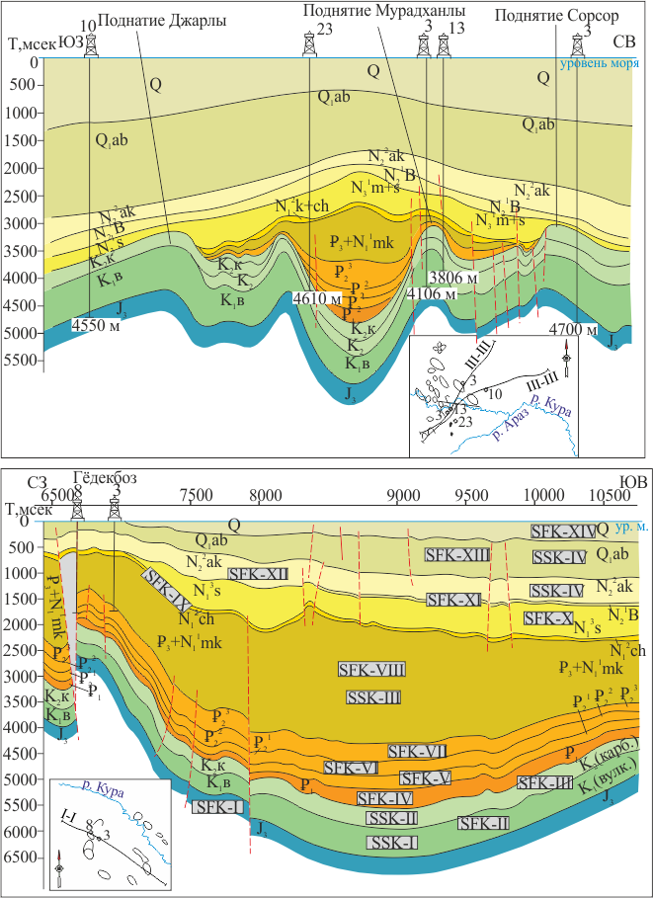
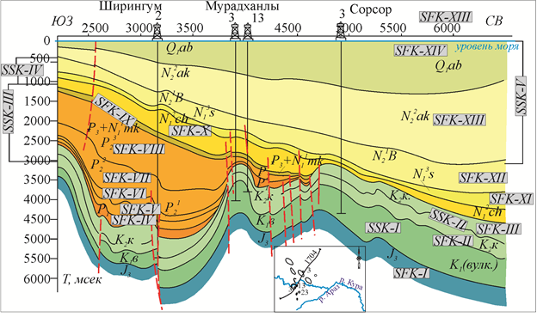
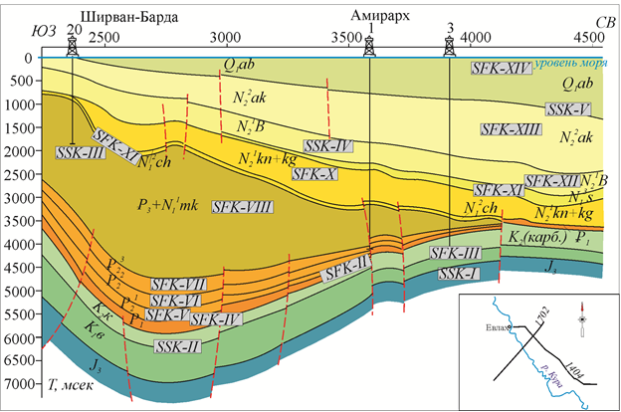
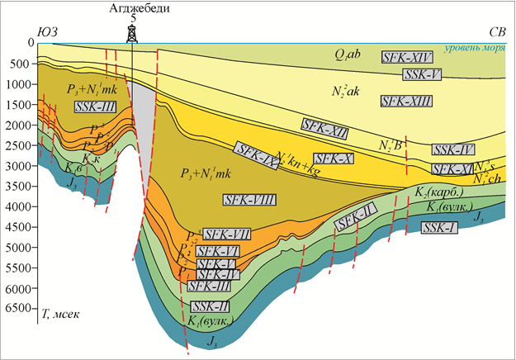
Structural-tectonic setting of the YAD based on the results of seismostratigraphic analysis
3
Shiringum–Muradkhanly–Sorsor uplift group
Gedekboz uplift
NW
GEDEKBOZ
SE
SHIRINQUM
MURADKHANLY
SORSOR
NE
Shirvan–Barda–Amirarkh uplift group
SW
SHIRVAN-BARDA
AMIRARKH
NE
AGDJEBEDI
NE
Agdjebedi uplift

Slide 14
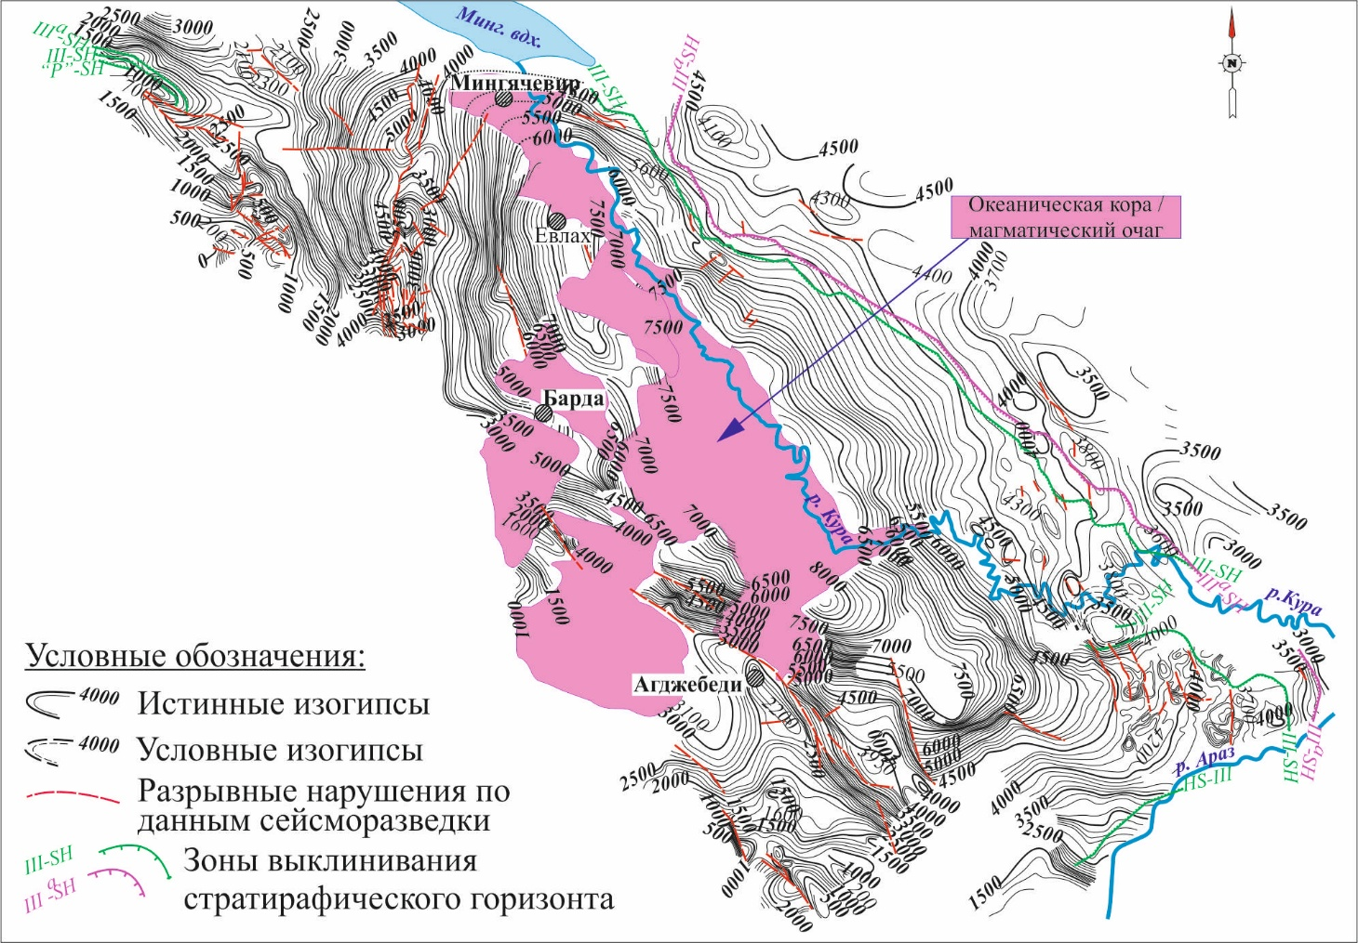
Structural map of the Mesozoic top with pinch-out zones and prospective oil and gas structures
3
OCEANIC FLOOR /
BASEMENT
Naftalan–Gedekboz–Duzdag
constructed from seismic data (along horizon 'R') and structural maps (Kocharli, 2010). Scale 1:200,000
Shiringum–Muradkhanly–Sorsor

Slide 15
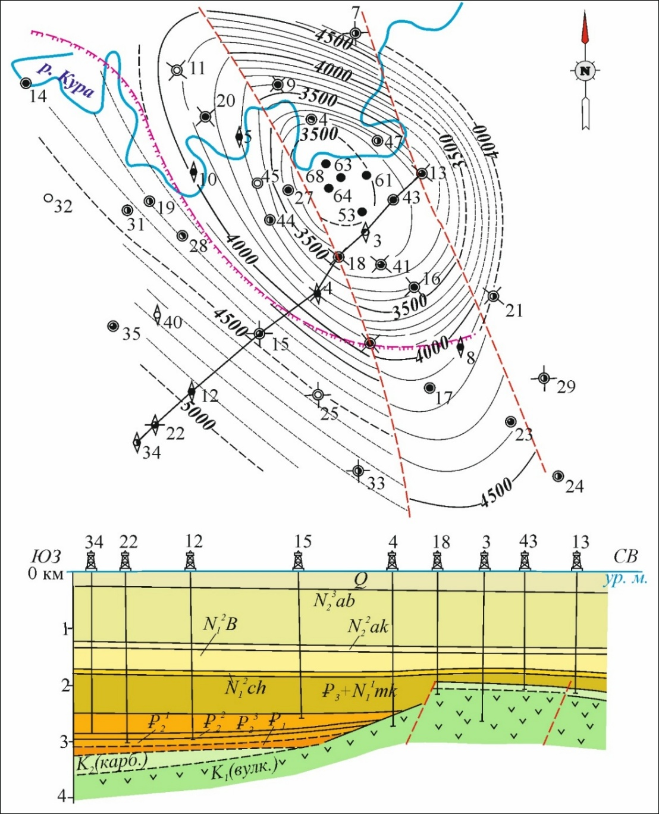
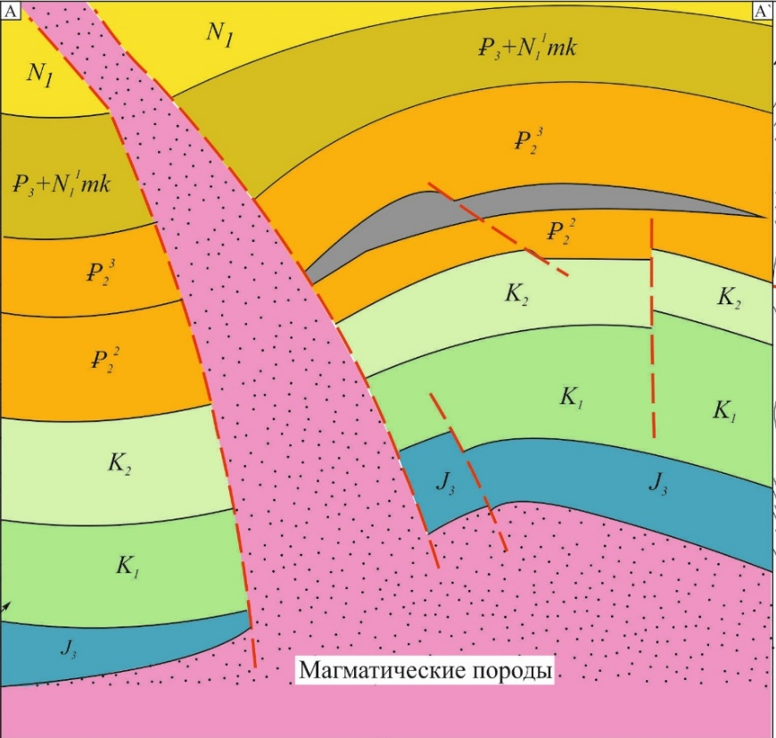
Naftalan and Muradkhanly anticlinal structures
3
Murakhanly
Naftalan
SW
NE
.
VOLCANIC INTRUSION

Slide 16
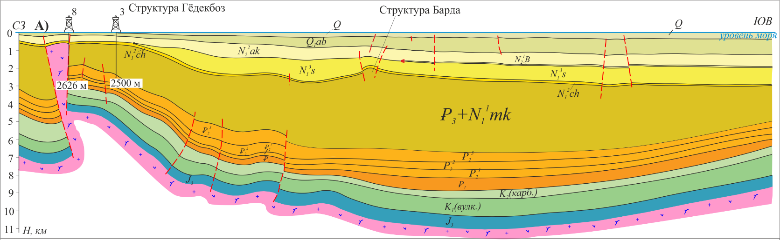
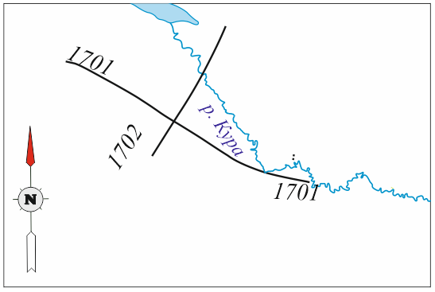
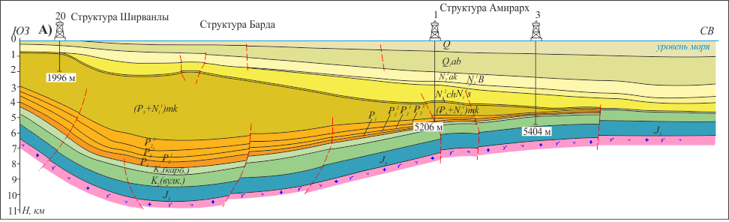
Tectono-structural interpretation of regional seismic profiles
А) №1701
NW
GEDEKBOZ
BARDA
4
ES
B) №1702
SHIRVANLI
AMIRARKH
EW
B)
BARDA
NE

Slide 17
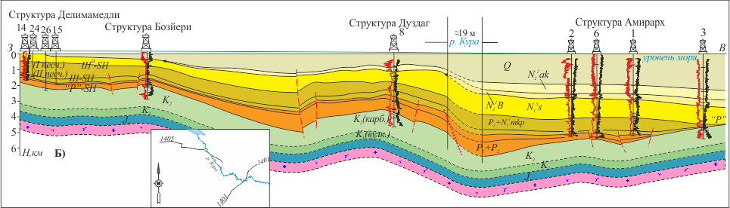
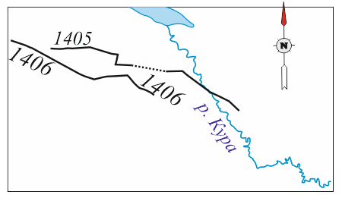
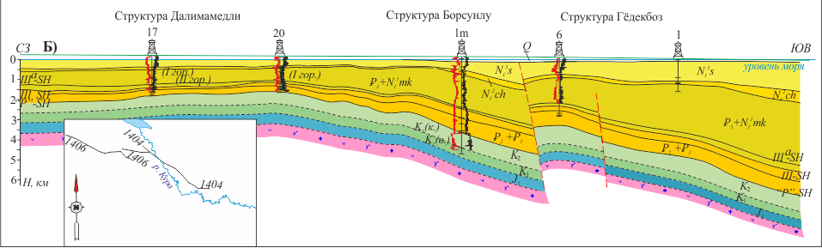
Tectono-structural interpretation of regional seismic profiles
4
DELIMAMEDLI
BOZYERI
DURZDAQ
AMIRARKH
А) №1405
W
Kura
E
А)
DELIMAMEDLI
BORSUNLU
GEDEKBOZ
B) №1406
NW
SE
Kura

Slide 18
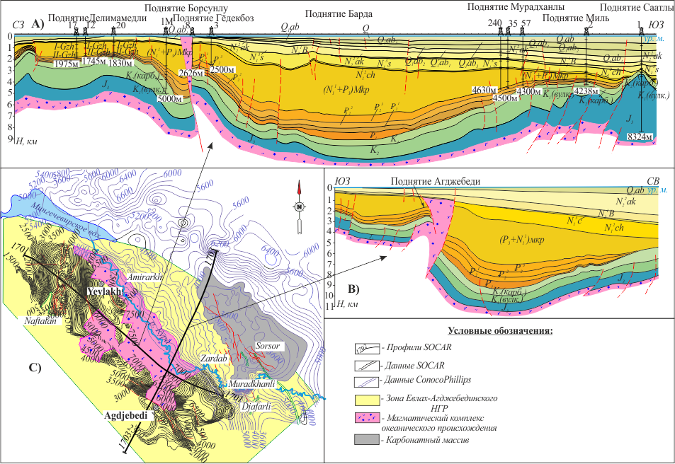
Integration of geological and geophysical data
4
DELIMAMEDLI
BORSUNLU
BARDA
MURADKHANLY
SAATLI
GEDEKBOZ
MIL
А) №1701
B) №1703
AGDJEBEDI
C) Structural map along the Upper Cretaceous horizon, compiled in 2017 based on ConocoPhillips (USA) data.
LEGEND
SOCAR profiles
SOCAR data
ConocoPhillips data
EAD zone
Volcanic complex
Carbonate body

Slide 19
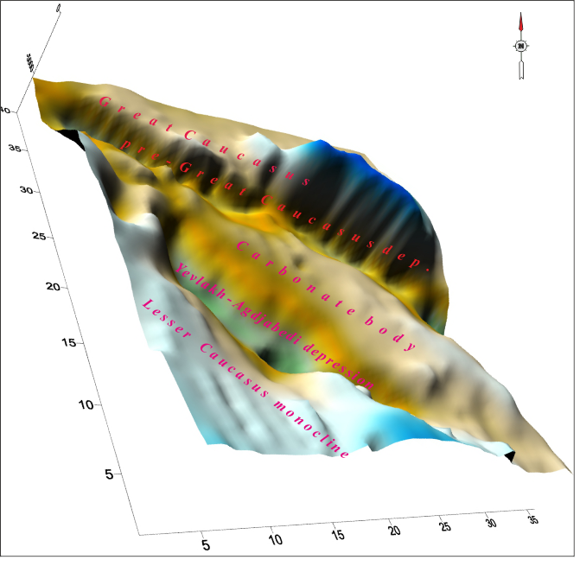
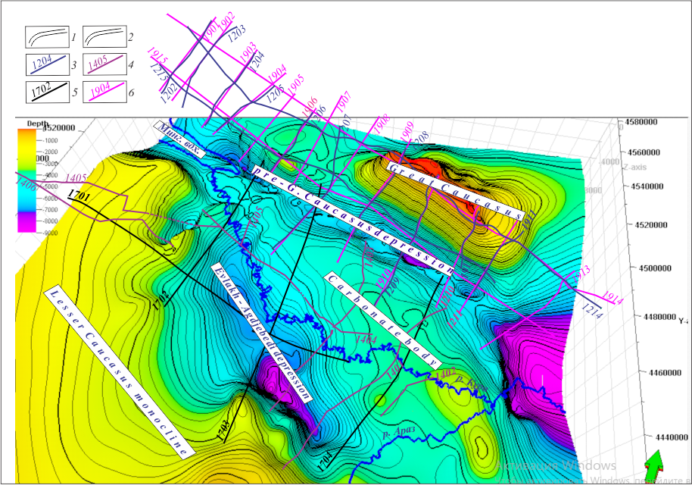
Identification of prospective structural trap zones and hydrocarbon migration pathways based on modeling of the Mesozoic top surface
4
«SURFER»
Petrel ©SLB

Slide 20
Conclusion
The Yevlakh-Agjabedi Depression is a complex, polystage structure formed at the border of major paleostructures. Upper Cretaceous deposits include carbonate and volcanic facies; Lower Cretaceous has a three-facies composition including clastic rocks.
Mesozoic rocks have low primary porosity; reservoir potential is realized through secondary porosity (fracturing, vugs). Permeability up to 527·10⁻¹⁵ m² (Muradkhanly).
Fundamental differences between Cenozoic (stratigraphic/lithologic traps) and Mesozoic (tectonically shielded and structural-block traps).
Two migration schemes for the Naftalan–Gedekboz–Duzdag meridional belt: vertical (along faults from Mesozoic) and lateral (from central depression).
Priority areas identified for high-resolution 2D-3D-4D seismic exploration to map migration pathways, pinch-out zones, and Mesozoic structural forms.

Slide 21
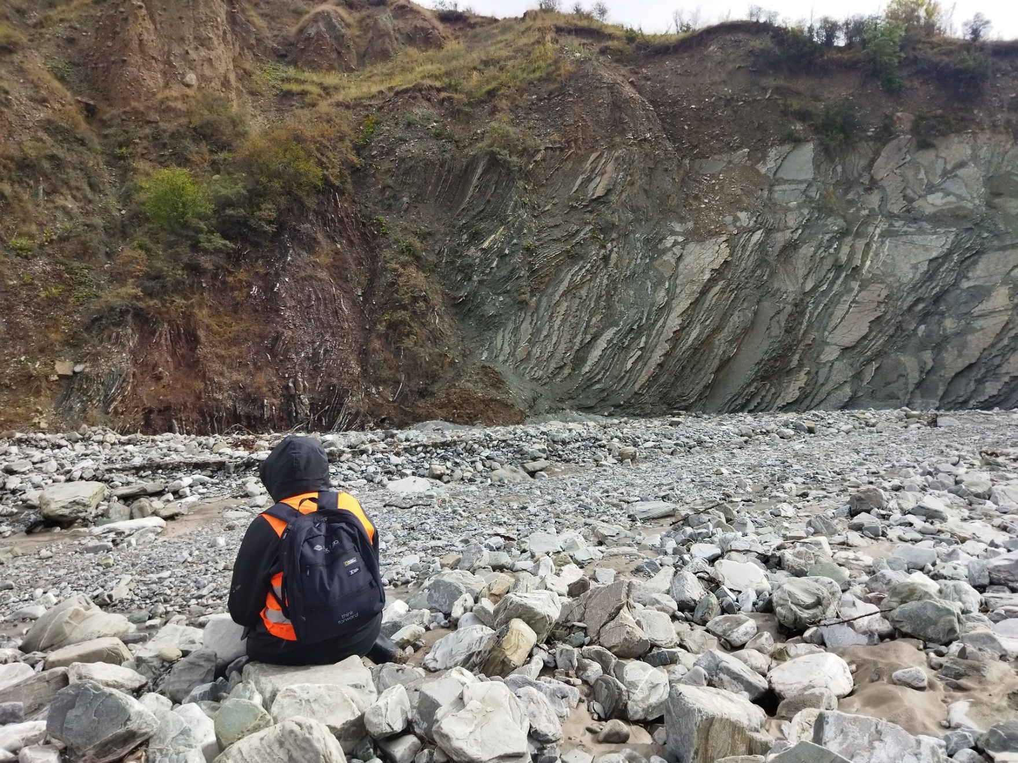
Thank you
Paleogene
Cretaceous
Girdiman river basin, E-S Greater Caucasus

