Slide 1

Assessing the risk of failure of tailings storage facilities due to changes in hydroclimatic stressors in a warming world - Case study of Chile
Pablo Baquedano, Eduardo Muñoz-Castro, Tomás Gómez, Ximena Vargas.

Slide 2
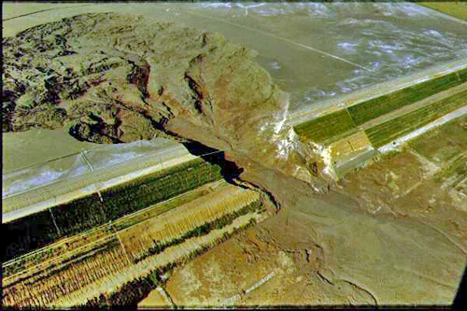
Motivation
Chile ranks third in the world in terms of the volume of mining tailings, behind China and the United States (Mining Council, 2023)
According to the Register of Tailings Dams in Chile (SERNAGEOMIN, 2025), there are a total of 846 tailings dams, of which:
470 inactive tailings dams
172 abandoned tailings dams
Figure 1: Tailing dam failure, Merriespruit, Sudáfrica 1994.

Slide 3
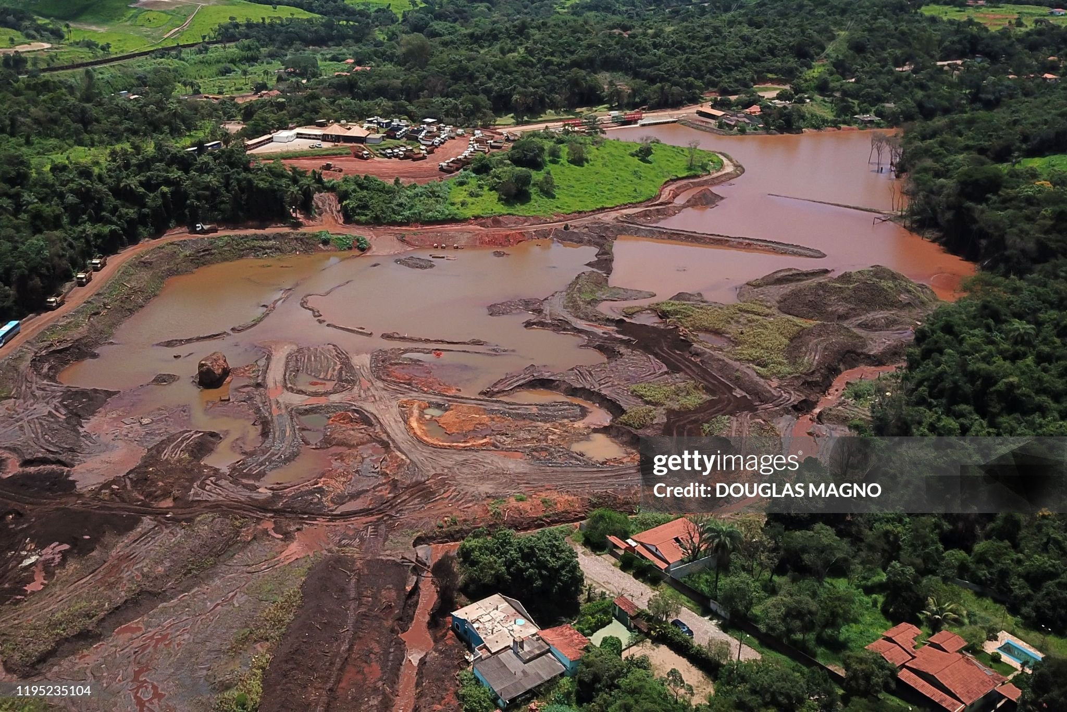
Chilean Regulation
Supreme Decree No. 248 of the Ministry of Mining establishes the guidelines for the design, construction, operation, and closure of tailings facilities.
These should be designed by selecting the highest value among (depending on the height of the wall) :
Probable Maximum Flood (PMF) by Probable Maximum Precipitation (PMP)
Maximum Precipitation for a 1.000 or 10.000-years return period.
Figura 3: Brumadinho Disaster, 2019.

Slide 4
PMP Estimate
Stadistical Approach
Hershfield (1965)
Adapted in Chile by Stowhas (1983)
Hydrometeorological Approach
WMO, 2009

Slide 5
Research Questions
I. What differences are observed in the assessment of the risk of hydrological failure in tailings dams when Probable Maximum Precipitation (PMP) estimated using hydrometeorological methods is compared with methods based on statistical analysis?
II. How does the risk of tailings dam failure change when incorporating future climate projections under three scenarios, compared to historical climate conditions?

Slide 6
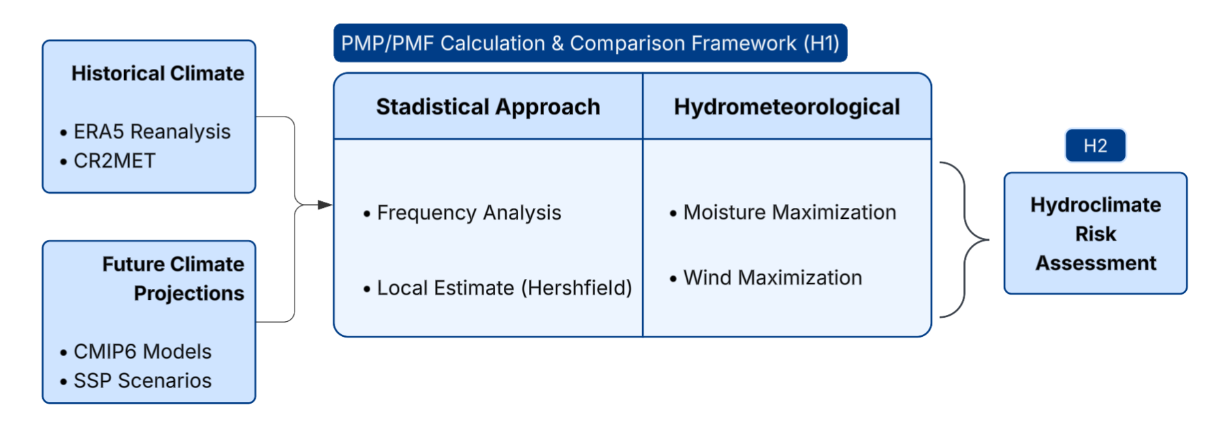
Methodology
Notes:
There is an increase of Precipitable Water (W) and Dewpoint Temperatura (Td) but a decrease of Storm Efficiency (Eta)

Slide 7
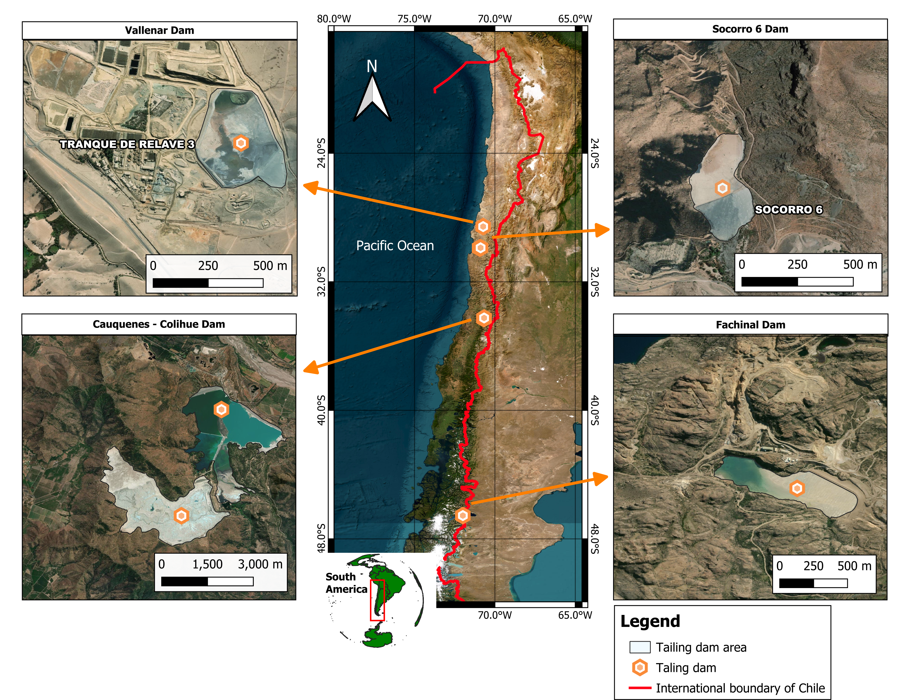

Study Domain
Notes:
There is an increase of Precipitable Water (W) and Dewpoint Temperatura (Td) but a decrease of Storm Efficiency (Eta)

Slide 8
Data Collect (Historical)
ERA5 (Periodo 1960 – 2021)
2m temperature
Total precipitation
Wind component (u y v)
Relative Humidity
CR2MET v2.5 (Periodo 1960 – 2021)
Daily precipitation
Daily air temperature (max/min)

Slide 9
Data Collect (Projections)
CMIP6 Models
Scenarios
Variables
Time Period
Historical
SSP 2-4.5
SSP 3-7.0
SSP 5-8.5
Precipitation
Air Temperature
Relative humidity
Specific humidity
Northern and Eastward wind
Historical: 1960 - 2014
Future: 2015 - 2100
CMCC-CM2-SR5 (Italy)
EC Earth3-veg-lr (EEUU)
MRI-ESM2.0 (Japan)
CANESM5 (Canada)

Slide 10
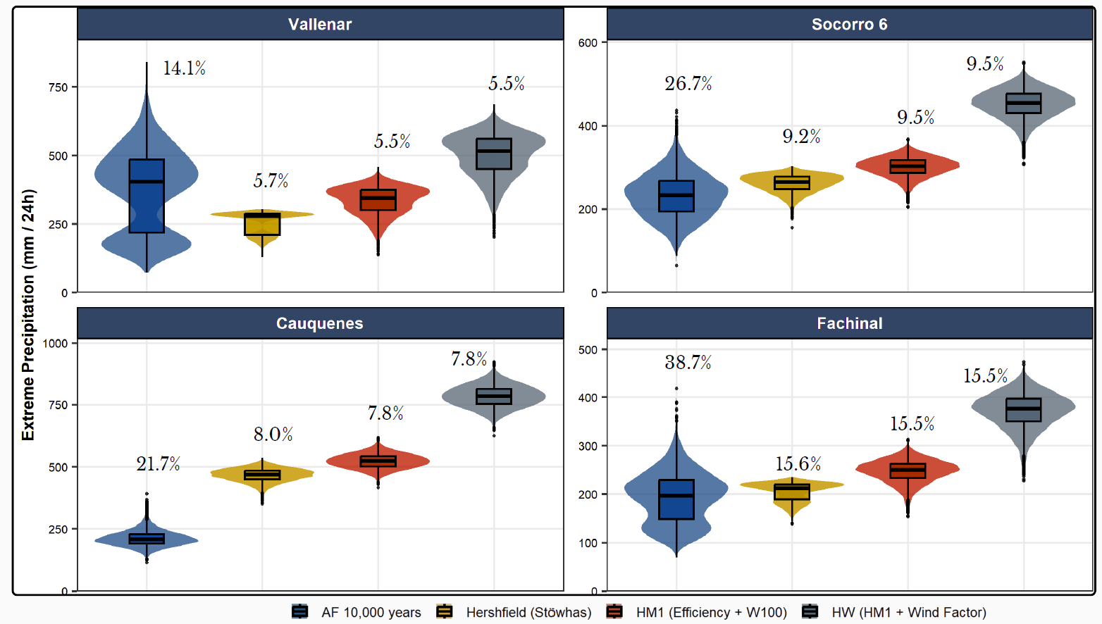
Results
Bootstrap
10.000 iterations
Using 4 different methods, 2 stadistical and 2 hydrometeorological.
Estimate coefficient of variation.

Slide 11
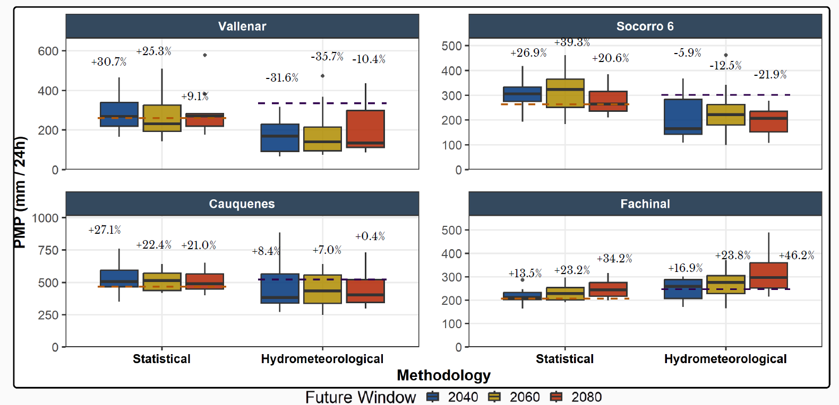
Results
PMP under climate change
Estimate using Hershfield and Moisture Maximization.
Historical PMP as benchmark.
Growth or decline relative to the 75th percentile was calculated.

Slide 12
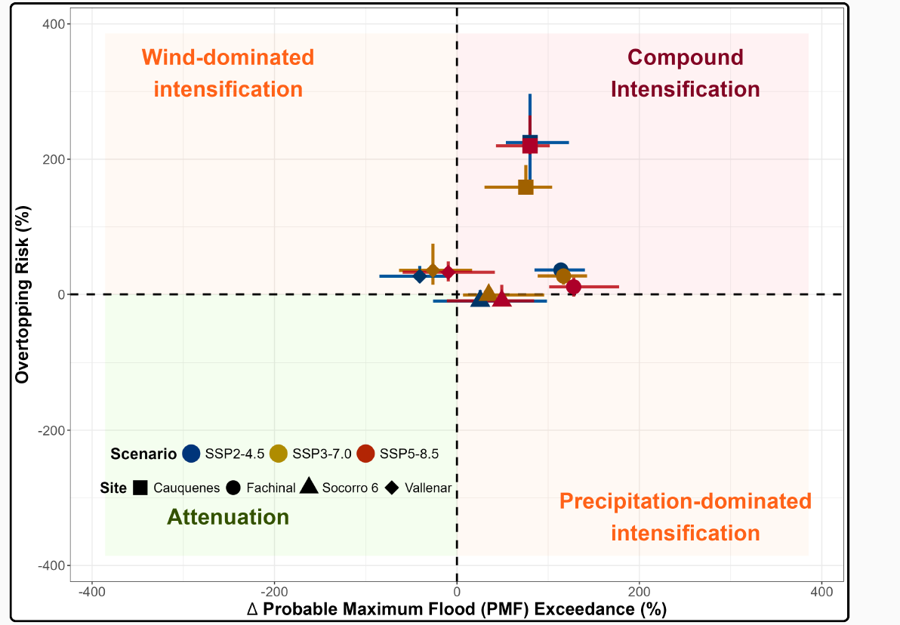
Results
Matrix Risk
PMF calculated as the percentage by which it exceeds the historical value.
Overtopping risk calculated as the excess over the design flood level

Slide 13
Conclusion
The results indicate a high degree of uncertainty in the estimation using frequency analysis, one of the most widely used methods. However, the hydrometeorological and regional methods exhibit lower sensibility to extreme events.
Future climate projections indicate an increased hydrological risk and overtopping. There is no single SSP scenario that predominates over the others. Cauquenes dam has the highest compound risk; however, SSP3-7.0 scenario is less unfavorable.
The assumption of stationarity in the design of tailings dams may be flawed in the context of climate change.
We must move toward resilient designs that take climate change into account.

Slide 14
References
Lagos, M., Rondanelli, R., Garreaud, R., (2021). Procesos Meteorológicos en Eventos de Precipitación y Simplificaciones en Ingeniería, Buscando el Equilibrio entre la Física y la Práctica. Rutas Hidrológicas.
Hershfield, D. M. (1965). Method for Estimating Probable Maximum Rainfall. Journal AWWA, 57(8), 965–972. https://doi.org/10.1002/j.1551-8833.1965.tb01486.x
SERNAGEOMIN (2025). Catastro Nacional de depósitos de relaves activos e inactivos.
Stowhas, L. (1983). Precipitaciones máximas diarias en Chile. VI Congreso Nacional de Ingeniería Hidráulica, Departamento de Ingeniería Hidráulica, Escuela de Ingeniería, Pontificia Universidad Católica de Chile., 455–473.
Stowhas, L. (2016). Fundamentos de hidrología aplicada. Alvaro Ossandon A. y Raul Flores A.
Visser, J. B., Kim, S., Wasko, C.,Nathan, R., & Sharma, A. (2022). Theimpact of climate change on operationalProbable Maximum Precipitationestimates. Water Resources Research,58, e2022WR032247.
WMO. (2009). Manual on estimation of probable maximum precipitation (PMP). World Meteorological Organization.

Slide 15
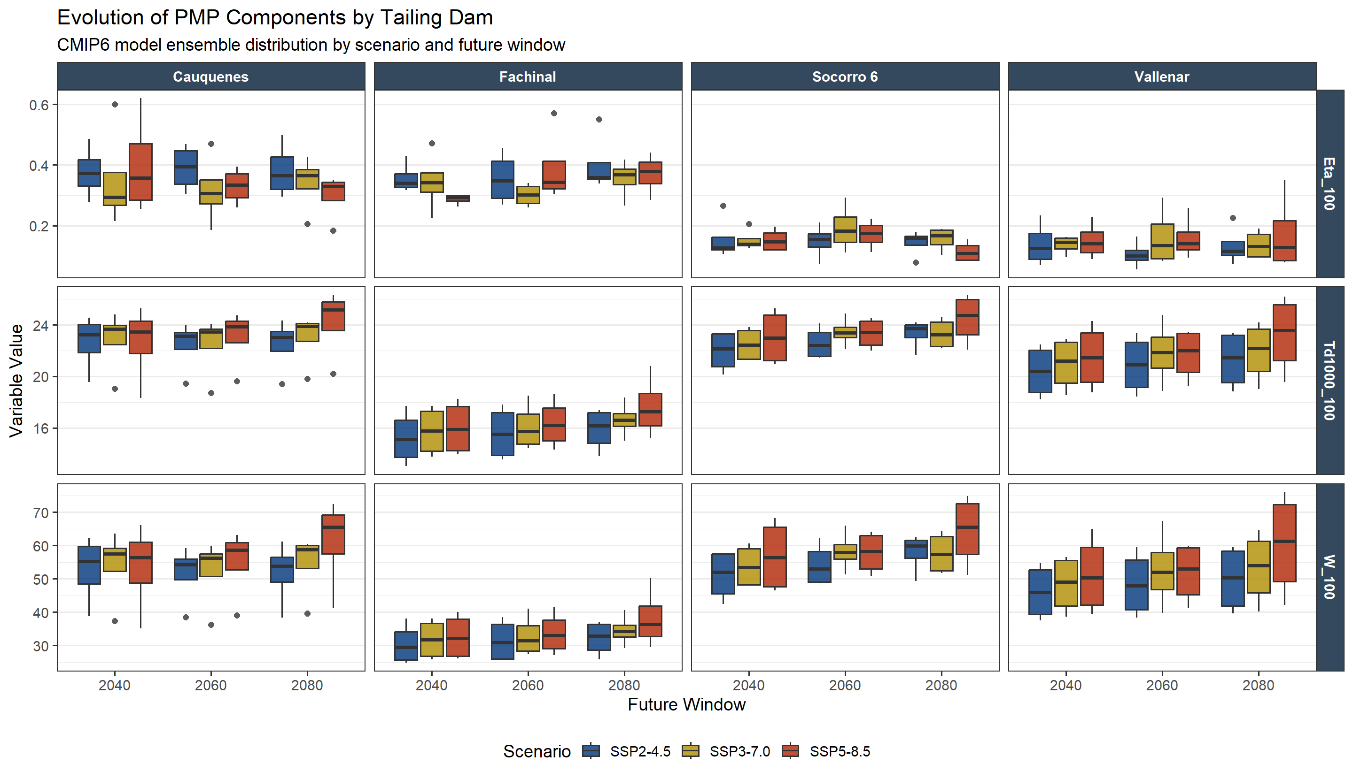
Appendix
Notes:
There is an increase of Precipitable Water (W) and Dewpoint Temperatura (Td) but a decrease of Storm Efficiency (Eta)

