Slide 1




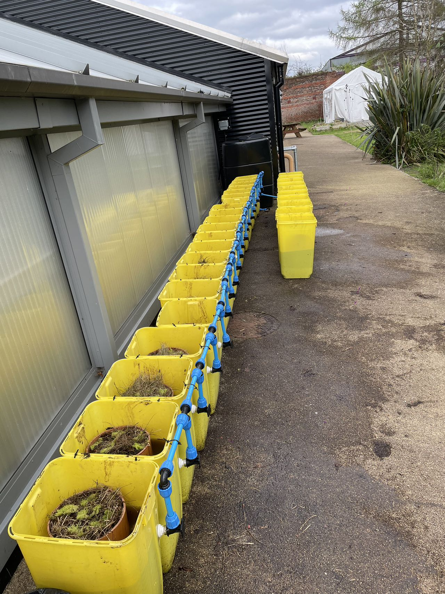
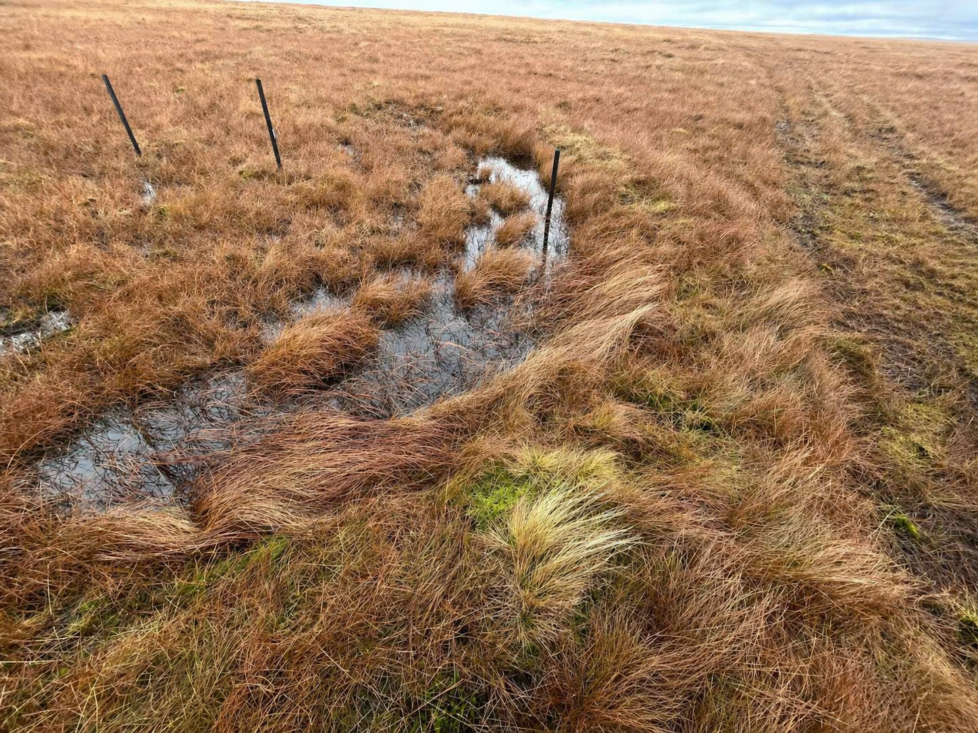
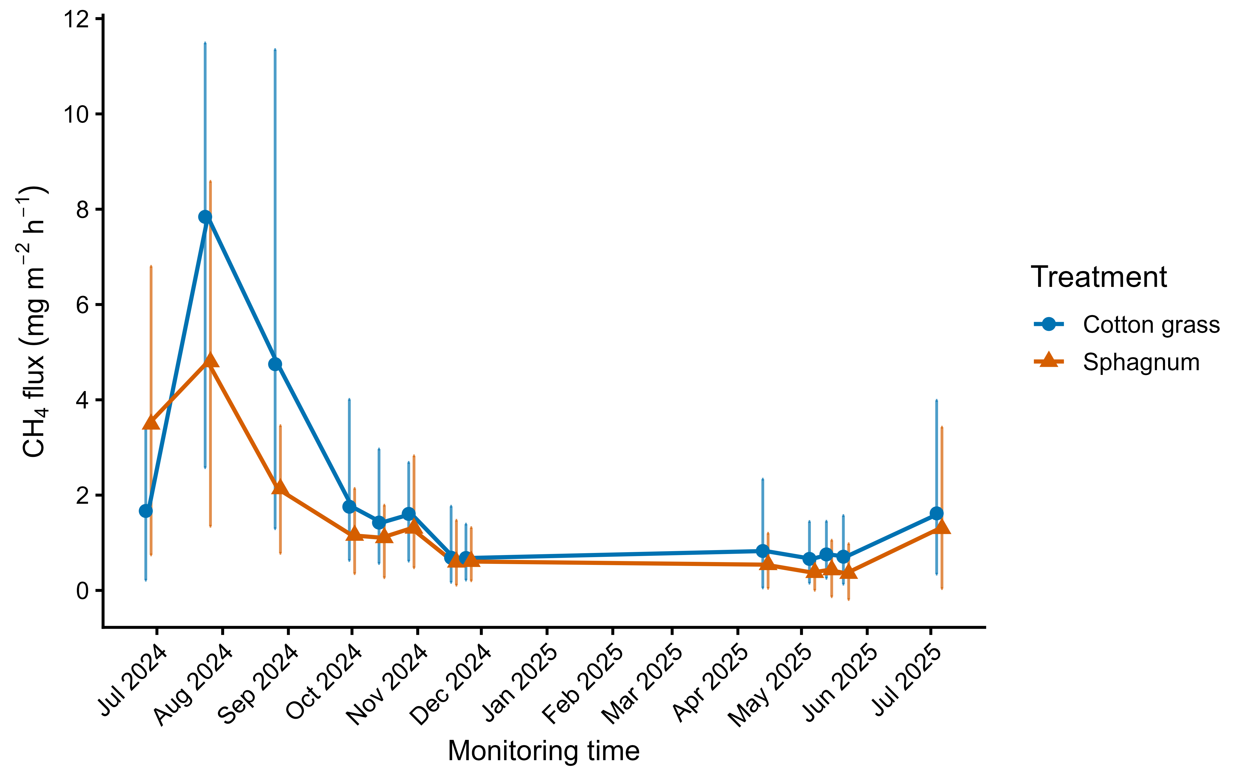
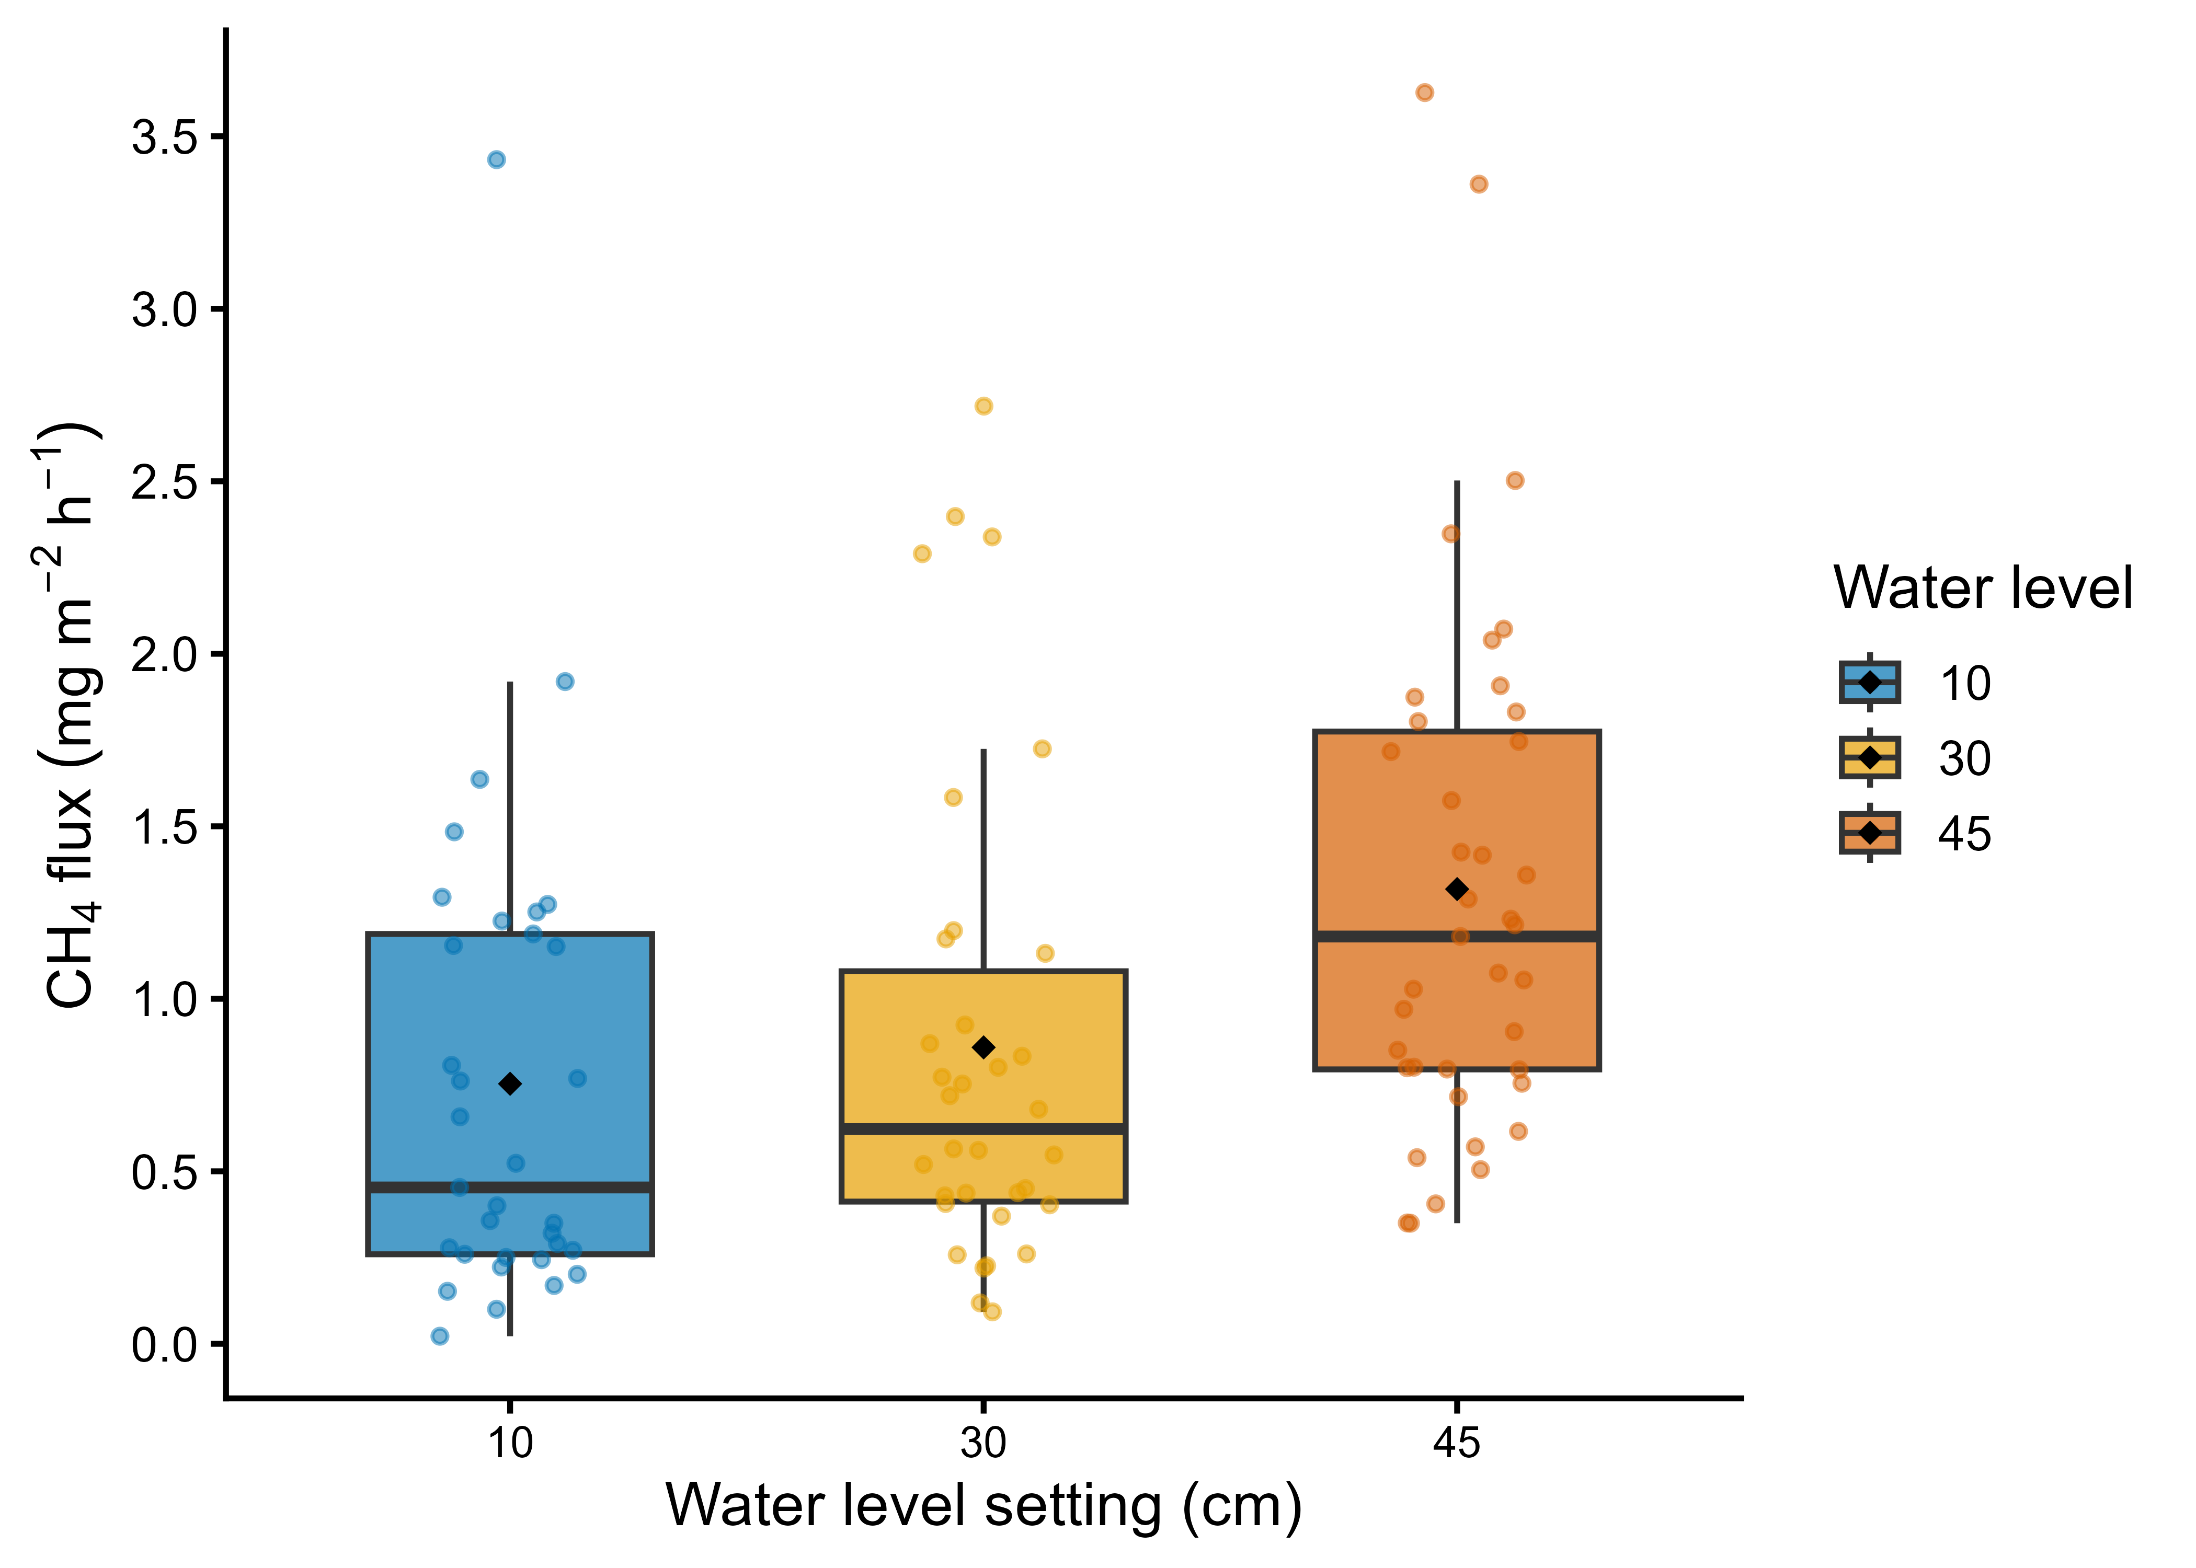
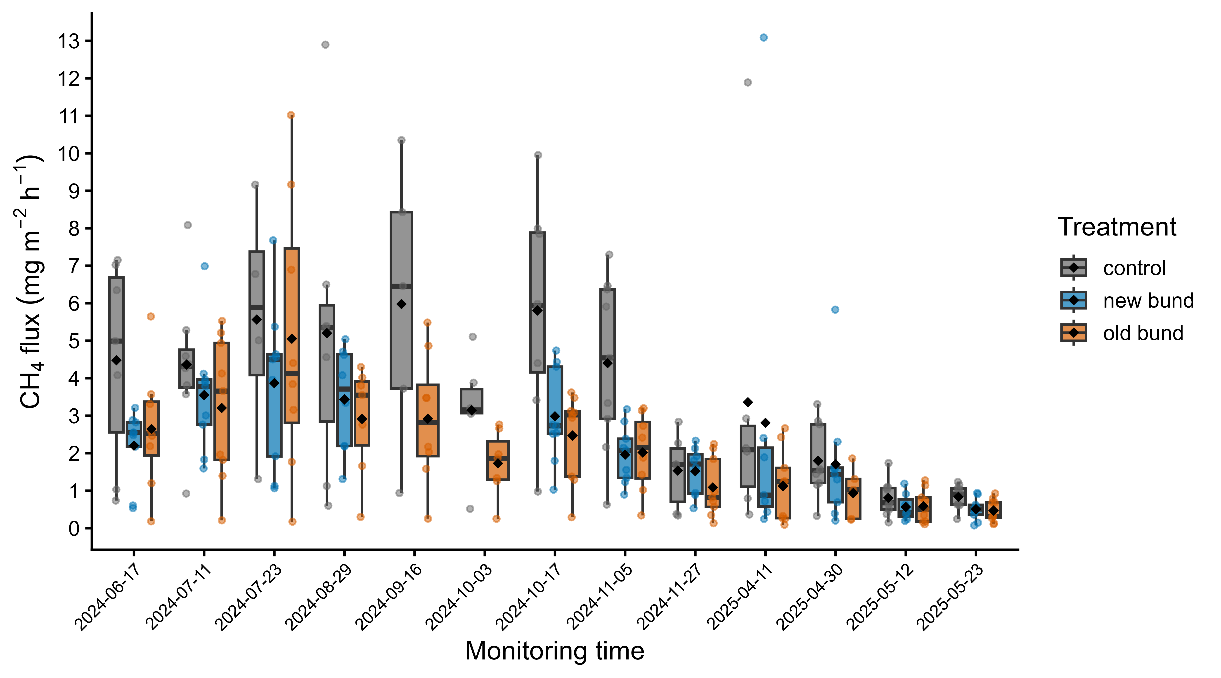
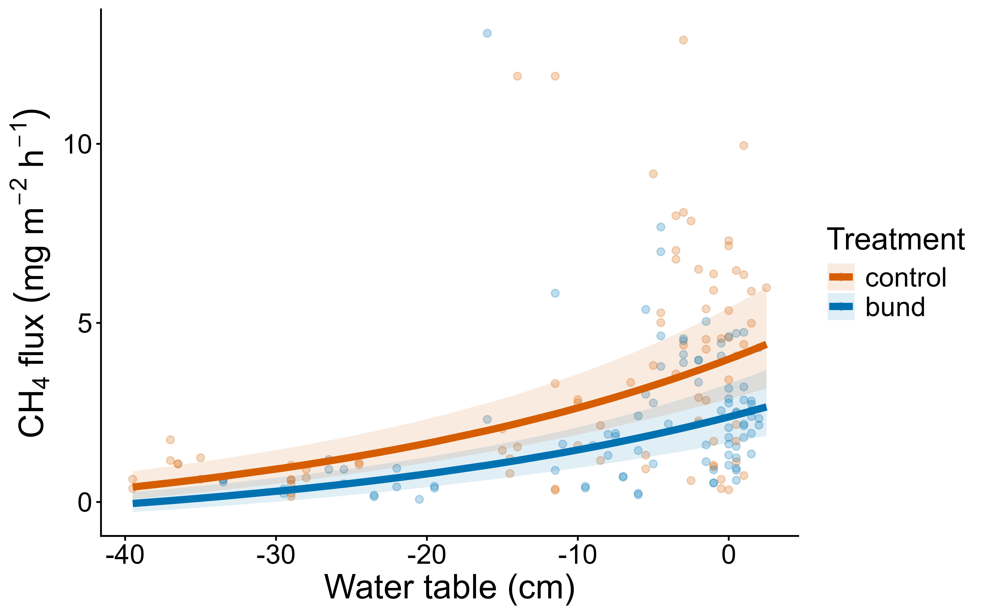
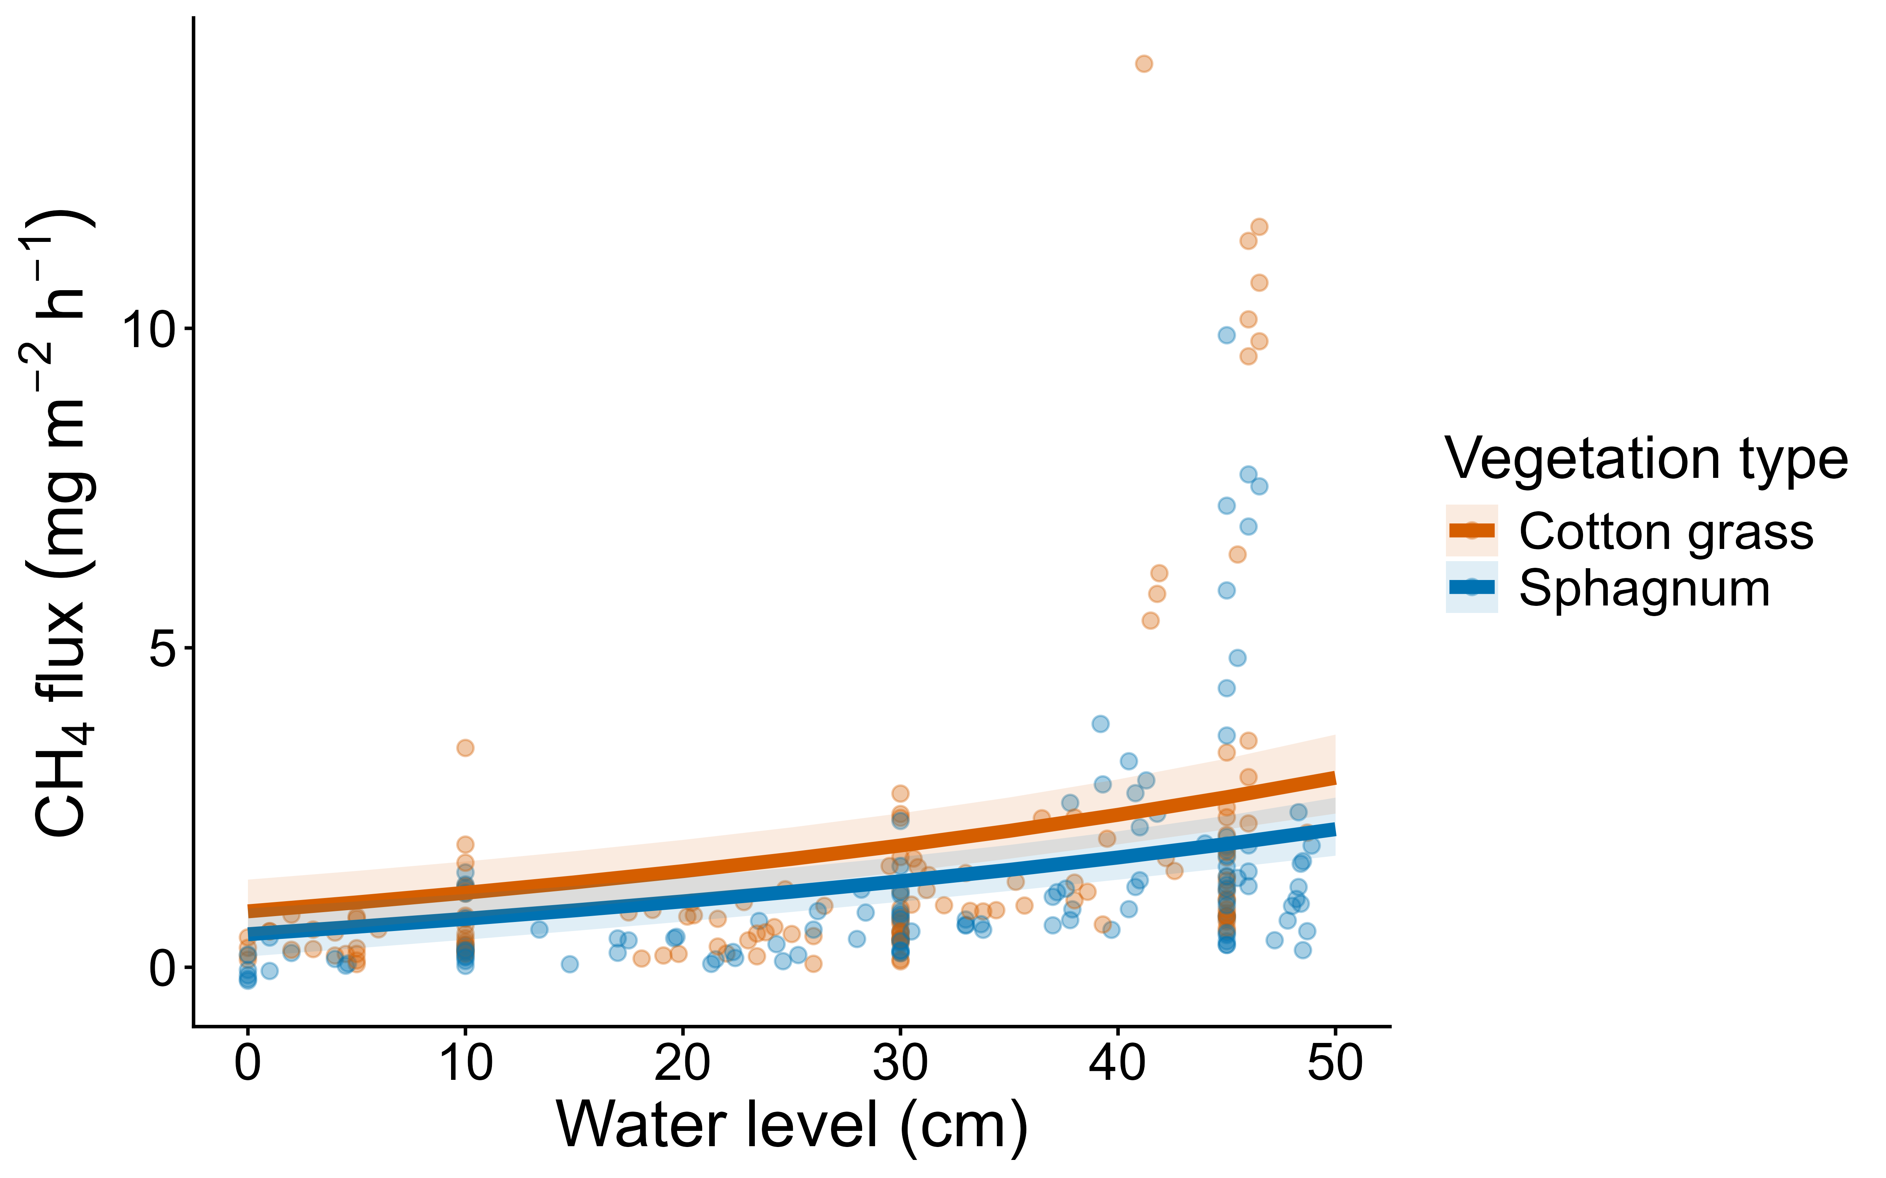
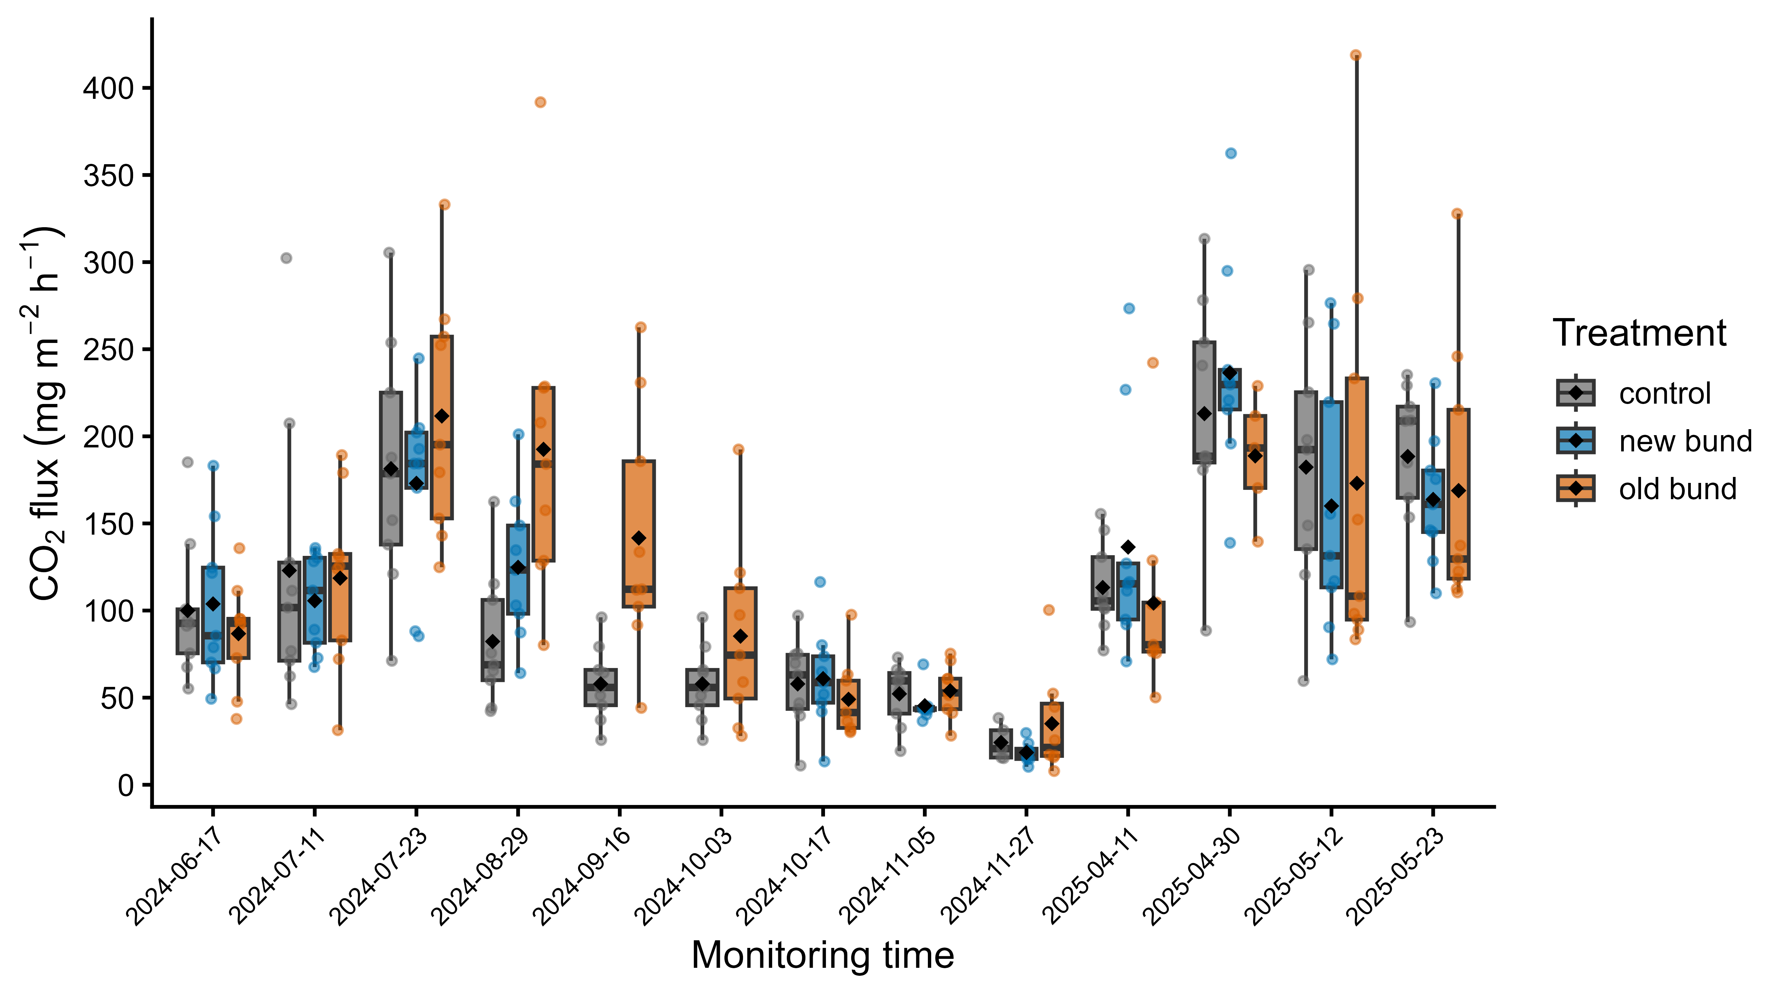
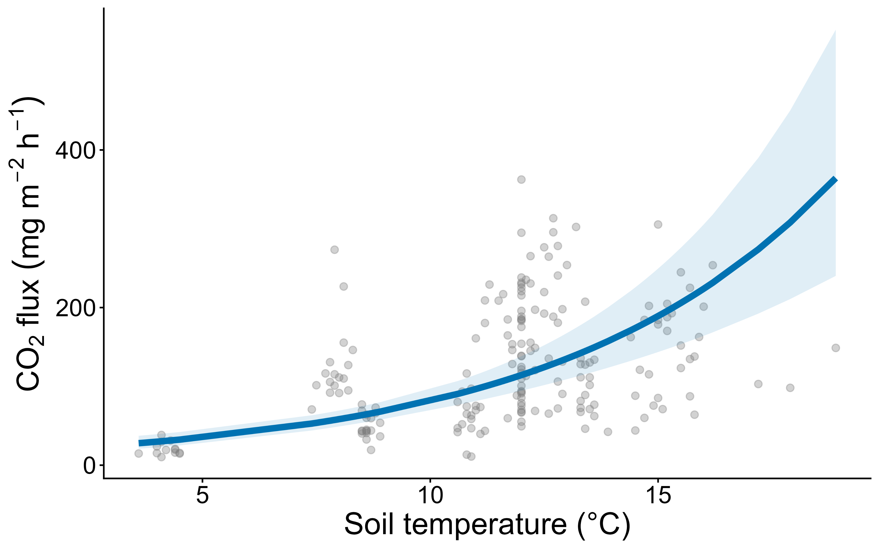
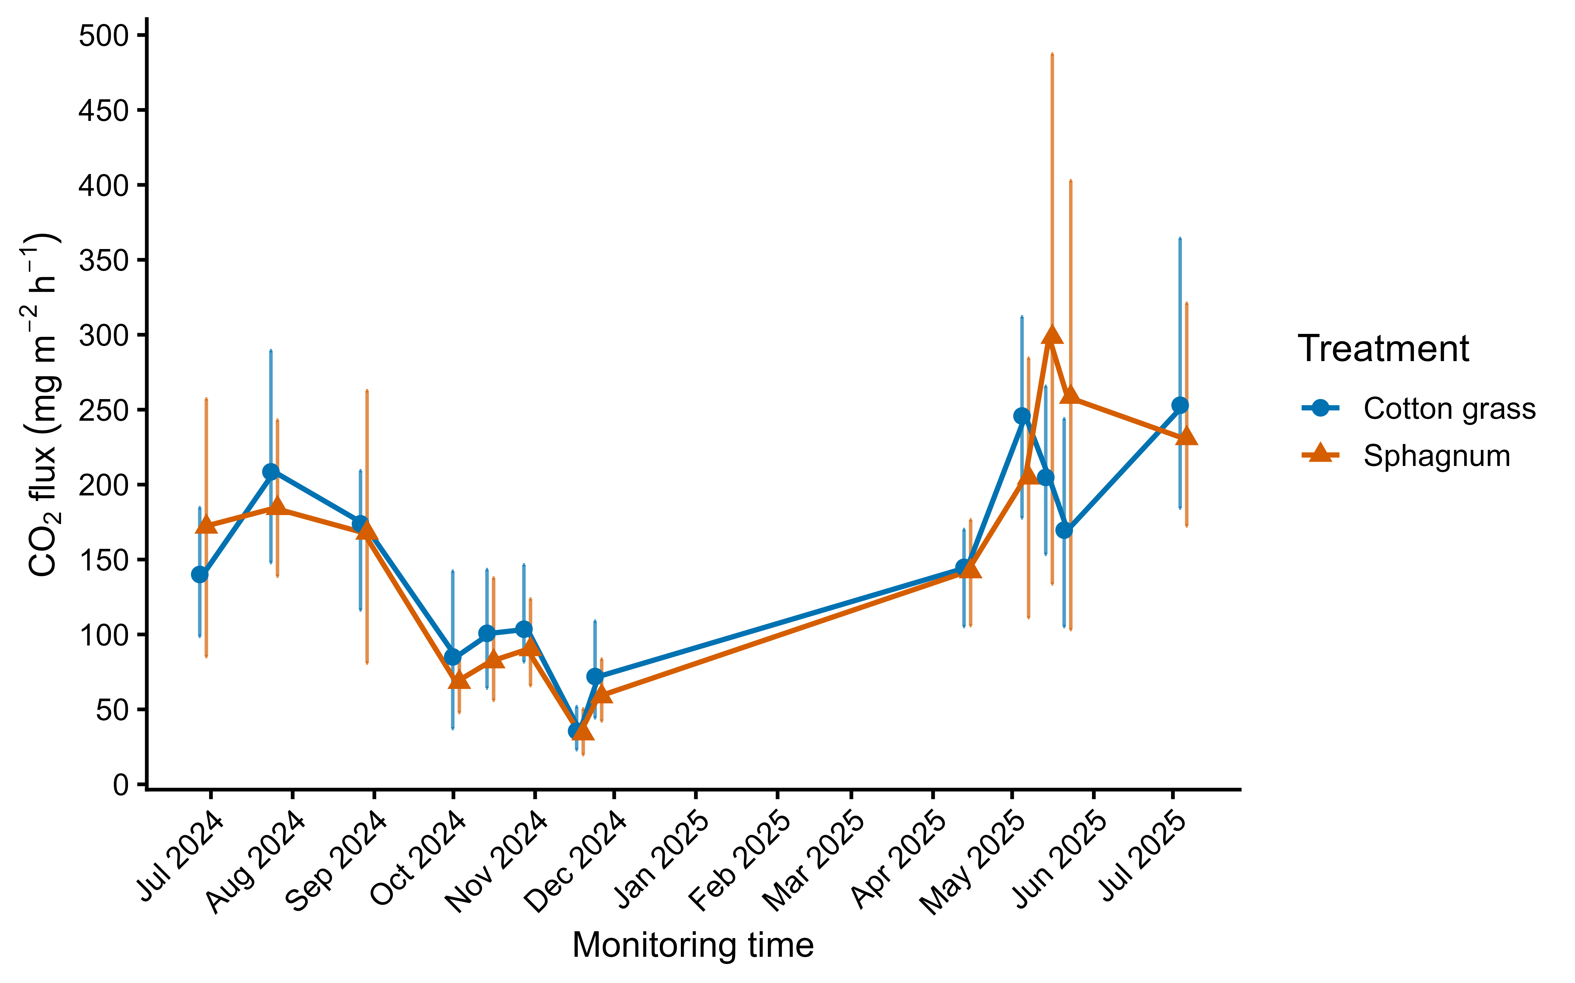
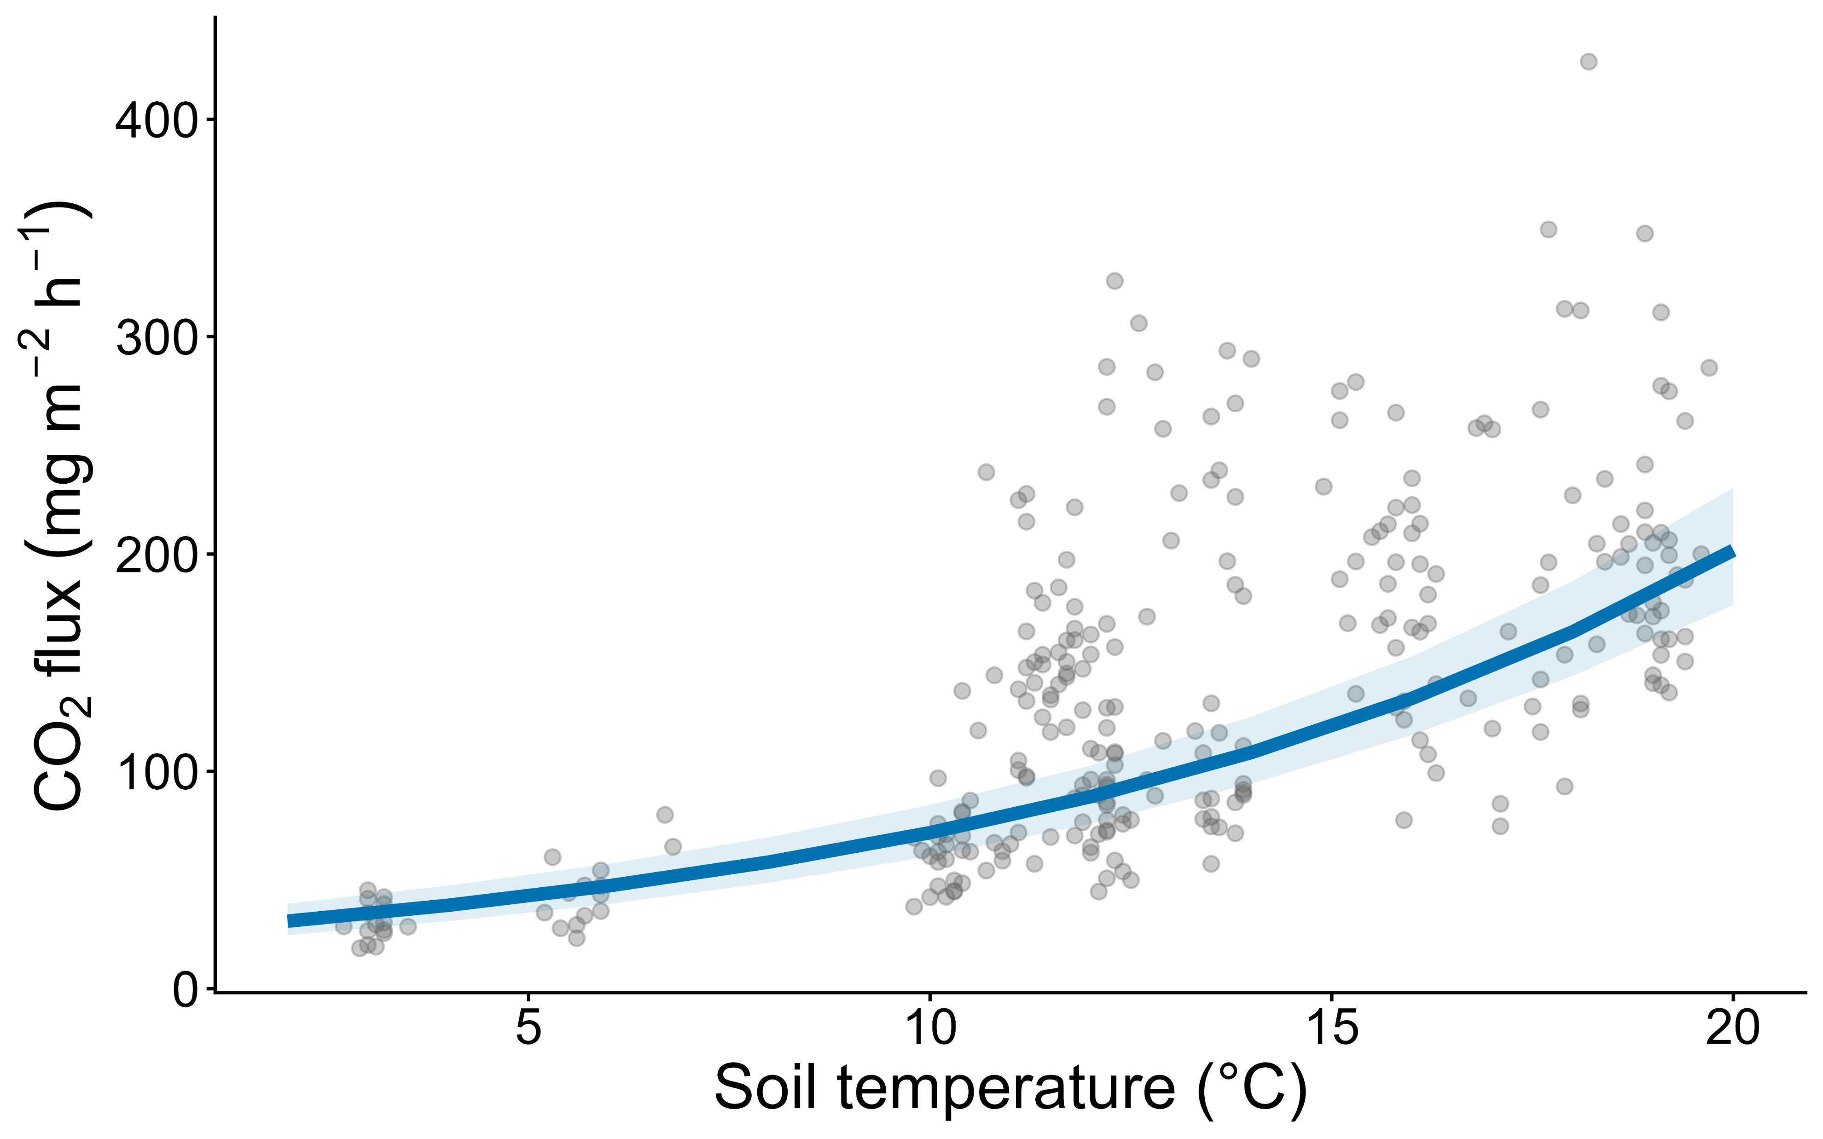
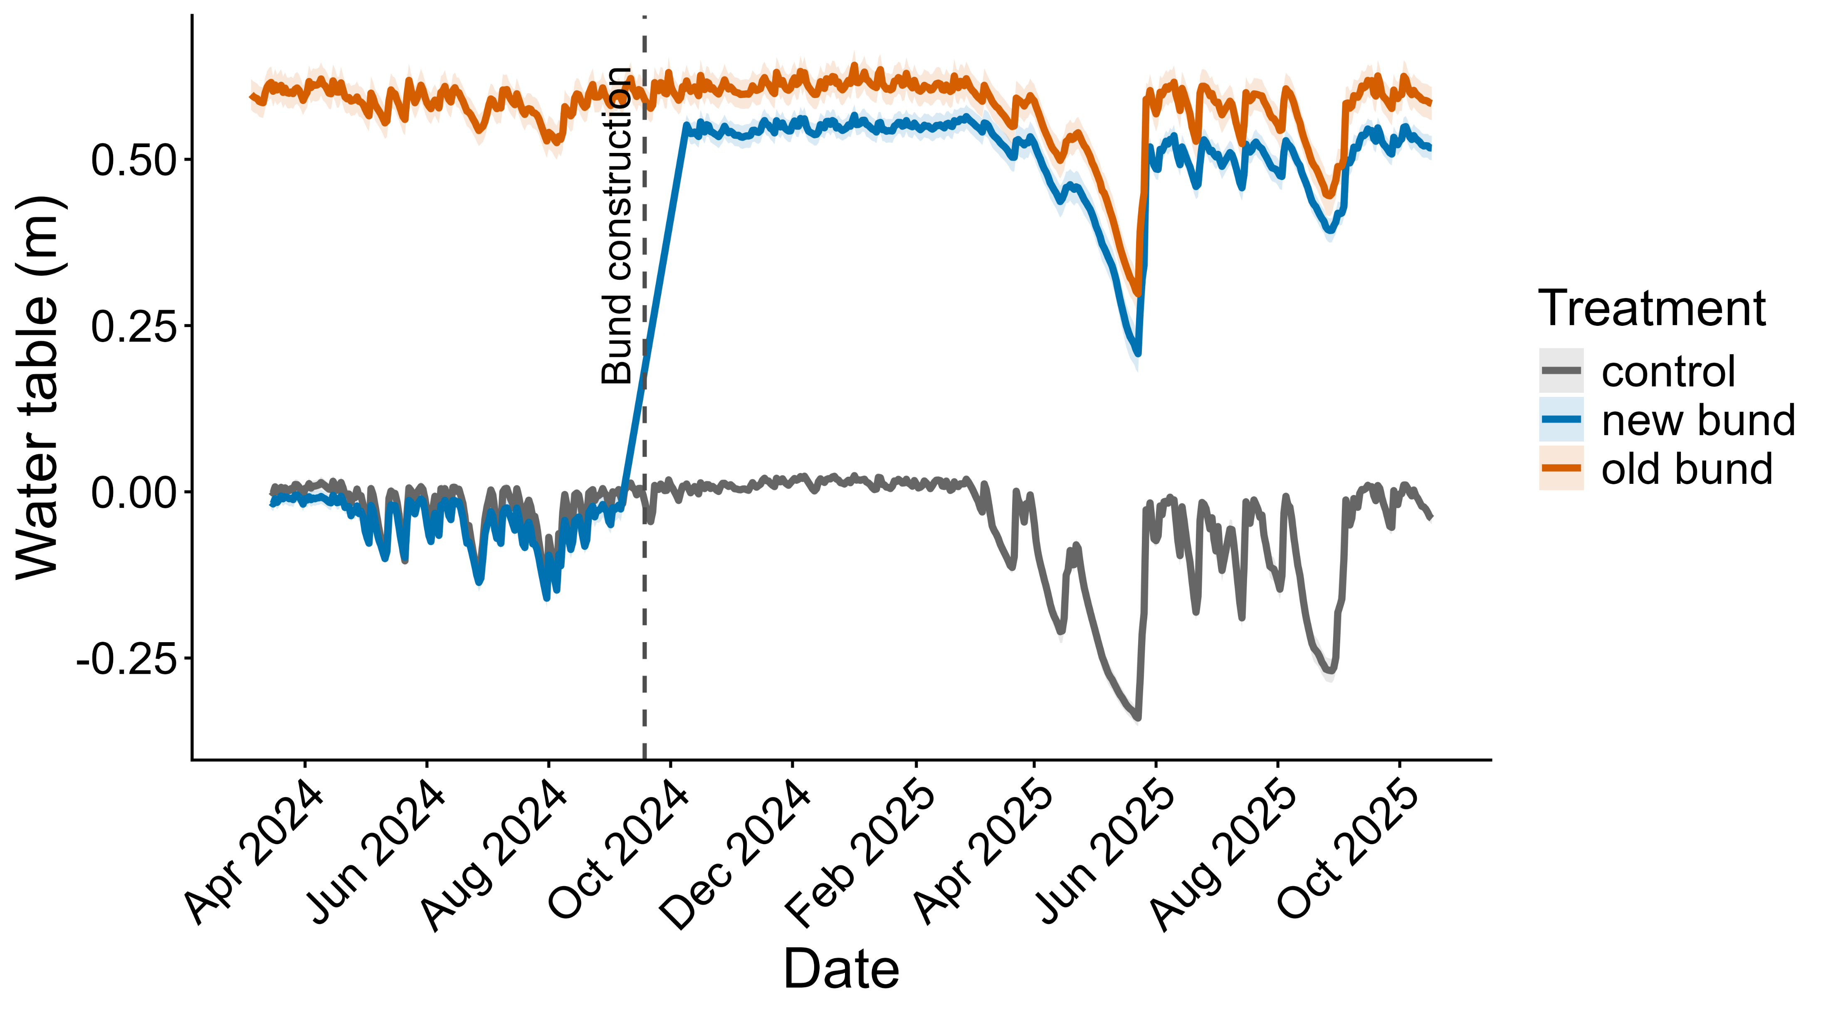
Impacts of bund construction and Sphagnum reintroduction on peatland CO₂ and CH₄ fluxes: insights from field monitoring and mesocosm experiments
Wenlue Miao¹, Jonathan Ritson², Emma Shuttleworth¹, Martin Evans³
¹Department of Geography, University of Manchester, M13 9PL, UK; ²Natural Resources Wales, Buckley, Flintshire, Wales, CH7 3AJ; ³Department of Geography, University of Durham, DH1 3LE, UK
Contact: Wenlue.Miao@postgrad.Manchester.ac.uk
Why does peatland restoration matter for greenhouse gases?
Controls on GHG flux: evidence from mesocosm experiments
Responses to bunding: Field monitoring at Holcombe Moor
Peatlands cover slightly over 3% of the Earth land surface but store almost twice the carbon of global forest biomass (Joosten 2015). However, widespread drainage and land-use change have degraded many peatland systems, converting them from net carbon sinks into important sources of greenhouse gases (GHG).
Water-table lowering is a key mechanism underlying this shift, as enhanced oxygen availability accelerates peat decomposition and alters CO₂ and CH₄ fluxes.
Vegetation, particularly Sphagnum, is a major contributor to peatland gross primary production and plays a critical role in peatland carbon dynamics and productivity (Antala et al. 2022).
Although restoration is widely promoted, the effectiveness of specific interventions—particularly bund construction and Sphagnum reintroduction—in regulating greenhouse gas emissions remains insufficiently understood.
A controlled mesocosm experiment was established to isolate vegetation and hydrological effects on greenhouse gas fluxes.
Field measurements were conducted at Holcombe Moor, a degraded blanket bog in northern England (UK), to assess greenhouse gas responses to bund construction under natural conditions.
Experimental design
• Intact peat cores under controlled conditions
• Vegetation treatments: Cottongrass vs Sphagnum
• Water-table treatments: high (45cm from the ground), medium (30cm), low (10cm)
• Biweekly measurements of CO₂ and CH₄ fluxes
Field design
• 13 monitoring rounds spanning before and after bund construction
• CH₄ and CO₂ fluxes measured using chamber methods
• Water-table data from monthly dipwell measurements and continuous pool monitoring
CH₄ dynamics
CH₄ flux responses
KEY FINDINGS
Vegetation regulates CH₄ sensitivity rather than magnitude
vegetation acts more as a regulator of CH₄ sensitivity than just a direct control on emission magnitude. Sphagnum does not simply reduce methane emissions. Instead, it modifies the response of CH₄ flux to hydrological conditions, reducing its sensitivity to increasing water table.
Multiple environmental controls govern GHG fluxes
Water table depth, soil temperature and vegetation jointly regulate greenhouse gas fluxes. CH₄ is primarily controlled by hydrology, while CO₂ is largely driven by temperature.
Field observations confirm dominant controls but reveal system complexity
At the field scale, water table and temperature remained the dominant controls on GHG fluxes. However, no direct flux response was detected despite rising water table, likely due to pre-existing differences (initial vegetation and hydrology), spatial mismatch (local water table changes not captured at chamber locations), and transport decoupling (episodic CH₄ release from compressed and lower-porosity peat).
Bunding influences GHG fluxes indirectly via hydrological change
Although no significant treatment effect on GHG flux was observed at the collar or plot scale, bunding significantly increased and stabilised water tables at the site scale, indicating a scale-dependent response. As water table was consistently identified as a key control on GHG fluxes across both field and experimental data, this supports an indirect pathway linking restoration to GHG dynamics through hydrological regulation.
Implications for peatland restoration
Given that bunding raises water tables while Sphagnum reduces the sensitivity of CH₄ emissions to increasing water tables, these findings suggest that hydrological restoration through bund construction should be accompanied by Sphagnum reintroduction. This combined approach may help maximise restoration benefits while mitigating potential increases in methane emissions.
Future work
Future work should incorporate longer-term and higher-frequency flux measurements, as well as improved spatial alignment between hydrological and flux measurements, to better capture GHG responses to restoration.
• Vegetation had a significant effect on CH₄ flux (p ≈ 0.015), with lower fluxes under Sphagnum
• CH₄ flux was strongly controlled by water table and soil temperature (p < 0.001)
• No significant BACI effect for CH₄
• CH₄ flux was strongly controlled by water table (p < 0.001)
• Soil temperature also had a significant but weaker effect
• Vegetation does not act as a simple driver of CH₄ emission magnitude but instead regulates the sensitivity of CH₄ flux to hydrological conditions
→ CH₄ flux increased more rapidly with rising water table under cotton grass than under Sphagnum
CO₂ flux responses
CO₂ dynamics
• No significant BACI effect for CO₂
• CO₂ flux was primarily controlled by soil temperature (p < 0.001)
• Water table and vegetation effects were not significant after accounting for temperature
Hydrological responses
• Water table increased after bunding (p < 0.001), confirming a strong hydrological response
• Spatial response was heterogeneous, indicating localised effects of bund construction
• Higher and more stable water table in bunded plots suggest reduced hydrological variability and increased saturation
• CO₂ flux was primarily controlled by soil temperature (p < 0.001)
• A significant phase effect reflects strong seasonal dynamics
• Water table and vegetation effects were not significant after accounting for temperature
Joosten, H. (2015). Peatlands, climate change mitigation and biodiversity conservation. Nordic Council of Ministers; Antala, M., Juszczak, R., van der Tol, C., & Rastogi, A. (2022). Impact of climate change-induced alterations in peatland vegetation phenology and composition on carbon balance. Science of the Total Environment, 827, 154294.
We would like to thank: Nikolas Taylor and the National Trust Holcombe team for allowing the research to be carried out on their land and for supporting the field monitoring; Oliver Hughes and the Firs Environmental Research Station team for allowing the mesocosm experiment to be carried out and for providing support.

