Slide 1

Evaluation of mesoscale eddies in an ensemble of ocean eddy permitting and a ocean eddy-resolving reanalyses

Slide 2
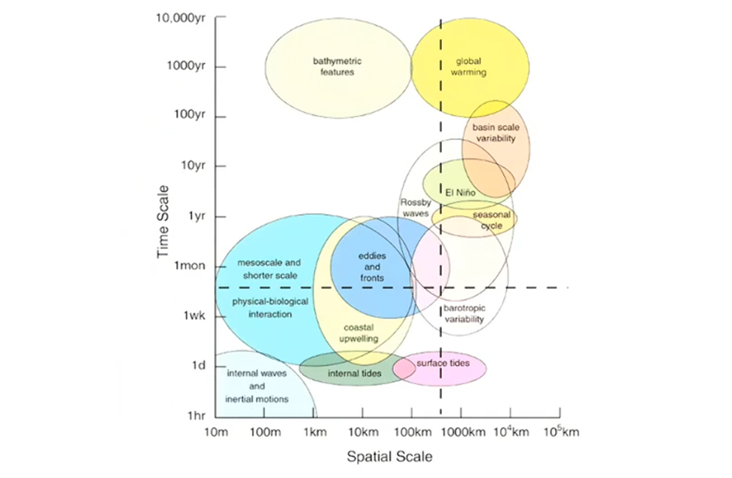
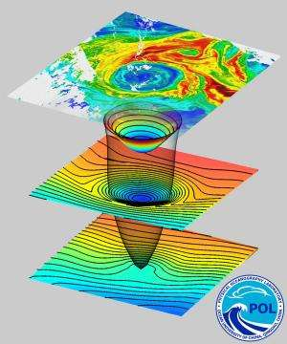
What are mesoscale eddies?
Ocean mesoscale eddies are often referred to as the 'weather' of the ocean.
They typically span spatial scales of ~ 10 – 300 Km and last from days to up to a months.
Energy Reservoir : Eddies are recognized as the primary reservoir of kinetic energy (EKE) in the ocean, holding over 90% of the ocean’s total EKE.
Climate and Ecosystem Modulation: Eddies critically modulate air–sea interactions (via changes in SSTs and meteorological parameters) and drive marine biogeochemical production and material cycling, making their precise representation essential for improving the accuracy of global climate models.
Mason et al.,2014
B. Yirka, 2014: https://phys.org/news/2014-06-mesoscale-eddies-ocean-previously-thought.html

Slide 3
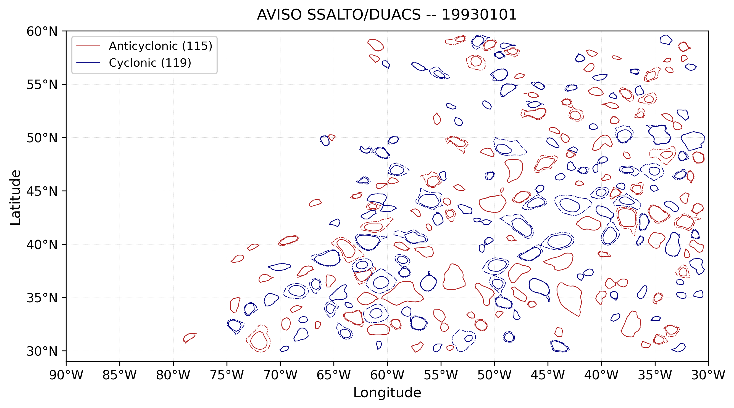
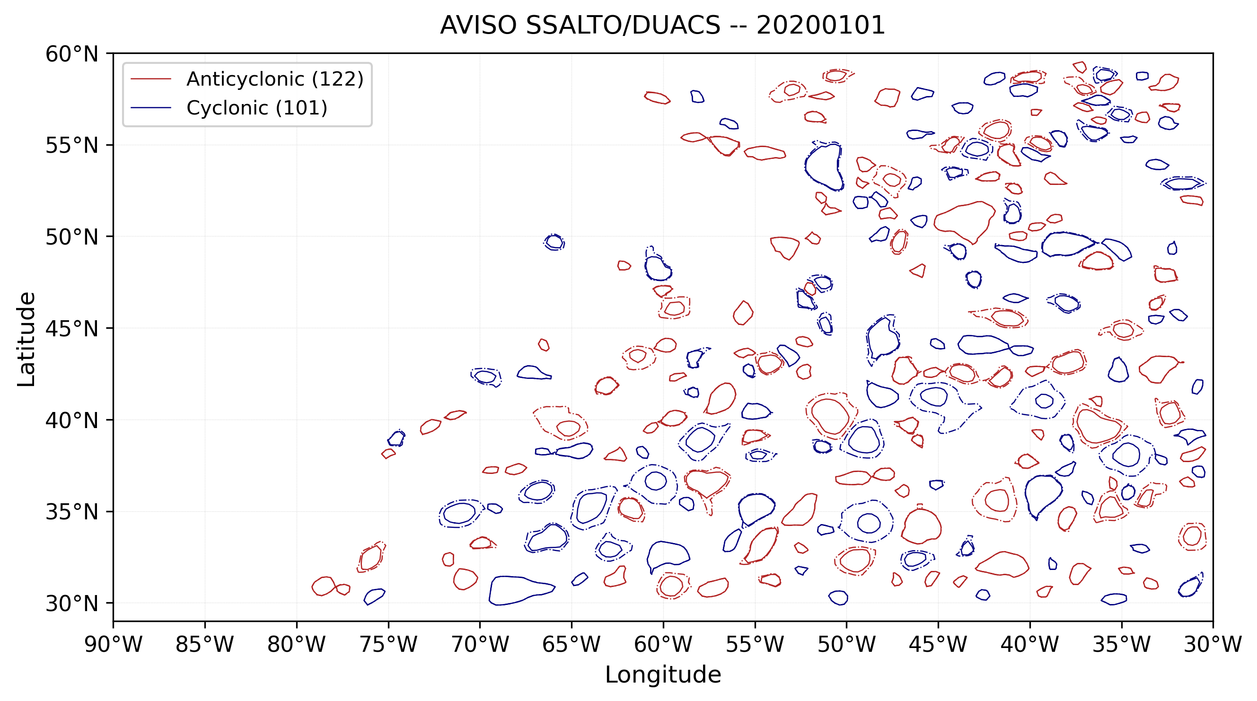
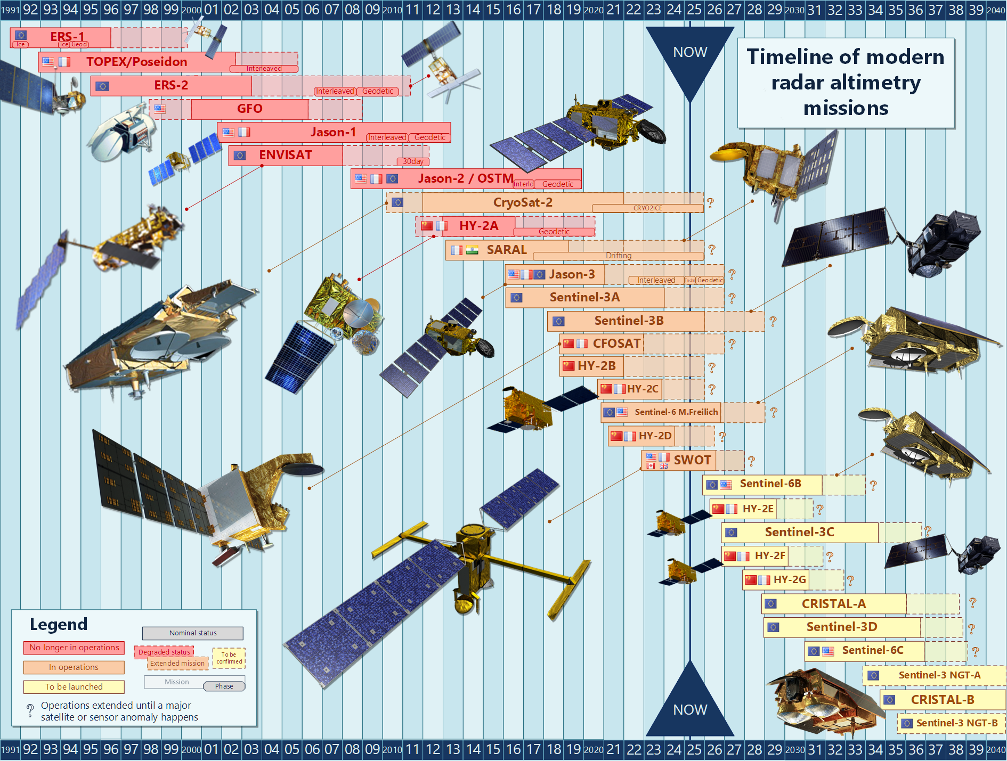
Background & Motivation
Several ocean eddy detection & tracking studies have been developed to evaluate eddy features: Chelton et al. (2011), Mason et al. (2014), Faghmous et al. (2015), Conti et al. (2016), Cipollone at al. (2017), Pegliasco et al. (2020), Smith et Fortin (2022), Zhang et al. (2024).
Verification of mesoscale eddies in Global Ocean Ensemble Reanalysis (as done for tropical cyclones).
Eddy tracking code to evaluate the representation of actual mesoscale eddies in Ensemble eddy-permitting reanalyses, eddy-resolving reanalysis system.
First, focus on a specific area: North-West Atlantic is an ideal region to study mesoscale eddies because it combines strong dynamics, high data availability, and climatic relevance.
What is the current capacity of Ocean Reanalysis product system to “capture” observed eddies features?
Analysis mesoscale eddies characteristics in satellite altimetry and Ocean Reanalysis data at different spatial resolutions to understand the impact of spatial resolution on ocean meso-scales in ocean models.

Slide 4
Analysis Framework
1. Model intercomparison (pilot phase)
Period: 1993–1995
Region: North-West Atlantic
(29.87°N–59.87°N; 80.13°W–30.13°W)
Datasets:
GREP (ensemble)
GLORYS12V1
GIOPS
Objective:
Evaluate model performance (POD / FAR).
Identify the best-performing systems for further analysis.
2. Long-term evaluation
Period: 1993–2022
Region: North-West Atlantic
Datasets:
GREP
GLORYS12V1
Objective:
Assess long-term eddy statistics and variability
Evaluate model consistency over decades
3. Global-scale comparison
Period: 2020–2022
Region: Global Ocean
Datasets:
GLORYS2V4
GLORYS12V1
Objective:
Compare eddy-resolving vs eddy-permitting systems
Test robustness of results beyond regional scale

Slide 5
Dataset
Dataset | Resolution & Grid | Assimilation / Forcing | Strengths | Limitations
AVISO SSALTO/DUACS L4 | 1/4° regular lat–lon grid (WGS84-like) | Multi-satellite altimetry (DT merged) | Reference dataset for sea level and eddy detection; consistent global coverage | Detection uncertainties, especially in energetic regions
GLORYS2V4 | 1/4°, 75 vertical levels | Assimilates altimetry, SST, sea ice, in-situ T/S (no surface nudging) | High mesoscale energy; realistic eddy statistics | Possible regional biases; high variability in energetic regions
GLORYS12V1 | 1/12°, 50 levels (eddy-resolving) | Strong altimetry + SST + in-situ assimilation; ERA forcing | Realistic eddy structure and sea-level variability; high resolution | May over-amplify mesoscale energy; regional imbalances
CGLORSv7 | 1/4°, 75 levels (NEMO ORCA025) | 3D-Var (OceanVar) + SST/SSS nudging | Robust large-scale circulation | Surface nudging damps mesoscale variability
ORAS5 | 1/4°, 75 levels (NEMO ORCA025) | NEMOVAR 3D-Var assimilation | Dynamically consistent large-scale variability | Smooths mesoscale features; regional biases (e.g. boundary currents)
GIOPS (ECCC) | 1/4° (eddy-permitting) | SEEK filter (SAM2) + altimetry + SST + in-situ | Consistent global reanalysis; good for large-scale dynamics | Limited mesoscale resolution; weaker eddy detection skill; smoother structures

Slide 6
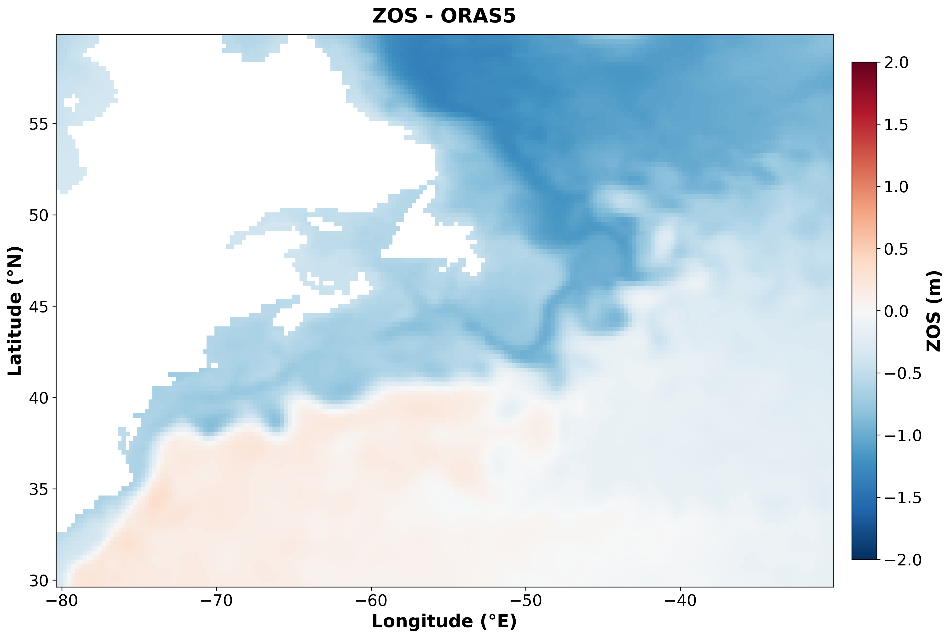
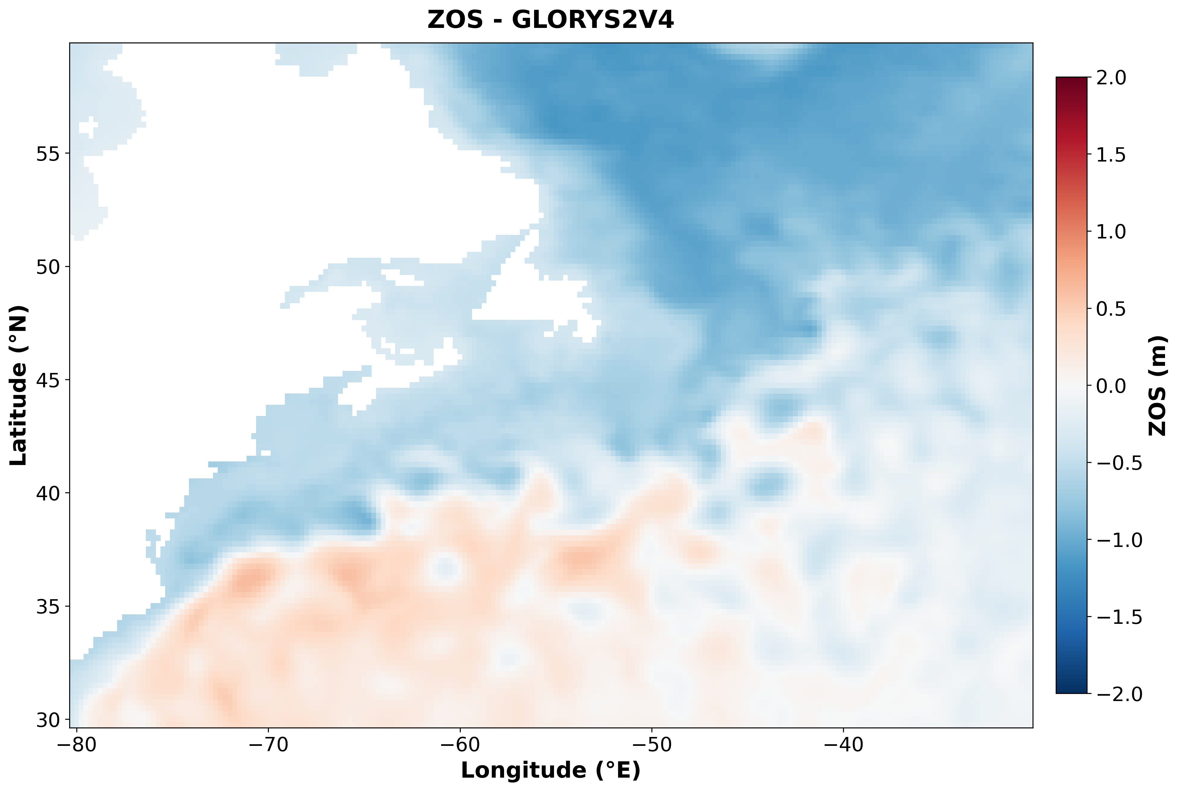
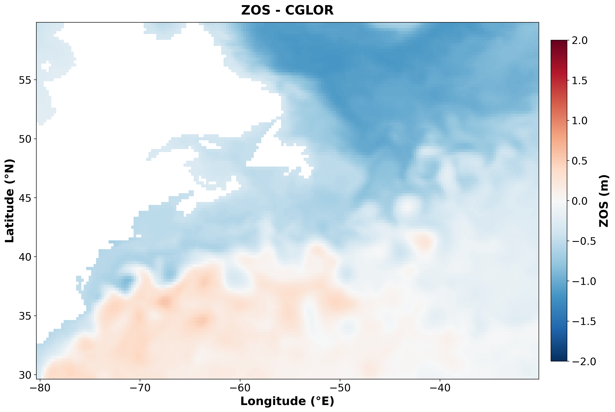
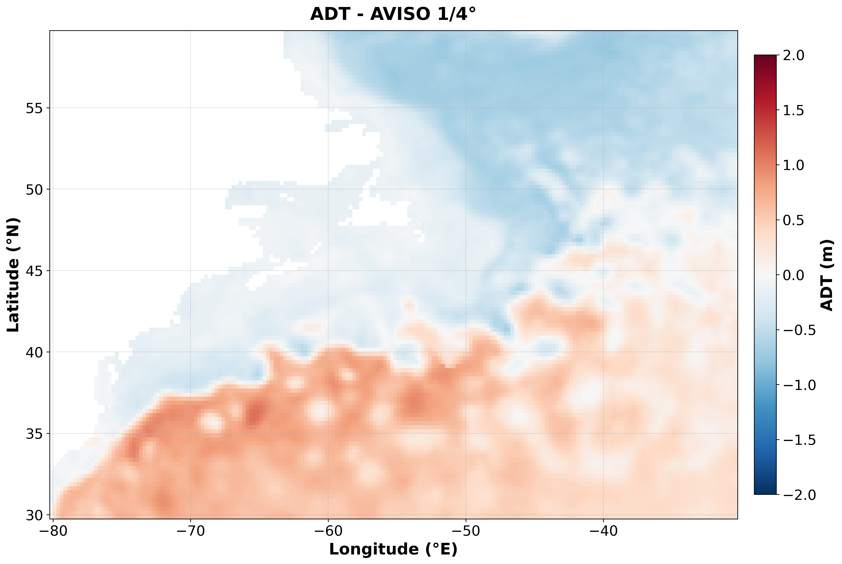

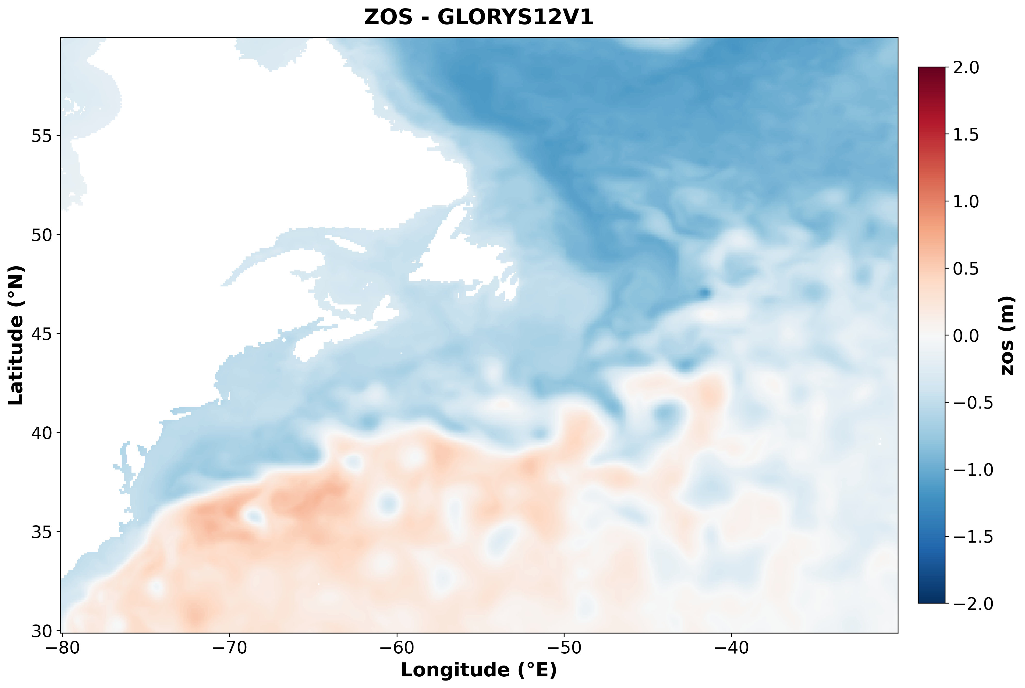
Absolute Dynamic Topography - Sea Surface Height
Absolute Dynamic Topography and ZOS, on 1993-01-01, for 6 different products.

Slide 7
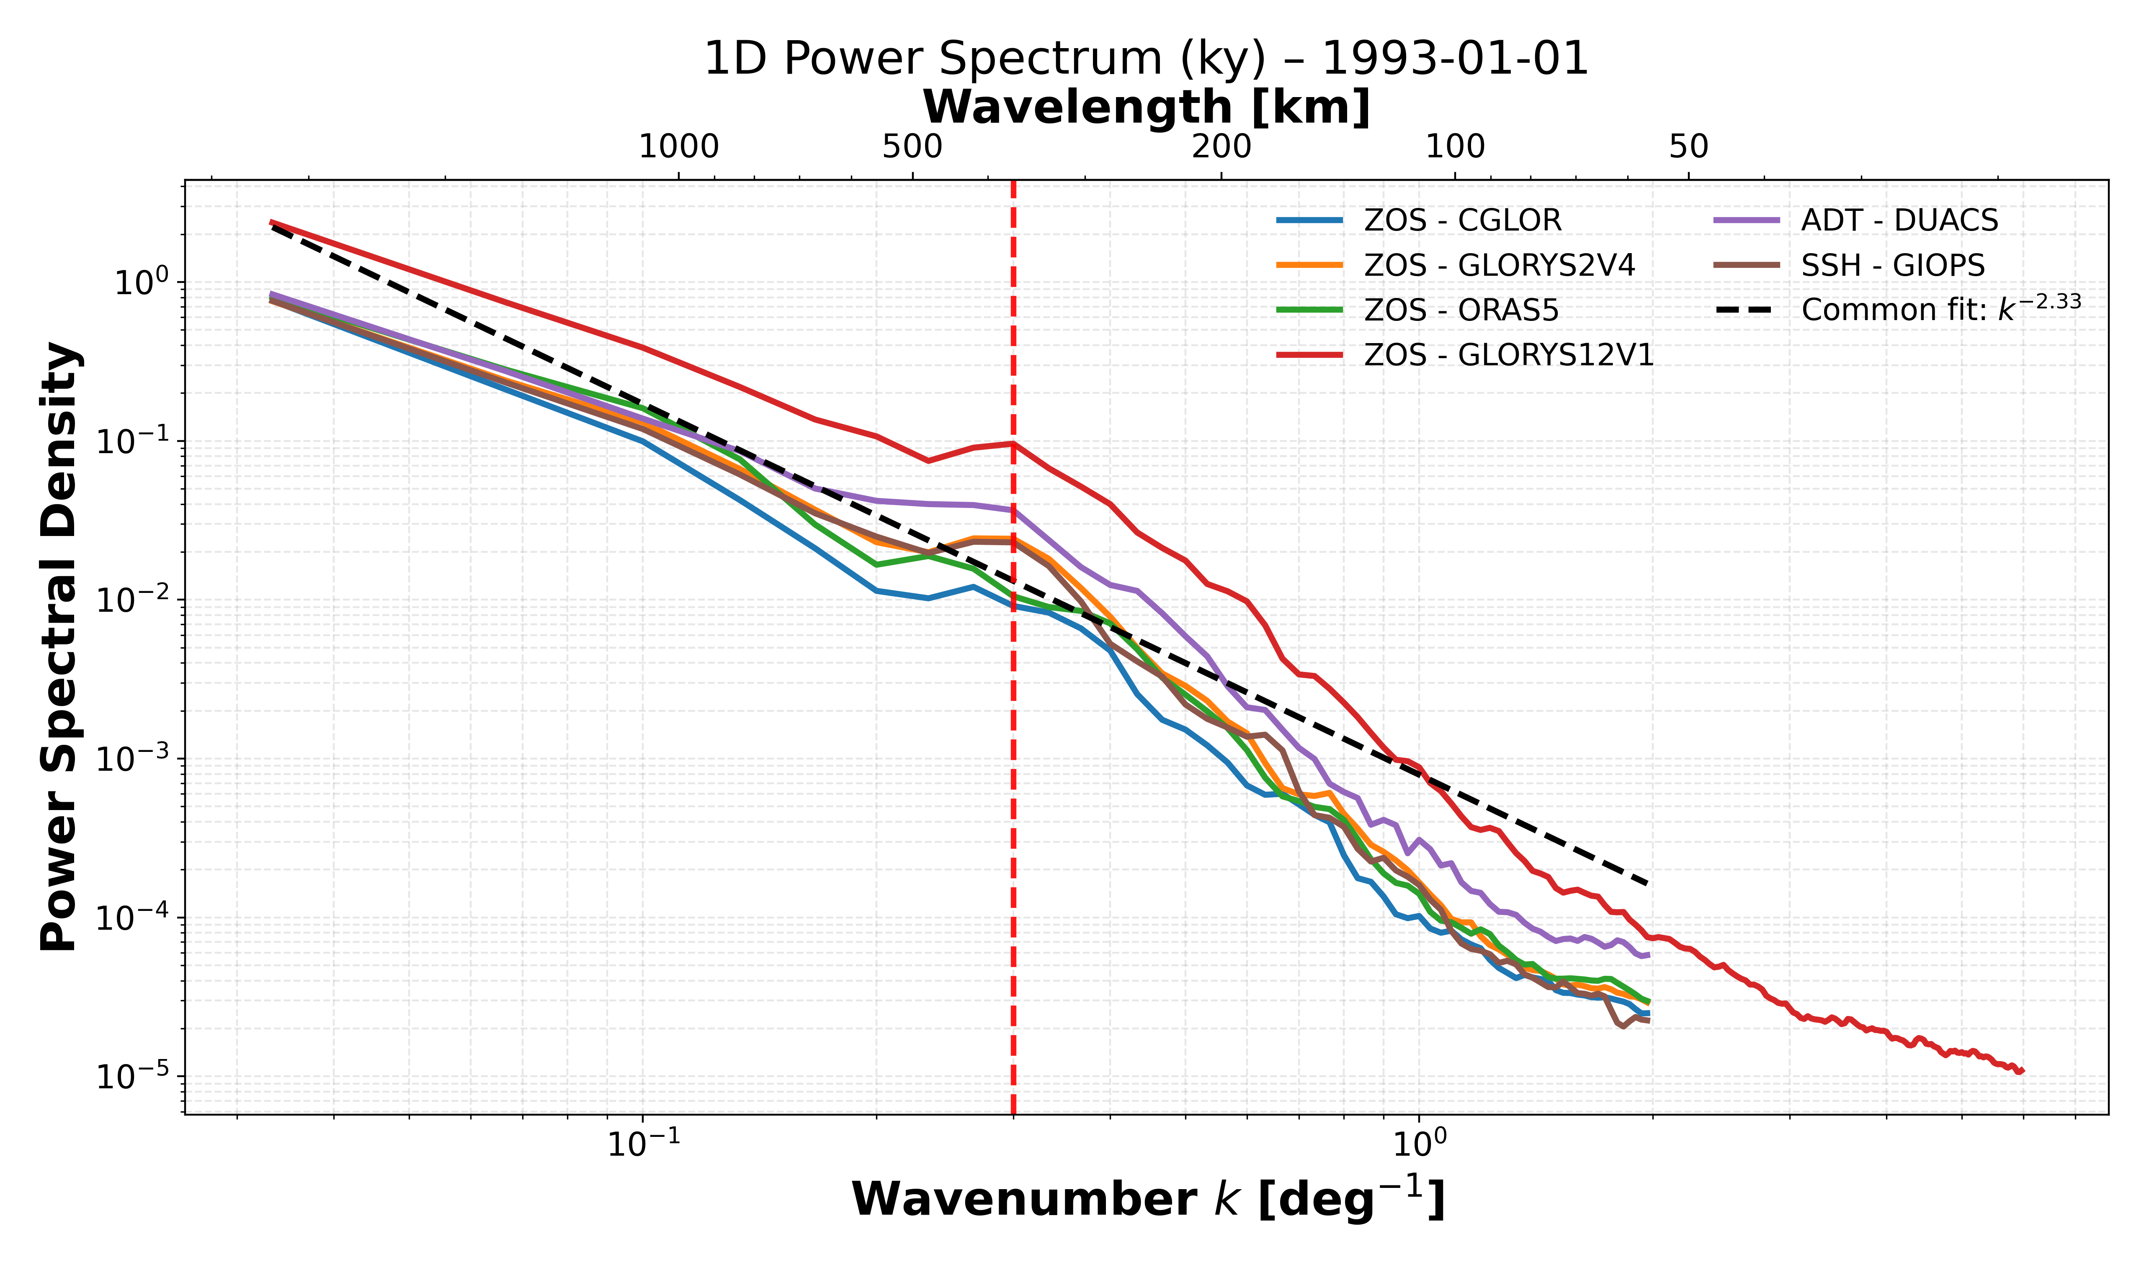
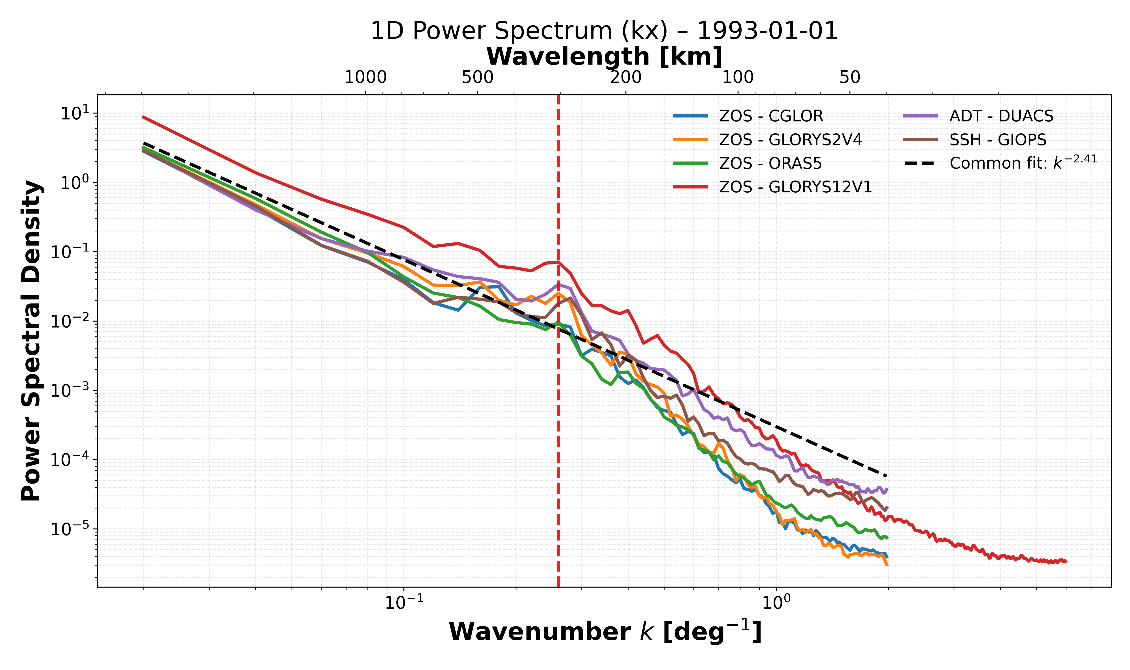
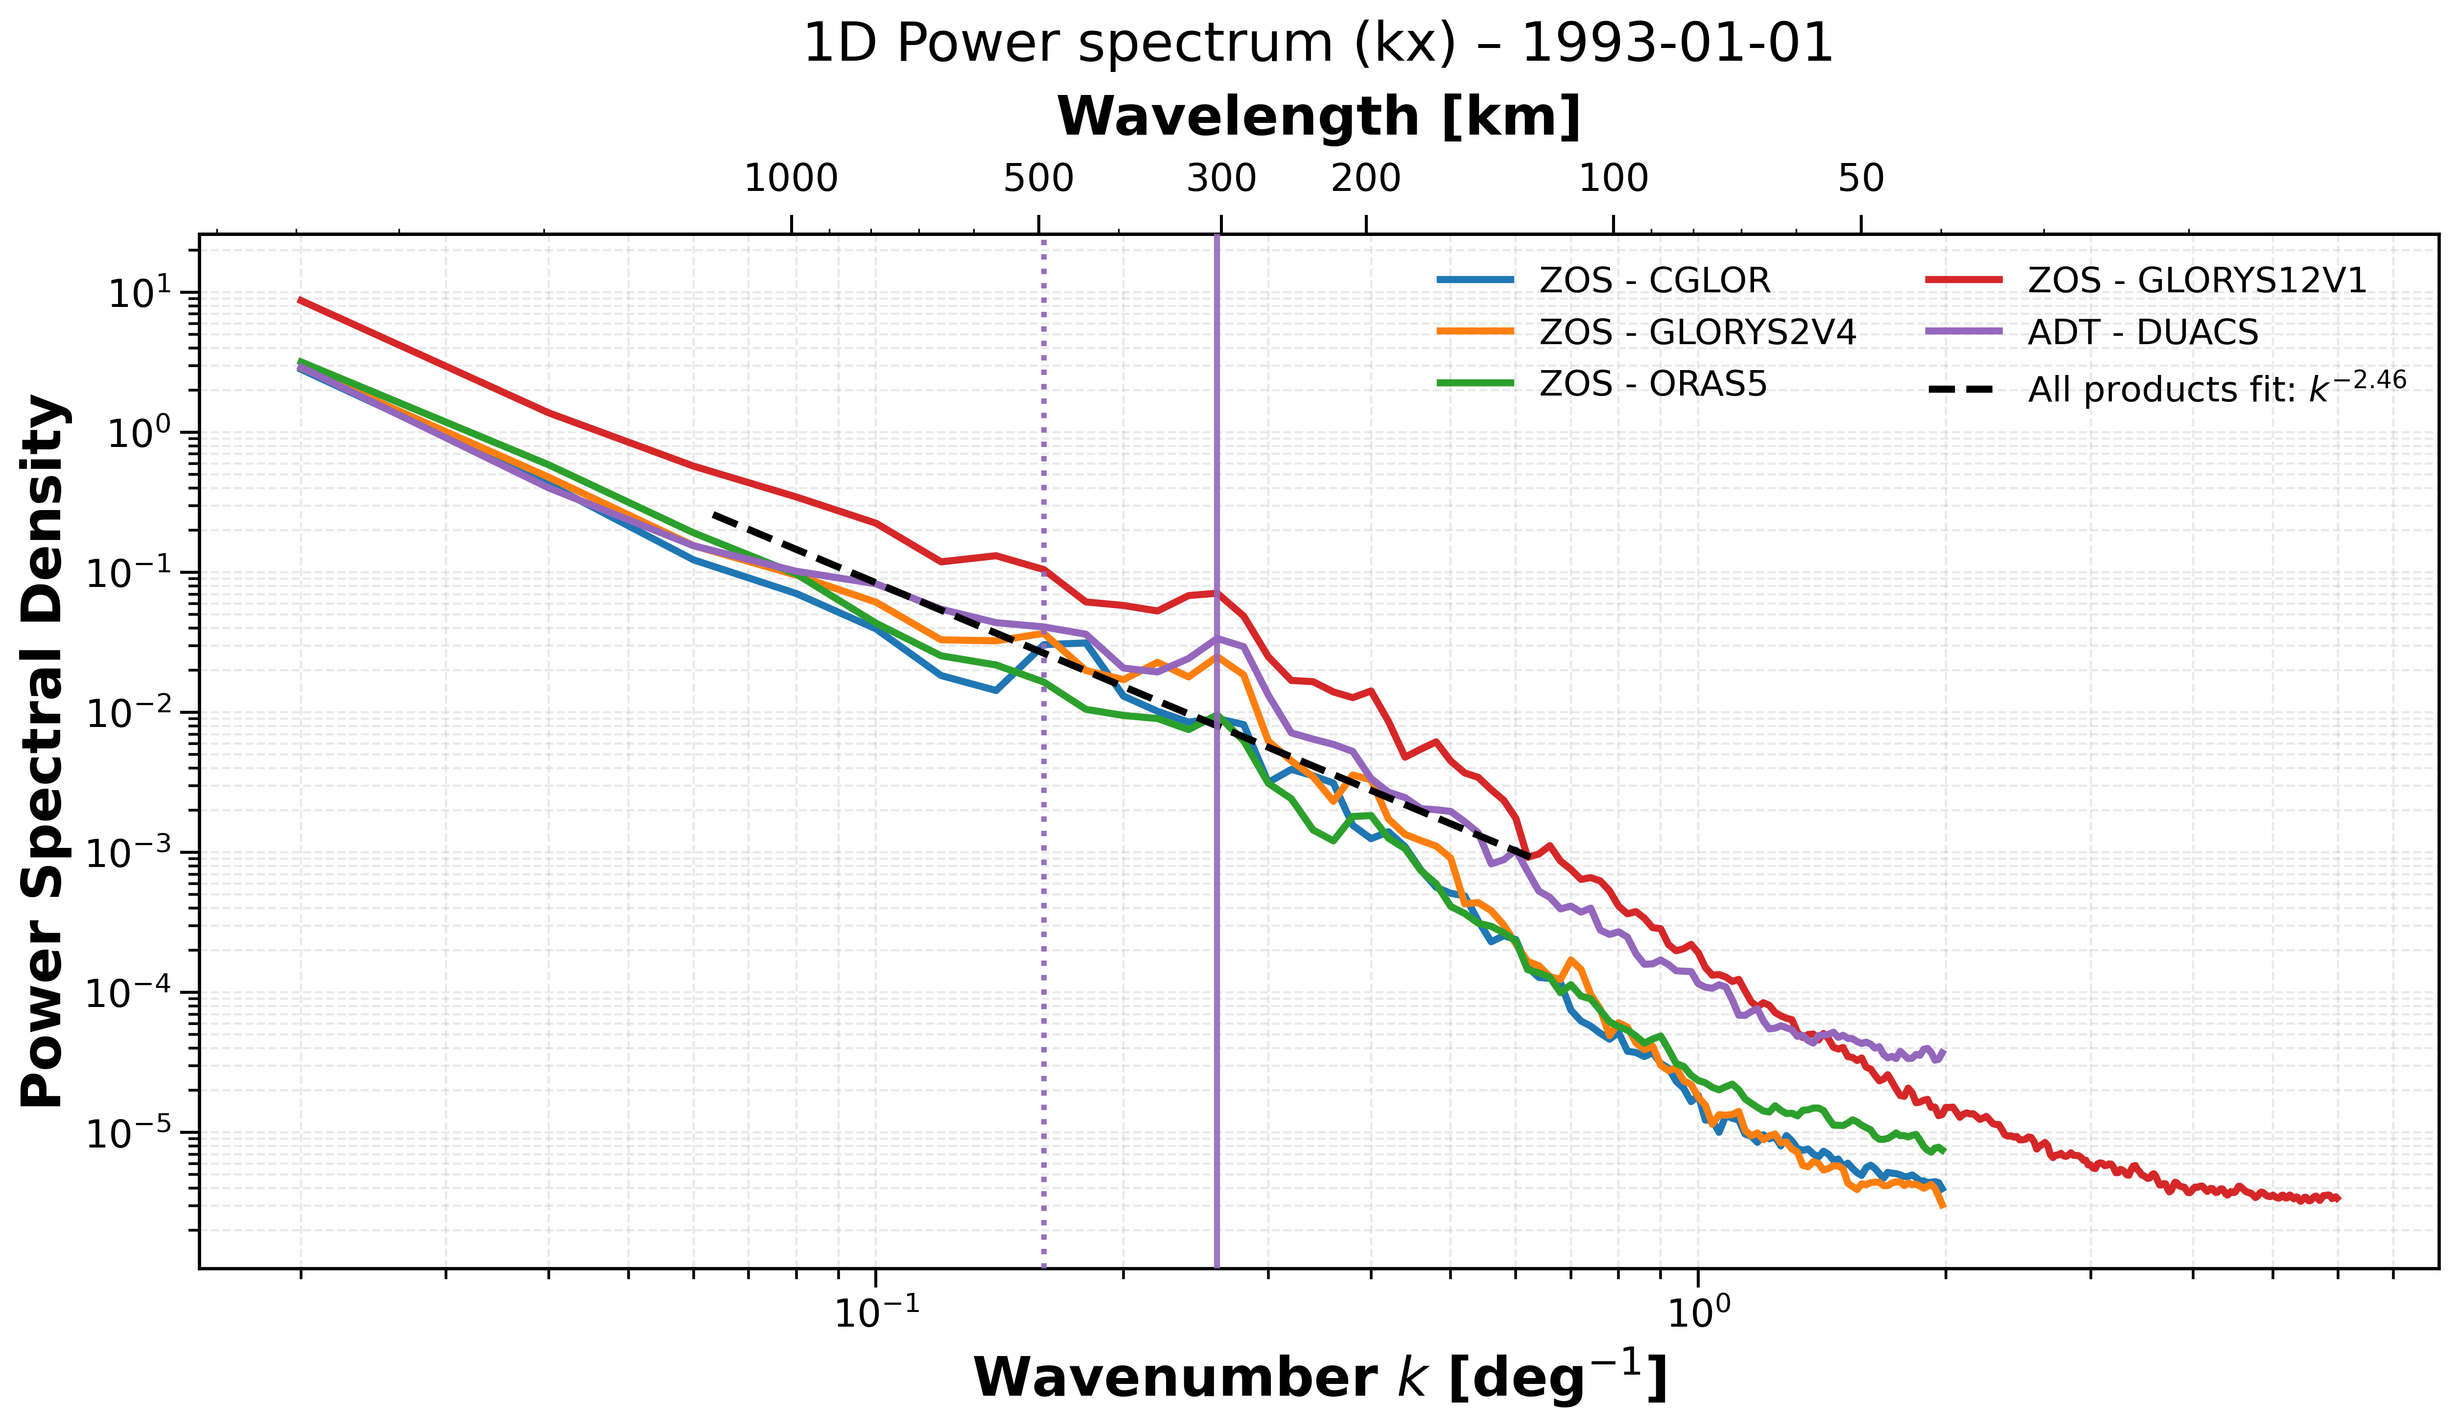
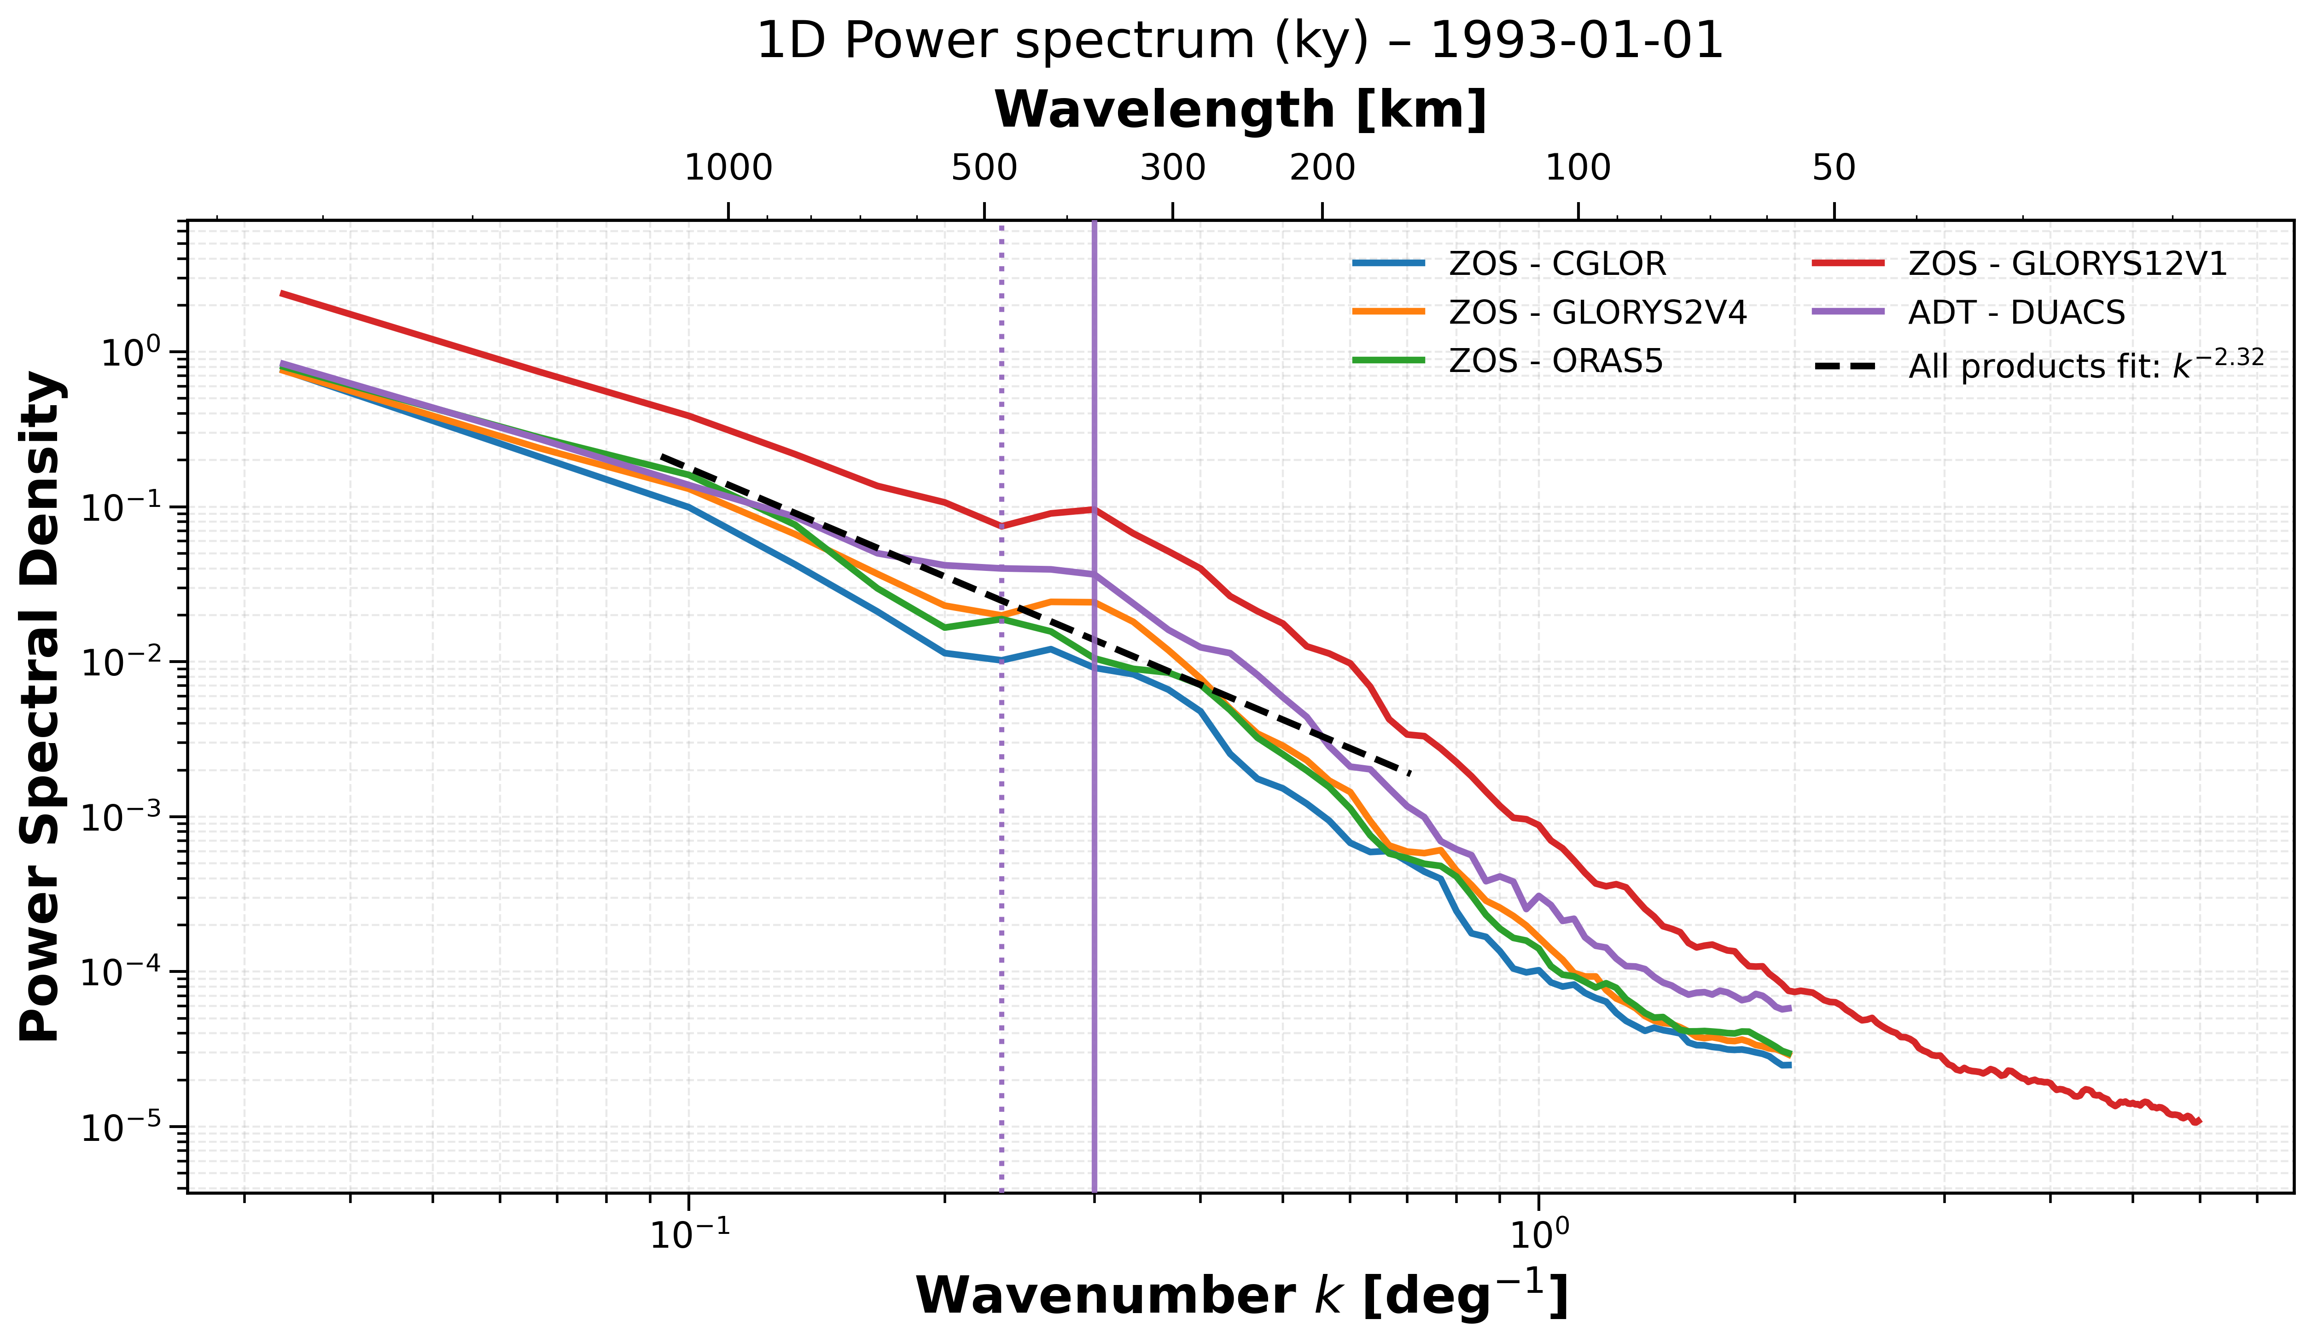
Power Noise Spectra
Plotting of Power Spectra along North-South and West-East directions, for the Sea Surface Height for all the products (Ciani et al. 2019).
We have chosen one day, as a test case, to show the differences between the SSH fields.
371
304

Slide 8
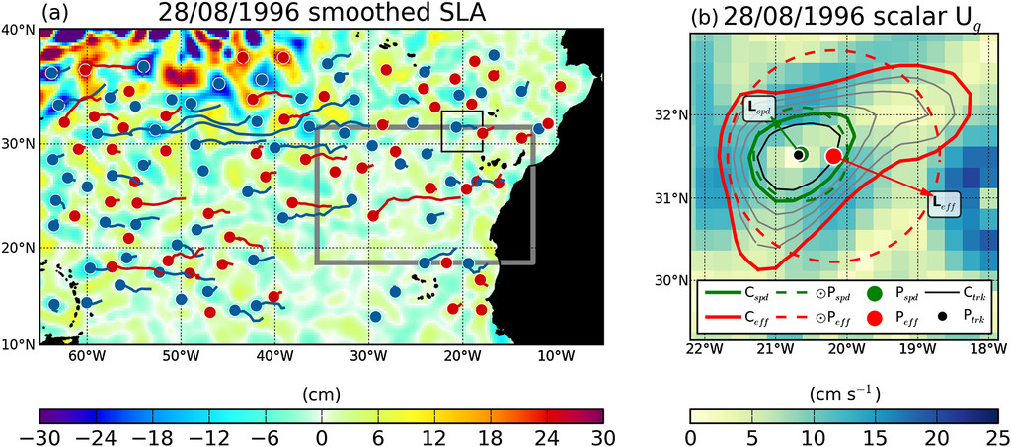
Eddy Detection & Tracking
Py-eddy-tracker (Mason E., et al., 2014)
Pre-detection: high-pass filter at 500 km (Bessel filter).
Contour the filtered SLA.
Identify closed contours of SLA or ADT field, at a specified timestep k (k ∈ N).
For a contour to be a valid eddy, it must satisfy the following criteria:
It must be closed.
Only one maxima (minima) allowed for an Anticyclonic (Cyclonic).
Pixel count 5 pixel =Imin ≤ I ≤ Imax = 2000 pixel : have between 5 and 2000 pixels.
Must fit a circle with a maximum of 55% error in area.
The Amplitude must be at least twice the contour interval (i.e. 0.4 cm).
Iterate the procedure at different timesteps (from k + 1 to … K + n).
Track all the eddies for all different timesteps : deal with eddy births and death.
Minimum eddy lifetime threshold: 4 days.
B. Yirka, 2014: https://phys.org/news/2014-06-mesoscale-eddies-ocean-previously-thought.html
Mason et al., 2014.
Eddy Identified plotted over U geostrophic velocity.
Ceff(red solid contour): Cyclonic eddy
Peff(red dot): Centroid of Ceff
Peff (red dashed contour): Circle with same area as Ceff

Slide 9
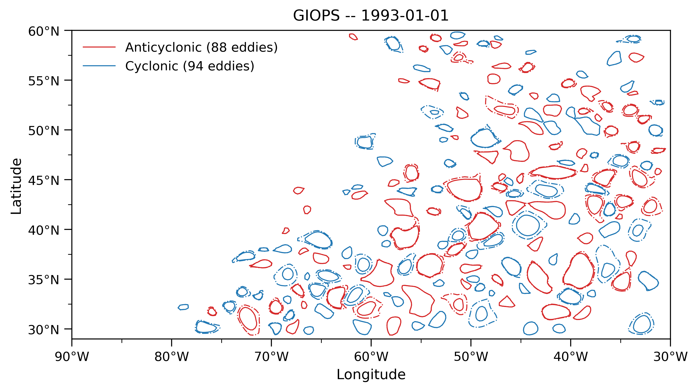
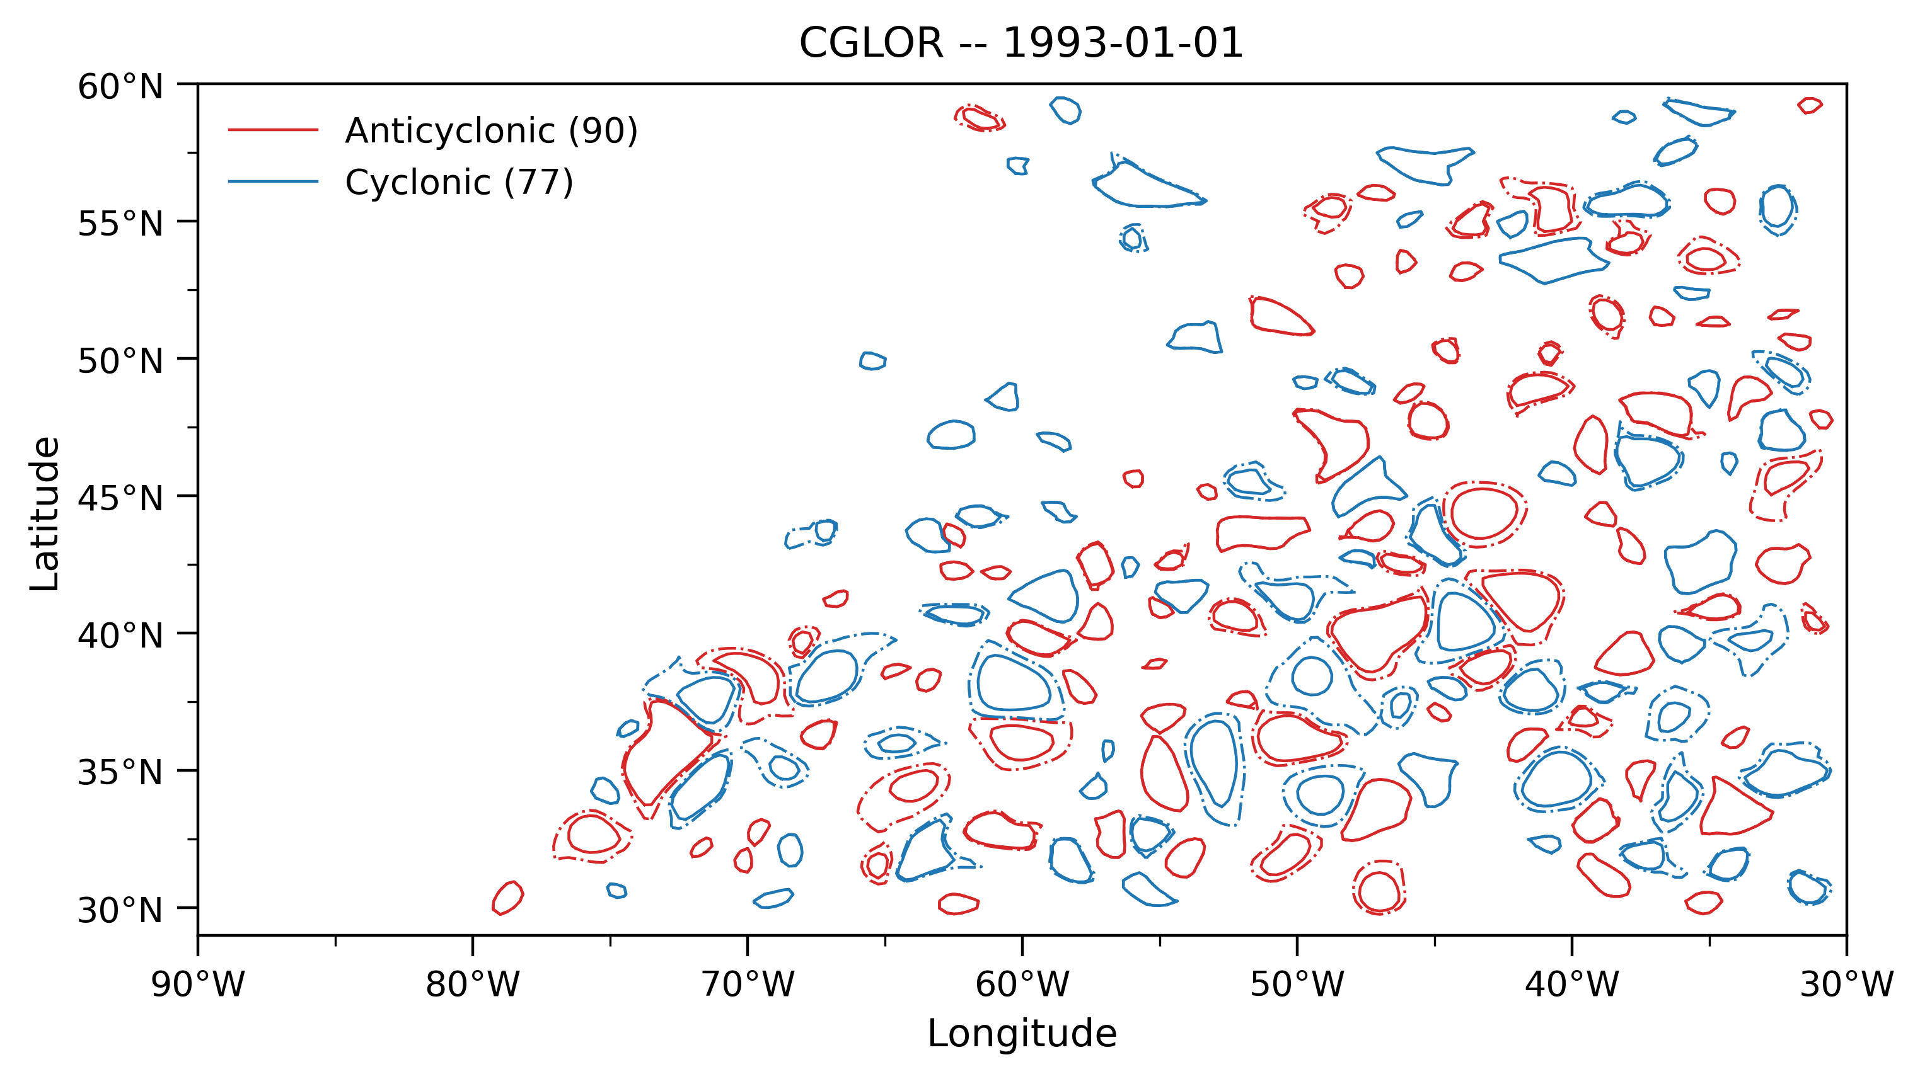
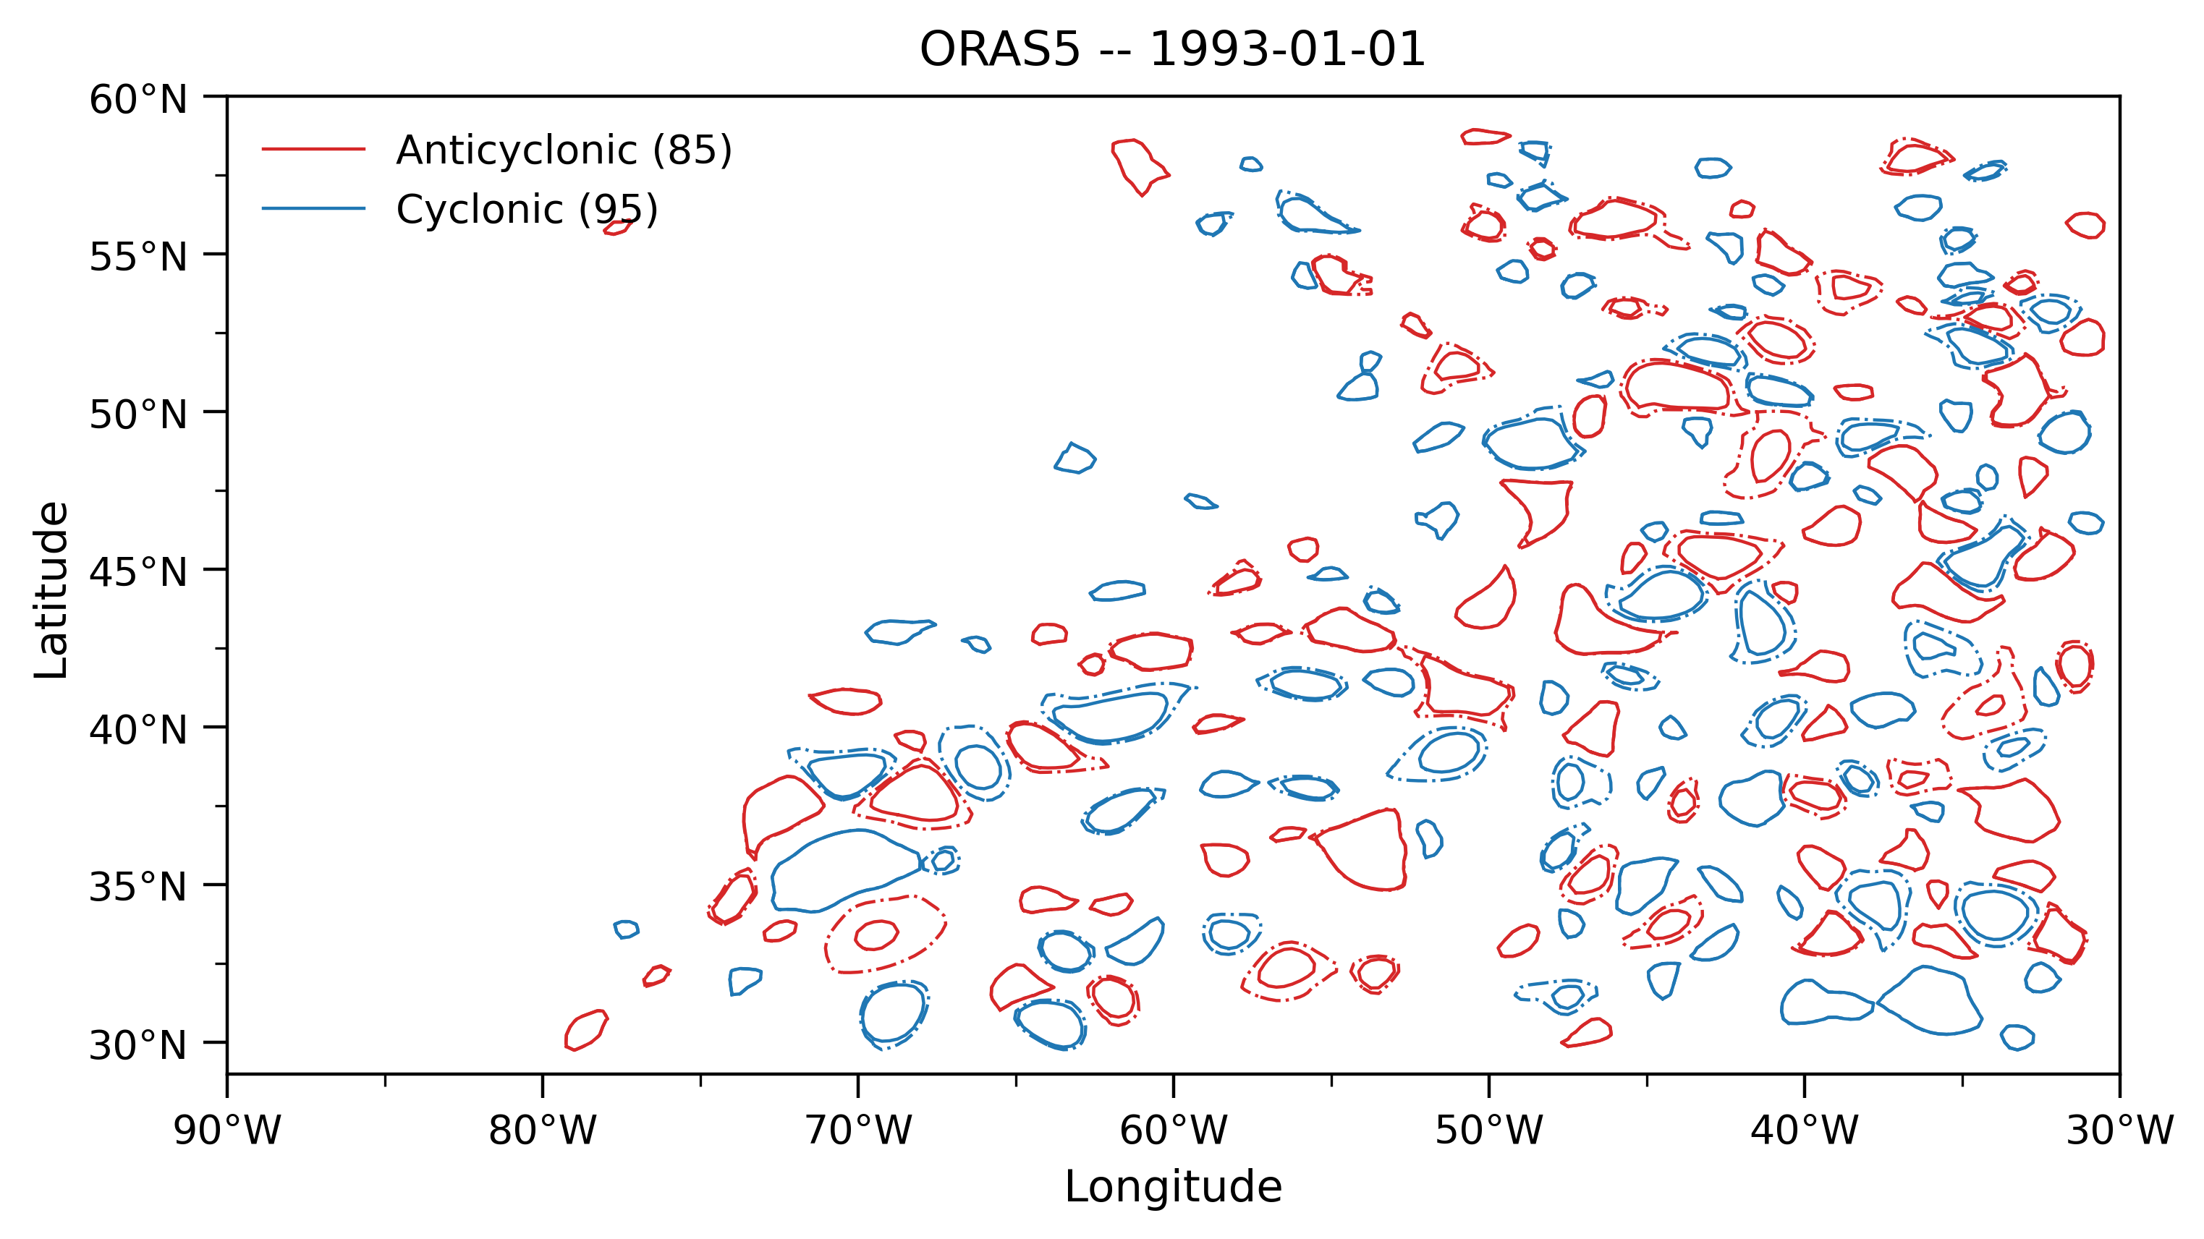
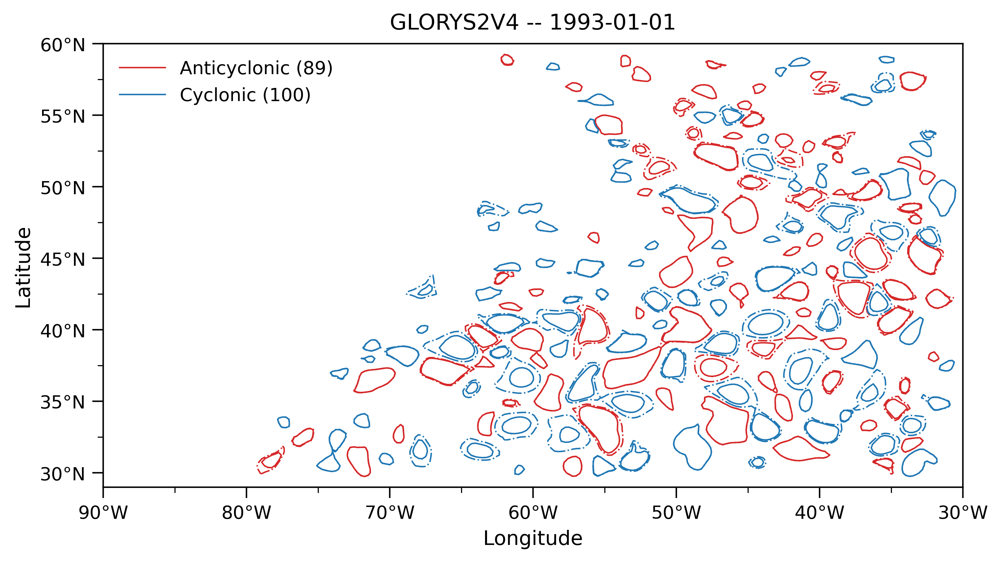
Eddy Detection

Slide 10
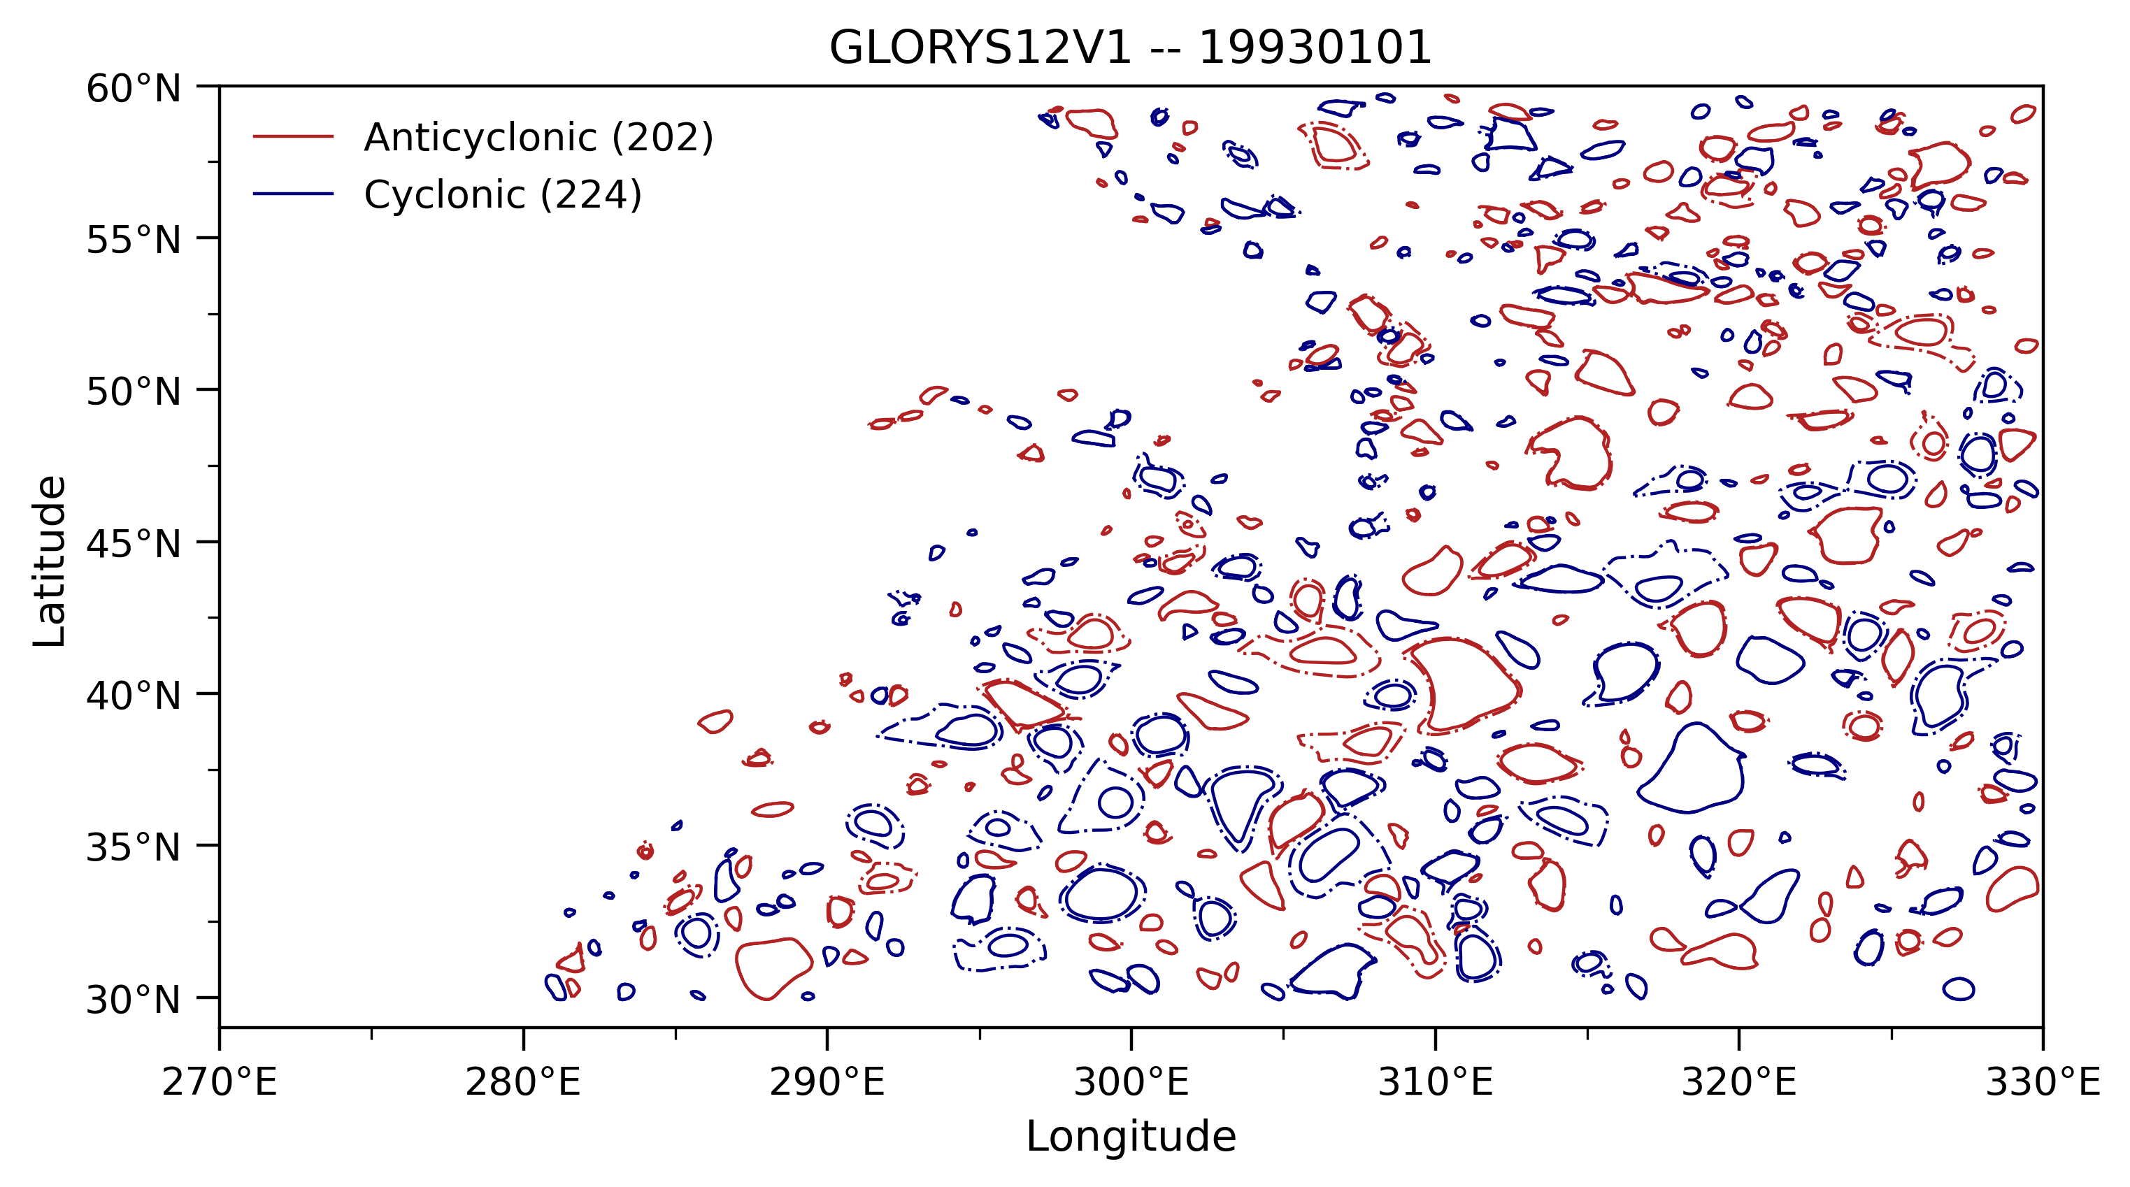
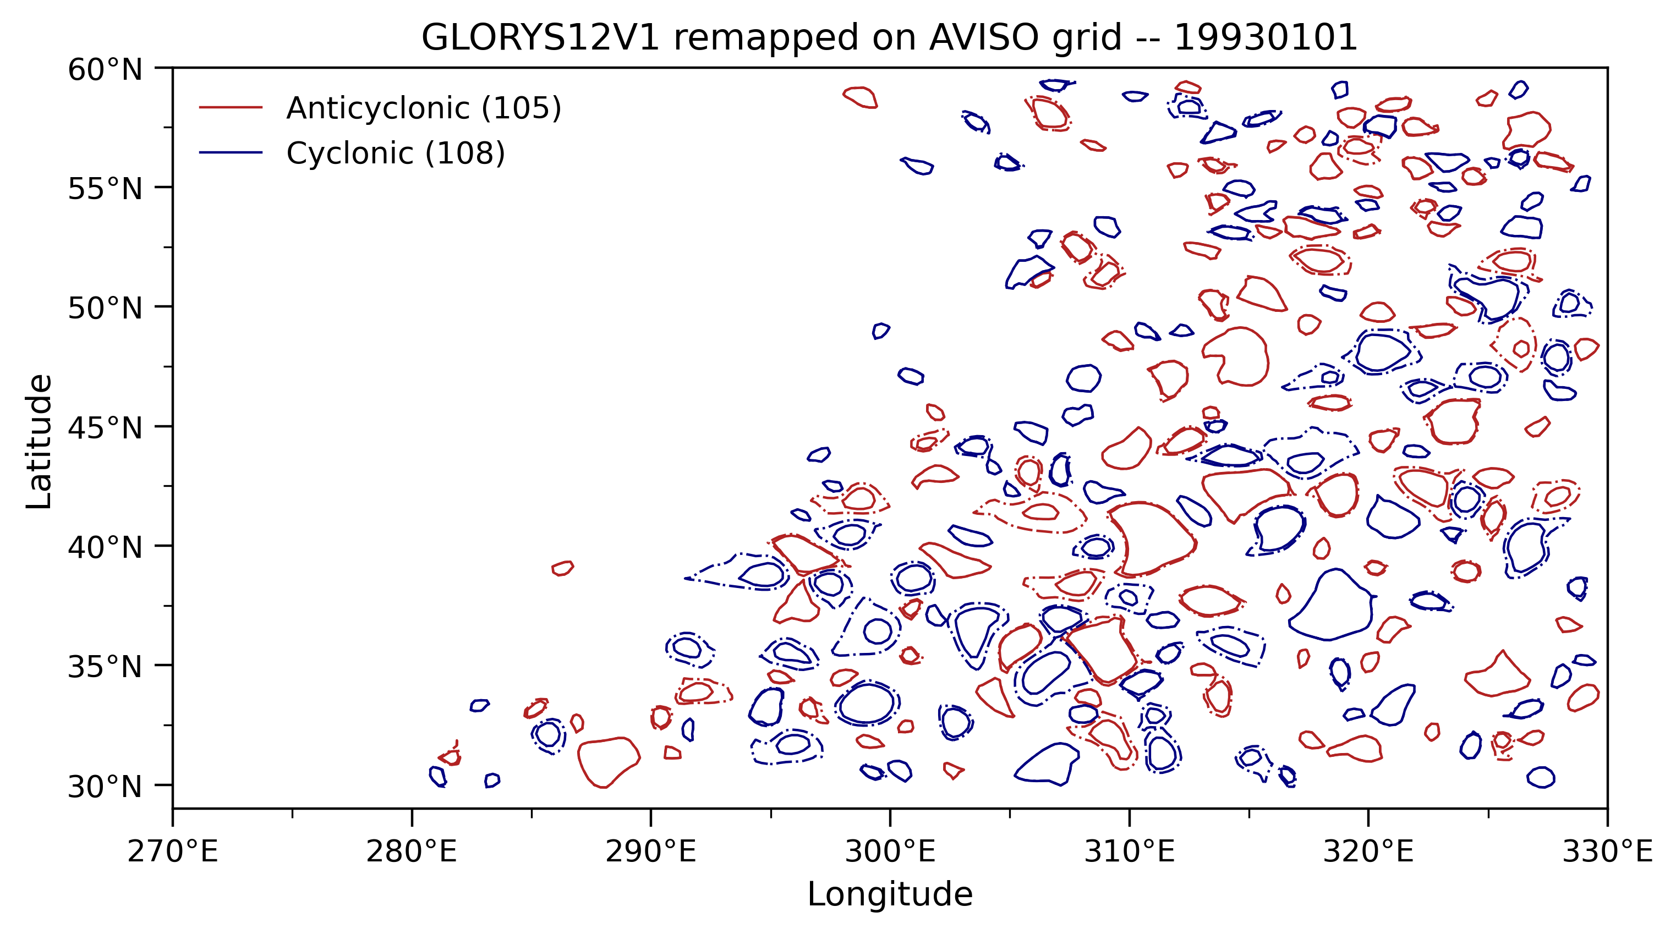
Eddy Detection

Slide 11
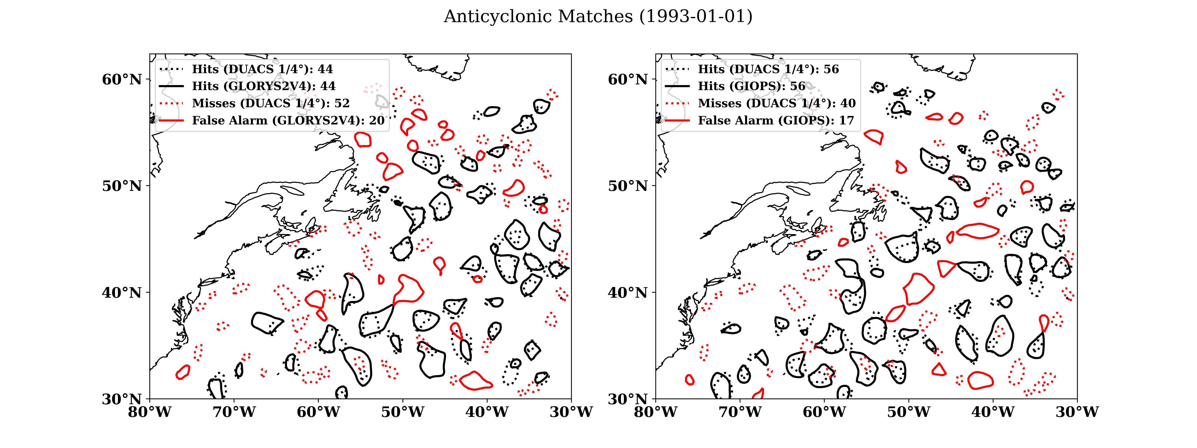
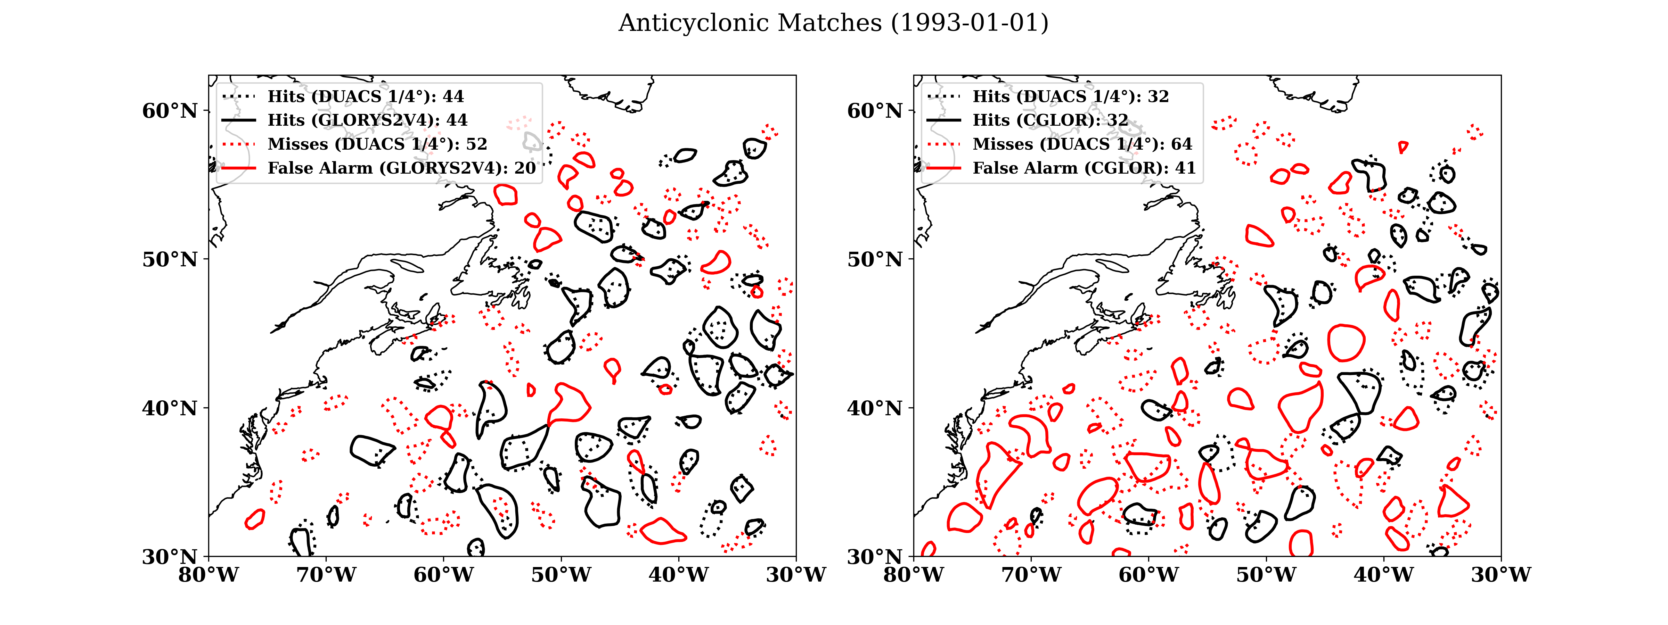
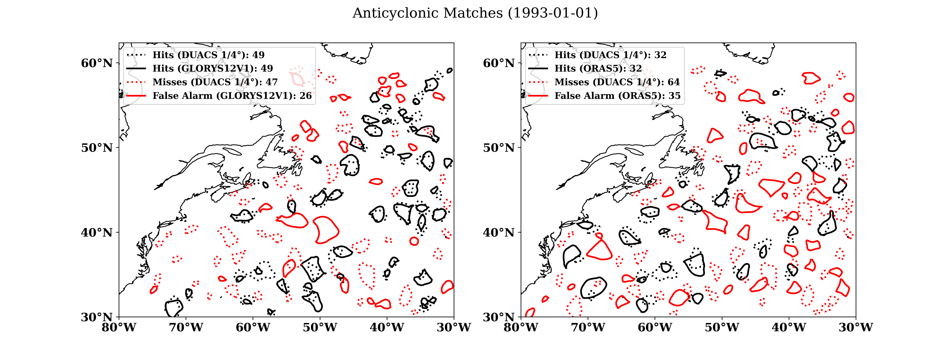
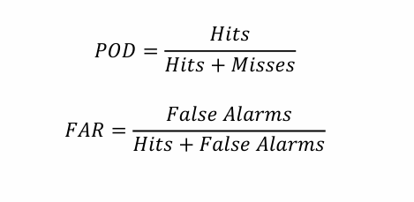
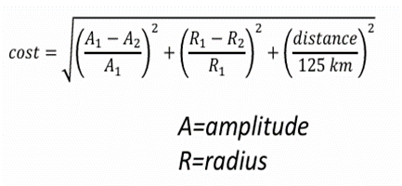
Eddy Matching
Evaluation of the goodness of each reanalysis and operational systems in counting the population of eddies.
We choose pair eddies, with the lowest Cost Function within 125 km of distance between centres:​ Amplitude and Radius must be close to the previous observation. In case of several candidates only the closest is kept (Smith G. C., & Fortin A. S., 2022).

Slide 12
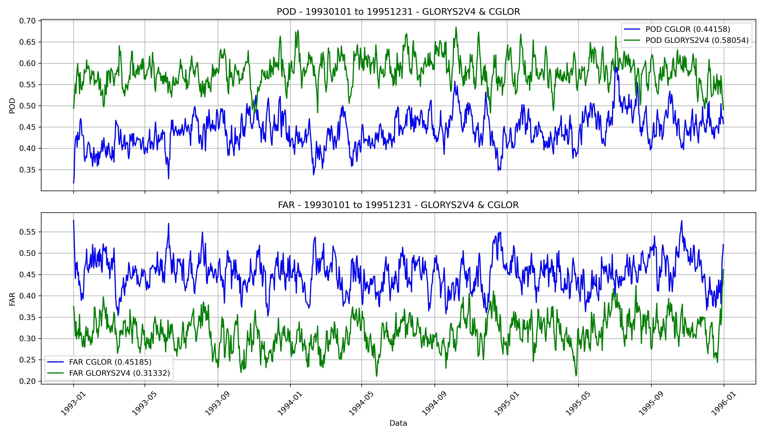
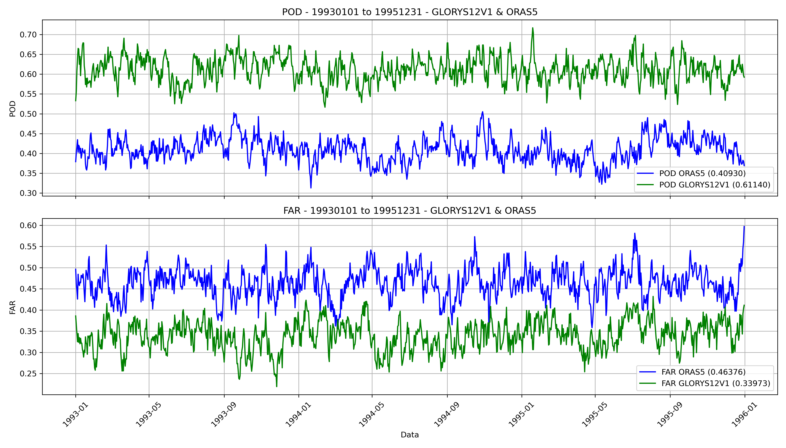
Eddy Matching: POD & FAR timeseries
Skill of reanalysis dataset, compared to the satellite data (AVISO: Multi-mission daily gridded (1/4°) product). ​
POD eddies is used to calculate the fraction of detected that are captured by Reanalysis Dataset, while FAR is used to calculate the fraction of detected eddies in Reanalysis Dataset that doesn’t occur.​
Stats. | GLORYS12V1 | ORAS5 | Diff. | Diff.(%)
POD | 0.61 | 0.41 | 0.20 | +48.7%
FAR | 0.34 | 0.46 | -0.12 | -26.1%
Stats. | GLORYS2V4 | CGLOR | Diff. | Diff.(%)
POD | 0.58 | 0.44 | 0.14 | +31.8%
FAR | 0.31 | 0.45 | -0.14 | -31.1%

Slide 13
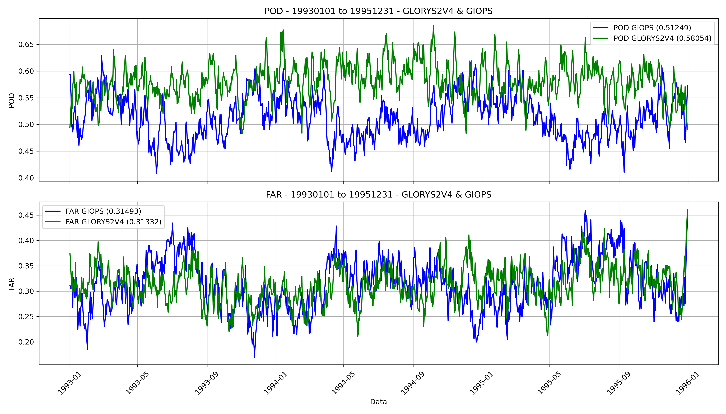
Eddy Matching: POD & FAR timeseries
Skill of reanalysis dataset, compared to the satellite data (AVISO: Multi-mission daily gridded (1/4°) product). ​
POD eddies is used to calculate the fraction of detected that are captured by Reanalysis Dataset, while FAR is used to calculate the fraction of detected eddies in Reanalysis Dataset that doesn’t occur.​
Stats. | GLORYS2V4 | GIOPS | Diff. | Diff.(%)
POD | 0.581 | 0.512 | 0.069 | +13.4%
FAR | 0.313 | 0.315 | -0.02 | -0.6%
Stats. | GLORYS2V4 | CGLOR | Diff. | Diff.(%)
POD | 0.58 | 0.44 | 0.14 | +31.8%
FAR | 0.31 | 0.45 | -0.14 | -31.1%

Slide 14
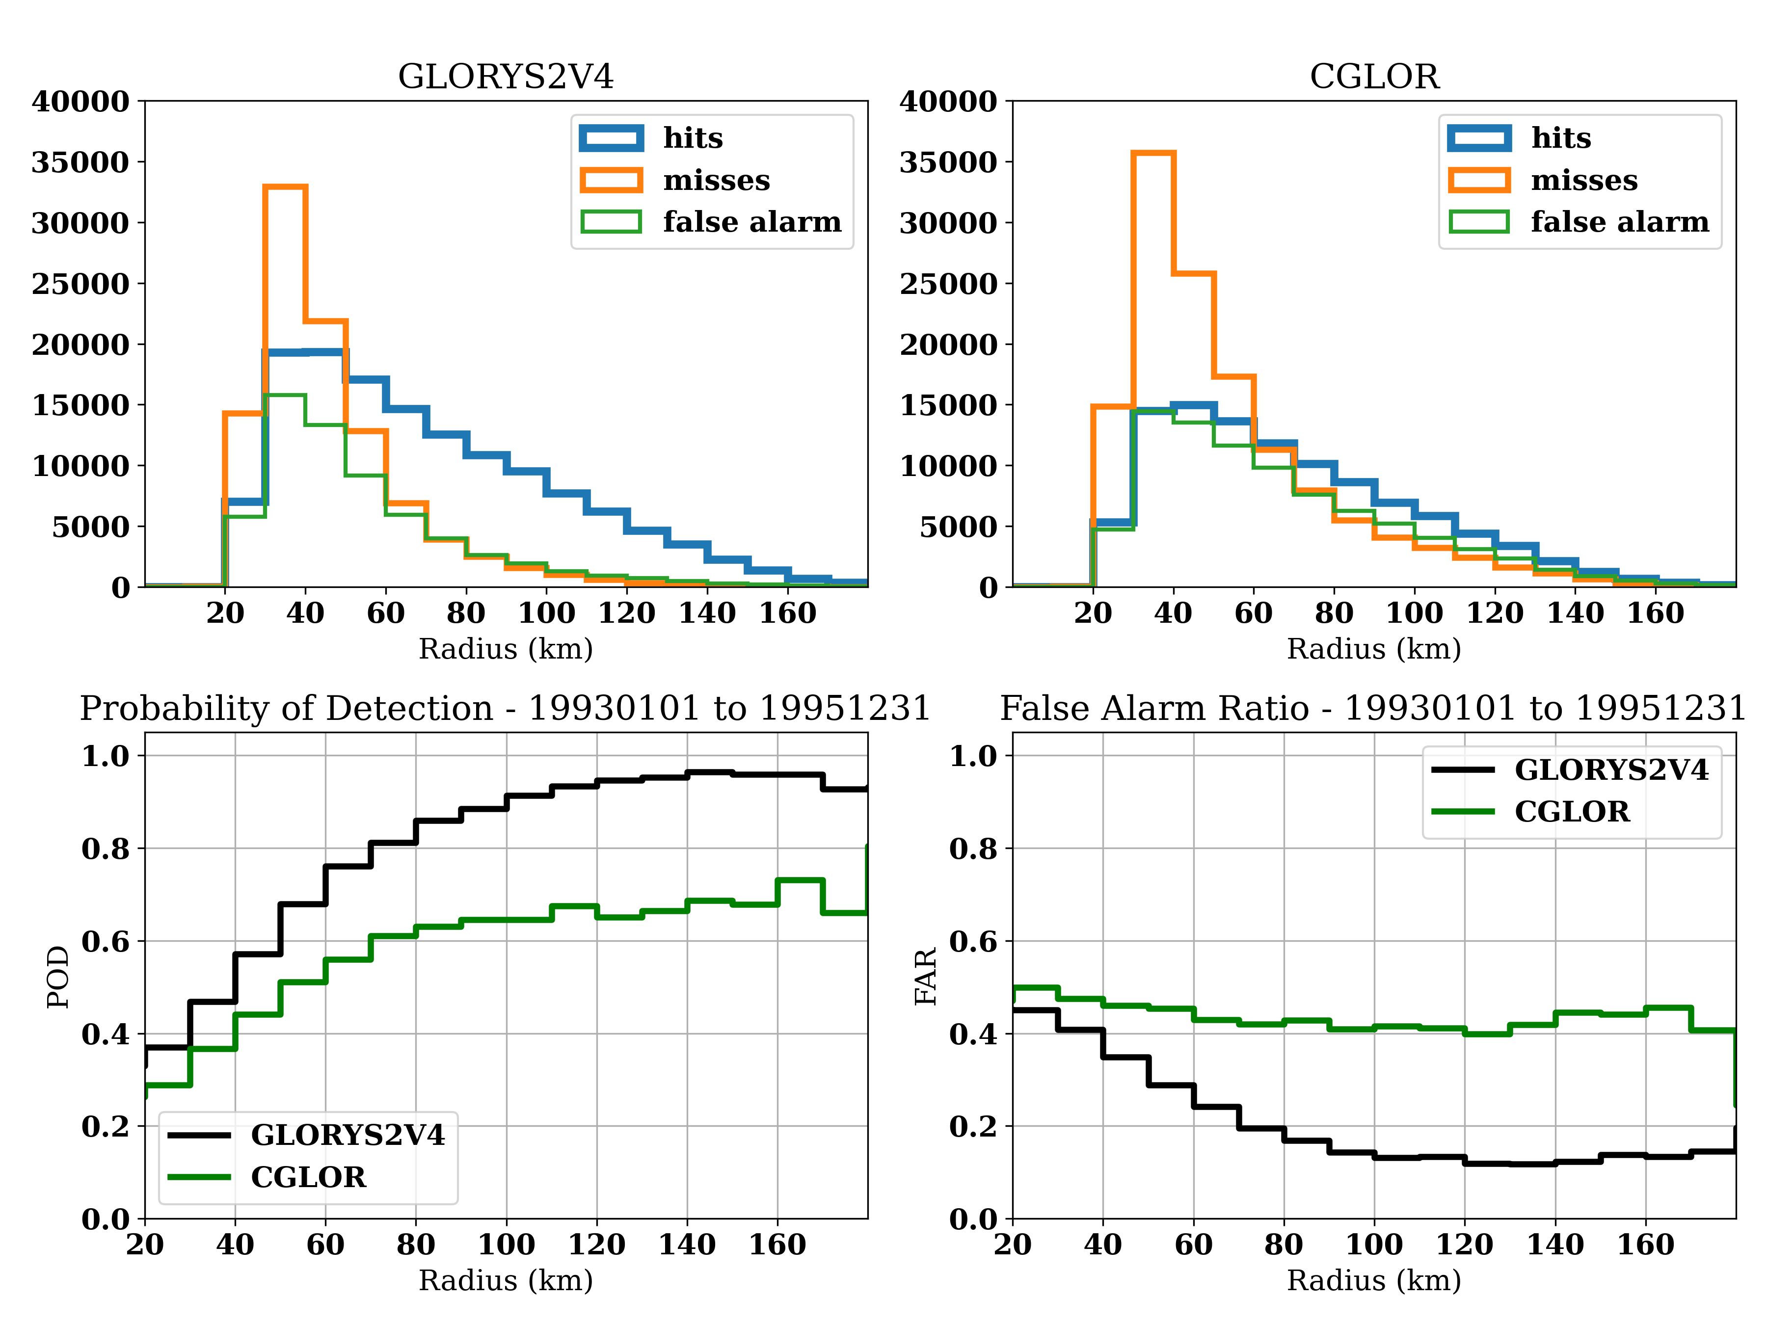
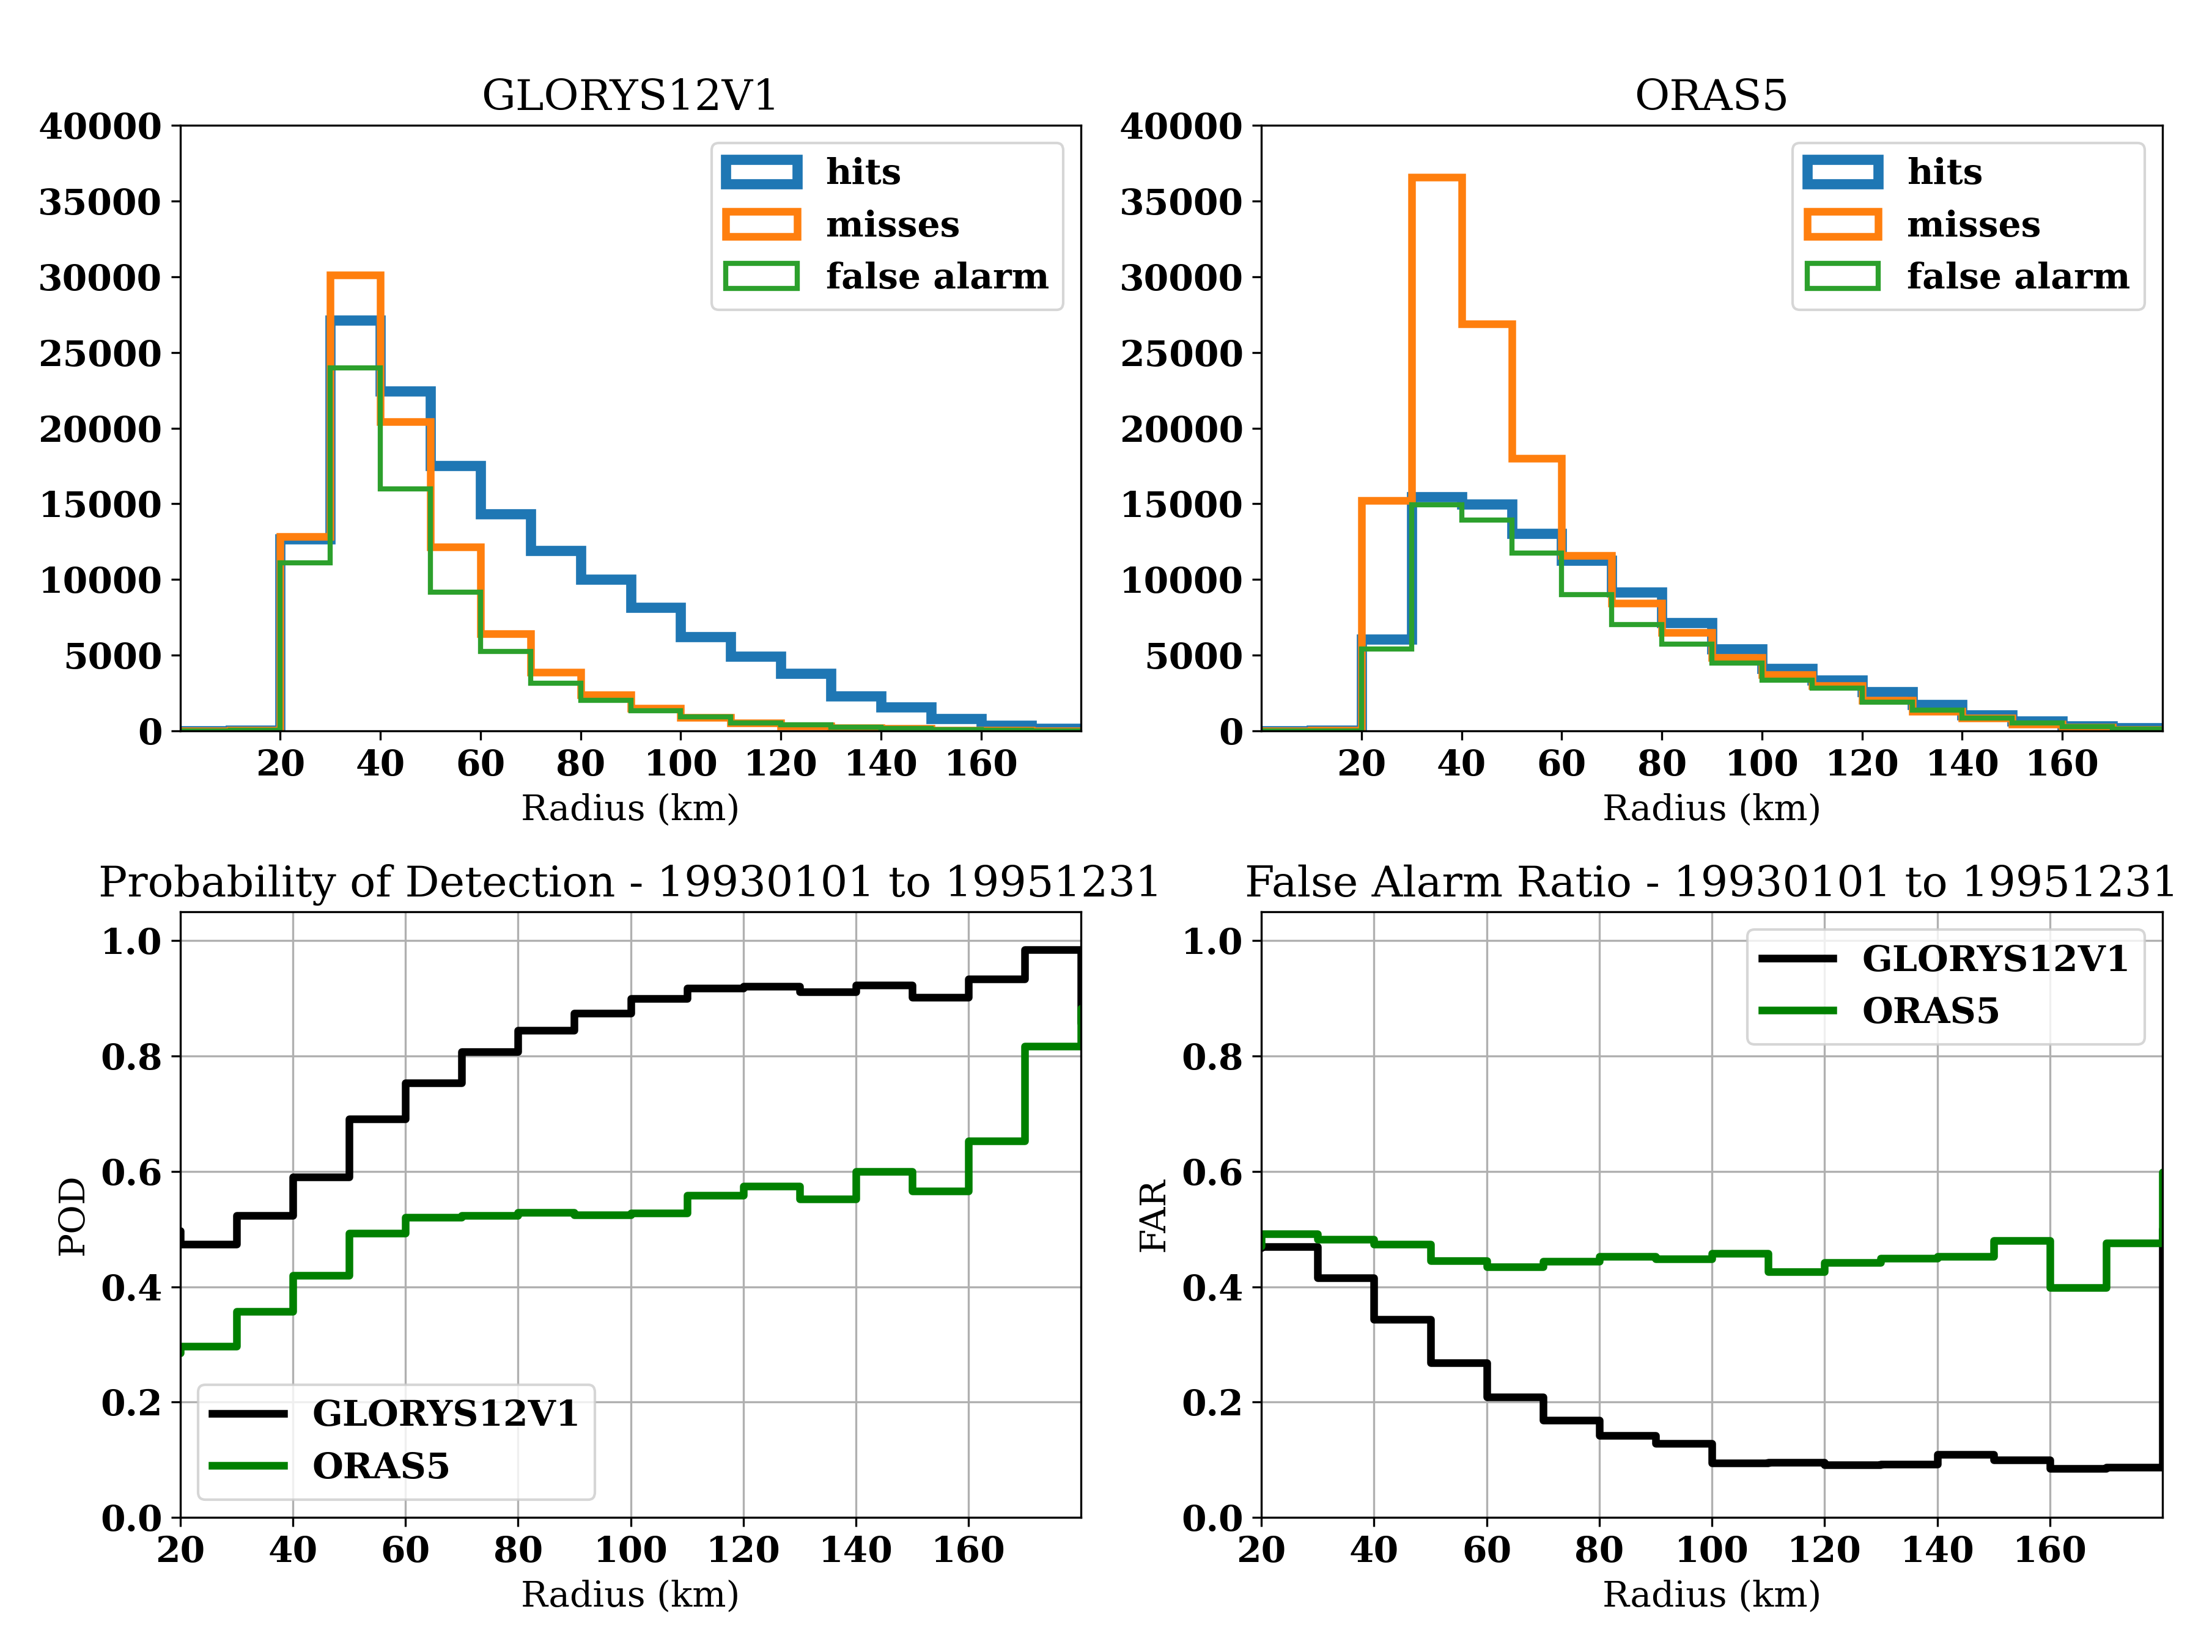
Eddy matching – As a Function of Radius
1993-01-01 to 1995-12-31: GLORYS2V4 VS CGLOR & GLORYS12V1 Remapped onto AVISO grid VS ORAS5

Slide 15
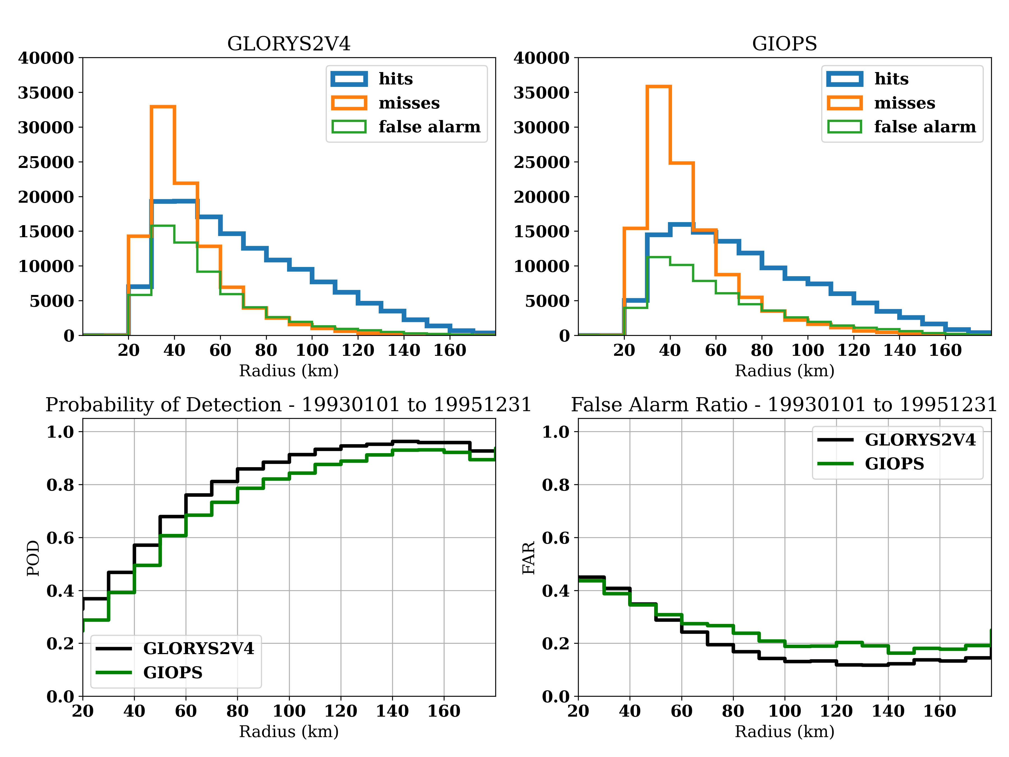
Eddy matching– As a Function of Radius
1993-01-01 to 1995-12-31: GLORYS2V4 VS GIOPS & GLORYS2V4 VS CGLOR

Slide 16
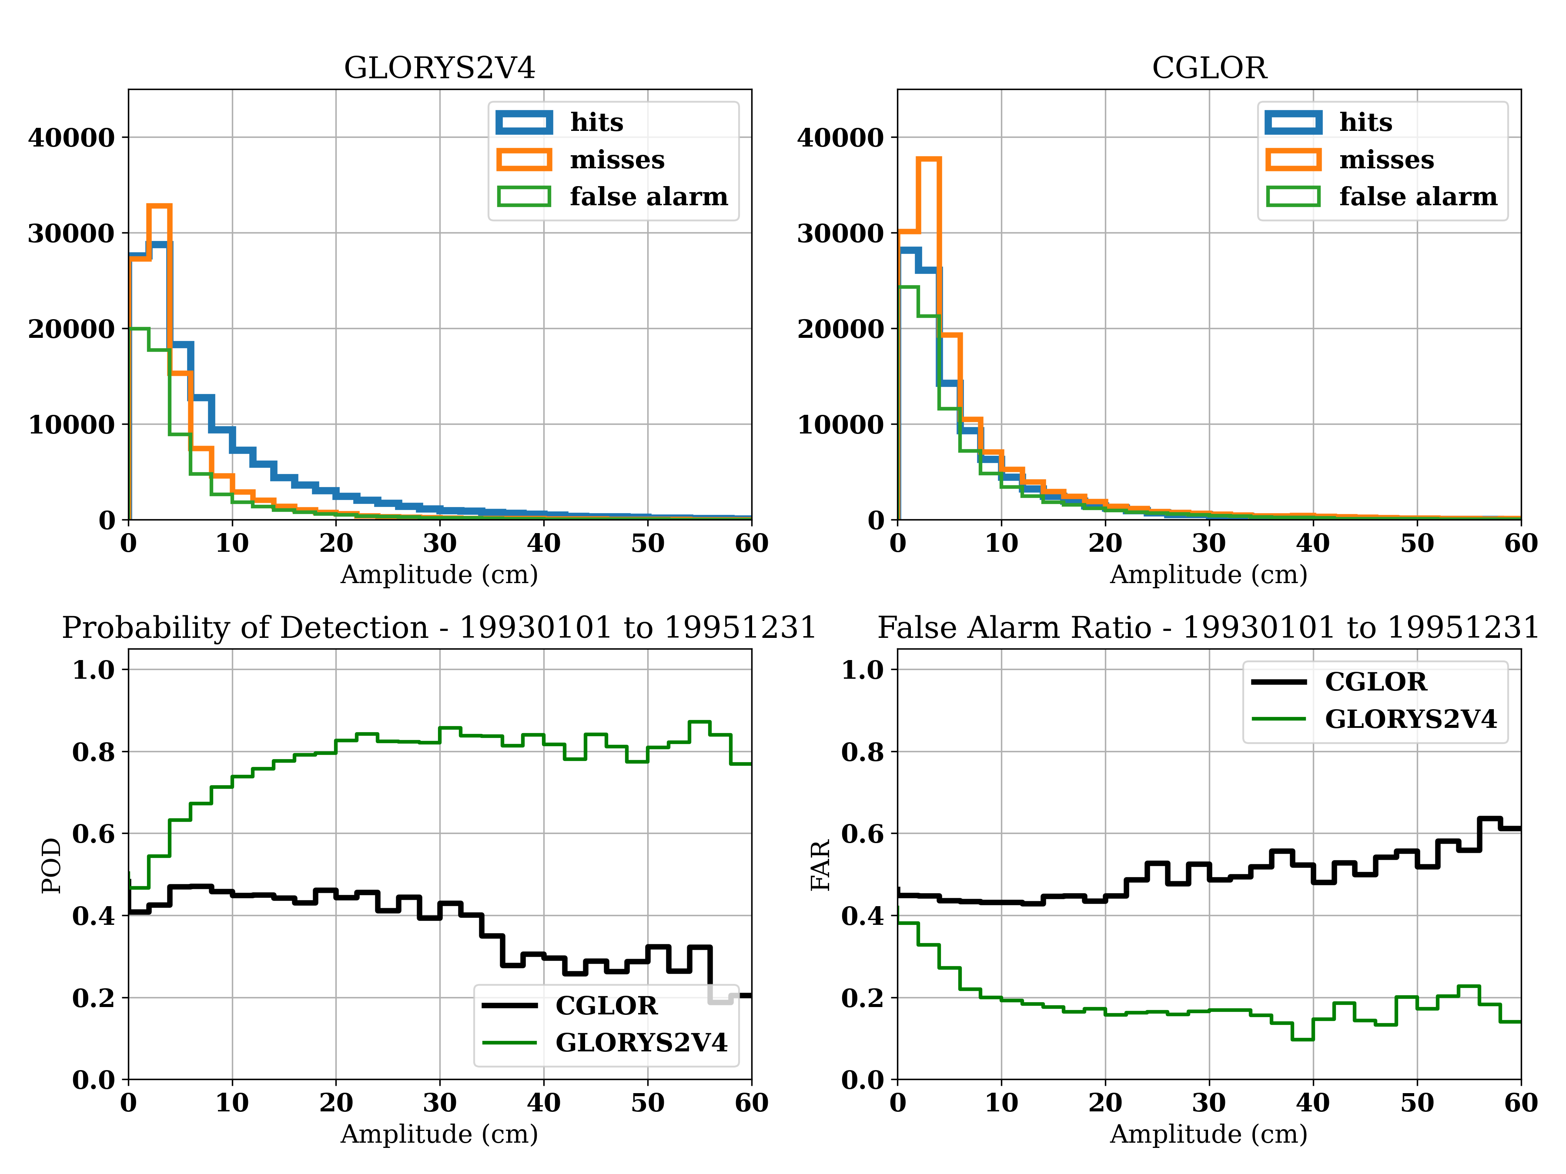
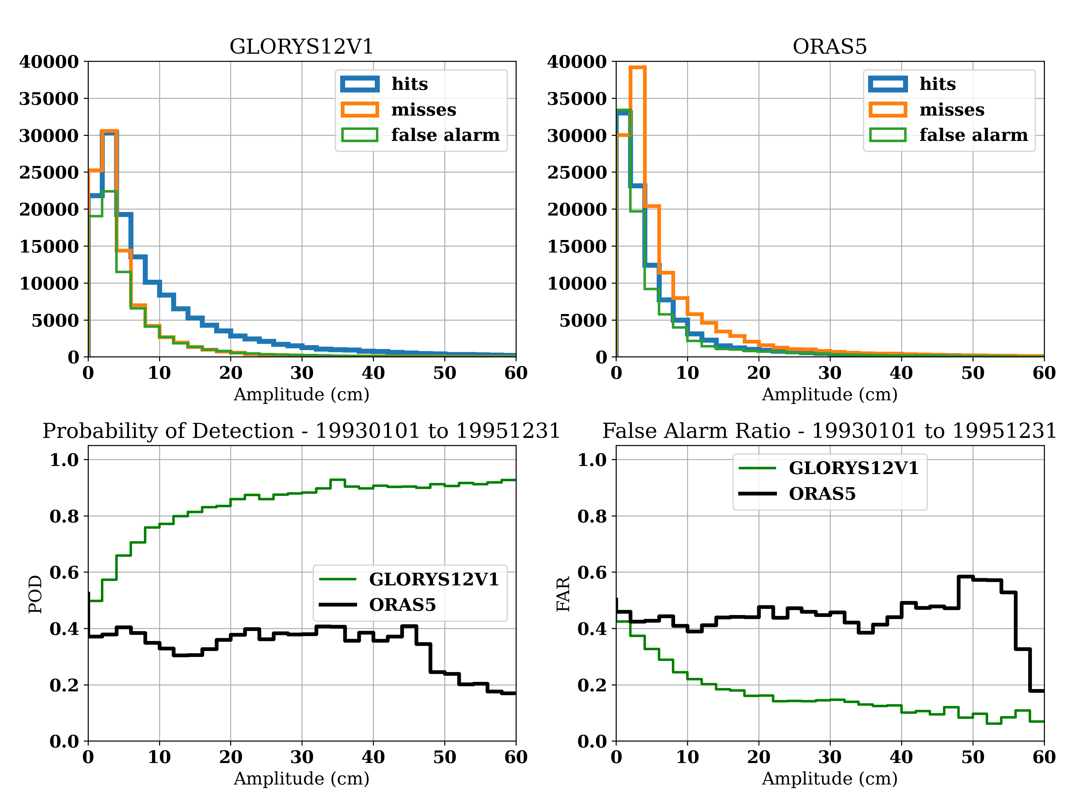
Eddy matching– As a Function of Amplitude
1993-01-01 to 1995-12-31: GLORYS2V4 VS CGLOR & GLORYS12V1 VS ORAS5

Slide 17
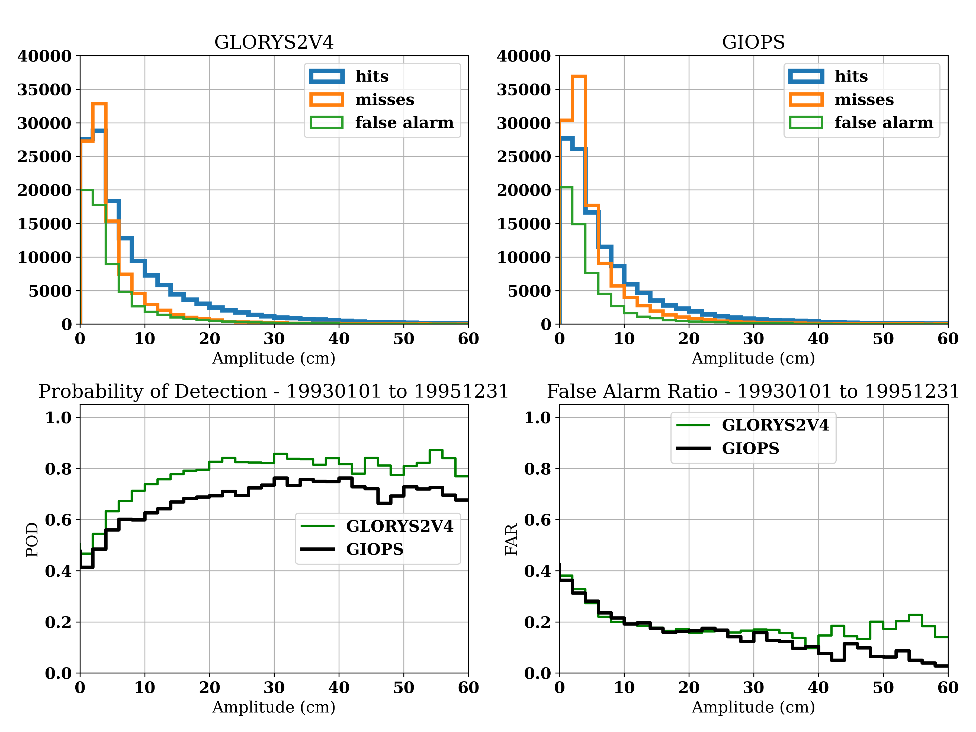
Eddy matching– As a Function of Amplitude
1993-01-01 to 1995-12-31: GLORYS2V4 VS CGLOR & GLORYS2V4 VS GIOPS

Slide 18
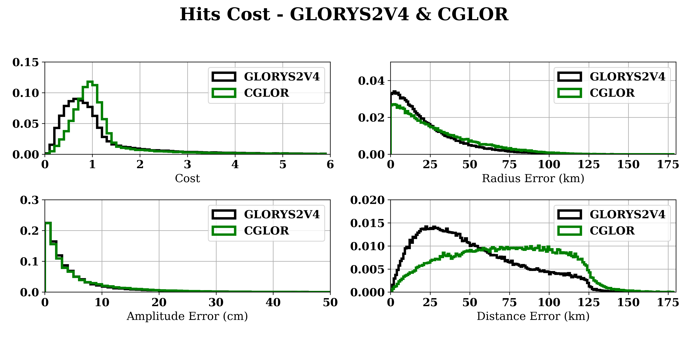
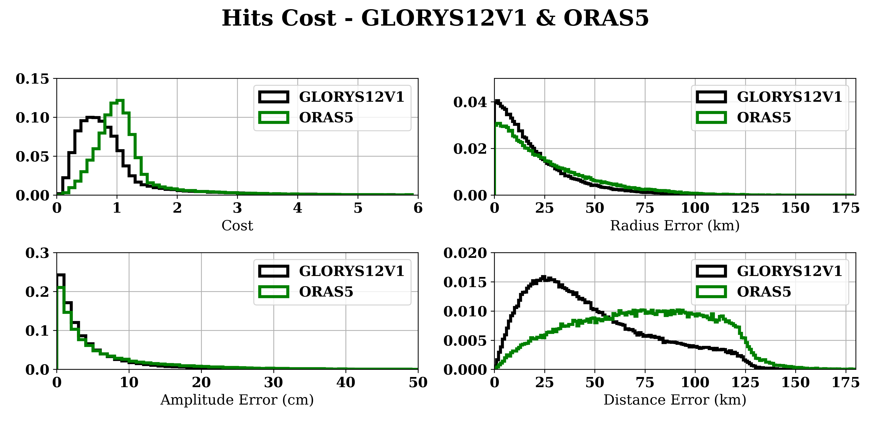
Evaluation of Hits Cost
-Can we detect an improvement in representation of “matched” eddies?
-The period covered spans from 1993-01-01 to 1995-12-31
MEDIAN VALUES
==============================
Radius Error (km)
GLORYS2V4: 17.100 km
CGLOR: 22.450 km
Amplitude Error (cm)
GLORYS2V4: 2.900 cm
CGLOR: 3.100 cm
Distance Error (km)
GLORYS2V4: 44.858 km
CGLOR: 72.033 km
MEDIAN VALUES
==============================
Radius Error (km)
GLORYS12V1: 14.750 km
ORAS5: 19.900 km
Amplitude Error (cm)
GLORYS12V1: 2.670 cm
ORAS5: 3.480 cm
Distance Error (km)
GLORYS12V1: 41.671 km
ORAS5: 74.044 km

Slide 19
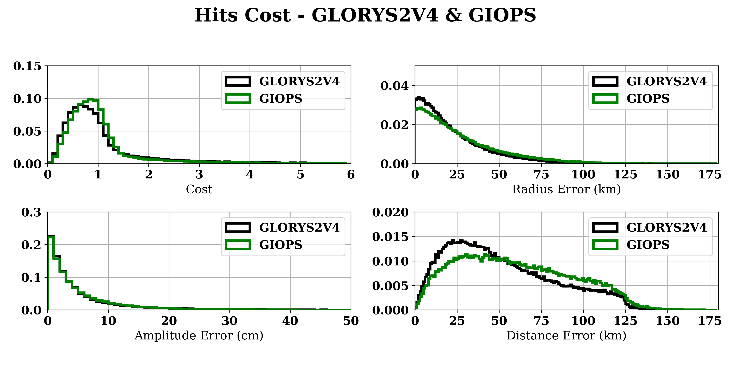
Evaluation of Hits Cost
Can we detect an improvement in representation of “matched” eddies?
The period covered spans from 1993-01-01 to 1995-12-31
MEDIAN VALUES
==============================
Radius Error (km)
GLORYS2V4: 17.100 km
GIOPS: 20.400 km
Amplitude Error (cm)
GLORYS2V4: 2.900 cm
GIOPS: 3.040 cm
Distance Error (km)
GLORYS2V4: 44.858 km
GIOPS: 55.982 km
MEDIAN VALUES
==============================
Radius Error (km)
GLORYS2V4: 17.100 km
CGLOR: 22.450 km
Amplitude Error (cm)
GLORYS2V4: 2.900 cm
CGLOR: 3.100 cm
Distance Error (km)
GLORYS2V4: 44.858 km
CGLOR: 72.033 km

Slide 20
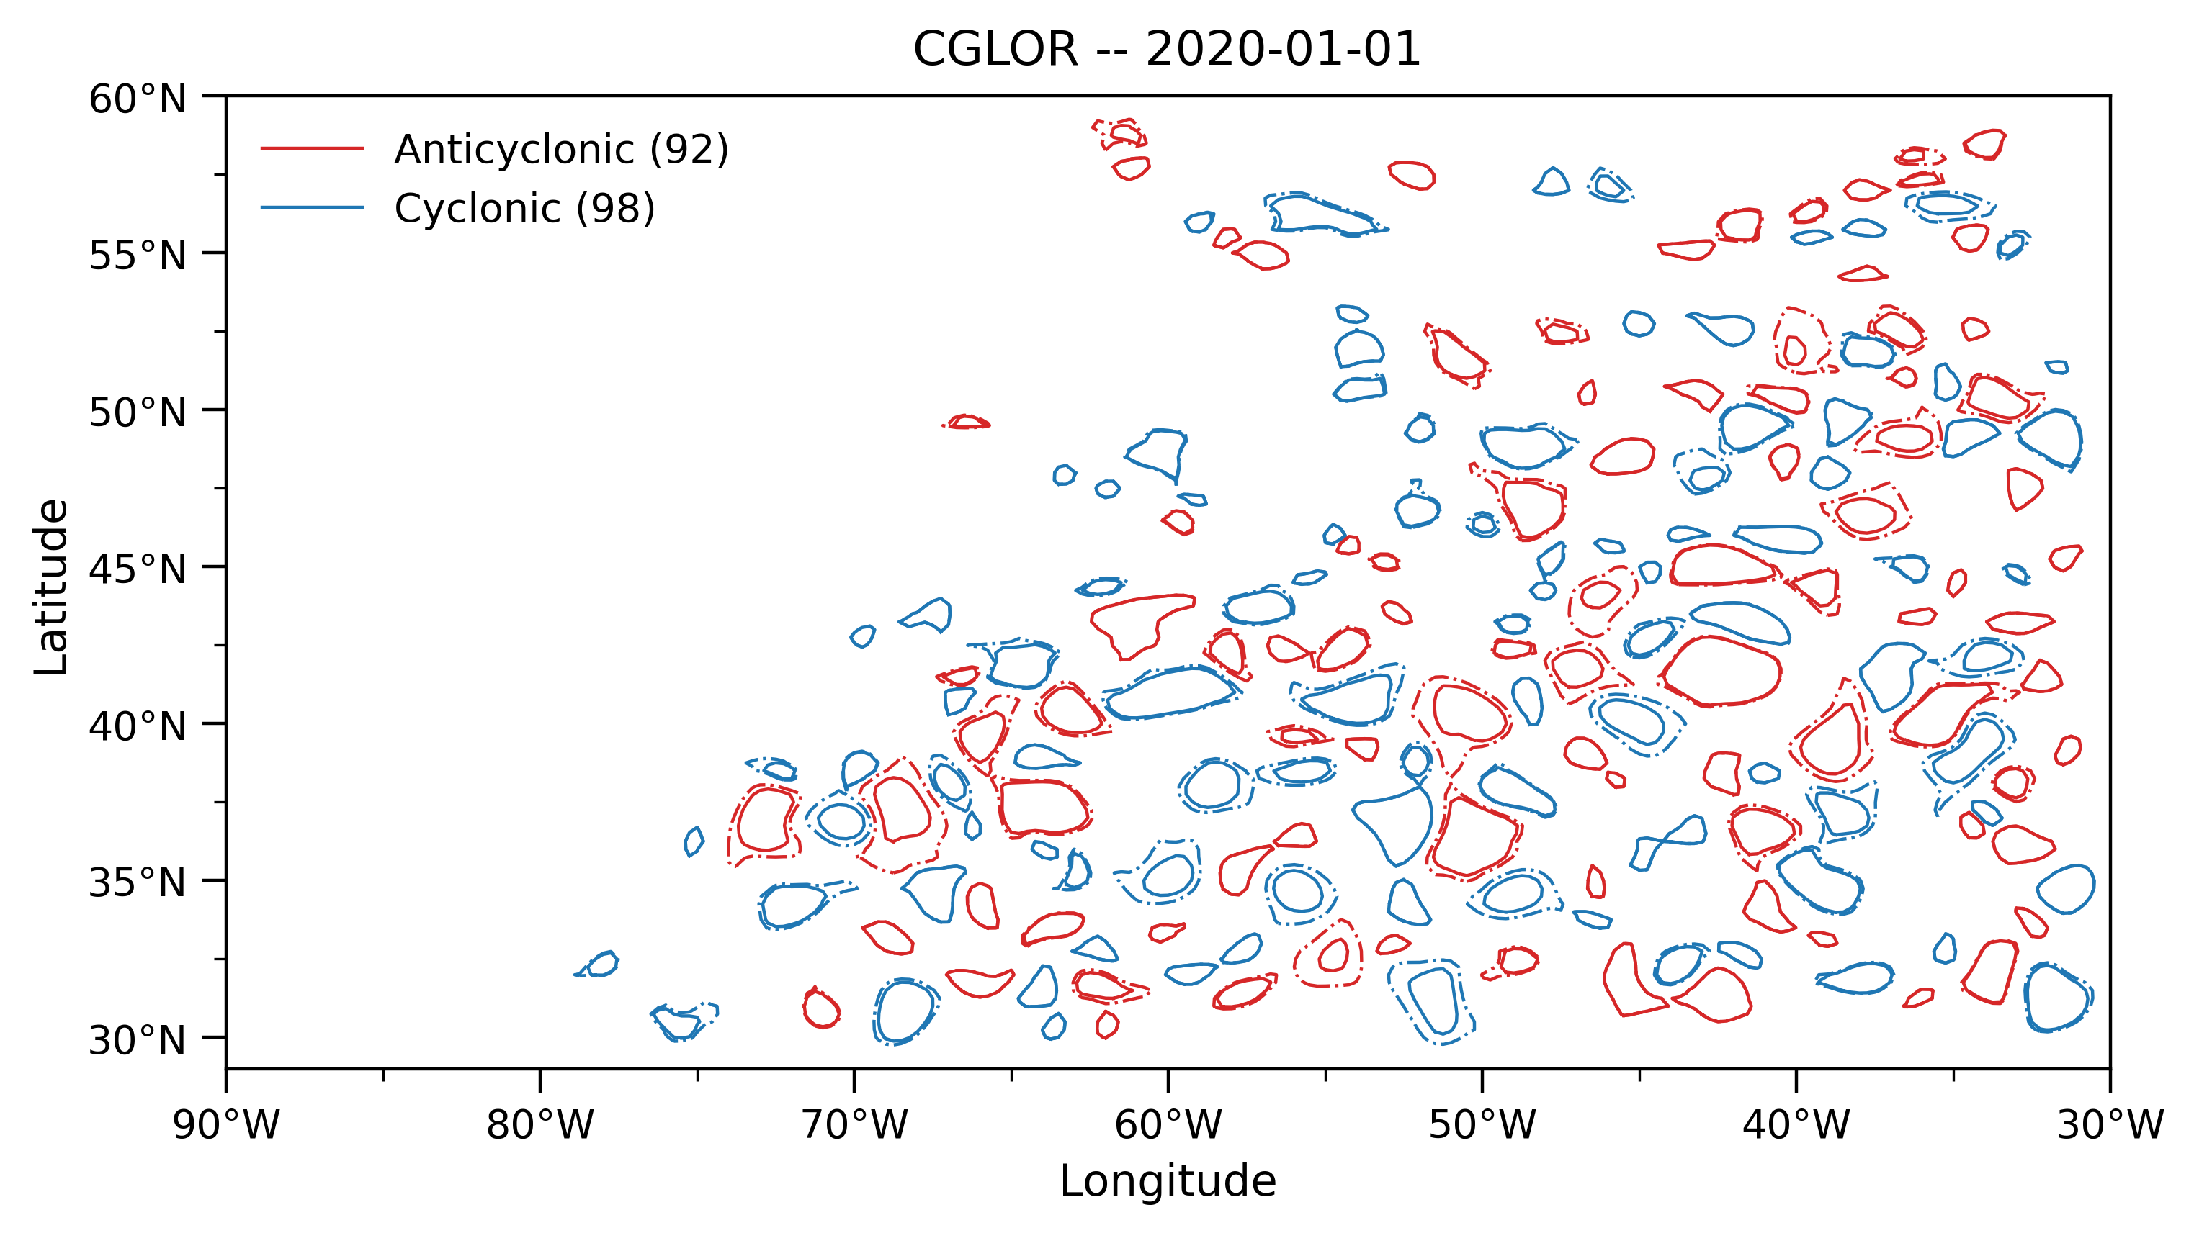
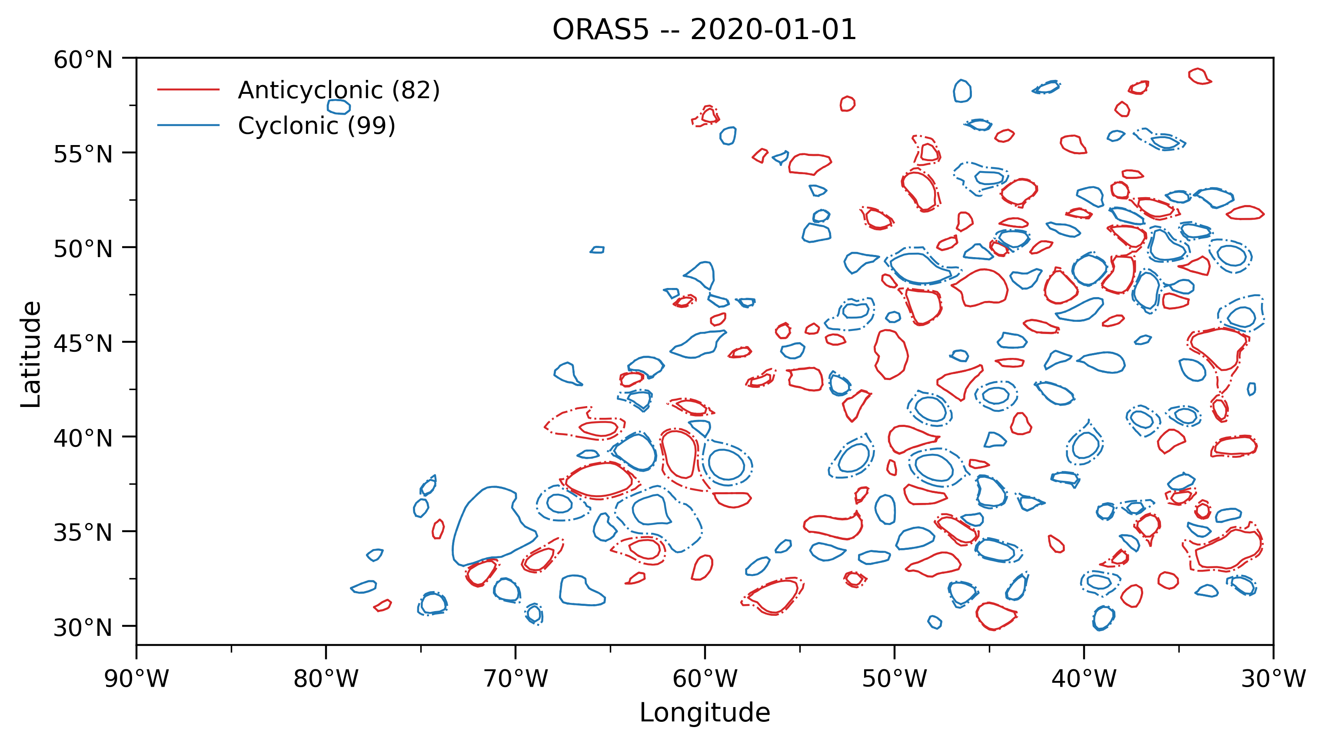
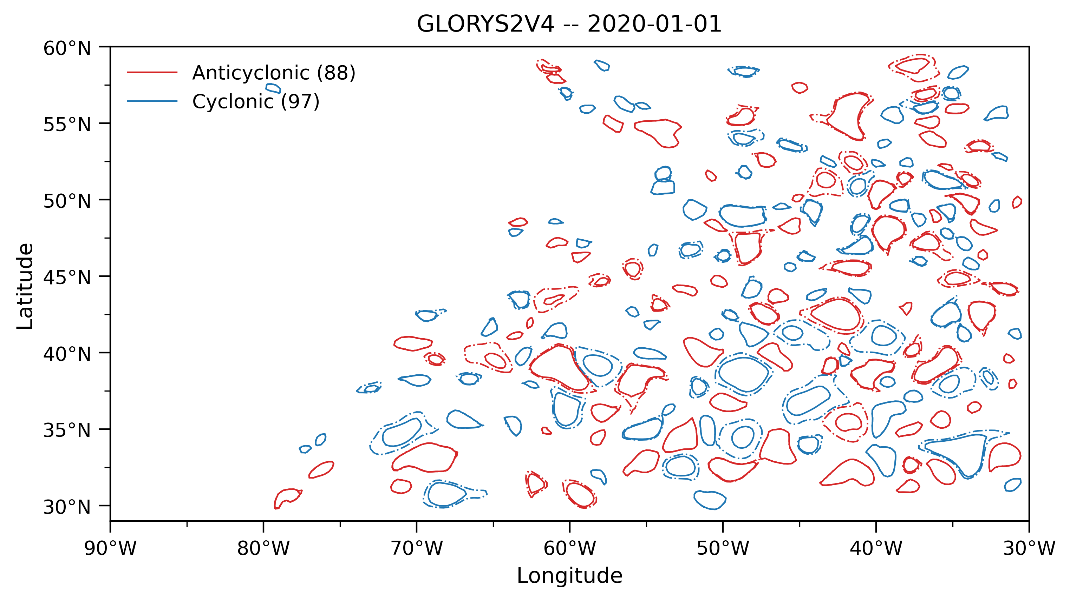
Eddy Detection & Tracking: Reanalyses time comparison
Reanalysis Dataset | Anticyclonic – 4 days lifetime threshold | Cyclonic – 4 days lifetime threshold | Sum: for each period
CGLOR 1993-1995 | 92039 | 98619 | 190658 (1993-1995)
CGLOR 2020-2022 | 92807 | 95336 | 188143 (2020-2022)
CGLOR 1993-2022 | 913925 | 967712 | 1881637
Reanalysis Dataset | Anticyclonic – 4 days lifetime threshold | Cyclonic – 4 days lifetime threshold | Sum: for each period
ORAS5 1993-1995 | 85264 | 95409 | 180673 (1993-1995)
ORAS5 2020-2022 | 84265 | 90612 | 174887 (2020-2022)
ORAS5 1993-2022 | 851288 | 921776 | 1773064
Reanalysis Dataset | Anticyclonic – 4 days lifetime threshold | Cyclonic – 4 days lifetime threshold | Sum: for each period
GLORYS2V4 1993-1995 | 98414 | 101823 | 200237 (1993-1995)
GLORYS2V4 2020-2022 | 99839 | 102439 | 202278 (2020-2022)
GLORYS2V4 1993-2022 | 966881 | 1000023 | 1966904

Slide 21
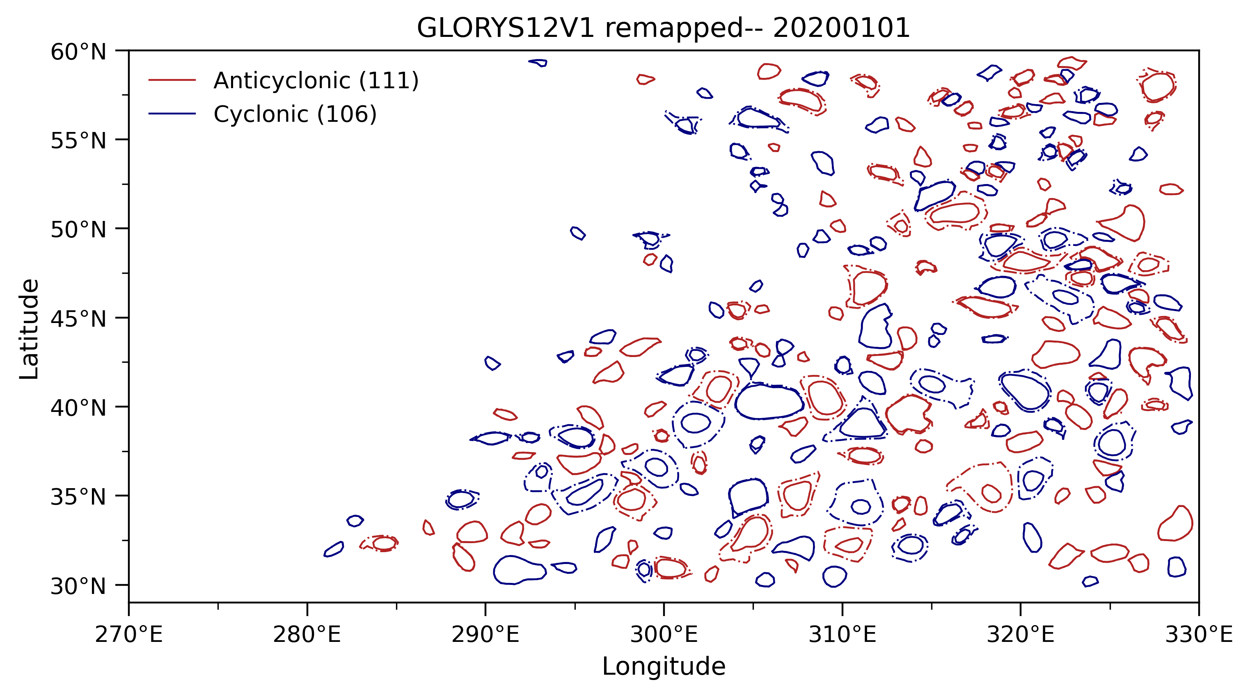
Eddy Detection & Tracking: time comparison
Dataset | Anticyclonic – 4 days lifetime threshold | Cyclonic – 4 days lifetime threshold | Sum: for each period
AVISO ¼° 1993-1995 | 117927 | 118909 | 236836 (1993-1995)
AVISO ¼° 2020-2022 | 1167820 | 119329 | 236111 (2020-2022)
AVISO ¼° 1993-2022 | 1200635 | 1206204 | 2406839
Dataset | Anticyclonic – 4 days lifetime threshold | Cyclonic – 4 days lifetime threshold | Sum: for each period
GLORYS12V1 remapped 1993-1995 | 115400 | 116909 | 232309 (1993-1995)
GLORYS12V1 remapped 2020-2022 | 114782 | 116029 | 232811 (2020-2022)
GLORYS12V1 remapped 1993-2022 | 1044776 | 1102005 | 2146781
Notes:
latitude:min = 30.13376f ;
latitude:max = 59.39465f ; Cyclonic_2020_2022.nc
latitude_max:min = 30.05576f ;
latitude_max:max = 59.41517f ; Cyclonic_1993_1995.nc
latitude_max:min = 30.10775f ;
latitude_max:max = 59.40285f ; Anticyclonic_2020_2022.nc
latitude_max:min = 30.06132f ;
latitude_max:max = 59.42984f ; Anticyclonic_1993_1995.nc

Slide 22
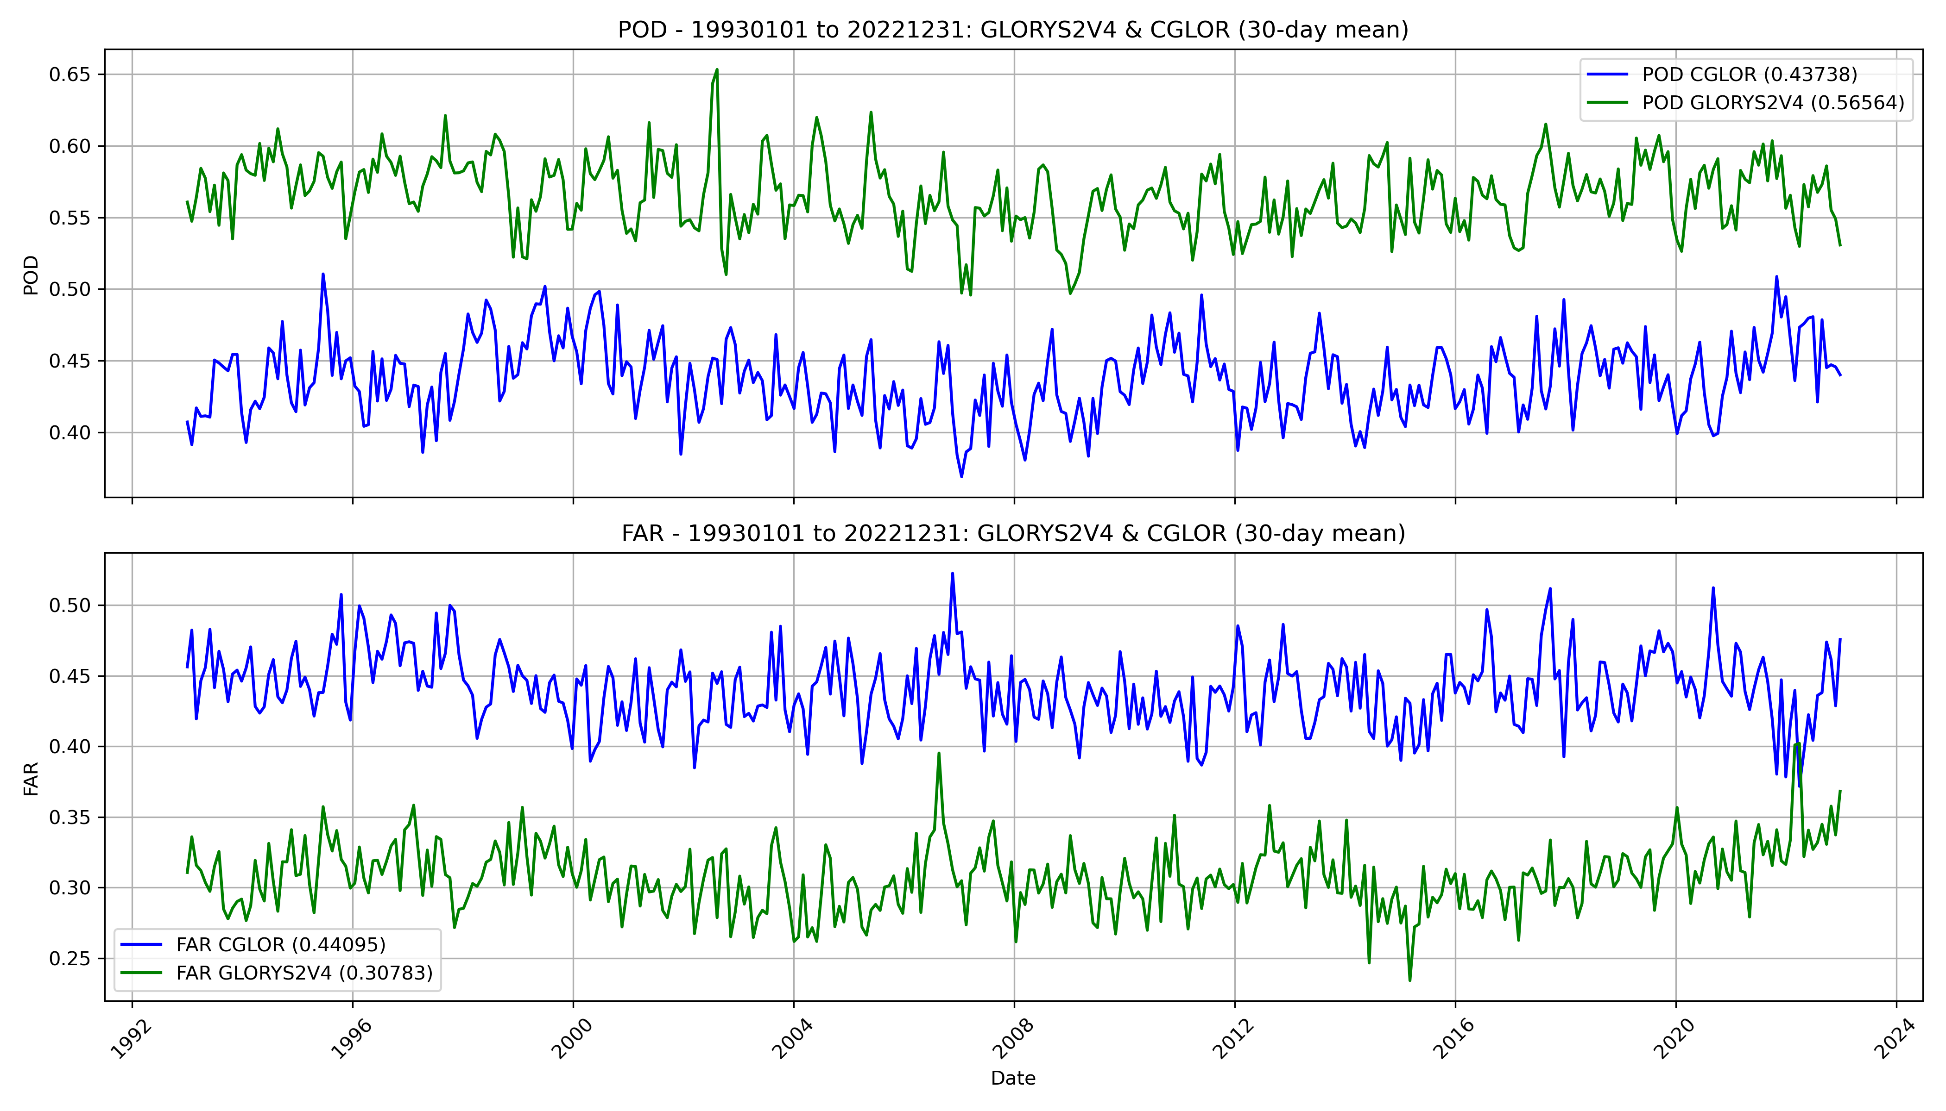
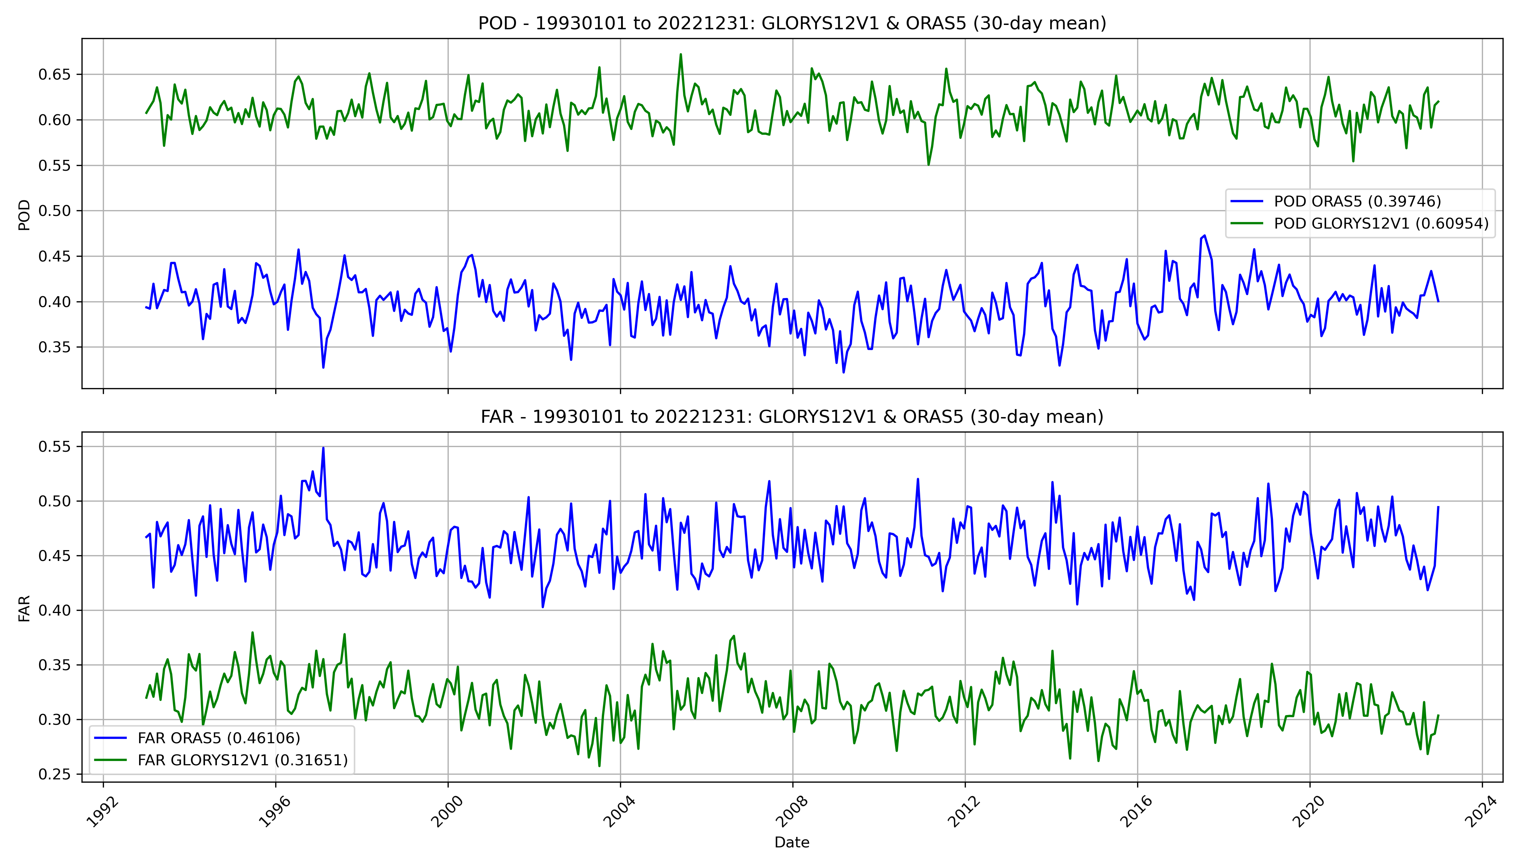
Eddy Matching: POD & FAR timeseries
Skill of reanalysis dataset, compared to the satellite data (AVISO: Multi-mission daily gridded (1/4°) product). ​
POD eddies is used to calculate the fraction of detected that are captured by Reanalysis Dataset, while FAR is used to calculate the fraction of detected eddies in Reanalysis Dataset that doesn’t occur.​
Stats. | GLORYS2V4 | CGLOR | Diff. | Diff.(%)
POD | 0.57 | 0.44 | 0.13 | +29.5%
FAR | 0.31 | 0.44 | -0.13 | -29.5%
Stats. | GLORYS12V1 | ORAS5 | Diff. | Diff.(%)
POD | 0.61 | 0.40 | 0.21 | +52.5%
FAR | 0.32 | 0.46 | -0.14 | -30.4%

Slide 23
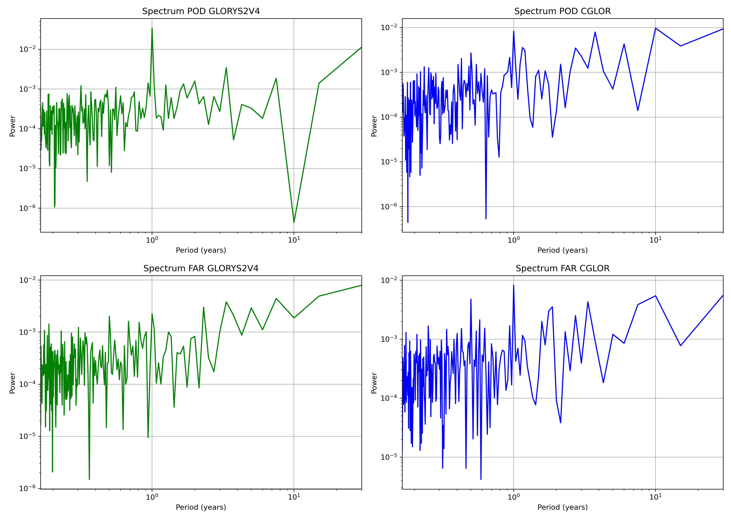
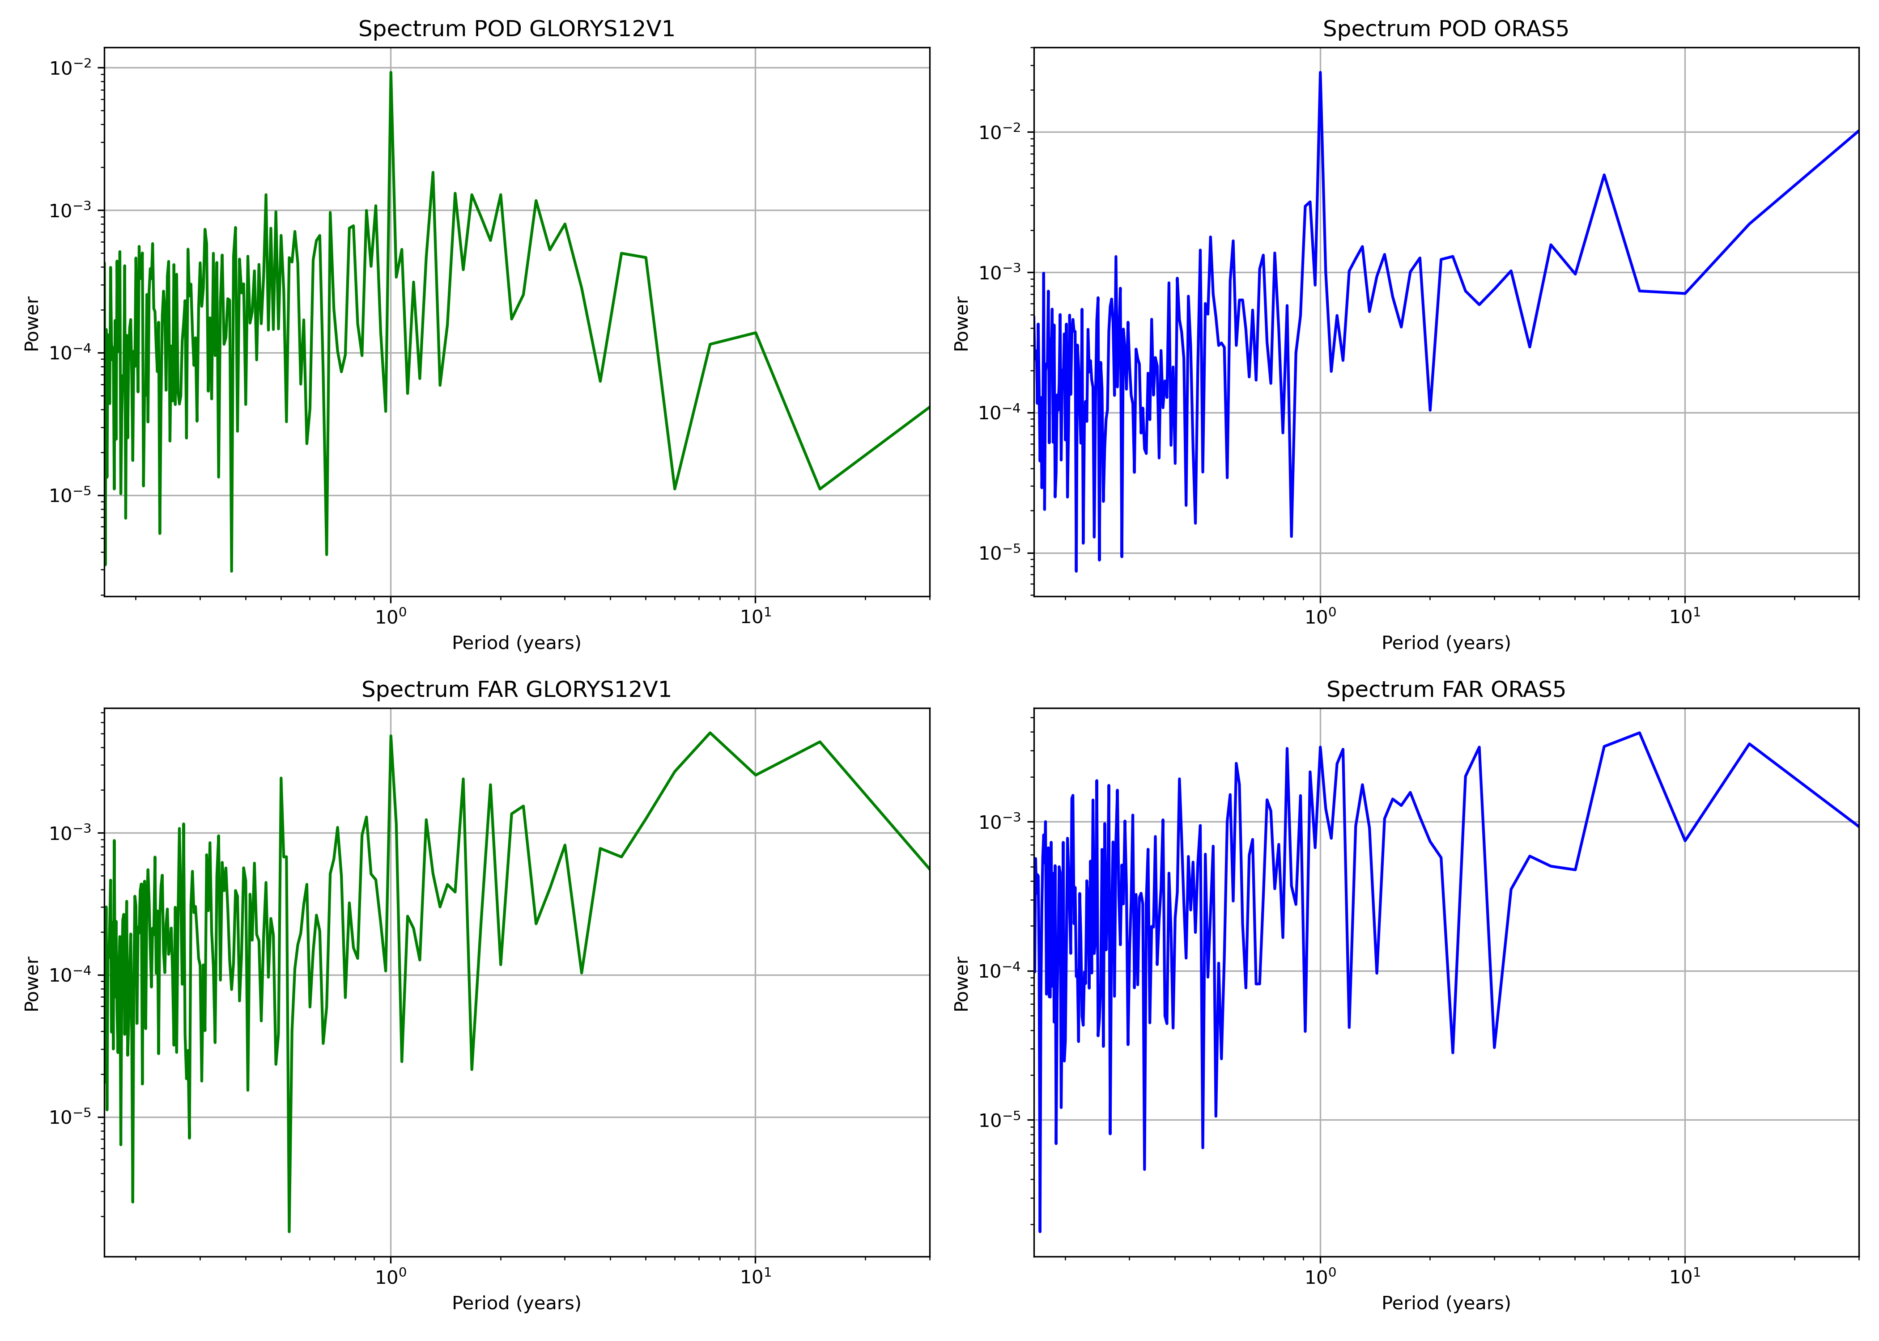
Eddy Matching: Frequency Spectra POD & FAR timeseries
3652.33 days
842.85 days
1095.70
2191.40
3652.33 days
5478.50 days
2739.25
2739.25

Slide 24
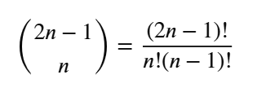
Eddy matching – bootstrap resample
To determine the statistical significance of differences, a 95% confidence intervals of the aggregated statistics are evaluated by a (paired) bootstrap, where for each re-sample the aggregated score, is evaluated from the sum of the hits, false alarm, misses for randomly selected dates (allowing repetition), within the verification period. ​
Daily values of POD and FAR show temporal autocorrelation: a standard (day-by-day) bootstrap would underestimate uncertainty.
Therefore, a Block Bootstrap was applied: sampling in 4-day blocks, consistent with minimum lifetime threshold.
Provides realistic uncertainty estimates for verification metrics: paired bootstrap resample. ​
Bootstrap Results (4-day blocks, 95% CI) — 1993 to 2022
Bootstrap Results (4-day blocks, 95% CI) — 1993–2022
Metric | GLORYS12V1 | ORAS5 | Difference
POD (Mean) | 0.607 | 0.397 | 0.21
POD (95% CI) | [0.603, 0.610] | [0.394 0.400] | [0.205, 0.214]
FAR (Mean) | 0.315 | 0.464 | -0.149
FAR (95% CI) | [0.303, 0.307] | [0.460, 0.468] | [-0.163, -0.155]
Metric | GLORYS2V4 | CGLOR | Difference
POD (Mean) | 0.568 | 0.448 | 0.039
POD (95% CI) | [0.566, 0.570] | [0.443, 0.452] | [0.115, 0.125]
FAR (Mean) | 0.329 | 0.439 | -0.109
FAR (95% CI) | [0.327, 0.331] | [0.327, 0.331] | [-0.115, -0.104]
Combinations with repetitions
Stats. | GLORYS12V1 | ORAS5 | Diff. | Diff.(%)
POD | 0.607 | 0.397 | 0.21 | +52.5%
FAR | 0.319 | 0.459 | -0.14 | -30.4%
Stats. | GLORYS2V4 | CGLOR | Diff. | Diff.(%)
POD | 0.569 | 0.447 | 0.13 | +29.5%
FAR | 0.318 | 0.439 | -0.13 | -29.5%

Slide 25
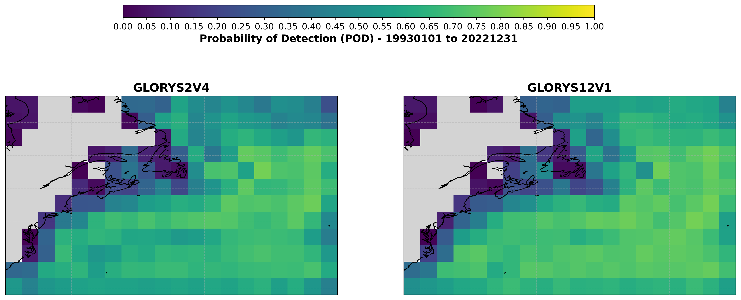
Eddy Matching: POD plot map
Division of the entire detectable ocean surface into many square boxes measuring 2.5° x 2.5° for North-West Atlantic (29.87°N – 59.87°N ; 80.13°W – 30.13°W).

Slide 26
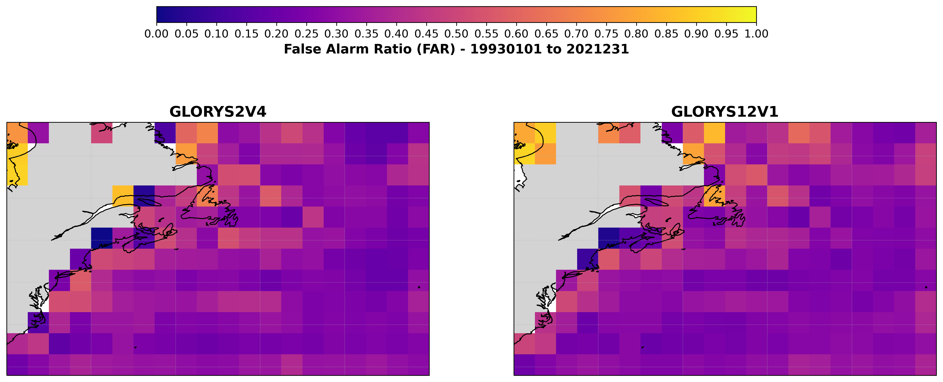
Eddy Matching: FAR plot map
Division of the entire detectable ocean surface into many square boxes measuring 2.5° x 2.5° for North-West Atlantic.

Slide 27
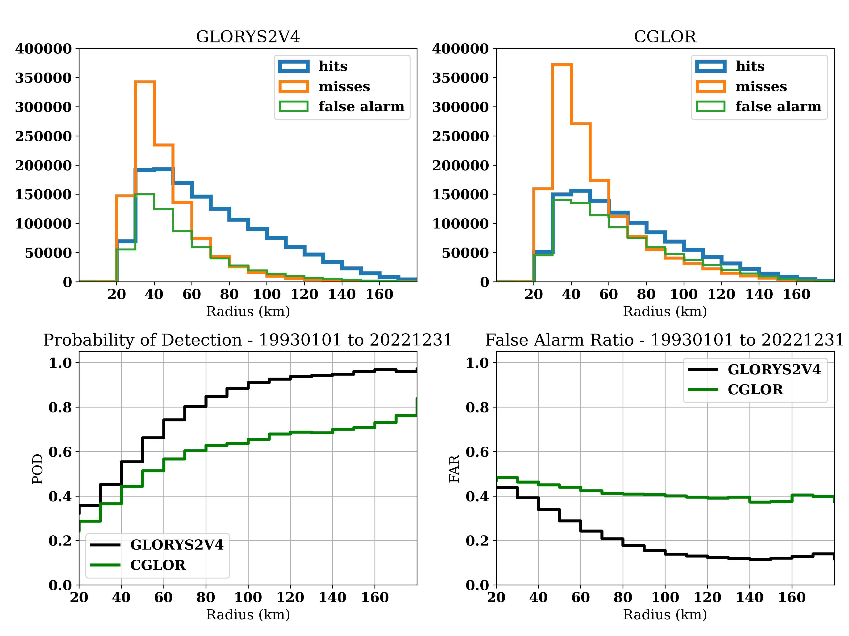

Eddy Matching- Radius
Statistical assessment by eddy radius for each detected eddy: 1993-01-01 to 2022-12-31.

Slide 28


Eddy Matching- Amplitude
Statistical assessment by eddy amplitude for each detected eddy: 1993-01-01 to 2022-12-31.

Slide 29



Evaluation of Hits Cost
Can we detect an improvement in representation of “matched” eddies over 30 years?
MEAN VALUES
Radius Error
GLORYS12V1: 19.81 km
ORAS5: 27.78 km
Amplitude Error (cm)
GLORYS12V1: 4.73 cm
ORAS5: 7.03 cm
Distance Error (km)
GLORYS12V1: 46.32 km
ORAS5: 73.76 km
MEDIAN VALUES
Radius Error (km)
GLORYS12V1: 14.050 km
ORAS5: 20.850 km
Amplitude Error (cm)
GLORYS12V1: 2.460 cm
ORAS5: 3.300 cm
Distance Error (km)
GLORYS12V1: 38.819 km
ORAS5: 74.748 km
MEDIAN VALUES
Radius Error (km)
GLORYS2V4: 17.500 km
CGLOR: 22.000 km
Amplitude Error (cm)
GLORYS2V4: 2.920 cm
CGLOR: 2.950 cm
Distance Error (km)
GLORYS2V4: 46.782 km
CGLOR: 69.987 km
MEAN VALUES
Radius Error
GLORYS2V4: 23.93 km
CGLOR: 28.67 km
Amplitude Error (cm)
GLORYS2V4: 5.73 cm
CGLOR: 5.87 cm
Distance Error (km)
GLORYS2V4: 52.76 km
CGLOR: 70.13 km

Slide 30



Eddy Detection & Tracking on global scale – 2020 to 2022
Dataset | Anticyclonic – 4 days lifetime threshold | Cyclonic – 4 days lifetime threshold | Sum
AVISO | 3526137 | 3632294 | 7158431 (2020-2022)
Dataset | Anticyclonic – 4 days lifetime threshold | Cyclonic – 4 days lifetime threshold | Sum
GLORYS2V4 | 2775745 | 2958824 | 5734569 (2020-2022)
Dataset | Anticyclonic – 4 days lifetime threshold | Cyclonic – 4 days lifetime threshold | Sum
GLORYS12V1 remapped | 3268692 | 3607777 | 6876469 (2020-2022)

Slide 31

Eddy Matching
Evaluation of the goodness of each reanalysis systems in counting the population of observed eddies.
We choose pair eddies, with the lowest Cost Function within 125 km of distance between centres:​ Amplitude and Radius must be close to the previous observation. In case of several candidates only the closest is kept (lowest Cost Function).
We consider only eddies with a lifetime ≥ 4 days.

Slide 32


Eddy Matching: POD & FAR timeseries
Skill of reanalysis dataset, compared to the satellite data (AVISO: Multi-mission daily gridded (1/4°) product). ​
POD eddies is used to calculate the fraction of detected that are captured by Reanalysis Dataset, while FAR is used to calculate the fraction of detected eddies in Reanalysis Dataset that doesn’t occur.​
Stats. | GLORYS12V1 | GLORYS2V4 | Diff. (mean values) | Diff.(%)
POD | 0.614±0.008 | 0.543±0.009 | 0.07 | +12.9%
FAR | 0.359±0.009 | 0.321±0.018 | 0.04 | +12.5%
Suspicious Period: Errors in DA window for GLORYS2V4!?!
Romain’s emails
Lifetime threshold tails
365.33
365.33
365.33
548

Slide 33
Eddy matching – bootstrap resample
To determine the statistical significance of differences, a 95% confidence intervals of the aggregated statistics are evaluated by a (paired) bootstrap, where for each re-sample the aggregated score, is evaluated from the sum of the hits, false alarm, misses for randomly selected dates (allowing repetition), within the verification period. ​
Daily values of POD and FAR show temporal autocorrelation: a standard (day-by-day) bootstrap would underestimate uncertainty.
Therefore, a Block Bootstrap was applied: sampling in 4-7 day blocks, consistent with minimum lifetime threshold.
Provides realistic uncertainty estimates for verification metrics. ​
Bootstrap Results (4-day blocks, 95% CI) — 2020 to 2022
Bootstrap Results (7-day blocks, 95% CI) — 2020 to 2022
Metric | GLORYS12V1 | GLORYS2V4 | Difference (12V1 − 2V4)
POD (Mean) | 0.615 | 0.544 | 0.071
POD (95% CI) | [0.613, 0.617] | [0.538, 0.549] | [0.068, 0.074]
FAR (Mean) | 0.360 | 0.321 | 0.039
FAR (95% CI) | [0.358, 0.361] | [0.314, 0.329] | [0.031, 0.044]
Metric | GLORYS12V1 | GLORYS2V4 | Difference (12V1 − 2V4)
POD (Mean) | 0.616 | 0.545 | 0.070
POD (95% CI) | [0.613, 0.619] | [0.542, 0.550] | [0.068, 0.073]
FAR (Mean) | 0.359 | 0.321 | 0.039
FAR (95% CI) | [0.356, 0.362] | [0.312, 0.333] | [0.024, 0.047]
Mean Value — 2020 to 2022
Formula for combinations with repetitions.
Stats. | GLORYS12V1 | GLORYS2V4 | Diff. (mean values) | Diff.(%)
POD | 0.614±0.008 | 0.543±0.009 | 0.07 | +12.9%
FAR | 0.359±0.009 | 0.321±0.018 | 0.04 | +12.5%

Slide 34

Eddy Matching: POD plot map
Division of the entire eddy-detectable ocean surface into many square boxes measuring 2.5° x 2.5°.

Slide 35

Eddy Matching: FAR plot map
Division of the entire detectable ocean surface into many square boxes measuring 2.5° x 2.5°.

Slide 36

Eddy Matching- Radius
Global statistical assessment by eddy radius for each detected eddy: 2020-01-01 to 2022-12-31.

Slide 37

Eddy Matching- Amplitude
Global statistical assessment by eddy amplitude for each detected eddy: 2020-01-01 to 2022-12-31.

Slide 38

Evaluation of Hits Cost
Can we detect an improvement in representation of “matched” eddies for a global detection for 3 years?
R1 – R2
A1 – A2
D1 – D2
MEDIAN VALUES
Radius Error (km)
GLORYS2V4: 18.600 km
GLORYS12V1: 18.050 km
Amplitude Error (cm)
GLORYS2V4: 1.770 cm
GLORYS12V1: 1.620 cm
Distance Error (km)
GLORYS2V4: 46.395 km
GLORYS12V1: 46.381 km
MEAN VALUES
Radius Error
GLORYS2V4: 25.28 km
GLORYS12V1: 24.62 km
Amplitude Error (cm)
GLORYS2V4: 3.09 cm
GLORYS12V1: 2.88 cm
Distance Error (km)
GLORYS2V4: 52.59 km
GLORYS12V1: 52.46 km

Slide 39
Supplementary material
Leave One Out Method: GLORYS12V1 Remapped onto AVISO Grid is assumed as «source of truth» for the verification methodology applied to GLORYS2V4 and GIOPS.

Slide 40

Eddy Matching
Evaluation of the goodness of each GLORYS2V4 and GIOPS systems in counting the population of eddies detected by GLORYS12V1, previously remapped onto AVISO SSALTO/DUACS grid.
We choose pair eddies, with the lowest Cost Function within 125 km of distance between centres:​ Amplitude and Radius must be close to the previous observation. In case of several candidates only the closest is kept (lowest Cost Function).
We consider only eddies with a lifetime ≥ 4 days.

Slide 41

Eddy Matching: POD & FAR timeseries
Skill of reanalysis and operational system dataset, compared to the Reanalysis Data GLORYS12V1 (remapped previously onto AVISO SSALTO/DUACS grid). ​
POD eddies is used to calculate the fraction of detected that are captured by GLORYS2V4 and GIOPS, while FAR is used to calculate the fraction of detected eddies in both dataset that doesn’t occur.​
Stats. | GLORYS2V4 | GIOPS | Diff. | Diff.(%)
POD | 0.581 | 0.512 | 0.069 | +13.4%
FAR | 0.313 | 0.315 | -0.02 | -0.6%
Stats. | GLORYS2V4 (GLORYS12V1) | GIOPS (GLORYS12V1) | Diff. | Diff.(%)
POD | 0.603 | 0.524 | 0.08 | +15.27%
FAR | 0.339 | 0.350 | -0.14 | -3.14%

Slide 42


Eddy Matching: Frequency Spectra POD & FAR timeseries

Slide 43

Eddy matching– As a Function of Radius
1993-01-01 to 1995-12-31: GLORYS2V4 VS GIOPS (on the left) & GLORYS2V4 VS GIOPS (on the right), with GLORYS12V1 remapped onto AVISO grid, as «True Observations» system.
Leave One Out Method

Slide 44

Eddy matching– As a Function of Amplitude
1993-01-01 to 1995-12-31: GLORYS2V4 VS CGLOR & GLORYS2V4 VS GIOPS with GLORYS12V1 remapped onto AVISO grid, as «True Observations» system
Leave One Out Method

Slide 45

Evaluation of Hits Cost
-Can we detect an improvement in representation of “matched” eddies?
-The period covered spans from 1993-01-01 to 1995-12-31
MEDIAN VALUES
==============================
Radius Error (km)
GLORYS2V4: 17.100 km
GIOPS: 20.400 km
Amplitude Error (cm)
GLORYS2V4: 2.900 cm
GIOPS: 3.040 cm
Distance Error (km)
GLORYS2V4: 44.858 km
GIOPS: 55.982 km
MEDIAN VALUES
==============================
Radius Error (km)
GLORYS2V4: 17.350 km
GIOPS: 20.400 km
Amplitude Error (cm)
GLORYS2V4: 2.900 cm
GIOPS: 3.040 cm
Distance Error (km)
GLORYS2V4: 47.196 km
GIOPS: 55.982 km

Slide 46

Next Steps
Extension for GIOPS
Eddy Predicability
Study Framework
Region: North-West Atlantic (Gulf Stream).
Time scale: 0–15 days.
Goal: Assess predictability of mesoscale eddies.
High eddy activity → strong signal + good satellite coverage.
Methodology
Satellite eddies (AVISO)
GEPS Forecast & GEPS Ensemble:
GEPS ensemble (20 members).
GEPS Forecast with Lead times: t + 1 → 15 days.
The Global Ensemble Prediction System (GEPS) carries out physics calculations to arrive at probabilistic predictions of atmospheric elements from the current day out to 16 days into the future.
Comparison:
Verification Metrics:
POD(t): eddy persistence (survival)
FAR(t): false eddy predictions
Matching criteria:
Same polarity
Distance threshold (~125 km)
Additional diagnostics:
Eddy structure (size, amplitude)
Position error
Cumulative POD & FAR
Bootstrap (paired)
Model Comparison
GEPS vs GU
GEPS vs No-Altimeter
Eddy Persistence
Statistical Robustness
Bootstrap (paired):
  Block length: ~4–7 days
  Resampling: ~100,000
Accounts for temporal autocorrelation

Slide 47
Thank you for your attention!

