Slide 1
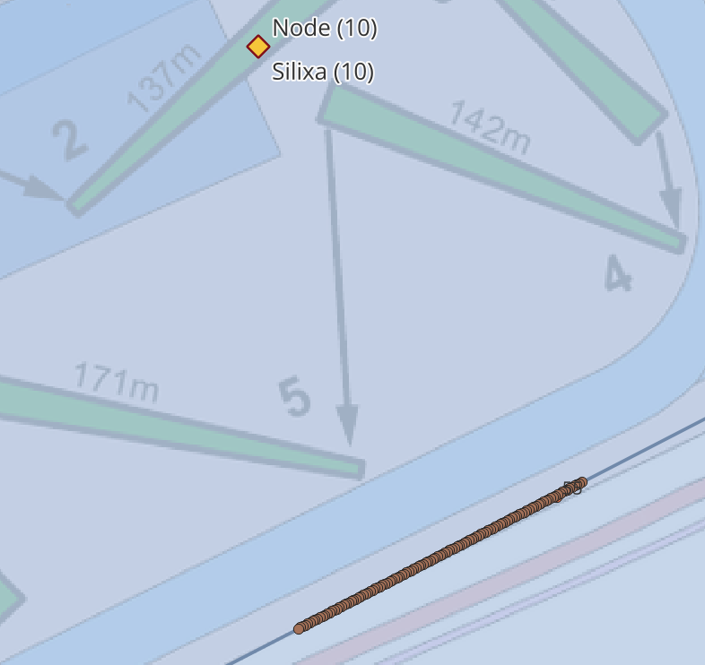
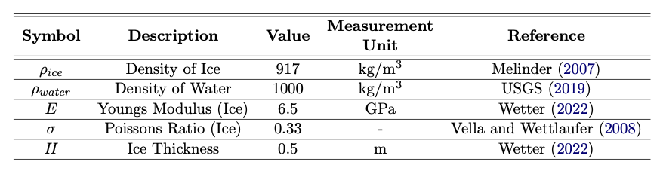

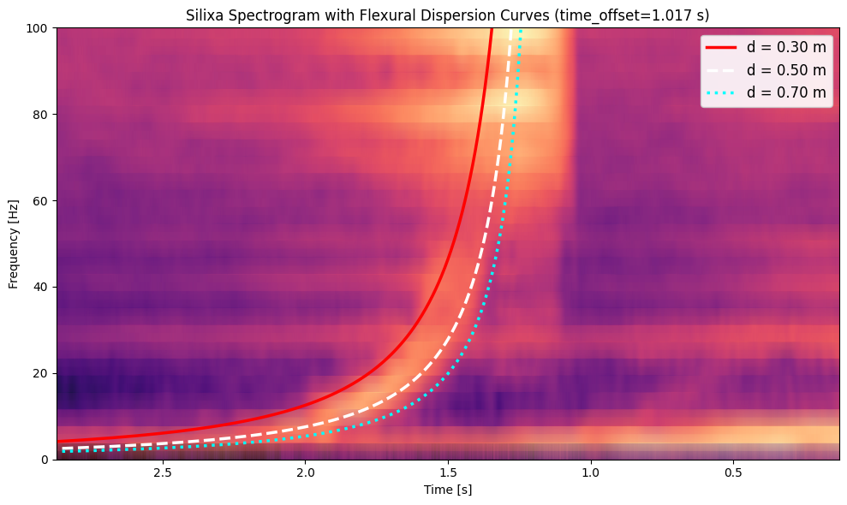
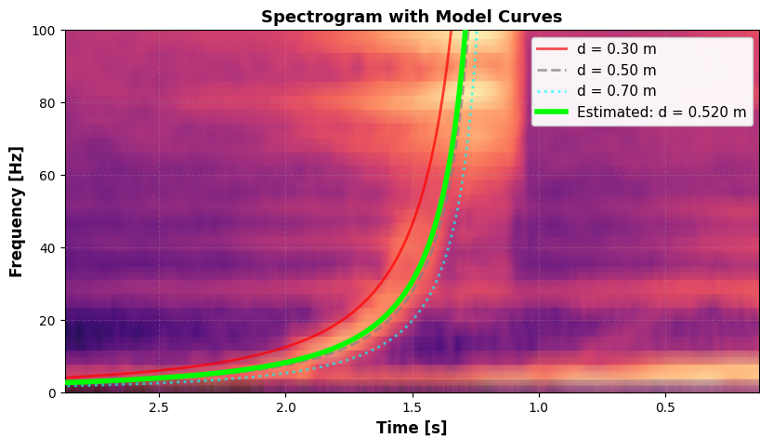
Supplement: Ice Thickness Calculation
Collate information from the detected ice quake event + location:
Event:
Knowns:
Use work from Press, Crary, et al. (1951) investigating
flexural wave velocity as a product of wavelength
+
+
~ 215m
where
Build on the work from Wetter (2022)
Create bounds for curve fitting
Fit the curve and calculate the estimated thickness.
Calculated: 0.52m
Measured: 0.55m
Citation:
- Wetter, Christoph (2022). “Seismo-Acoustic Lake Ice Monitoring”. Master’s Thesis. ETH Zürich
-Press, Frank and Maurice Ewing (Oct. 1951). “Propagation of elastic waves in a floating ice sheet”. In: Transactions American Geophysical Union 32.5, pp. 673–678.

