Slide 1
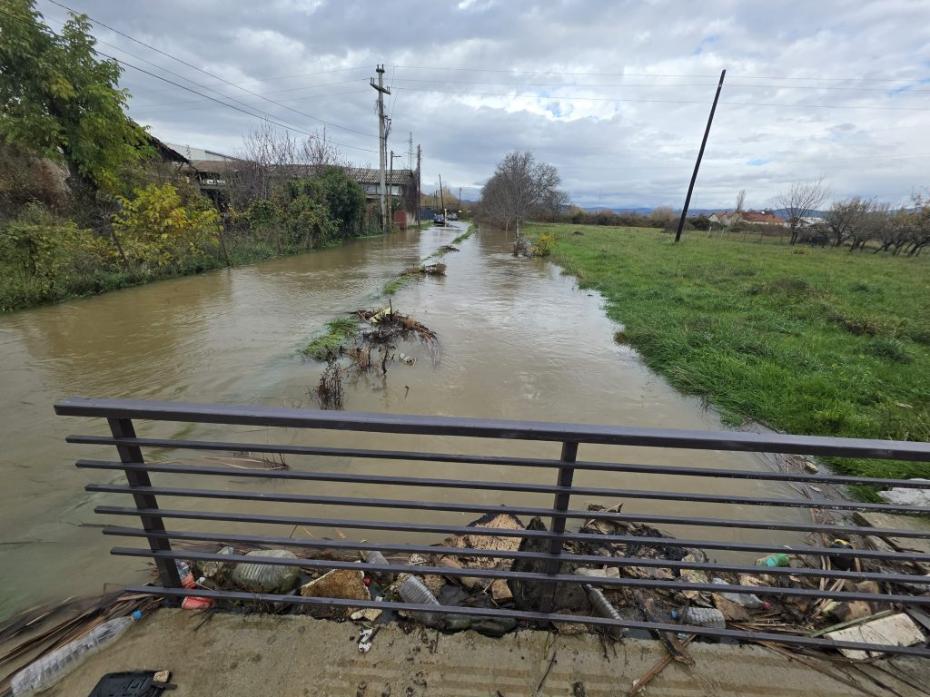
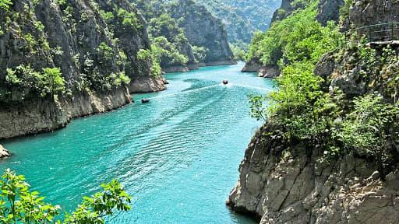
Mathematical Modeling of Floods:
Natural Hazards and Human Impact
How numbers help us understand the world in the era of climate change
Urbanization vs Natural Ecosystems: Surface Runoff and Infiltration

Slide 2


Project Learning Objectives:
Why Mathematics Matters in Ecology
Apply mathematical
models to real-world
environmental
problems.
            Evaluate the role of
            human activity in
            environmental change

Slide 3
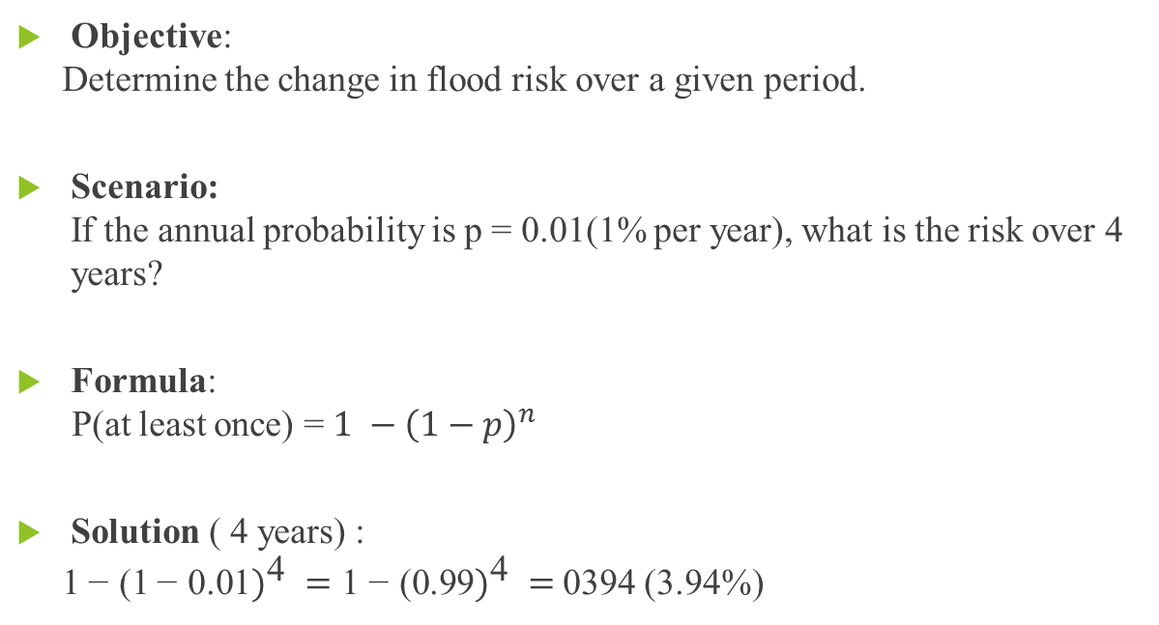
Activity 1 :
What is the Probability of a Flood?
Objective:
Determine the change in flood risk over a given period.
Scenario:
If the annual probability is p = 0.01(1% per year), what is the risk over 4 years?
Formula:
P(at least once) = ${1 −\left(1−p\right)}^{n}$
Solution ( 4 years) :
${\text{1}\text{− } \text{(}\text{1}\text{− } \text{0.}\text{01})}^{\text{4} }={\text{1} \text{−} \text{(}\text{0.}\text{99})}^{\text{4 }}=$0394 (3.94%)

Slide 4
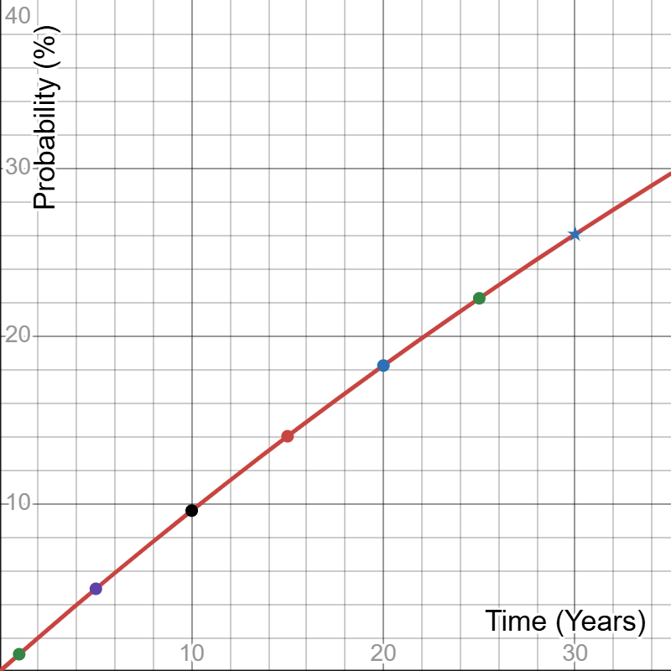
Conclusion:
Even small probabilities grow over time.
In 30 years, risk increases to 26%.

Slide 5
What did we learn?
We learned that a small yearly probability (1%) does not stay small over time, but increases when we look at more years.
We learned how to use a formula to calculate the probability of a flood happening at least once over several years.
We saw that the risk over 4 years is higher than over 1 year, and over 30 years it becomes much higher (about 26%).
We understood that probability helps us predict real-life risks, such as floods, and helps us make better decisions.

Slide 6
Activity 2 : Urbanization and Floods
Why does concrete increase the risk of flooding and what are the consequences?
Objective:
Determine how different surfaces (forest and concrete) affect the
volume of runoff water and increase flood risk.
Scenario:
A heavy rainfall of 50 mm (0.05 m) falls over an area of 1 km² (1,000,000 m²).
We compare two environments:
  Forest: The soil absorbs most of the water. Only 20% becomes runoff (C = 0.2).
  Concrete: The surface absorbs no water. All water becomes runoff (C = 1.0).
Calculate the volume of runoff water in both cases.
Formula: V = A ⋅ h ⋅ C
Where:
  V = volume of runoff water (m³)
  A = area (m²)
  h = rainfall height (m)
  C = runoff coefficient

Slide 7
Solution:
Forest (C = 0.2):
V = 1,000,000 × 0.05 × 0.2 = 10,000 m³
Concrete (C = 1.0):
V = 1,000,000 × 0.05 × 1 = 50,000 m³
Conclusion:
The concrete surface produces 50,000 m³ of runoff water, while the forest produces only 10,000 m³.
This means concrete creates 5 times more runoff water than forest. Since concrete does not absorb water, more water flows into streets and drainage systems, increasing the risk of flooding in urban areas.

Slide 8
What did we learn?
We learned that surface type greatly affects how much rainwater becomes runoff.
Forest soil absorbs most of the water, so only a small amount contributes to flooding.
Concrete surfaces absorb no water, so all the rainwater runs off, dramatically increasing flood risk.
Even with the same rainfall, urban areas produce much more runoff than natural areas.
We learned that urbanization can increase the risk of flooding because it replaces natural surfaces with impermeable ones.
Using the formula V = A · h · C, we can calculate the volume of water that contributes to flooding in different environments.

Slide 9
Insights from both activities:
Connecting math and nature:
Through both activities (flood probability and urbanization), we learned how statistics and math help analyze and predict natural events.
Impact of human actions:
We saw that urbanization increases water runoff and flood risk, showing a direct connection between human construction and the environment.
Critical thinking and problem solving:
Working on real-life scenarios, we asked important questions like:
  "Where is the boundary between urbanization and environmental safety?"
  "How does urban construction affect community safety?“
Collaboration and application:
By completing the activities together, we shared ideas, compared results, and learned from each other, gaining practical experience in using math to solve environmental problems.

Slide 10
Building a Safer Future
In an era of climate change, it is important to understand and protect our environment.
By learning math and statistics, we can use data to design safer and sustainable cities.
We can also apply modeling to predict risks from floods and other natural hazards.
This helps us reduce dangers, protect communities, and take care of the planet.

