Slide 1
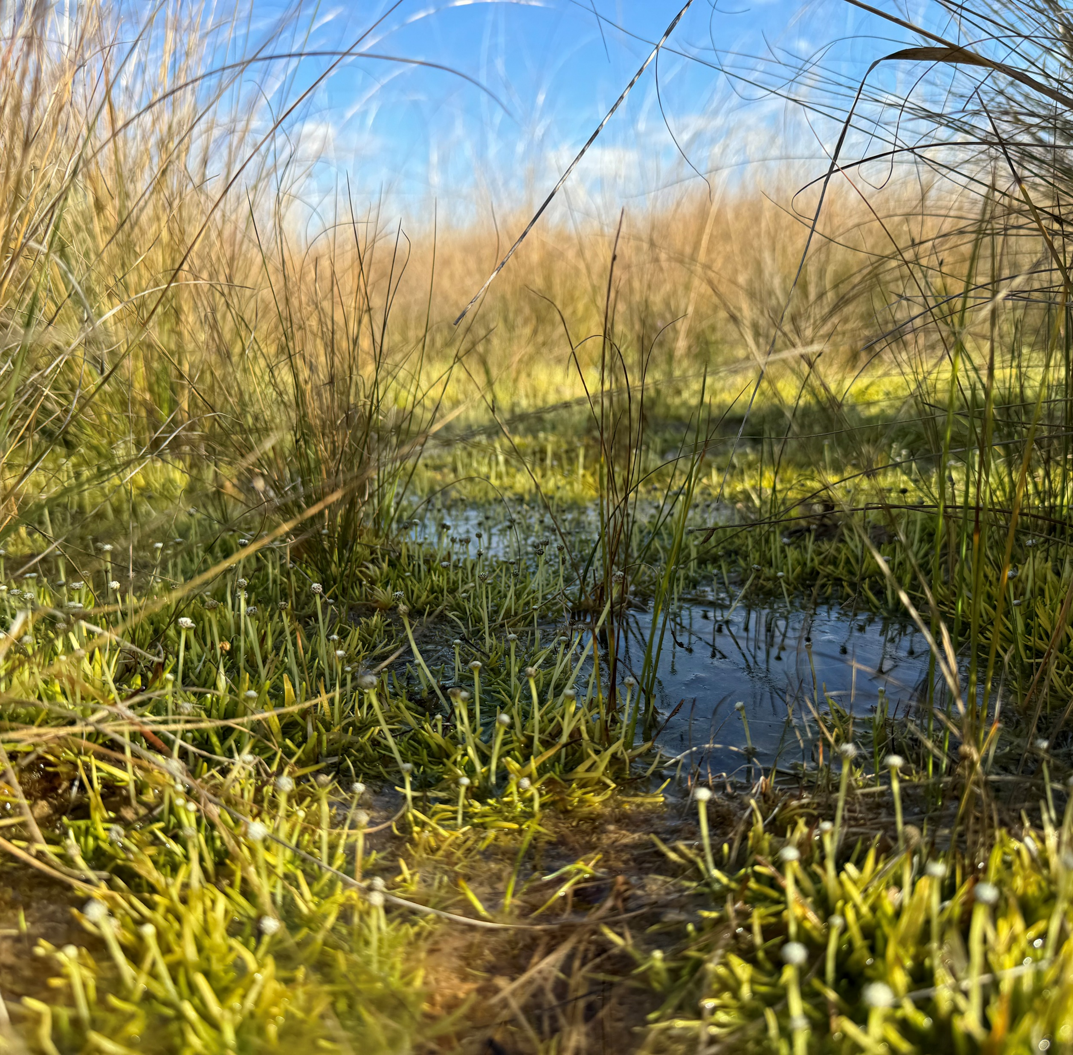
Using a novel chain of models to mimic source aquifer depressurisation impacts across the Doongmabulla Springs Complex , Queensland, Australia
Anne Gibson¹ Richard Cresswell¹ Jarrah Muller² Samantha Capon³ Rebekah Grieger³ Penn Lloyd⁴ David Stanton⁵ Miles Yeates⁶
5 May 2026
¹ Eco Logical Australia ⁴ BAAM Ecology
² EMM Consulting ⁵ Watermark Ecohydrology
³ Griffith University ⁶ Essence Environmental

Slide 2
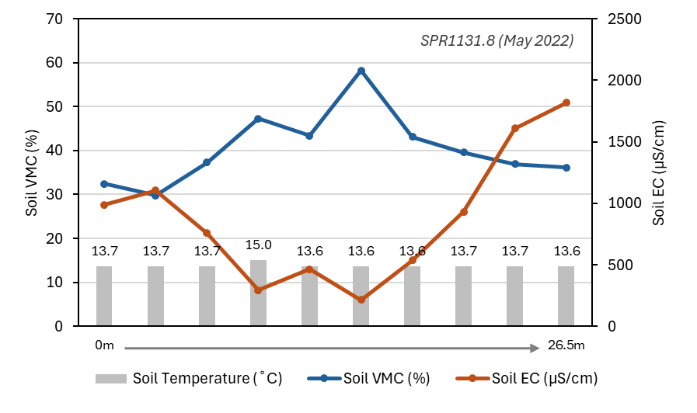
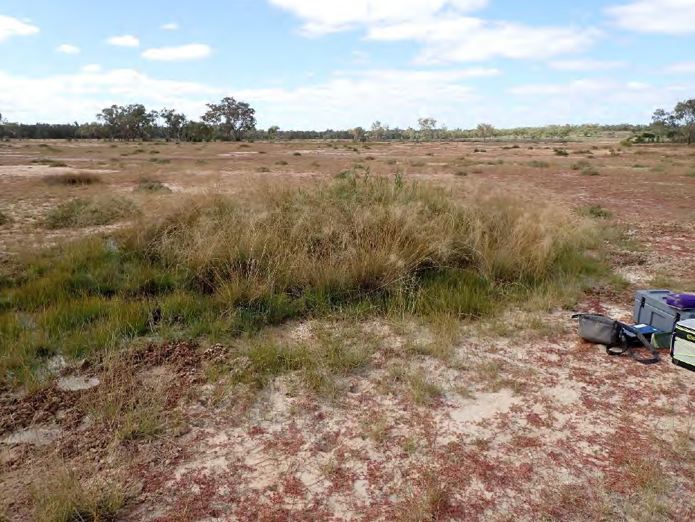
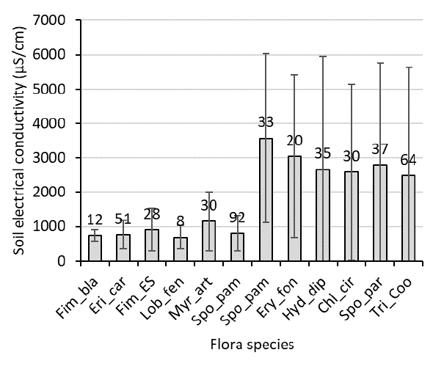
Hydro-ecological conceptualisation
Wetland margins;
intermittently
wet
Wetland body;
permanently
wet
Spring vent
wetland
scald
Saline/scald

Slide 3
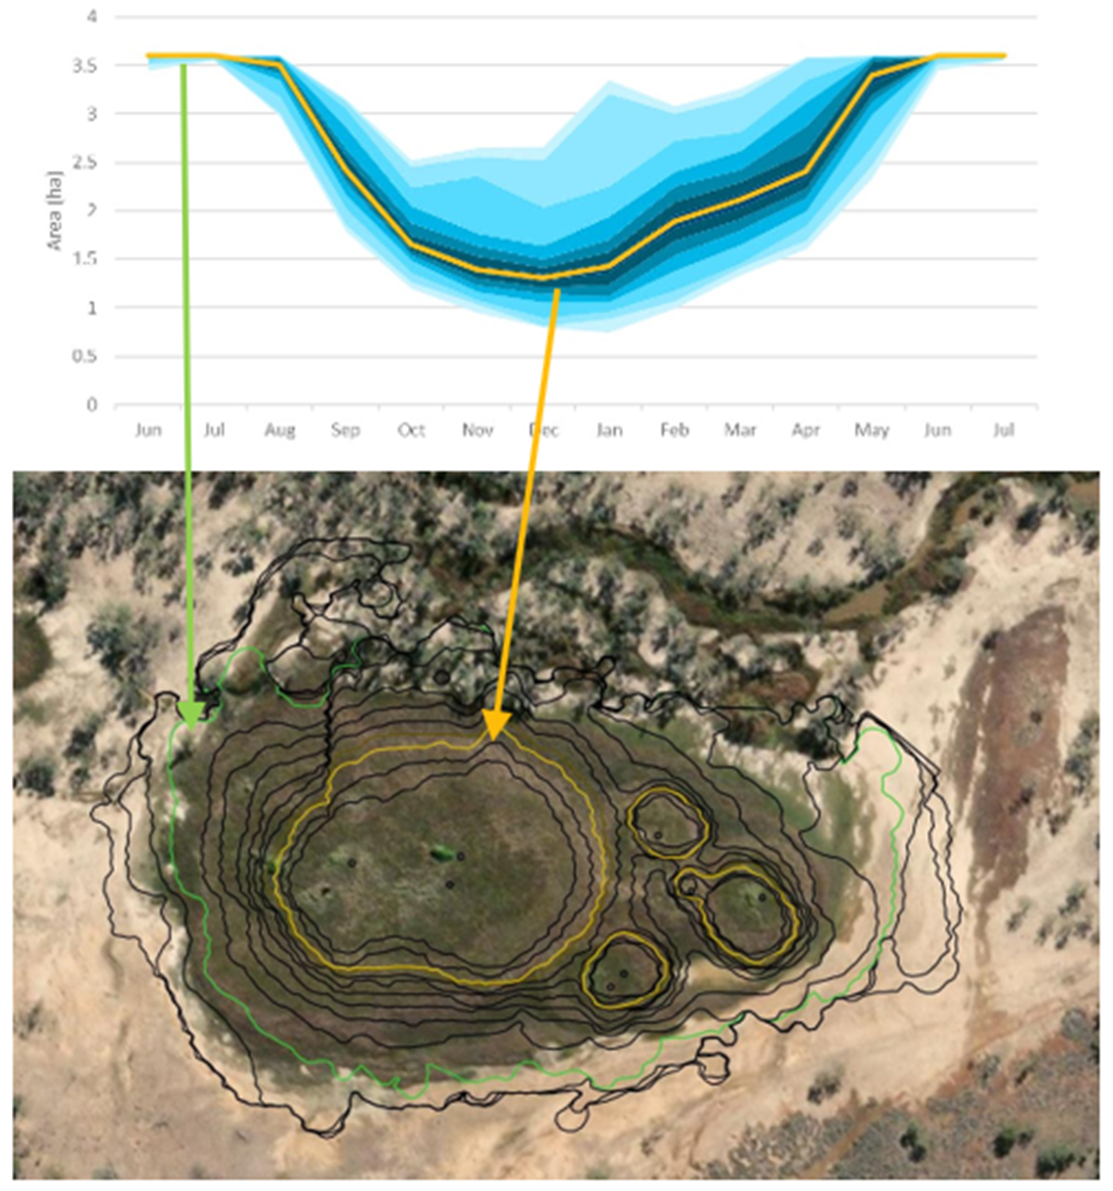
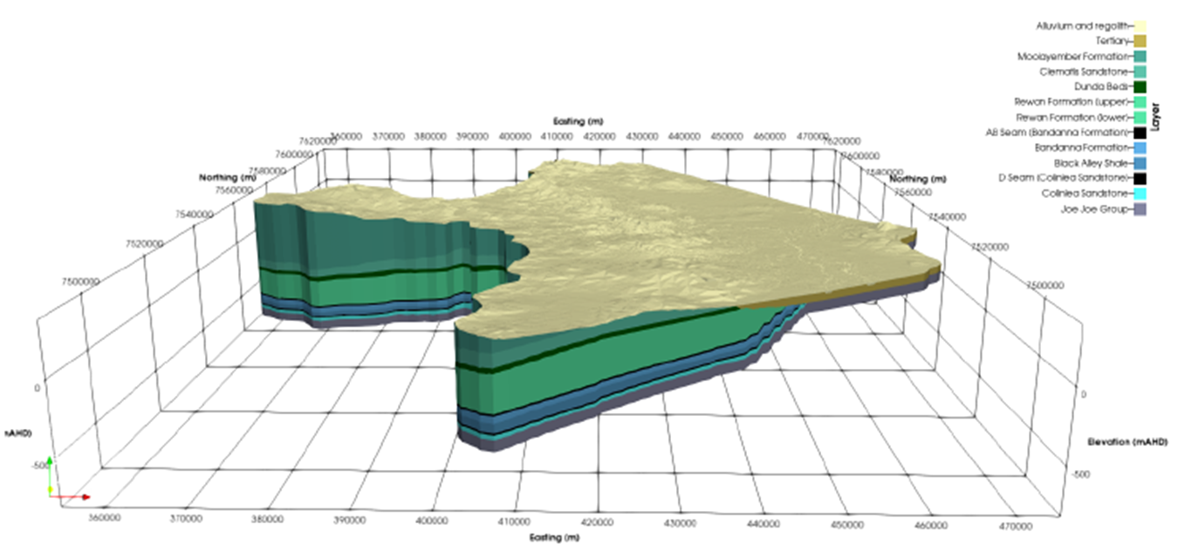
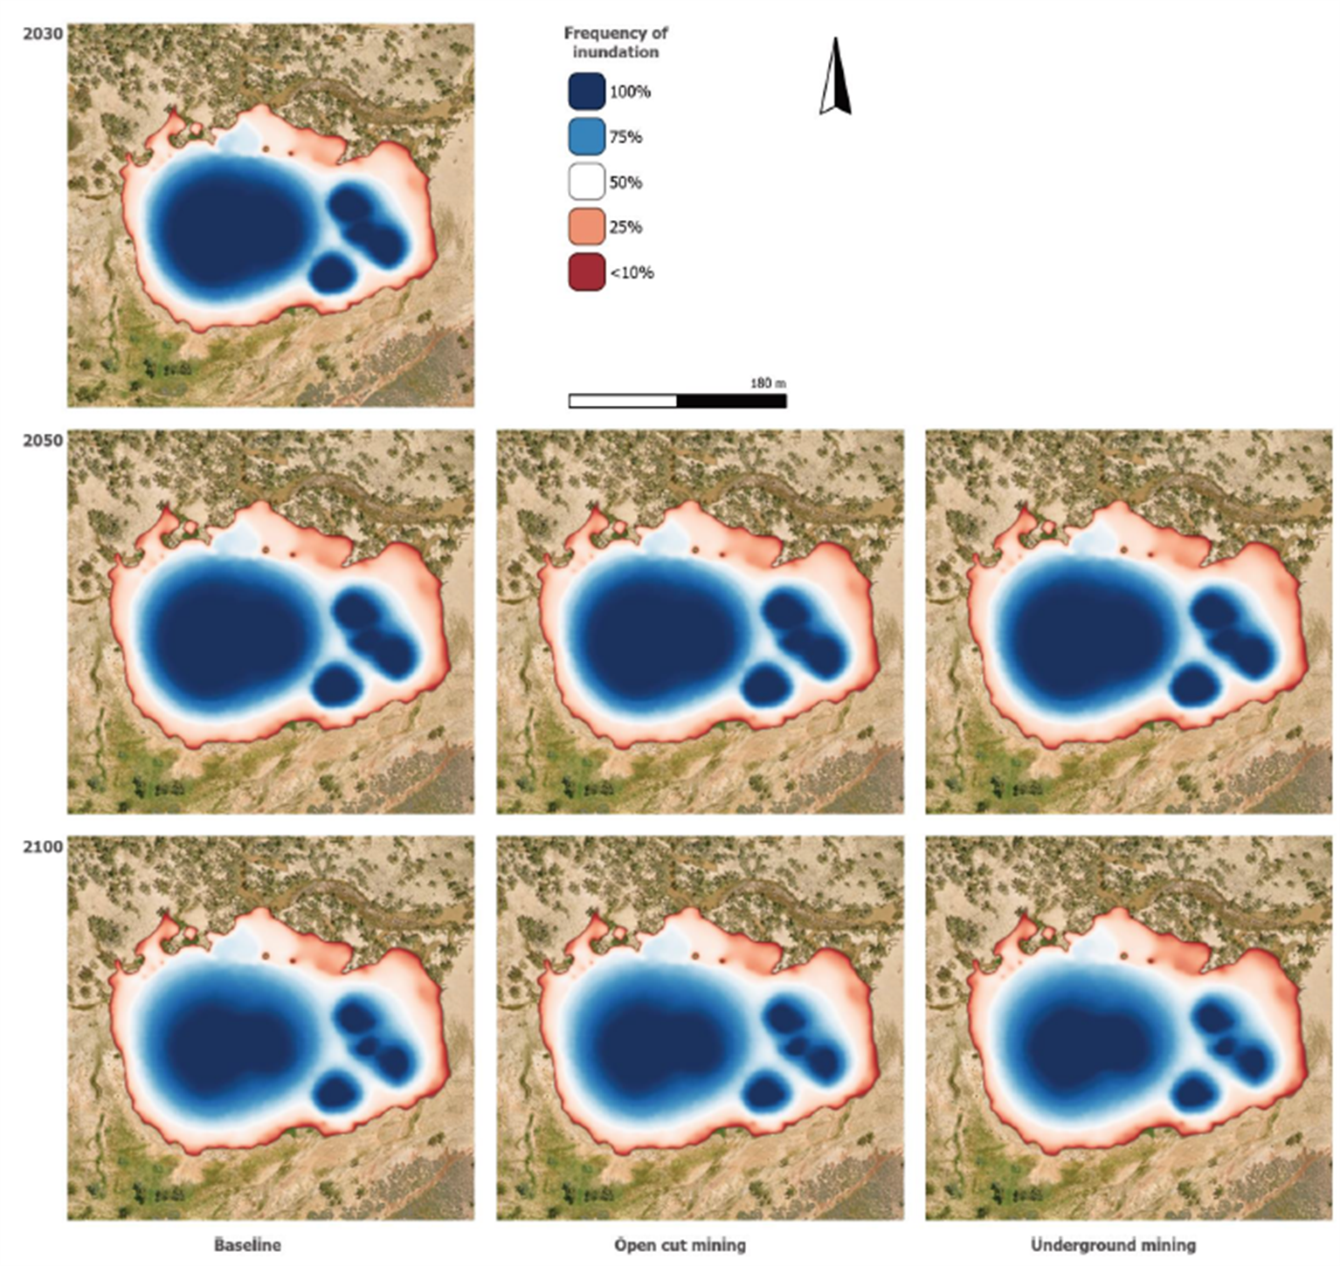
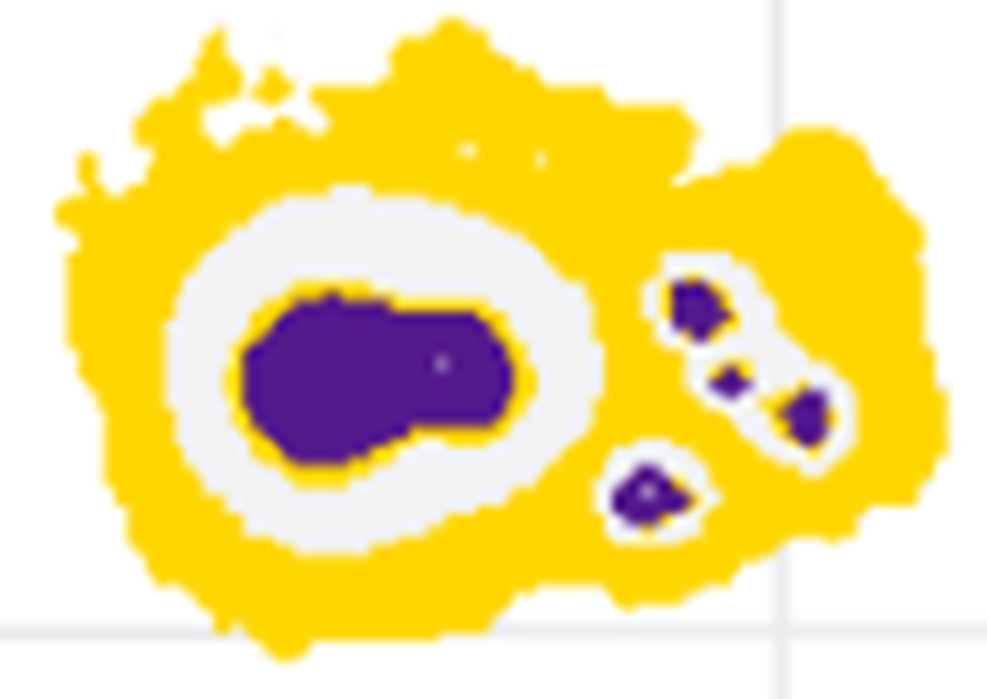
Hydro-ecological modelling
1. Regional groundwater model (MODFLOW)
To understand potential changes to groundwater discharge
at the springs
1
2
2. Wetland water balance model (GoldSim)
To describe wetland persistence, size and seasonality
3. Spatial representations of spring hydrology (TUFLOW)
To predict the area and shape of springs under changing hydrological
scenarios, to be compared to historical wetland persistence data
3
4
4. Species Distribution modelling (MaxEnt)
To predict potential effects on suitable habitat for key flora
species under a range of scenarios

Slide 4

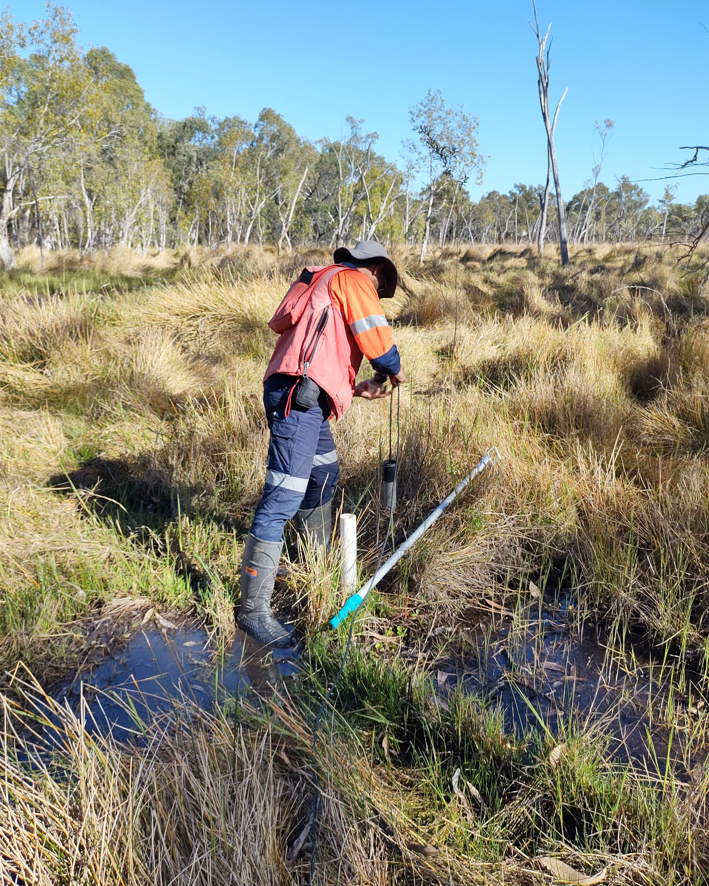










Acknowledgements
Cresswell et al: #15005
HS8.2.14
17:00–17:10
Room 2.31

