Slide 1
High-resolution seismic tomography of the central Chile subduction zone: implications for volcanoes, plate coupling and flat subduction
Lei Gao^{1,2}, Haijiang Zhang², Zixin Chen², Ying Liu²
¹Chinese Academy of Geological Sciences
²University of Science and Technology of China
2026.05.05

Slide 2
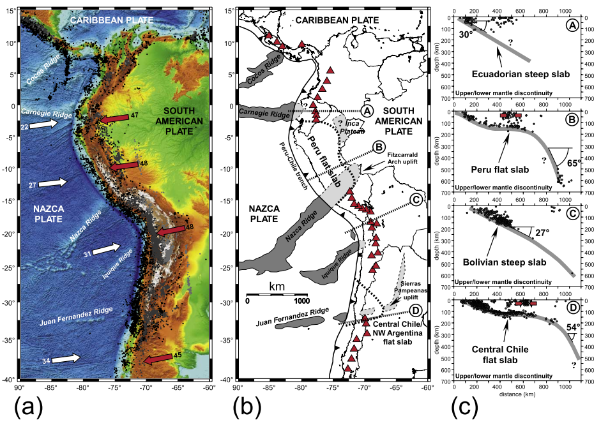
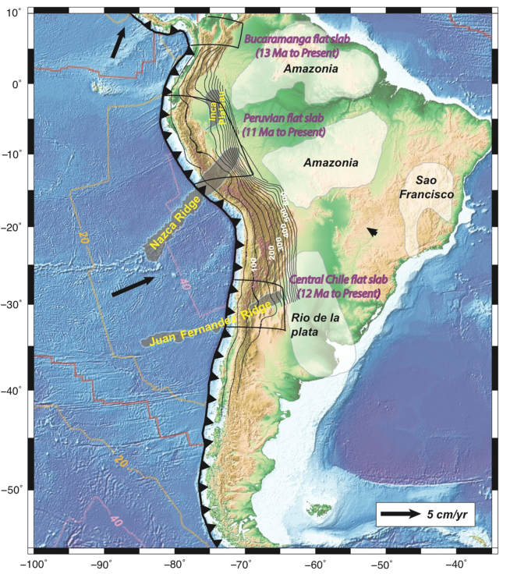
There are three segments of flat slab subduction in South America:
（Hu et al., 2016）
(Nicolas et al., 2008)
Notes:
the Bucaramanga flat slab (between 5◦N and 9◦N),
the Peruvian flat slab (between 5◦S and 14◦S),
and the central Chile flat slab (between 27◦S and 33.5◦S)

Slide 3
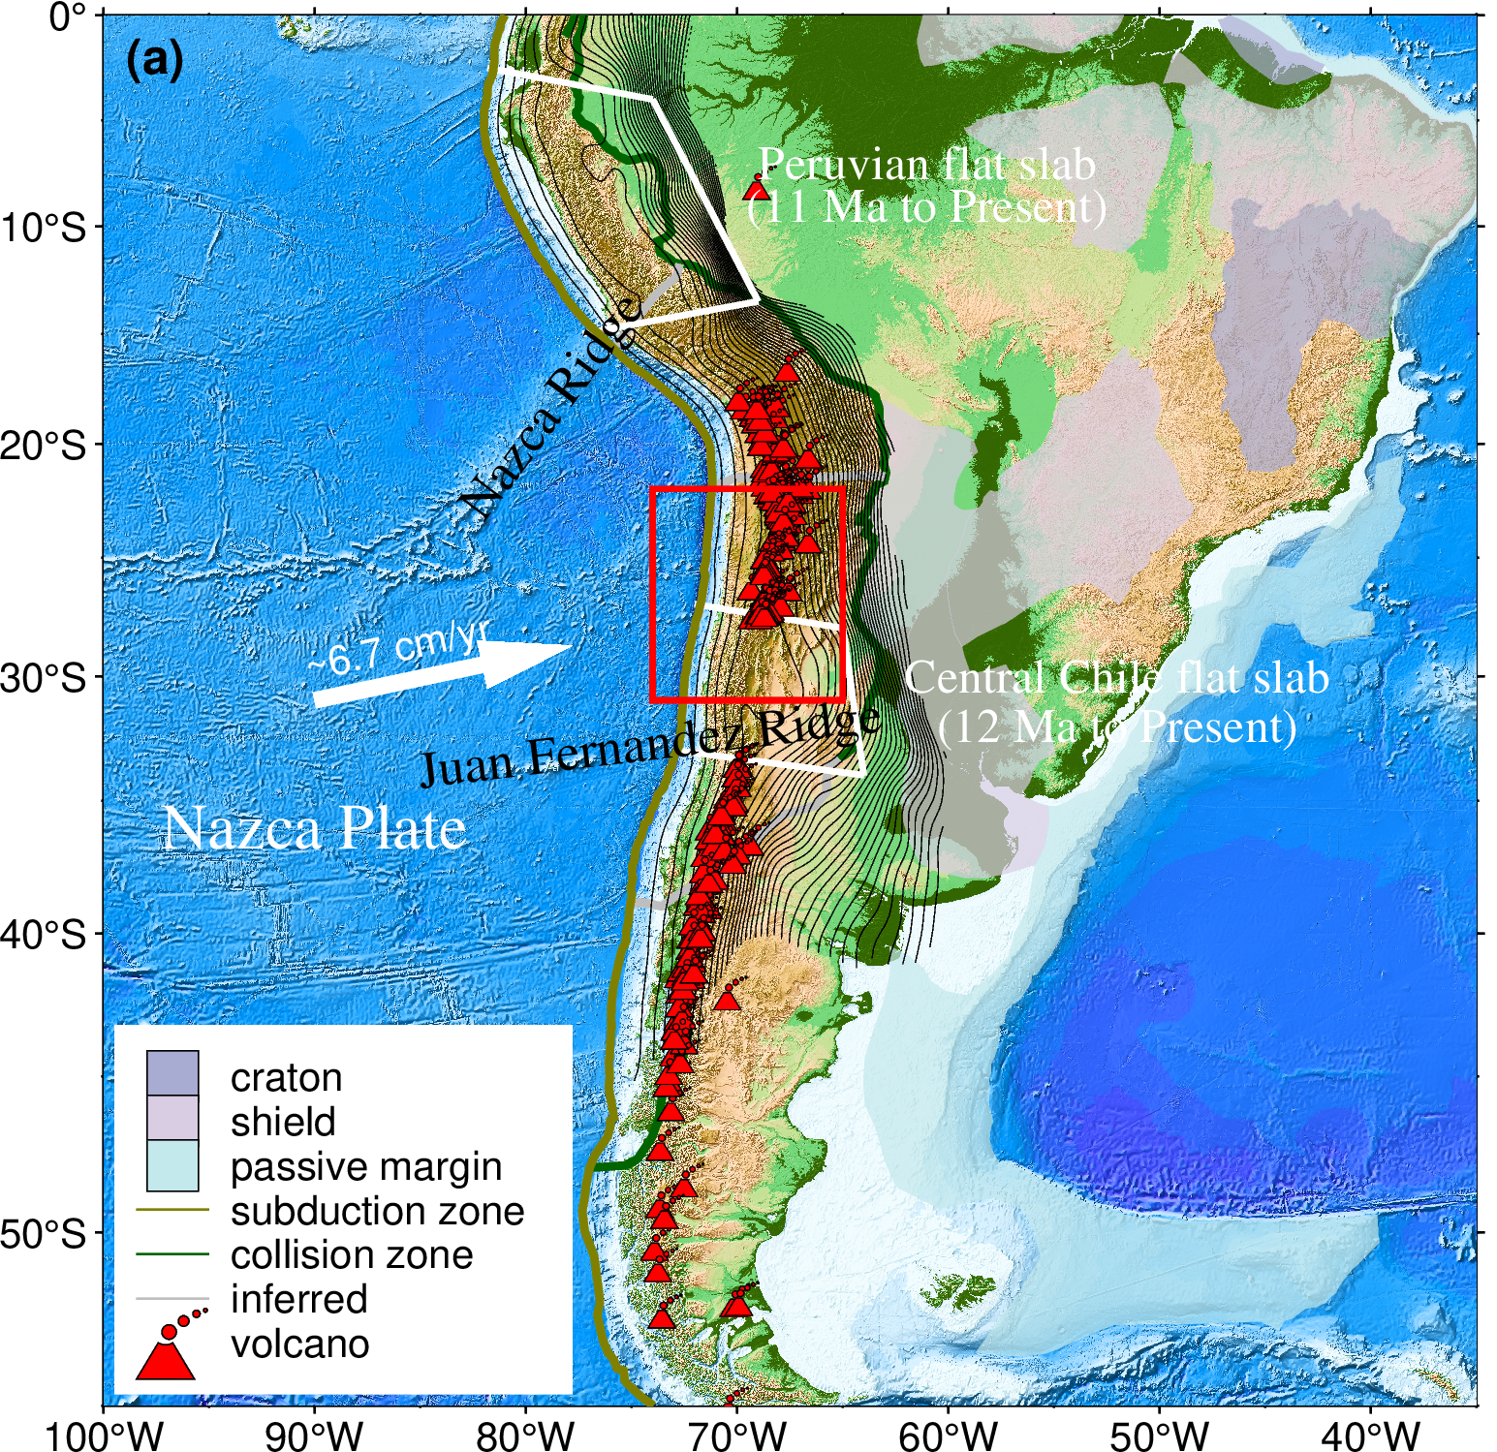
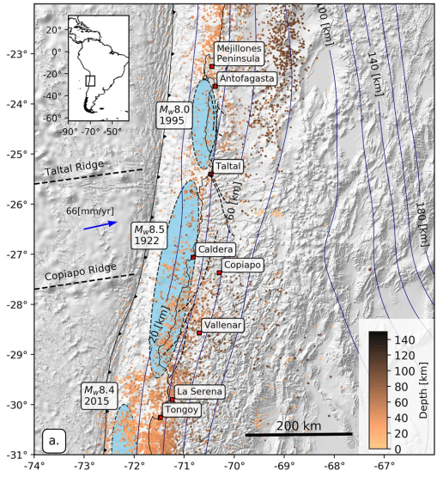
To better understand the relationship between slab morphology and the distribution of volcanoes and earthquakes, a high-resolution velocity model is required.
（Yáñez-Cuadra et al., 2022）

Slide 4
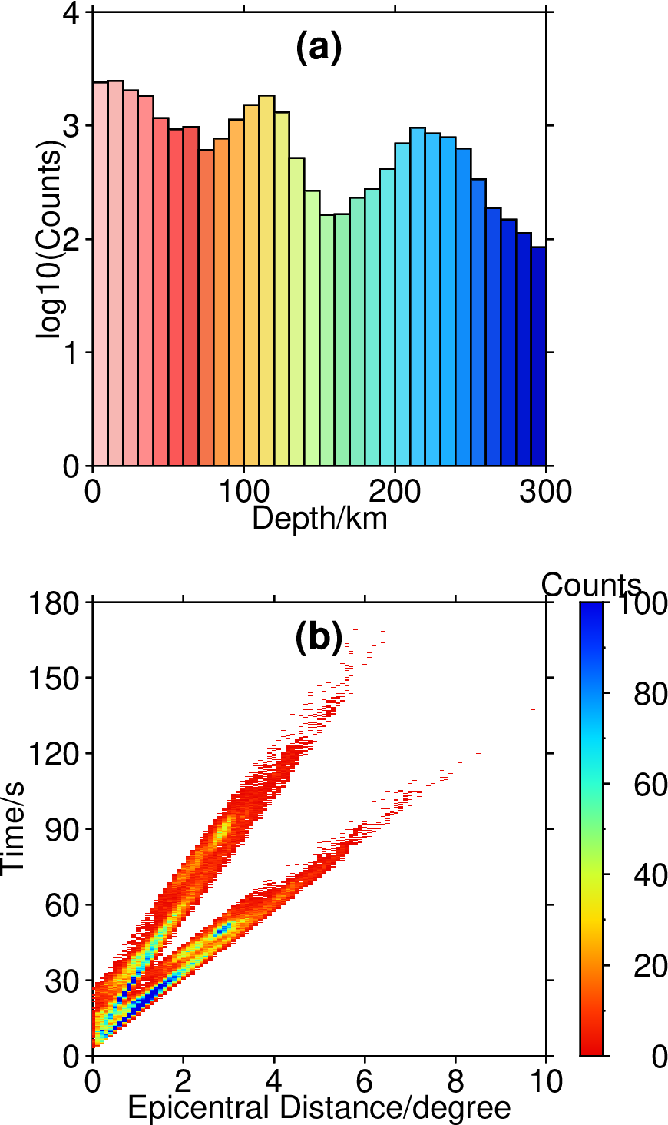
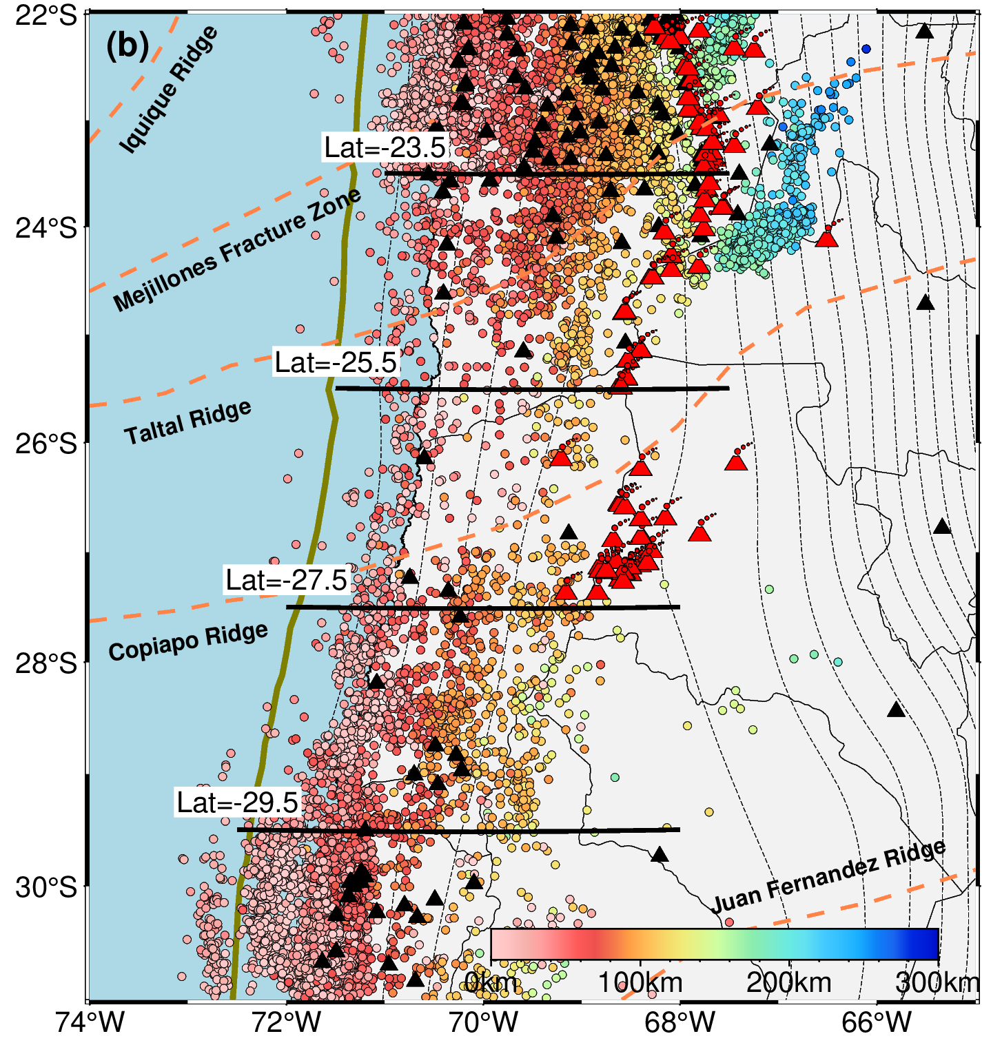
Data: events and stations distribution
Histogram of event depth distribution
Epicentral distance-traveltime curve
~25,000 seismic events, 124 stations.
Events are primarily located near the trench.

Slide 5
Method: Vp/Vs model consistency-constrained DD tomography method (Guo et al., 2018)
P-wave arrival times
P-wave velocity
stations
Vp/Vs (model2)
Event location & origin time
traditional tomography
S-wave arrival times
S-wave velocity
Model consistency constraint
large anomalies
S-P arrival times
Vp/Vs (model1)
DD tomography
 | absolute arrival times | event-pair differential times
P-wave data | 156,000 | 1,376,000
S-wave data | 125,000 | 1,081,000
S-P data | 110,000 | 936,000
small anormalies
source region
A total of 3.78 million arrival-time data are used in the inversion!

Slide 6
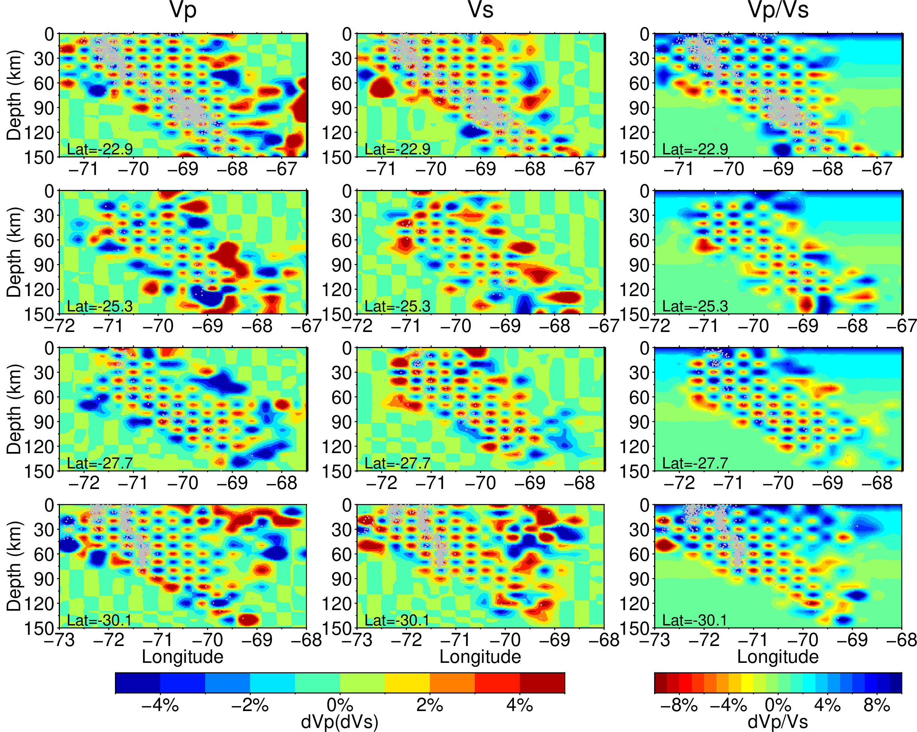
Checkerboard resolution test:
Horizontal grid spacing: 0.3°
Vertical grid spacing: 10 km
The regions with events and stations densely distributed are well recovered.

Slide 7
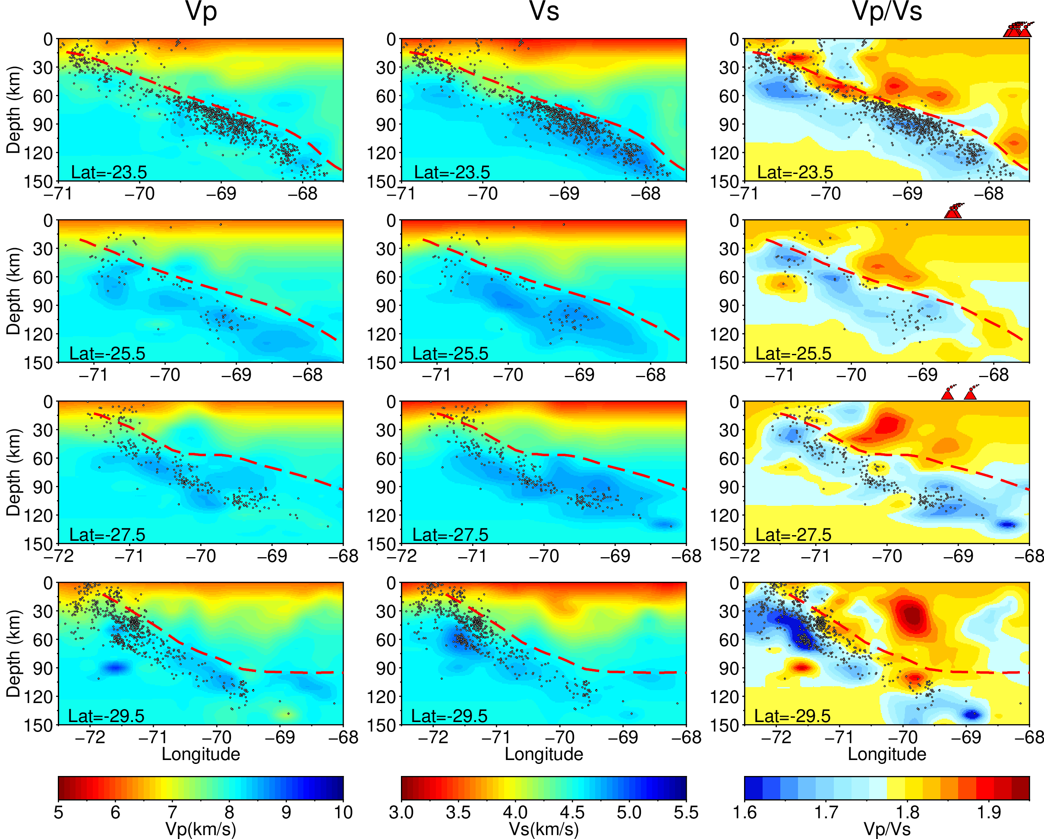
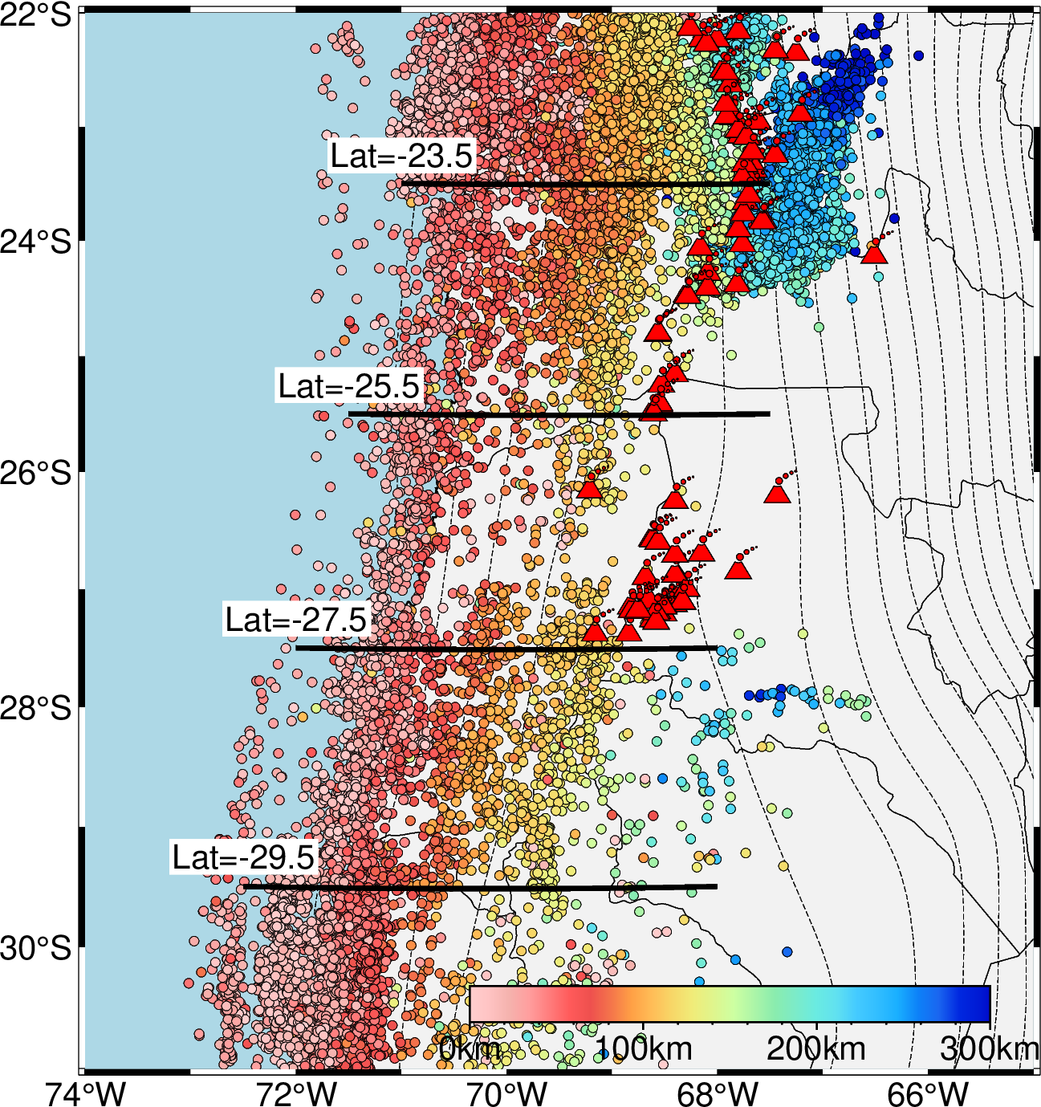
Results:
The slab is mainly associated with relatively high Vp, high Vs, and low Vp/Vs values along the slab.

Slide 8
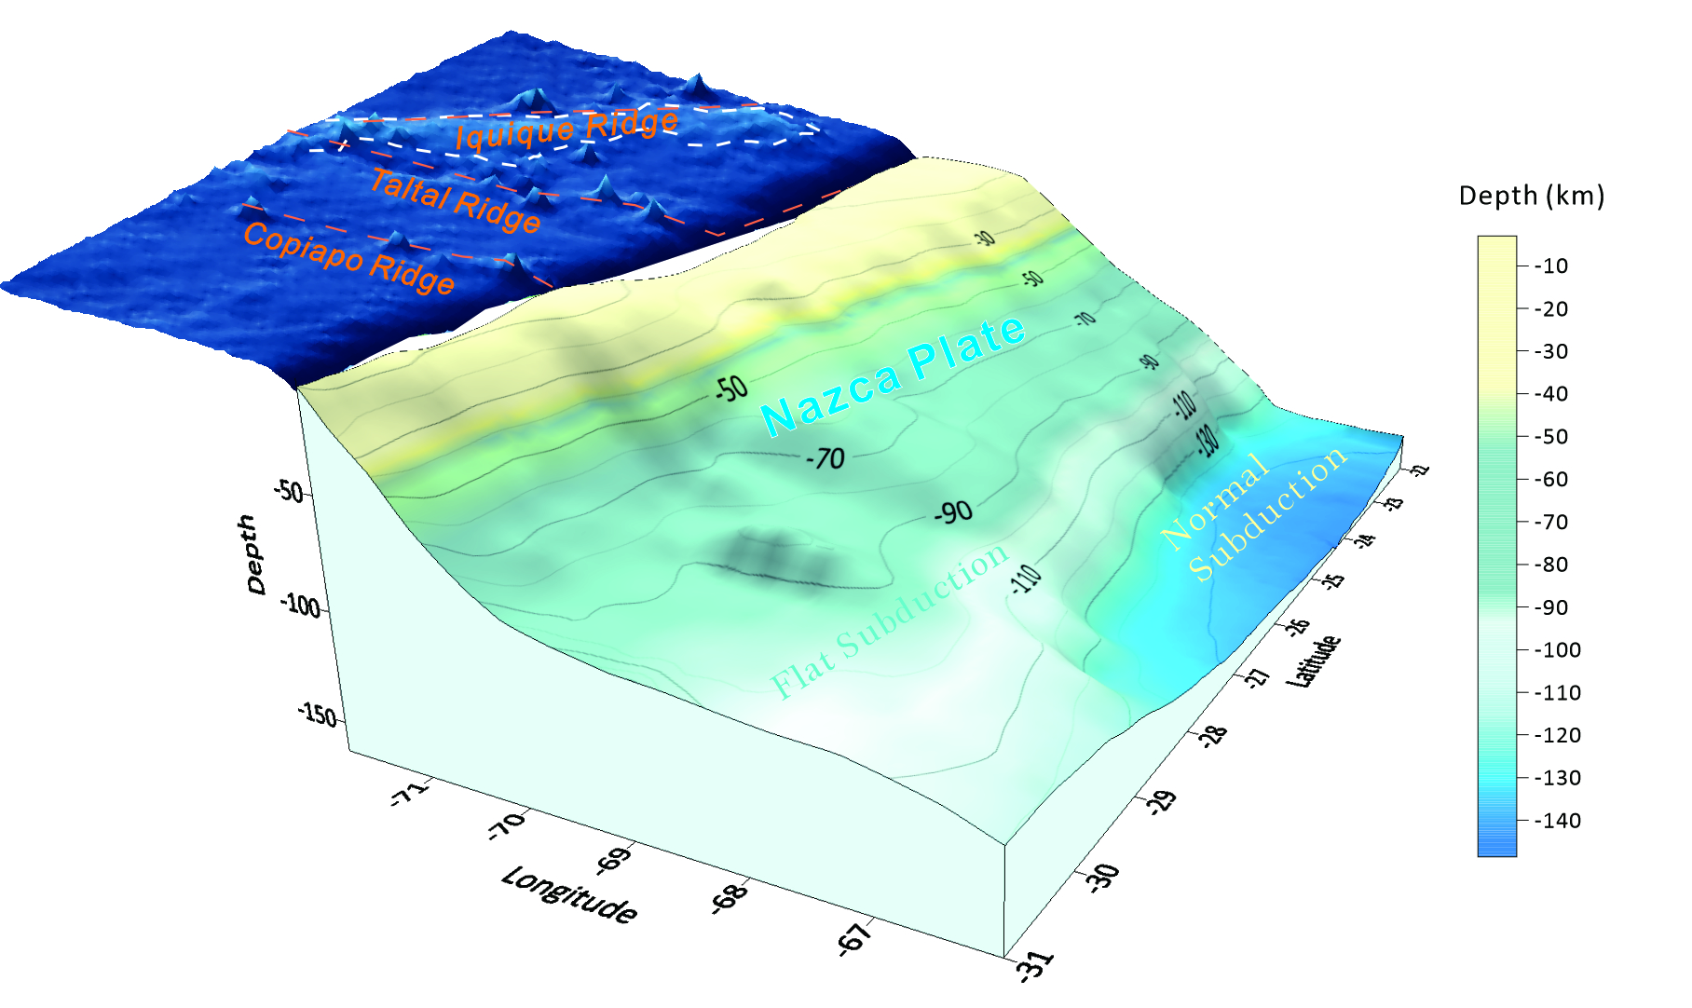
Discussion 1: Slab surface model
The subduction angle varies from north to south. The northern segment exhibits normal slab subduction, while in the southern segment the slab gradually flattens at ~100 km depth.
A slab tear maybe exist in the transition zone?

Slide 9
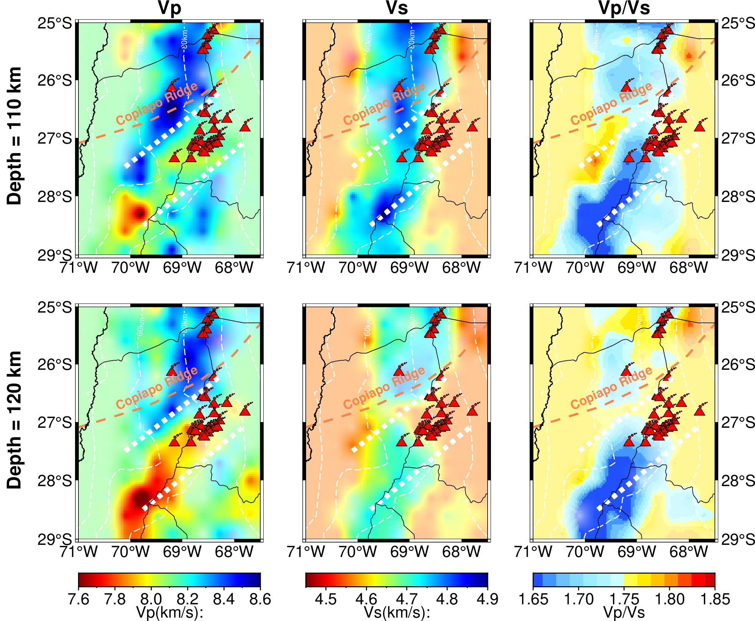
Discussion 2: A slab tear exists in the transition zone
The slab could be torn to form a slab tear when it transits from normal slab subduction to flat slab subduction.
Through the slab tear, subslab hot materials characterized by low velocity anomalies can migrate upwards to form volcanoes.

Slide 10
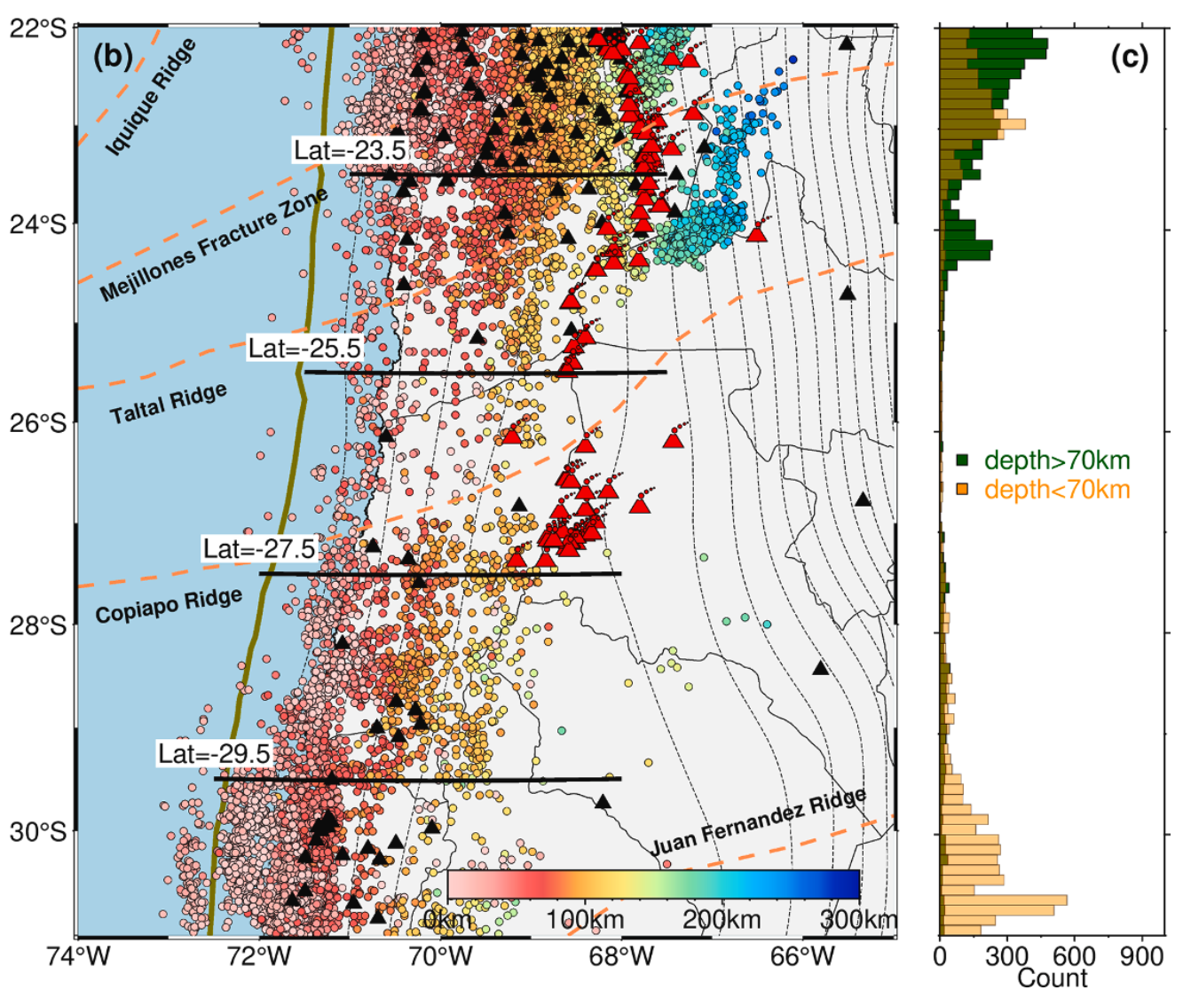
Discussion 2: A slab tear exists in the transition zone
relocated events distribution
The slab could be torn to form a slab tear when it transits from normal slab subduction to flat slab subduction.
Through the slab tear, subslab hot materials characterized by low velocity anomalies can migrate upwards to form volcanoes.
seismic gap
Since temperatures are too high for this part of the slab, both shallow and intermediate-depth earthquakes are very limited.

Slide 11
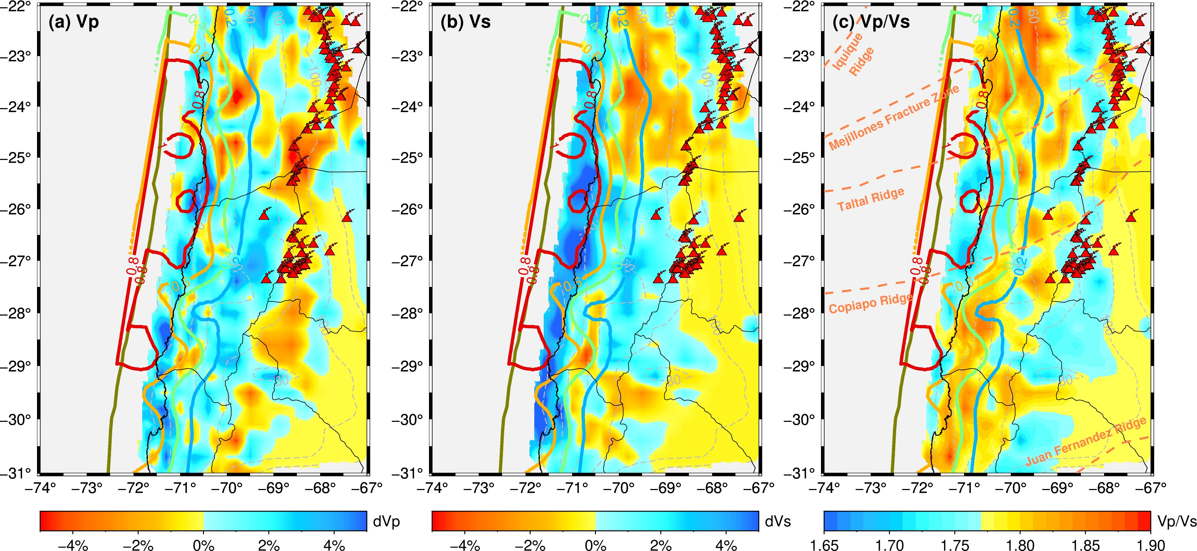
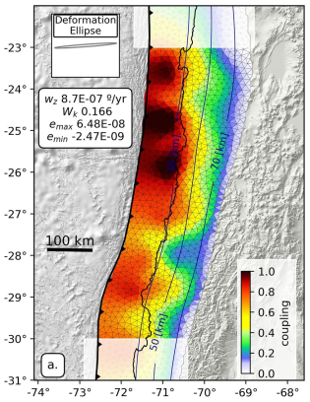
Discussion 3: Correlation between seismic velocity and plate coupling variations along the plate interface
Vp
Vs
Vp/Vs
plate coupling
（Yáñez-Cuadra et al., 2022）
Vp/Vs is roughly inversely correlated with the degree of plate coupling.
Notes:
with low Vp/Vs values associated with
strong coupling and high Vp/Vs values corresponding to weak coupling

Slide 12
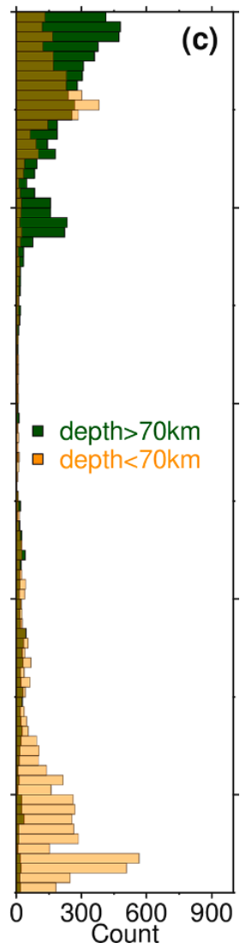
Discussion 3: Correlation between seismic velocity and plate coupling variations along the plate interface
Vp/Vs
plate coupling
event distribution
high Vp/Vs values
relatively weak coupling
more fluids in the northern part
seismic gap
low Vp/Vs values
highest plate coupling
seismic gap
the plate is highly locked in the shallow depth
（Yáñez-Cuadra et al., 2022）
Generally, high Vp/Vs values can be interpreted due to the existence of fluids and high fluid pore pressures.

Slide 13
Discussion 3: Correlation between seismic velocity and plate coupling variations along the plate interface
Vp/Vs
the northern cluster
plate coupling
event distribution
high Vp/Vs values
relatively weak coupling
events predominantly concentrate at intermediate depths
low Vp/Vs values
highest plate coupling
seismic gap
the central cluster
（Yáñez-Cuadra et al., 2022）
the northern cluster of volcanoes is predominantly associated with abundant intermediate-depth earthquakes
the intermediate-depth earthquakes are generally attributed to the dehydration of various hydrous minerals
Notes:
The intermediate-depth earthquakes in the slab are generally
attributed to the dehydration of various hydrous minerals, such as
metabasalt, metagabbro, chlorite, and serpentine
The fluids
released from dehydration could migrate upwards into the mantle
wedge, inducing partial melting to form volcanoes. This can explain the
correlation between the abundant intermediate-depth earthquakes and
densely distributed volcanoes to the north of 25.5◦S.

Slide 14
Discussion 3: Correlation between seismic velocity and plate coupling variations along the plate interface
Vp/Vs
the northern cluster
plate coupling
event distribution
high Vp/Vs values
relatively weak coupling
events predominantly concentrate at intermediate depths
low Vp/Vs values
highest plate coupling
seismic gap
the central cluster
medium Vp/Vs values (>1.73)
relatively weak coupling
events predominantly concentrate at shallower depths
（Yáñez-Cuadra et al., 2022）
For the southernmost part, we think the subduction of the Juan Fernandez Ridge could partly contribute to the reduced plate coupling.
Notes:
The intermediate-depth earthquakes in the slab are generally
attributed to the dehydration of various hydrous minerals, such as
metabasalt, metagabbro, chlorite, and serpentine
The fluids
released from dehydration could migrate upwards into the mantle
wedge, inducing partial melting to form volcanoes. This can explain the
correlation between the abundant intermediate-depth earthquakes and
densely distributed volcanoes to the north of 25.5◦S.

Slide 15
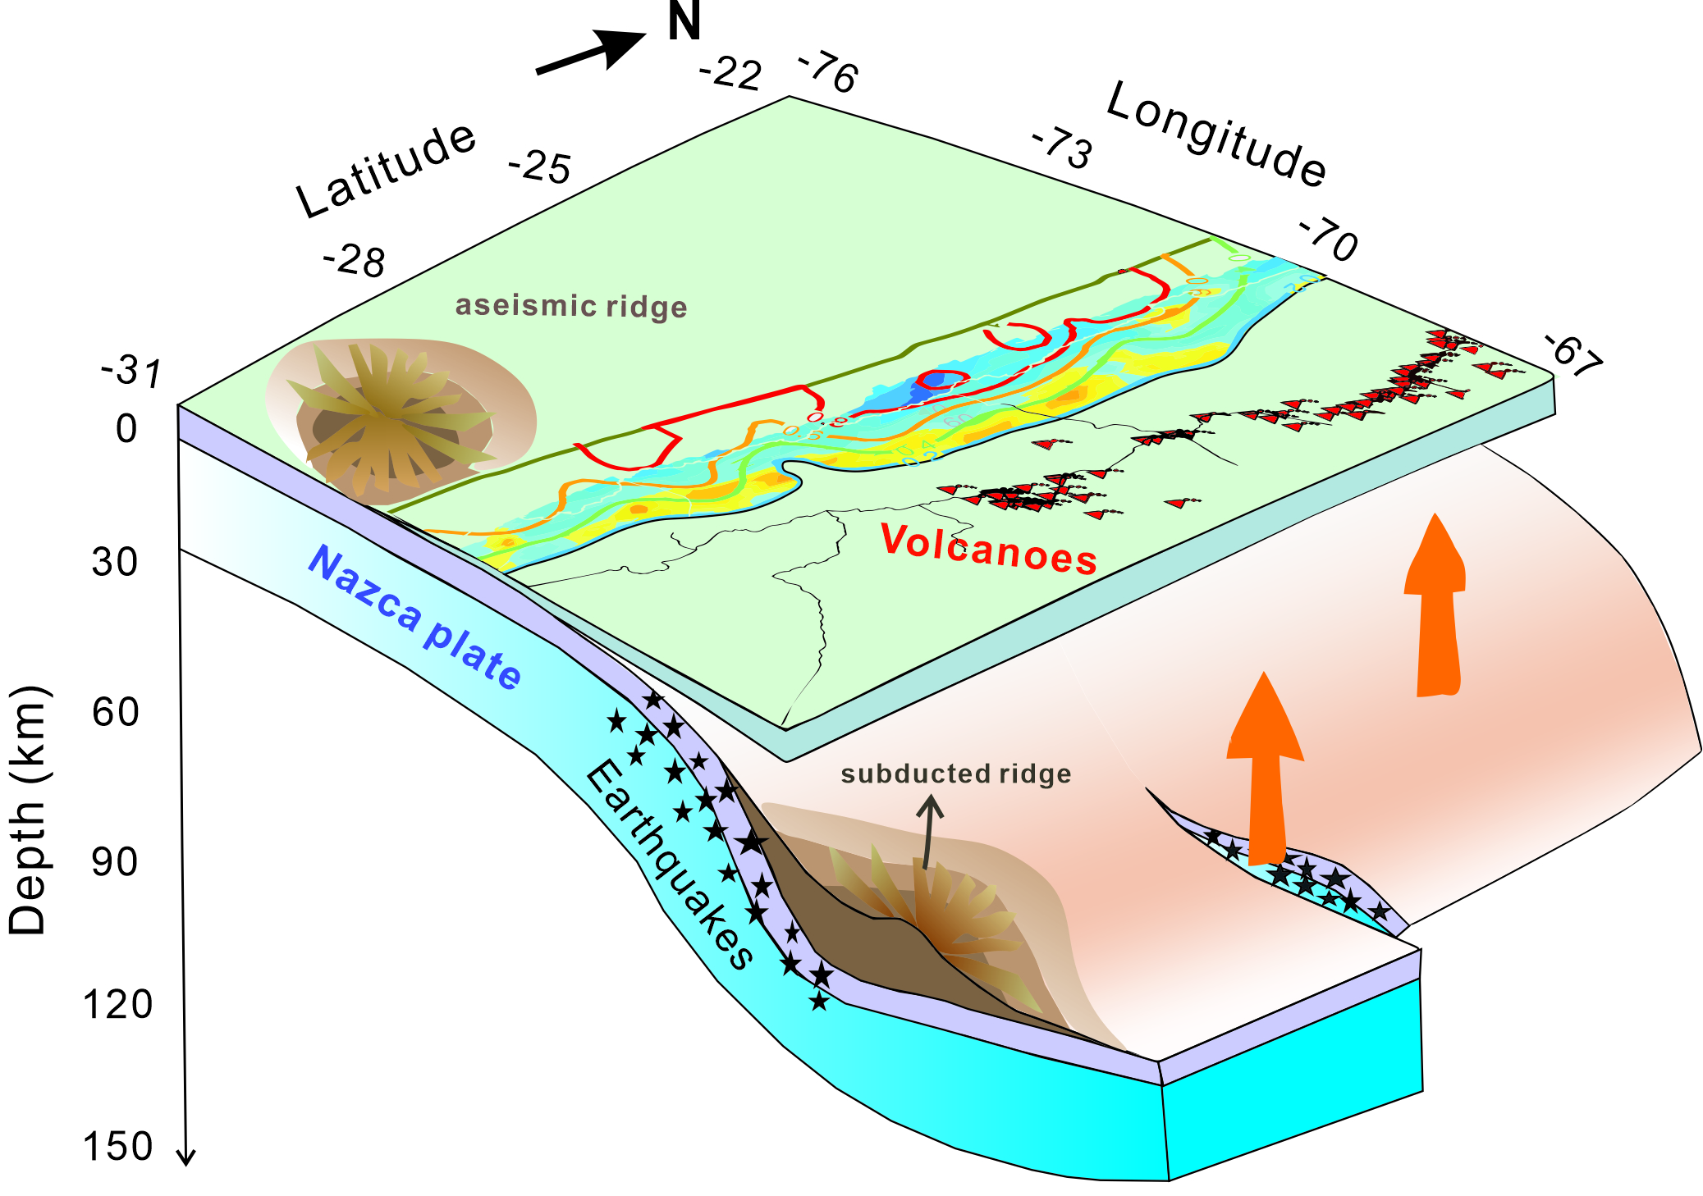
Conclusion:
From north to south, the slab subduction angle transitions from normal subduction to flat-slab subduction;
A slab tear occurs in the central segment, leading to the formation of a seismic gap and a volcanic cluster;
Variations in Vp/Vs along the slab upper surface are closely related to the slab coupling model and the distribution of earthquakes and volcanoes.

Slide 16
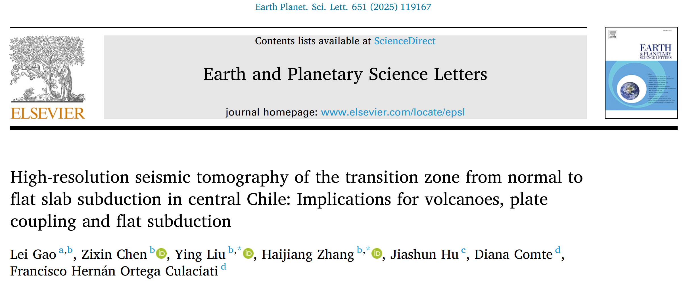
Thanks for your listening!

