Slide 1

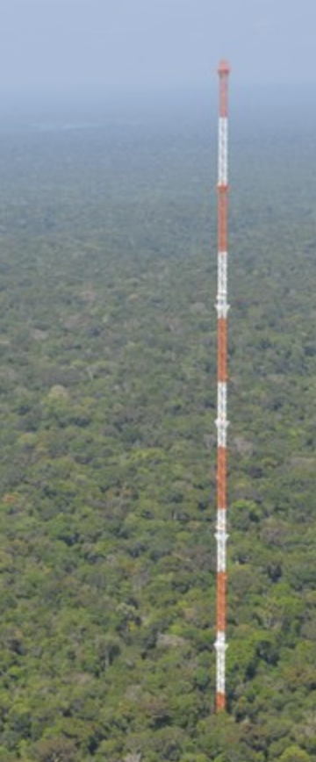
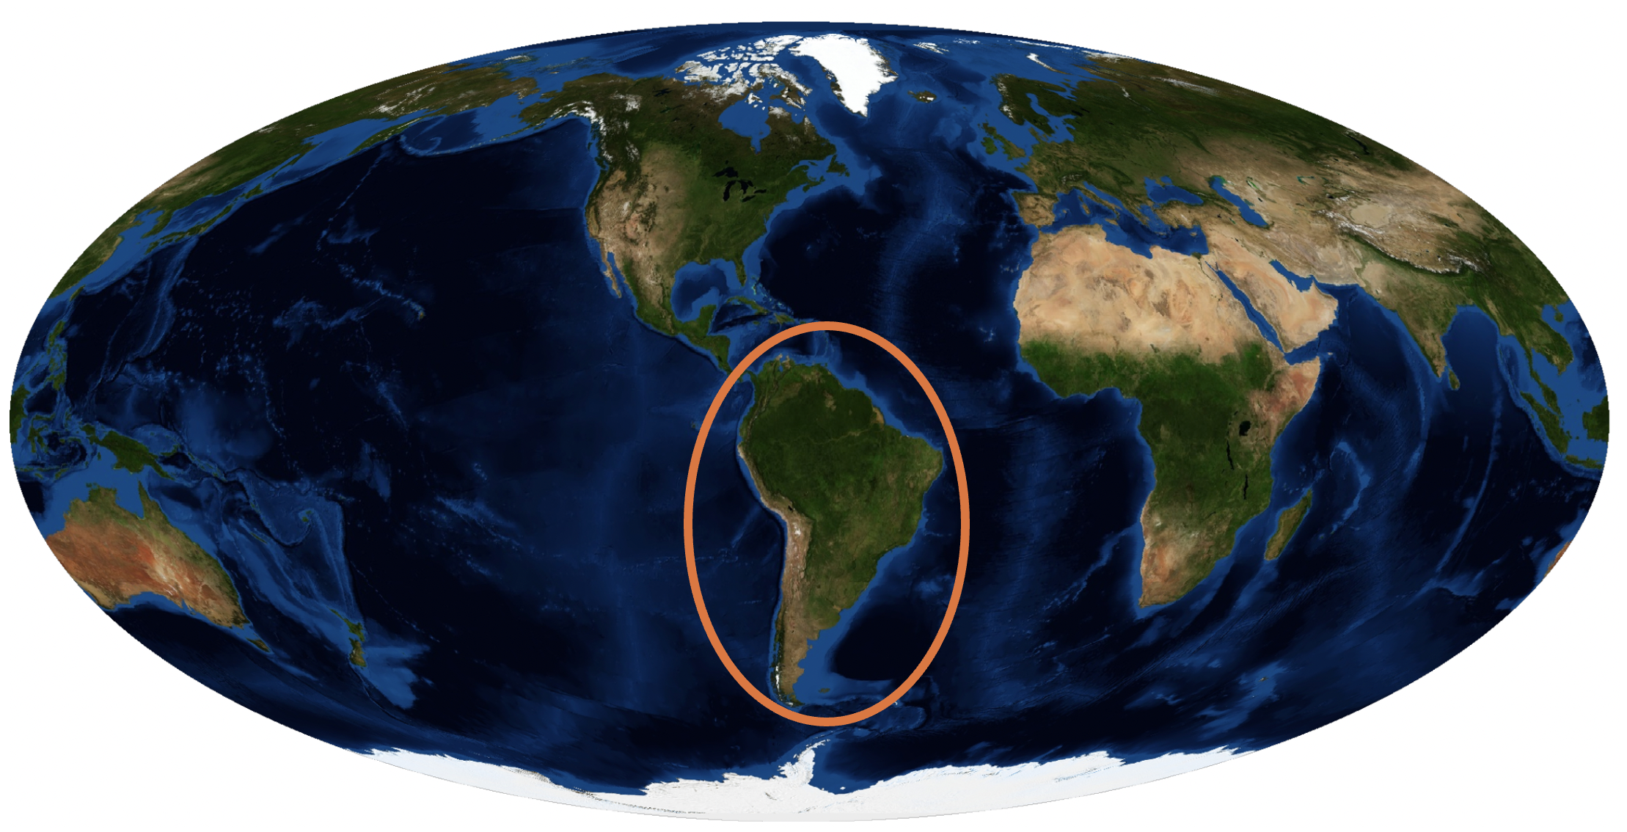


Aerosols Properties and their Long-Term Variability in the Andes
EGU26
Diego Aliaga^{1,2}, Sara Blichner^{1,2}, F. Velarde³, M. Andrade³, P. Laj^{4,5}, G. Uzu⁵, K. Weinhold⁶, A. Wiedensohler⁶,
I. Riipinen^{1,2}, R. Krejci^{1,2}
¹Stockholm University, Department of Environmental Science, Stockholm, SE-106 91, Sweden
²Bolin Centre for Climate Research, Stockholm University, Stockholm, Sweden
³Laboratory for Atmospheric Physics, Institute for Physics Research, Universidad Mayor de San Andrés, La Paz, Bolivia
⁴Institute for Atmospheric and Earth System Research (INAR)/Physics, University of Helsinki, Helsinki, 00014, Finland
⁵Institut des Géosciences de l’Environnement, IGE, UGA, CNRS, IRD, G-INP, 38000 Grenoble, France
⁶Department of Experimental Aerosol and Cloud Microphysics, Leibniz Institute for Tropospheric Research (TROPOS), 04318 Leipzig, Germany

Slide 2
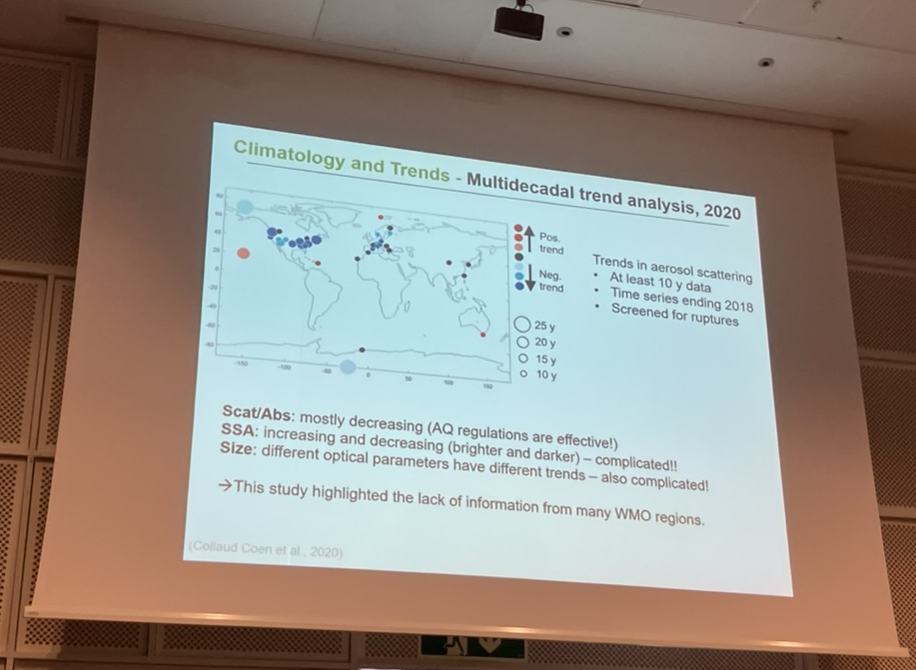
Why in the Andes?
Chacaltaya GAW station (CHC)
CHC
From plenary session at ACTRIS26

Slide 3
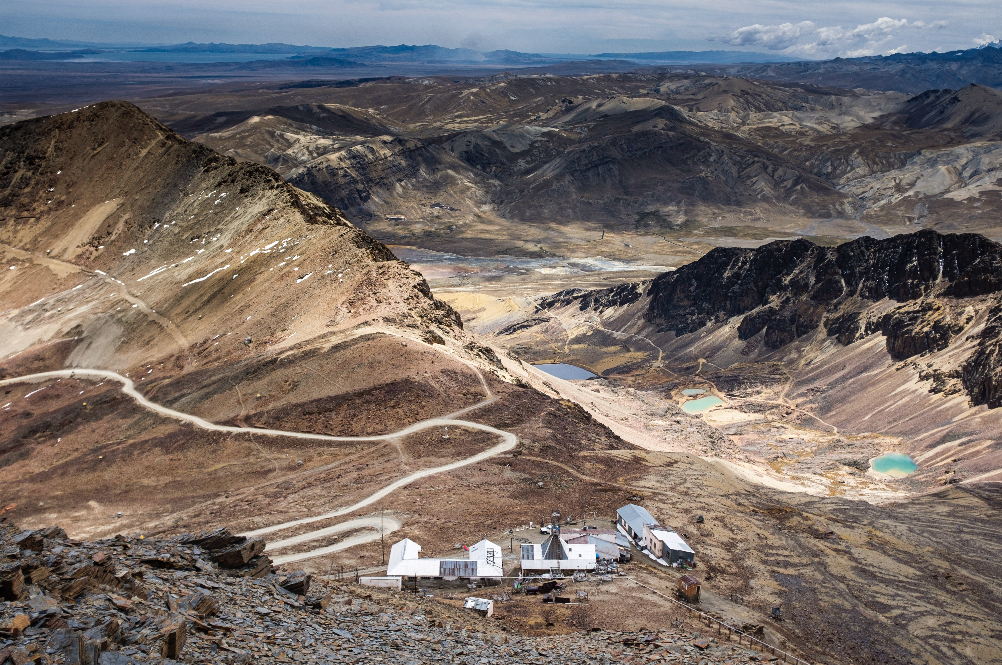
Chacaltaya GAW station (CHC)

Slide 4
In this study
Long term (13 years ) in-situ measurements
Focus: particle number size distribution (PNSD)
Also:
  eBC [MAAP]
  CO [Picarro]
  meteo variables
  hysplit backtrajectories (ERA5)
Aims and Questions:
  Identify general atmospherics regimes based on aerosol properties
  Identify trends in aerosol properties (quantity, frequency)
  Do we measure in the free troposphere?

Slide 5
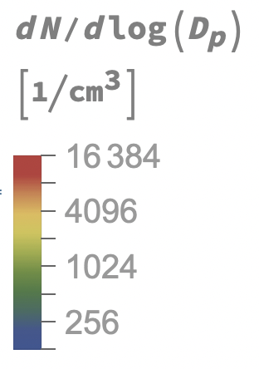
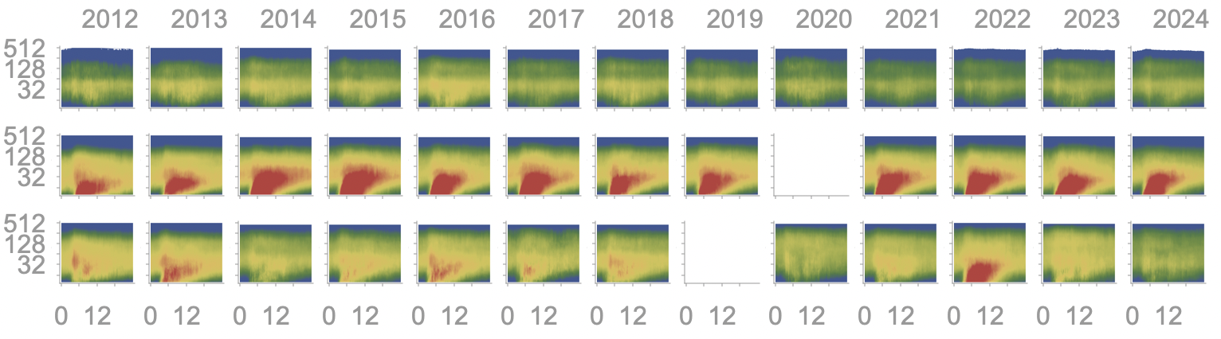
Seasonal diurnal trends
Year
D_{p}
[nm]
Wet (DJFM)
Dry (MJJA)
BB (SON)
Hours since sunrise

Slide 6
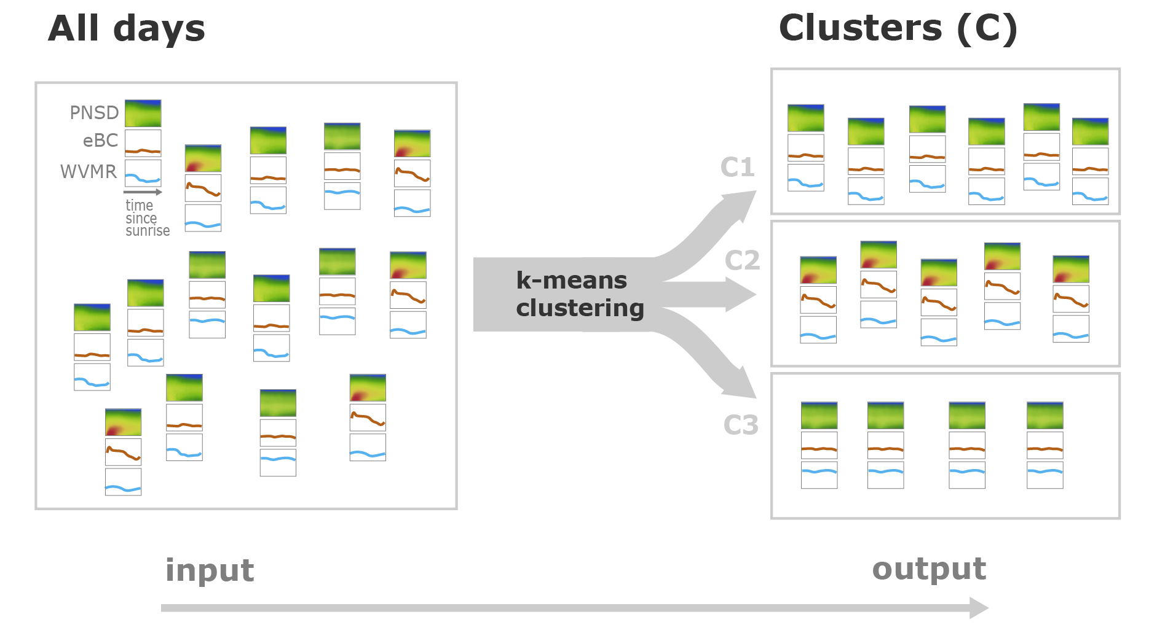
K-mean clustering scheme

Slide 7
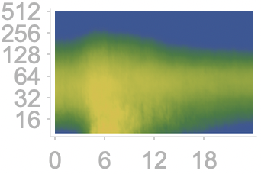
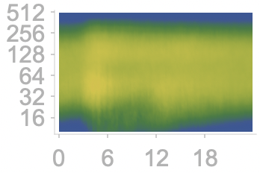
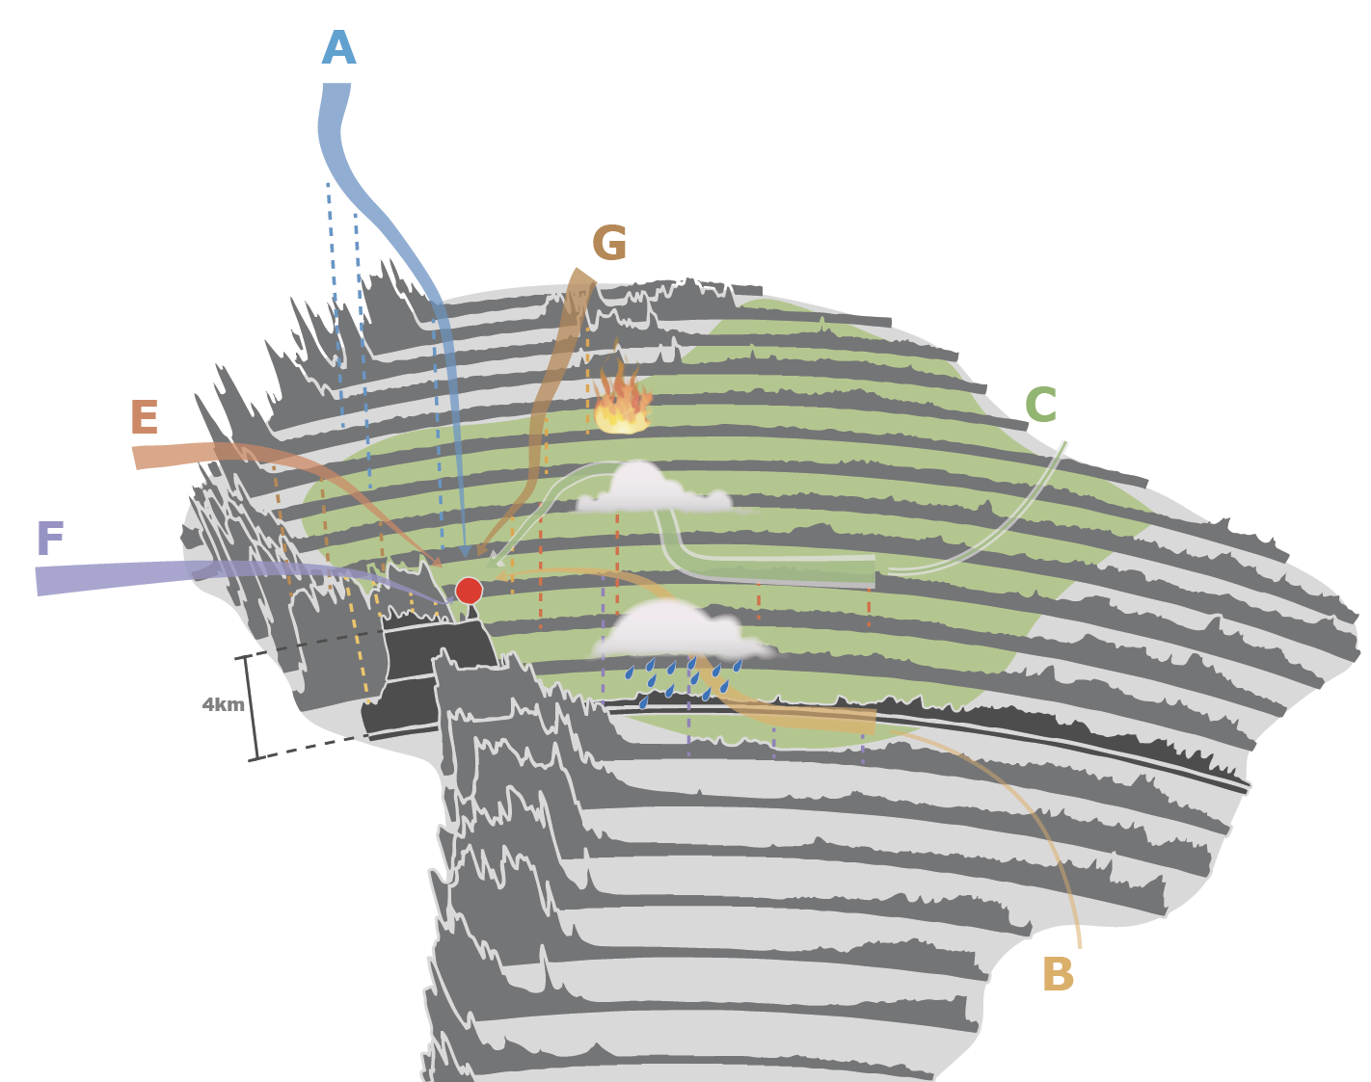
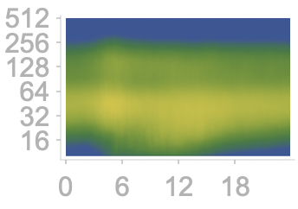
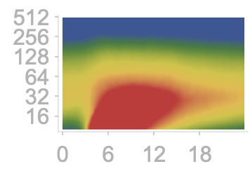
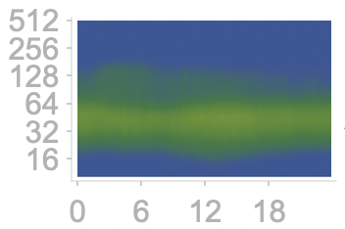
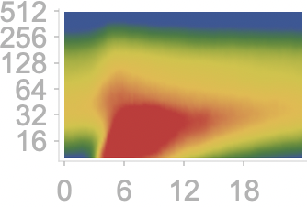

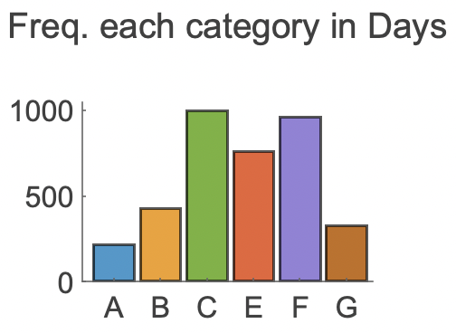

6 atmospheric regimes
D_{p}
[nm]
Hours since sunrise
F

Slide 8
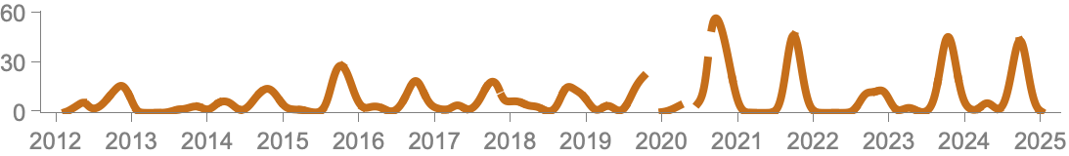
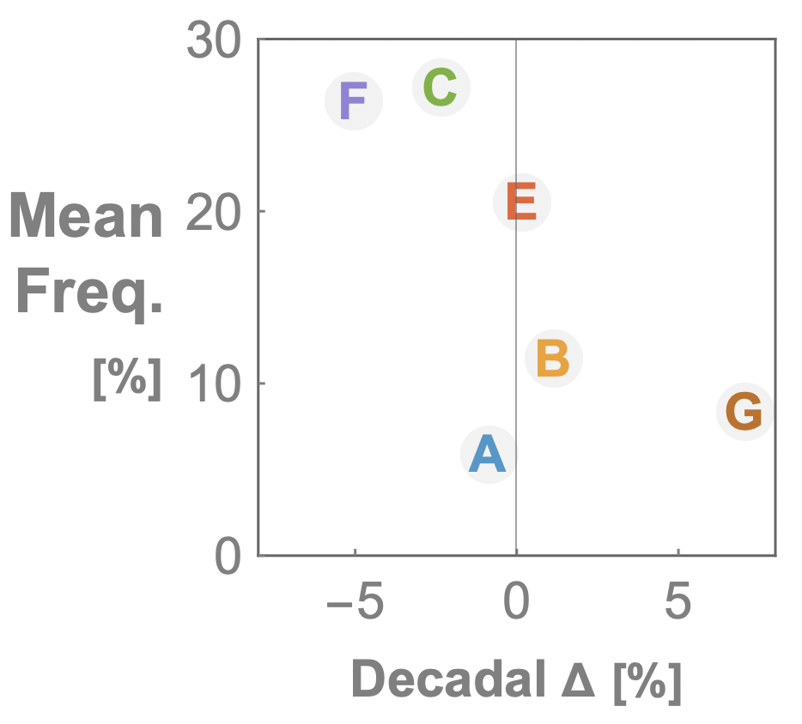
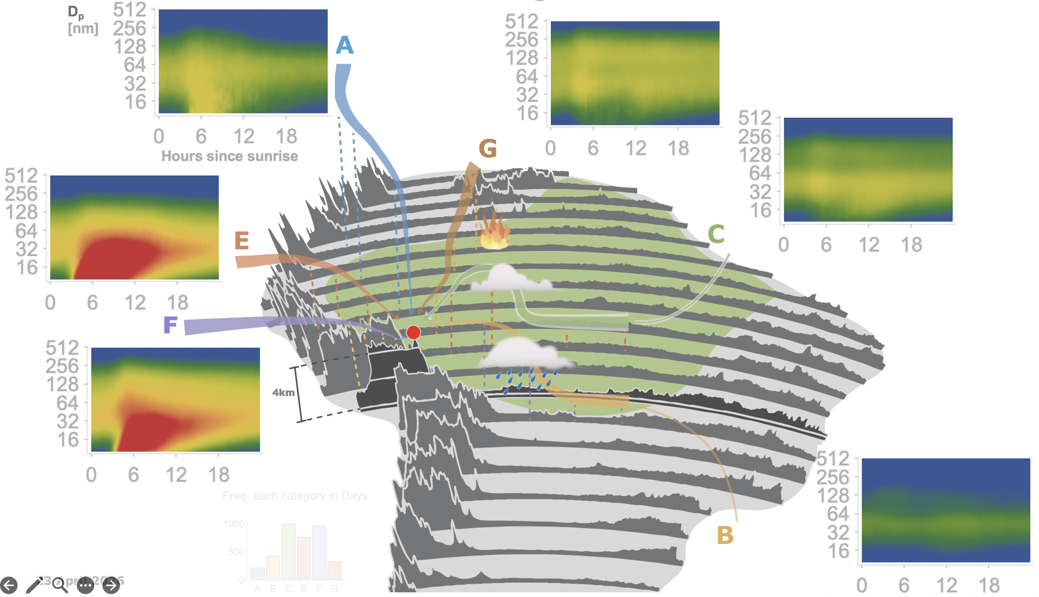

Trends in frequency
Frequency occurrence for G (BB)
Freq.
[%]
Year

Slide 9
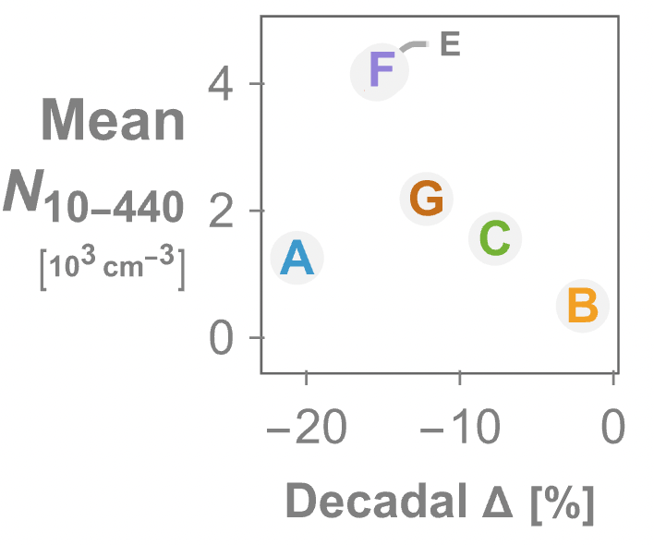
Trends in total concentration

Slide 10
Take home messages
Do we measure in the free troposphere ?
Can we detect any trends ?
What kind of atmospheric regimes and aerosol processes do we measure?
Yes, around 6% of the time
Yes
  Increase on BB freq.
  General reduction in N₁₀₋₄₄₀
    Specially in FT
6 distinct identified regimes with explainable differences

Slide 11
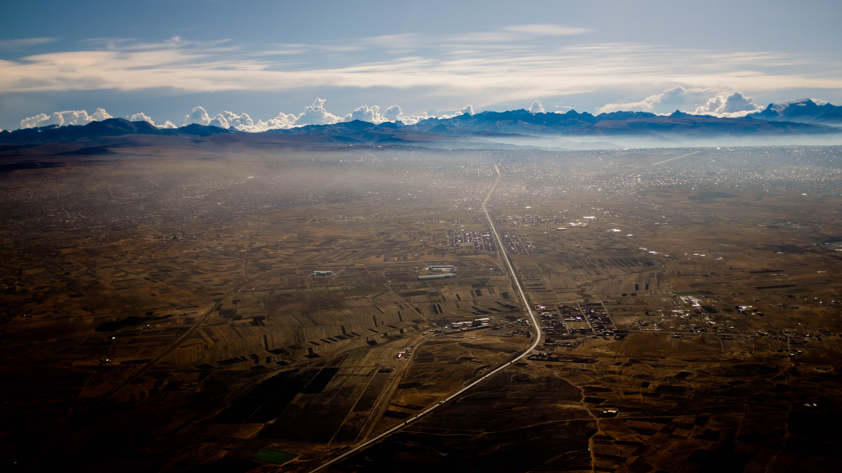
Thank you!
CHC

