Slide 1

EGU 2026 Ingra Barbosa
Supplementary Material

Slide 2
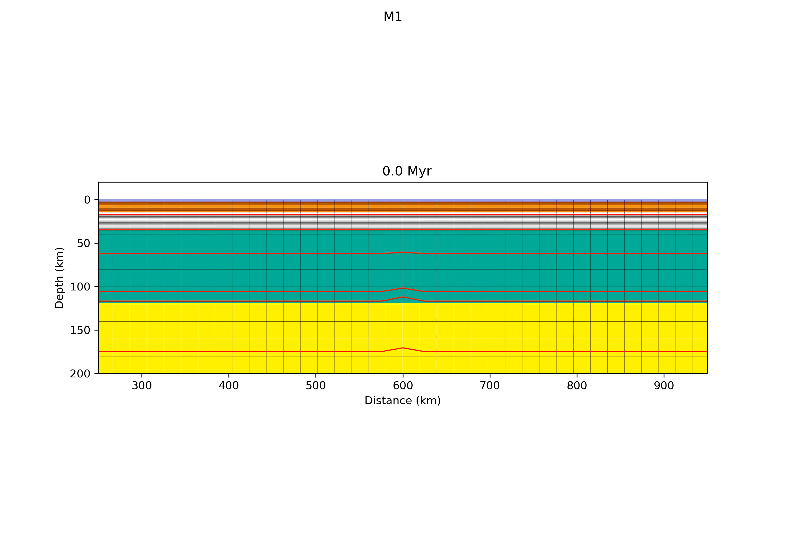
No Surface Processes

Slide 3
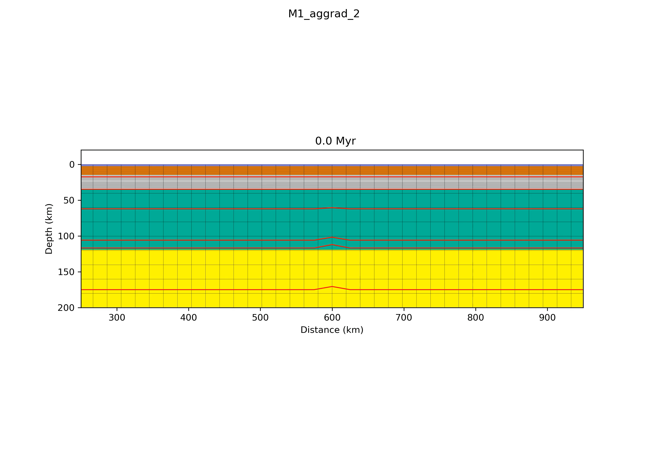
Aggradation

Slide 4

Progradation

