Slide 1


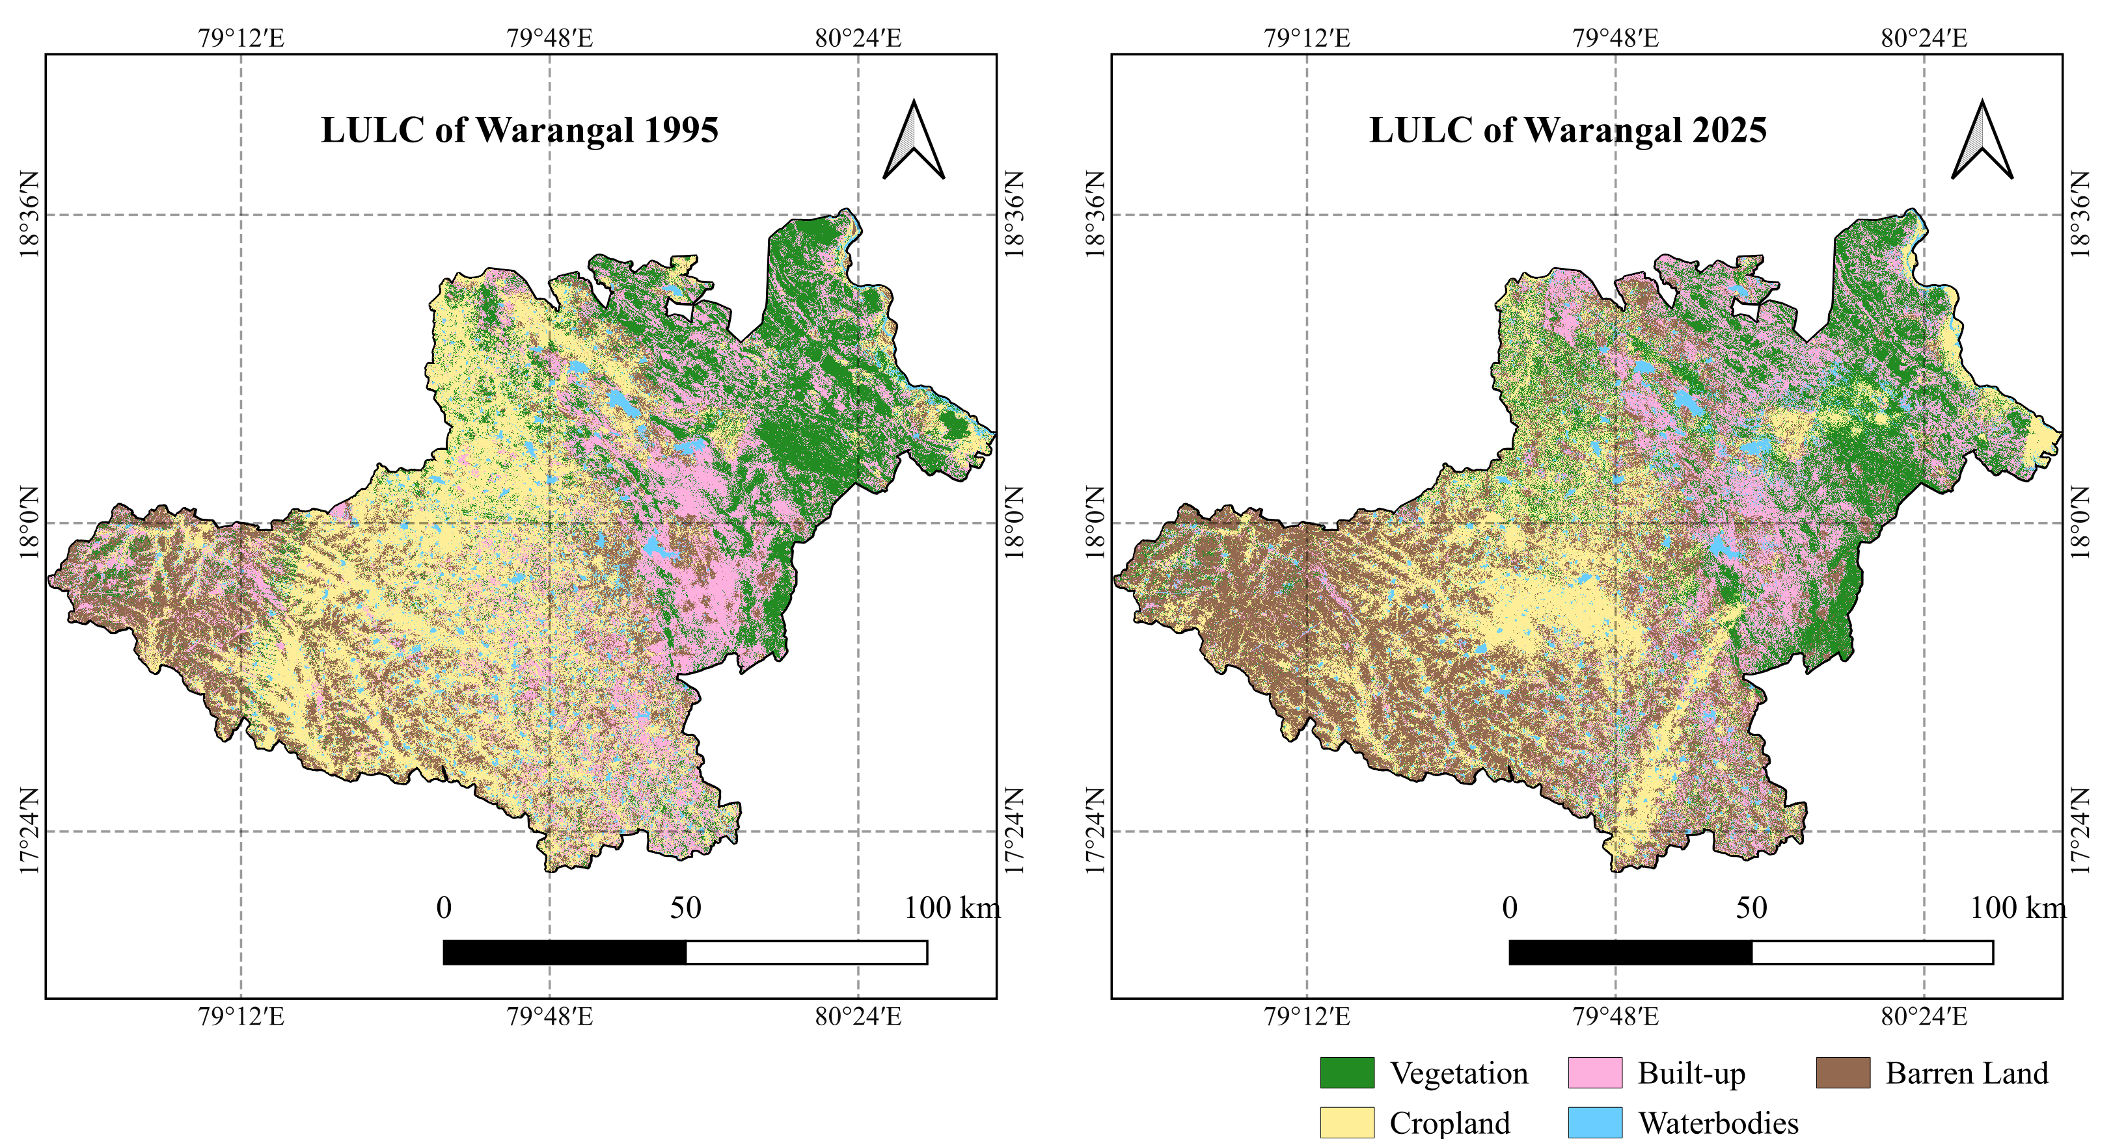
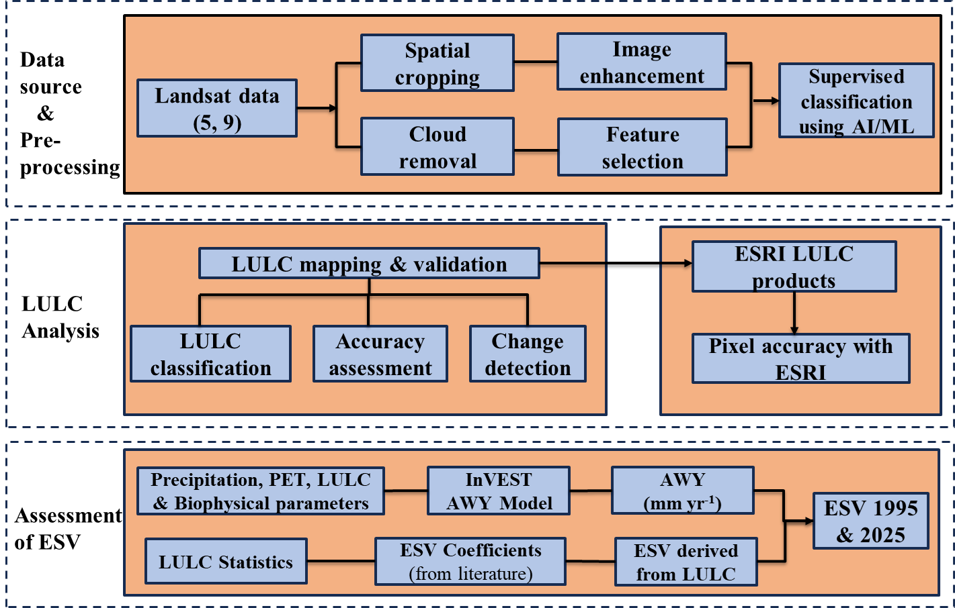
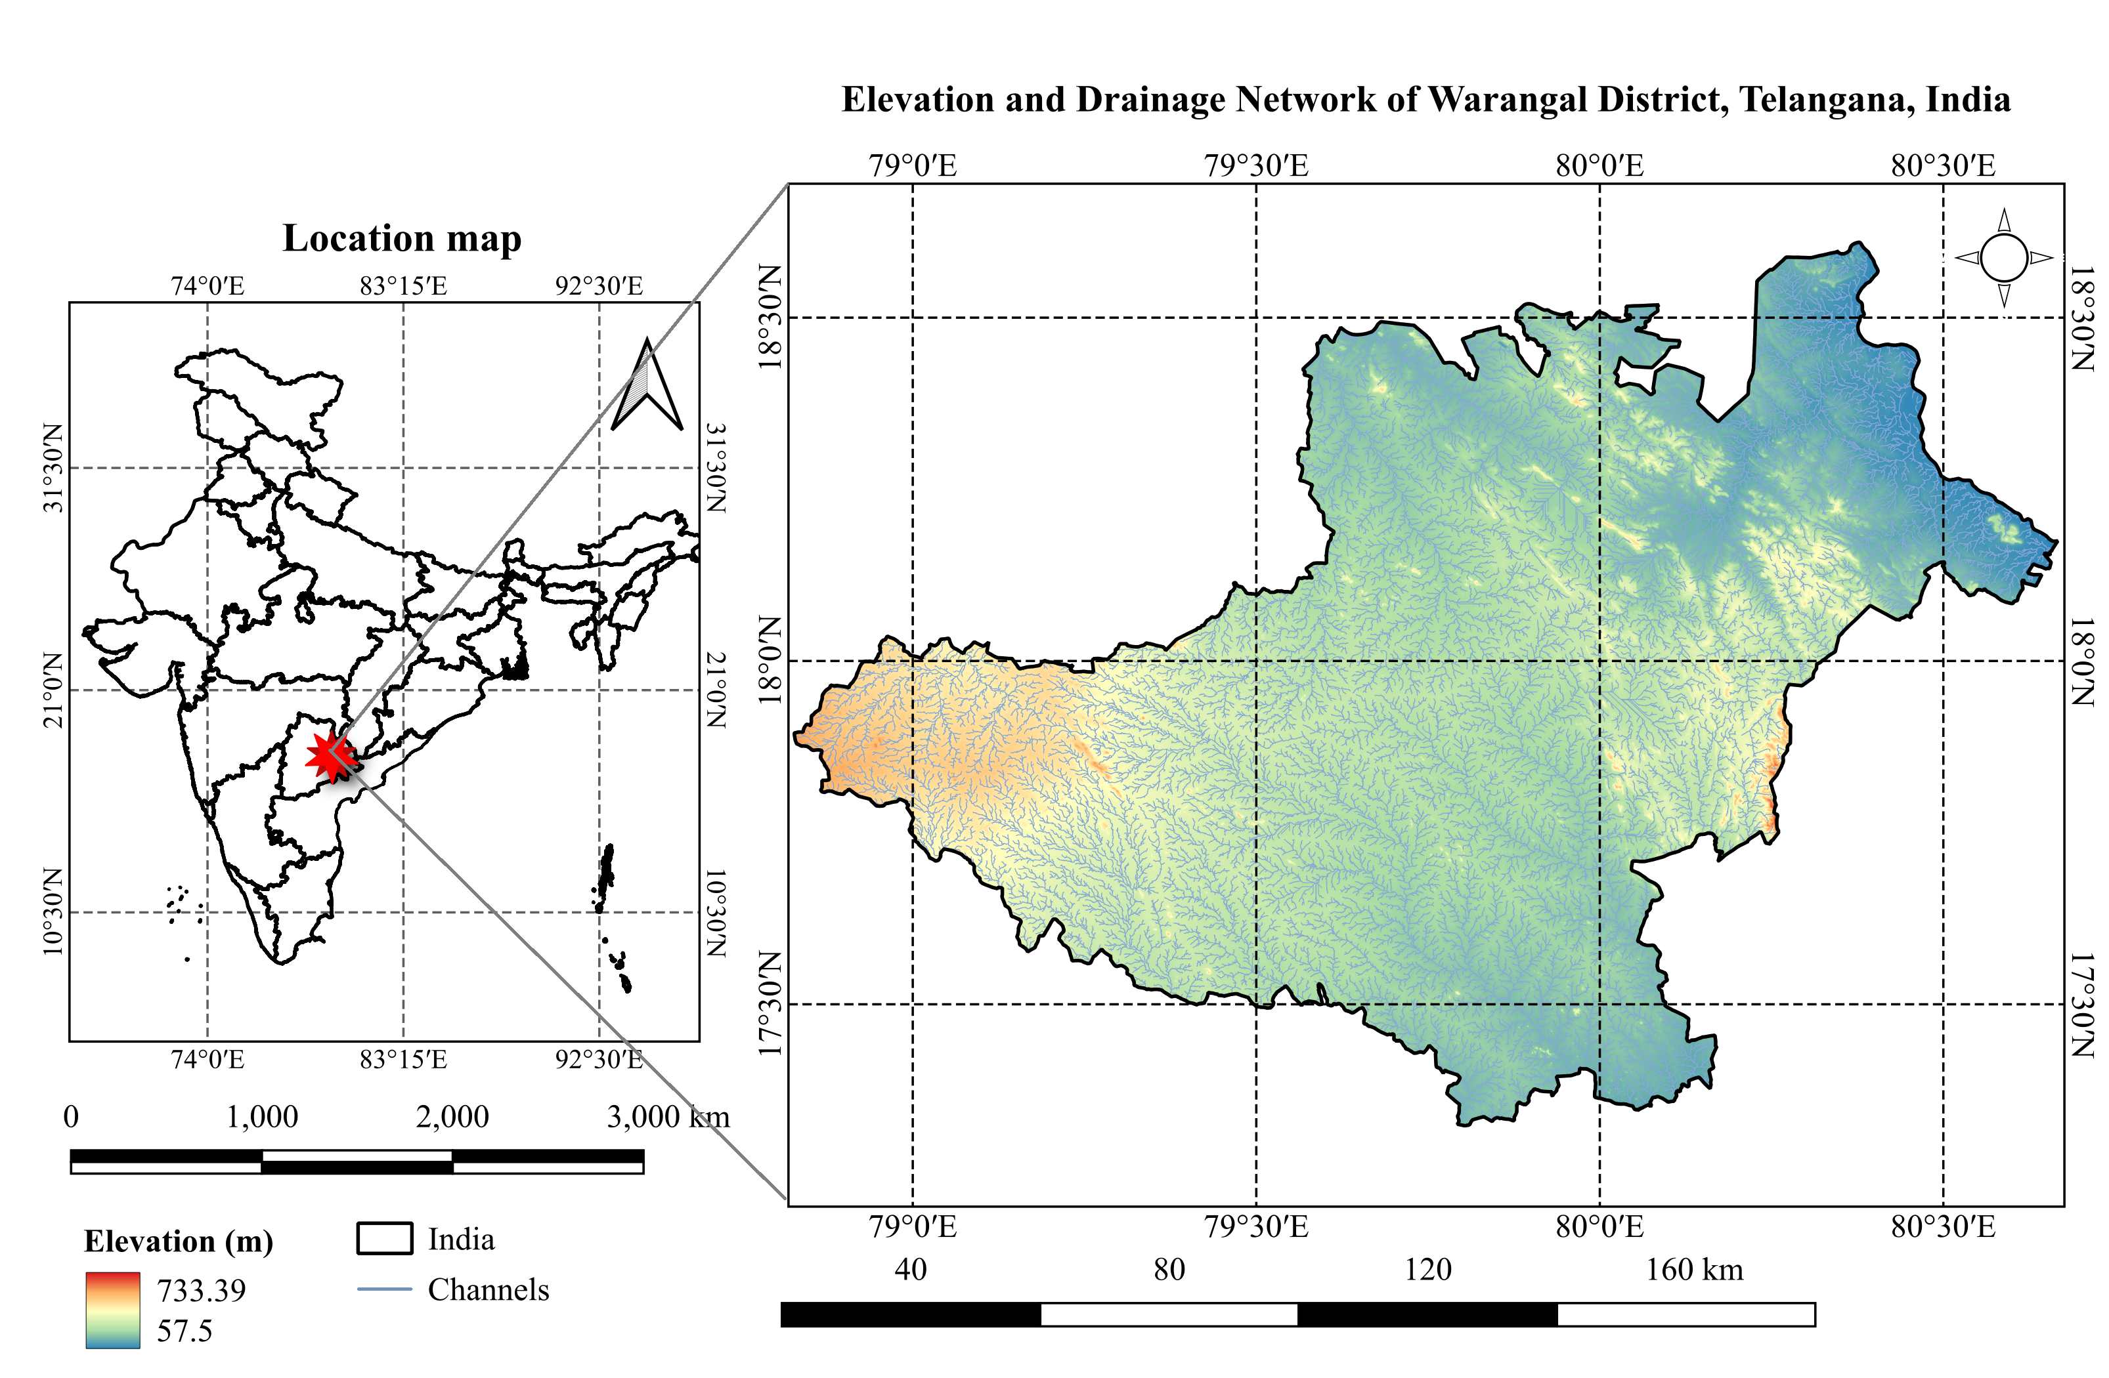
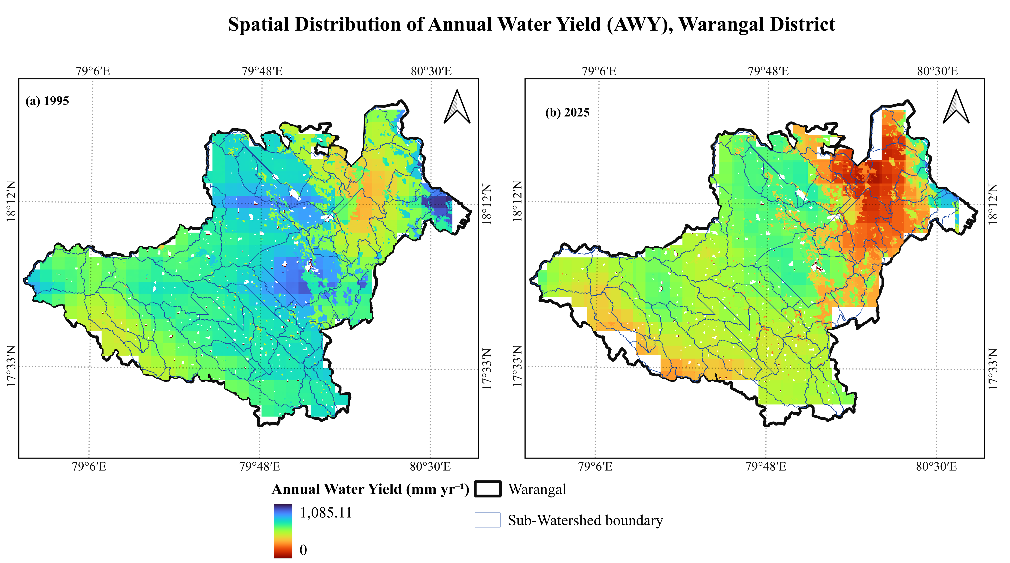
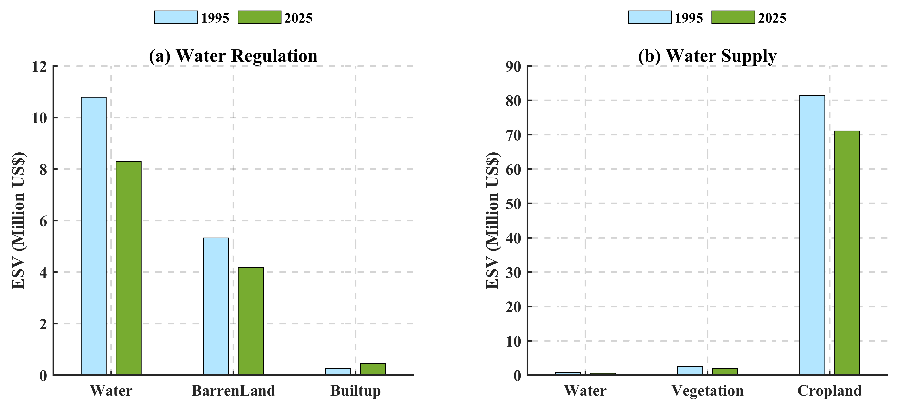

Ecohydrological Modelling of Annual Water Yield and Water-Related Ecosystem Services in the Semi-Arid Region of Warangal, India
Swetha Dasari¹, Manali Pal² and Venkata Reddy Keesara³ National Institute of Technology Warangal, India
Motivation
Methodology
Results
Urban landscapes are becoming more vulnerable to hydrological stress due to climatic variability and rapid metropolitan expansion. The watershed water balance in these areas is altered by declining precipitation, increasing evaporative demand, and land use transformation, which has significant effects on freshwater availability and ecosystem functionality. The quantity of water produced and held in a watershed is known as the Annual Water Yield (AWY), and it offers a useful framework for assessing these hydro-ecological changes. However, the majority of current research evaluates hydrological response at coarse spatial scales or overlooks the combined effects of land-use and climate controls on water-related ecosystem service values (ESV) at the watershed level (Dai et al., 2025). To address this gap, the current study integrates the InVEST Annual Water Yield model with ecosystem service valuation to quantify long-term changes in AWY and water-related ESV.
The InVEST Annual Water Yield (AWY) model is applied to sub-watersheds in the Warangal area for two-time steps: 1995 and 2025. Annual precipitation, potential evapotranspiration (PET), and LULC-derived biophysical factors are primary input drivers. LULC maps for both years are classified using supervised classification of Landsat data with AI/ML. Ecosystem service values (ESV) for water regulation and water supply are calculated using LULC and coefficients from Sannigrahi et al., 2019. Sensitivity analysis (elasticity, E) has been performed to quantify the relative response of AWY to changes in individual input parameters.
Rising PET combined with declining precipitation governed the overall temporal decline in AWY, with sensitivity analysis confirming precipitation as the dominant control (E=1.84), signifying that future climate variability will disproportionately dictate water yield dynamics across the district.
The negative sensitivity to Kc and root restricting depth highlights that urban expansion directly degrades hydrological functioning - not just through impervious surfaces but through loss of deep-rooted vegetation.
Study Area
The Warangal district is situated within the Godavari River Basin and the semi-arid Deccan Plateau in Telangana, India. The region is characterized by a hot semi-arid to tropical monsoonal climate with significant seasonality typified by prolonged dry spells, scorching summers, and a rainfall regime driven by the southwest monsoon. The study area is dominated by cropland and barren land, with expanding built-up areas concentrated around the urban core, while vegetation and surface water bodies are distributed across the peri-urban and rural sub-watersheds. This spatial heterogeneity makes Warangal a suitable case for evaluating long-term hydro-ecological change and water-related ecosystem service dynamics at sub-watershed scale.
Fig. 4. LULC classification of Warangal District using SVM algorithm (1995 & 2025)
Vegetation transitioned from a continuous north-eastern belt to fragmented patches by 2025, while built-up expanded from a single central core outward in multiple directions, squeezing cropland between urban sprawl and persistent barren land.
Fig. 2. Workflow of the InVEST Annual Water Yield (AWY) modelling framework used to assess water yield and water-related service values.
Results
LULC analysis reveals significant urban expansion across central sub-watersheds (1995-2025), with built-up area surging by +72.6%, at the expense of vegetation (-21.7%), waterbodies (-23.2%), and cropland (-12.7%), systematically undermining the district's natural capacity to sustain water-related ecosystem services.
The decline in mean AWY (718.51 to 476.36 mm yr⁻¹) over 30 years signals a critical reduction in freshwater availability in water-stressed semi-arid region.
Fig. 1. Study area showing (a) location of Warangal district within Telangana, India, and (b) elevation, drainage network of the study area.
Data Used
Fig. 5. Spatial Distribution of AWY, Warangal District (1995 & 2025)
The hydrological resilience of semi-arid watersheds is being quietly undermined - not by a single driver, but by the compounding interplay of climatic intensification and landscape transformation, manifesting as a 34% erosion in water yield, a systematic decline in ecosystem service value, and an accelerating disconnect between urban demand and freshwater supply.
The multi-temporal Landsat imagery for LULC, precipitation, evapotranspiration, Plant available water content (PAWC), root depth, biophysical parameters and seasonality factor (Z) are harmonized to a uniform resolution in this study.
Fig. 3. LULC-wise ESV for Water Regulation and Water Supply services, Warangal District
contact:
swethadasari529@gmail.com
manalipal000@gmail.com
kvreddy@nitw.ac.in
References:
Dai, X., Wang, L., Gong, J., Niu, Z., & Cao, Q. (2025). Extreme weather characteristics and influences on urban ecosystem services in Wuhan Urban Agglomeration. Geography and Sustainability, 6(1), 100201.
Sannigrahi, S., Chakraborti, S., Joshi, P. K., Keesstra, S., Sen, S., Paul, S. K., ... & Dang, K. B. (2019). Ecosystem service value assessment of a natural reserve region for strengthening protection and conservation. Journal of Environmental Management, 244, 208-227.

