Slide 1
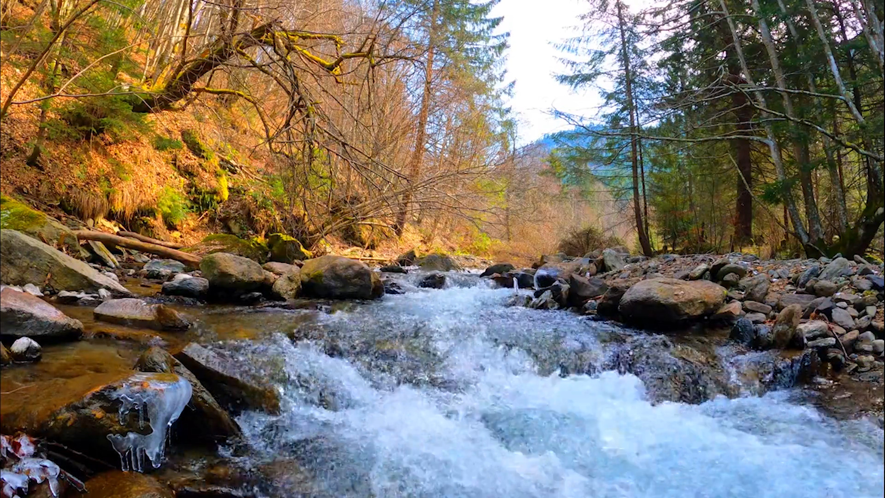


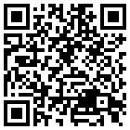



Accounting for human implementation uncertainties in the discovery of robust water supply infrastructure pathways using evolutionary multi-objective reinforcement learning (eMORL)
Lillian Lau, Patrick Reed, and David Gold
EGU General Assembly 2026 | May 5th
1
1
2
1
2
Cornell University, Utrecht University
Prev.
Home
Next

Slide 2


Supporting Information
WaterPaths | Research Triangle | Reinforcement Learning | Sampling Strategy | Decision Variable Use | Sensitivity Analysis

Slide 3
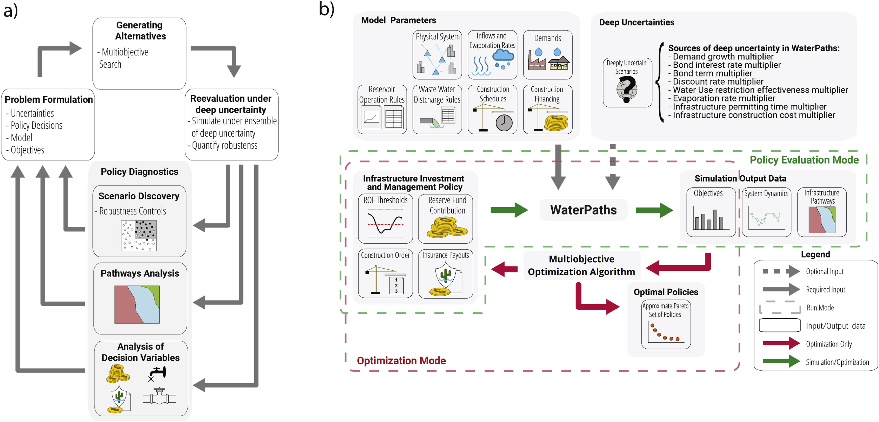
WaterPaths | Research Triangle | Reinforcement Learning | Sampling Strategy | Decision Variable Use | Sensitivity Analysis
The WaterPaths utility planning and management tool
A generalizable, open-source exploratory modeling tool
Identified coordinated planning and management policies for regionalized water utilities
Can account for a broad range of hydroclimatic and socioeconomic uncertainties.
Trindade et al. (2017)
Notes:
A generalizable, open-source exploratory modeling tool capable of identifying coordinated planning and management policies for regionalized of water utilities sharing water resources by accounting for a broad range of hydroclimatic and socioeconomic uncertainties.

Slide 4
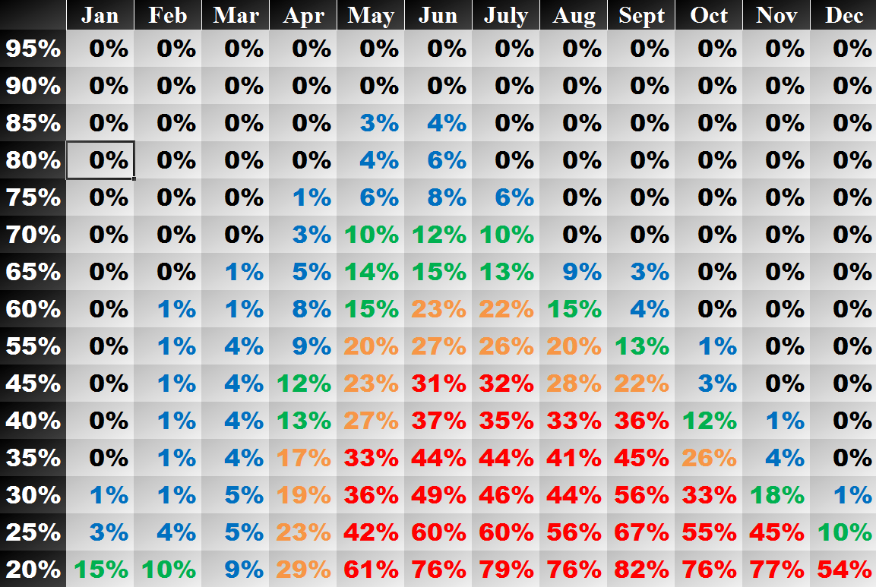
WaterPaths | Research Triangle | Reinforcement Learning | Sampling Strategy | Decision Variable Use | Sensitivity Analysis
The WaterPaths utility planning and management tool
Exploits dynamic and adaptive storage-to-capacity risk-of-failure (ROF) rules
Scales efficiently with the number of regional actors and their candidate actions.
Adapted from Trindade et al. (2017)
Notes:
Exploits dynamic and adaptive storage-to-capacity risk-of-failure (ROF) rules to trigger management and planning actions in temporally-consistent pathways
ROF rules reflect level of risk in the system

Slide 5
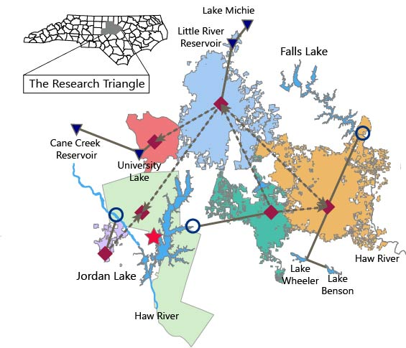
The North Carolina Research Triangle
WaterPaths | Research Triangle | Reinforcement Learning | Sampling Strategy | Decision Variable Use | Sensitivity Analysis
Population of over 2 million
10th fastest-growing region in the United States
Notes:
Regional cooperation enables the coordination of drought mitigation actions and the sharing of financial and supply resources

Slide 6
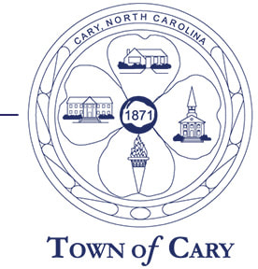
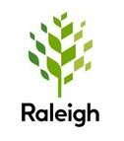




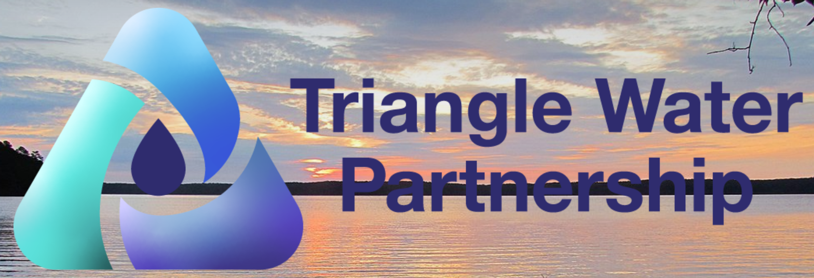
The North Carolina Research Triangle
WaterPaths | Research Triangle | Reinforcement Learning | Sampling Strategy | Decision Variable Use | Sensitivity Analysis
Population of over 2 million
10th fastest-growing region in the United States
$1 billion allocated for planned clean water and drinking infrastructure
Consists of three large and three medium water utilities cooperating via the Triangle Water Partnership
Notes:
Regional cooperation enables the coordination of drought mitigation actions and the sharing of financial and supply resources

Slide 7
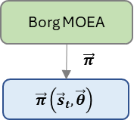
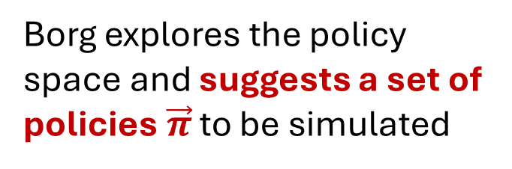
Baseline evolutionary multi-objective reinforcement learning (eMORL) methods can discover robust, high-performing pathway strategies
WaterPaths | Research Triangle | Reinforcement Learning | Sampling Strategy | Decision Variable Use | Sensitivity Analysis
Borg explores the policy space and suggests a set of policies $\vec{π}$ to be simulated

Slide 8
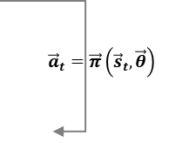

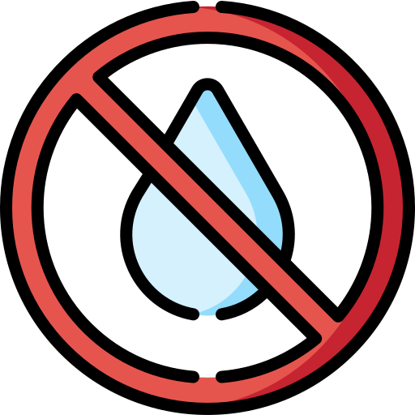
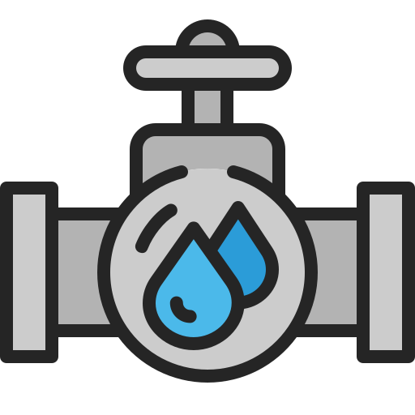

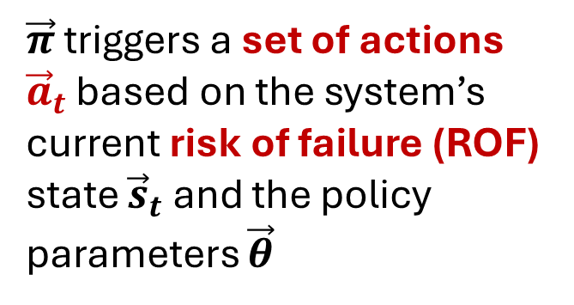
Baseline evolutionary multi-objective reinforcement learning (eMORL) methods can discover robust, high-performing pathway strategies
WaterPaths | Research Triangle | Reinforcement Learning | Sampling Strategy | Decision Variable Use | Sensitivity Analysis
$\vec{π}$ triggers a set of actions ${\vec{a}}_{t}$ based on the system’s current risk of failure (ROF) state ${\vec{s}}_{t}$ and the policy parameters $\vec{θ}$
Water-use restrictions
(RT)
Treated transfers
(TT)
Infrastructure construction
(INF)

Slide 9
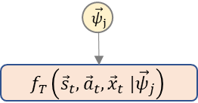

Baseline evolutionary multi-objective reinforcement learning (eMORL) methods can discover robust, high-performing pathway strategies
WaterPaths | Research Triangle | Reinforcement Learning | Sampling Strategy | Decision Variable Use | Sensitivity Analysis
DU SOW $j$
Actions and deep uncertainties force system (environment) changes
WaterPaths
WaterPaths

Slide 10
Baseline evolutionary multi-objective reinforcement learning (eMORL) methods can discover robust, high-performing pathway strategies
WaterPaths | Research Triangle | Reinforcement Learning | Sampling Strategy | Decision Variable Use | Sensitivity Analysis
Actions and deep uncertainties force system (environment) changes
WaterPaths
Deep Uncertainty (DU)
Stakeholders do not know or agree on:
A system model and its relationships
Probability distributions
Preference ranking

Slide 11
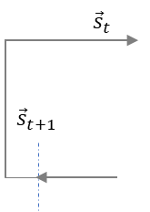
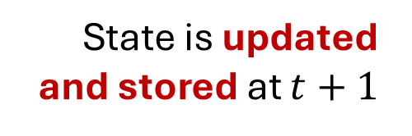
Baseline evolutionary multi-objective reinforcement learning (eMORL) methods can discover robust, high-performing pathway strategies
WaterPaths | Research Triangle | Reinforcement Learning | Sampling Strategy | Decision Variable Use | Sensitivity Analysis
State is updated and stored at $t+1$
WaterPaths
WaterPaths

Slide 12
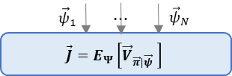

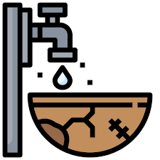



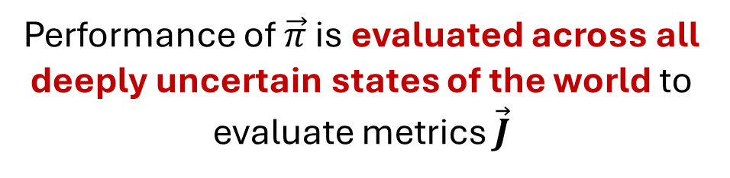
Baseline evolutionary multi-objective reinforcement learning (eMORL) methods can discover robust, high-performing pathway strategies
WaterPaths | Research Triangle | Reinforcement Learning | Sampling Strategy | Decision Variable Use | Sensitivity Analysis
WaterPaths
WaterPaths
Performance of $\vec{π}$ is evaluated across all deeply uncertain states of the world to evaluate metrics $\vec{J}$

Slide 13
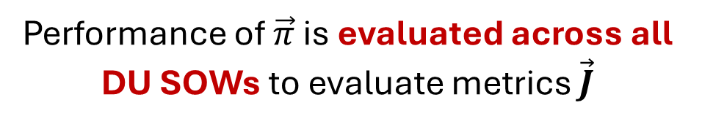
Baseline evolutionary multi-objective reinforcement learning (eMORL) methods can discover robust, high-performing pathway strategies
WaterPaths | Research Triangle | Reinforcement Learning | Sampling Strategy | Decision Variable Use | Sensitivity Analysis
WaterPaths
WaterPaths
Performance of $\vec{π}$ is evaluated across all DU SOWs to evaluate metrics $\vec{J}$

Slide 14
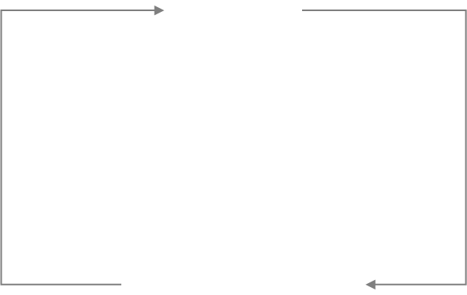
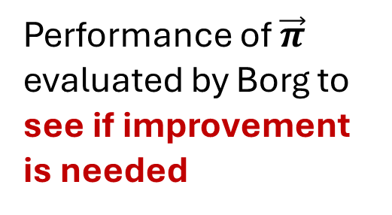
Baseline evolutionary multi-objective reinforcement learning (eMORL) methods can discover robust, high-performing pathway strategies
WaterPaths | Research Triangle | Reinforcement Learning | Sampling Strategy | Decision Variable Use | Sensitivity Analysis
Performance of $\vec{π}$ evaluated by Borg to see if improvement is needed
WaterPaths
WaterPaths

Slide 15

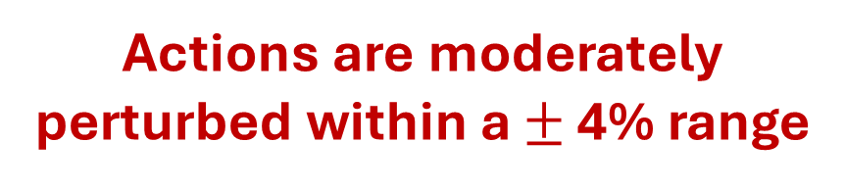




Pathway strategies are perturbed prior to evaluating them across each potential future state of the world
WaterPaths | Research Triangle | Reinforcement Learning | Sampling Strategy | Decision Variable Use | Sensitivity Analysis
$${\tilde{π}}_{ND}$$
$${\vec{π}}_{ND}$$
$${\tilde{π}}_{ND}$$
Water-use restrictions
(RT)
Treated transfers
(TT)
Infrastructure construction
(INF)
$$⋯$$
$${\tilde{π}}_{ND}$$
Actions are moderately perturbed within a $±$ 4% range

Slide 16








Pathway strategies are perturbed prior to evaluating them across each potential future state of the world
WaterPaths | Research Triangle | Reinforcement Learning | Sampling Strategy | Decision Variable Use | Sensitivity Analysis
$${\tilde{π}}_{ND}$$
$${\vec{ψ}}_{1}$$
$${\vec{x}}_{1}$$
$${\vec{ψ}}_{2}$$
DU State of the World (SOW)
$${\vec{π}}_{ND}$$
$${\tilde{π}}_{ND}$$
$${\vec{x}}_{2}$$
$$⋯$$
$$⋯$$
$$⋯$$
$${\tilde{π}}_{ND}$$
$${\vec{ψ}}_{N}$$
$${\vec{x}}_{N}$$

Slide 17

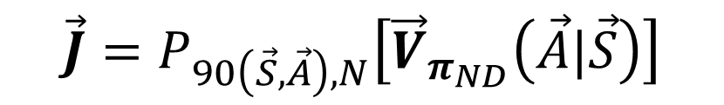


Pathway strategies are perturbed prior to evaluating them across each potential future state of the world
WaterPaths | Research Triangle | Reinforcement Learning | Sampling Strategy | Decision Variable Use | Sensitivity Analysis
$${\tilde{π}}_{ND}$$
$${\vec{ψ}}_{1}$$
$${\vec{x}}_{1}$$
$${\vec{π}}_{ND}$$
$${\tilde{π}}_{ND}$$
$${\vec{ψ}}_{2}$$
$$\vec{J}=P_{90\left(\vec{S},\vec{A}\right),N}\left[{\vec{V}}_{π_{ND}}\left(\vec{A}|\vec{S}\right)\right]$$
$${\vec{x}}_{2}$$
$$⋯$$
$$⋯$$
$$⋯$$
$${\tilde{π}}_{ND}$$
$${\vec{ψ}}_{N}$$
$${\vec{x}}_{N}$$

Slide 18
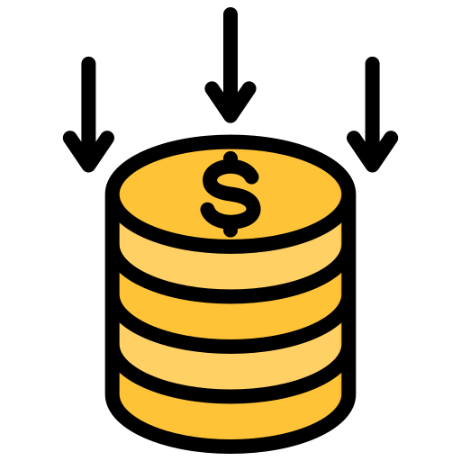
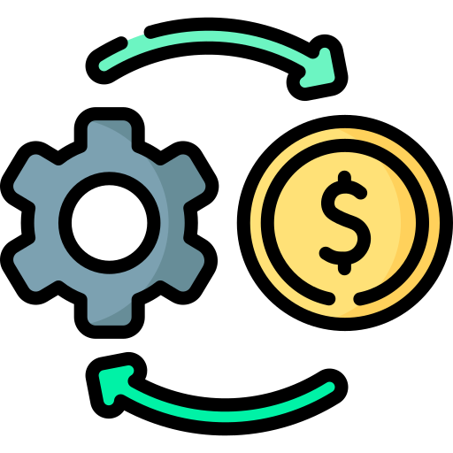
Pathway strategies are perturbed prior to evaluating them across each potential future state of the world
WaterPaths | Research Triangle | Reinforcement Learning | Sampling Strategy | Decision Variable Use | Sensitivity Analysis
$${\tilde{π}}_{ND}$$
$${\vec{ψ}}_{1}$$
$${\vec{x}}_{1}$$
Reliability
Restriction freq.
Peak financial cost
$${\tilde{π}}_{ND}$$
$${\vec{ψ}}_{2}$$
$$\vec{J}=P_{90\left(\vec{S},\vec{A}\right),N}\left[{\vec{V}}_{π_{ND}}\left(\vec{A}|\vec{S}\right)\right]$$
$${\vec{x}}_{2}$$
$$⋯$$
$$⋯$$
$$⋯$$
Drought mitigation cost
Infrastructure NPC
$${\tilde{π}}_{ND}$$
$${\vec{ψ}}_{N}$$
$${\vec{x}}_{N}$$

Slide 19

WaterPaths | Research Triangle | Reinforcement Learning | Sampling Strategy | Decision Variable Use | Sensitivity Analysis
The IU pathway strategies better adapt to expected and challenging conditions by utilizing their full suite of planning and management tools
Three trigger-based actions
IU strategies’ distribution of actions
Water-use restrictions (RT)
Inter-utility water transfers (TT)
More strategies
Baseline strategies’ distribution of actions
Infrastructure construction (INF)
Increased use of action

Slide 20
WaterPaths | Research Triangle | Reinforcement Learning | Sampling Strategy | Decision Variable Use | Sensitivity Analysis
The adaptation is enabled by the frequent use of cooperative treated transfers and infrastructure investments
Watertown
Dryville
Fallsland
Infrastructure investments
More IU pathway strategies invest in new infrastructure to hedge against future extremes and uncertainties in their counterparts’ actions

Slide 21
WaterPaths | Research Triangle | Reinforcement Learning | Sampling Strategy | Decision Variable Use | Sensitivity Analysis
The adaptation is enabled by the frequent use of cooperative treated transfers and infrastructure investments
Watertown
Dryville
Fallsland
Infrastructure investments
These strategies are also more cooperative in the long term, collaborating on shared infrastructure investments

Slide 22
WaterPaths | Research Triangle | Reinforcement Learning | Sampling Strategy | Decision Variable Use | Sensitivity Analysis
The adaptation is enabled by the frequent use of cooperative treated transfers and infrastructure investments
Watertown
Dryville
Fallsland
IU pathway strategies simultaneously allow utilities to cooperate in the short-term via selling or buying treated transfers
Infrastructure investments
Treated transfers
Notes:
Unlike the baseline set of strategies where Fallsland relies primarily on infrastructure investments, the IU set of strategies actively use both weekly transfer purchases and long-term infrastructure investments

Slide 23
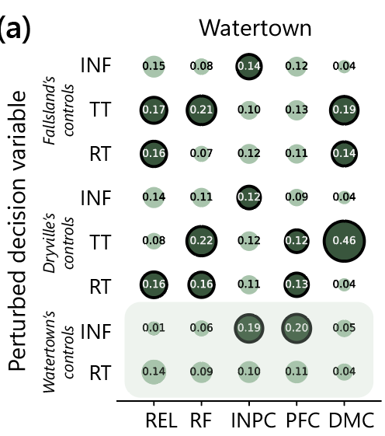
WaterPaths | Research Triangle | Reinforcement Learning | Sampling Strategy | Decision Variable Use | Sensitivity Analysis
Individual utilities’ baseline strategy performance is highly dependent on their partners’ precise implementation of cooperative actions
Watertown’s performance is highly dependent Dryville and Fallsland’s ability to accurately implement their cooperative actions
Notes:
Watertown’s drought mitigation cost is disproportionately influenced by Dryville’s use of treated transfers
An unexpected change in how frequently Dryville buys treated transfers can result in Watertown having insufficient supply for its own customers

Slide 24
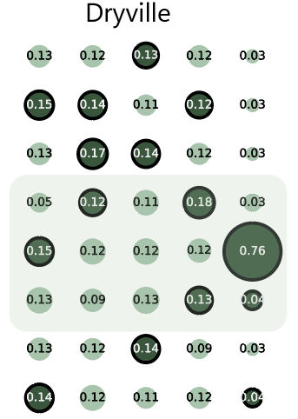
WaterPaths | Research Triangle | Reinforcement Learning | Sampling Strategy | Decision Variable Use | Sensitivity Analysis
Individual utilities’ baseline strategy performance is highly dependent on their partners’ precise implementation of cooperative actions
With access to its own resources, Dryville has reduced sensitivity to others’ actions, but still exhibits limited vulnerability to implementation uncertainty
Notes:
Dryville only cooperates via treated transfers, but “competes” with Fallsland for purchased treated transfers from Watertown
Failing to account for implementation uncertainty exposes it to risks that arise from Fallsland’s imperfect implementation of its short-term management action

Slide 25
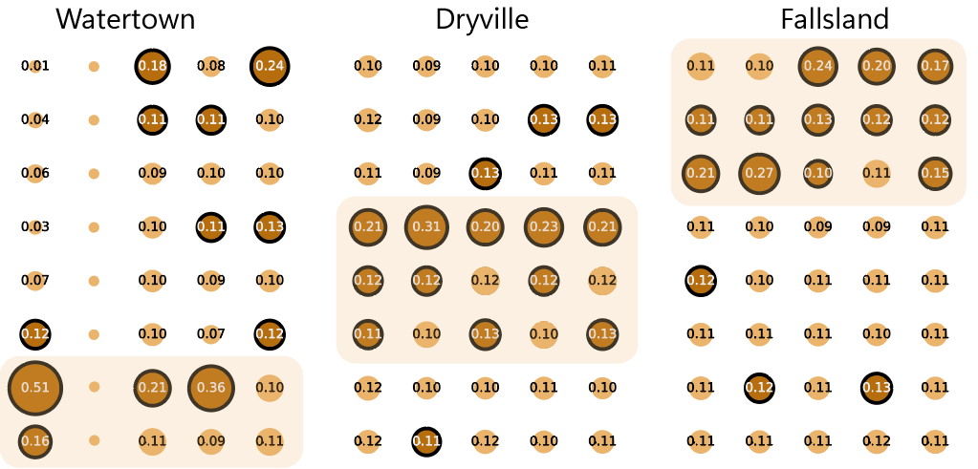
WaterPaths | Research Triangle | Reinforcement Learning | Sampling Strategy | Decision Variable Use | Sensitivity Analysis
The IU strategy affords utilities better control over their individual performance, reducing vulnerability to implementation uncertainty
Watertown’s performance change is primarily driven by perturbations in its own actions
Notes:
Unlike in the baseline strategy, Watertown’s performance is primarily sensitive to implementation uncertainty in its own actions

Slide 26
WaterPaths | Research Triangle | Reinforcement Learning | Sampling Strategy | Decision Variable Use | Sensitivity Analysis
The IU strategy affords utilities better control over their individual performance, reducing vulnerability to implementation uncertainty
Accounting for implementation uncertainty affords Dryville more control over its own performance and minimal exposure to its other partners’ actions
Notes:
We see a similar pattern with Dryville, where sensitivity to implementation uncertainty is corralled within its “region of control”
This means that Dryville has more agency over its own performance, even when its other cooperating partners fail to implement their strategies accurately

