Slide 1
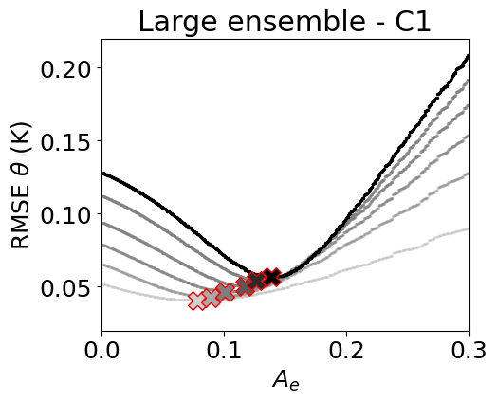
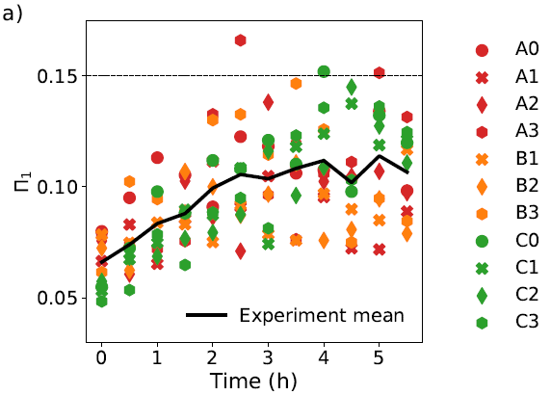
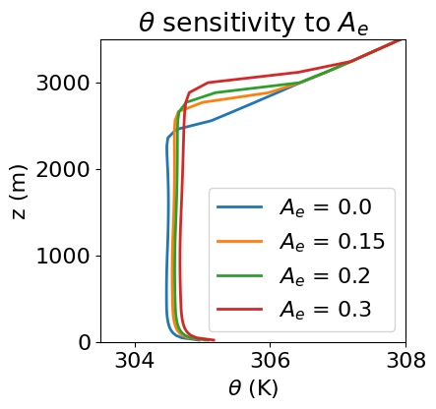
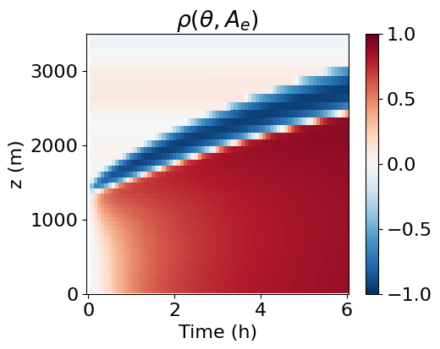
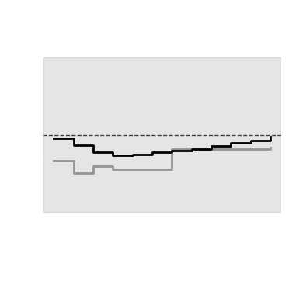
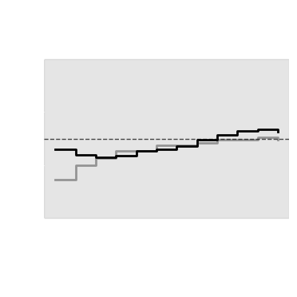
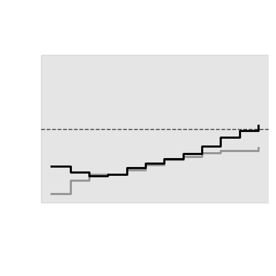
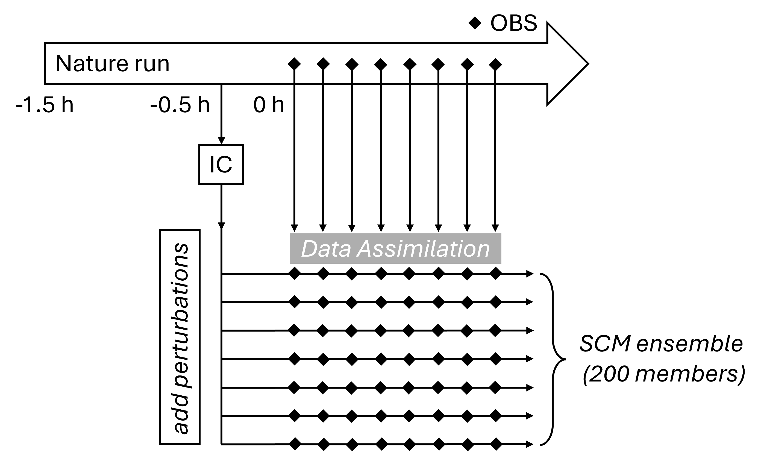
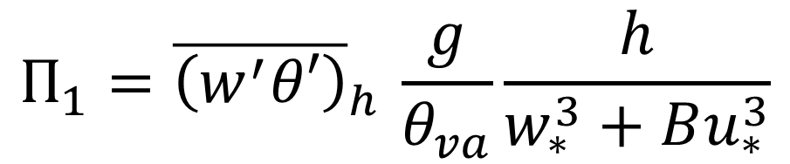
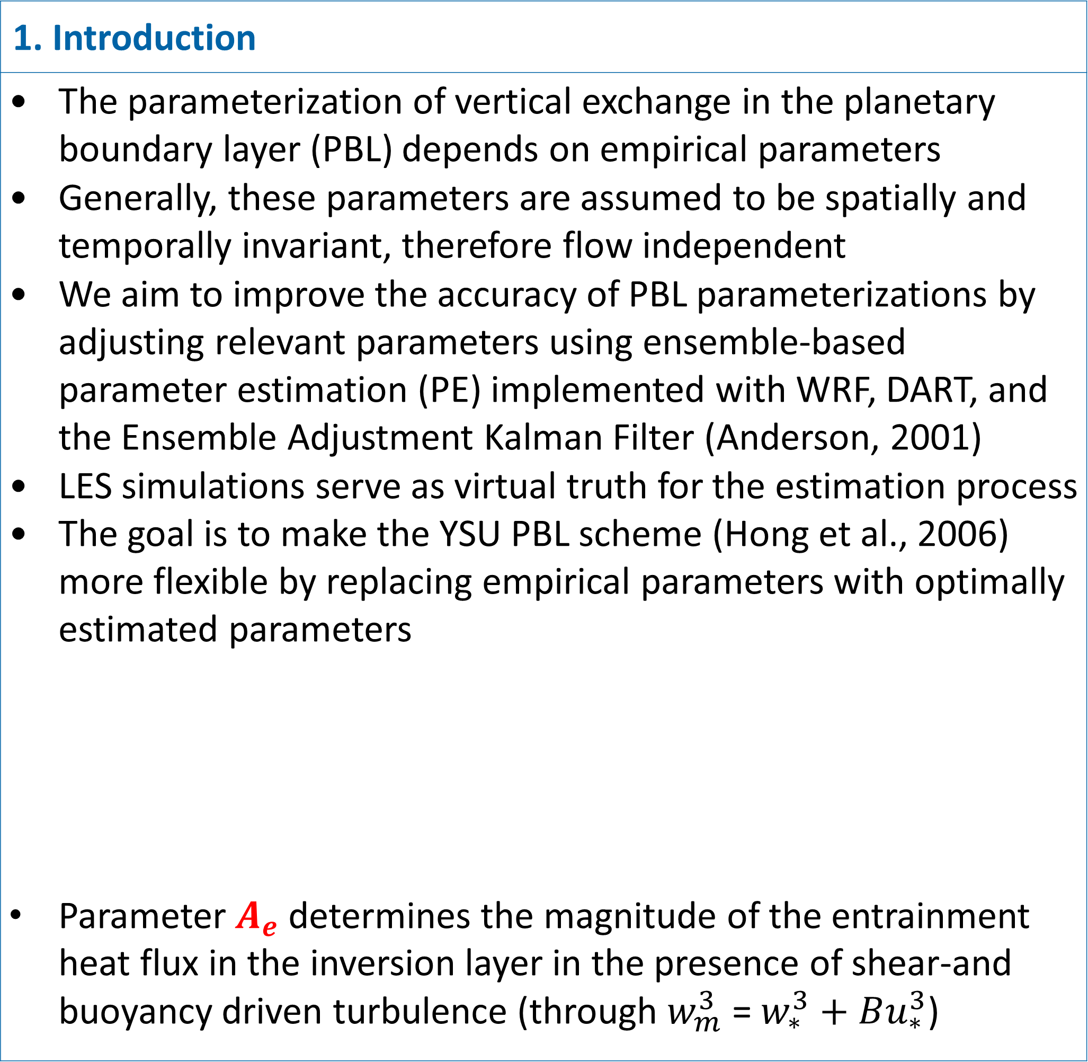
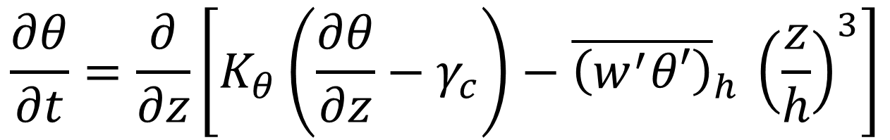
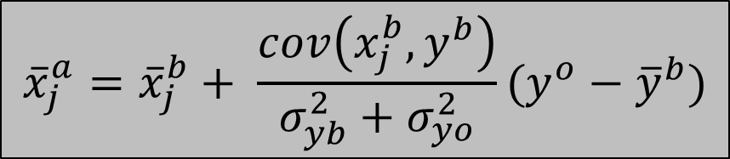
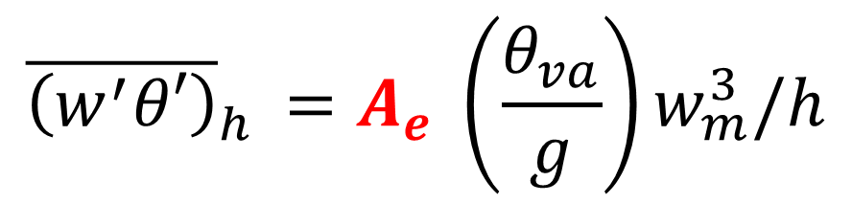
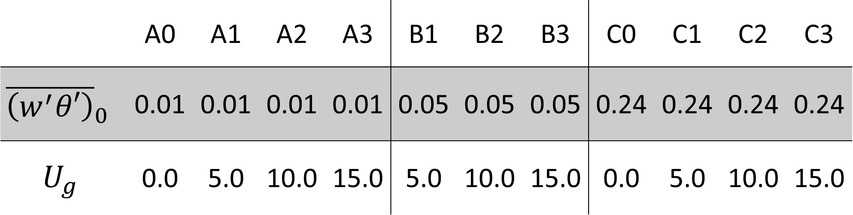
1. Introduction
The parameterization of vertical exchange in the planetary boundary layer (PBL) depends on empirical parameters Generally, these parameters are assumed to be spatially and temporally invariant, therefore flow independent We aim to improve the accuracy of PBL parameterizations by adjusting relevant parameters using ensemble-based parameter estimation (PE) implemented with WRF, DART, and the Ensemble Adjustment Kalman Filter (Anderson, 2001) LES simulations serve as virtual truth for the estimation process The goal is to make the YSU PBL scheme (Hong et al., 2006) more flexible by replacing empirical parameters with optimally estimated parameters Parameter $A_{e}$ determines the magnitude of the entrainment heat flux in the inversion layer in the presence of shear-and buoyancy driven turbulence (through $w_{m}^{3}$ = $w_{∗}^{3}+Bu_{∗}^{3}$)
X5.68
3. Optimal parameters are flow-dependent
Free ensemble runs are conducted with N=1000 ensemble members and perturbed parameters The temporal evolution of the RMSE between LES and ensemble runs is shown The temporal shift in RMSE minima suggests that parameterization accuracy would benefit from progressively adjusting the parameter
Compensating structural errors in entrainment parameterizations with ensemble-based parameter estimation
$$\frac{∂θ}{∂t}=\frac{∂}{∂z}\left[K_{θ}\left(\frac{∂θ}{∂z}−γ_{c}\right)−{\overline{\left(w^{′}θ′\right)}}_{h }{\left(\frac{z}{h}\right)}^{3}\right]$$
(EQ. 1)
Magdalena Fritz^{1,*}, Stefano Serafin^{1,*}, Martin Weissmann¹
¹Department of Meteorology and Geophysics, University of Vienna, Austria
m.fritz@univie.ac.at
* Contribution to this research was funded by the Austrian Science Fund (FWF), grant DOI: 10.55776/P37259
$${\overline{\left(w^{′}θ′\right)}}_{h }=A_{e} \left(\frac{θ_{va}}{g}\right)w_{m}^{3}/h$$
(EQ. 2)
4. Verifying the closure assumption with LES data
Derive a dimensionless entrainment rate from EQ. 2 and evaluate it from LES output:
A) We use LES of free and forced convection in the PBL as virtual truth and objectively determine the optimal value of the parameter that controls the entrainment rate at the top of the PBL in a first-order turbulence parameterization for km-scale simulations (see Box 1).
2. Performing PE in an ensemble DA framework
(LHS): Higher/lower A_{e} implies stronger/weaker downward heat flux and creates a deeper/shallower PBL (RHS): State-parameter correlations provide an initial assessment whether a parameter is detectable with PE We perform idealized data assimilation experiments:
$$Π_{1}={\overline{\left(w^{′}θ′\right)}}_{h }\frac{g}{θ_{va}}\frac{h}{w_{∗}^{3}+Bu_{∗}^{3}}$$
(EQ. 4)
B) The process is based on the EAKF, which adjusts parameter values using ensemble covariances (see Box 2).
C.1) Optimal parameter values are found to be flow-dependent (see Box 3).
LES data indicate that no universal parameter value leads to an accurate closure of the entrainment heat flux.
 | A0 | A1 | A2 | A3 | B1 | B2 | B3 | C0 | C1 | C2 | C3
$${\overline{\left(w^{′}θ′\right)}}_{0 }$$ | 0.01 | 0.01 | 0.01 | 0.01 | 0.05 | 0.05 | 0.05 | 0.24 | 0.24 | 0.24 | 0.24
$$U_{g}$$ | 0.0 | 5.0 | 10.0 | 15.0 | 5.0 | 10.0 | 15.0 | 0.0 | 5.0 | 10.0 | 15.0
$${\overline{x}}_{j}^{a}={\overline{x}}_{j}^{b}+ \frac{cov\left(x_{j}^{b},y^{b}\right)}{σ_{yb}^{2}+σ_{yo}^{2}}(y^{o}−{\overline{y}}^{b})$$
(EQ.3)
C.2) Variations in the optimal parameters compensate for errors in the entrainment closure assumption (see Box 4).
Tab. Configurations of nature runs (dry simulations). (Noh et al., 2003)
References
Anderson, J. L., 2001: An Ensemble Adjustment Kalman Filter for Data Assimilation. Mon. Wea. Rev., 129, 2884–2903, https://doi.org/10.1175/1520-0493(2001)129<2884:AEAKFF>2.0.CO;2. Hong, et al., 2006: A New Vertical Diffusion Package with an Explicit Treatment of Entrainment Processes. Mon. Wea. Rev., 134, 2318-2341, http://dx.doi.org/10.1175/MWR3199.1

