Slide 1
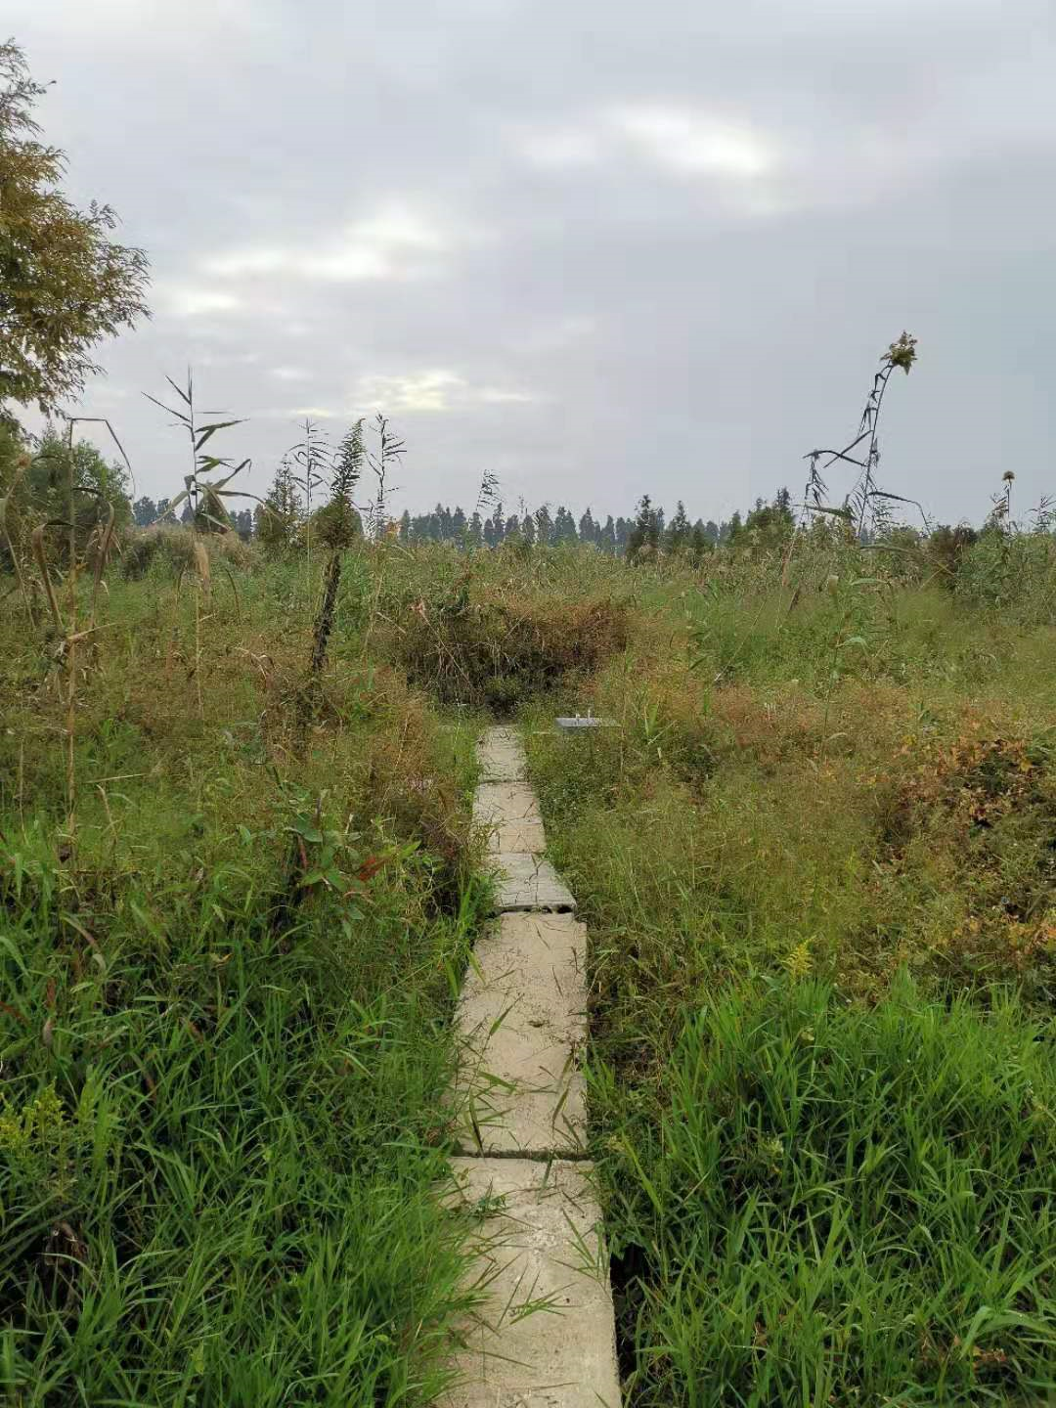
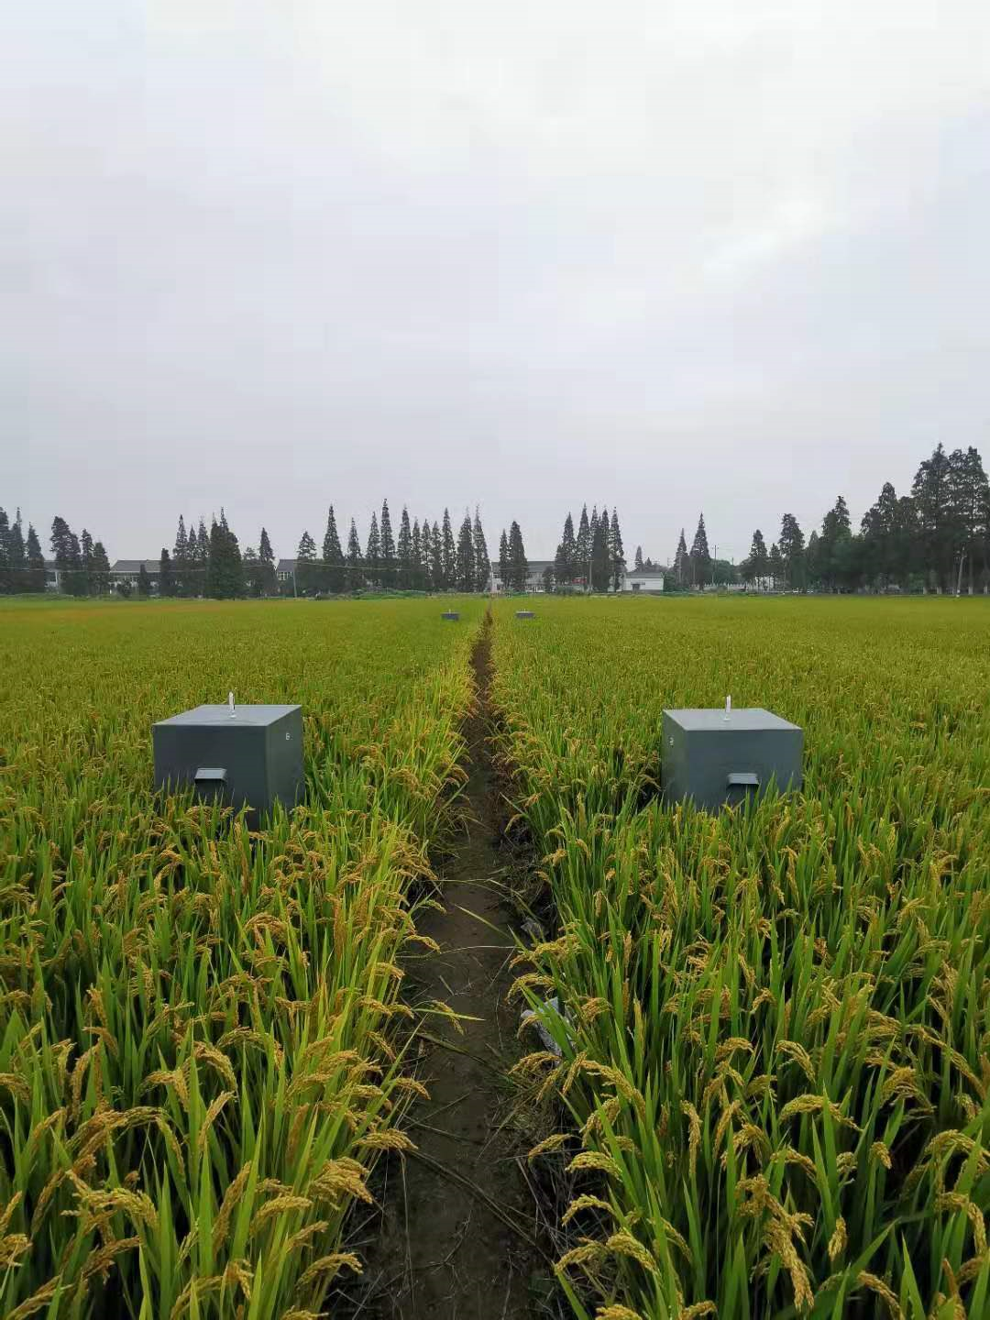
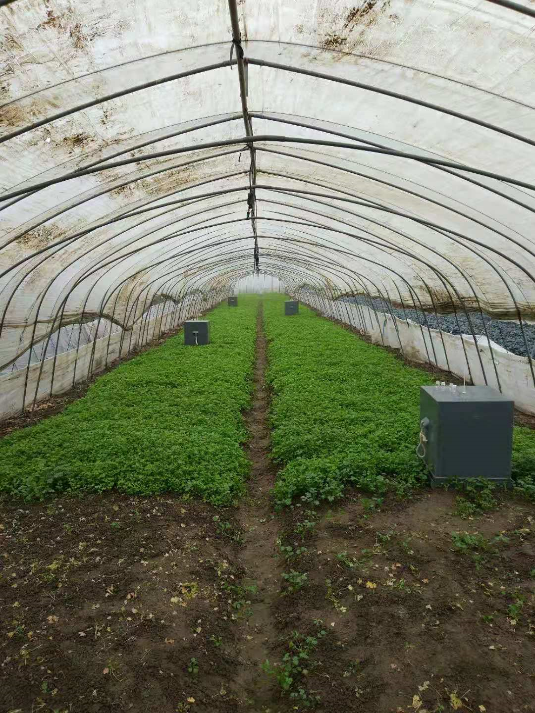
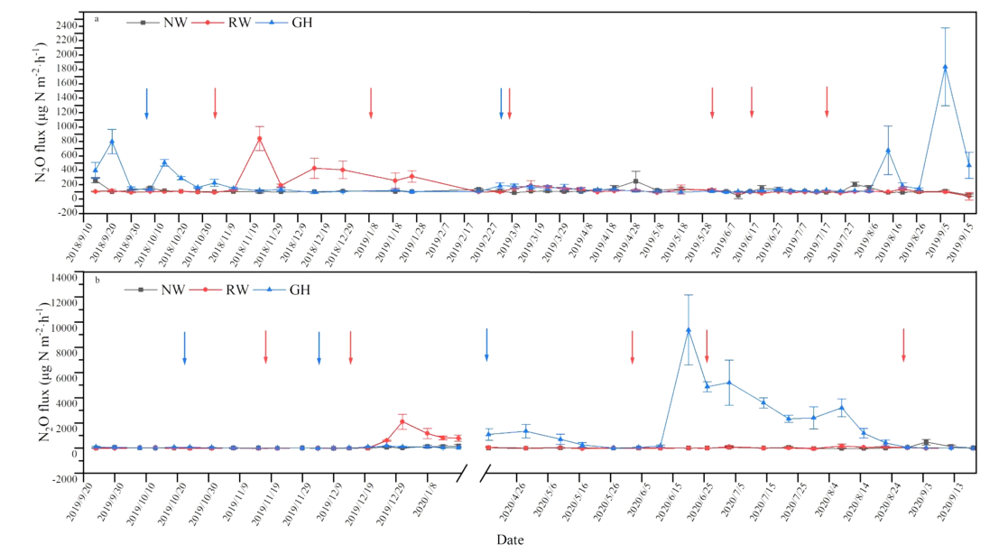

Land-use intensification significantly increases N₂O emissions
Natural wetlands
Rice-wheat rotation fields
Greenhouse vegetable fields
China has lost more than 50% of its wetlands, mainly due to the conversion of wetlands to rice cultivation
Intensification of land use significantly increases N₂O emissions in Taihu Lake region
N₂O flux in different land use of Taihu Lake region

Slide 2
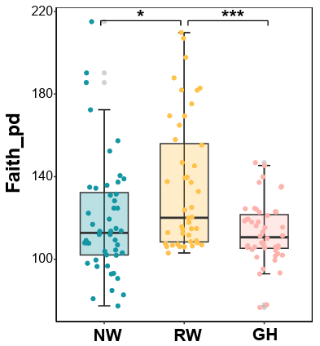
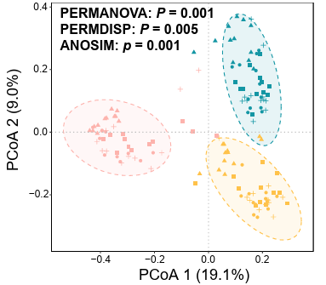
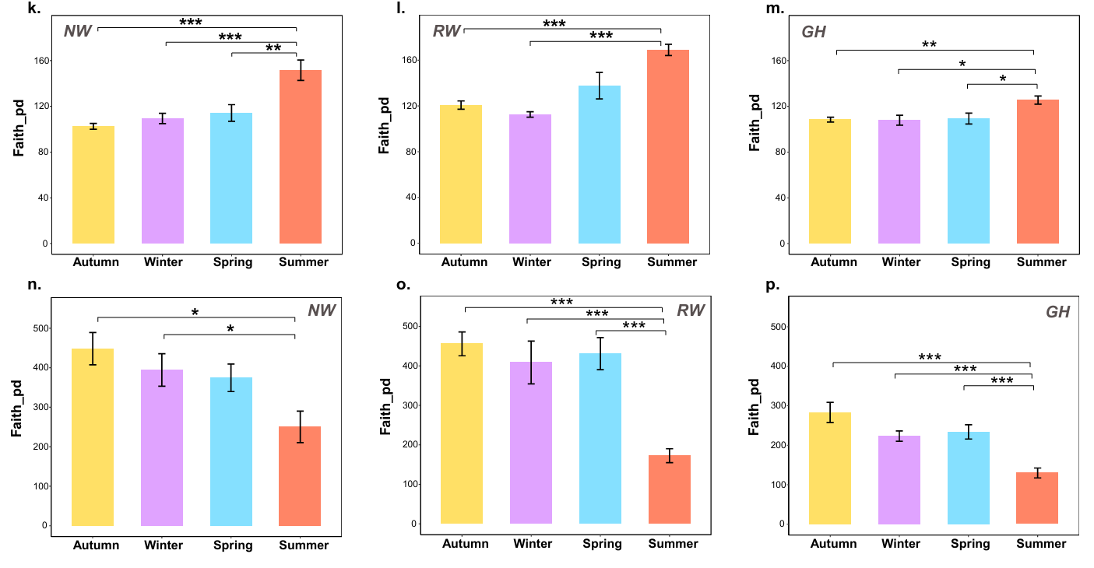
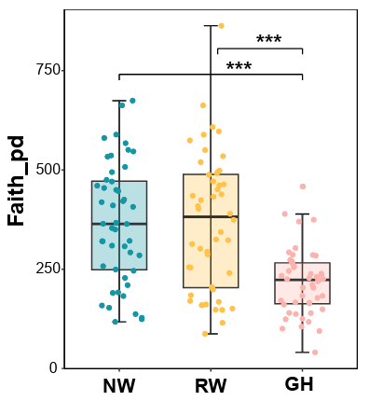
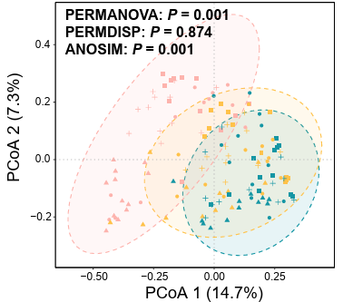
Land-use intensification exerts a greater influence on soil microbial communities than seasonal variations
Microbial diversity in different land use
α diversity in different seasons
Bacteria
1
Fungi
β diversity in different seasons
Land-use intensification has a significant impact on the diversity and composition of bacterial and fungal communities
So do seasonal changes

Slide 3
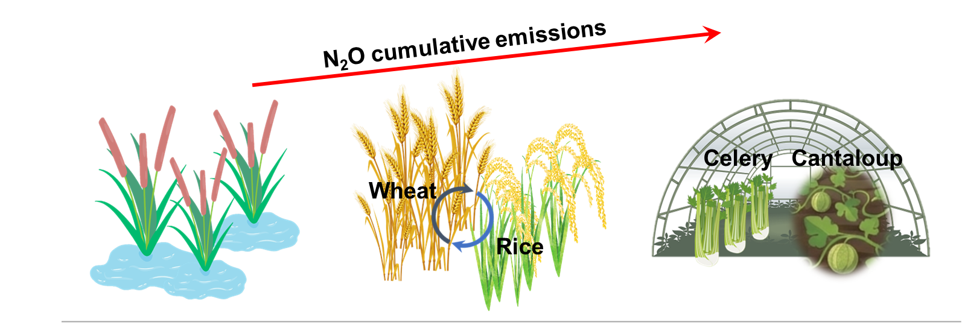
Microbial functional imbalance drives elevated N2O emissions from intensified agriculture
qPCR
Significantly enhanced the absolute abundance of functional genes driving nitrification and denitrification processes
Metagenomics
The shift from natural ecosystems to intensive agriculture amplified genetic potential for N₂O production by enriching denitrifying guilds (e.g., Pseudomonadota) while disrupting the functional equilibrium of denitrification pathways

