Slide 2
Towards a Particle-Based Finite Element Framework for Ice Calving Simulation Supplementary Materials
Sayako Hirobe¹, Yota Sato², Kenji Oguni¹
Japan Agency for Marine-Earth Science and Technology (JAMSTEC), Japan
Institute of Science and Technology Austria (ISTA), Austria
E-mail: hirobes@jamstec.go.jp (Sayako Hirobe)

Slide 3




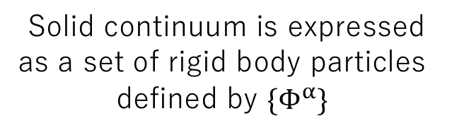
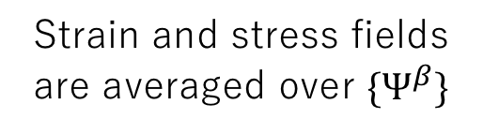


PDS：Particle Discretization Scheme
Analysis domain is discretized by a pair of conjugate geometries
⇒ Voronoi tessellations, Delaunay tessellations
$$Φ^{α}$$
$$Ψ^{β}$$
Notes:
From here, I explain about our numerical analysis method. Firstly, I talk about the Particle Discretization Scheme. The analysis domain Ω is discretized in different ways by a pair of conjugate geometries, Voronoi tessellations and Delaunay tessellations, corresponding to a set of nodes. The solid continuum is expressed as a set of rigid body particles defined by Voronoi tessellations and Delaunay tessellations are used for the averaged domain for the strain and stress field. The Delaunay tessellation becomes a set of triangles in the two-dimensional case and becomes a set of tetrahedrons in three-dimensional case.

Slide 4







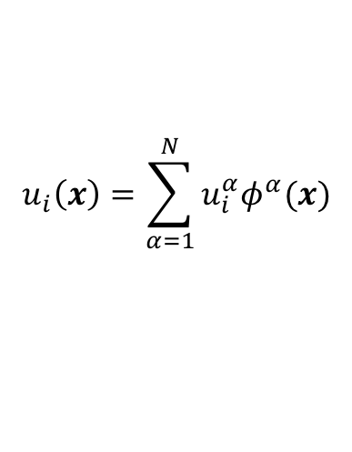
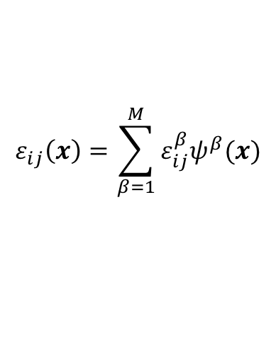
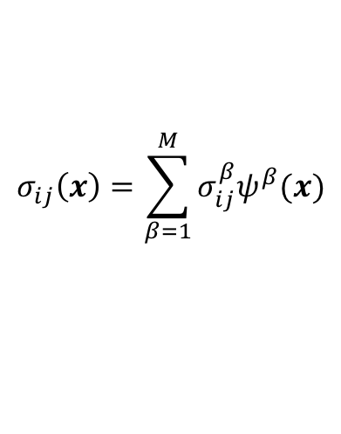



PDS：Particle Discretization Scheme
$$Φ^{α}$$
$$Ψ^{β}$$
Voronoi tessellatios
Delaunay tessellations
Discontinuous and non-overlapping shape functions
Notes:
The field variables are discretized by using the following discontinuous and non-overlapping shape functions on Voronoi tessellations and Delaunay tessellations. The displacement field is discretized by Voronoi tessellations and strain and stress field is discretized by Delaunay tessellations. These discontinuous and non-overlapping shape functions enable the treatment of the discontinuous field due to fracture.

Slide 5
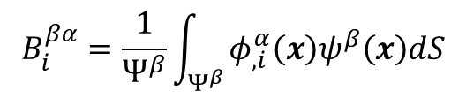


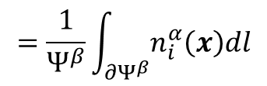
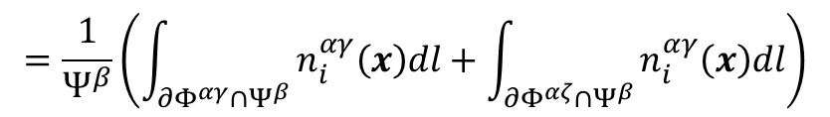


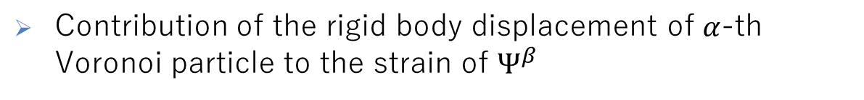



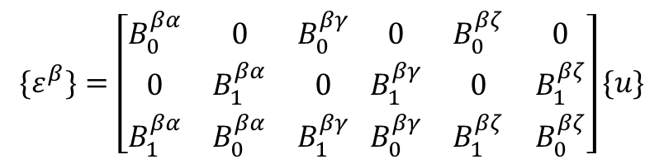
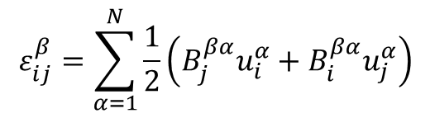
Displacement-Strain Relationship
The components of B matrix are identical to
those of the displacement-strain matrix for the conventional FEM
Notes:
According to this discretization scheme, the displacement field in PDS-FEM becomes discontinuous in Delaunay triangle (tetrahedron）. For evaluation of physical quantities related to the spatial differentiation of the displacement, thus strain and stress, we need the displacement-strain relationship. In conventional FEM, the displacement-strain relationship is expressed by using the B matrix and this B matrix is composed of the differentiation of shape functions.
In two-dimensional PDS-FEM, for example, the components of B matrix, are expressed as the line integral of the unit normal vector of the boundary of Voronoi tessellations. This expresses the contribution of the rigid body displacement of alpha-th Voronoi particle to the strain of beta-th Delaunay triangle. On the other two Voronoi particles, the components of B matrix are defined in the same way. In spite of using the discontinuous shape functions, the components of B matrix are identical to those for the ordinary FEM with linear triangle or tetrahedral elements. This is the most essential part of this particle discretization scheme.

Slide 6


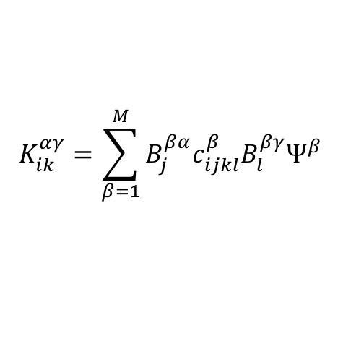
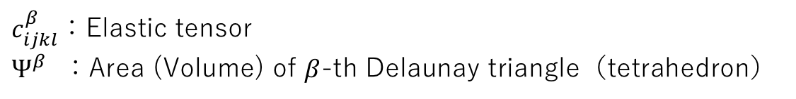





Stiffness Matrix
Express the interaction between Voronoi particles
The stiffness matrix can be regarded as a spring constant connecting Voronoi particles
The stiffness matrix of PDS-FEM is identical to those of conventional FEM
Notes:
By using this B matrix, the stiffness matrix is defined like this. This stiffness matrix expresses the interaction between Voronoi particles, thus, the stiffness matrix can be regarded as a spring constant connecting Voronoi particles. Because of the agreement of the B matrix used in PDS-FEM and the ordinary FEM, the stiffness matrix is also identical to that of the ordinary FEM with linear triangular or tetrahedral elements.

Slide 7




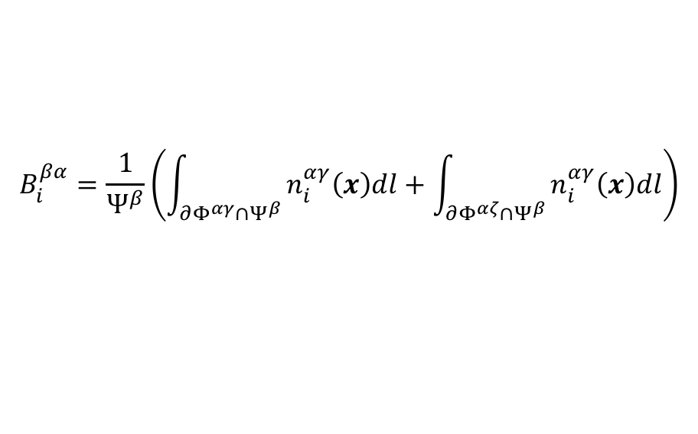
Expression of Fracture
Loss of the interaction between two adjacent Voronoi particles
Fracture surface is defined on the boundary of Voronoi particles
The removal of the line (surface) integral of B matrix on the fractured Voronoi boundary
Fracture
Surface
zero
Notes:
By using this B matrix, the stiffness matrix is defined like this. This stiffness matrix expresses the interaction between Voronoi particles, thus, the stiffness matrix can be regarded as a spring constant connecting Voronoi particles. Because of the agreement of the B matrix used in PDS-FEM and the ordinary FEM, the stiffness matrix is also identical to that of the ordinary FEM with linear triangular or tetrahedral elements.

Slide 8
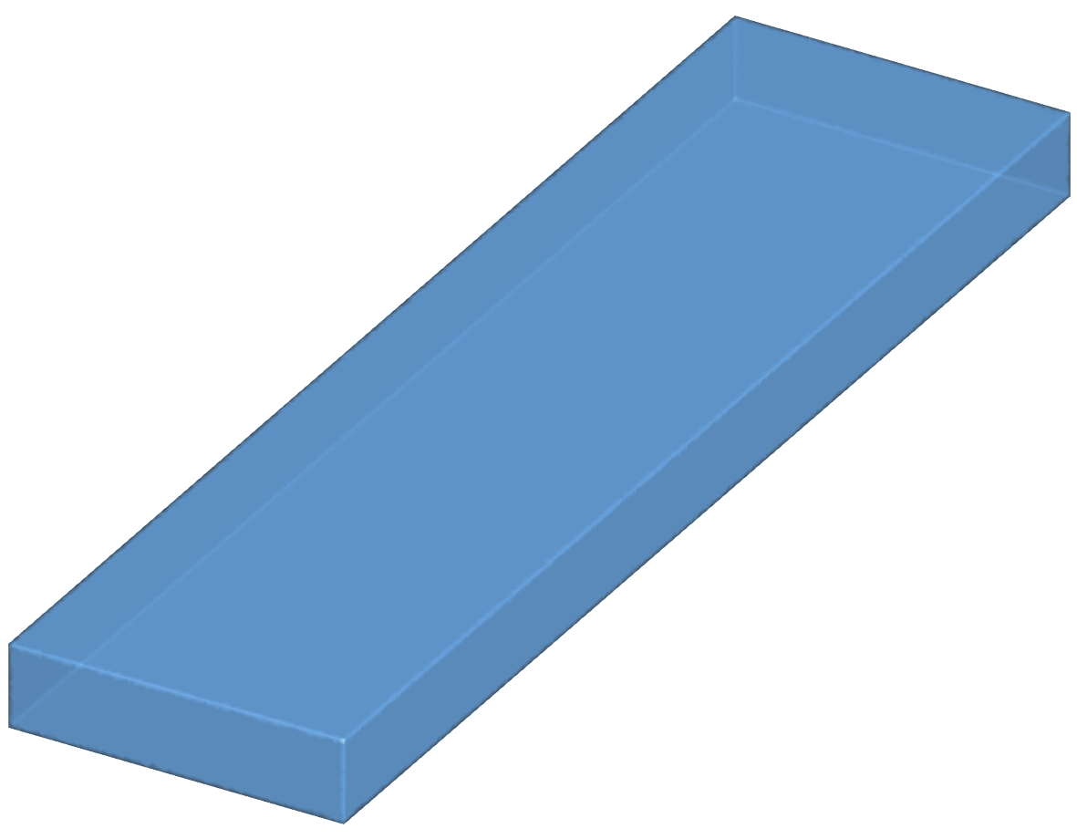
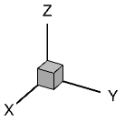
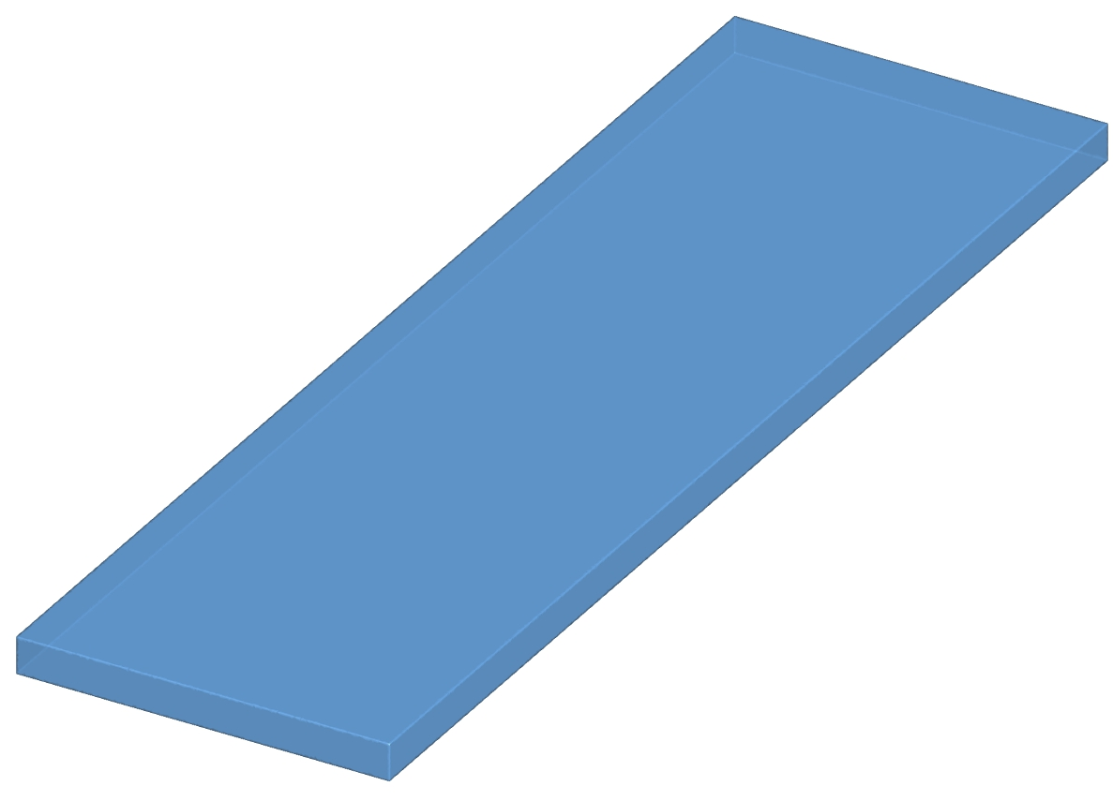
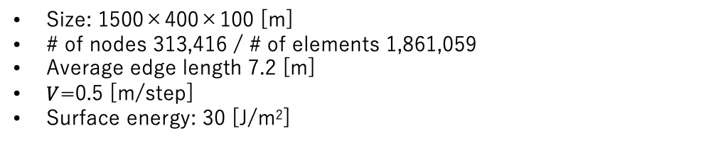
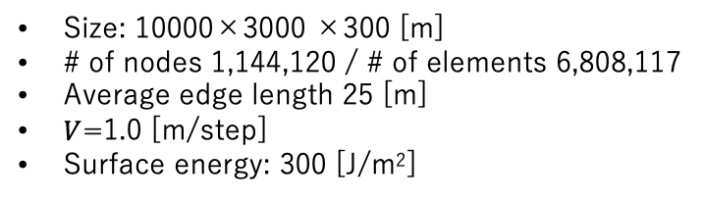
Numerical Conditions
Small glacier model
Large glacier model
Parameters
Young’s modulus | 9 [GPa]
Poisson’s ratio | 0.3
mass density | 910 [kg/m³]
time step | 2.0×10⁻⁴ [sec]
0
200m
400m
Note: Glacier length is shortened for computational efficiency.
0
1km
2km
Size: 1500×400×100 [m]
# of nodes 313,416 / # of elements 1,861,059
Average edge length 7.2 [m]
$V$=0.5 [m/step]
Surface energy: 30 [J/m²]
Size: 10000×3000 ×300 [m]
# of nodes 1,144,120 / # of elements 6,808,117
Average edge length 25 [m]
$V$=1.0 [m/step]
Surface energy: 300 [J/m²]
cf. Lugge glaciers, Bhutanese Himalaya
About 3.5km×400m×100m
Flow velocity: 50m/year
cf. Glaciar Perito Moreno, Patagonia
About 30km×3km×300m
Flow velocity: 600m/year
Sato Y, Fujita K, Inoue H, Sakai A and Karma (2022) Land- to lake-terminating transition triggers dynamic thinning of a Bhutanese glacier. The cryosphere 16(6), 2643–2654.
Tsutaki S and others (2019) Contrasting thinning patterns between lake- and land-terminating glaciers in the Bhutanese Himalaya. The cryosphere 13(10), 2733–2750.
Koch M and others (2025) The state and fate of Glaciar Perito Moreno Patagonia. Communications earth & environment 6(1), 1–12.

Slide 9
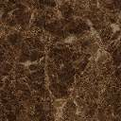






















Numerical Procedure
Flow chart
Boundary conditions
$$z$$
$$y$$
start
$$x$$
$$step=0$$
$$t=0$$
bed rock
$$∅$$
$V$ [m/step]
Solve equilibrium of force
$$t=0$$
$$z$$
$$y$$
Solve equation of motion
$$x$$
New crack formed?
NO
bed rock
$$∅$$
$V$ [m/step]
YES
$$t+=∆t$$
BC I (Partial Fix): Fixed on bedrock; free once protruding.
$$t=∆t$$
$$z$$
$$step+=1$$
$$y$$
$$x$$
YES
$$step≤400$$
bed rock
$$∅$$
$V$ [m/step]
NO
Blue part: static analysis
Orange part: dynamic analysis
end
BC II (Full Fix): All lateral faces are permanently fixed.

Slide 10
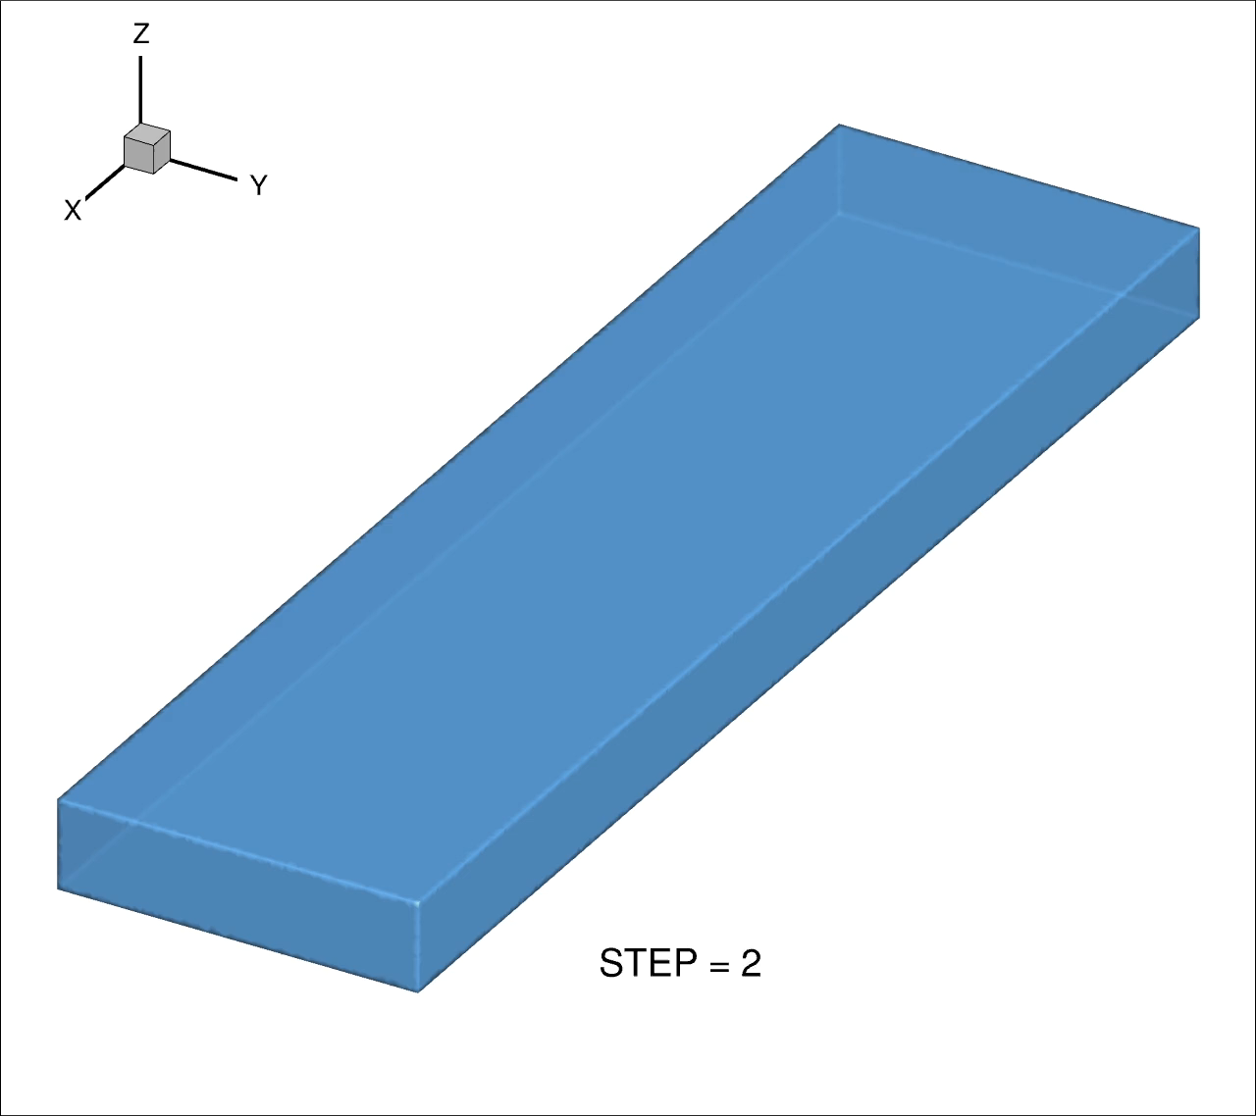
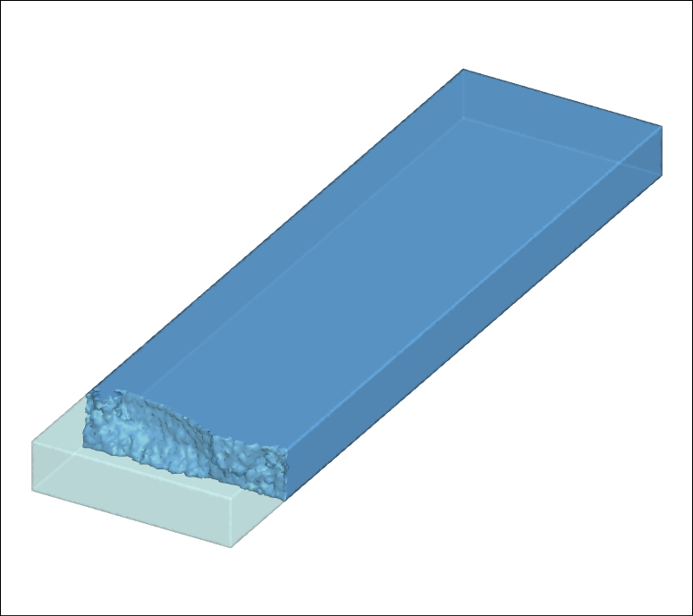
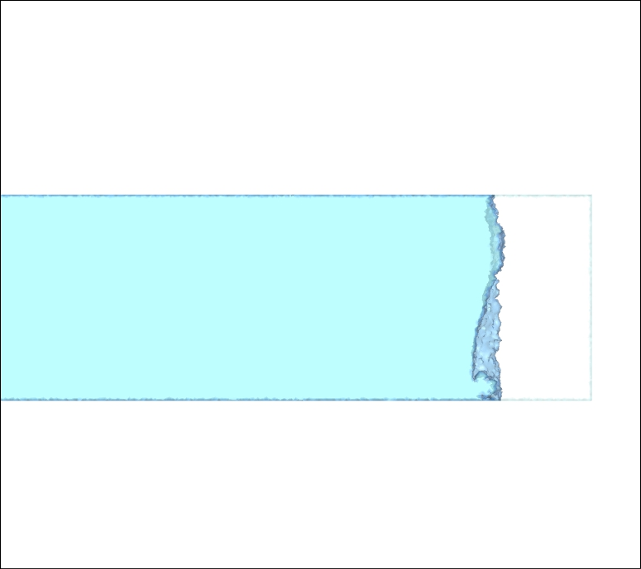
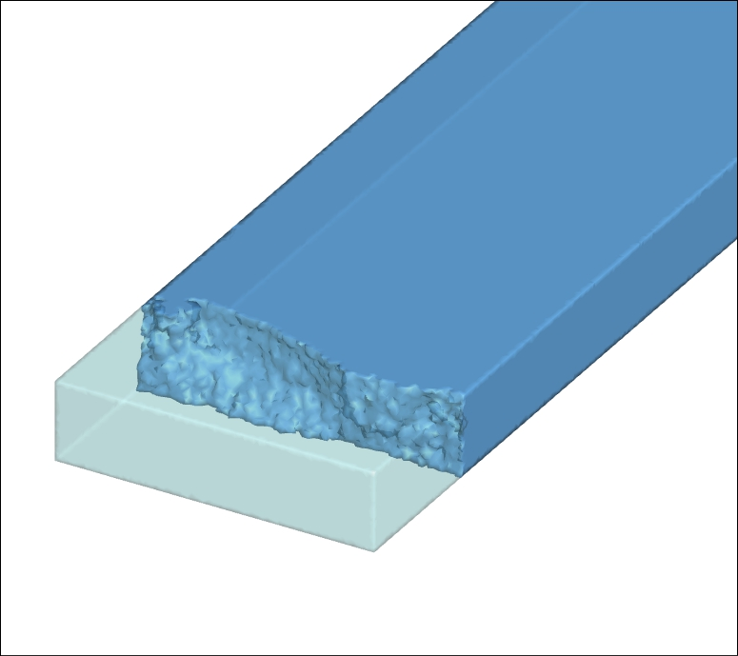
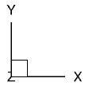
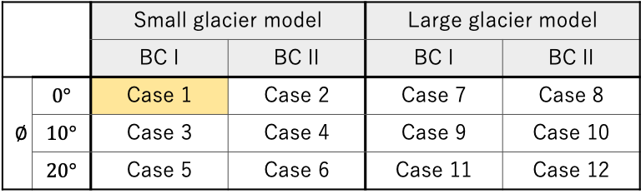

Numerical Results: Case 1
 |  | Small glacier model |  | Large glacier model
 |  | BC I | BC II | BC I | BC II
$$∅$$ | $$0°$$ | Case 1 | Case 2 | Case 7 | Case 8
 | $$10°$$ | Case 3 | Case 4 | Case 9 | Case 10
 | $$20°$$ | Case 5 | Case 6 | Case 11 | Case 12
0
200m
400m
0
100m
200m
$V$=0.5 [m/step]
0
200m
400m
0
100m
200m

Slide 11

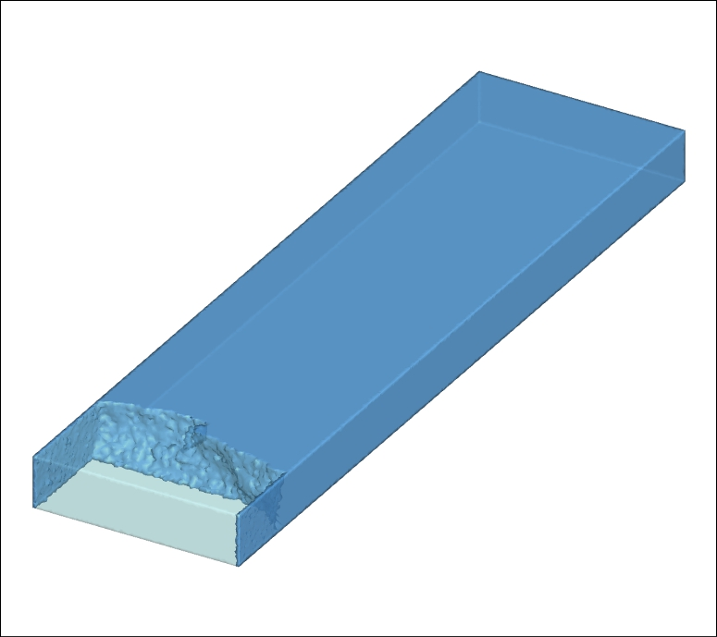
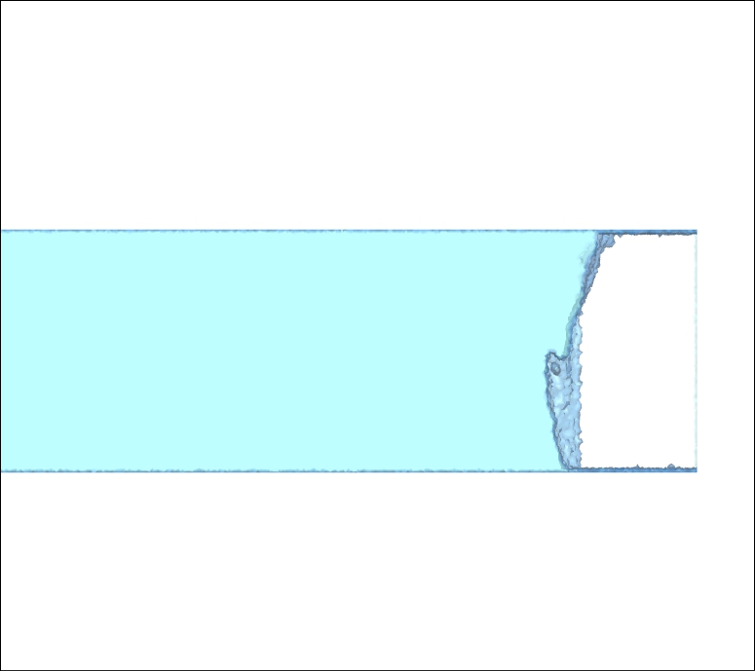
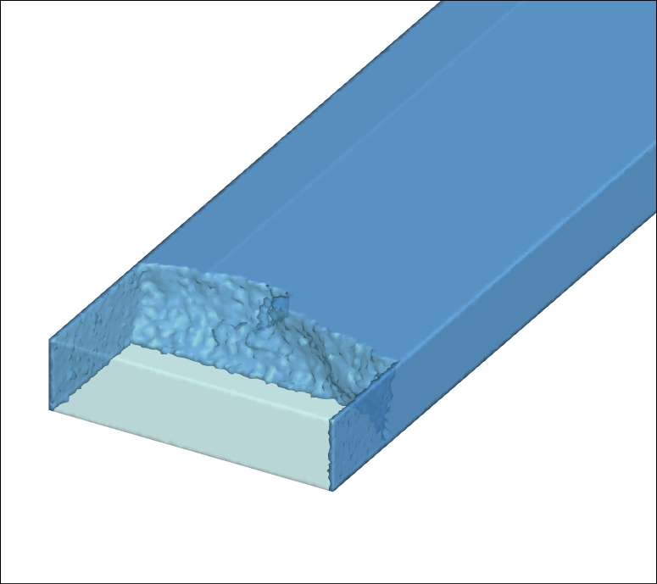
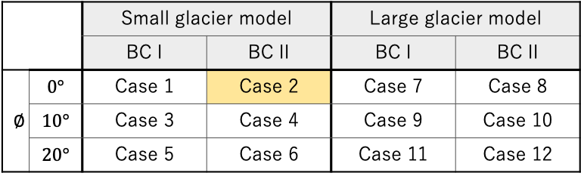
Numerical Results: Case 2
 |  | Small glacier model |  | Large glacier model
 |  | BC I | BC II | BC I | BC II
$$∅$$ | $$0°$$ | Case 1 | Case 2 | Case 7 | Case 8
 | $$10°$$ | Case 3 | Case 4 | Case 9 | Case 10
 | $$20°$$ | Case 5 | Case 6 | Case 11 | Case 12
0
200m
400m
0
100m
200m
$V$=0.5 [m/step]
0
200m
400m
0
100m
200m

Slide 12

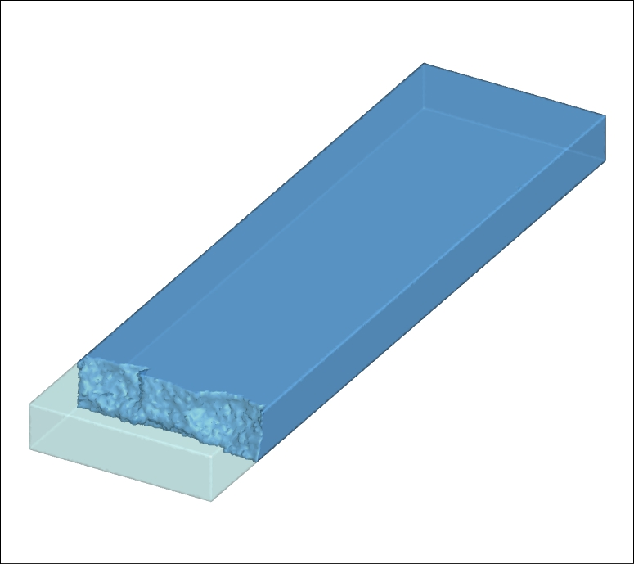
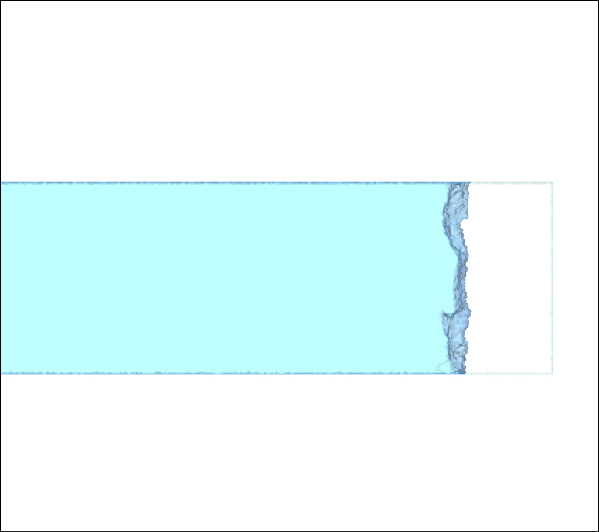
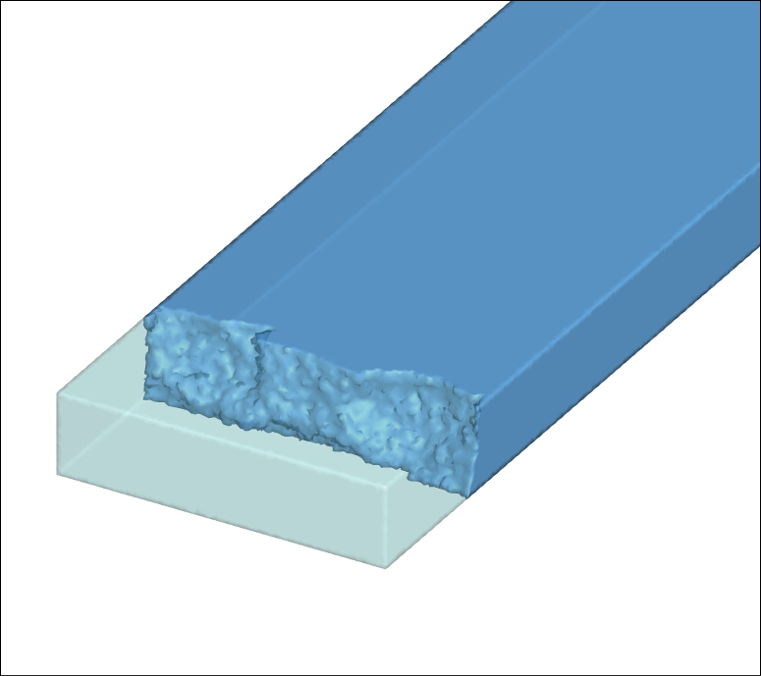
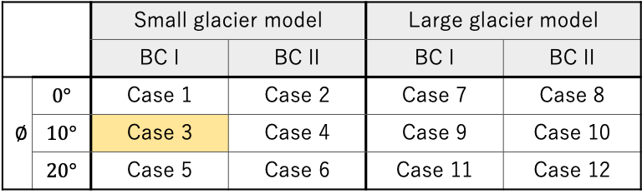
Numerical Results: Case 3
 |  | Small glacier model |  | Large glacier model
 |  | BC I | BC II | BC I | BC II
$$∅$$ | $$0°$$ | Case 1 | Case 2 | Case 7 | Case 8
 | $$10°$$ | Case 3 | Case 4 | Case 9 | Case 10
 | $$20°$$ | Case 5 | Case 6 | Case 11 | Case 12
0
200m
400m
0
100m
200m
$V$=0.5 [m/step]
0
200m
400m
0
100m
200m

Slide 13


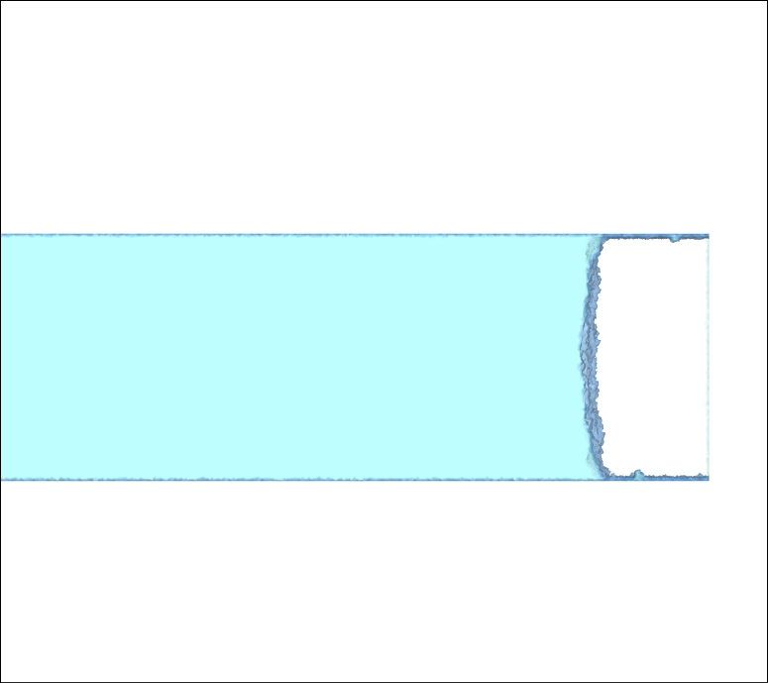
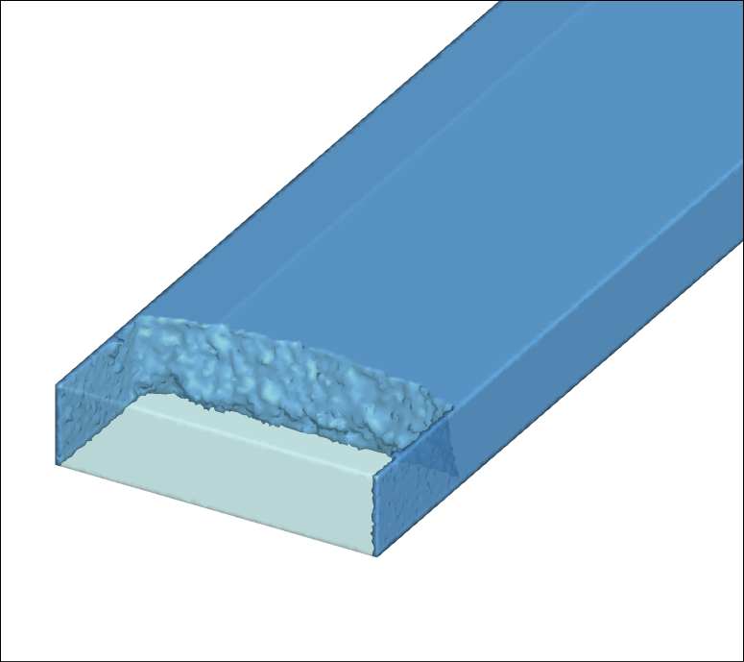
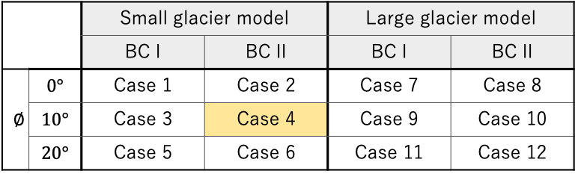
Numerical Results: Case 4
 |  | Small glacier model |  | Large glacier model
 |  | BC I | BC II | BC I | BC II
$$∅$$ | $$0°$$ | Case 1 | Case 2 | Case 7 | Case 8
 | $$10°$$ | Case 3 | Case 4 | Case 9 | Case 10
 | $$20°$$ | Case 5 | Case 6 | Case 11 | Case 12
0
200m
400m
0
100m
200m
$V$=0.5 [m/step]
0
200m
400m
0
100m
200m

Slide 14
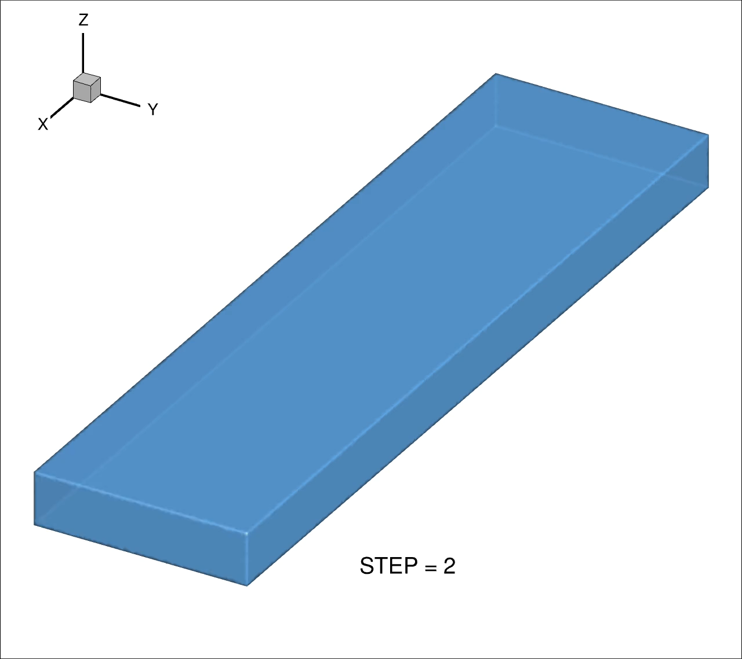
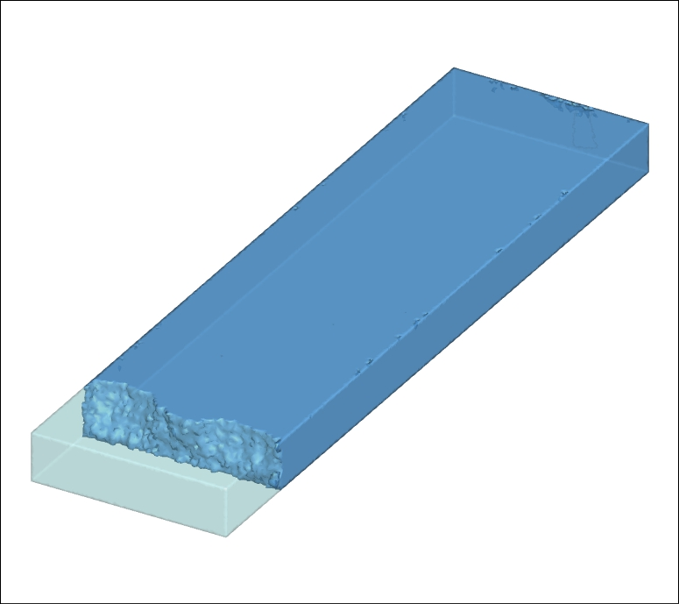
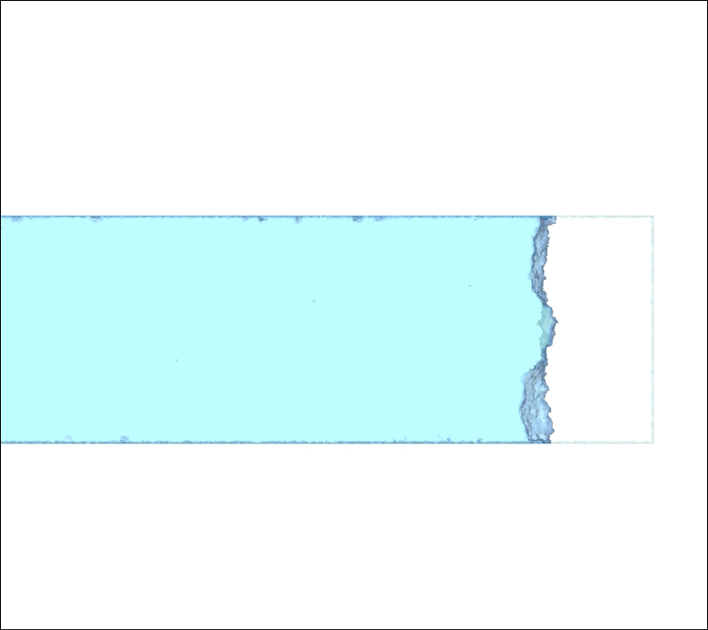
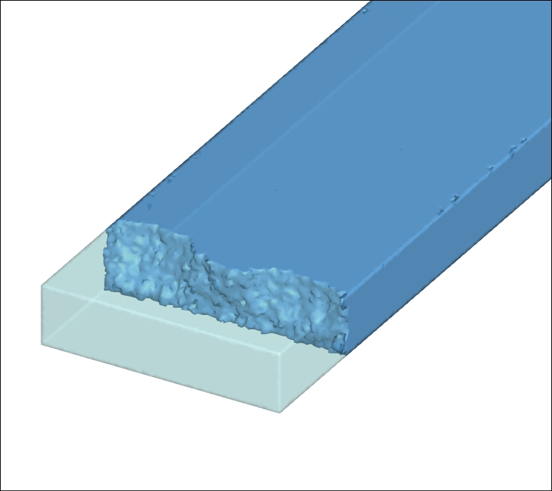
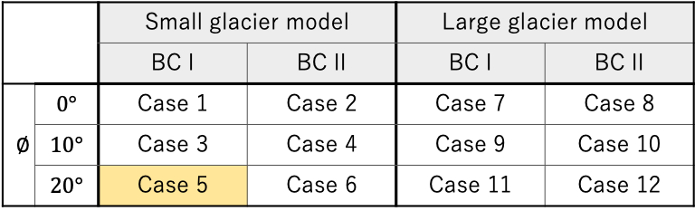
Numerical Results: Case 5
 |  | Small glacier model |  | Large glacier model
 |  | BC I | BC II | BC I | BC II
$$∅$$ | $$0°$$ | Case 1 | Case 2 | Case 7 | Case 8
 | $$10°$$ | Case 3 | Case 4 | Case 9 | Case 10
 | $$20°$$ | Case 5 | Case 6 | Case 11 | Case 12
0
200m
400m
0
100m
200m
$V$=0.5 [m/step]
0
200m
400m
0
100m
200m

Slide 15

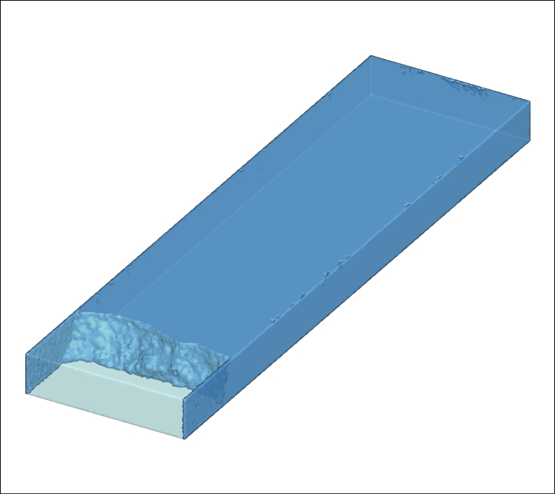
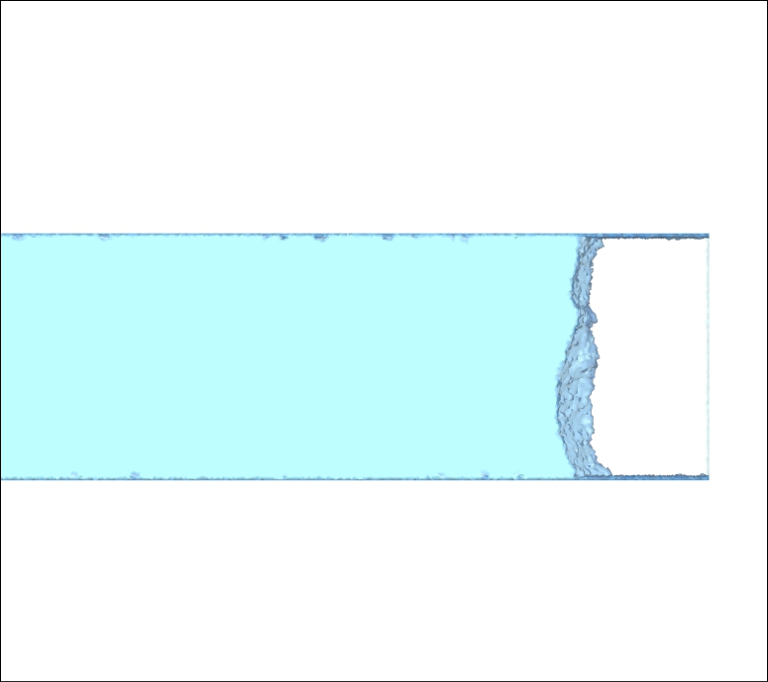
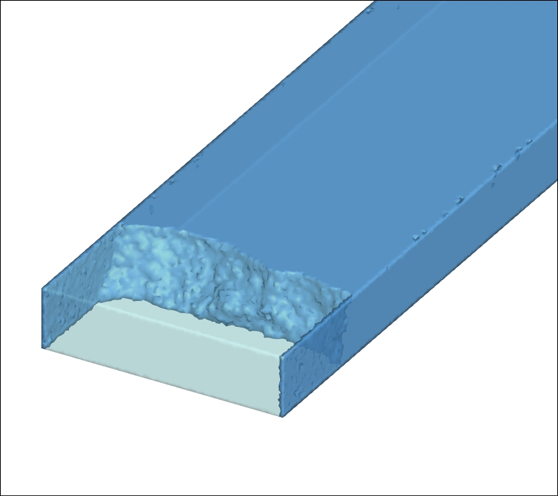
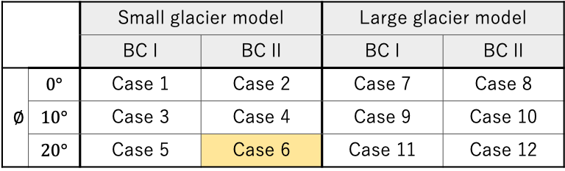
Numerical Results: Case 6
 |  | Small glacier model |  | Large glacier model
 |  | BC I | BC II | BC I | BC II
$$∅$$ | $$0°$$ | Case 1 | Case 2 | Case 7 | Case 8
 | $$10°$$ | Case 3 | Case 4 | Case 9 | Case 10
 | $$20°$$ | Case 5 | Case 6 | Case 11 | Case 12
0
200m
400m
0
100m
200m
$V$=0.5 [m/step]
0
200m
400m
0
100m
200m

Slide 16
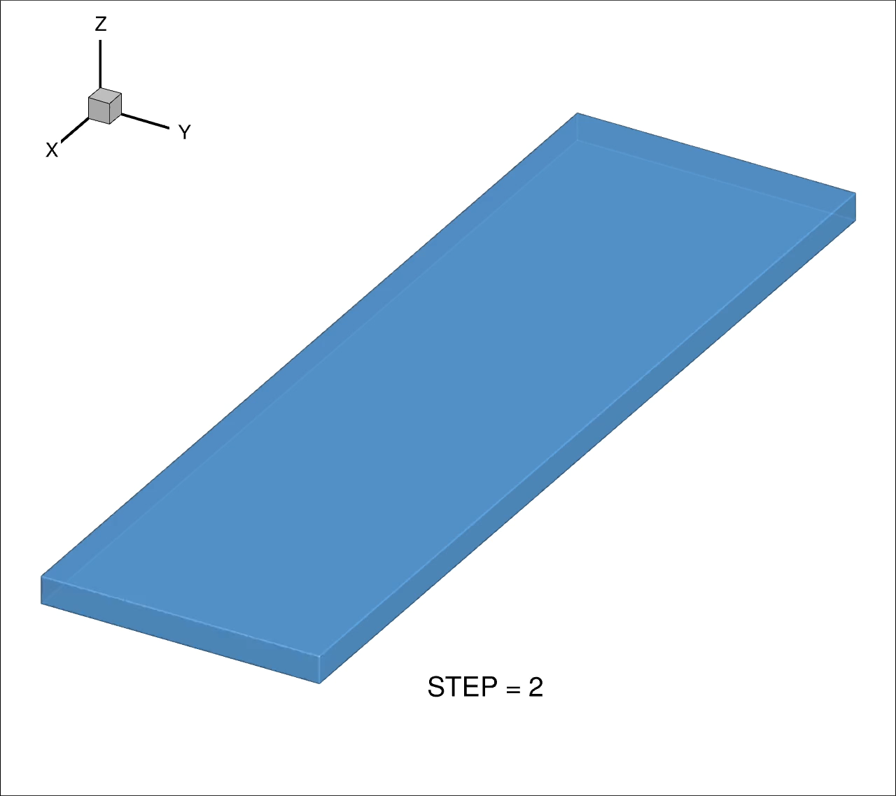
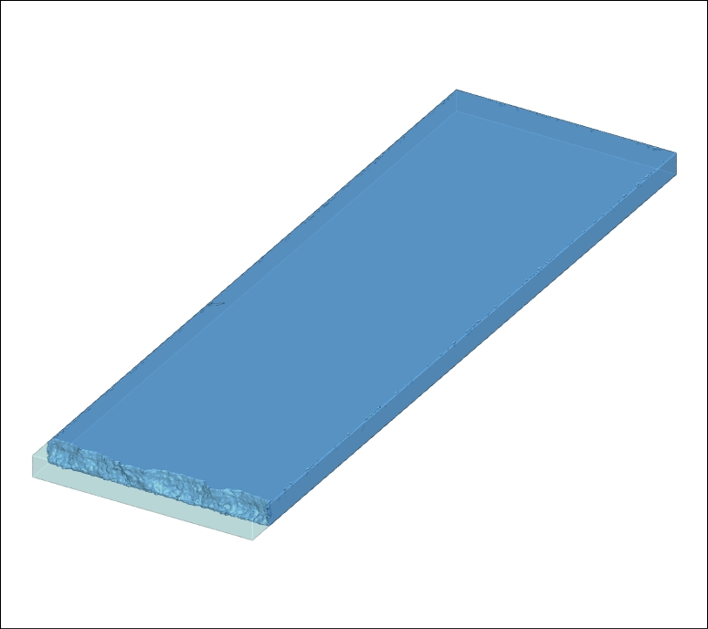
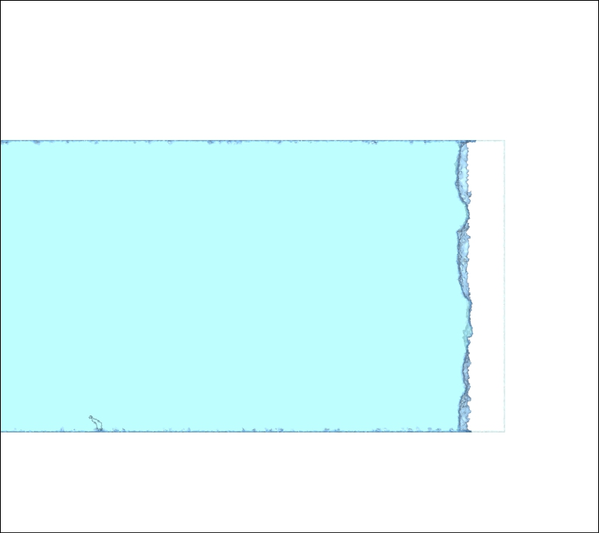
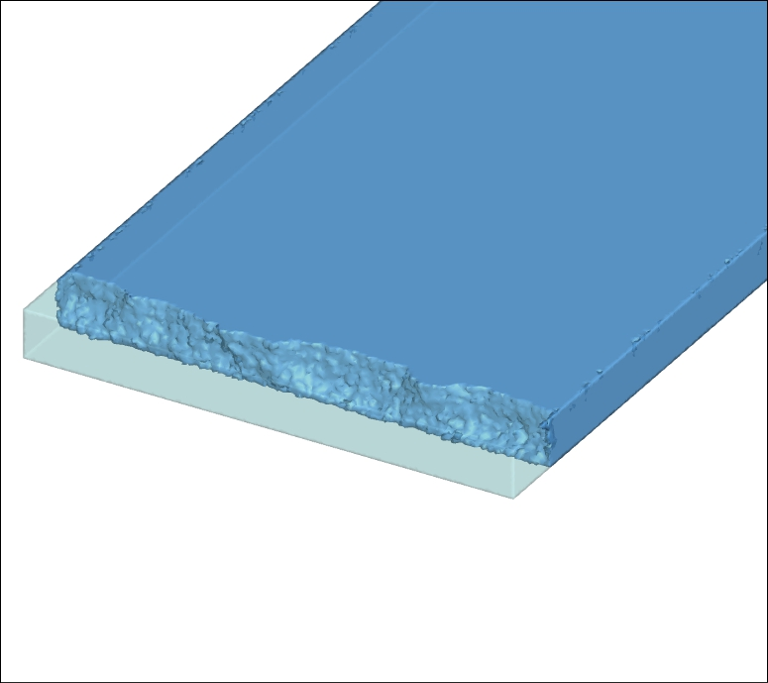


Numerical Results: Case 7
 |  | Small glacier model |  | Large glacier model
 |  | BC I | BC II | BC I | BC II
$$∅$$ | $$0°$$ | Case 1 | Case 2 | Case 7 | Case 8
 | $$10°$$ | Case 3 | Case 4 | Case 9 | Case 10
 | $$20°$$ | Case 5 | Case 6 | Case 11 | Case 12
0
1km
2km
0
6km
12km
$V$=1.0 [m/step]
0
1km
2km
0
2km
4km

Slide 17





Numerical Results: Case 8
 |  | Small glacier model |  | Large glacier model
 |  | BC I | BC II | BC I | BC II
$$∅$$ | $$0°$$ | Case 1 | Case 2 | Case 7 | Case 8
 | $$10°$$ | Case 3 | Case 4 | Case 9 | Case 10
 | $$20°$$ | Case 5 | Case 6 | Case 11 | Case 12
0
1km
2km
0
6km
12km
$V$=1.0 [m/step]
0
1km
2km
0
2km
4km

Slide 18







Numerical Results: Case 9, 10
 |  | Small glacier model |  | Large glacier model
 |  | BC I | BC II | BC I | BC II
$$∅$$ | $$0°$$ | Case 1 | Case 2 | Case 7 | Case 8
 | $$10°$$ | Case 3 | Case 4 | Case 9 | Case 10
 | $$20°$$ | Case 5 | Case 6 | Case 11 | Case 12
Most of the glacier collapsed at $step=1$ on case 9, 10, 11, 12.
Case 9
Case 10
0
0
1km
2km
1km
2km
0
1km
2km
0
0
1km
2km
0
2km
4km
2km
4km

Slide 19







Numerical Results: Case 11, 12
 |  | Small glacier model |  | Large glacier model
 |  | BC I | BC II | BC I | BC II
$$∅$$ | $$0°$$ | Case 1 | Case 2 | Case 7 | Case 8
 | $$10°$$ | Case 3 | Case 4 | Case 9 | Case 10
 | $$20°$$ | Case 5 | Case 6 | Case 11 | Case 12
Most of the glacier collapsed at $step=1$ on case 9, 10, 11, 12.
Case 11
Case 12
0
0
1km
2km
1km
2km
0
1km
2km
0
0
1km
2km
0
2km
4km
2km
4km

