Slide 1
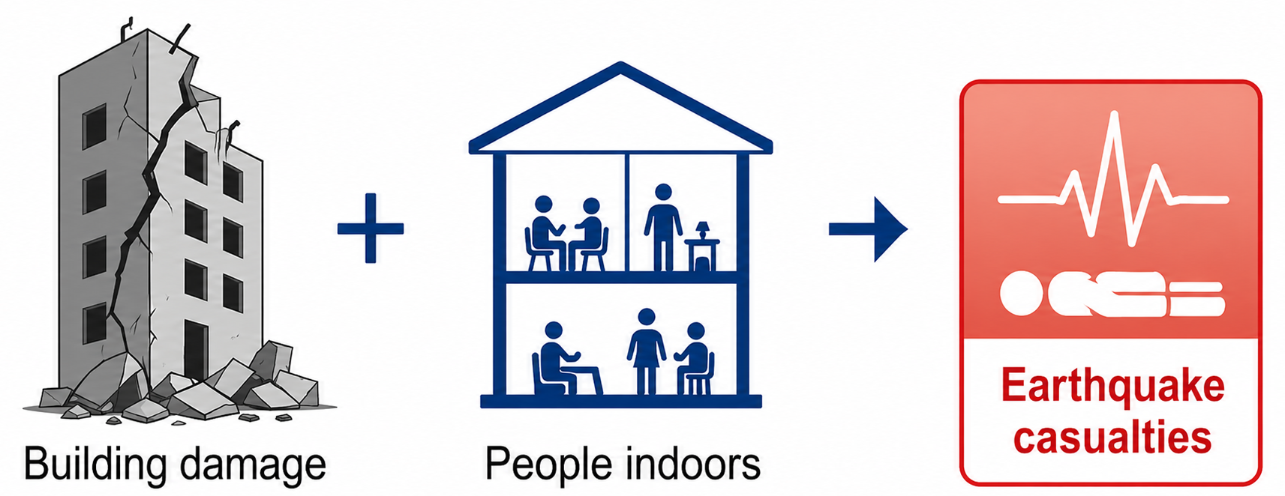
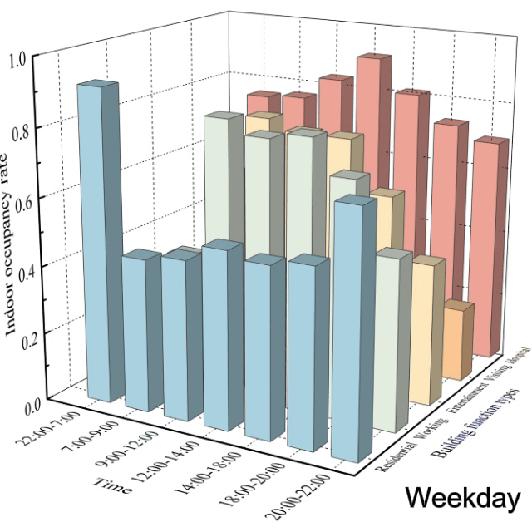
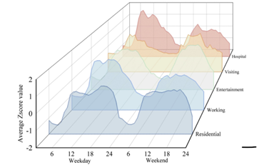
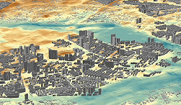
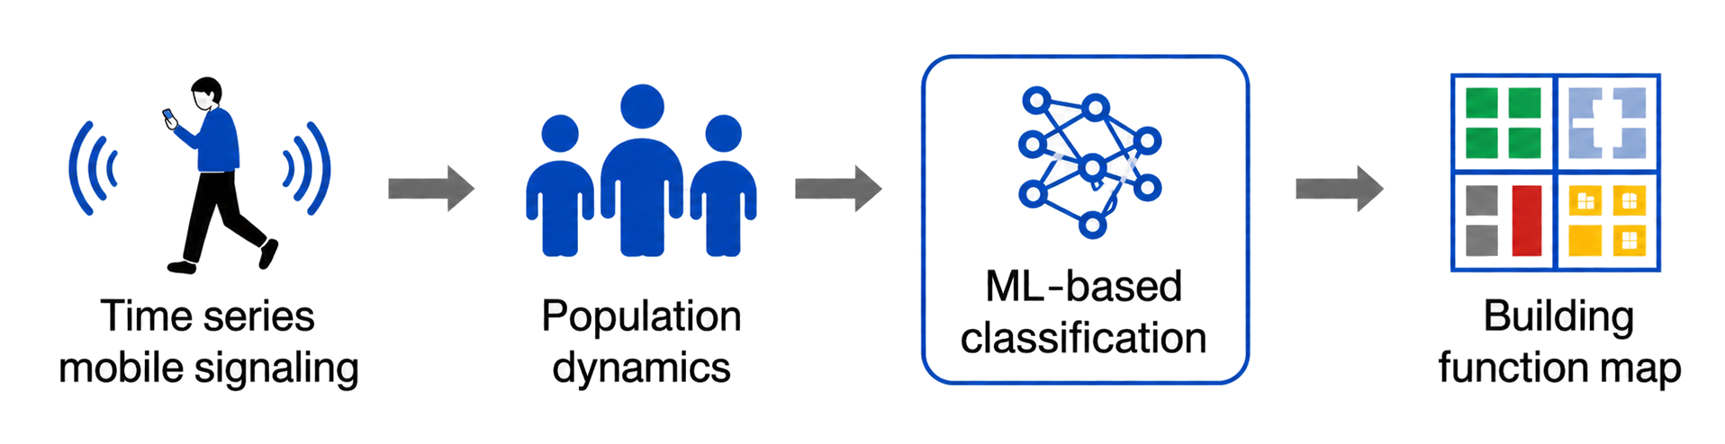
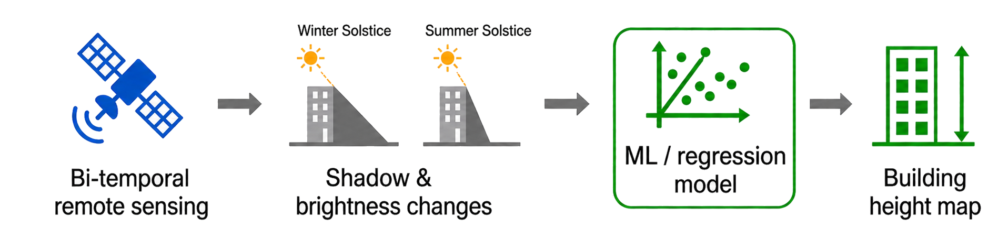




High-resolution Building Exposure Extraction for Fine-scale Earthquake Fatality Risk Assessment
Based on Multi-source Data and Machine Learning
Why fatalities occur
Why building function and height matter
？
Challenge and solution
From indoor population exposure
Challenge:
large-scale acquisition
dynamic updating
Building function type (BFT)
Severe building damage/collapse
People are inside
BFT affects indoor occupancy rate and activity patterns
BH reflects potential indoor capacity
Building height (BH)
Fine –scale fatality risk assessment
building vulnerability
indoor population distribution
From building vulnerability
Key parameters for structure inference
Support building vulnerability analysis
Multi-source data and machine learning make large-scale, updatable building exposure extraction possible.
Abstract / OSPP

Slide 2
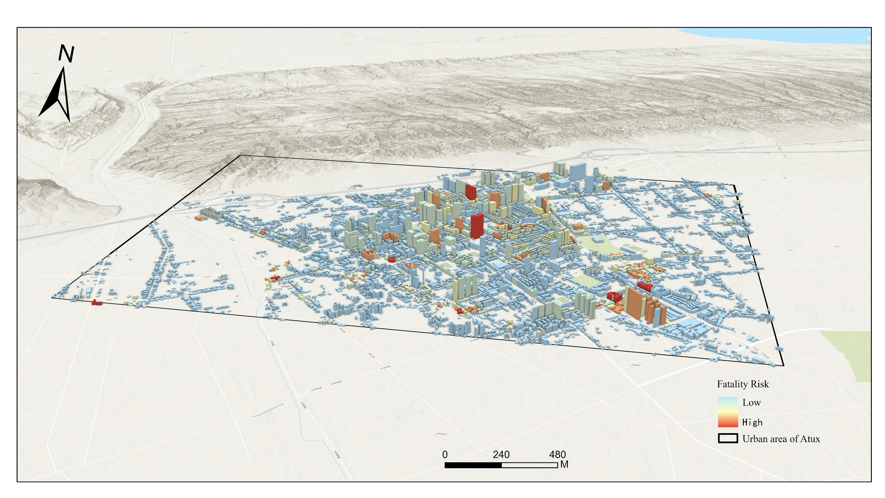
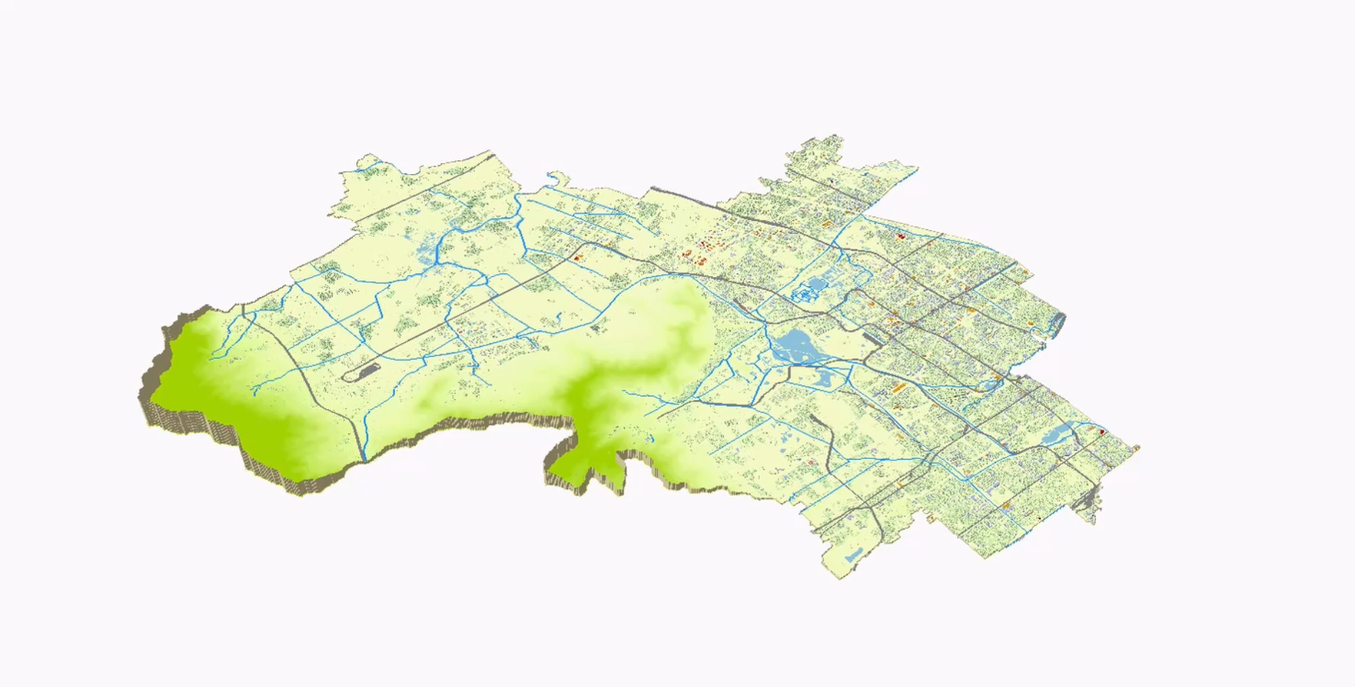
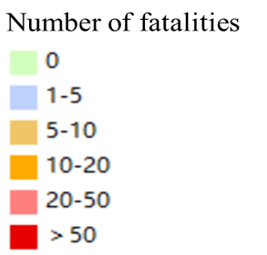


High-resolution Building Exposure Extraction for Fine-scale Earthquake Fatality Risk Assessment
Based on Multi-source Data and Machine Learning
Application on fine-scale earthquake fatality risk assessment
Expected fatality risk at night in the urban area of Artux City, China under a 10,000-year return-period earthquake scenario
Expected fatality risk in Haidian District, Beijing, China at 10am under seismic intensity X
High-resolution building exposure information makes fine-scale spatiotemporal earthquake fatality risk assessment possible.
Abstract / OSPP

