Slide 1





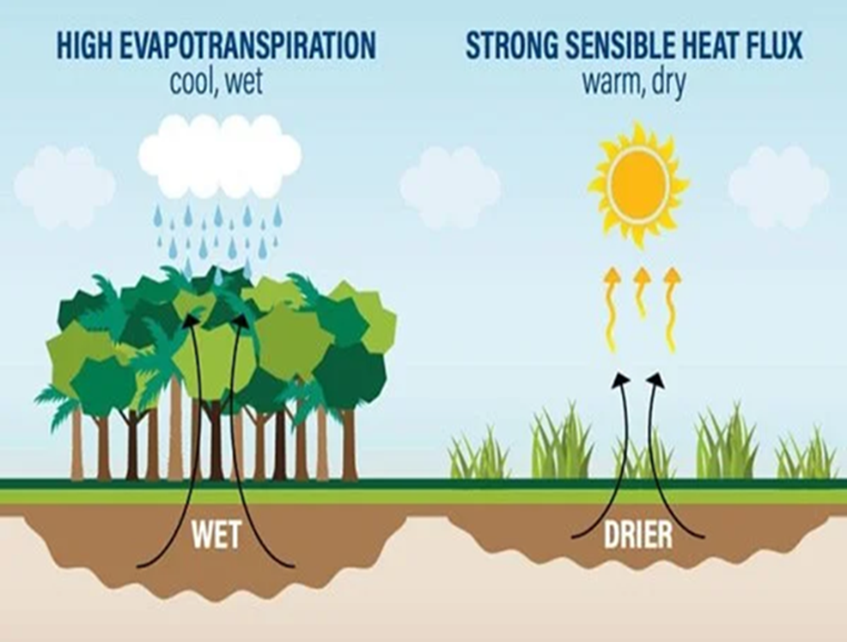

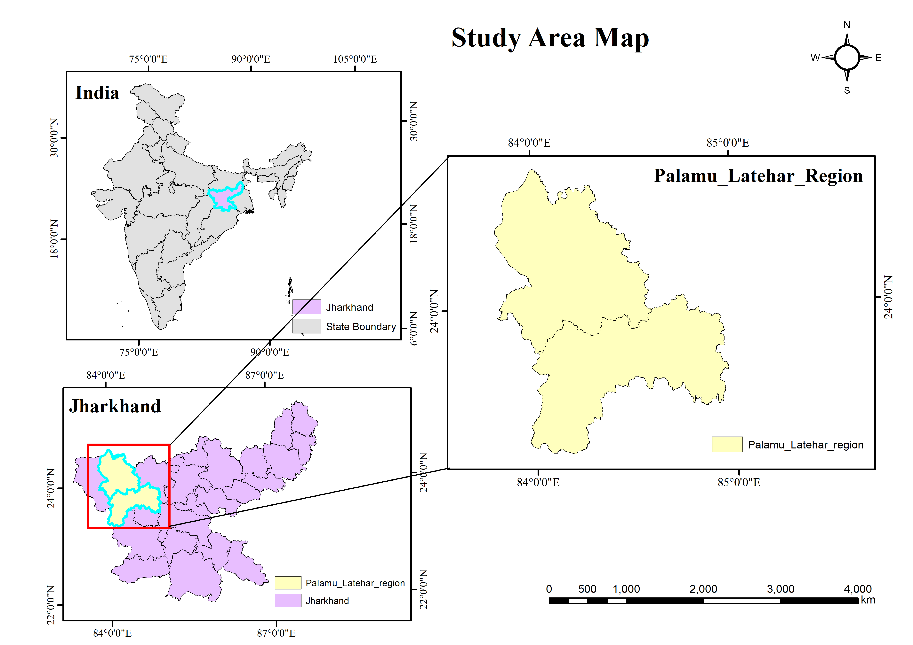



Deforestation-Driven Surface Warming and Heat Exposure in a Tropical Dry Forest District
Sweeti Rani¹ and Subir Sen²
¹Indian Institute of Technology Roorkee, Centre of Excellence in Disaster Mitigation and Management, India (sweeti_r@dm.iitr.ac.in)
EGU General Assembly 2026, Vienna, Austria
Background/ Motivation
Data & Methodology
Results
Discussion
Forests regulate temperature via:
  evapotranspiration
  canopy shading
Deforestation → increases surface heating
Most studies:
coarse resolution
lack district-scale analysis
Tropical dry forests in India:
  high heat stress
  high vulnerability
Hansen GFC
(treecover2000, lossyear)
Aggregation ( 30m → 1 km)
MEAN (tree cover)
MODIS LST (2002, 2018, 2024)
Annual Mean daytime LST (°C)
Forest Masks
Stable vs Deforested
Forest defined as tree cover > 50% (year 2000)
ΔLST = Tdef − Tstable
Region | Year | Stable Forest (°C) | Deforested Pixels (°C) | ΔLST (°C)
Palamu–Latehar | 2002 | 26.59 | 26.68 | 0.09
Palamu–Latehar | 2018 | 26.71 | 26.92 | 0.22
Palamu–Latehar | 2024 | 25.38 | 26.19 | 0.81
Strong increase in warming over time
4× increase from 2018 to 2024
Absolute temperature decreased in 2024
BUT temperature difference increased
Meaning: deforestation impact intensified
Forest loss leads to: reduced evapotranspiration & reduced shading
Results in increased land surface heating
Increasing ΔLST suggests:
cumulative land degradation
stronger land–atmosphere coupling
Climate variability affects:
absolute temperature
NOT relative differences
Likely to increase heat exposure and unsafe working conditions
Fig.1 - Trees pull water from the ground and release water vapor through their leaves, generating atmospheric rivers of moisture (Adapted from: World Resources Institute, June 2018)
Key Finding - Deforestation-driven warming increased from 0.09°C to 0.81°C (2002–2024)
Maps
Objective
Conclusion
Quantify deforestation-induced warming
Compare:
stable forest vs deforested pixels
Analyze temporal change:
2002 → 2018 → 2024
Isolate biophysical impact of forest loss
Deforestation causes measurable warming
Impact increased significantly over time
ΔLST (deforested – stable) is key indicator
Forest conservation = climate regulation
Fig. 2: Sal forest canopy (Source: Adapted from Catch Foundation, 2026)
Study Area
Workflow Diagram
Hansen → Forest Masks → Deforestation
↓
MODIS → LST → ΔLST
↓
ERA5 → Diurnal Cycle → Heat Index
↓
Comparison: Stable vs Deforested
Authors
¹Indian Institute of Technology Roorkee, Centre of Excellence in Disaster Mitigation and Management, India (sweeti_r@dm.iitr.ac.in)
²Indian Institute of Technology Roorkee, Centre of Excellence in Disaster Mitigation and Management, India (subir.sen@hs.iitr.ac.in)
Data Sources
Hansen Global Forest Change v1.12
MODIS MOD11A1 LST
ERA5 reanalysis
Location: Palamu–Latehar, Jharkhand
Forest type: Tropical dry deciduous
Characteristics:
high summer temperature
significant deforestation
Selected References
Sweeti Rani
Research Scholar
Centre of Excellence in Disaster Mitigation and Management
Indian Institute of Technology, Roorkee, Uttarakhand, India.
Email- sweeti_r@dm.iitr.ac.in
Includes: Betla National Park & Palamu Tiger Reserve
Wolff, N.H. et al. (2021). Deforestation, climate change, and heat exposure. The Lancet Planetary Health
Hansen, M.C. et al. (2013). Global Forest Change dataset
MODIS Land Surface Temperature (MOD11A1), NASA
Contact us:

