Slide 1




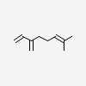
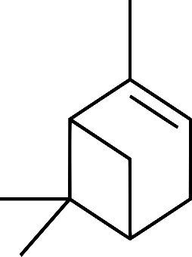




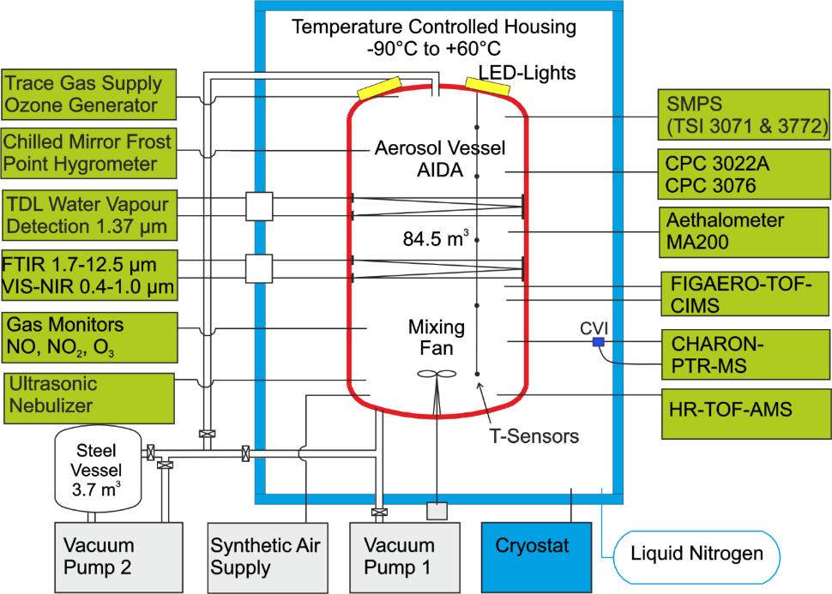
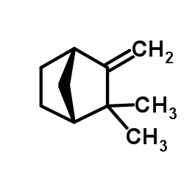
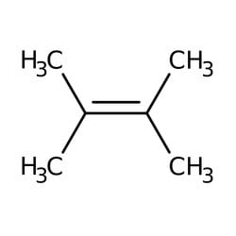
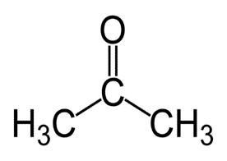





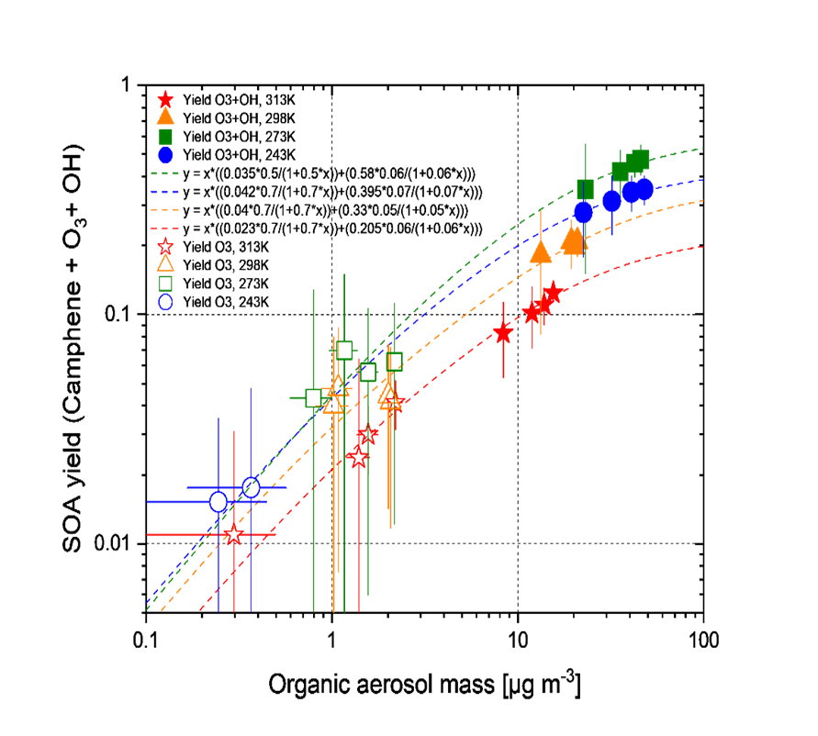
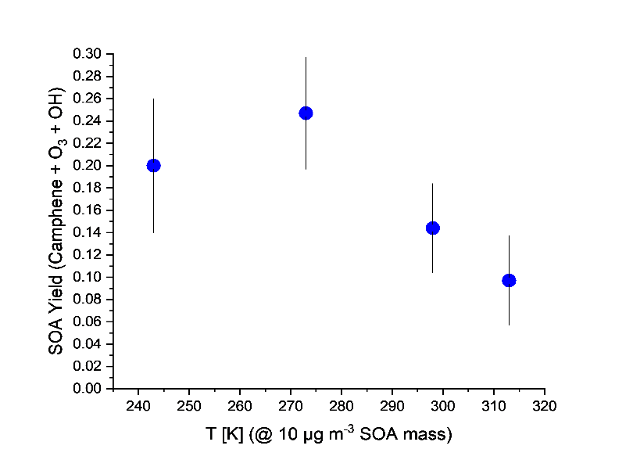


Institute of Meteorology and Climate Research (IMK）
Atmospheric Aerosol Research (IMK-AAF)
Secondary organic aerosol from oxidation of camphene with ozone and OH radicals – kinetics, yields and molecular composition at 313 – 243K
Uzoamaka Ezenobi, H.Saathoff, Yanxia Li, and T. Leisner
Motivation & Methods
Fig.1
Camphene is an important biogenic VOC contributing to secondary organic aerosol
formation, with implications for particle growth and climate-relevant processes. ¹⁾³⁾
Only a few studies covering 288–311 K ³⁾²⁾¹⁾ exist, limiting its representation in
atmospheric models.
NO₃
Radiative forcing
O₃
OH
SOA
Atmospheric Oxidants
AIDA simulation chamber, instrumentation, and experimental conditions
Fig.2
+
O₃
SOA
VOCs precursors
☁️☁️☁️☁️ ☁️☁️☁️☁️
+
O₃
OH•
+
+
Prod.
CCN
Temperatures: 243, 273, 298, 313K
Pressure: 1 atm
Humidity: 13 – 85 %
Seed particles: (NH₄)₂SO₄
Camphene: 26 – 44 ppb
O₃ : 2.18 – 3.72 ppm
50 cm³/min of 1% TME in N₂
Atmosphere biosphere feedback
Results: Kinetics of camphene + O₃ and OH radicals, SOA yields & composition
Fig.3,a)
Kinetics
SOA yields of camphene + O₃ and OH radicals
+
O₃
→ Products
Fig.3,b)
+
OH•
→ Products
Fig.4,a)
ΔH_{R} = 17.1 ± 1.5 KJ/mol
k = (6.7 ± 4.1) × 10 ⁻¹⁶ exp[-(2055 ± 174)/T]
ΔH_{R} = 6.3 ± 0.3 KJ/mol
k = (4.1 ± 0.2) × 10 ⁻¹² exp[-(756 ± 32)/T]
Fig.4,b)
Camphene + O₃
SOA molecular composition
Camphene + O₃ + OH
Fig.5,a)
C₉H₁₆O₄
C₁₇H₃₀O₃
Camphene + O₃
Fig.5,b)
C₉H₁₆O₃
C₉H₁₆O₄
C₂H₂O₄
C₉H₁₄O₄
C₁₆H₂₆O₆
C₁₈H₃₆O₇
C₇H₁₀O₆
C₁₀H₁₈O₄
C₁₈H₂₂O₈
C₁₃H₂₄O₅
C₈H₁₂O₅
C₃H₁₆O₂
C₁₀H₂₀O₂
C₉H₁₂O₅
C₉H₁₆O₃
C₁₀H₁₂O₈
C₃H₆O₃
C₉H₁₂O₅
C₉H₁₂O₅
Temperature ↓ → yield peaks at 273 K
Higher OA mass → yield ↑
Conversion of SVOC to LVOC by OH → yield ↑
Higher yields observed by OH radical reactions
Main products are: C₂H₂O₄, C₃H₆O₃, C₉H₁₆O₃, C₉H₁₆O₄ and C₉H₁₂O₅
Heavier monomers and more dimers formed at lower temperatures
HOMs are more abundant in the OH radical system compared to ozonolysis
C₂H₂O₂
C₃H₆O₃
C₉H₁₂O₅
C₆H₆O₅
C₁₁H₂₀O₅
C₇H₁₀O₅
C₈H₁₀O₅
C₉H₁₂O₅
C₃H₆O₃
C₉H₁₂O₅
C₆H₆O₅
Conclusion
References
A linear Arrhenius behavior is observed showing a positive temperature dependence for O₃ and negative for OH radicals while the ozonolysis is too slow to have impact in the atmosphere.
The reaction rate determined for O₃ shows a stronger temperature dependence than in the literature.
The SOA yield is dominated by OH radical reactions and shows a nonlinear temperature dependence.
The SOA composition shows heavier monomers and more dimers at lower temperatures.
Gaona-Colmán et al., RSC Adv., 7, 2733–2744, https://doi.org/10.1039/c6ra26656h, 2017.
Mehra et al., Atmos. Chem. Phys., 20, 10953-10965, https://doi.org/10.5194/acp-20-10953-2020, 2020.
Li et al., Atmos. Chem. Phys., 22(5), 3131–3147. https://doi.org/10.5194/acp-22-3131-2022, 2022.
Contact: uzoamaka.ezenobi@kit.edu

