Slide 1






Evaluating Environmental and Temporal Performance of Machine Learning Calibration Models for Low-cost Particulate Matter Sensors: A Case Study Across 4 Indian Cities
Supplementary Information
Roshan Wathore^{1,2*}, Devishree Jadhao¹, Abhishek Chakraborty^{3,4}, and Nitin Labhasetwar^{1,2 #}
¹CSIR-National Environmental Engineering Research Institute, CSIR-NEERI, Nagpur 440020, India
²Academy of Scientific and Innovative Research (AcSIR), Ghaziabad 201002, India
³Environmental Science and Engineering Department, Indian Institute of Technology Bombay, Mumbai, 400076, India
⁴Centre for Climate Studies, Indian Institute of Technology Bombay, Mumbai, 400076, India
# Current affiliation: Somaiya Institute for Research and Consultancy (SIRAC), Somaiya Vidyavihar University (SVU), Mumbai - 400077, India
* Corresponding author Email address: r.wathore@neeri.res.in

Slide 2
Evaluation Metrics of the best performing models (Delhi)
Model | Model Name | RMSE (µg/m³) | R² | NRMSE | Slope | Intercept
MLR | 7 parameters | 33.6618 | 0.8182 | 0.3231 | 1.0699 | -2.4952
RF | 7 parameters | 21.6314 | 0.9249 | 0.2076 | 1.0951 | -5.6541
XGB | 7 parameters | 21.9805 | 0.9225 | 0.2110 | 1.0824 | -4.1549
Hybrid | Best 3 | 20.7565 | 0.9308 | 0.1992 | 1.0654 | -2.6320
Table S1. Model performance in Delhi shows a substantial reduction in RMSE from 33.66 µg/m³ (baseline) to 20.76 µg/m³ (hybrid), indicating significant improvement in predictive accuracy with machine learning approaches

Slide 3
Evaluation Metrics of the best performing models (Hamirpur)
Model | Model Name | RMSE (µg/m³) | R² | NRMSE | Slope | Intercept
MLR | 5 parameters (H) | 8.2225 | 0.9539 | 0.2003 | 1.0131 | -0.4317
RF | 5 parameters (M) | 6.6994 | 0.9694 | 0.1632 | 0.9347 | 1.8674
XGB | 7 parameters | 8.0715 | 0.9555 | 0.1967 | 0.9834 | 0.5480
Hybrid | Best 3 | 7.2777 | 0.9638 | 0.1773 | 0.9493 | 1.5284
Table S2. For Hamirpur, RMSE is reduced from 8.22 µg/m³ (baseline) to 6.70 µg/m³ with Random Forest, with the hybrid model maintaining low error while ensuring consistent overall performance

Slide 4
Evaluation Metrics of the best performing models (Bangalore)
Model | Model Name | RMSE (µg/m³) | R² | NRMSE | Slope | Intercept
MLR | 7 parameters | 4.8292 | 0.8839 | 0.1903 | 1.0072 | -0.4465
RF | 7 parameters | 2.0968 | 0.9781 | 0.0826 | 1.0233 | -0.7755
XGB | 7 parameters | 2.5717 | 0.9670 | 0.1013 | 1.0130 | -0.5336
Hybrid | Best 3 | 1.9210 | 0.9816 | 0.0757 | 1.0002 | -0.1344
Table S3. A substantial RMSE reduction (~60%) in Bangalore demonstrates strong gains in predictive accuracy, with the hybrid model achieving the lowest error

Slide 5
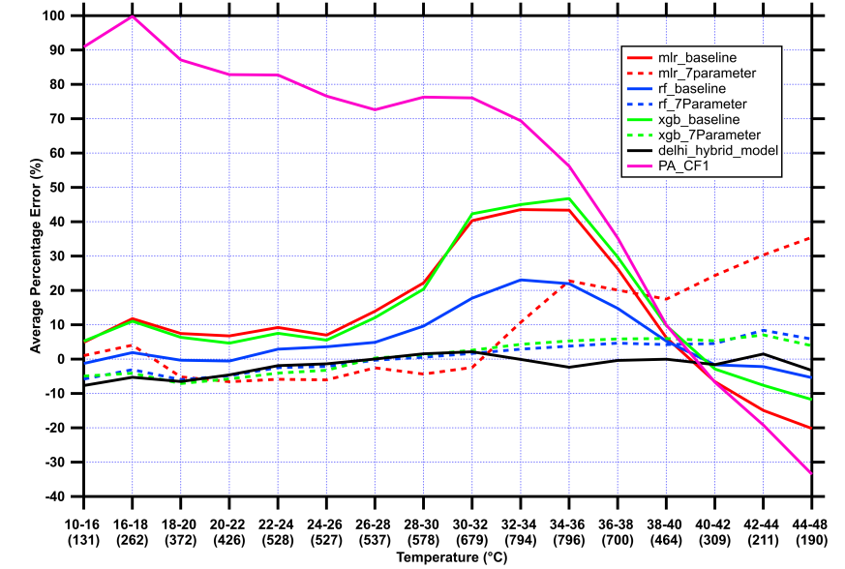
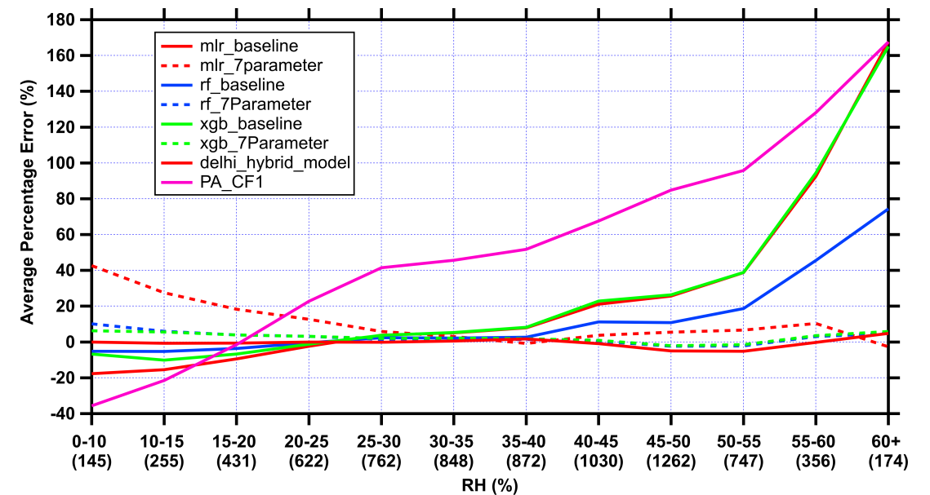
Model Evaluation Under Environmental Conditions (Delhi)
Temperature Relative Humidity
Figure S1. The hybrid model consistently maintains near-zero error (±5%) across nearly all temperature and RH ranges, outperforming all baselines. The 7-parameter variants (mlr, rf, xgb) substantially reduce errors of their respective baselines, while xgb_7Parameter performs closest to the hybrid model, particularly at moderate RH levels.

Slide 6
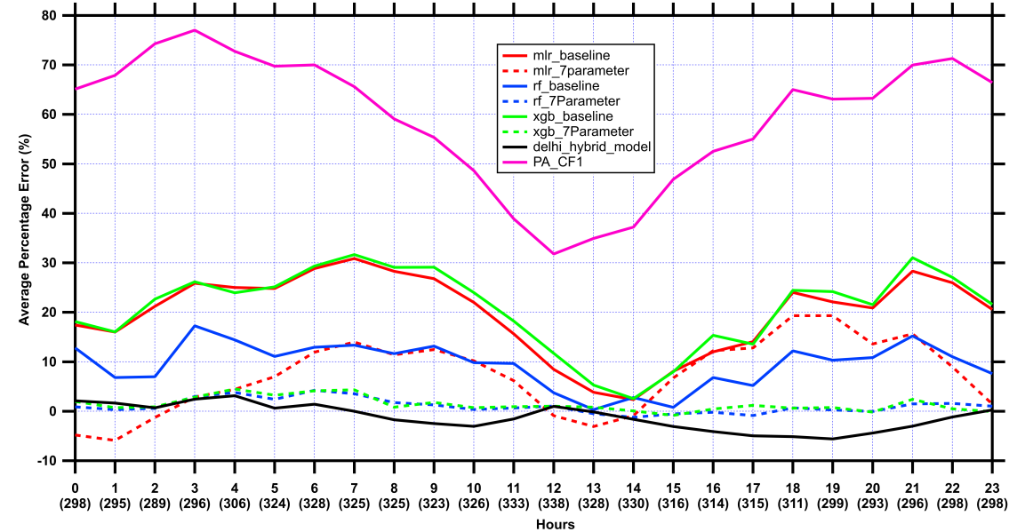
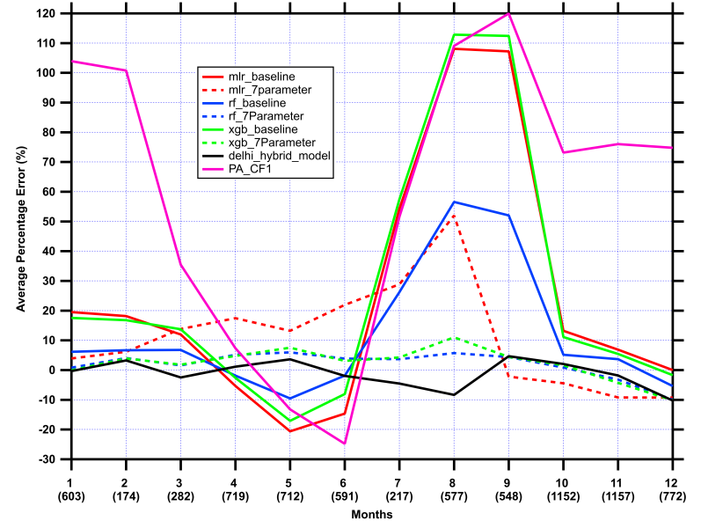
Model Evaluation Under Temporal Conditions (Delhi)
Hour of the Day Month of the Year
Figure S2. The hybrid model remains the most stable across all hours (within ±5%) and seasons (within ±10%) whereas baseline MLR and XGB models show elevated errors (~20–30%) during daytime hours and monsoon season, reflecting humidity-driven aerosol hygroscopic growth. The 7-parameter corrections markedly reduce seasonal and diurnal bias across all ML models.

Slide 7
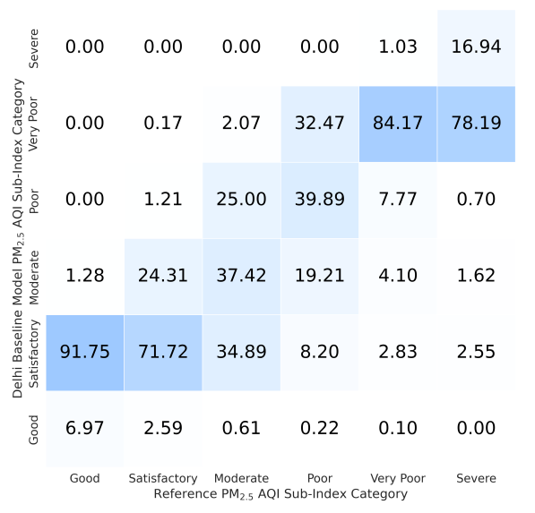
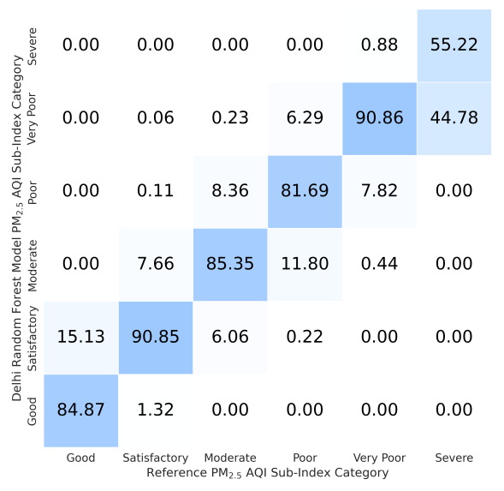
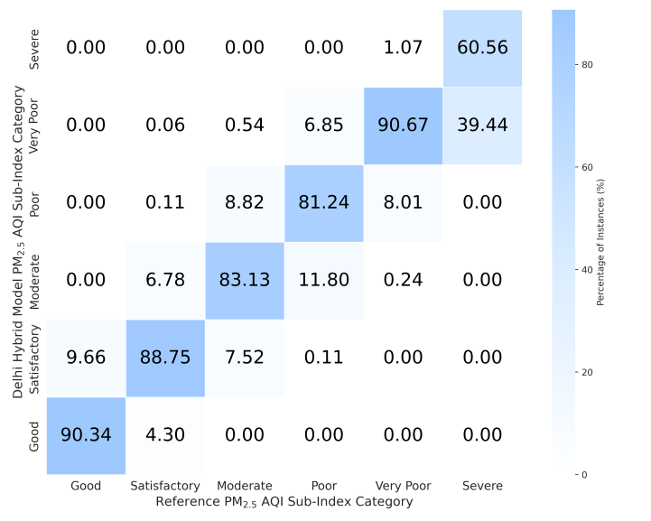
AQI Classification - Delhi
Baseline Random Forest Hybrid
Figure S3. Random forest improves predictions in mid-range pollution levels but overall hybrid model enhances sensitivity to higher pollution levels while maintaining overall classification accuracy

Slide 8
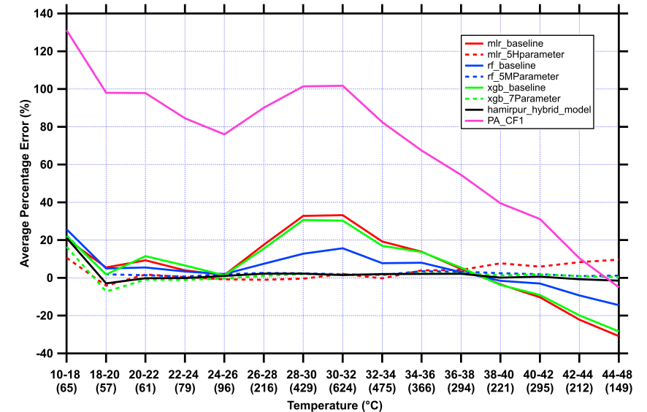
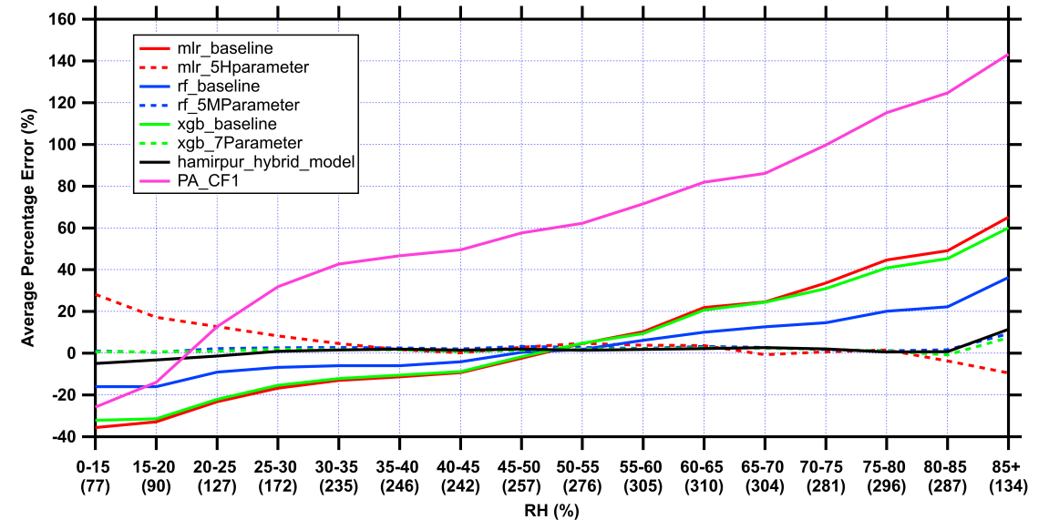
Model Evaluation Under Environmental Conditions (Hamirpur)
Temperature Relative Humidity
Figure S4. The hybrid model maintains near-zero error (within ±5%) across all temperature and RH ranges, demonstrating the strongest overall performance. Baseline MLR and XGB models show moderate overestimation (~25-33%) in the 28-32 °C range and increasing negative bias at high temperatures, while their 5H/7-parameter variants substantially reduce these errors, remaining close to zero across most bins.

Slide 9
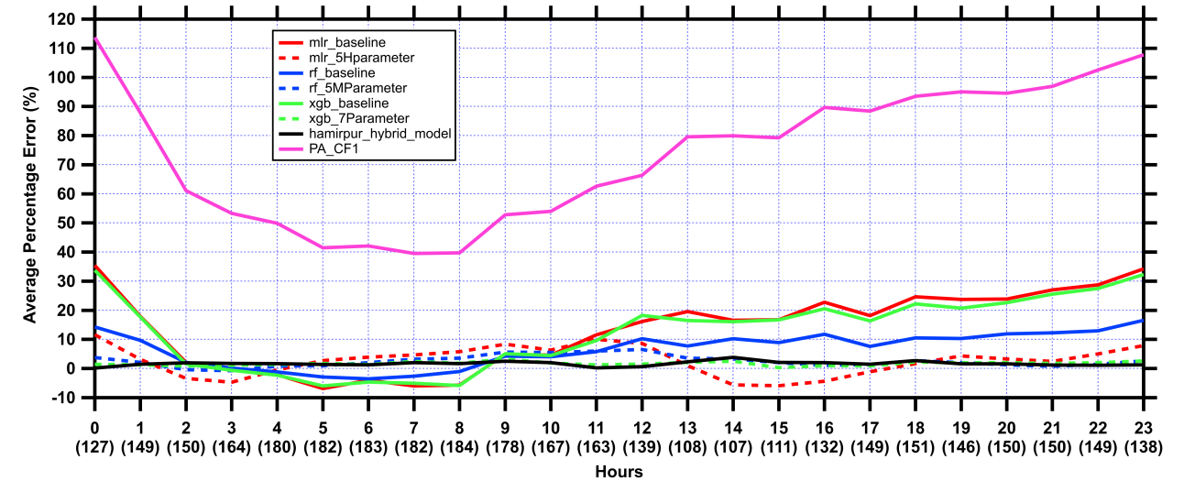
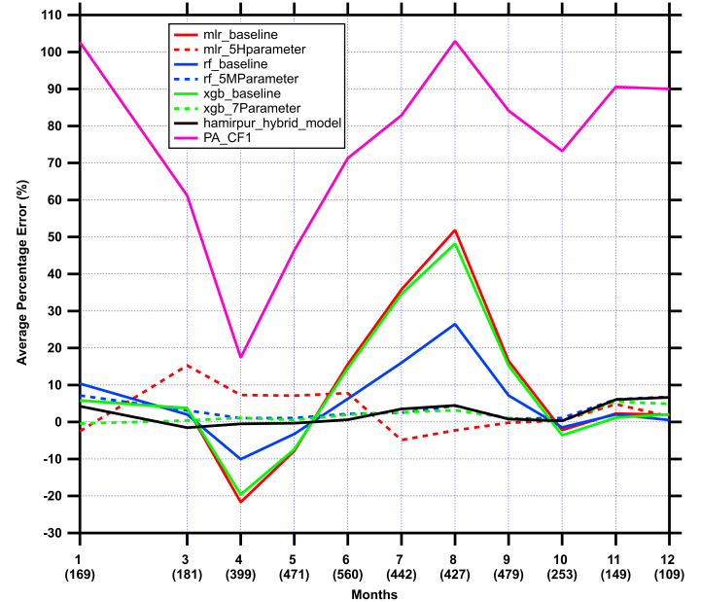
Model Evaluation Under Temporal Conditions (Hamirpur)
Hour of the Day Month of the Year
Figure S5. Average percentage error by hour-of-day (0–23) and month (1–12) at Hamirpur. Hybrid model is the most stable model across all hours (within ±5%) and months (within ±8%), with no notable diurnal or seasonal drift. Baseline MLR and XGB models show increasing positive bias through afternoon and evening hours (~20–35%) and a sharp monsoon-season peak (~50%), which the 5H/7-parameter corrections substantially reduce, bringing errors near zero across most hours and months.

Slide 10
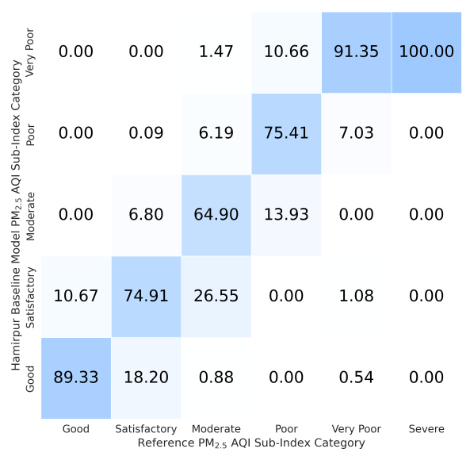
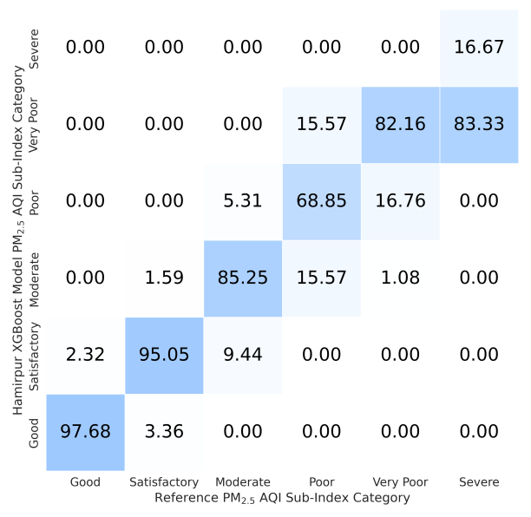

AQI Classification - Hamirpur
Baseline XGBoost Hybrid
Figure S6. The hybrid model reduces confusion between ‘Poor’ and ‘Very Poor’ categories indicating improved sensitivity to extreme pollution conditions

Slide 11
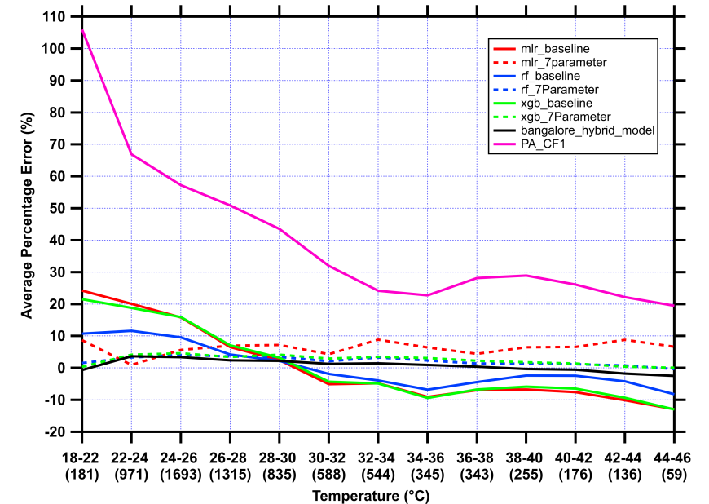
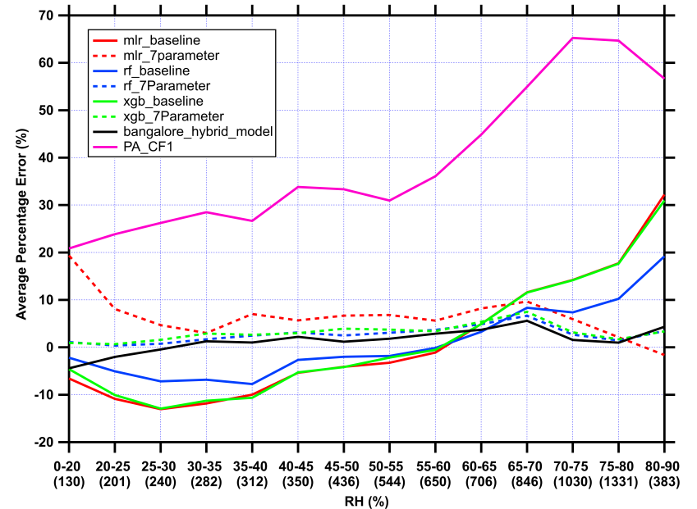
Model Evaluation Under Environmental Conditions (Bangalore)
Temperature Relative Humidity
Figure S7. Hybrid model maintains near-zero error (within ±5%) across all temperature and RH ranges, consistently outperforming all other models. Baseline MLR and XGB models exhibit moderate overestimation (~20-24%) at lower temperatures and a systematic negative bias (~-10%) at mid-range RH (20-45%), which the 7-parameter corrections largely resolve, keeping errors within ±5% across most bins.

Slide 12
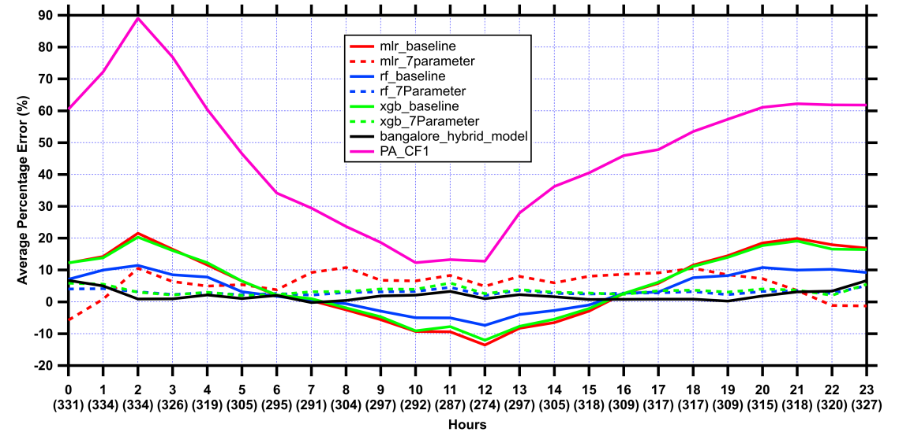
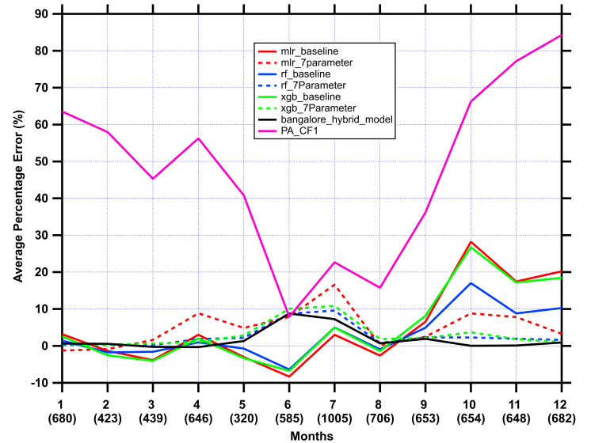
Model Evaluation Under Temporal Conditions (Bangalore)
Hour of the Day Month of the Year
Figure S8. Hybrid model is the most stable across all hours (within ±5%) and months (within ±10%), showing no significant diurnal or seasonal drift. Baseline MLR and XGB models show a moderate October peak (~28%) that the 7-parameter corrections largely suppress, keeping seasonal bias near zero.

Slide 13
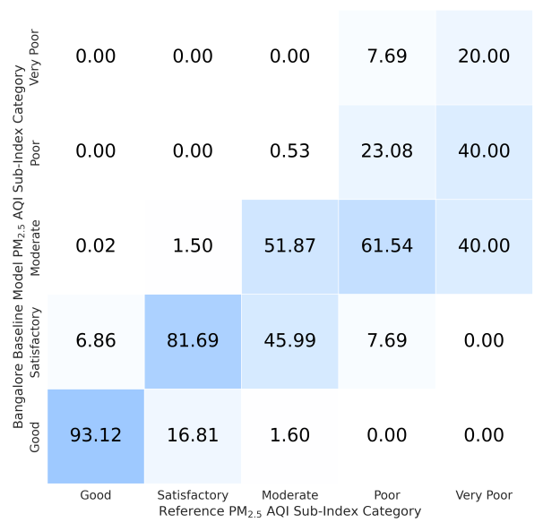
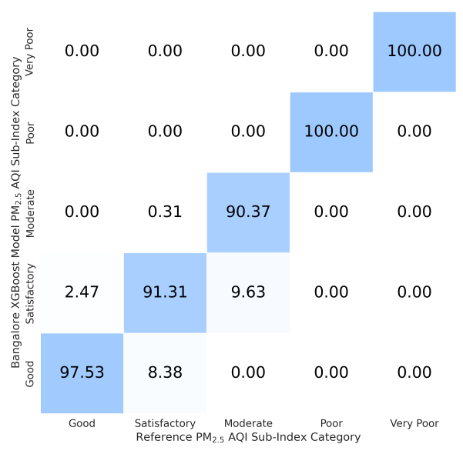
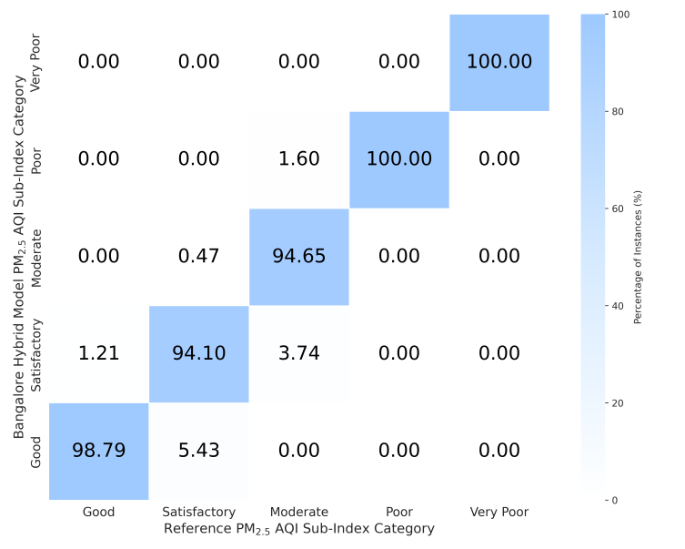
AQI Classification - Bangalore
Baseline XGBoost Hybrid
Figure S9. A similar trend is observed where XGBoost and hybrid models better capture extreme conditions (‘Poor’ and ‘Very Poor’) while the baseline performs reliably only under ‘Good’ conditions

