Slide 1


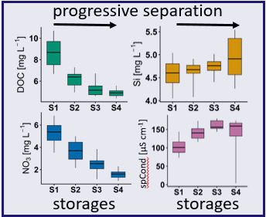
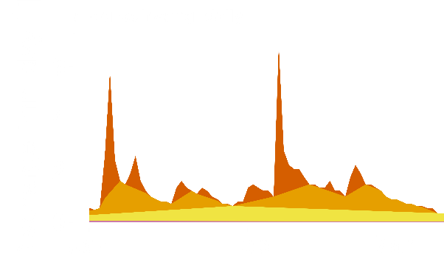
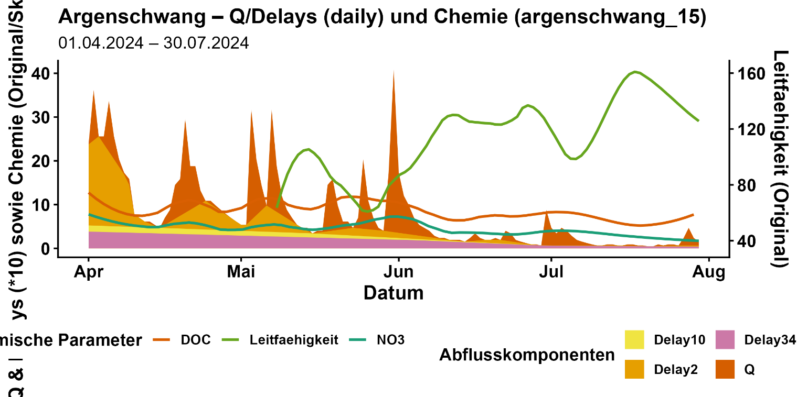
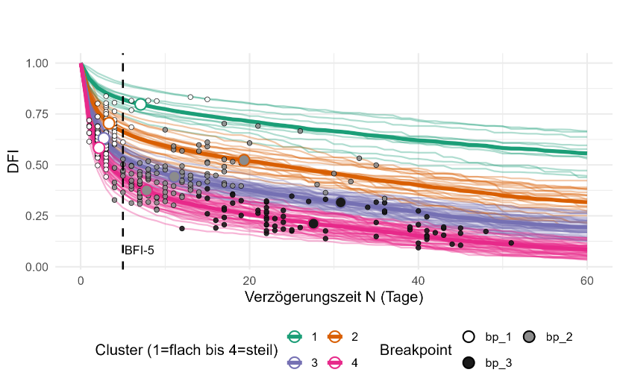
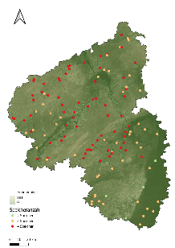
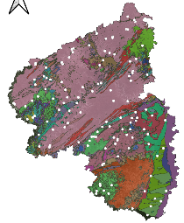
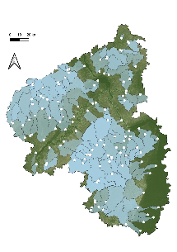
Are hydro-graphically assessed streamflow components hydro-chemically meaningful?
Sofia Frietsch and Tobias Schütz
University of Trier
Motivation
Hydro-chemical signature
DelayedFlowIndex⁺
Develop a work routine to identify dynamic catchment storages.
Opportunities & Application Fields
Methods
Results & Discussion
Components
DFI⁺: A hydrographical multi-filter algorithm and linear storage detection method derived from the Baseflow Index (IH-UK).
fast
moderate
Beyond BFI -
Identification of streamflow
components
delayed
high delayed
Conclusion
DFI⁺-derived streamflow components correlate with distinct solute signatures.
Morphology-driven
storage complexity
References & Authors

Slide 2
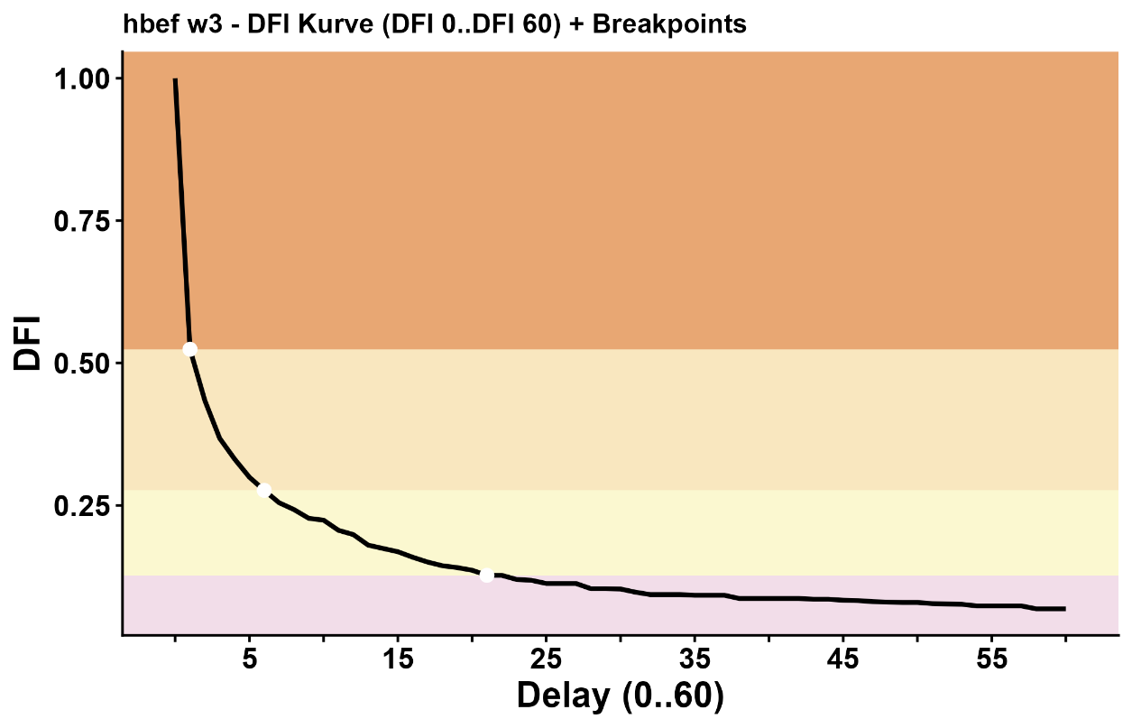
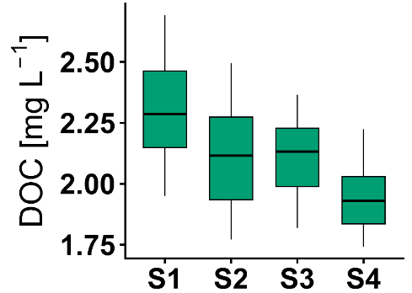
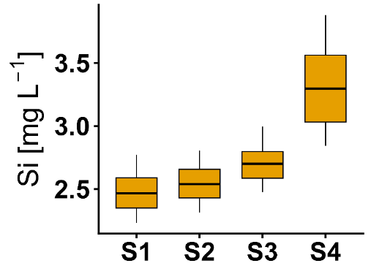

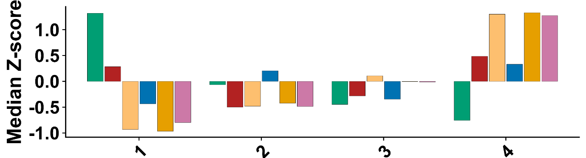


Are hydro-graphically assessed streamflow components hydro-chemically meaningful?
Sofia Frietsch and Tobias Schütz
CDC: Catchment HBEF (USA)
progressive separation
S1
Storage 1
DFI
S2
Storage 2
S3
PICO 4.15
S3
storages
storages
S4
S4
Filter: Delay N (0-60 days)
!
DFI⁺-components confirming their hydro-chemical relevance.
Catchments with 4 storages
chemical parameters
storages

Slide 3

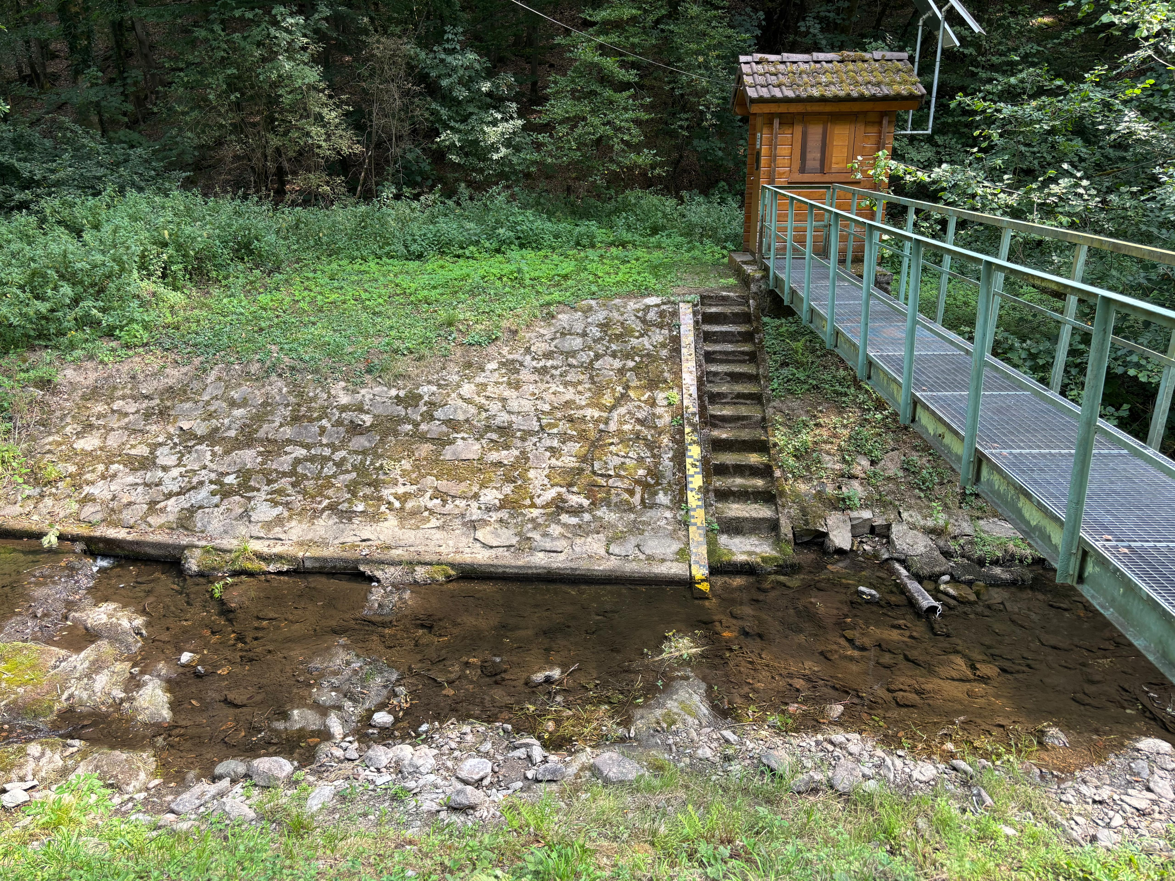
Motivation
Increasing hydrological extremes
Hydrological extremes are intensifying worldwide, with more severe droughts and rainfall, increasing variability and pressure on water resources.
Knowledge gap in catchment functioning
Storage-flow interactions in complex hydrogeological systems remain poorly understood, especially regarding streamflow generation under dry conditions.
Drought and low-flow event
from February to April 2025 (Hunsrück, Germany)

Slide 4
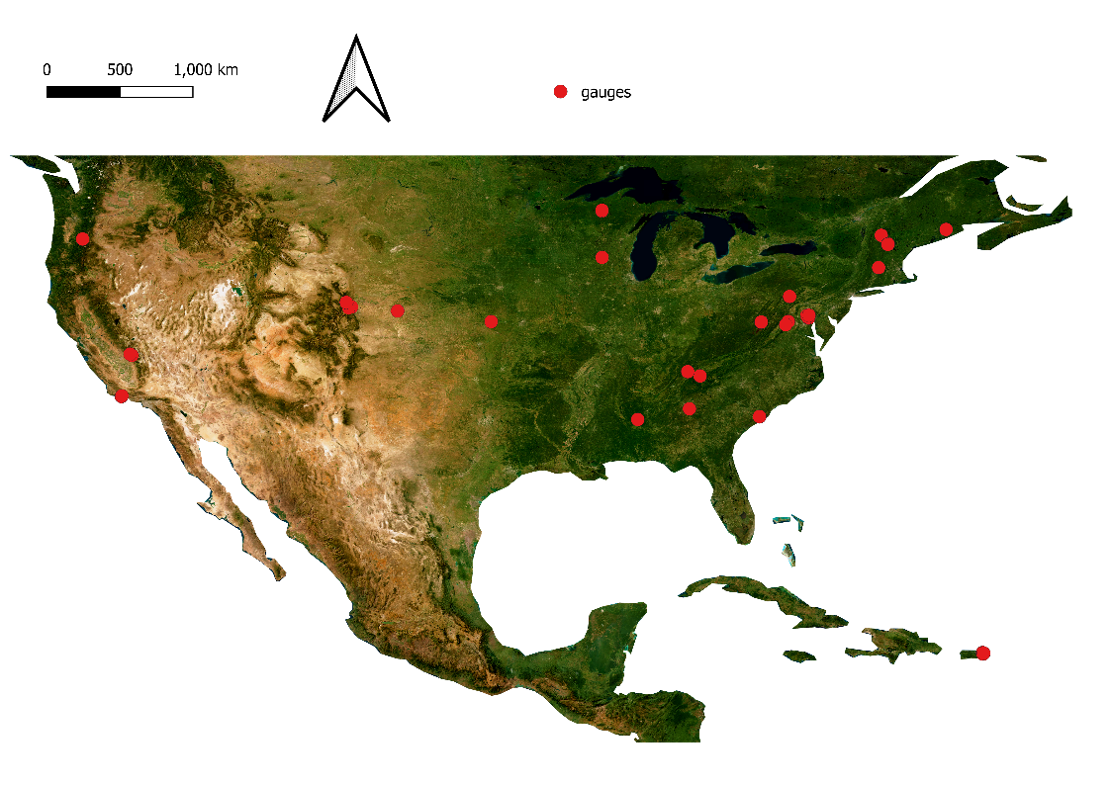

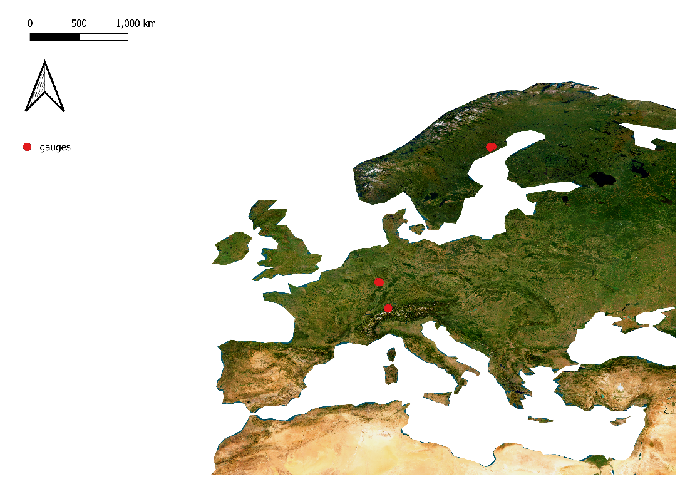

Motivation
Limitations of existing approaches
Many methods are too data-intensive or too complex, limiting their transferability and applicability across diverse catchments.
Need for parsimonious frameworks
DFI⁺ is a simple approach leverages existing (discharge) data structures to identify key streamflow components and storage dynamics to support predictions.
Relevance for water management
Better understanding improves flood mitigation, drought resilience, and sustainable water management.
Diverse catchments across the world
USA
Europe

Slide 5
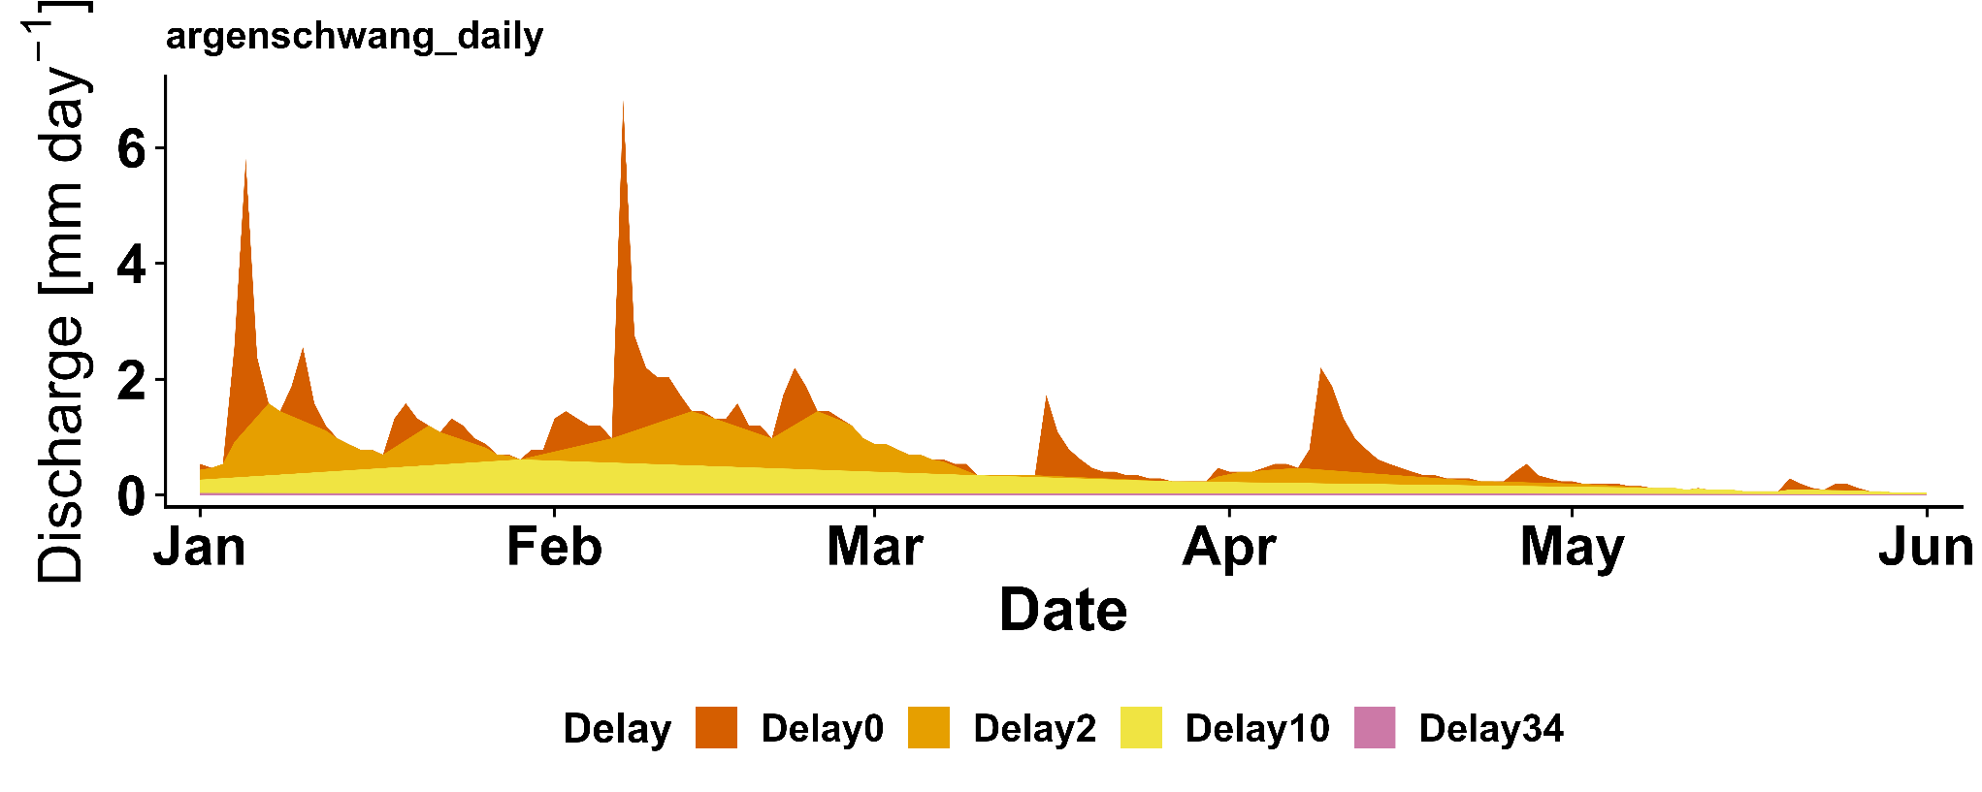
Methods
Approach: Delayed Flow Index⁺ (DFI⁺), a hydrographical filter algorithm (Stoelzle et al., 2020) combined with a linear storage detection approach
Testing the hydro-chemical interpretability of DFI⁺-derived linear storage by using data of nested catchments in Switzerland, Germany, Sweden, and the United States.
Are streamflow components with different delays hydrochemically meaningful?
streamflow components:
fast
moderate
delayed
highly delayed

Slide 6
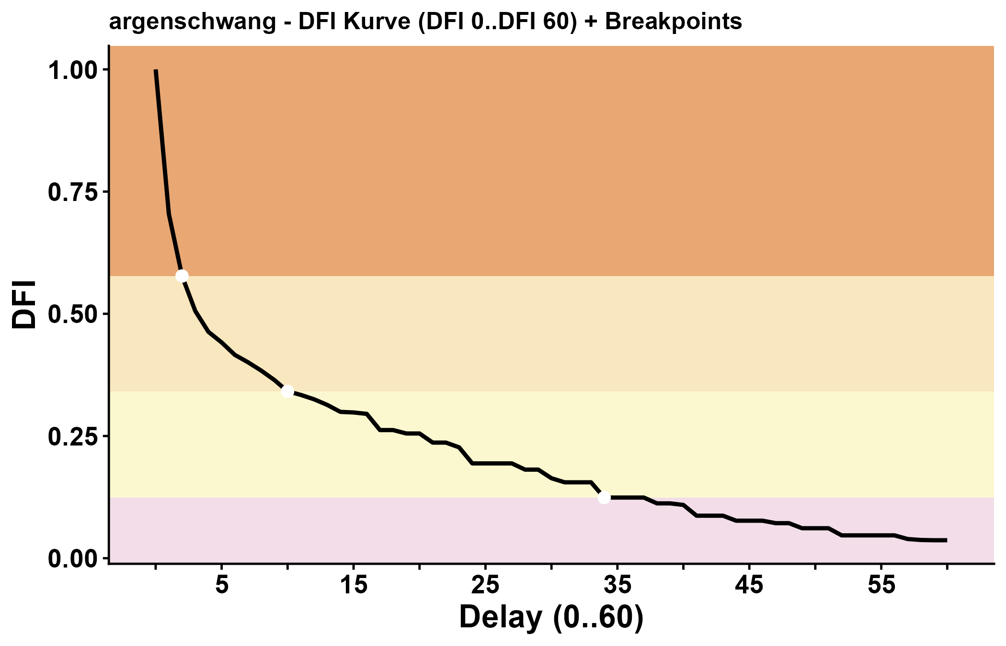

Methods
CDC: Catchment Hunsrück (Germany)
The Delayed Flow Index (DFI), derived from the Baseflow Index (IH-UK), generates Characteristic Delay Curves (CDCs) that describe catchment drainage behaviour as a function of delay (N days).
Storage 1
DFI
S 2
S 3
$$DFI(N)= \frac{delayed flow at delay N }{total flow}$$
S 4
Filter: Delay N (0-60 days)

Slide 7
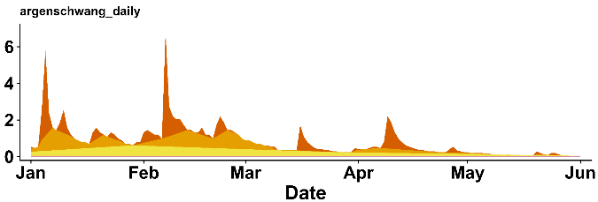

Methods
CDC: Catchment Hunsrück (Germany)
DFI(N) calculation workflow:
Division of the hydrograph into N-day block
Identification of minima within each block
Interpolation between successive lower minima for each filter N (N = 0–60)
Calculation of DFI(N)
Storage 1
hydrograph
DFI
S 2
S 3
S 4
$$DFI(N)= \frac{delayed flow at delay N }{total flow}$$
Filter: Delay N (0-60 days)

Slide 8
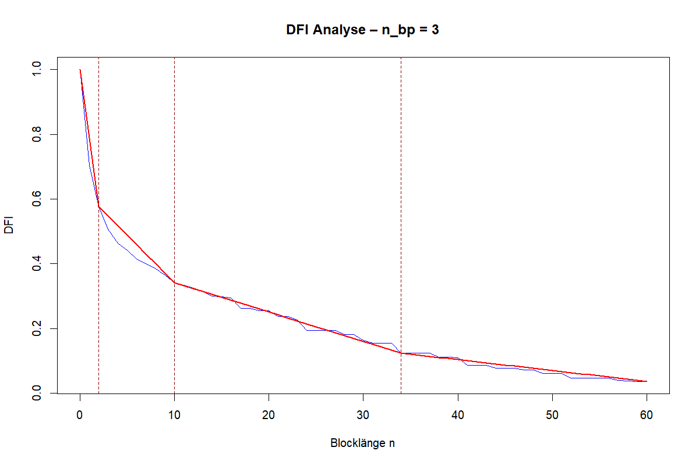

Methods
CDC: Catchment Hunsrück (Germany)
Storage Detection Method for CDC Segmentation
A workflow was developed to segment CDCs into linearly draining subsets.
Each subset represents a homogeneously draining storage (S).
The storage detection method finalizes the DFI⁺ approach.
Storage 1
DFI
S 2
S 3
bias < 0.02
S 4
Filter: Delay N (0-60 days)
$DFI+=$ DFI (N) + storage detection method

Slide 9
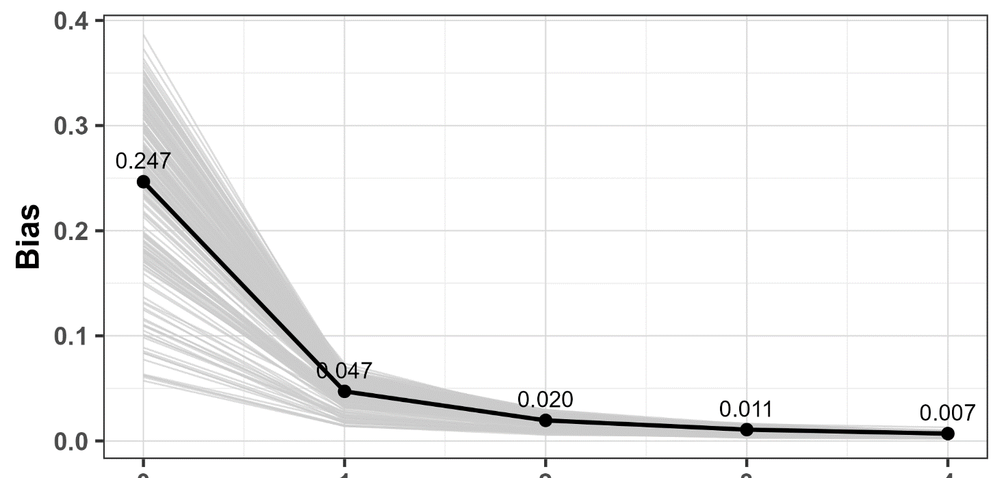
Methods
Model Optimization
Model optimization of the linear storage detection method until bias < 0.02 is achieved (bias defined as the mean of MSE and RMSE, 50:50 weighting).
model over- parameterization
BIAS
1 2 3 4 5
number of linear segments / drainage subsets

Slide 10
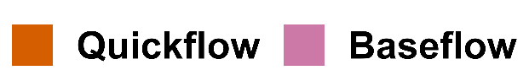


Methods
Delayed Flow Index⁺ (DFI⁺)
High-resolution hydrograph separation
Filters from 0 to 60 days (→ 61 delay curves)
Automatic identification of homogeneously draining storage components (bias < 0.02) adapted to individual drainage behaviour
Convergence between hydrographical and hydrochemical separation
Baseflow Index (BFI)
Dual hydrograph separation
Binary separation
Fixed filter (e.g., 5-day filter)

Slide 11
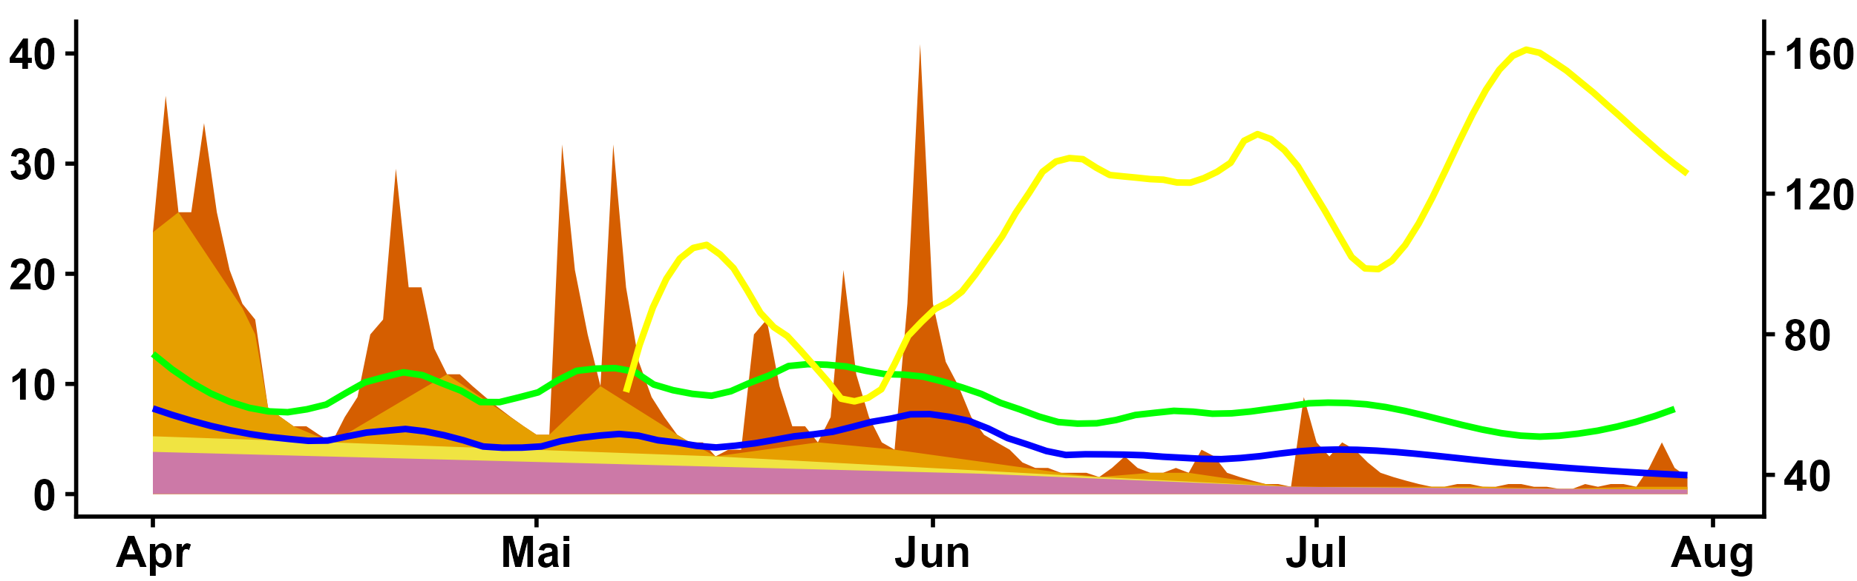
Methods
Chemical signatures are assigned to streamflow components by identifying the shortest delay component equal to the total streamflow.
As delays increase, contributions from faster components are successively removed, leaving only delayed flow components.
This results in a progressive separation of hydrochemical signatures and enables the identification of distinct source areas.
chemical signature assigned to the fast component
NO₃ [mg L⁻¹] DOC [mg L⁻¹] Q*10 [mm day⁻¹]
spCond [µs cm⁻¹]

Slide 12
Methods
Dataset 1:
Multi-catchment dataset across countries:
USA including Puerto Rico
Germany, Sweden, and Switzerland
USA
Setup dataset:
74 nested catchments
Daily measurements of discharge and chemical parameters
Heterogeneous catchment characteristics:
Europe
Diverse landscape
Diverse geology
Diverse climate
Diverse land-use
Various hydrological regimes

Slide 13
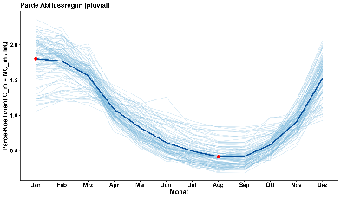



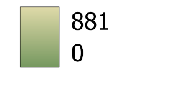
Methods
Dataset 2:
Pardé-Coef. (pluvial)
Multi-catchment dataset across Rhineland-Palatinate:
Region of Germany with divers landscape but identical hydrological regime (Pardé-Coef.)
Q during year
Setup dataset:
123 catchments
Daily discharge measurements for periods >10 years, up to >60 years (n=41)
Heterogeneous catchment characteristics:
Diverse landscape
Diverse geology
Diverse land-use
gauges
catchments
DEM m.a.s.l.

Slide 14
Hydrochemical signature of DFI⁺ streamflow components
CDC: Catchment HBEF (USA)
progressive separation
S1
Storage 1
DFI
S2
Storage 2
S3
S3
storages
storages
S4
S4
Filter: Delay N (0-60 days)
!
DFI⁺-components confirming their hydro-chemical relevance.
Catchments with 4 storages
chemical parameters
storages

Slide 15
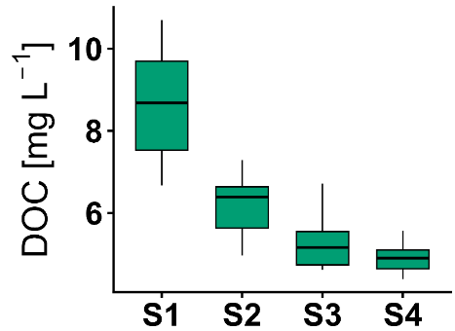
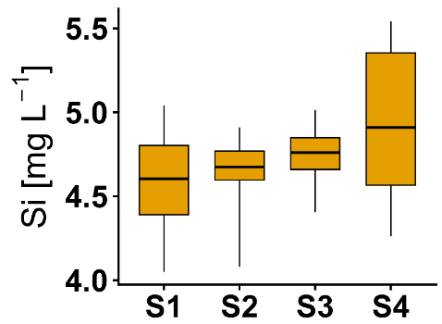

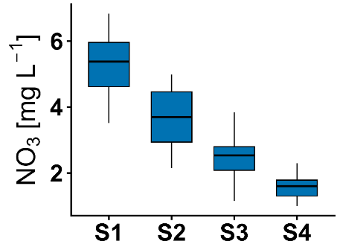
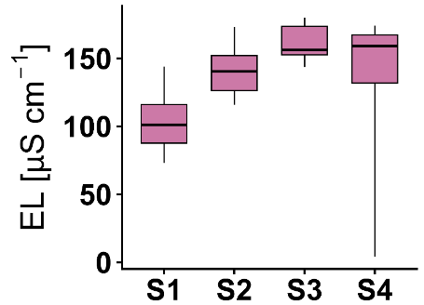
Hydrochemical signature of DFI⁺ streamflow components
Hydrochemical data were used to evaluate the hydrochemical interpretability of streamflow components derived from the DFI⁺.
Progressive separation of storage components (S) during catchment drainage
→ distinct hydrochemical signatures for each subset, reflecting different flow paths and source zones.
progressive separation
CDC: Catchment Hunsrück (Germany)
Storage 1
DFI
S2
spCond [µS cm⁻¹]
S3
S4
storages
storages
Filter: Delay N (0-60 days)

Slide 16
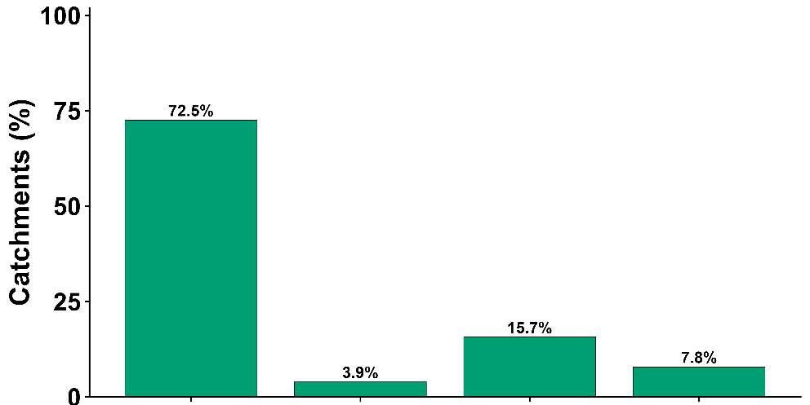
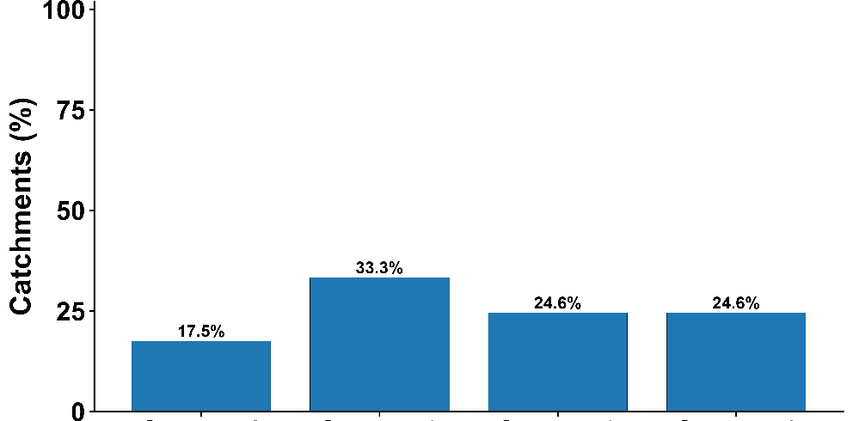
Hydrochemical signature of DFI⁺ streamflow components
Stream flow components and their typical hydrochemical marker
Storage with highest median concentration across catchments worldwide
Streamflow Component | Sto-rage | Typical hydro-chemical marker
Rapid components reflecting near-surface flow | S1 | Dissolved organic carbon (DOC)
Linked to different layers (e.g. biologically active soil layer, NO₃-N-rich groundwater) | S2 | NO₃-N
Delayed components indicating longer residence times and stronger water–rock interaction | S3 & S4 | Silica (Si) and electrical conductivity (spCond)
DOC (n=51)
72.5%
Catchments (%)
15.7%
3.9%
7.8%
NO₃-N (n=57)
Catchments (%)
33.3%
17.5%
24.6%
24.6%
S1 S2 S3 S4
Notes:
Intermediate components linked to biologically active soil layers

Slide 17
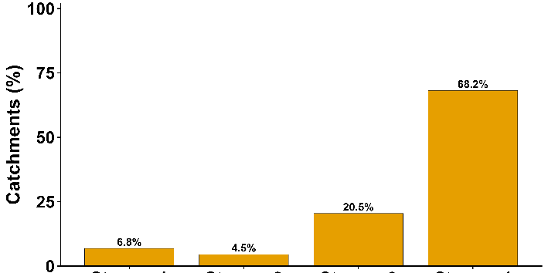
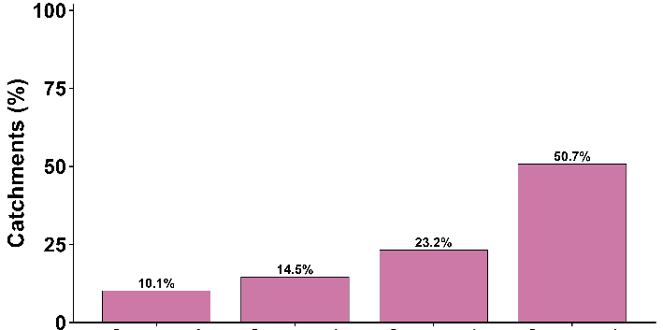
Hydrochemical signature of DFI⁺ streamflow components
Stream flow components and their typical hydrochemical marker
Storage with highest median concentration across catchments worldwide
Streamflow Component | Sto-rage | Typical hydro-chemical marker
Rapid components reflecting near-surface flow | S1 | Dissolved organic carbon (DOC)
Linked to different layers (e.g. biologically active soil layer, NO₃-N-rich groundwater) | S2 | NO₃-N
Delayed components indicating longer residence times and stronger water–rock interaction | S3 & S4 | Silica (Si) and electrical conductivity (spCond)
Si (n=44)
68.2%
Catchments (%)
20.5%
6.8%
4.5%
spCond (n=69)
60.7%
Catchments (%)
23.2%
10.1%
14.5%
S1 S2 S3 S4

Slide 18
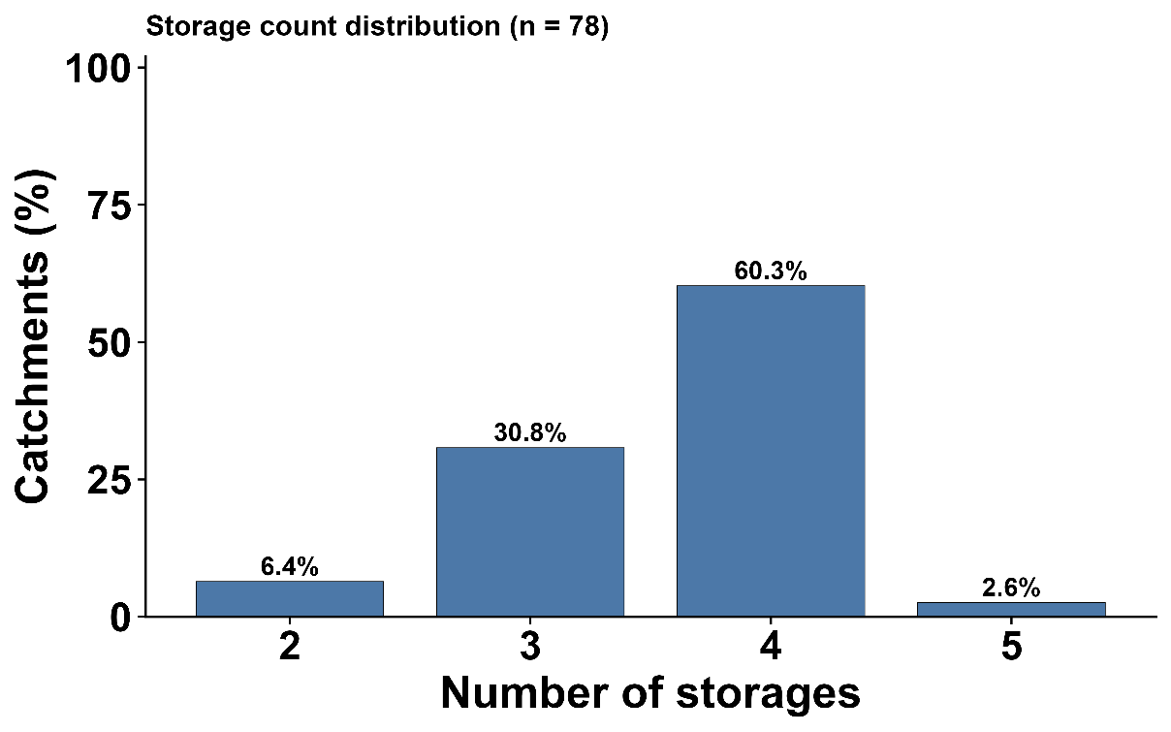
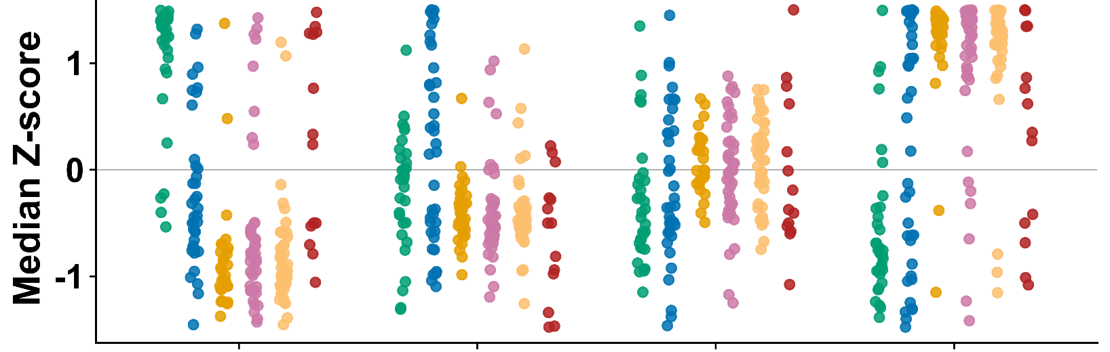
Hydrochemical signature of DFI⁺ streamflow components
Storage count distribution (n=74)
Overall, hydrochemical gradients reflect increasing residence time along flow paths, supporting the interpretation of DFI-derived components as hydrological and hydrochemical meaningful.
es.
chemical parameters
storages 1 2 3 4

Slide 19
Hydrochemical signature of DFI⁺ streamflow components
Storage count distribution (n=74)
Median Z-scores were calculated for each catchment and subsequently averaged across catchments, representing generalized hydrochemical gradients along flow paths, supporting the interpretation of DFI⁺-derived components as hydrochemically meaningful.
es.
catchments with 4 storages (n=45)
chemical parameters
storages

Slide 20
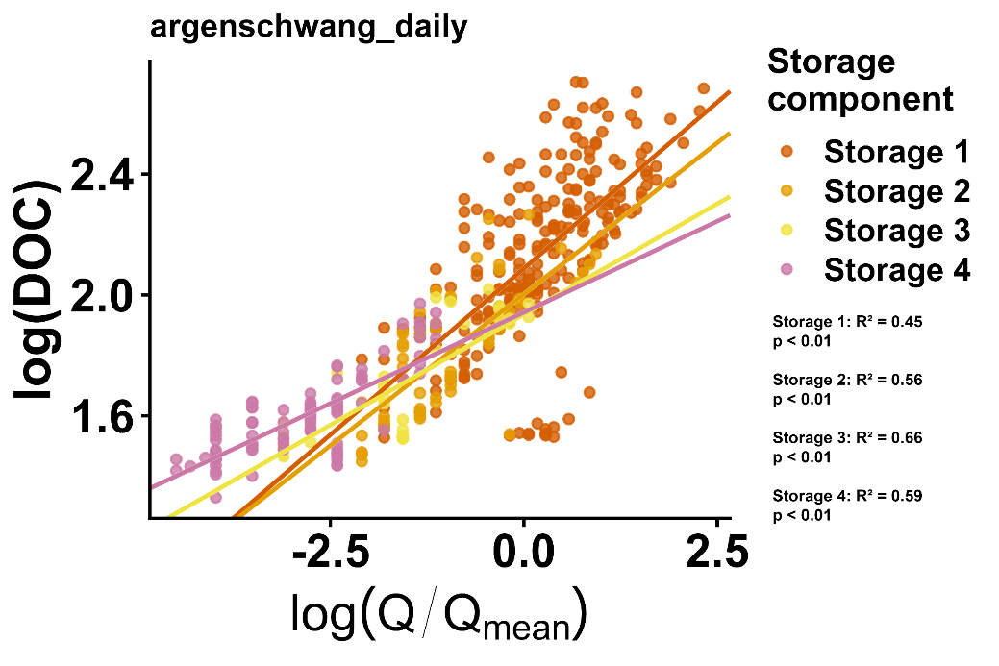
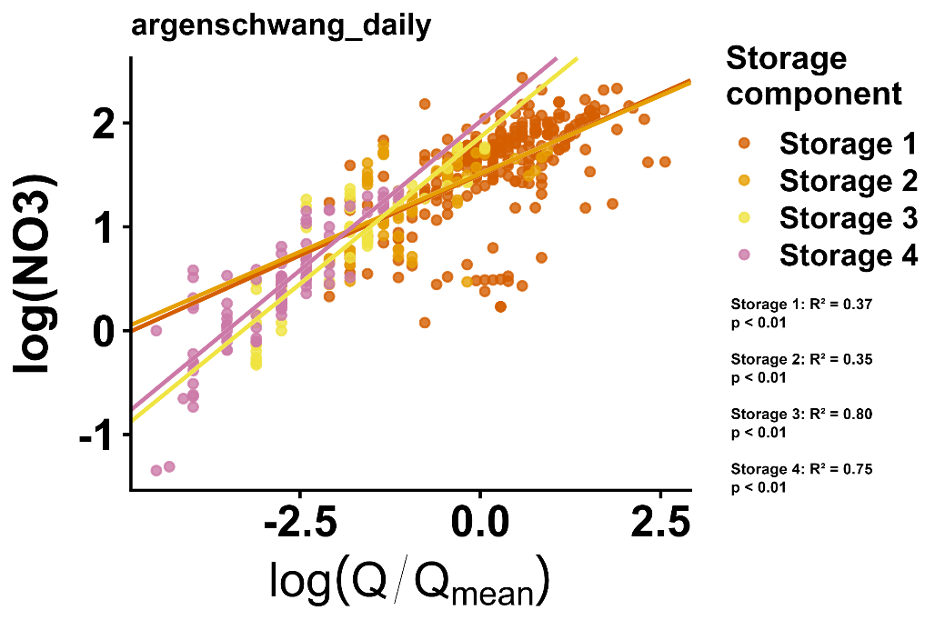
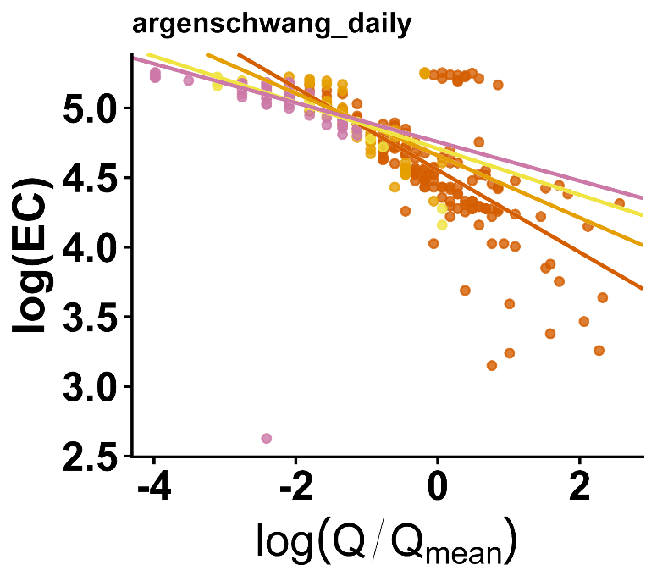
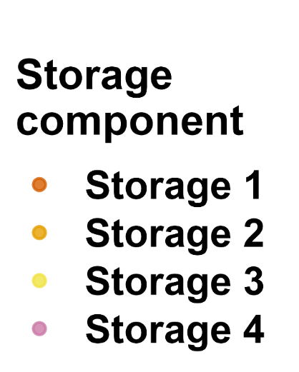
Hydrochemical signature of DFI⁺ streamflow components
Concentration–discharge relationships further demonstrate a strong coupling (p < 0.1) between flow dynamics and solute behaviour in each streamflow component. However, these signals are not strictly chemostatic but vary with discharge and season.
cQ relationships for a catchment in Hunsrück (Germany)
Storage Components
EC (spCond) – electrical conductivity

Slide 21
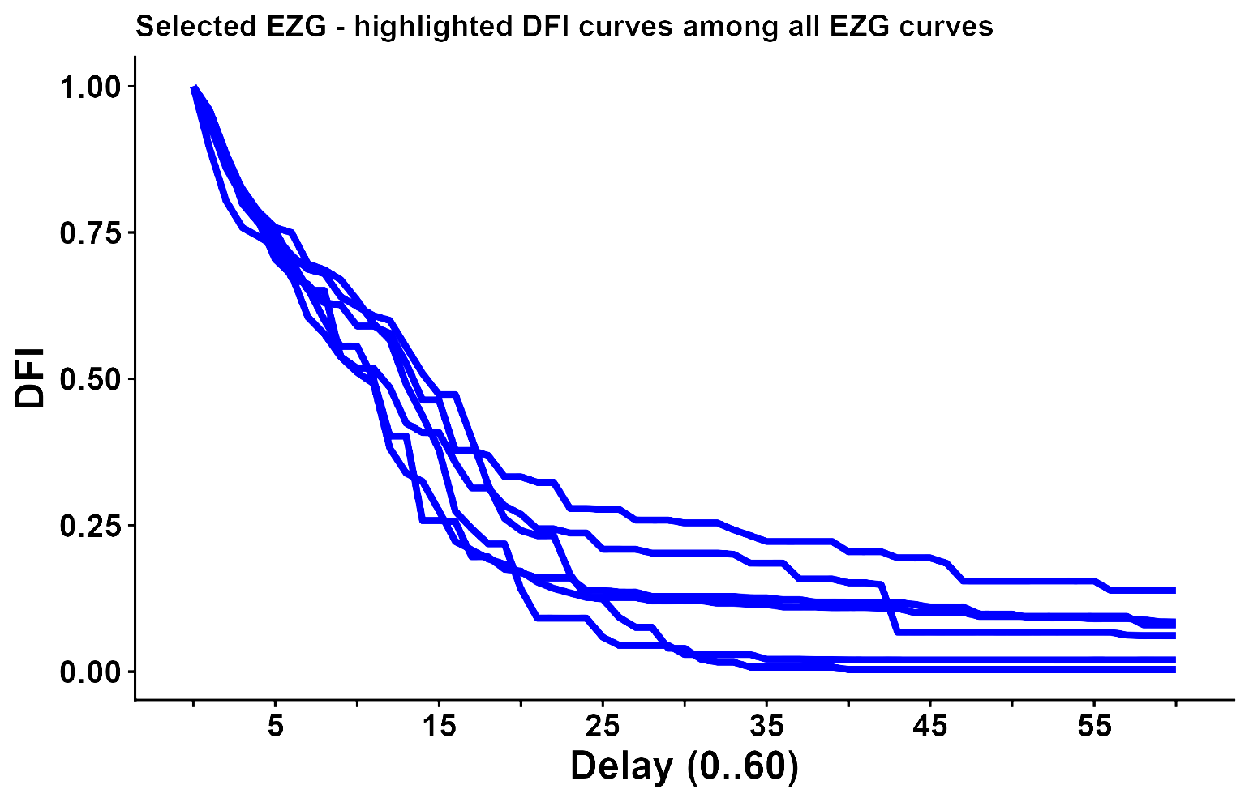
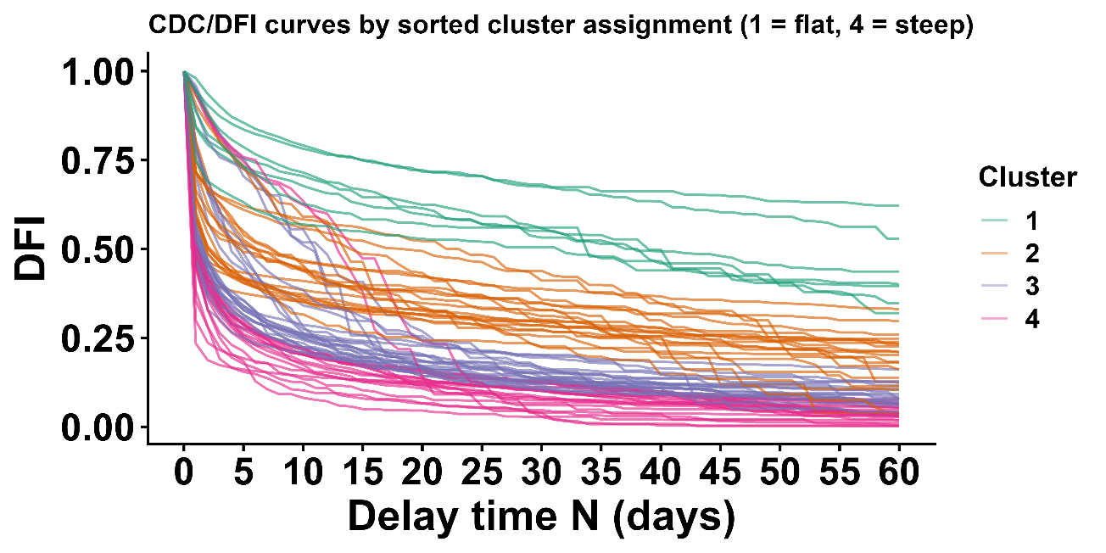
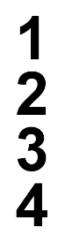
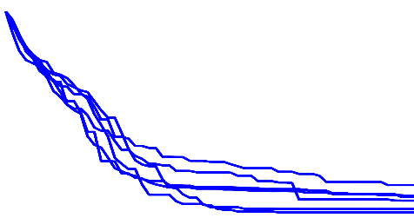

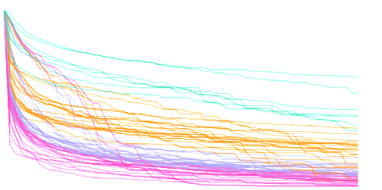
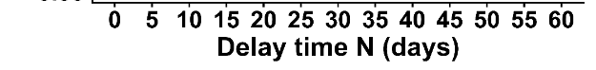
Hydrochemical signature of DFI⁺ streamflow components
The c–Q relationships vary between clusters (1–4) and storage components (S1–S4), suggesting that catchment-specific drainage behaviour influences solute transport. This behaviour is closely linked to the landscape characteristics identified by PCA.
Dataset 1 including catchments worldwide
PCA explanatory variables
cluster of characteristic delay curves (CDCs)
high geological hydraulic conductivity
PCA: static morphological variables (e.g. elevation, geological hydraulic conductivity) dominate over temporal hydrological parameters like hydrological regime
high elevation
catchments under glacial influence
under investigation

Slide 22
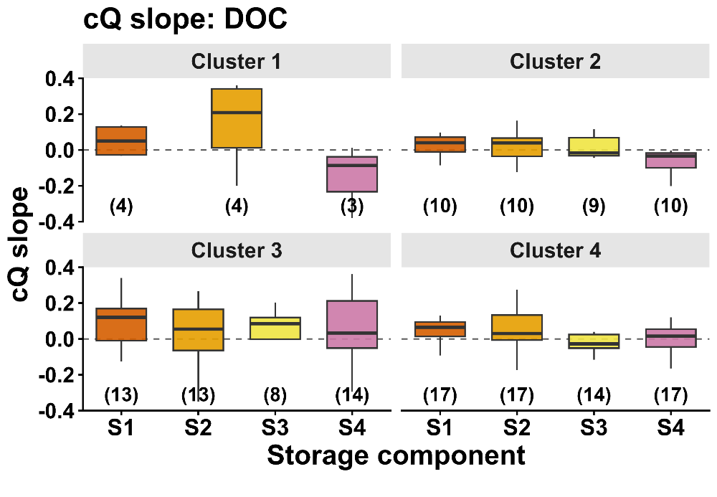
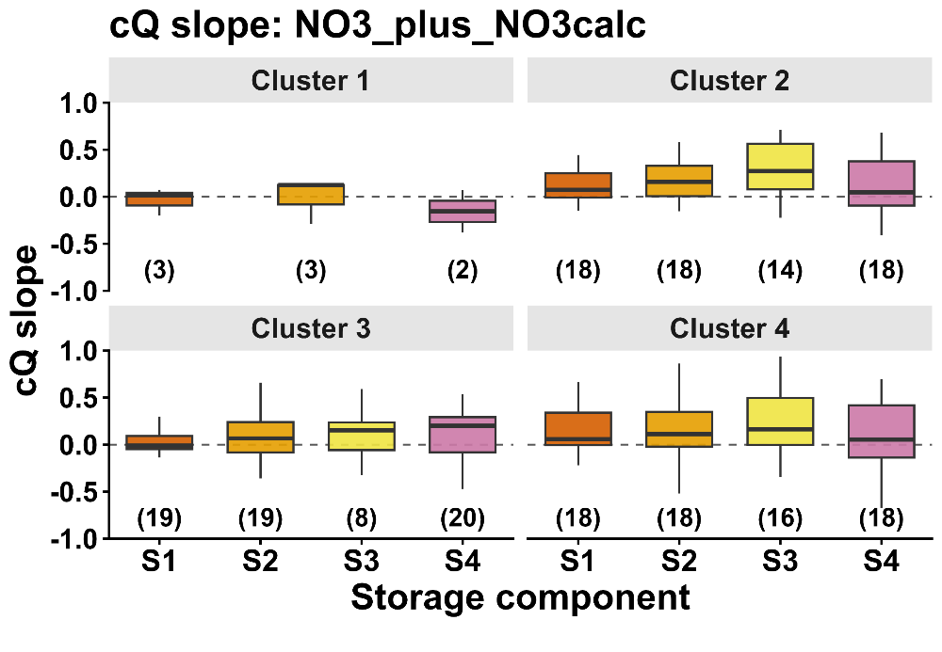
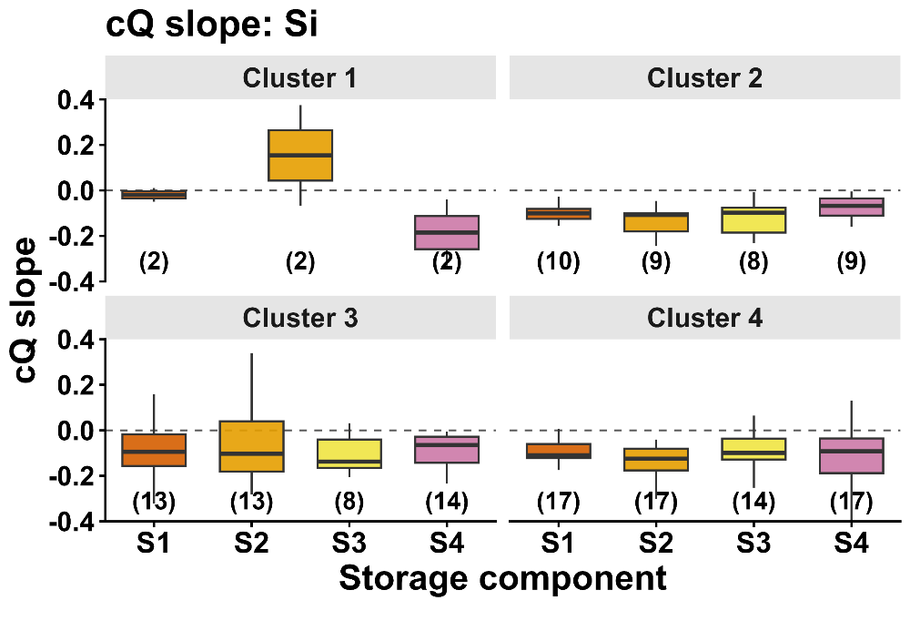
Hydrochemical signature of DFI⁺ streamflow components
The cQ relationships vary between clusters (1–4) and storage components (S1–S4), suggesting that catchment-specific drainage behaviour influences solute transport.
DOC
NO₃
silicate
cQ-slope
storage component
storage component
storage component
Additional catchments are required to verify the differential transport behaviour, particularly for Cluster 1.

Slide 23

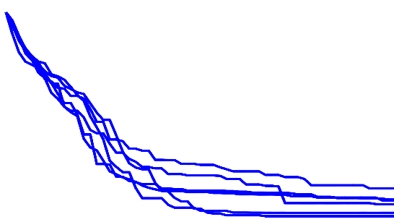


Hydrochemical signature of DFI⁺ streamflow components
The results show that there is an interaction between drainage behaviour and its storage structure, landscape morphology, and solute transport. This is supported by the hydrochemical relevance of DFI⁺-derived components. Further investigations are ongoing to better quantify these relationships.
interaction between…
landscape morphology
drainage behaviour
solute transport

Slide 24
Beyond BFI - Identification of streamflow components
DFI⁺ | BFI
Multi-filter approach (0–60 days) | Fixed filter (e.g., ~5 days), dual separation
Resolves streamflow into multiple linear drainage subsets (DS) | Separates streamflow only into quickflow and baseflow
Each subset represents a distinct delayed response | Leads to aggregation and potential misclassification of flow components
Enables high-resolution, process-based analysis of drainage behaviour and storage dynamics | Provides a simplified, lumped representation of streamflow components
Baseflow at DFI₆₀ approximates the mean annual low flow | Baseflow at BFI₅ may include dynamic streamflow components

Slide 25

Beyond BFI - Identification of streamflow components
DFI⁺: Characteristic delay curves (CDC) reveal distinct drainage behaviours (Cluster 1-4), with increasing storage complexity and hydrological delay response reflected by multiple breakpoints (bps) and drainage segments (segments separated by bps).
BFI: uses a fixed, non-adaptive filter that does not account for catchment-specific drainage behaviour, and its rigid separation into quickflow and baseflow can misclassify delayed components (e.g., moderately delayed flow being assigned to quickflow).
dataset 2
DFI
Filter: Delay N (0-60 days)
cluster of characteristic delay curves (CDCs)
breakpoints

Slide 26

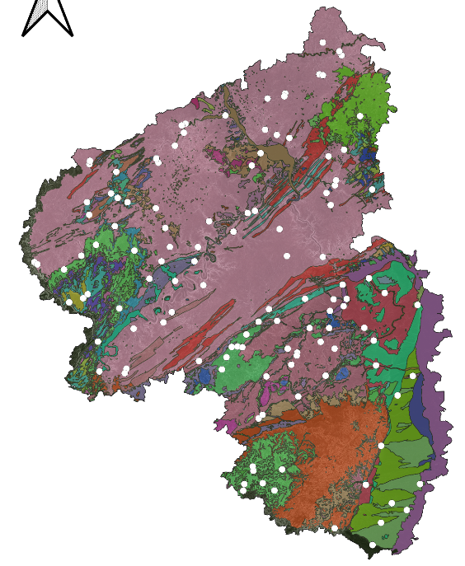

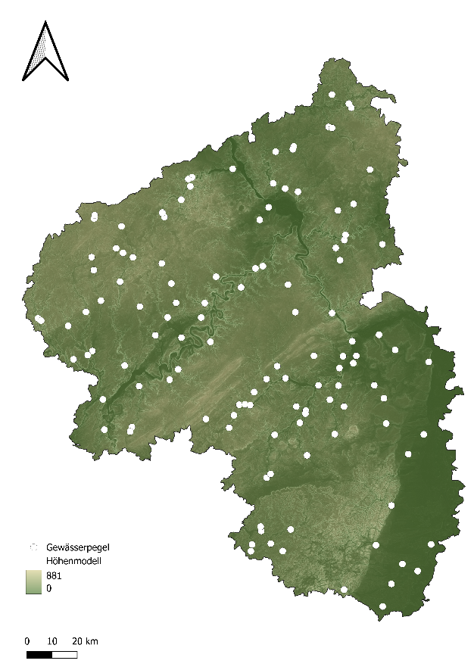
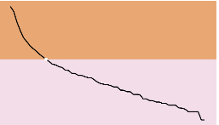


Morphology-driven storage complexity
Identical hydrological regime
Approach: Principal Component Analysis (PCA)
Diverse landscapes and topography (elevation)
Storage complexity is mainly driven by geology, elevation, and soil permeability
Q during year
!
!
Diverse storage complexity
2S 3S 4S
number of storages
Diverse geology and soil properties

Slide 27




Morphology-driven storage complexity
Various storage complexity is driven by…
… catchment drainage behaviour
… share of catchment characteristics
2 storages
3 storages
depletion rate of the fast storage (storage slope)
sandstone systems with
porous–fractured properties [%]
the share of fast storage (S1)
DFI ranges from 0 to 1
fractured, clay-rich systems [%]
value at DFI₆₀
Elevation [%]
4 storages
Filter: Delay N (0-60)
Notes:
Aus rlp datensatz verwenden

Slide 28





Morphology-driven storage complexity
Approach: PCA based on 29 landscape characteristics to explain storage structure and drainage behaviour.
Storage complexity is mainly driven by geology, elevation, and soil permeability and further characterized by storage parameters:
the value at DFI₆₀
the share of fast storage (S1)
and depletion rate of S1 (storage slope)
Varying storage complexity
Conclusion: Storage complexity is closely linked to landscape properties, with spatial characteristics and storage parameters jointly controlling hydrological response and drainage behaviour.

Slide 29
Conclusion
DFI-derived streamflow components show consistent hydro-chemical signatures
→ hydrological and hydrochemical separation show strong agreement
→ indicating physically and process-based meaningful streamflow components
Robust identification of storage structure
→ automated detection of linear drainage subsets
Hydro-chemical validation strengthens interpretability
→ links flow components to flow paths and source zones
Transferable approach across catchments
→ applicable to diverse hydrogeological settings
Key insight: improved understanding of storage depletion and groundwater dynamics, especially under low-flow and drought conditions

Slide 30


References & Authors
Sources
ESRI Satellite URL type=xyz&url=https://server.arcgisonline.com/ArcGIS/rest/services/World_Imagery/MapServer/tile/%7Bz%7D/%7By%7D/%7Bx%7D&zmax=19&zmin=0 last access: 25.04.2026
Federal Institute for Geosciences and Natural Resources (BGR) & State Geological Surveys (SGD). (2019). Hydrogeological Overview Map of Germany 1:250,000 (HÜK250): Digital dataset. https://www.bgr.bund.de/DE/Themen/Wasser/Projekte/laufend/Beratung/Huek200/huek200_projektbeschr.html
Authors
Faculty of Spatial and Environmental Sciences – Department of Hydrology at Trier University
Frietsch, Sofia
Tobias, Schuetz
EGU26-998
QR code for our abstract

Slide 31
References & Authors
Sources
Federal Institute for Geosciences and Natural Resources (BGR) (2023). Land-use differentiated soil overview map of Germany (BÜK1000N).https://geoportal.bgr.de/mapapps/resources/apps/geoportal /index.html?lang=en#/datasets/portal/9F57D939-7BF4-4E0B-A13D-2F07009E08C1
Knapp, J.L.A., Napitupulu, T., von Freyberg, J., Ruecker, A., Studer, B., Zappa, M. and Kirchner, J.W. (2024): Multi-years time series of daily solute and isotope measurements from three Swiss pre-Alpine catchments, Sci Data.
Mike Vlah, spencerrhea, Wes Slaughter, Matthew R.V. Ross, Nicholas Gubbins, Biniam Garomsa, & Pranavi Reddi. (2023). MacroSHEDS/data_processing: MacroSheds data pipelines (v1.0.0). Zenodo. https://doi.org/10.5281/zenodo.7633926
State Office for Surveying and Geobasis Information. (2019). Digital Elevation Model (DGM25), 25 m resolution. https://lvermgeo.rlp.de/geodaten-geoshop/open-dataState Office for the Environment Rhineland-Palatinate. (2025). Water Portal Rhineland-Palatinate: Data, maps and applications. https://wasserportal.rlp-umwelt.de/auskunftssysteme/analysen-und-messwerte

Slide 32
References & Authors
Sources
Stoelzle, M., Schuetz, T., Weiler, M., Stahl, K., Talaksen, L.M. (2020): Beyond binary baseflow separation: a delayed-flow index for multiple streamflow contributions. Hydrology and Earth System Sciences, 4, 2, doi: 10.5194/hess-24-849-2020.
Stoelzle, M., Weiler, M., Stahl, K., Morhard, A., & Schuetz, T. (2015). Is there a superior conceptual groundwater model structure for baseflow simulation? Hydrological Processes, 29(6), 1301–1313. https://doi.org/10.1002/hyp.10251

