Slide 1
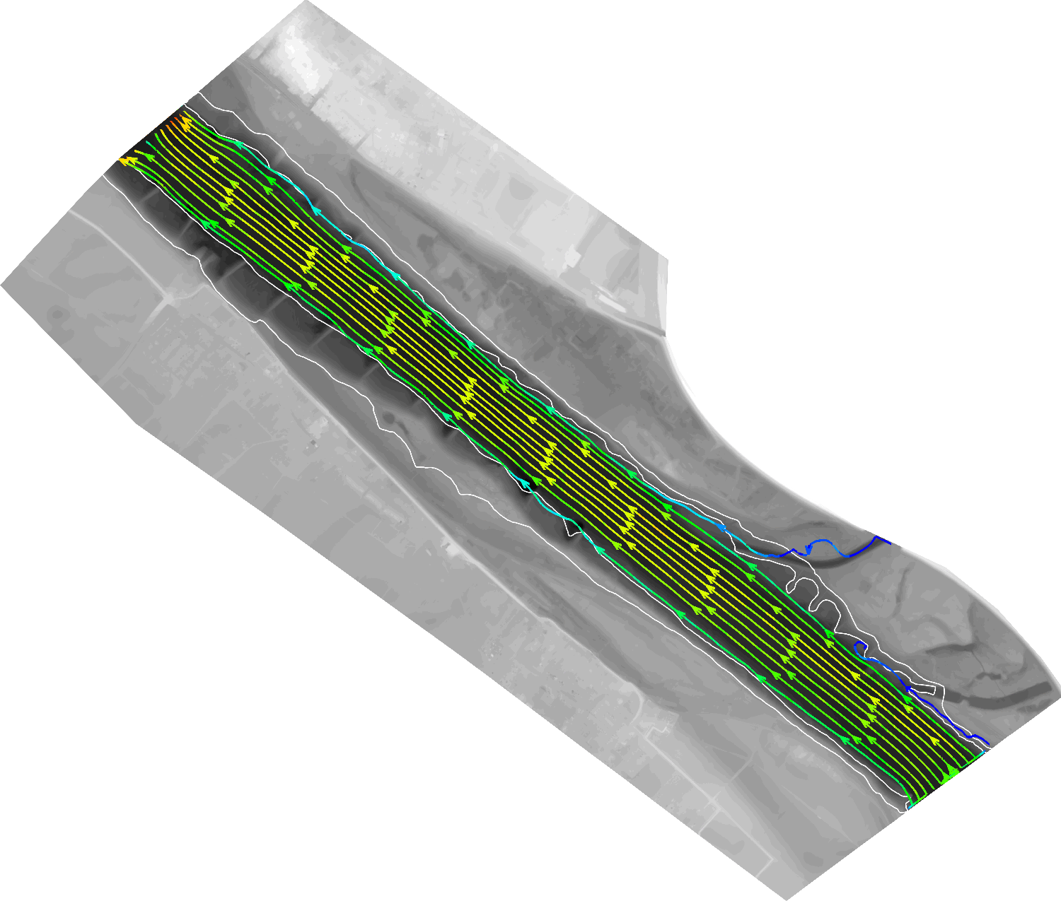
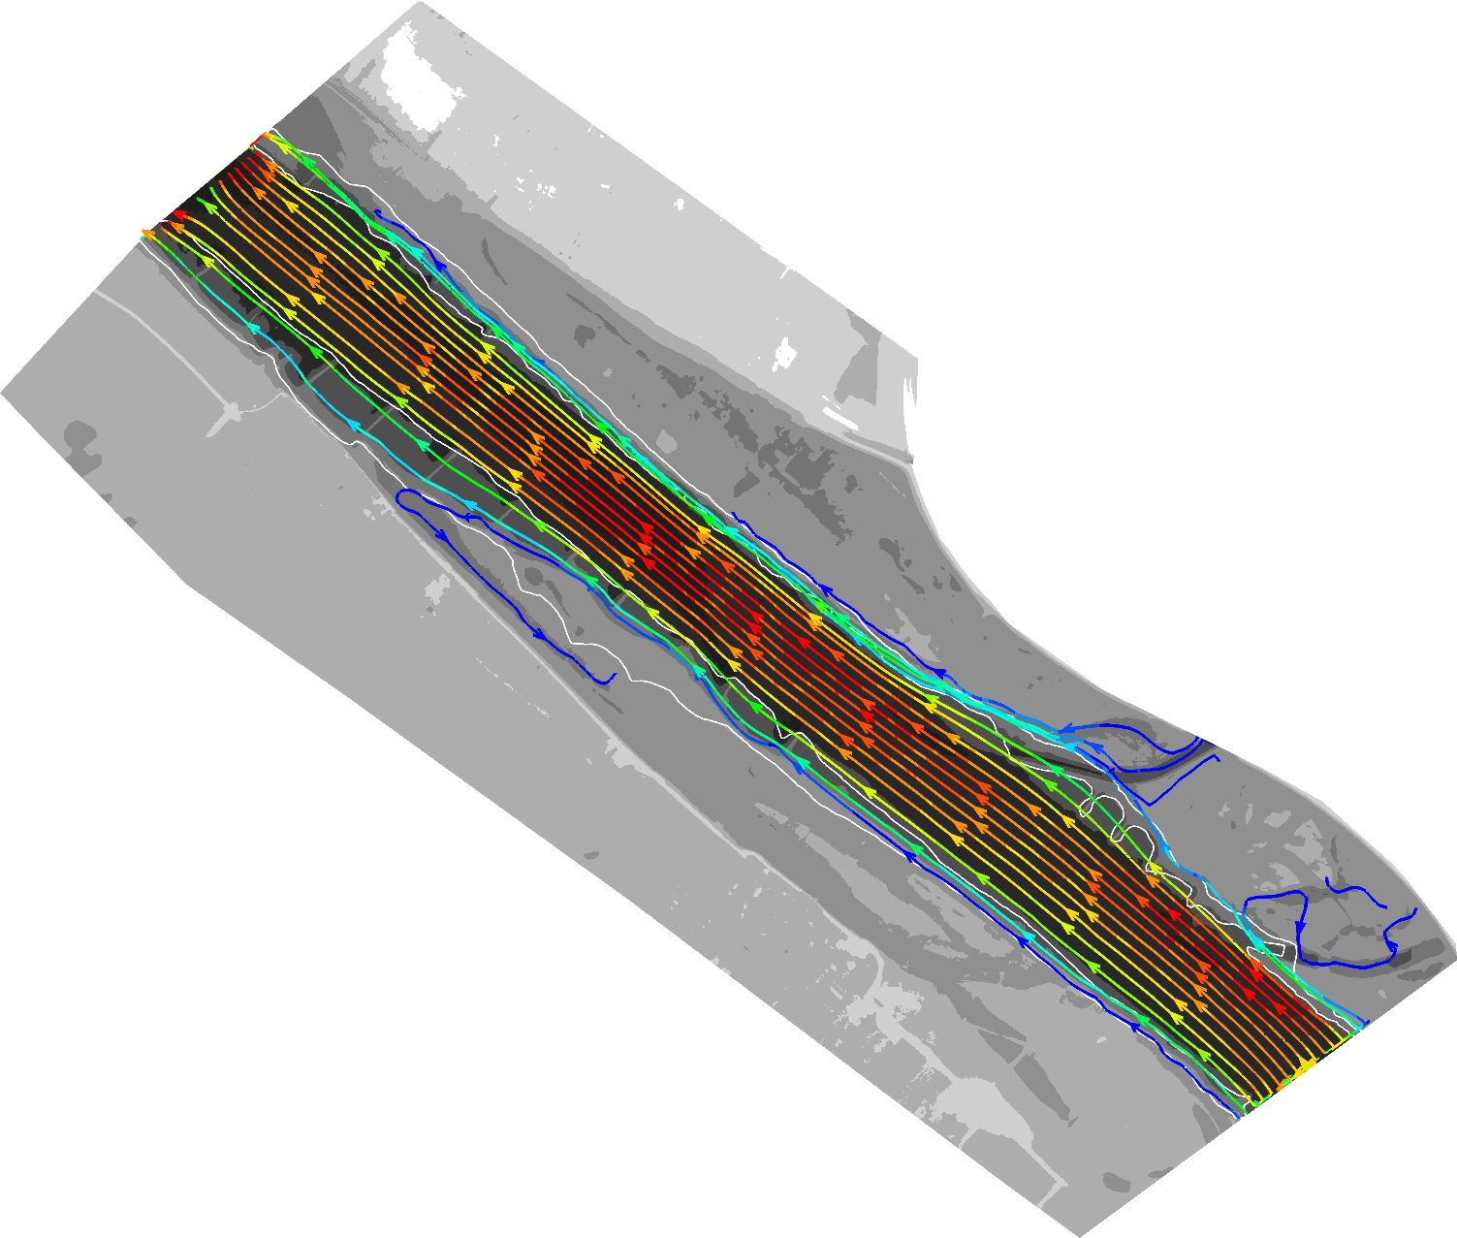
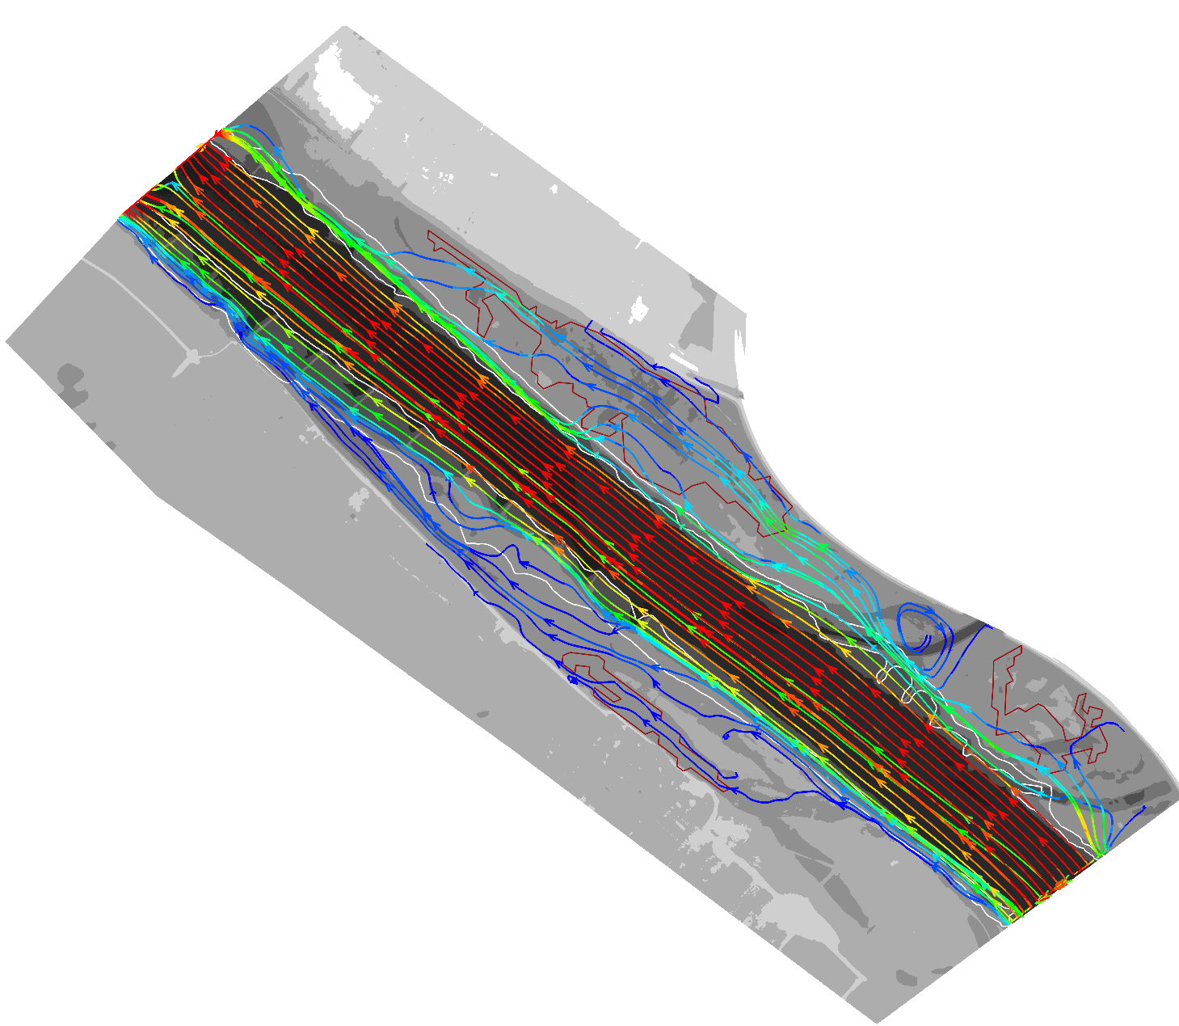
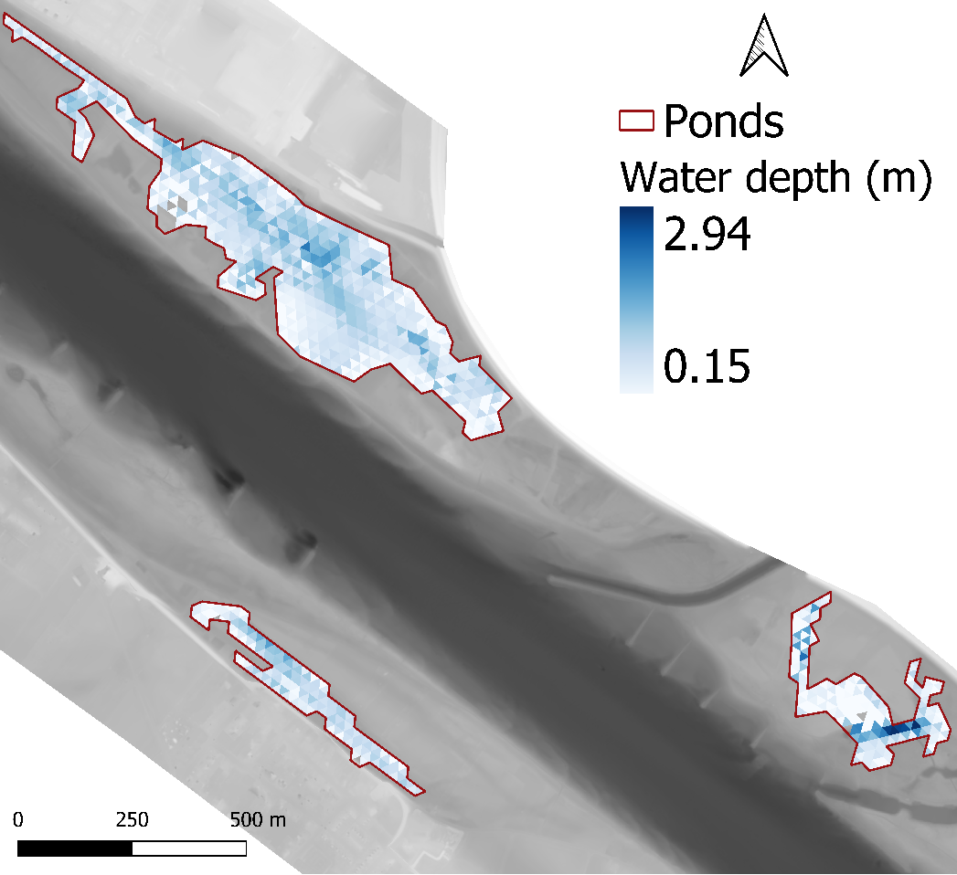
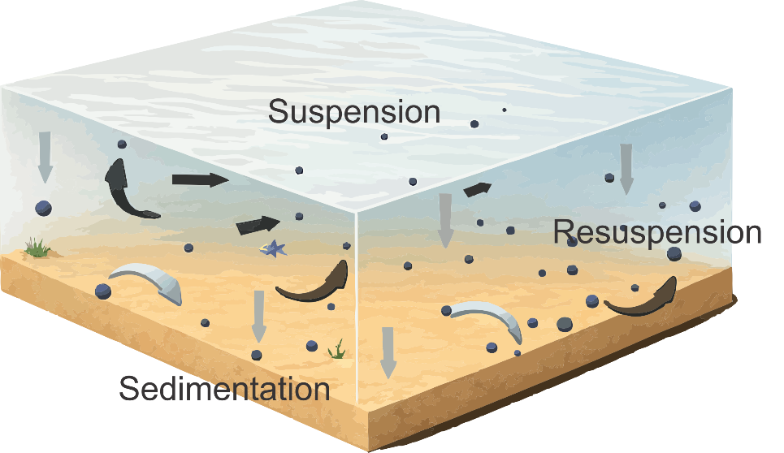
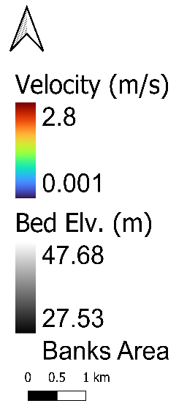
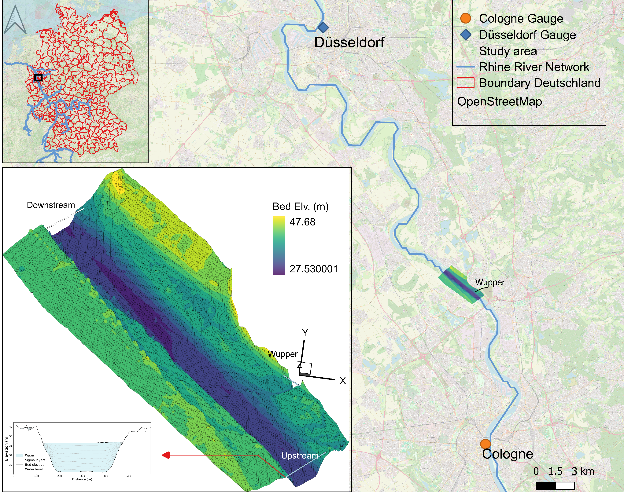
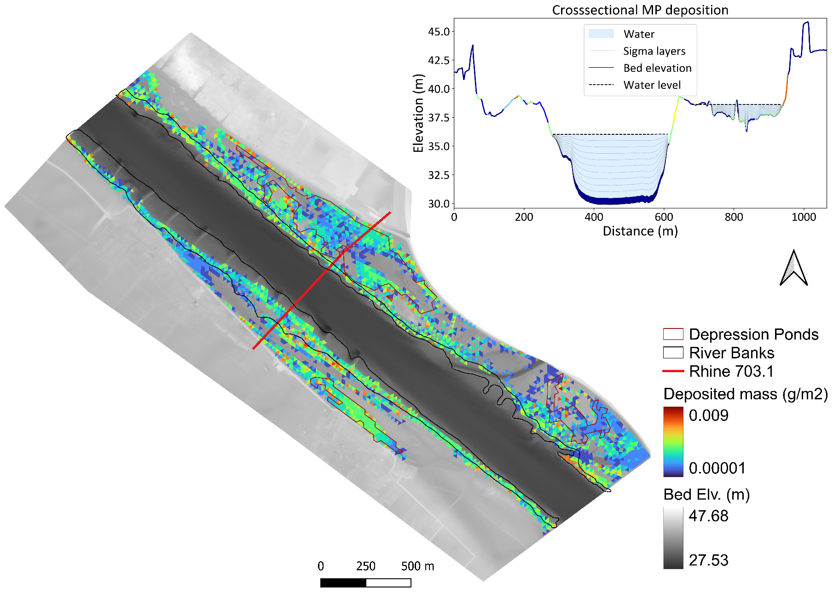
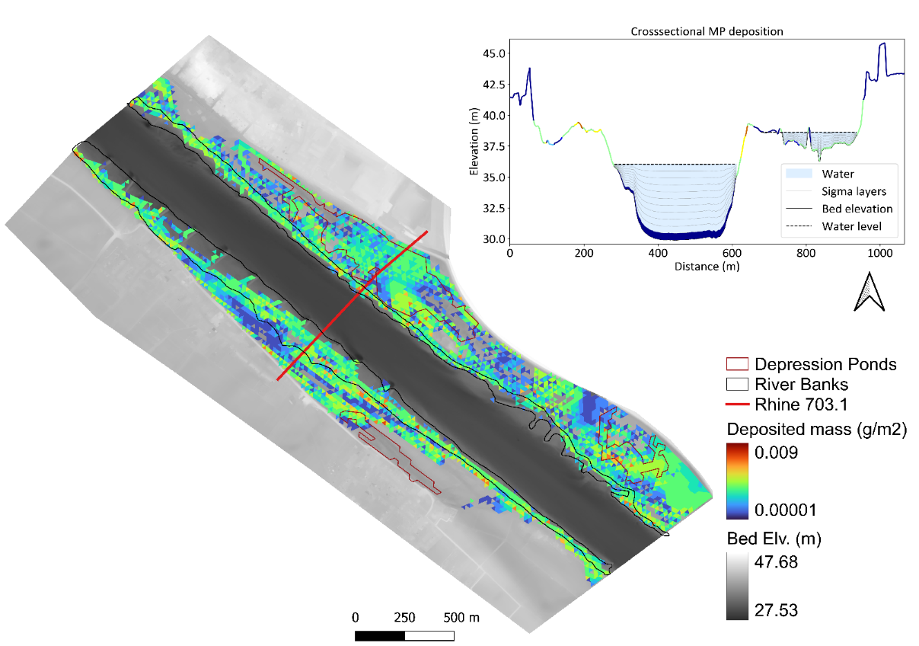
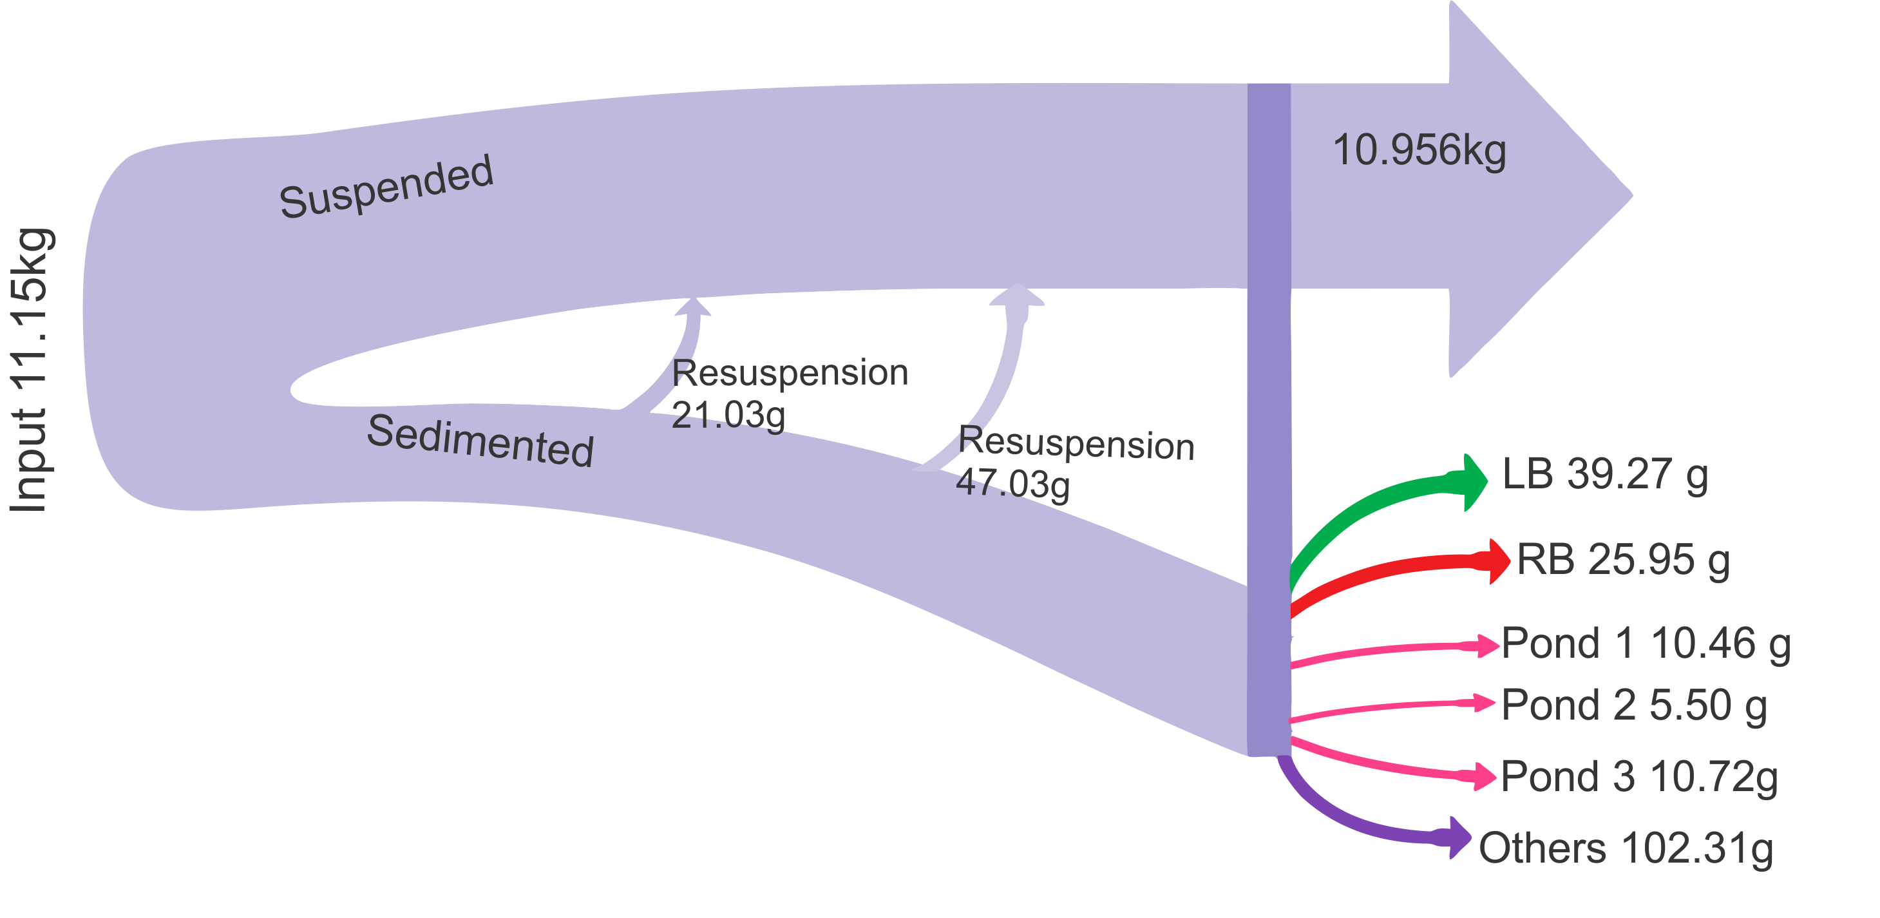
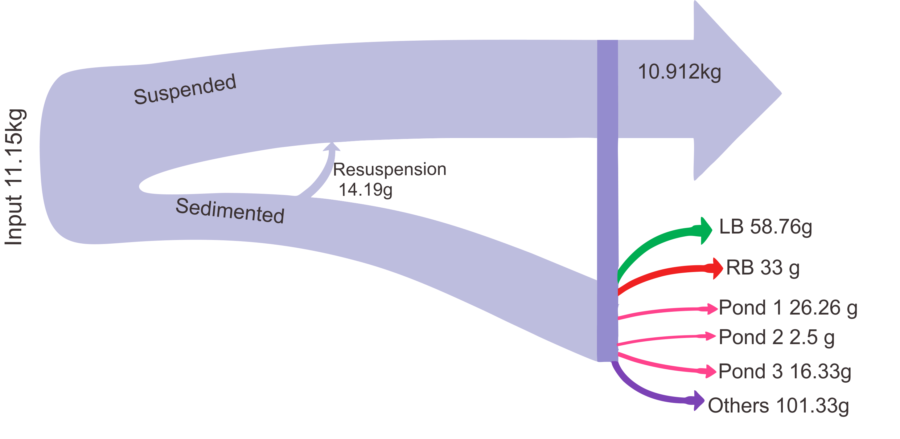
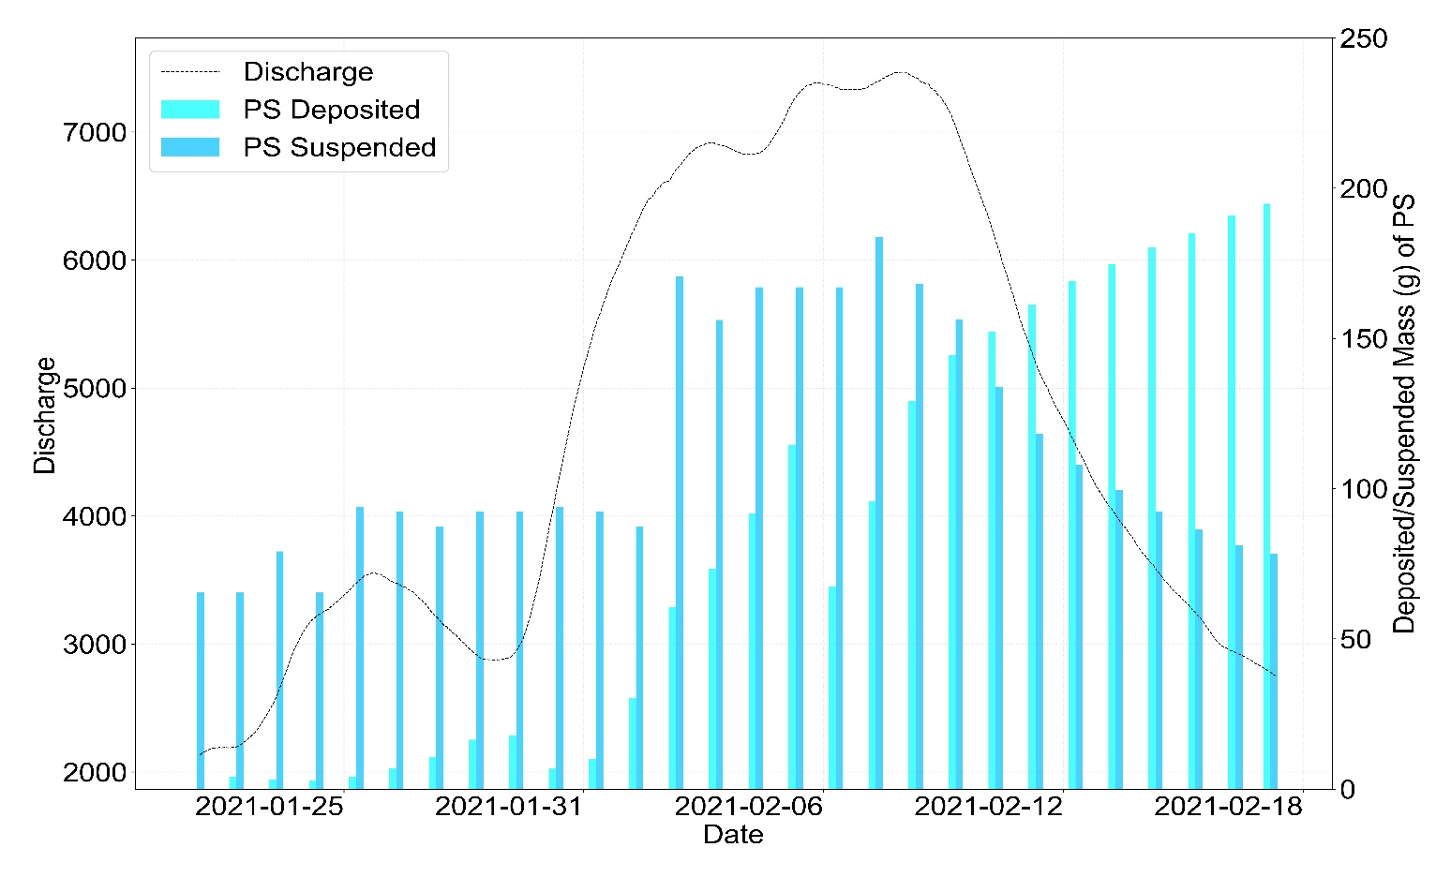
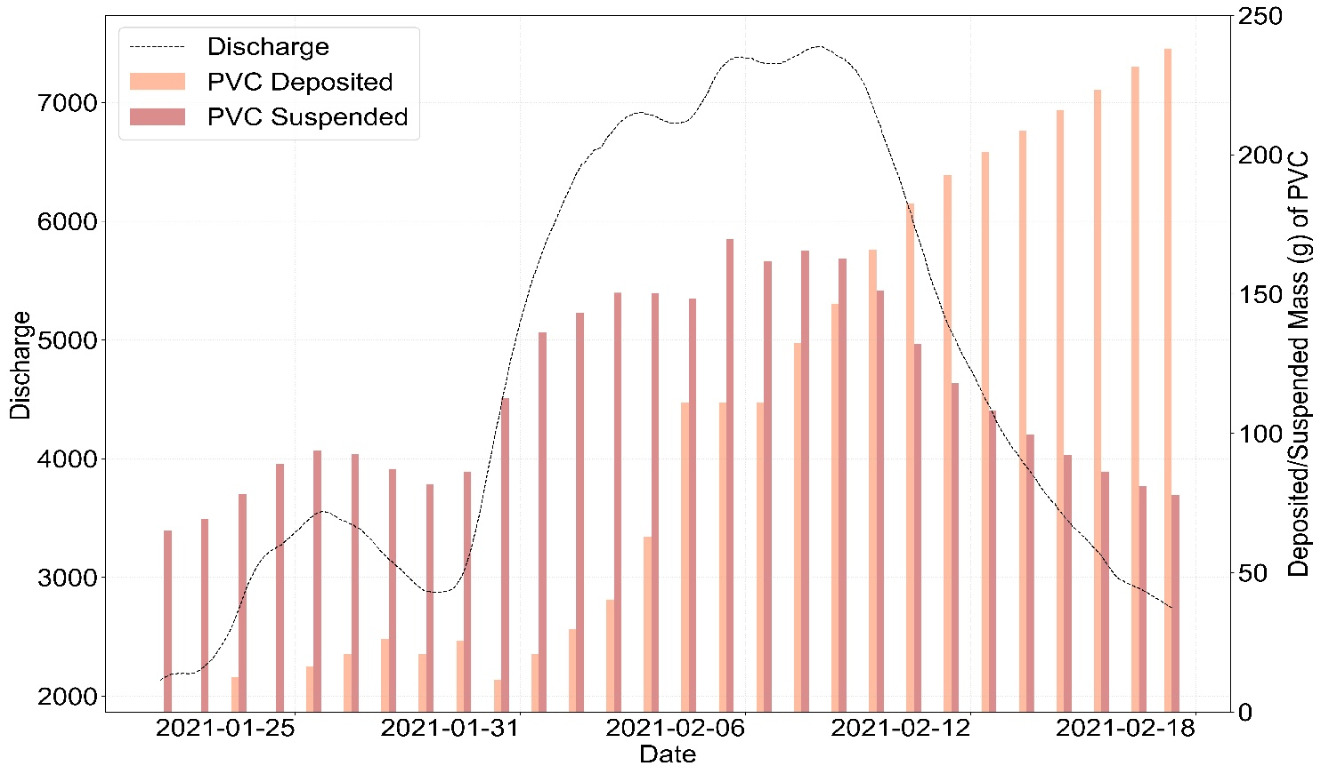
Simulating the fate and Transport of Microplastics (MP) in a river corridor (Rhine River)
Shabiha Sultana Rimi¹, Christian Schmidt¹, Jan H. Fleckenstein^{1,2}
¹Helmholtz Centre for Environmental Research, UFZ, Department of Hydrogeology, Leipzig, Germany; ² Hydrologic Modeling Unit, BayCEER, University of Bayreuth, Germany
Motivation
Outcome
Widespread occurrence of MP across natural compartments.
MP are transported through river corridor to land and oceans.
Floods mobilize and re/distribute MP, enhancing deposition
Flow path under 3 different flow conditions
Ponding after flood
Research Questions
Pond 1
Pond 1
How MP are transported in fluvial system?
Where are they deposited in floodplains?
How much of MP mobilized during and deposited after the flood event.
D
Pond 3
Pond 2
Pond 3
Method
Pond 2
A
B
C
Polystyrene (PS)
Polyvinylchlorid (PVC)
Flood 2021 (February)
D
Bank full discharge is 3903m³/s
Deposition from total MP input
PS = 2.5%
PVC = 2.84%
Major deposition is at banks
PS = 33.5%
PVC = 38.23%
Resuspension from deposited MP
PS = 40%
PVC = 6%
3.5 km Rhine River section in Cologne, Germany
Flood event : 2021 winter (3.5 years return period) (Stadtentwässerungsbetriebe Köln,2026)
3D Hydrodynamic model: Delft3D FM
Triangular grid (25 m resolution)
11 vertical sigma layers.
Boundary Conditions
Upstream: discharge, Downstream: water surface elevation
Calibration parameter Manning’s n, varied on landuse : 0.027–0.04)
Constant upstream MP input (1 µm/m³)
MP type (diameter: 0.1mm)
Polyvinylchlorid (PVC): 1195 kg/m³)
Polystyrene (PS): 1030 kg/ m³
Resuspension
Resuspension
Conclusion
Advection and turbulence processes drive MP transport.
Higher discharge increases suspended concentrations, reduces sedimented MP.
Elevated discharge enhances remobilization of deposited particles.
High-density MP shows greater deposition and lower resuspension than low-density MP.
References
Rolf, M., Laermanns, H., Kienzler, L., Pohl, C., Möller, J. N., Laforsch, C., Löder, M. G. J., & Bogner, C. (2022). Flooding frequency and floodplain topography determine abundance of microplastics in an alluvial Rhine soil. Science of the Total Environment,
836, 155141. https://doi.org/10.1016/j.scitotenv.2022.155141
Lu, X., Wang, X., Liu, X., & Singh, V. P. (2023). Dispersal and transport of microplastic particles under different flow conditions in riverine ecosystem. Journal of Hazardous Materials, 442, 130033. https://doi.org/10.1016/j.jhazmat.2022.130033
Deltares. (2025). D-Flow Flexible Mesh User Manual (Version 2025, Revision 80442). Delft, The Netherlands: Deltares
Stadtentwässerungsbetriebe Köln. (2026). Hochwasser­geschichte Kölns. Steb-Koeln.De.

