Slide 1
Gustiness parameterization in the atmospheric boundary layer
Irene Suomi
Timo Vihma
Sven-Erik Gryning

Slide 2

Definition
Peak gust (or here gust) is the maximum wind speed of short duration (t = 1…3 s) during a sampling period of length T=10min…1h.
Gust factor is the ratio of peak gust and mean wind speed:
$$G=\frac{U_{max}}{U}$$

Slide 3
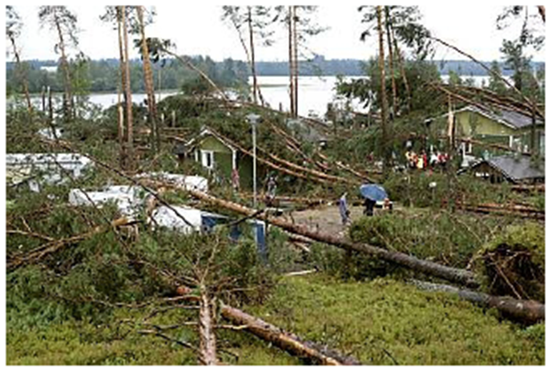
Motivation
large impacts: in Finland typically cut trees/forests, power cuts, broken structures, etc
relevant for the wind energy (siting and turbine control) at different heights (~100m)
gusts are not (yet) directly available from numerical weather prediction models: parameterizations are needed

Slide 4
Research questions
Are gust parameterizations applicable above 10 m height?
What kind of a gust parameterization method is optimal (based on observations)?

Slide 5
Overview
Observations
Gust parameterization methods
A new method
Results
Conclusions and ongoing/future work

Slide 6
Observations
Two weather masts: Isosaari (83m) and Loviisa (143m)
One year of data: 4/2009-3/2010, excluding from Isosaari months when sea ice

Slide 7
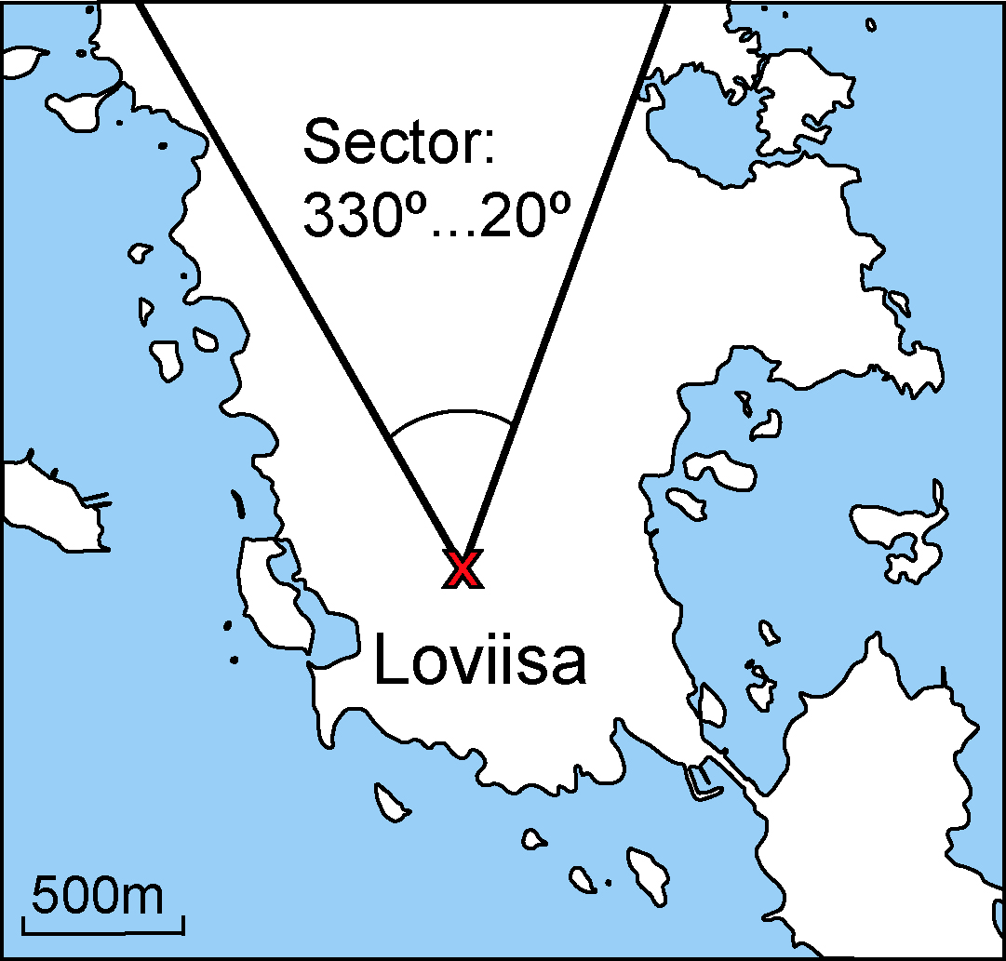
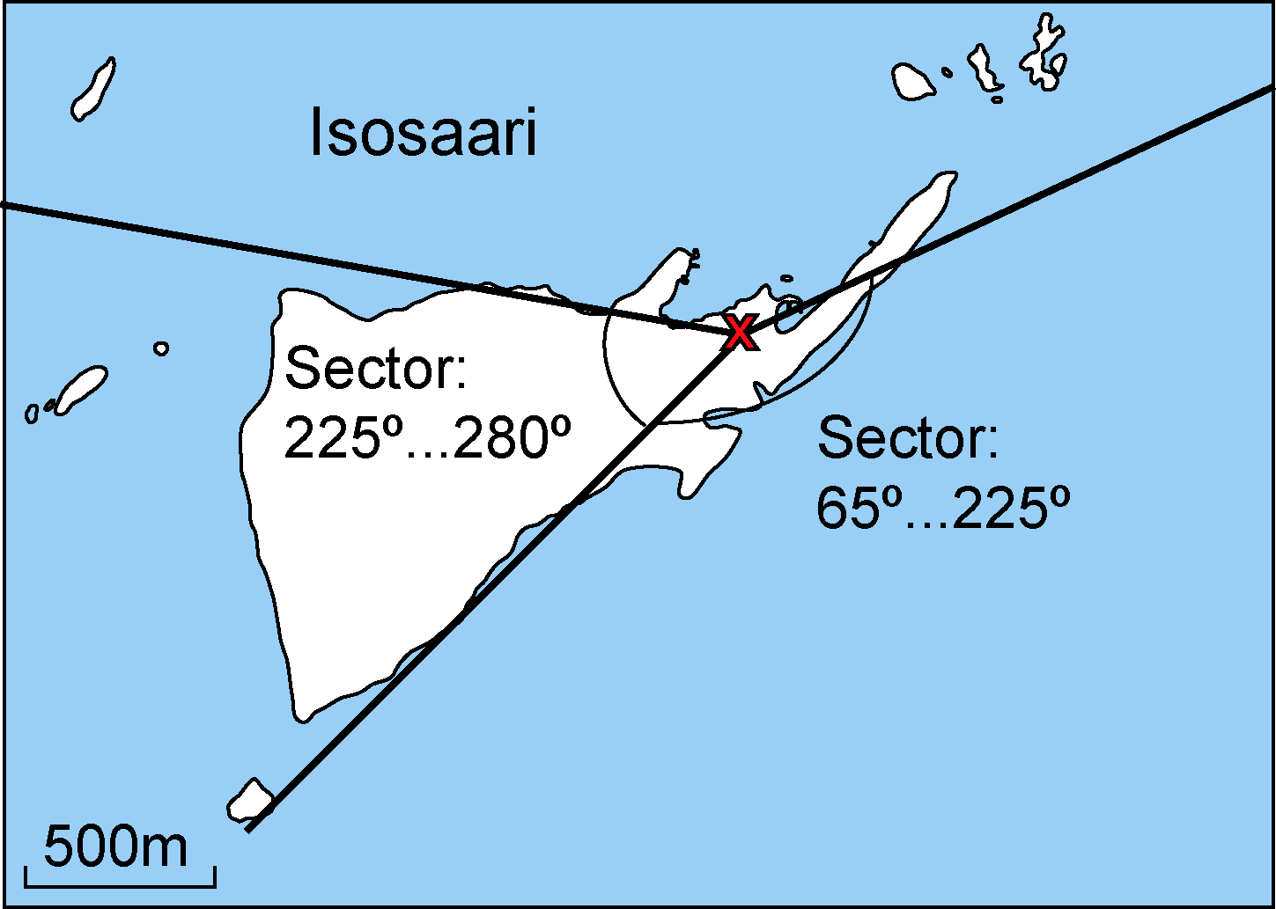




Observations
Loviisa
143m
103m
Isosaari
83m
62m
42m
30m

Slide 8
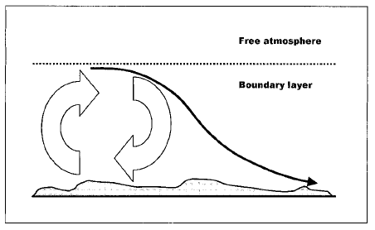
Type A Type B
Gust parameterization methods
Wieringa (1973, W73)
  G = f ( U, t, T, z, z₀ )
Woetman-Nielsen and Petersen (2001, WNP01)
  G = f ( U, u_{*0}, w* )
Wichers Schreur and Geertsema (2008, WSG08)
  G = f ( U, t, T, z, E )
U = mean wind speed
t = gust duration
T = sampling period
z = height a.g.l.
u_{*0} = surface firction velocity
w_{*0} = convective velocity scale
E = turbulent kinetic energy
θ = potential temperature
Brasseur (2001, B01)
    G = f ( U, z, θ, θ_{v}, E )

Slide 9

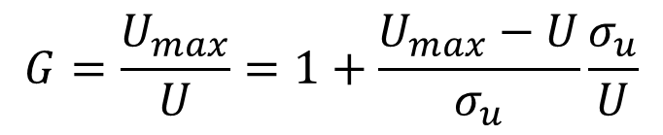
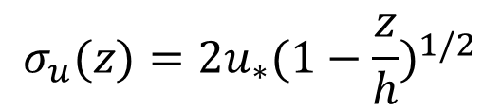
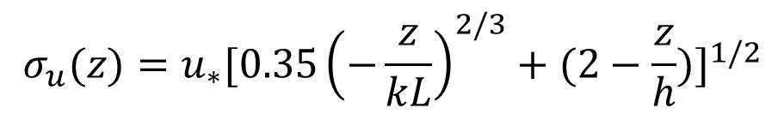
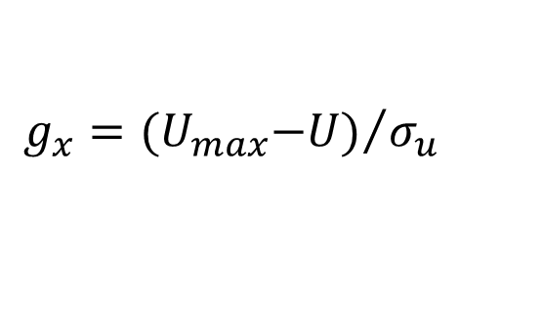
A new method (”type A”)
$$G=\frac{U_{max}}{U}=1+\frac{U_{max}−U}{σ_{u}}\frac{σ_{u}}{U}$$
From the definition of gust factor:
where is the normalized gust.
For unstable conditions:
and stable conditions:
(Gryning et al, 1987)
$$G=1+g_{x}\frac{σ_{u}}{U}$$
$$g_{x}={{(U}_{max}−U)}/{σ_{u}}$$
$$σ_{u}(z)=u_{∗}{[0.35{\left(−\frac{z}{kL}\right)}^{2/3}+(2−\frac{z}{h})]}^{1/2}$$
$$σ_{u}(z)=2u_{∗}{(1−\frac{z}{h})}^{1/2}$$

Slide 10
Results: Isosaari East/South (marine sector)
OBS
W73

Slide 11
Results: Isosaari East/South (marine sector)
OBS
WNP01

Slide 12
Results: Isosaari East/South (marine sector)
OBS
New method

Slide 13
Results: Isosaari West (”rough” sector)
OBS
W73

Slide 14
Results: Isosaari West (”rough” sector)
OBS
WNP01

Slide 15
Results: Isosaari West (”rough” sector)
OBS
New method

Slide 16
Results: Loviisa North (land sector)
OBS
W73

Slide 17
Results: Loviisa North (land sector)
OBS
WNP01

Slide 18
Results: Loviisa North (land sector)
OBS
New method

Slide 19
Conclusions
In marine sector stability did not have significant role
Over rough surface, stability had effect, but the method by WNP01 overestimated it, especially in Loviisa with unstable conditions
The new method performed best in all cases. But: tuning of normalized gust is needed
Ongoing / future work:
  Normalized gust: g_{x} = f ( t, T, z₀, z, ? )
  Test all methods within NWP model framework

Slide 20
Thank You!

Slide 21
Acknowledgements
The research leading to these results has received funding from the European Research Council under the European Community's 7 th Framework Programme (FP7/2007-2013) / ERC grant agreement number 227915, project PBL-PMES.

