Slide 1
Correcting monthly precipitation in 8 RCMs over Europe
Blaž Kurnik (European Environment Agency)
Andrej Ceglar, Lucka Kajfez – Bogataj (University of Ljubljana)

Slide 2
Outline
Regional climate models and observation
- observation from E-OBS
- RCMs from ENSEMBLES project
Techniques for correcting precipitation prior use in impact models – bias corrections
Validation of the methodology with results

Slide 3
The question
Can we use precipitation fields from RCMs directly
in impact models?

Slide 4
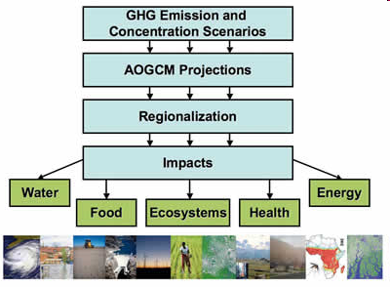

Climate models
Climate
model
Impact
models

Slide 5
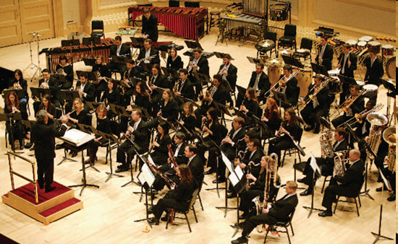
Ensembles of Climate models -simplified
RCM7
RCM6
RCM5
RCM4
GCM
RCM3
RCM1
RCM2

Slide 6
RCMs used in the study
RCM GCM* | SMHI RCA3 | MPI REMO | KNMI RACMO | ETHZ CLM | DMI HIRLAM | CNRM ALADIN
BCM METNO
ECHAM5 MPI
HadCM3Q UK - MET
ARPEGE CNRM
* Only 1 scenario - A1B - which is version of A1 SRES scenario

Slide 7
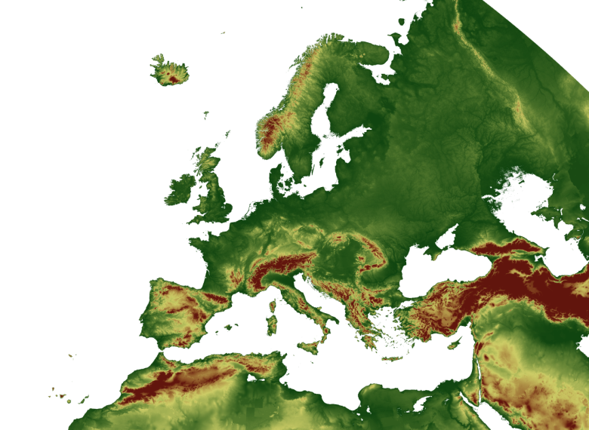
Outputs from RCMs
Monthly precipitation PDFs at different locations

Slide 8
Correction of the climate model data – workflow
Observations
DM1
Bias
correction
DM2
ETH
25 km x 1 day
Europe, between 1961 - 1990
MPI
CNR
SM1
SM2
KNM

Slide 9
Correction of the climate model data
Adjusting of the distribution function at every grid cell
Long time series (> 40 years) of observation data are needed - correction and validation of the model (20 +20 years)
Corrections are needed for each model separately

Slide 10
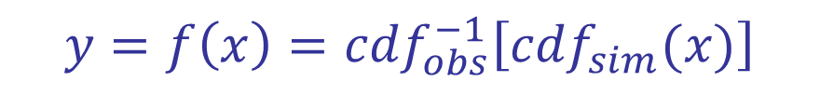
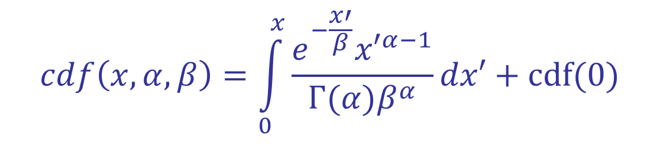
Precipitation correction the climate model data – transfer function
Piani et al, 2010
Cumulative distribution
$$cdf\left(x,α,β\right)=\int_{0}^{x}{\frac{e^{−\frac{x′}{β}}{x′}^{α−1}}{Γ(α)β^{α}}dx′}+cdf(0)$$
Probability for dry event
cdf_{obs}(y) = cdf_{sim}(x)
Fulfilling criteria
$$y=f\left(x\right)={cdf}_{obs}^{−1}\left[{cdf}_{sim}(x)\right]$$
Corrected precipitation
Modelled precipitation

Slide 11
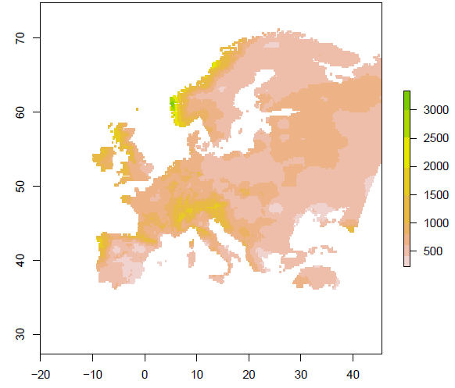
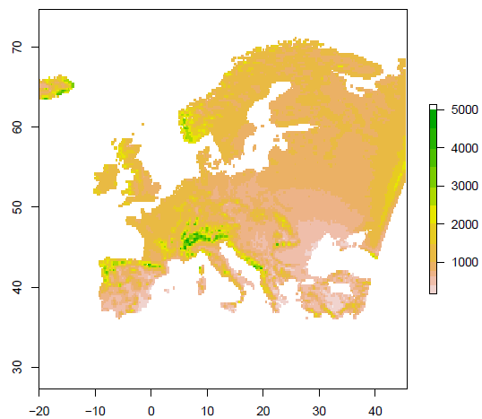
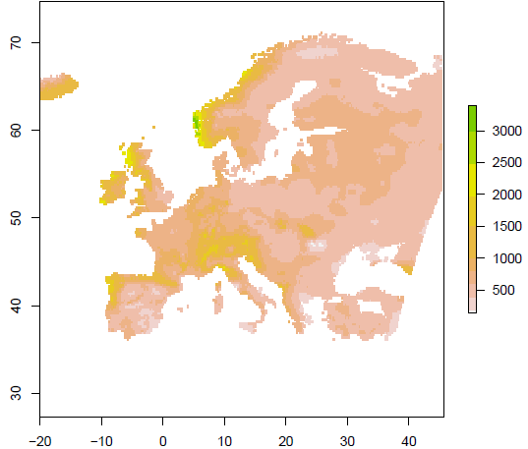
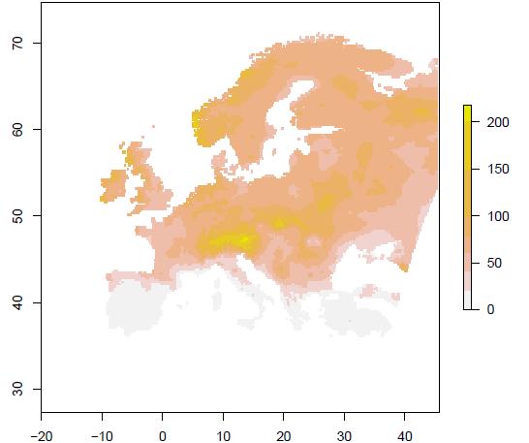
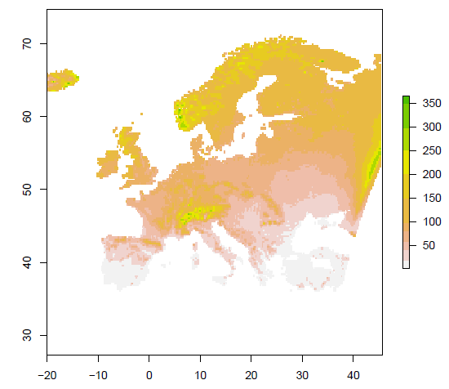
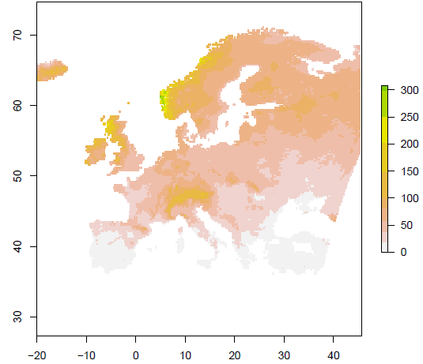
Bias corrected data – ensemble mean of annual/July precipitation
Kurnik et al, 2011, submitted to IJC
Observed
Simulated
Corrected
Annual
1991 - 2010
Observed
Simulated
Corrected
July
1991 - 2010

Slide 12
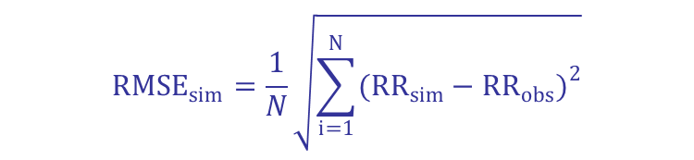

RMSE of simulated and corrected
$${RMSE}_{sim}=\frac{1}{N}\sqrt{\sum_{i=1}^{N}{{({RR}_{sim}−{RR}_{obs})}^{2}}}$$
$${RMSE}_{cor}=\frac{1}{N}\sqrt{\sum_{i=1}^{N}{{({RR}_{cor}−{RR}_{obs})}^{2}}}$$
simulated
corrected

Slide 13
Failed correction – number of models
RMSE_{sim} < RMSE_{cor}
1.5 % area all models failed
4.5 % area > 6/8 models failed
DM1 90% cases cor(RMSE) < sim(RMSE)
ETH 75% cases cor(RMSE) < sim(RMSE)

Slide 14
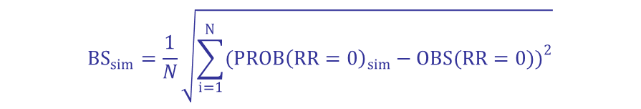

Brier Score – zero precipitation
$${BS}_{sim}=\frac{1}{N}\sqrt{\sum_{i=1}^{N}{{({PROB\left(RR=0\right)}_{sim}−OBS(RR=0))}^{2}}}$$
$${BS}_{cor}=\frac{1}{N}\sqrt{\sum_{i=1}^{N}{{({PROB\left(RR=0\right)}_{cor}−OBS(RR=0))}^{2}}}$$
BS → 0: the best probabilistic prediction
BS → 1: the worst probabilistic prediction
simulated
corrected

Slide 15
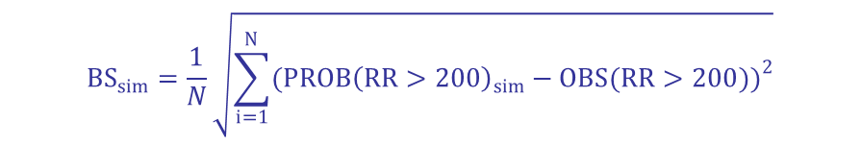
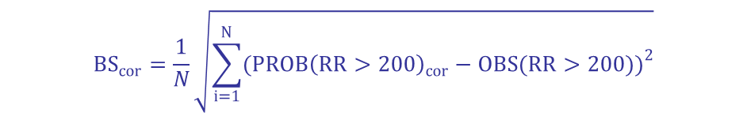
Brier Score – heavy precipitation (RR> 200mm)
$${BS}_{sim}=\frac{1}{N}\sqrt{\sum_{i=1}^{N}{{({PROB\left(RR>200\right)}_{sim}−OBS(RR>200))}^{2}}}$$
$${BS}_{cor}=\frac{1}{N}\sqrt{\sum_{i=1}^{N}{{({PROB\left(RR>200\right)}_{cor}−OBS(RR>200))}^{2}}}$$
BS → 0: the best probabilistic prediction
BS → 1: the worst probabilistic prediction
simulated
corrected

Slide 16
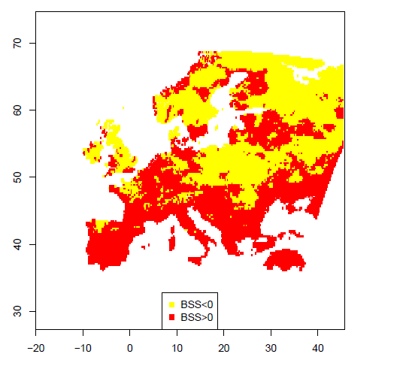
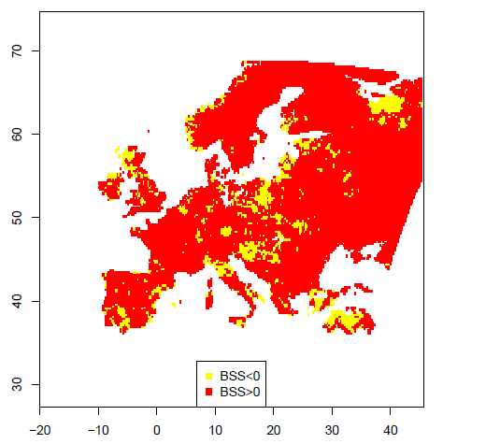
Brier skill score– extremes
Kurnik et al, 2011, submitted to IJC
BSS=1- BS_{cor} / BS_{sim}
BSS < 0: no improvements
BSS > 0: corrections improve predictions
Dry event
RR > 200 mm

Slide 17
Conclusions
Various RCMs have been corrected, using same approach
Bias correction is necessary, prior use of data in impact models – significant improvements
Bias correction needs to be relatively “robust”
Dry months need to be studied carefully
Selection of validation technics is important (RMSE, BS, BSS)

