Slide 1
Thermal Bioclimate as factor in urban and architectural planning in tropical climates – The case of Campinas, Brazil
Loyde Vieira de Abreu¹ ² , Lucila C. Labaki¹ and Andreas Matzarakis ²
¹ School of Civil Engineering, Architecture and Urban Design of State University of Campinas, Brazil – loydeabreu@gmail.com
² Meteorological Institute, Albert-Ludwigs-University Freiburg, Germany –

Slide 2
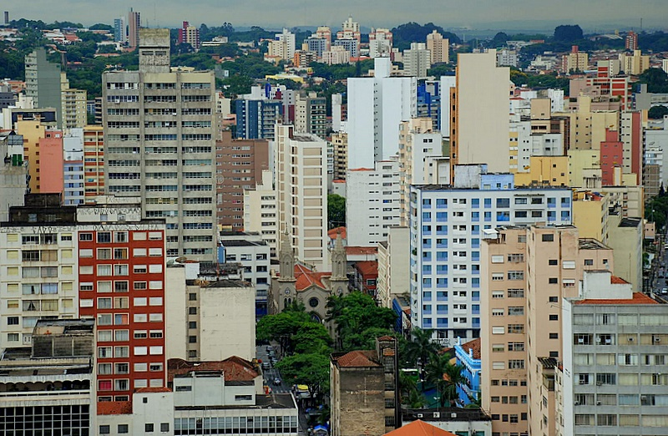
INTRODUCTION
DATA & METHODS
RESULTS
urban expansion without climate responsive guidelines
energy consumption as consequence of climatic modifications
CONCLUSION

Slide 3
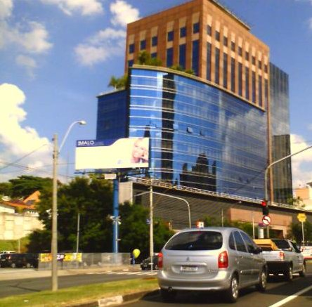
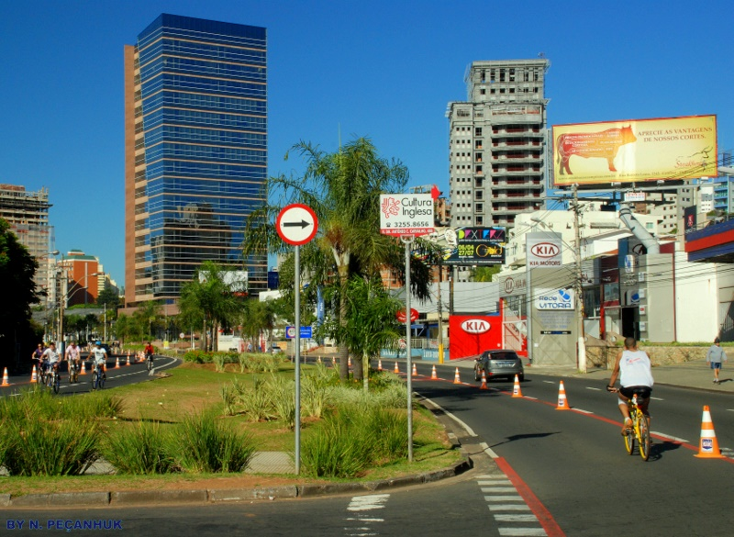
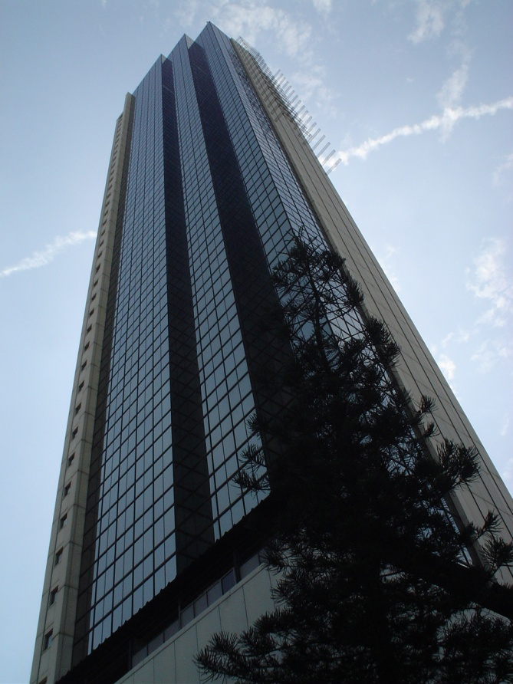
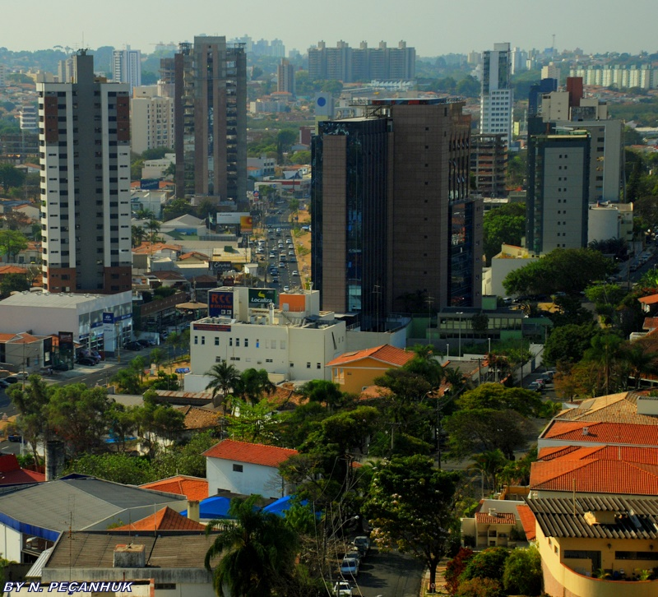
commercial buildings
INTRODUCTION
DATA & METHODS
RESULTS
CONCLUSION

Slide 4
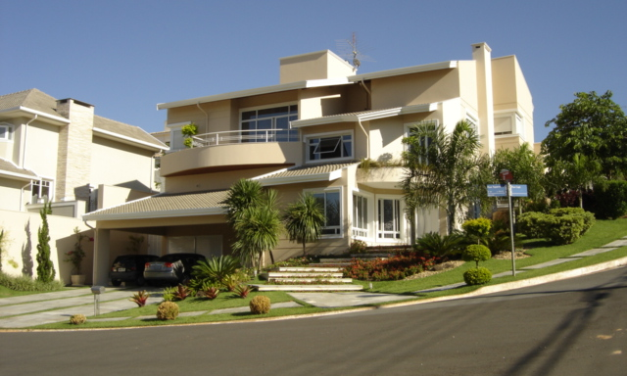
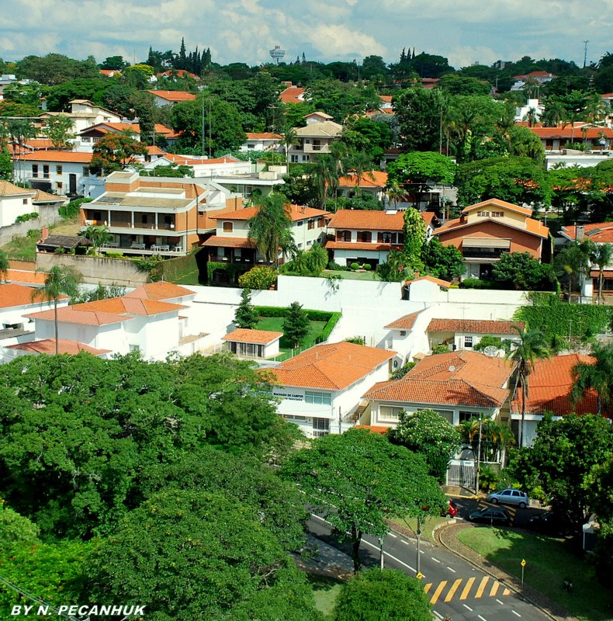
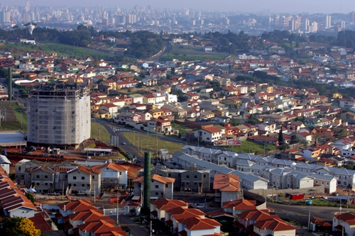
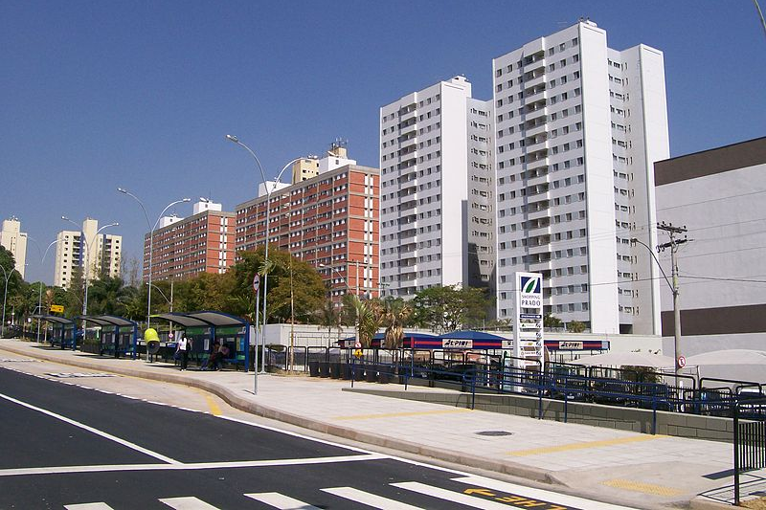
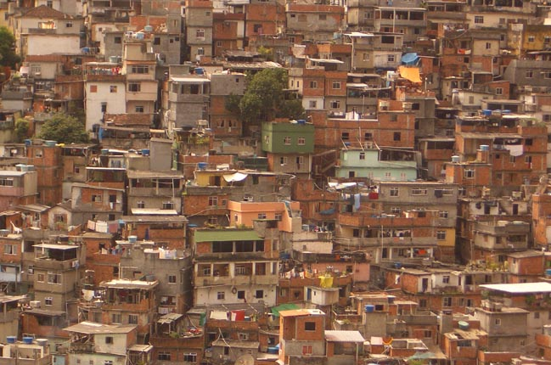
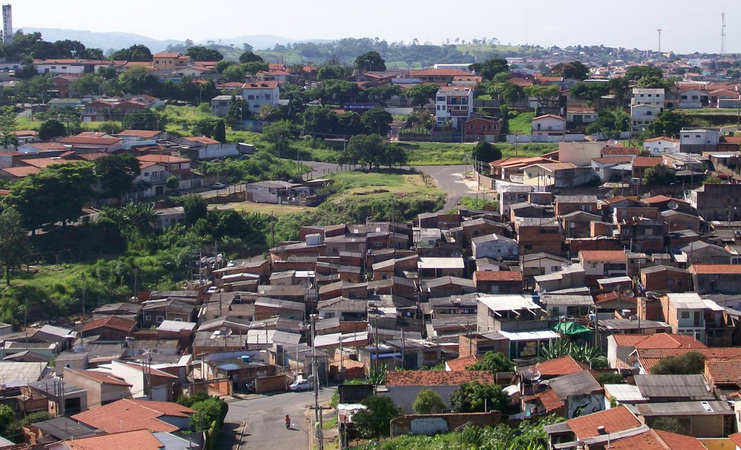
housing by social class
INTRODUCTION
High Level
DATA & METHODS
Medium Level
RESULTS
Popular Level
CONCLUSION

Slide 5
goals
INTRODUCTION
This study presents thermal bioclimatic analyses of
air temperature and
physiologically equivalent temperature
conditions at Campinas, Brazil,
as factor for the development of guidelines in urban and architectural planning in tropical climates.
DATA & METHODS
RESULTS
CONCLUSION

Slide 6
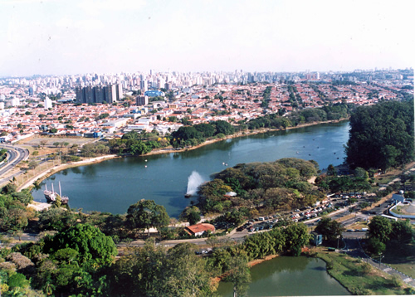
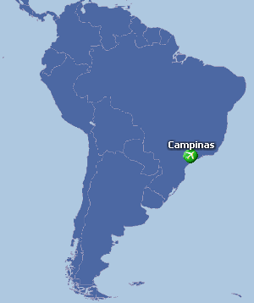
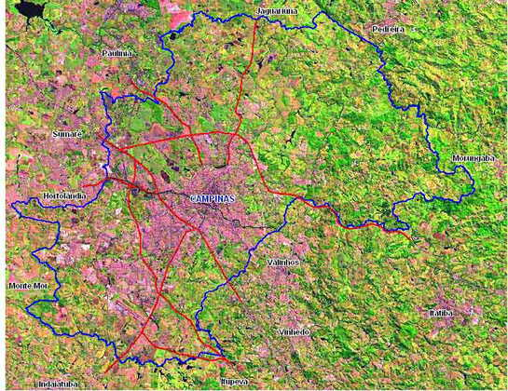
study area and data
INTRODUCTION
Hourly measurements of air temperature, air humidity, wind speed and global radiation of an over seven year period (25.6.2003 to 14.12.2010).
DATA & METHODS
RESULTS
Campinas, Brazil
22 ° 48'57 "S
47 ° 03'33" W
Altitude: 640 m
Subtropical climate
CONCLUSION

Slide 7
Air temperature frequencies (°C)
INTRODUCTION
DATA & METHODS
RESULTS
CONCLUSION

Slide 8
Mean Radiant Temperature frequencies (°C)
INTRODUCTION
DATA & METHODS
RESULTS
CONCLUSION

Slide 9
PET frequencies (°C)
INTRODUCTION
DATA & METHODS
RESULTS
CONCLUSION
RayMan Pro input data: air temperature, relative humidity, wind speed and global radiation.

Slide 10
Mean monthly diurnal course of PET (°C)
INTRODUCTION
DATA & METHODS
RESULTS
CONCLUSION

Slide 11
Mean monthly diurnal course of PET (°C) – shade variation
INTRODUCTION
DATA & METHODS
RESULTS
CONCLUSION

Slide 12
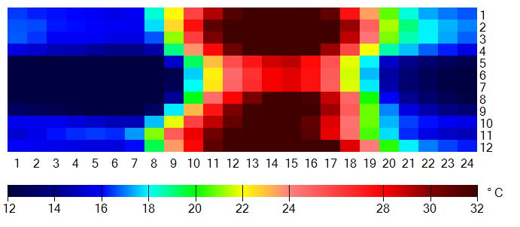
Mean monthly diurnal course of PET (°C) – wind speed variation
INTRODUCTION
DATA & METHODS
+ 1m/s
RESULTS
- 1m/s
CONCLUSION

Slide 13
Annual percentages of thresholds based on PET for the period 25th June, 2003 to 31th December 2010.
INTRODUCTION
DATA & METHODS
 | PET>25 | PET>30 | PET>35 | PET>40
v-1 m/s | 49.3% | 29.0% | 19.1% | 10.2%
v+1 m/s | 40.6% | 21.9% | 11.4% | 3.1%
T_{mrt} = T_{ar} | 75.7% | 34.1% | 6.3% | 0.1%
PET | 44.4% | 26.8% | 16.7% | 7.8%
RESULTS
CONCLUSION

Slide 14
INTRODUCTION
Solar radiation, typical of tropical cities influences significantly thermal comfort.
Urban and architectural planning need to promote wind and shade to improve thermal comfort.
An awareness of these issues would be valuable to architects, planners and urban designers, not by the way of limiting possible solutions, rather by enriching the design possibilities.
DATA & METHODS
RESULTS
CONCLUSION

Slide 15
INTRODUCTION
DATA & METHODS
This work was sponsored by DAAD/CAPES.
loydeabreu@gmail.com
andreas.matzarakis@meteo.uni-freiburg.de
RESULTS
CONCLUSION

