Slide 1
Drought monitoring in Isfahan province(IRAN) by comparison of Standard Precipitation Index(SPI) & Reconnaissance Drought Index(RDI)
S.M.Mostafavi Darani(1), J.Khoshhal Dastjerdi(2), A.Parandeh(3), M.Ghatrehsamani(4)
(1) PhD student of Agroclimatology, Department of Geography, University of Isfahan-IRAN
(2)Associated Professor, Department of Geography, University of Isfahan-IRAN
(3)Senior expert of climatology, Isfahan meteorological Bureau-IRAN
(4)General manager of Isfahan meteorological Bureau-IRAN

Slide 2
Contents:
Introduction
Materials and Methods
Results and discussion
EMS, Berlin, 12-16 Sep - 2011

Slide 3
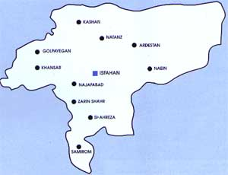
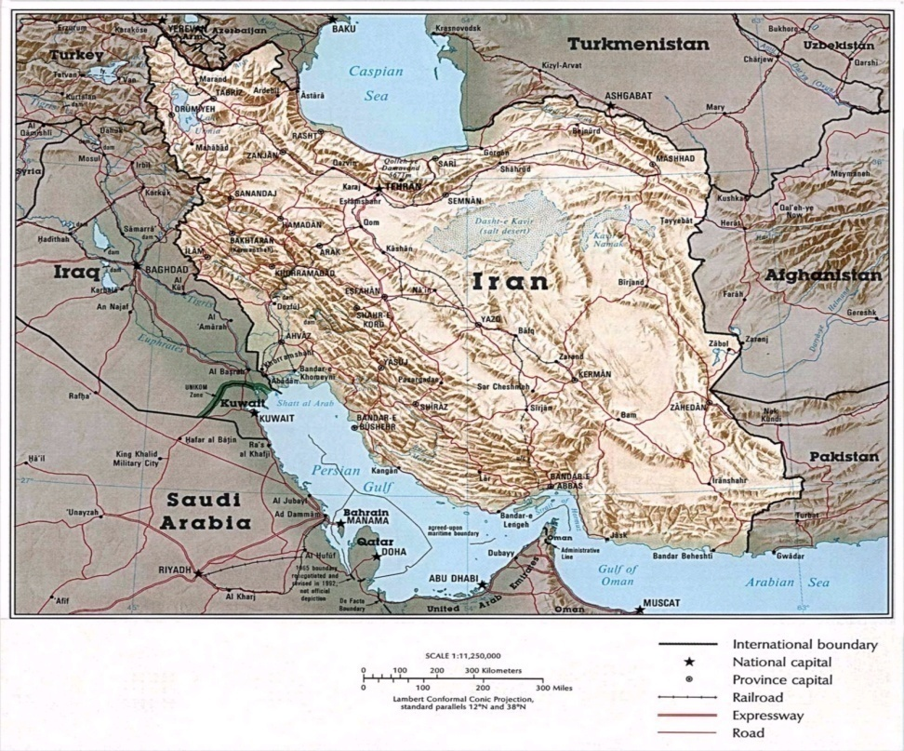
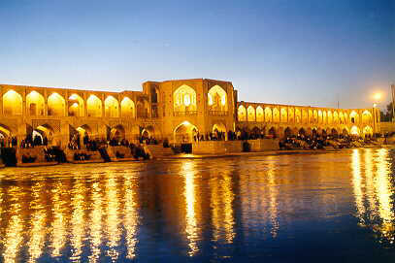
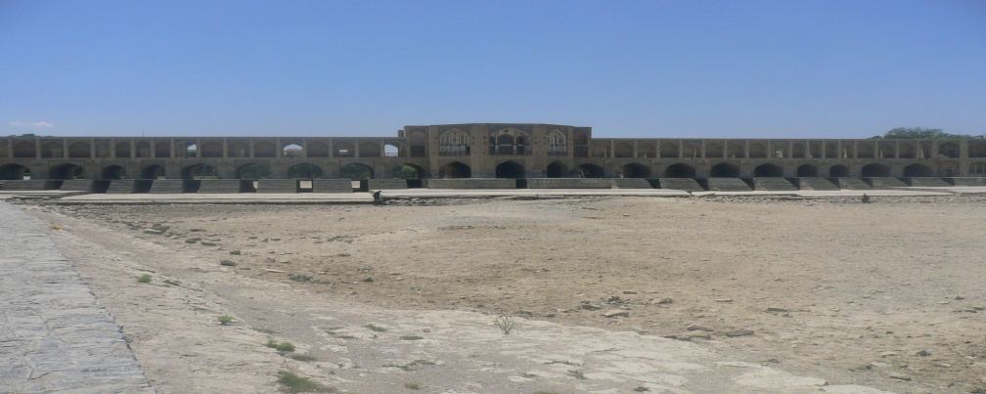
Study Area
Isfahan Province
Zayande rood River
EMS, Berlin, 12-16 Sep - 2011
Notes:
Arid & semi arid (more than 60%)
- Average rainfall
- More than 94% water consumption by agricultural sector
GCM (2010-2039)&(2070-2099)
Irrigation scheduling is important in water management
- Importance of soil moisture
- Purpose of the study

Slide 4
Introduction
Major disaster
Drought Indices…………SPI & RDI
More than 80 percent of surface water and soil moisture is escaped from environment by evapotranspiration
The goal of this research operational drought monitoring in Esfahan province(IRAN) by comparison of Standard Precipitation Index(SPI) & Reconnaissance Drought Index(RDI) and potential assignment of Reconnaissance Drought Index(RDI)
EMS, Berlin, 12-16 Sep - 2011

Slide 5
Materials & Methods
weather data of 10 synoptic stations of Isfahan province for 13 years(1992-2005) were used
Monthly values of precipitation, temperature, relative humidity, wind and solar radiation were used for calculation of potential evapotranspiration(Penman Monteith –FAO and Thorntwaite methods) by CROPWAT(ver.8)software and BASIC program
Runtest, correlation and Kolmogorov-Smirnov were used for homogeneity, gap analysis and normality test respectively.
EMS, Berlin, 12-16 Sep - 2011

Slide 6
-
DrinC(Drought Indices calculator) was used(Tsakiris et al., 2007b) and an online version of the software can be found at www.ewra.net/DrinC

Slide 7
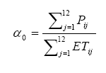
RDI (Reconnaissance Drought Index)
Ratio of accumulated precipitation to potential evapotranspiration. Three expressions of RDI are the initials, the normalised and standardized
initial value
The Standardised RDI behaves in a similar manner as the SPI . yk is the ln ak, yk is its arithmetic mean and is its standard deviation

Slide 8
Drought categories based on RDIst & SPI
Drought Categories | RDIst – SPI Values
Extremely Wet | 2 ‹
Very Wet | 1.5 to 1.99
Moderately Wet | 1 to 1.49
Near Normal | -0.99 to 0.99
Moderately Dry | -1 to -1.49
Severely Dry | -1.50 to -1.99
Extremely Dry | - › 2

Slide 9
Results and Discussions
SPI and RDIst were calculated using Penman-Monteith FAO for 3, 6 and 12 month time scales and statistical period of (1992-2005)for 10 synoptic stations
In all stations in extremely dry periods the values of RDIst is less than SPI similar values
Mean differences test among 3,6 and 12 monthly basis of SPI and RDIst was done by unpaired T-test and Mann-Whitney and Spearman and Pearson tests were used for correlation tests
EMS, Berlin, 12-16 Sep - 2011

Slide 10
SPI & RDIst values in Isfahan station (1992-2005)
EMS, Berlin, 12-16 Sep - 2011

Slide 11
Mean differences comparison and correlation between SPI & RDIst
RDIst -SPI | P | r
3 Month | 0.3184 | 0.99
6 Month | 0.4953 | 0.99
12 Month | 0.4601 | 0.99
EMS, Berlin, 12-16 Sep - 2011

Slide 12
Results: con…
According to obtained results and calculated P, mean differences between SPI and RDIst (3,6,12) are not significant. There was a very significant correlation between SPI and RDIst
For calculation of RDIst two methods of Penman-Monteith FAO and Thorntwaite were used for evapotranspiration calculation
Comparisons of two methods for equal or less than -2 values(extremely dry) showed that in all cases except 3 and 6 monthly basis in Kashan station, two methods had similar result and Drought (extremely dry) were occurred in 1999-2000, 1996-1997 respectively
EMS, Berlin, 12-16 Sep - 2011

Slide 13
For comparison of Penman Monteith-FAO and thorntwaite for RDIst(12 month) and correlation test Mann-Whitney and Spearmen tests were used. In this case P value of 0.4817 showed that there is no significant differences between them
As data required for calculation of Penman Monteith-FAO are available only in synoptic stations, having lack of data, using Thorntwaite is advisable
Zoning of SPI and RDIst for time steps of 3, 6 and 12 monthly basis in extremely dry years (1996-1997 and 1999-2000) for overall of Isfahan province was done by ArcGis software
Results: con…
EMS, Berlin, 12-16 Sep - 2011

Slide 14
Comparison of generated maps for SPI and RDIst on 12 monthly basis showed that zoning patterns are similar but drought areas in North, central and North eastern of province specially in Natanz and drought severity of Naeen in RDIst is more than SPI
Results: con…
EMS, Berlin, 12-16 Sep - 2011

Slide 15
RDI-Time scale 12, Isfahan province

Slide 16
SPI-Time scale 12, Isfahan province

Slide 17
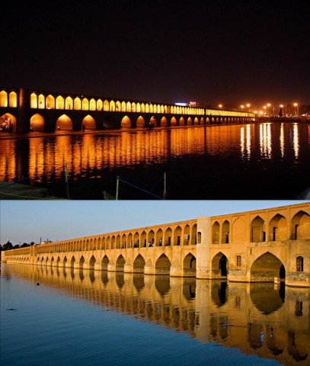
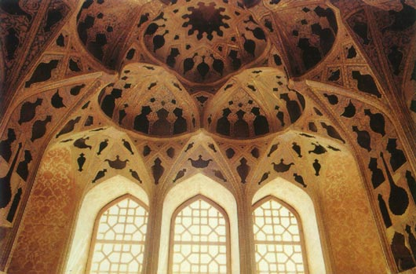
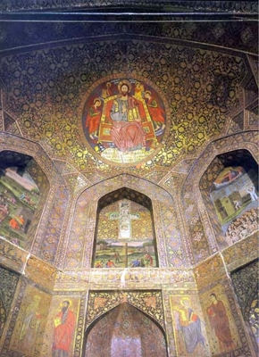
Thank you for your attention!

