Slide 1
Solar radiation estimate differences between traditional and advanced view factor analysis methods
Sookuk Park
Climate Lab., Department of Geography, University of Victoria, B.C., Canada

Slide 2
Human radiation exchange model
Shortwave (solar) radiation:
direct beam: sun’s altitude and azimuth angles
diffuse beam: sky view factor
reflected by buildings, vegetation (trees) and ground surfaces
Longwave (terrestrial) radiation:
from the sky: sky view factor
from building surfaces
from vegetation (trees) surface
from the ground surface
Lsky
Kdif Kref Kdir
Lbody
Lbuild Ltree
Lgrd
Human radiation exchange model

Slide 3
Limitations of Previous Studies
Shadow effect
In urban geometry, not whole but parts of building walls, vegetation and ground surfaces are shaded depending on sun’s location.
It affects reflected solar radiation and longwave radiation after dividing each whole surface to sunny/shaded surfaces.
Vegetation effect
vegetation has a different reflectivity and transmissivity for solar radiation and a much different surface temperature than buildings which affects longwave radiation analysis.
It affects reflected solar radiation and longwave radiation after separating vegetation view factors from the view factors of buildings and other structures in the sky hemisphere.
Notes:
Universal Thermal Climate Index

Slide 4
Purpose
This study compares the traditional view factor analysis method for estimating radiation exchange and the advanced one which includes vegetation and shadow effects.

Slide 5
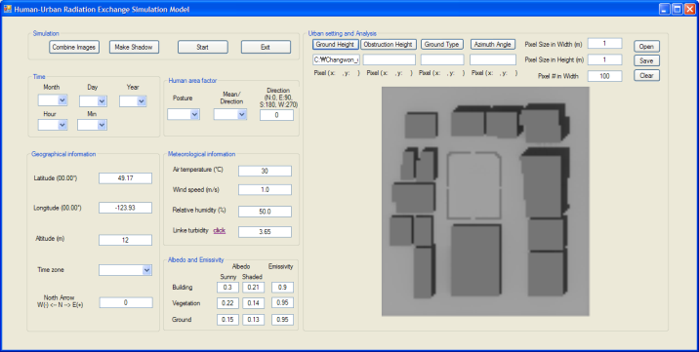
Methods 1. Human-urban radiation exchange simulation model
Developing :
Microsoft visual basic 2008
Raster image processing method
View factor analysis method: Johnson and Watson (1984) ¹
Solar radiation analysis
- Rigollier et al. (2000)’s equation ²
- vegetation and shadow effects included (Advanced method)
- albedo: Park (2011)’s collected values ³
- Oke (1987)’s slope geometry method: building walls
¹ Johnson GT, Watson ID (1984) The determination of view-factors in urban canyons. Journal of Climate and Applied Meteorology 23: 329-335
² Rigollier C, Bauer O, Wald L (2000) On the clear sky model of the ESRA–European Solar Radiation Atlas–with respect to the heliosat method. Solar Energy 68(1): 33-48
³ Park S (2011) Human-urban radiation exchange simulation model. PhD dissertation, University of Victoria, B.C., Canada
 | Building walls | Vegetation (trees) | Ground
Sunny | 0.30 | 0.22 | 0.15
Shaded | 0.21 | 0.14 | 0.13

Slide 6
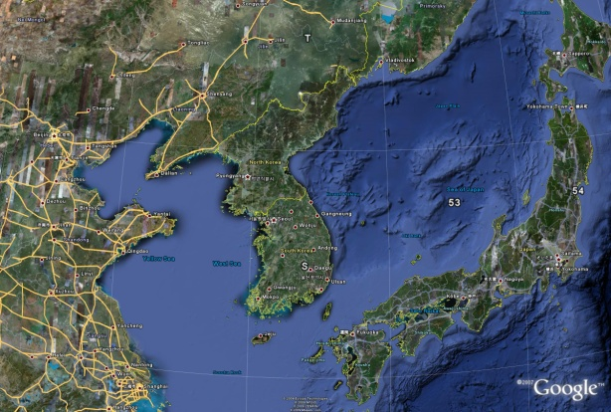
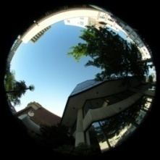
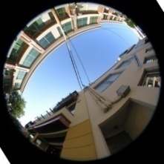
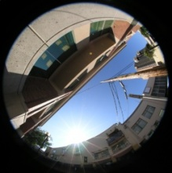
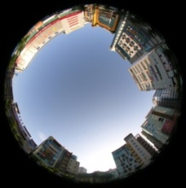
Methods 2. Comparisons
Comparing with existing-methods:
Existing-method1: 100% sunny, no vegetation (trees)
Existing-method2: 50% sunny and 50% shaded, no vegetation (trees)
Comparing with collected solar radiation data:
Location: NE-SW narrow streets, Nanaimo, B.C., Canada
(49º10' N, 123º56' W; altitude, 12 m; sky view factor, 0.35-0.43)
Square-shaped small park, Changwon, Republic of Korea
(35º13' N, 128º41' E; altitude, 17 m; sky view factor, 0.79)
Date: August 5, 2008 and July 26, 2009 at Nanaimo
June 11, 2009 at Changwon
Sky view factors: Nanaimo (0.35-0.43) Changwon (0.79)

Slide 7
Results 1. Comparison between advanced and two existing-methods
Tab. 1: Differences of solar radiation from the sky hemisphere (K↓) and from the ground hemisphere (K↑) between advanced and two existing-methods
Location and date | Sunny/ Shaded | Difference (Wm⁻²)
 |  | Advanced method– Existing-method1 |  |  |  | Advanced method– Existing-method2
 |  | Mean difference |  | Mean absolute |  | Mean difference |  | Mean absolute
 |  | K↓ | K↑ | K↓ | K↑ | K↓ | K↑ | K↓ | K↑
Nanaimo (Aug. 5, 2008 & July 26, 2009) | Sunny | -70.6 ±25.9 | -28.6 ±18.3 | 70.6 ±25.9 | 28.6 ±18.3 | -25.7 ±25.9 | 28.0 ±20.4 | 32.9 ±14.3 | 30.1 ±16.9
 | Shaded | 9.1 ±9.9 | 9.8 ±14.2 | 9.1 ±9.9 | 9.9 ±14.1 | 9.1 ±9.9 | 9.8 ±14.2 | 9.1 ±9.9 | 9.9 ±14.1
 | All | -37.1 ±45.2 | -12.4 ±25.4 | 44.7 ±37.2 | 20.7 ±18.8 | -11.1 ±26.9 | 20.4 ±19.9 | 22.9 ±17.2 | 21.6 ±18.5
Changwon (June 11, 2009) | Sunny | -21.7 ±9.9 | -6.8 ±2.1 | 21.7 ±9.9 | 6.8 ±2.1 | -7.5 ±4.4 | 59.1 ±17.7 | 7.5 ±4.4 | 59.1 ±17.7

Slide 8
Results 2. Comparison with collected solar radiation data
Tab. 2: Differences of solar radiation from the sky hemisphere (K↓) and from the ground hemisphere (K↑) between collected data and advanced/existing-methods
Location and date | Sunny/ Shaded | Difference (Wm⁻²)
 |  | Advanced method– Collected data |  |  |  |  |  | Existing-method1– Collected data |  |  |  |  |  | Existing-method2– Collected data
 |  | Mean difference |  |  | Mean absolute |  |  | Mean difference |  |  | Mean absolute |  |  | Mean difference |  |  | Mean absolute
 |  | K↓ | K↑ | K dif. | K↓ | K↑ | K dif. | K↓ | K↑ | K dif. | K↓ | K↑ | K dif. | K↓ | K↑ | K dif. | K↓ | K↑ | K dif.
Nanaimo (Aug. 5, 2008 & July 26, 2009) | Sunny | -20.7 ±25.0 | -16.8 ±21.9 | -37.5 ±36.1 | 26.5 ±18.0 | 20.6 ±18.0 | 47.1 ±31.3 | 49.9 ±36.1 | 11.9 ±21.5 | 61.8 ±48.8 | 53.2 ±30.5 | 19.2 ±14.6 | 69.1 ±36.4 | 5.0 ±37.3 | -44.7 ±24.8 | -39.8 ±48.8 | 31.9 ±17.2 | 44.7 ±24.8 | 76.7 ±32.5
 | Shaded | 7.1 ±5.8 | 5.8 ±14.3 | 13.1 ±10.5 | 7.6 ±5.0 | 9.3 ±12.0 | 17.1 ±10.6 | -2.0 ±9.0 | -4.0 ±4.3 | -6.0 ±7.2 | 6.7 ±5.9 | 4.0 ±4.3 | 10.6 ±8.4 | -2.0 ±9.0 | -3.9 ±4.3 | -6.0 ±7.2 | 6.7 ±5.9 | 3.9 ±4.3 | 10.6 ±8.4
 | All | -9.0 ±23.7 | -7.3 ±21.9 | -16.2 ±37.8 | 18.6 ±16.8 | 15.8 ±16.4 | 34.5 ±28.6 | 28.1 ±38.1 | 5.2 ±18.1 | 33.3 ±50.2 | 33.6 ±33.0 | 12.8 ±13.6 | 44.5 ±40.5 | 2.0 ±28.6 | -27.6 ±27.9 | -25.5 ±40.5 | 21.3 ±18.5 | 27.6 ±28.0 | 48.8 ±42.0
Changwon (June 11, 2009) | Sunny | 5.5 ±15.0 | -2.9 ±3.5 | 2.6 ±13.8 | 13.3 ±7.8 | 3.3 ±2.8 | 16.7 ±9.4 | 27.2 ±22.8 | 3.9 ±2.4 | 31.1 ±22.6 | 28.5 ±21.0 | 4.0 ±2.3 | 32.5 ±20.8 | 12.9 ±17.8 | -62.0 ±15.5 | -49.0 ±32.1 | 18.3 ±11.5 | 62.0 ±15.5 | 80.3 ±7.5

Slide 9
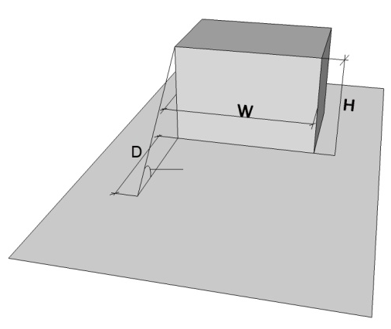
Discussions
β
Tab. 3: Johnson and Watson (1984)’s sky view factor analysis method: Height
D (m) | W= 12m | H (m)
 |  | 72 |  |  |  | 36 |  |  |  | 24 |  |  |  | 12
 | W/D | H/D | J & W | 5° | Diff. | H/D | J & W | 5° | Diff. | H/D | J & W | 5° | Diff. | H/D | J & W | 5° | Diff.
2 | 6 | 36 | 0.777 | 0.737 | -0.040 | 18 | 0.779 | 0.738 | -0.041 | 12 | 0.782 | 0.741 | -0.041 | 6 | 0.797 | 0.754 | -0.043
4 | 3 | 18 | 0.803 | 0.779 | -0.024 | 9 | 0.807 | 0.784 | -0.023 | 6 | 0.813 | 0.791 | -0.022 | 3 | 0.839 | 0.820 | -0.019
6 | 2 | 12 | 0.826 | 0.808 | -0.018 | 6 | 0.832 | 0.814 | -0.018 | 4 | 0.841 | 0.824 | -0.017 | 2 | 0.876 | 0.862 | -0.014
12 | 1 | 6 | 0.879 | 0.879 | 0 | 3 | 0.890 | 0.890 | 0 | 2 | 0.905 | 0.904 | -0.001 | 1 | 0.944 | 0.944 | 0
24 | 1/2 | 3 | 0.934 | 0.938 | 0.004 | 1.5 | 0.950 | 0.953 | 0.003 | 1 | 0.964 | 0.966 | 0.002 | 1/2 | 0.986 | 0.987 | 0.001
36 | 1/3 | 2 | 0.959 | 0.956 | -0.003 | 1 | 0.975 | 0.972 | -0.003 | 2/3 | 0.985 | 0.983 | -0.002 | 1/3 | 0.995 | 0.995 | 0

Slide 10
Discussions
β
Tab. 4: Johnson and Watson (1984)’s sky view factor analysis method: Width
D (m) | H= 12m | W (m)
 |  | 6 |  |  |  | 12 |  |  |  | 24
 | H/D | W/D | J & W | 5° | Diff. | W/D | J & W | 5° | Diff. | W/D | J & W | 5° | Diff.
2 | 6 | 3 | 0.813 | 0.763 | -0.050 | 6 | 0.797 | 0.754 | -0.043 | 12 | 0.792 | 0.747 | -0.045
4 | 3 | 1.5 | 0.866 | 0.854 | -0.012 | 3 | 0.839 | 0.820 | -0.019 | 6 | 0.831 | 0.816 | -0.015
6 | 2 | 1 | 0.905 | 0.891 | -0.014 | 2 | 0.876 | 0.862 | -0.014 | 4 | 0.865 | 0.851 | -0.014
12 | 1 | 1/2 | 0.964 | 0.966 | 0.002 | 1 | 0.944 | 0.944 | 0 | 2 | 0.931 | 0.929 | -0.002
24 | 1/2 | 1/4 | 0.992 | 0.991 | -0.001 | 1/2 | 0.986 | 0.987 | 0.001 | 1 | 0.979 | 0.978 | -0.001
36 | 1/3 | 1/6 |  |  |  | 1/3 | 0.995 | 0.995 | 0 | 2/3 | 0.992 | 0.991 | -0.001

Slide 11
Discussions
β
Tab. 5: Johnson and Watson (1984)’s sky view factor analysis method: Rotation angle
H (m) | W/D = H/D | Manual | Computer program
 |  | Johnson and Watson’s (1984) equation | Johnson and Watson’s (1984) fisheye lens photographic method |  |  |  |  |  | Oke’s (1987) Basin equation
 |  |  | 1° | 5° | 10° | Diff. with 1° | Diff. with 5° | Diff. with 10° | 5° & 10° | Diff.
12 | 6 | 0.797 | 0.754 | 0.754 | 0.767 | -0.043 | -0.043 | -0.030 | 0.767 | -0.030
 | 3 | 0.839 | 0.817 | 0.820 | 0.816 | -0.022 | -0.019 | -0.023 | 0.816 | -0.023
 | 2 | 0.876 | 0.863 | 0.862 | 0.880 | -0.013 | -0.014 | 0.004 | 0.880 | 0.004
 | 1 | 0.944 | 0.941 | 0.944 | 0.949 | -0.003 | 0 | 0.005 | 0.949 | 0.005
 | 1/2 | 0.986 | 0.986 | 0.987 | 0.985 | 0 | 0.001 | -0.001 | 0.985 | -0.001
 | 1/3 | 0.995 | 0.995 | 0.995 | 0.995 | 0 | 0 | 0 | 0.995 | 0
24 | 6 | 0.797 | 0.775 | 0.782 | 0.769 | -0.022 | -0.015 | -0.028 | 0.769 | -0.028
 | 3 | 0.839 | 0.828 | 0.828 | 0.840 | -0.011 | -0.011 | 0.001 | 0.840 | 0.001
 | 2 | 0.876 | 0.870 | 0.874 | 0.880 | -0.006 | -0.002 | 0.004 | 0.880 | 0.004
 | 1 | 0.944 | 0.942 | 0.944 | 0.949 | -0.002 | 0 | 0.005 | 0.949 | 0.005
 | 1/2 | 0.986 | 0.986 | 0.987 | 0.985 | 0 | 0.001 | -0.001 | 0.985 | -0.001
 | 1/3 | 0.995 | 0.995 | 0.995 | 0.995 | 0 | 0 | 0 | 0.995 | 0

Slide 12
Discussions
β
Tab. 6: Johnson and Watson (1984)’s sky view factor analysis method: Cases
Location | Sky view factor |  |  | Difference
 | 1° | 5° | 10° | 5° – 1° | 10° – 1°
Nanaimo_1 | 0.398 | 0.397 | 0.401 | -0.001 | 0.003
Nanaimo_2 | 0.374 | 0.379 | 0.361 | 0.005 | -0.013
Nanaimo_3 | 0.344 | 0.346 | 0.348 | 0.002 | 0.004
Changwon | 0.736 | 0.734 | 0.746 | -0.002 | 0.010

Slide 13
Conclusions
1. The advanced view factor analysis method which includes vegetation and shadow effects should improve radiation exchange estimates for human thermal sensation (comfort) analysis in complicated 3D urban environments.
2. The 50% shadow effect produced almost two-thirds K↓ difference reductions at the sunny locations in both Nanaimo and Changwon.
3. When only the vegetation effect was considered after converting all obstruction view factors to vegetation in existing-method1, the sunny locations had up to 38.8 Wm⁻² reductions in Nanaimo’s narrow urban canyons, and up to 19.6 Wm⁻² reductions at the more open Changwon site. More reductions happened at the lower solar altitudes, in the morning and afternoon.

Slide 14
Limitations
1. More case studies required
2. More input values of albedo and emissivity of each type of sunny/shaded building, tree or ground surface should be developed.
3. Vertical vegetation (trees)’s trunk height should be subtracted from vegetation height data.

Slide 15
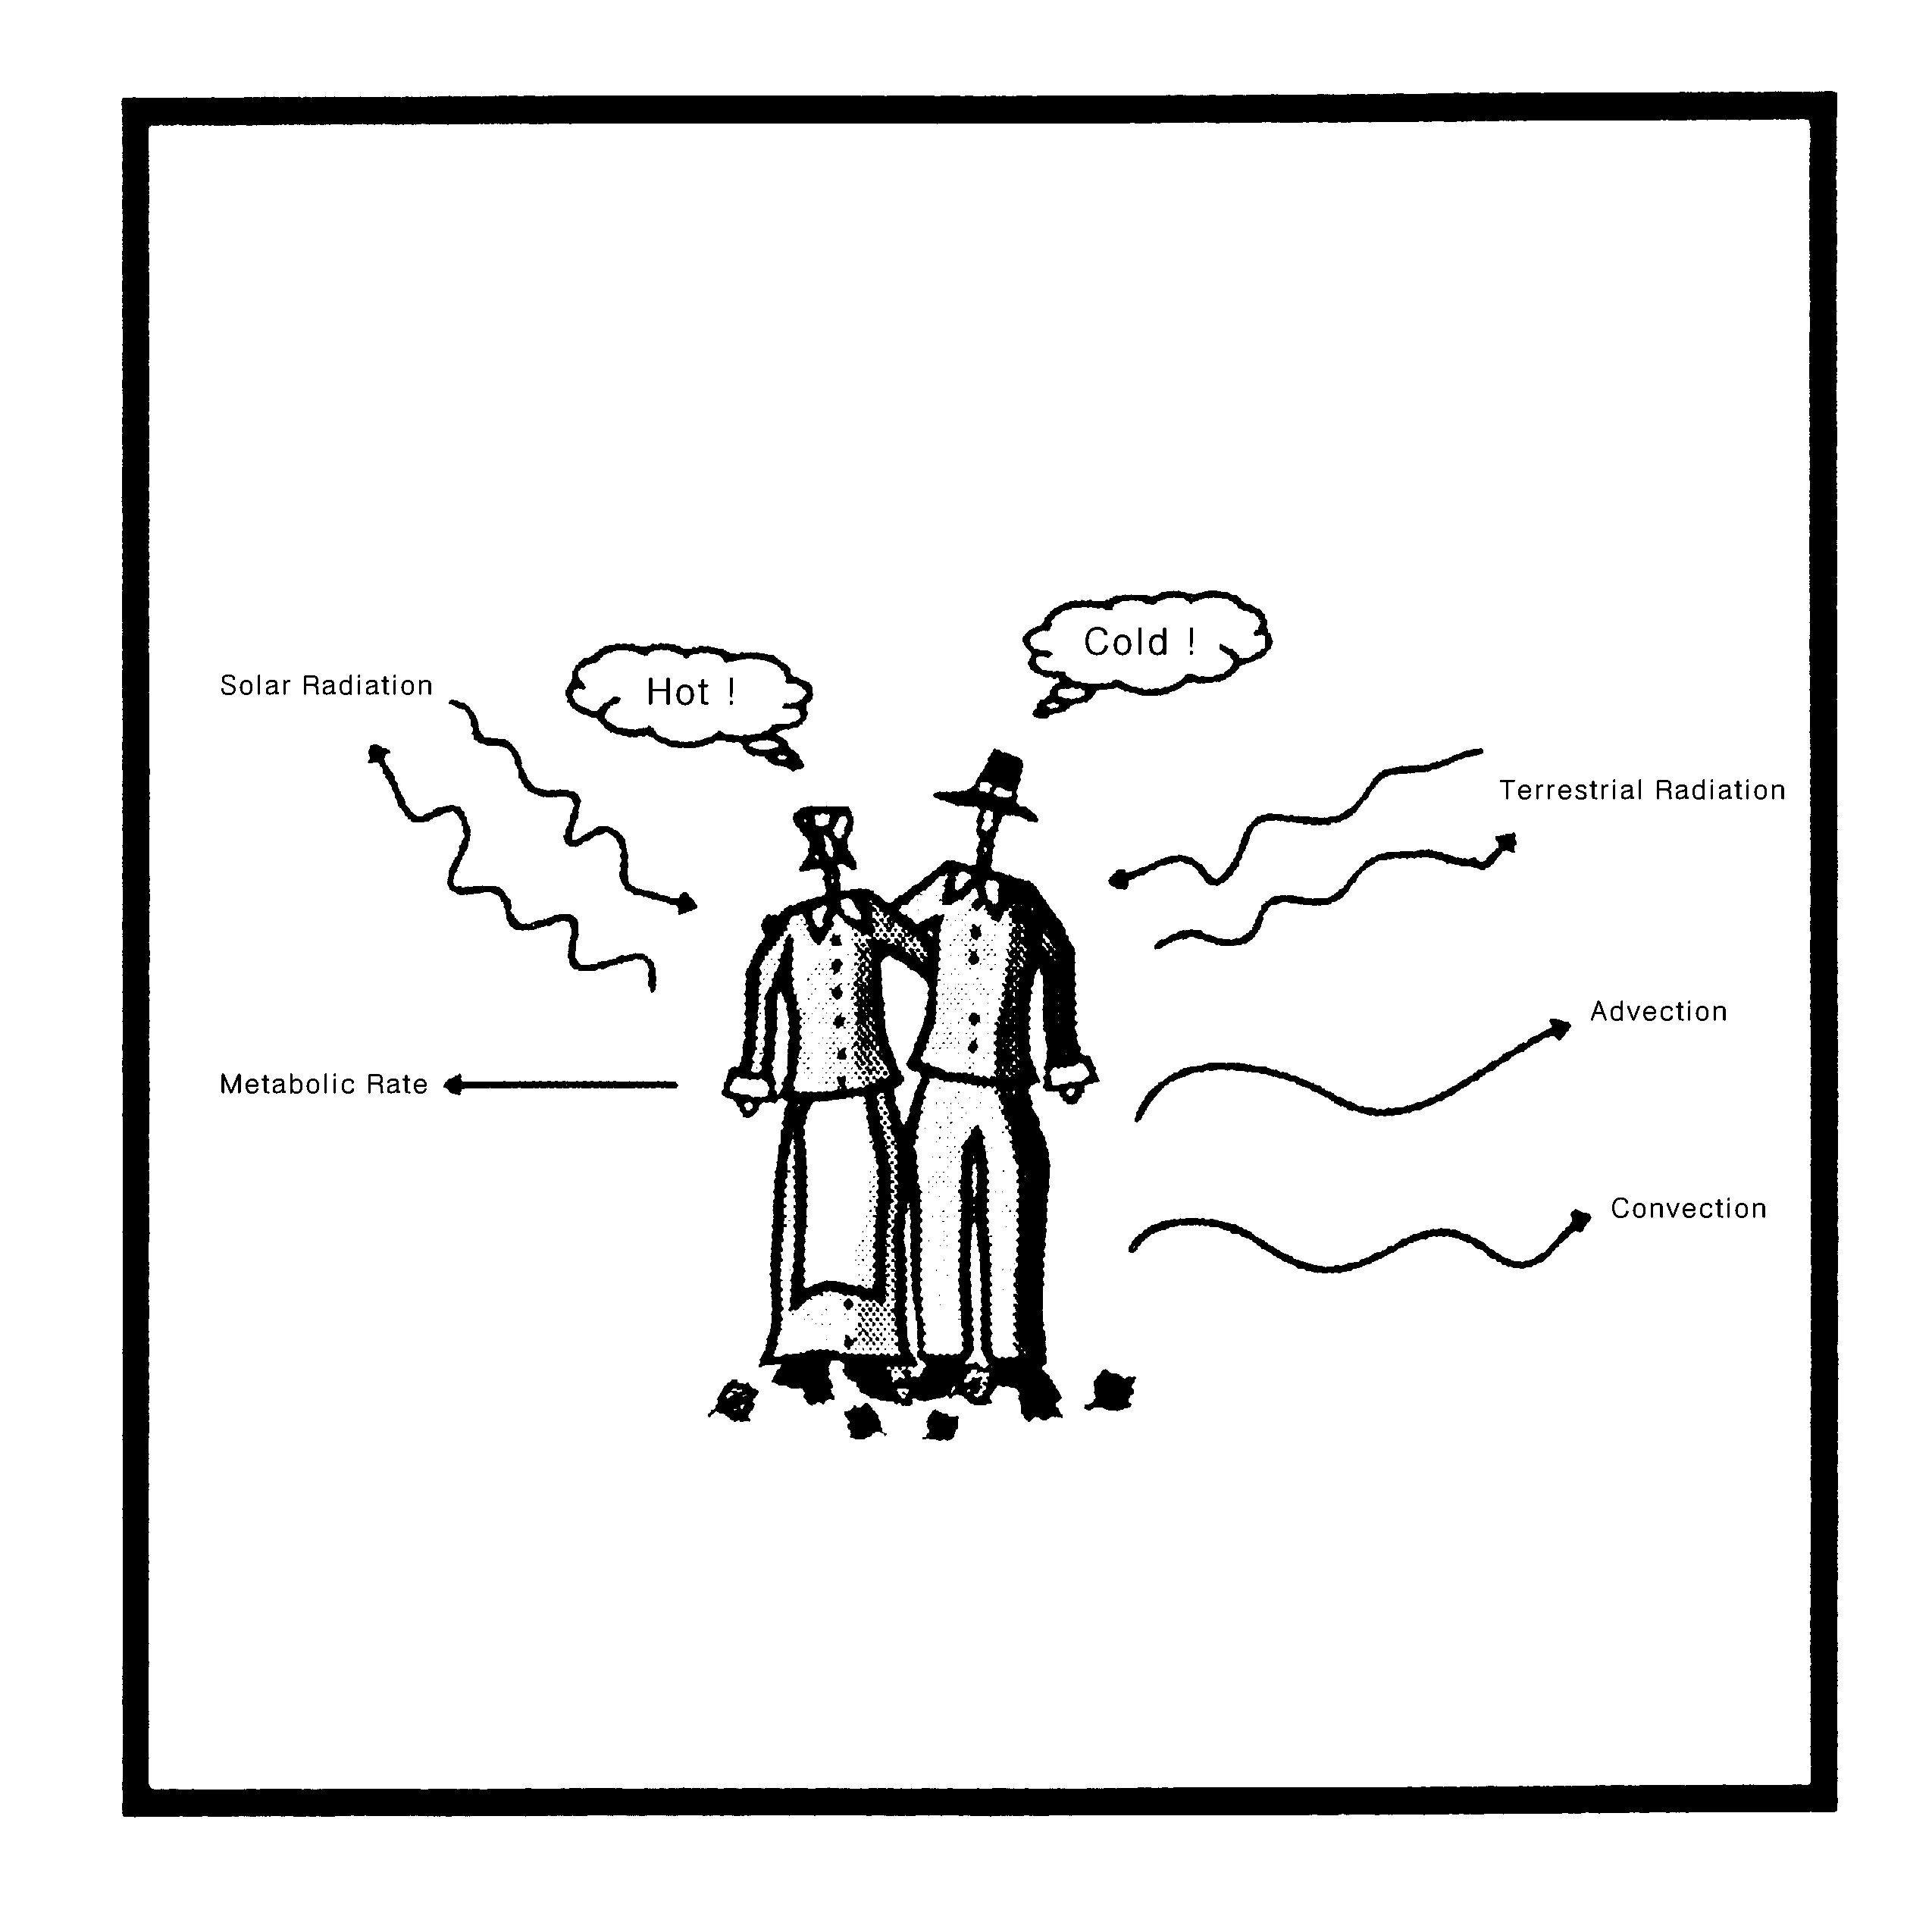
Thank you

