Slide 1
Spatially distributed temperature, topographic heterogeneity and ecosystem refugia in a changing climate
Nikki Vercauteren
Johan Dahlberg
Norris Lam
Georgia Destouni
Kristoffer Hylander

Slide 2
Context
Ecological refugia: small scale temperature heterogeneity can lead to the presence of refugia for species
Topography (North slope or south slopes, shading…) controls the local temperature to a large extent
Can we use topographic information to downscale climatic temperature series?

Slide 3
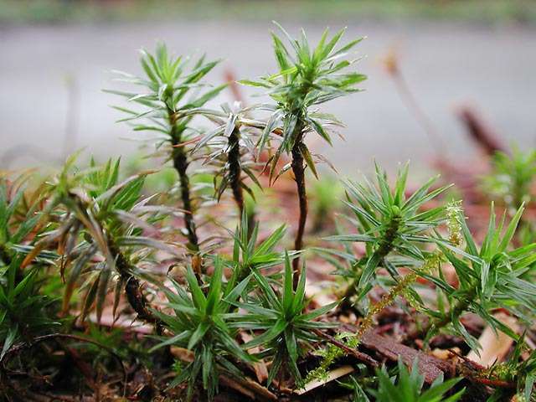
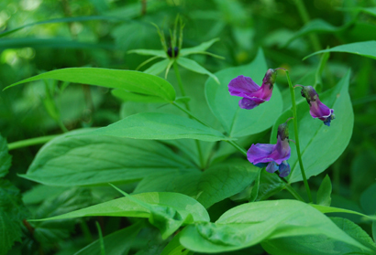
Climate change effect on plants
Bryophytes
Vascular plants
Notes:
Effects of climate change on vascular plants and bryophytes.

Slide 4
South and north facing slopes
Notes:
This picture shows a south facing slope with a high insolation and it therefore gets warmer than the surrounding landscape. This leads to the survival of southernly distributed plants that are favoured by a warmer climate and that doesn’t manage to exist in the colder surrounding landscapes.
These populations constitute outposts isolated from the main distribution range. The location of these isolated populations is called refugia. For example there is a refugium with hazel on this specific mountain.
The study area lies on the range borders of several plants and due to the topography holds many refugia.

Slide 5
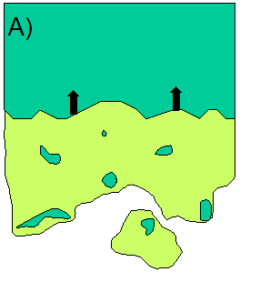
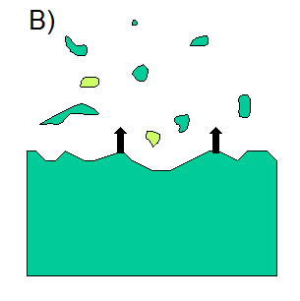
Plant refugia in a changing climate
Warmer climate
Northern species
Location of new refugia?
B. Warmer climate
Southern species
The role of existing refugia?
Notes:
A central part of Johans phD-project is to study plant refugia in a changing climate.
How and where in the landscape will new refugia arise for northern species if the climate gets warmer? The main population range will retract to the
north if it gets warmer but you can suspect that refugia will arise at favourable places such as mountain sides.
B. What is the role of existing refugia if climate gets warmer? The distribution range of southernly distributed species will expand to the north if it gets warmer and gradually they will meet the populations in existing refugia.
When this happens, how will the refugia contribute to the expansion of the population? Do refugial populations have evolved adaptions that are missing in the main population? If so, how will this affect the expansion?

Slide 6
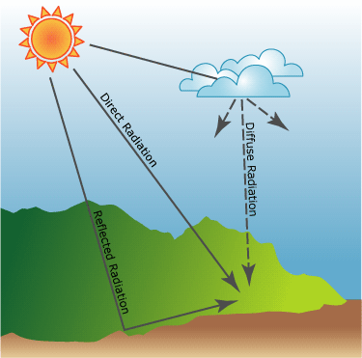
Solar radiation tool
ArcGIS solar radiation tool used to calculate insolation on daily, weekly or monthly periods. (hemispherical viewshed algorithm developed by Rich et al. (1990, 1994), Fu and Rich (2000, 2002), see ArcGIS desktop help)
Accounts for the effect of elevation, surface orientation, sun-earth geometry, sky obstruction caused by neighbor topography and atmospheric conditions.
Source: ArcGIS desktop help

Slide 7
Methodology
Compute solar radiation, parameters used: monthly atmospheric transmissivity and diffuse proportions estimated from cloud cover data (SMHI)
Transmissivity: t = 0.7 p_{clear sky} + 0.5 p_{partly cloudy} + 0.3 p_{cloudy}
Diffuse proportion = 0.2 p_{clear sky} + 0.45 p_{partly cloudy} + 0.7 p_{cloudy}
Temperature = f (solar radiation, lapse rate, time lag)
Are other parameters important? Distance to the sea?
Source: Huang et al. 2008, Physical Geography

Slide 8
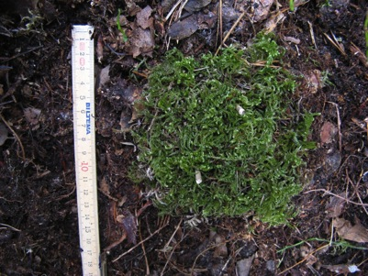
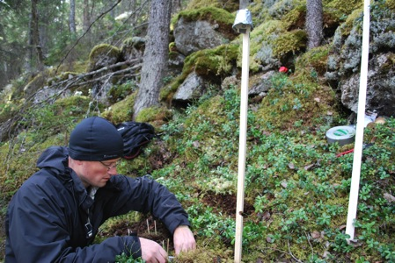
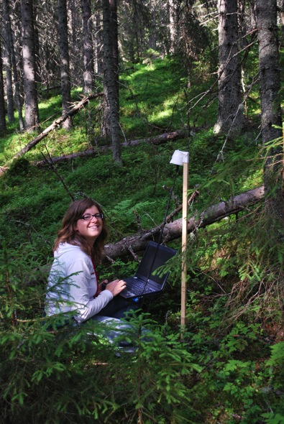
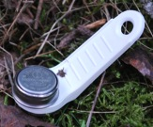
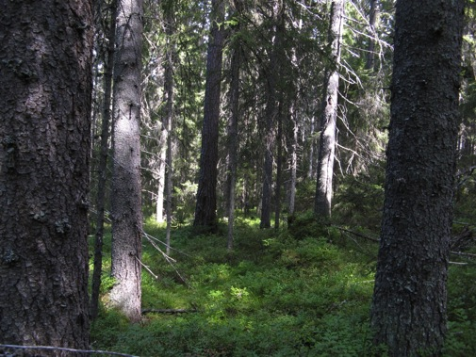
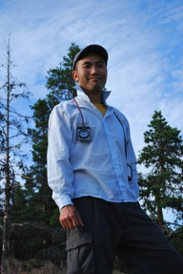
Field studies in Sweden
Moss transplants
Temperature measurements
iButton sensors,
ground and near air temperature
Inventories
Notes:
We will conduct field studies on different vascular plants and bryophytes.
The aim with the field studies is to investigate plant populations along a climate gradient. This summer we have made inventories of all bryophytes and vascular plants within 25 m squares at south and north facing slopes (36 in total) in the study area. The inventories will continue next summer. Which of these species prefers south facing slopes (warm local climate) and which prefers north facing slopes (cold local climate)? We have also collected soil samples and other data (dead wood, rocks, tree height and density for example) from the localities.
We have placed moss transplants at these localities (2 northern species and 2 southern species). The aim is to compare growth and fertility of the northern species with the southern species. Do they have a preference for south or north facing slopes?
The studies will lead to knowledge about distribution and growth of the populations.
With the help of the climate models we will also try to predict the future status of the populations.

Slide 9
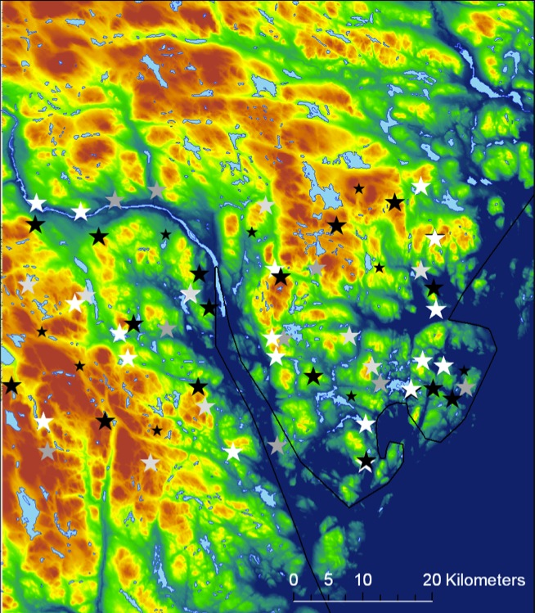
Site location and DEM
Umeå
Stockholm
3000 km²
Temperature sensors (64)
★
Flat

Slide 10
Monthly insolation
Insolation [WH/m²]

Slide 11
Temperature measurements
[C]
Flat
Altitude of the sensors is between 7 m and 400 m a.s.l.
➔ Effect of the sea is dominant

Slide 12
Diurnal temperature variations
June, diurnal variation of air temperature
Average daily insolation
[WH/m2]

Slide 13
Diurnal temperature variations
June, diurnal variation of ground temperature
Average daily insolation
[WH/m2]

Slide 14
Examples of averaged diurnal temperature
Sea shore
Inland
Averaged diurnal variations of temperature during the month of june at 2 sites.

Slide 15
Factors controlling temperature variations
50% correlation between the daily insolation and the air temperature diurnal variation (ground: 27%)
58% correlation between the distance to the sea and the air temperature diurnal variation (ground: 10%)

Slide 16
Temperature response
Both insolation and distance to the sea control the response of local temperature variations.
On long time scale, the presence of the sea regulates the coastal temperature leading to warmer spring temperatures by the coast.
On daily timescales, the presence of the sea dampens the diurnal temperature variations.

Slide 17
Future work
Gathering several months of temperature data, we will look at the time delay between maximal insolation and maximal temperature (monthly scale)
How is this time delay dependent on the distance to the sea?
Modeling the combined response of local temperature to the insolation and to the distance to the sea can help downscale large scale temperature series, but also maybe diurnal temperature maxima.

Slide 18
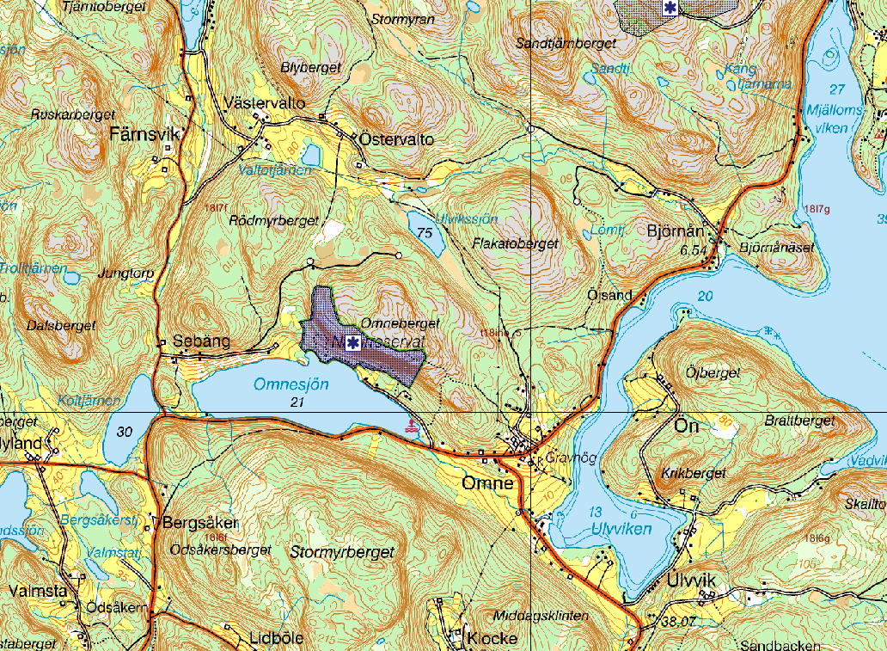
Protected areas
Notes:
Why are these studies of high value? This is important knowledge which can be used in environmental planning and maybe in fields such as cultivation of forests and crops.
The studies can also be used in protection of nature. For example, this is the nature reserve Omneberget on a south facing slope in the study area. The aim with the reserve is to protect an area with refugia for species which prefers a warmer climate.
Maybe, if the climate gets warmer, you should also protect north facing slopes with species that prefers a colder climate.

Slide 19
Thank you
Questions?
Contact: Nikki.vercauteren@natgeo.su.se

