Slide 1
Use of CALIOP aerosol optical depth retrievals for assessment of air quality in the city of Athens, Greece
Vasilis Pappas, Nikos Hatzianastassiou
University of Ioannina, Greece
Notes:
Thank you all for being here. This is a talk on the use of CALIOP aerosol optical depth in order to assess air quality in the urban area of Athens, Greece.

Slide 2
Air quality and aerosols
Air quality is commonly conceived as an index that is ~inversely proportional to the amount of particles that exist in the atmosphere, especially in the lower part of it (boundary layer), where humans live.
Anthropogenic emissions (traffic, industry, biomass burning etc.) have resulted in deterioration of air quality in developed and developing countries, often blamed to be responsible for increased levels of mortality.
A universal way of assessing air quality is by measuring Particulate Matter (PM) concentration at the surface.
EU has attempted to improve air quality by issuing daily and monthly limits that should not be exceeded.
Notes:
When talking about air quality to someone who is not meteorologist, some people might think that someone is trying to sell equipment for cleaner air indoors. In the atmospheric sciences community, air quality is usually combined with the amount and the kind of particles that exist in the atmosphere at a certain place.
Numerous studies have used reliable ground-based data and have proved that anthropogenic emissions in urban areas have deteriorated air quality there. How do we measure air quality and why? Obviously, policy-makers and the whole society has the right to know the quality of air that they breathe. This is achieved by measuring Particulate Matter concentration close to the surface. In fact, we measure the mass of aerosol particles suspended in the lowest few meters within a specific volume of air.

Slide 3
Ways to measure PM values
In order to measure PM values, ground-based monitoring stations have been used. Subject to their routine maintenance and calibration, they are a very good resource for the area they represent (usually an area of 20-30 km²).
However, the network of PM measuring stations is not as dense as we would like, especially outside main metropolitan centers.
On the other hand, satellites nowadays cover nearly the whole globe. Hence, they could be potentially used as an assistant to PM measurements.
Notes:
Although PM measurements are usually very reliable, given of course the fact that there is a routine maintenance and calibration, the network of PM measurement stations is not as dense as we would like. Such stations are mostly limited to large cities, and even there they can only be representative for a small area around them.
On the other hand, more and more satellite missions cover nearly the whole planet. Bearing this in mind, satellites could be used to assist to PM measurements and finally assess air quality above larger parts of the globe.

Slide 4
Our idea (I)
Based on the fact that the largest fraction of the columnar AOD is attributed to aerosol particles in the boundary layer, a link can be found between aerosol optical properties in the boundary layer and PM surface concentration.
The ability of CALIOP lidar to identify the altitude of aerosol particles with a vertical resolution of 30 m from the ground up to ~8km is an ideal way to ‘see’ the aerosol layer in the boundary layer.
Notes:
So, how can satellites retrievals be related to PM ground-based measurements? It has been proved that high aerosol columnar events are usually linked to elevated surface values of PM. Another thing we know from literature is that the largest fraction of the columnar AOD can be attributed to the lowest 2-3 km. This is where CALIOP comes in. CALIOP’s lidar has been designed in such a way, as to be able to identify the altitude of each feature (aerosol/cloud) at a good vertical resolution. This, of course, is subject to the thickness of cloud/aerosol layers above. CALIOP algorithm provides up to 8 layer of aerosols, the first being the top and moving to the surface.

Slide 5
Our idea (II)
Aerosol Optical Depth is an index that shows the amount of radiation being absorbed and/or scattered due to aerosols. It is being provided at the wavelength of 532nm and 1064nm, the former being used here.
An accurate relationship between AOD and PM10 or PM2.5 can enable a complete monitoring of air quality over the whole greater Athens area and other megacities in the Mediterranean basin and Europe.
Notes:
CALIOP provides a number of different optical properties. Aerosol Optical Depth is an index that shows the amount of radiation being absorbed or scattered due to aerosols. It is provided for the wavelengths of 532nm and 1064nm.
If we are able to find a relationship between AOD and PM10, this can in fact be used for a complete monitoring of air quality over the area of Athens. Applying the relationship to other areas of Mediterranean with similar characteristics-with regards to the aerosol species- we could predict PM10 values.

Slide 6
Some info on Athens
Athens has a population of ~4.5 million people, with heavy emissions from industry in the suburbs, a lot of pollutants coming from traffic and on top of that it frequently undergoes dust transportation from Sahara desert, under favourable cyclonic conditions.
The aerosol load in Athens is a composite of a number of sources, such as Istanbul metropolitan area, power plants in Balkans and Africa etc (Gerasopoulos et al., 2011). The geographical distribution of those sources lead to mixed types of aerosols over Athens with the contribution of fine and coarse particles being highly variable, extending from 10% to 90%.

Slide 7
Review of previous similar studies
Most –if not all- of those studies use columnar-integrated aerosol optical properties, usually by MODIS sensor(Di Nicolantonio et al., 2009; Koelemeijer et al., 2006). The problems with this methodology are the following:
  Columnar AOD (measured by MODIS) is obviously different than boundary layer AOD, with the latter being more tightly related to PM surface concentration.
  Retrieval of AOD by MODIS is restricted to cloud-free conditions.
  There is a much larger degree of confidence in MODIS retrievals over ocean than over land. However, PM values are more important in urban areas, which are obviously in land.
  In MODIS retrieval, there is an assumption that AOD is negligible at 2.1 μm. This is not the case, though, for when the atmosphere contains many larger particles, such as dust (Koelemeijer et al., 2006). For areas in Southern Europe, like Athens, this is quite usual due to frequent transport of Saharan dust.
Notes:
So, the new stuff in our study is not the idea for correlating AOD and PM10 or PM2.5.
However, most of those studies have used columnar-integrated aerosol optical properties, usually by MODIS sensor.
The problems with that methodology are listed here: ……

Slide 8
Our data
CALIPSO’s Cloud-Aerosol Lidar with Orthogonal Polarisation (CALIOP) data from nearly 5 years of continuous measurements (June 2006-December 2010) are analysed for the urban area of Athens, Greece.
CALIOP aerosol products include an identification of each aerosol type, namely dust, biomass burning, polluted continental, marine and polluted dust. This enables an assessment of the certain type of aerosol that deteriorates air quality in the specific area.
PM10, PM2.5 measurements are taken from the Greek Ministry of Environment and are on a daily basis (daily average). Unfortunately, hourly data are not available.
Notes:
The data that we used are from nearly 5 years of observations. Apart from the ability to detect the altitude of the aerosol layers, an aerosol speciation is also provided. The shown in bold subtypes are those that CALIOP can identify. Of course, the algorithm that identifies the different subtypes needs validation. This is part of our future work, where the aerosol species over a number of sites shall be compared to the species detected by CALIOP.

Slide 9
Methodology I
Spatial collocation:
  Data from CALIOP within a range of ~11 km (0.1°latitude/longitude degree) from each PM measurement site are considered.
Temporal collocation:
  CALIOP passes from Athens area at ~11.30 and ~00.30 UTC time. The night pass cannot be correlated to PM value of the same day, as emissions occur later on the day. Hence, it has been correlated to the PM value of the previous day.
6 sites in Athens area have been used for the correlation between PM and AOD.

Slide 10
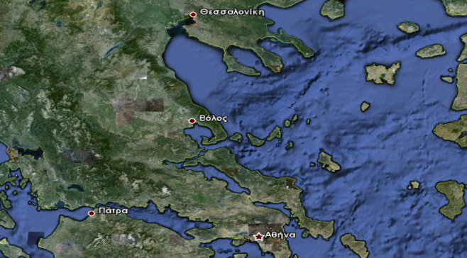
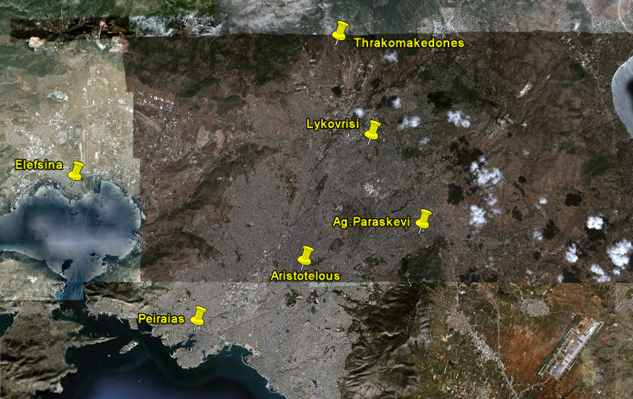
Sites of Athens

Slide 11
Methodology II
Data screening:
  Features with CAD(Cloud-Aerosol Distinction)<-20 have been used.
  Retrievals that come from horizontal averaging of 5 km.
  The lowest layer detected has been used with the limitation that ‘Base Altitude+ Layer Thickness<=2.5 km’ in order to have a better relationship with PM measurements. This has screened out almost all day passes.
Notes:
Explain what is CAD.

Slide 12
All sites (PM10)
Correlation coefficient R=-0.0524
RMSE=54.93
Bias=-45.19
 | AOD | PM10
Mean | 0.18 | 45.3
Median | 0.1114 | 35
Min | 0.0115 | 12
Max | 1.2464 | 150
Notes:
Both PM10 and PM2.5 values (you will see in the next slide) prove that Athens are characterised by high PM concentrations.
Maximum PM values are observed in mid-February (0.4529) and mid-September (0.3862).

Slide 13
All sites (PM 2.5)
Correlation coefficient R=-0.0658
RMSE=25.99
Bias=-28.56
 | AOD | PM10
Mean | 0.18 | 28.7
Median | 0.1114 | 29.5
Min | 0.0115 | 13
Max | 1.2464 | 48

Slide 14
Seasonal aerosol speciation
 | clean marine (1) | dust (2) | polluted continental (3) | clean continental (4) | polluted dust (5) | smoke (6) | TOTAL
winter | 0 | 5 | 7 | 2 | 4 | 2 | 20
spring | 0 | 3 | 0 | 0 | 0 | 0 | 3
summer | 0 | 0 | 0 | 0 | 15 | 1 | 16
autumn | 1 | 0 | 5 | 0 | 5 | 1 | 12
TOTAL | 1 | 8 | 12 | 2 | 24 | 4 | 51
Notes:
this table shows the various types of aerosol (subtypes) identified and classified by CALIOP algorithms.
Throughout the year, there is variability in subtypes, with the most occurrences being POLLUTED DUST, then
POLLUTED CONTINENTAL and then DUST. A large number of POLLUTED DUST is seen during summer.
DO NOT FORGET THAT THIS IS THE LOWEST AEROSOL LAYER. IN MANY DAYS, THERE WERE MORE THAN ONE AEROROL LAYERS OF DIFFERENT SUBTYPE.

Slide 15
More statistics on seasonal variability (PM10)
winter
spring
R=0.52
R=-0.14
summer
autumn
R=-0.72
R=0.68

Slide 16
Notes:
This is the actual time-series of our data. For some days, there were no PM data available for some of the sites.
From this plot, someone can observe again that the seasons with most well-fitted data is spring and autumn. Besides that, it appears again that the correlation is better when there are average values considered. This means that for PM values up to 50 and AOD up to 0.4 the correlation is optimal.

Slide 17
Analysis
The night passes of CALIPSO make it very difficult to successfully correlate AOD with previous day’s PM measurements.
No information on standard deviation (measurement error) of PM measurements makes the correlation even harder.
Based on boundary-layer theory, during summer, boundary layer – and along with it the pollutants- are lifted higher during the evening and dispersed into the free troposphere. Hence, no matter what the PM values are, at midnight the retrieved AOD remains justifiably low due to dispersion of the aerosol particles.
Use of daily mean instead of hourly values affects the correlation.

Slide 18
Conclusions
A first inspection of the CALIOP AOD 532nm retrievals and Greek Ministry of Environment PM10 data showed no correlation between the two.
Looking at the seasonal plots, spring (only 3 pairs) and autumn revealed a correlation of R=0.52 and R=0.68, respectively.
Based on spring and autumn, a linear relationship between AOD and PM10 is found for the city of Athens:
  PM10=43.7*AOD+23.6 with a correlation coefficient of 0.234, valid for the specific weather conditions
Polluted dust and polluted continental are the main aerosol subtypes ‘seen’ above Athens urban area.

Slide 19
Further work
The 1064 nm channel has better sensitivity than the 532 nm channel in the boundary layer, where signals are stronger. Hence, a correlation shall also be attempted with the 1064 nm AOD.
Data from more sites shall be used, perhaps relaxing the limitation for the lowest 2.5 km.
Aerosol speciation algorithm shall be evaluated against quality ground-based databases.
Availability of hourly data is expected to greatly improve the correlation, ideally comparing AOD with PM values of the 1-hour time interval around the passage of CALIOP.

Slide 20
References
Di Nicolantonio et al., 2009.: Particulate matter at surface: Northern Italy monitoring based on satellite remote sensing, meteorological fields, and in-situ samplings.
Gerasopoulos et al., 2011: Three-year ground based measurements of aerosol optical depth over the Eastern Mediterranean: the urban environment of Athens.
Koelemeijer, RBA, Homan , CD, Matthinsen, J. (2006). Comparison of spatial and temporal variations of aerosol optical thickness and particulate matter over Europe.
Schaap et al., 2009: Exploring the relation between aerosol optical depth and PM2.5 at Cabauw, the Netherlands.

