Slide 1
Verification Approaches for Ensemble Forecasts of Tropical Cyclones
Eric Gilleland, Barbara Brown, and Paul Kucera
Joint Numerical Testbed, NCAR, USA
ericg@ucar.edu, bgb@ucar.edu, pkucera@ucar.edu
ECAM/EMS 2011 14 September 2011

Slide 2
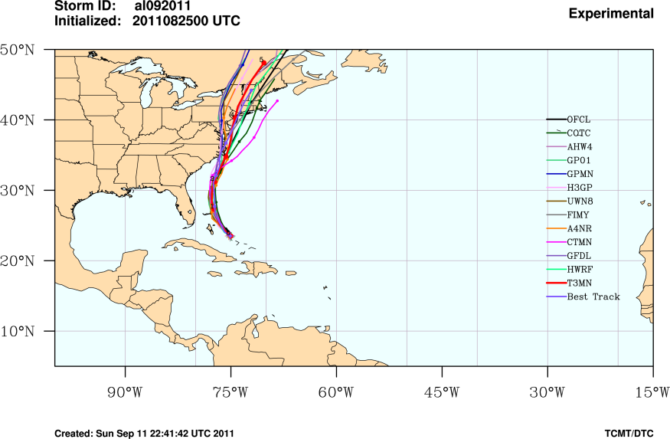
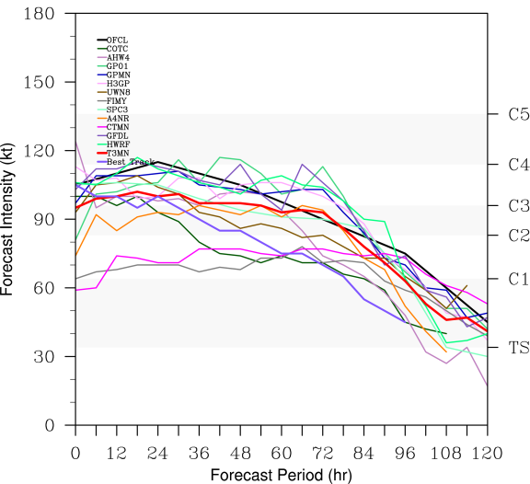
Motivation, Goals, and Approach
Ensemble NWP have potential to provide valuable probabilistic information for hurricane emergency planning
Verification methodology development is lagging behind forecast development
Goal here: Exploration of new approaches to
Evaluate ensemble TC forecasts
Consider multivariate attributes of TC performance
Approach
Outline suggested methods
Demonstrate some methods (MST) with simulations
Demonstrate on a set of ensemble forecasts

Slide 3
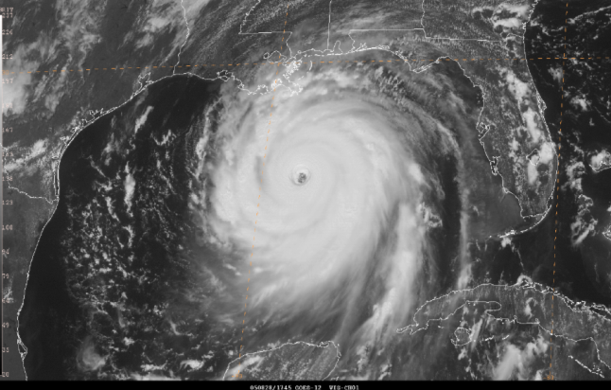
Hurricane Forecast Improvement Program (HFIP)
What is HFIP?
U.S. NOAA-funded and organized program to improve predictions of hurricanes
HFIP Goals
20% (50%) improvements in intensity and track forecasts over 5 (10) years
20% increase in POD and 20% decrease in FAR for rapid changes in intensity
7-day accuracy = 5-day accuracy in 2003
Similar improvements in storm surge and rainfall forecasts
Hurricane Katrina; 1745 UTC 28 August 2005, near peak intensity of 150 kt (from NHC Tropical Cyclone Report on Katrina)

Slide 4
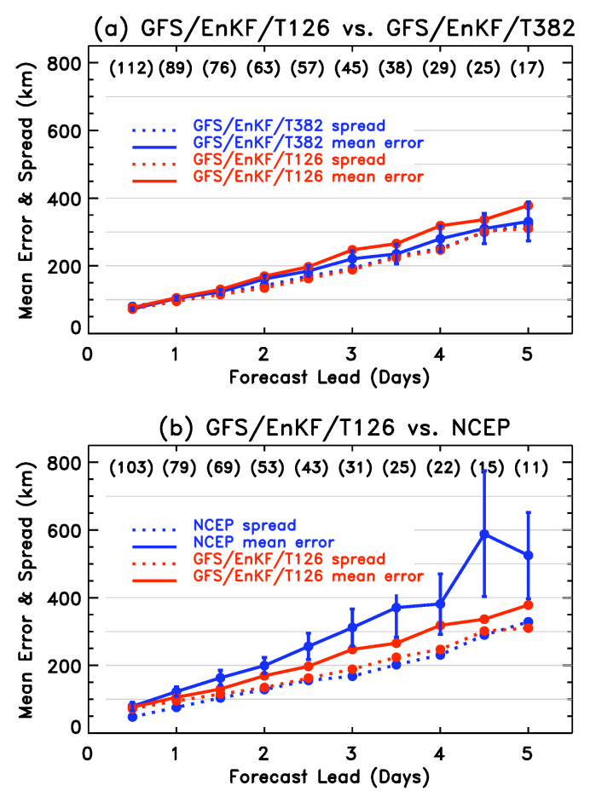
Current (common) approaches
Evaluation of mean track and intensity
Traditional focus is on these 2 variables
Evaluate spread for each variable
Evaluation of individual members as deterministic forecasts
Use of standard ensemble procedures to evaluate intensity forecasts
From Hamill et al. 2011 (MWR)
Notes:
Add example from Hamill paper / ppt

Slide 5
Simulations and data
Simulations
Track and intensity variables are assumed to be normally distributed
Various types of dispersion errors and bias applied
Real forecasts and observations
Mesoscale model ensemble forecast predictions for tropical cyclones over a four-year period
Observations: Official Best Track data

Slide 6
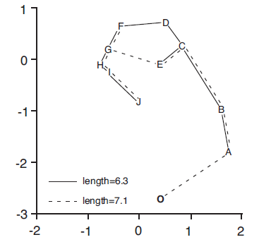
Minimum spanning tree
Analogous to Rank Histogram for multivariate ensemble predictions
Treat track location and intensity as a 3-dimensional vector
Great Circle and Euclidean distances
Bias correction and Scaling recommended (Wilks)
From Wilks (2004)

Slide 7
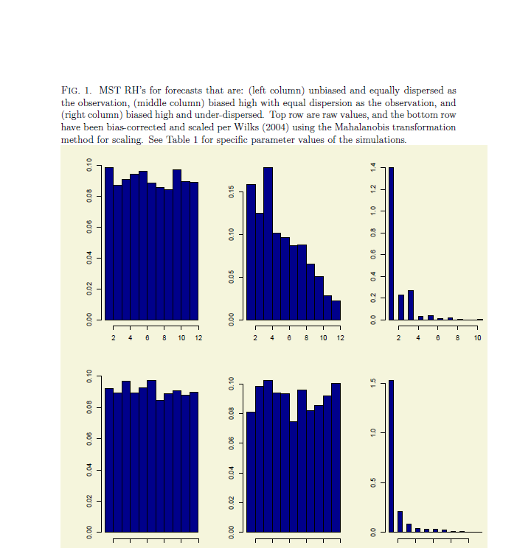
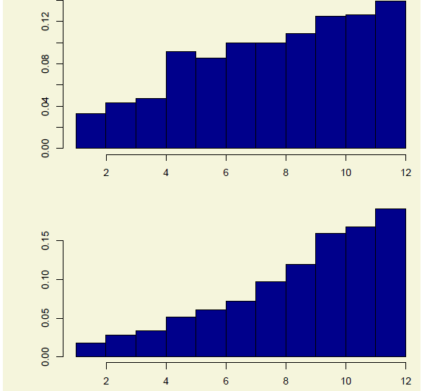
Simulated MSTs
Unbiased, Equally dispersed
Biased high, Equally dispersed
Biased high, Under-dispersed
Ubiased, Over-dispersed
Raw
Raw
Bias-corrected, Scaled
Bias-corrected, Scaled

Slide 8
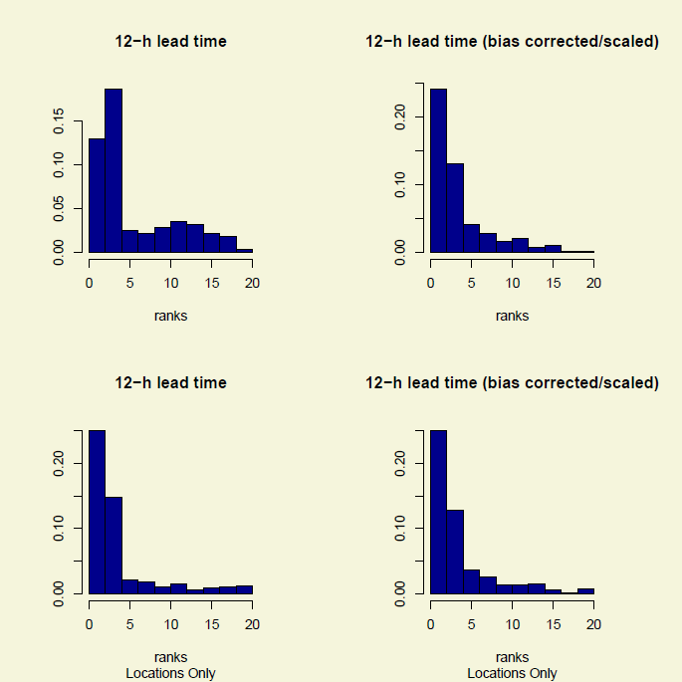
Forecast MSTs
Forecast appears to be greatly under-dispersive
Bias correction and scaled results suggest that forecasts are even more under-dispersive than shown by raw MST

Slide 9
MSTs for location and intensity
Track
Intensity
Overall under-dispersion seems to be related to tracks more than intensity

Slide 10
Energy score
Multivariate generalization of CRPS:
where are d-variate ensemble members and is the d-variate observation

Slide 11
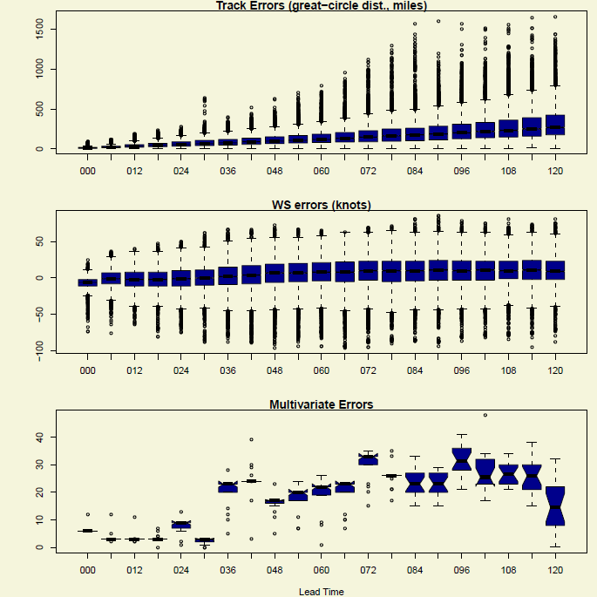
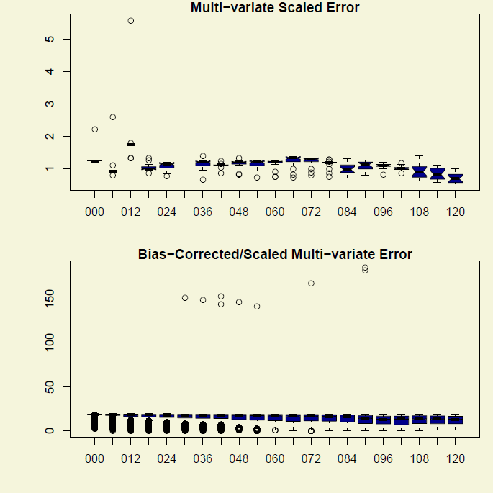
Multivariate and scalar errors
Track
Scaled and Bias-Corrected
WS
Errors
Multivariate

Slide 12
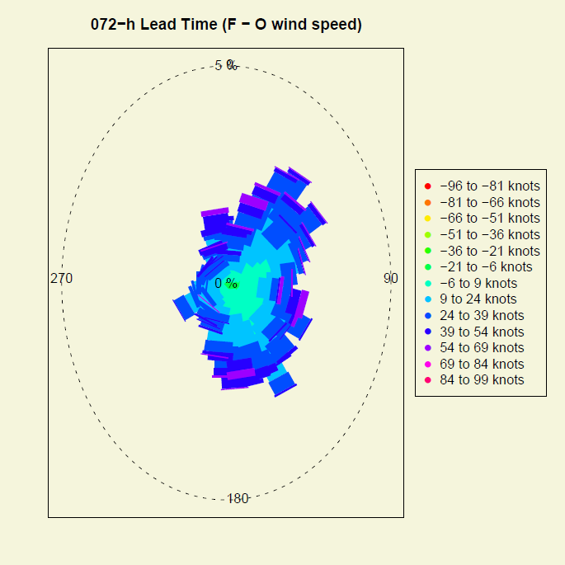
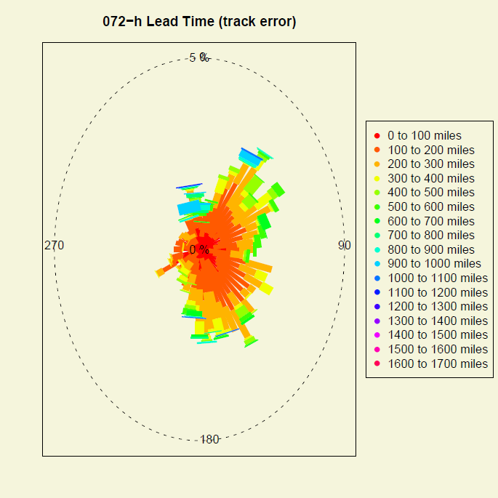
Directional distributions of errors
Bearing and Wind speed errors
Bearing and Track errors

Slide 13
Final comments
Evaluation of ensemble tropical cyclone forecasts suffers from same deficiencies as evaluation of non-probabilistic TC forecasts
Data issues
Limited variables
Need to “exercise” new methods on additional ensemble datasets to understand sensitivities and capabilities
Additional approaches to be explored further
Ex: Evaluation of ellipses, new measures of spread

