Slide 1
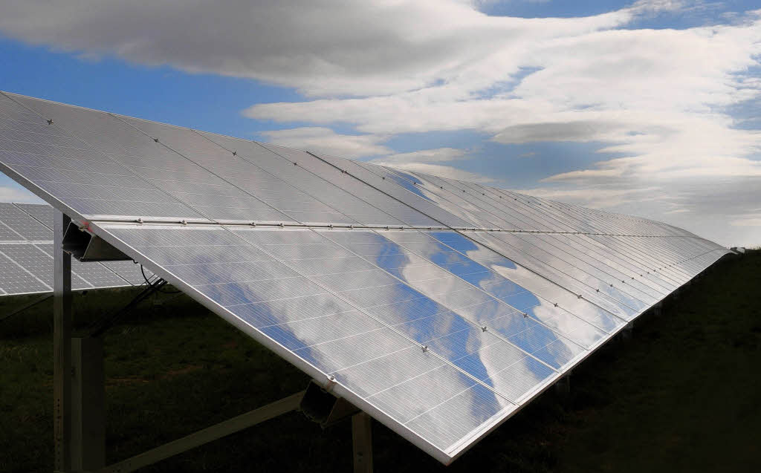
Towards a more accurate wind and solar power prediction by improving NWP model physics
Carmen Köhler and Andrea Steiner

Slide 2
Outline
EWeLiNE Project
Modeling Errors
Clouds and Other Uncertainties
Diurnal Cycle of Wind
Conclusion

Slide 3
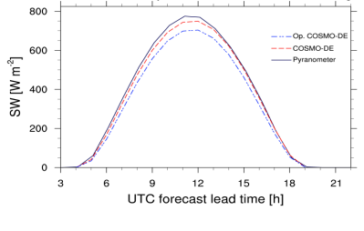
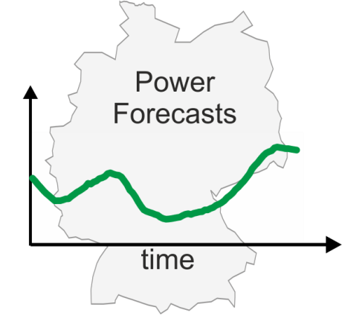
EWeLiNE
DWD
IWES
Weather-
forecast
TSOs
Feedback
Power-
forecast
Notes:
Goal is to improve weather and power forecasts and develope new forecast products especially to ensure a stable transmission network system.

Slide 4
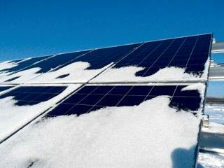
PV Modeling Errors
Photovoltaik:
→ Shallow convection after cold frontal passage
→ Spatial and temporal resolution of convection
→ Low stratus
→ Snow cover on solar panels
www.solarify.eu/

Slide 5
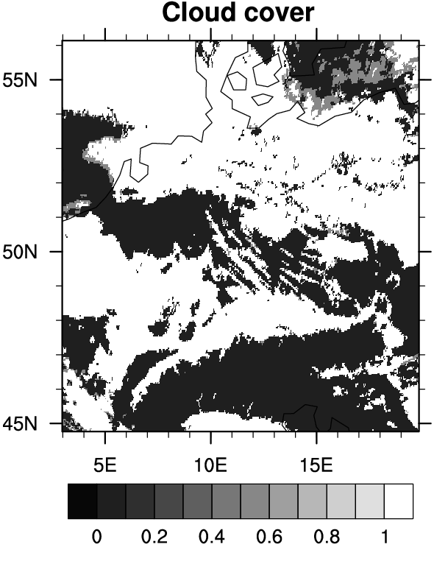
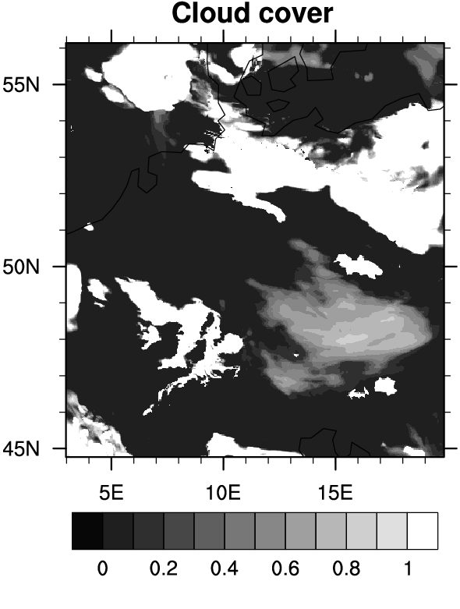
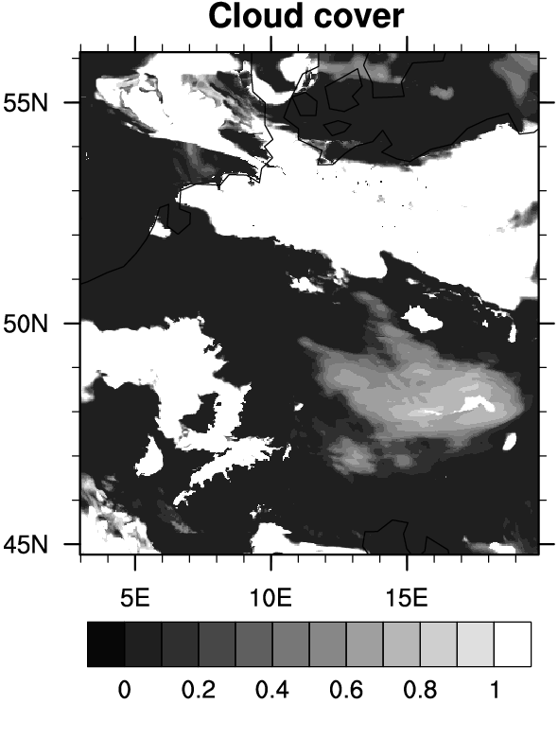
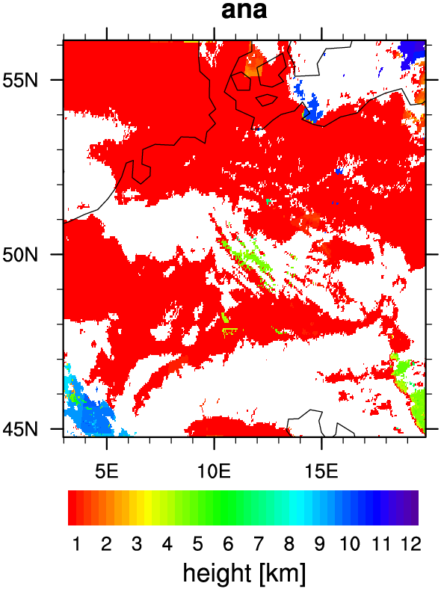
Data Assimilation- Low Stratus
Total cloud cover after 12 h free forecast
conventional + cloud assimilation
satellite obs
conventional only
Cloud top height NWC SAF
15. Nov 2011, 6:00 UTC
Annika Schomburg, DWD
Notes:
Free- without further assimilation after t=0, convential without cloud product, + Minimal diffusion coefficient

Slide 6
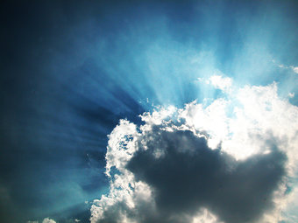
PV Modeling Errors
From a modelers perspective:
→ Cloud-free days
→ Optical thickness of clouds
→ Aerosol interactions
http://www.photocase.de/stock-fotos/33254-stock-photo-himmel-sonne-wolken-kalt-strahlung.jpg

Slide 7
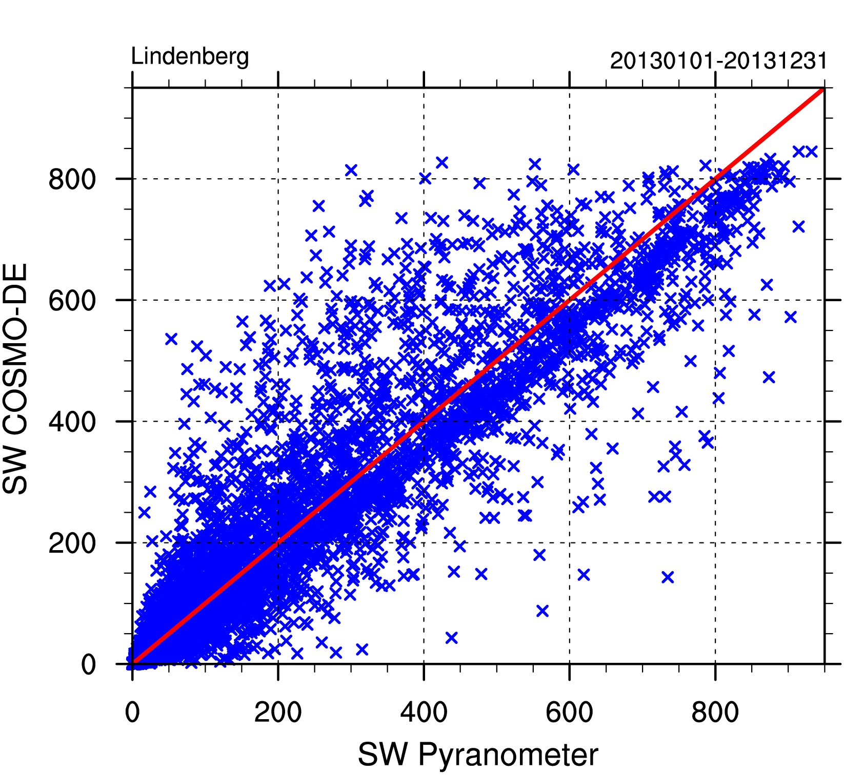
PV Modeling Errors
Too much radiation for cloudy conditions
Insufficient radiation for clear sky conditions
Notes:
Effect of the Tegen aerosol climatology (already implemented by Jürgen Helmert, DWD FE14)?

Slide 8
PV Modeling Errors
Insufficient radiation for clear sky conditions
Notes:
Effect of the Tegen aerosol climatology (already implemented by Jürgen Helmert, DWD FE14)

Slide 9
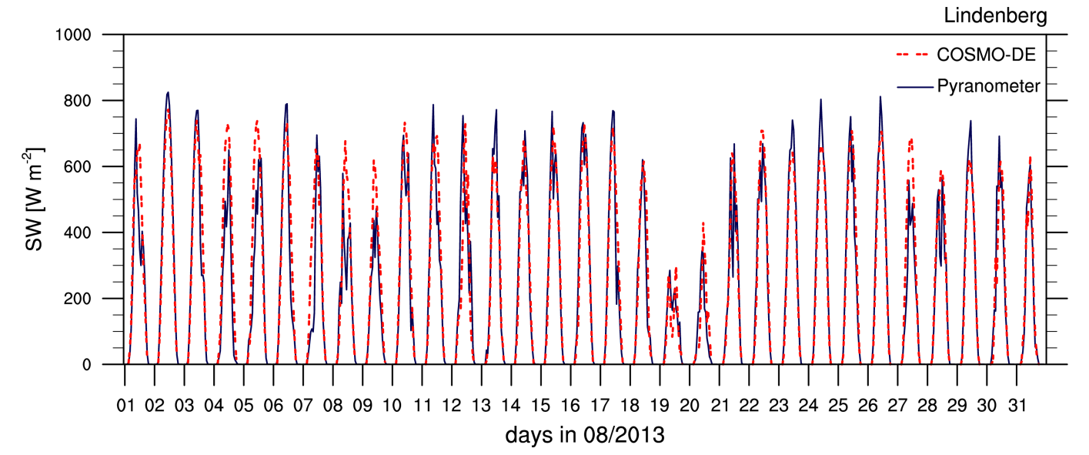
Cloud-free Days
Aerosols from Tanré et al. 1984 are operational
Constant in time
On cloud free days the shortwave radiation forecast of the COSMO-DE model is underpredicted

Slide 10
Aerosols based on Tanré, 1984 (operationel)
Cloud-free Days
Aerosol climatology from Tegen, 1997
Source:Jürgen Helmert, DWD
Source: Helmert et al. (2007)
$$τ$$
optical thickness
extinction coefficient
wave length
$$σ_{ext}$$
$$λ$$
Notes:
Tanré constant over time, Aerosol optical thickness over Germany average of tau=0.38. Tegen aerosol climatology has a lower average optical thickness of 0.18. Aerosol optical thickness is the degree to which aerosols prevent the transmission of solar radiation by absorption or scattering, so extinction.

Slide 11
Clear Sky Day- 18.08.2012
COSMO Tanré (op.)
COSMO Tegen
Pyranometer
Hourly averages of the surface shortwave irradiance
Using the Tegen aerosol climatology shows an improvement due to reduced optical
thickness of the atmosphere

Slide 12
PV Modeling Errors
Too much radiation for cloudy conditions
Notes:
Effect of the Tegen aerosol climatology (already implemented by Jürgen Helmert, DWD FE14)?

Slide 13
PV Modeling Errors
Radiation scheme based on Ritter und Geleyn 1992 only includes cloud ice and cloud water
Rain, snow and graupel are neglected
Clouds optically too thin
Optical properties are being revised and rain, snow and graupel accounted for in te radiation scheme (Uli Blahak, DWD)

Slide 14
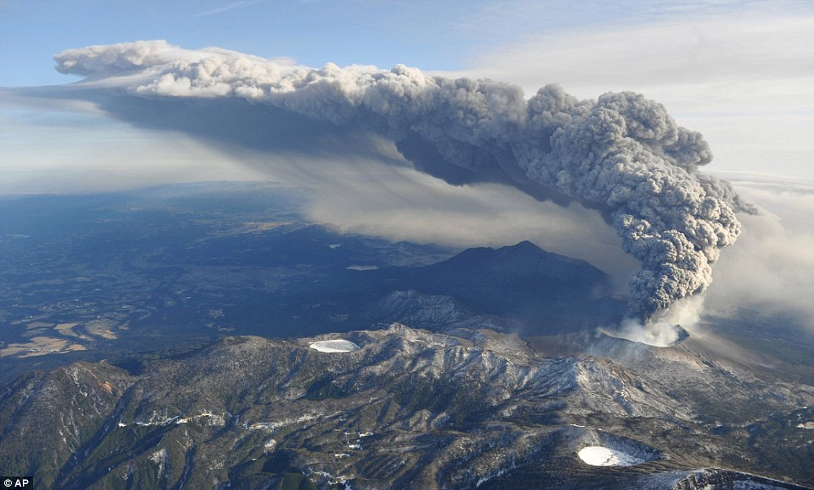
Other Challenges
External factors important for PV power forecast which are currently not included in the operational model:
Sahara dust events
Solar eclipse

Slide 15
Sahara Dust
Aerosol optical thickness
Source: B. Vogel (KIT),
J. Förstner (DWD)

Slide 16
Sahara Dust
COSMO-ART prog. Dust
COSMO-ART Aeros. Clim.
COSMO-ART prog. Dust
COSMO-ART Aeros. Clim.
Notes:
16%

Slide 17
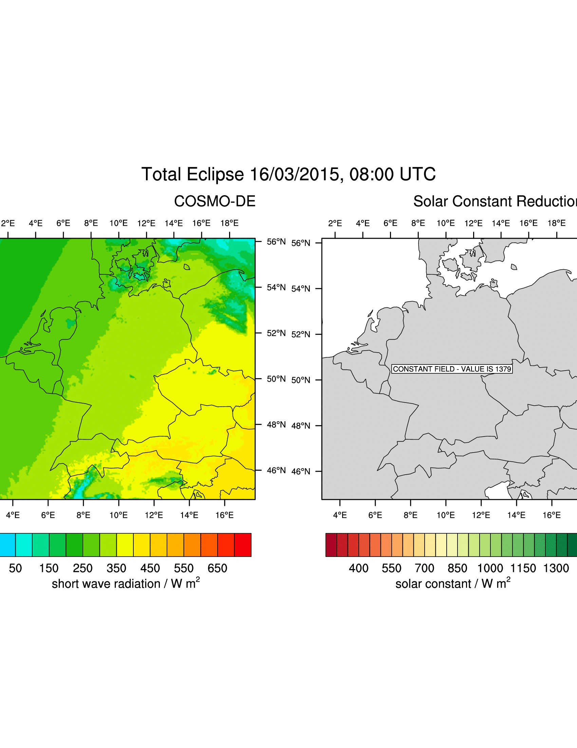
Solar Eclipse
March 20th 2015, 08:20-11.05h

Slide 18
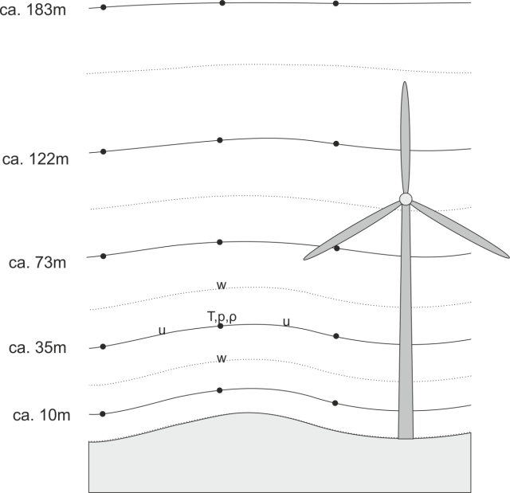
Wind Modeling Errors
Which parameterization schemes have a significant impact on forecasts of diurnal cycle in wind speed?
Soil-model: provides temperature and specific humidity at the ground
Transfer-Scheme: provides surface fluxes of momentum heat and moisture
Turbulence Scheme: provides vertical turbulent exchange of momentum, heat and humidity
Diurnal cycle needs to be improved for Wind Energy applications
Turbulence-Model
Transfer-Model
Soil-Model
Notes:
Spatial resolution is limited by computational power
Forecast time step is governed by spatial resolution and numerics
Hydrostatisch – nicht hydrostatisch!!!!
IFS Δx ∼ 16km (91 levels, top at 0.01 hPatime step 600s)
COSMO-DE Δx ∼ 2.8km (50 levels, top at 0.01 hPatime step 25s)
Global Model Δx → 16 km, Mesoscale Model Δx → 1km
The outer layer: (PBL above surface layer): fluxes are not constant as n the surface layer but decrease monotonically from their surface values

Slide 19
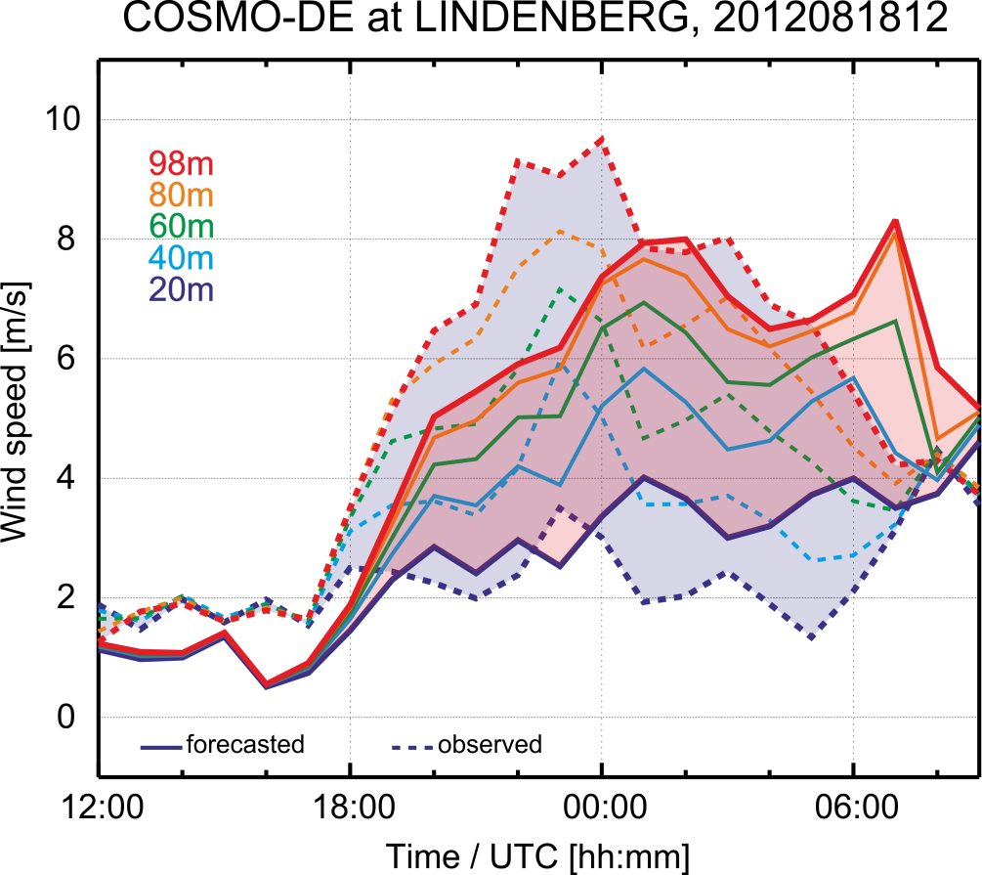
Parameterization in NWP models
Modified turbulence parameters allow for higher nocturnal wind speeds
Example of sensitivity study
Operational
“turb_mod”
patlen=200, rlammom=0.7, tkh/min=0.1, astab=1
Observations operated by Meteorologisches Observatorium Lindenberg
Notes:
Where – in the sense of which parameterization scheme could be improed

Slide 20
Summary
Data Assimilation:
Assimilate cloud information from various sources at the convective scale in a LETKF system ongoing:
Satellite products, PV power
Model physics: Solar
Revision of optical cloud particle properties
Change aerosol climatology
Quantify effects of sahara dust and solar eclipse
Model physics: Wind
Critical parameters localized
Work on stability functions in turbulence scheme
Experiments with improved setup

Slide 21
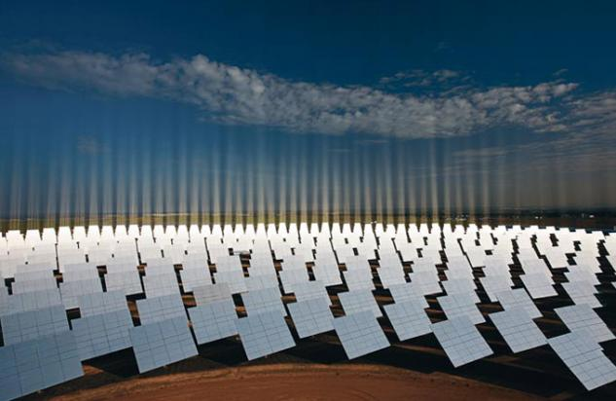
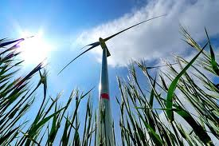
Thank you!
www.nationalgeographic.de
Questions?
www.geo.de

