Slide 1
Further Refinement and Evaluation of a Statistical Approach for Determining Concentration Increments in Urban Areas
Nicolas Moussiopoulos¹,
John Douros¹, Sandra Torras Ortiz², George Tsegas¹,
Eleftherios Chourdakis¹ and the WRF-chem AQMEII-2 team
¹Laboratory of Heat Transfer and Environmental Engineering,
Aristotle University of Thessaloniki
² Institute of Energy Economics and the Rational Use of Energy (IER),
University of Stuttgart

Slide 2
Introduction
In order to evaluate the impact of European based abatement policies, pollutant concentrations in urban areas need to be readily and accurately assessed since a quite significant fraction of the population resides in cities.
Regional scale models cannot resolve the concentration gradients found in urban areas, while full urban scale model calculations for a multitude of cities are very expensive.
The Urban Increment (UI) methodology is a computational tool that efficiently estimates urban concentration increments for various pollutants by taking into account urban emissions, city morphology and prevailing meteorological conditions.
The method has already been applied and evaluated in several forms (Moussiopoulos et al., 2011), while in the frame of the present study the effectiveness of the approach in combination with online regional models is investigated.

Slide 3


Slide 4
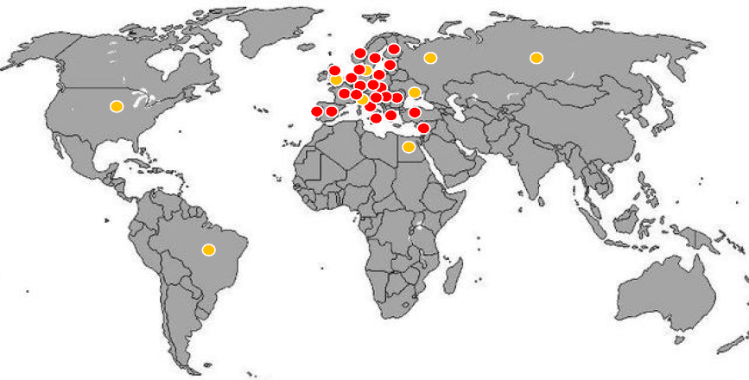

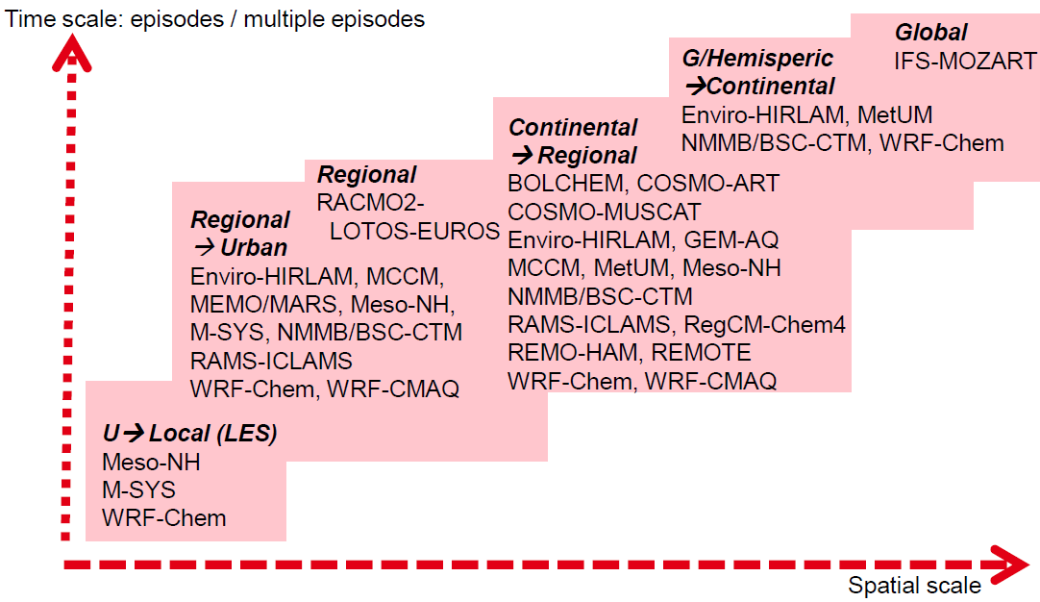
COST Action ES1004 EuMetChem
Base map: © 2004-2009 schulbilder.org
23 COST countries
4 COST neighbour countries
2 COST partner countries
3 EU institutions
18 online models analysed =>
www.eumetchem.info
Notes:
4
(© Schulbilder.org (© Schulbilder.org

Slide 5
AQMEII phase 2
Closely linked to the COST ES1004 action is the AQMEII (Air-Quality Model Evaluation International Initiative) phase 2, which attempts to address policy-relevant questions such as:
  Do current versions of coupled models accurately simulate aerosol-radiation feedback processes over North America and Europe?
  How important are scale interactions in air quality and climate change studies?
Some characteristics of the online model comparison:
  Model runs are performed with and without feedbacks
  Two year-long simulations (2006, 2010)
  Comparison to multiple data sources – quantitative evaluation of the impact of feedbacks on weather.

Slide 6
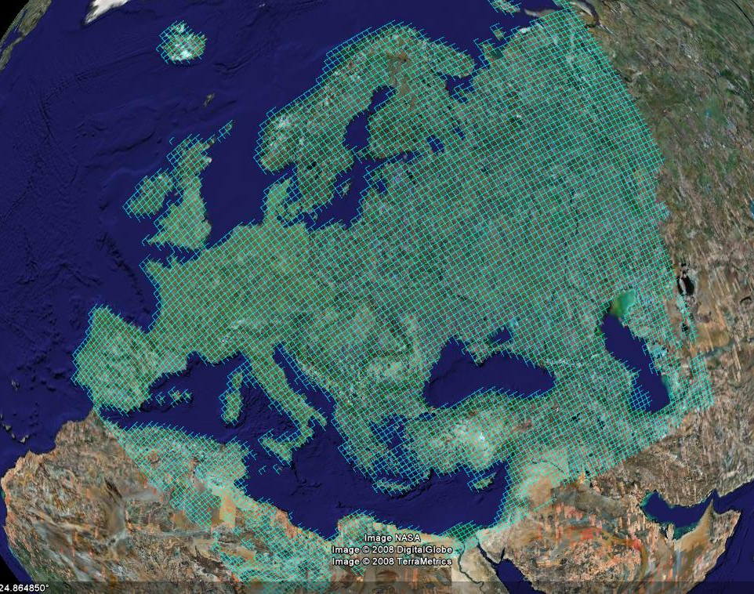
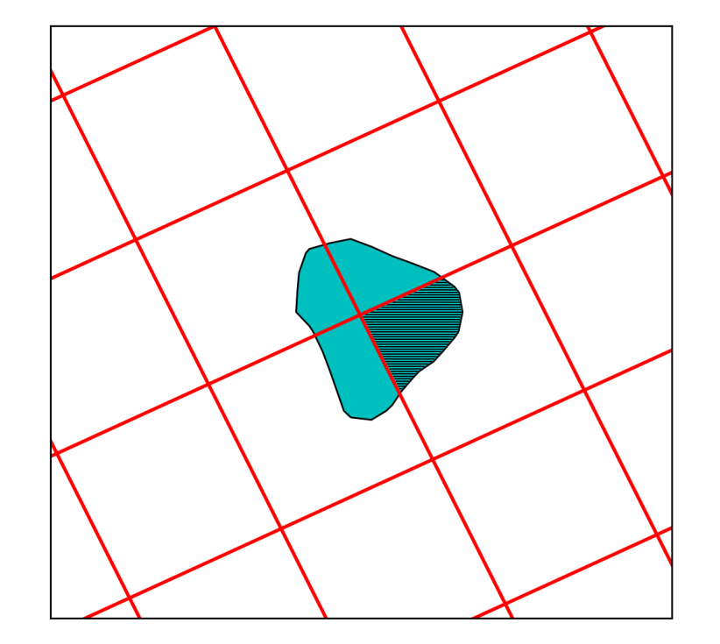
UI methodology basics
Starting from regional model results, can we provide estimates of how much concentrations differ inside urban areas?
“Urban increments” can either
refer to the increment in the urban fraction of each regional model cell or to the increment of a city as a whole.
Notes:
Example from “skewed” EMEP grid.

Slide 7
UI methodology basics
Spatial sampling: Extract initial (sample) increments using either of two methods:
  Measurement station pairs
  Urban scale models
Multiple regression analysis to formulate a functional relationship between urban increments and emissions, city size and meteorological variables (wind speed, stability, etc.)
Generalisation: Use functional relationship to estimate urban increment on cities across Europe
Measurement station pairs in sample city
Notes:
Background of methodology: IIASA/Citydelta (Amann), NEEDS (AUTH, IER), IER (Sandra Ortiz, PhD)
Urban scale models can be used in two ways to extract increments: Either by switching urban emissions on and off and probing at a specific urban cell, or by examining two distinct cells inside and outside the city

Slide 8
Urban increment methodology
C_{i urban} = Urban increment of pollutant i.
E_{iUE} = Total emission of pollutant i within an urban entity in tons.
A_{UE} = Urban area in km2.
u_{avg} = Urban average wind speed in m/s.
C_{i rural} = Rural background concentration of pollutant i in µg/m3.
ω_{i}, φ_{i}, and γ_{i} = Multiple-regression parameters for pollutant i.
A separate version of the above formulation is extracted for each of the seven Pasquill-Gifford stability classes (SC=1...7) or a prespecified number of mixing height classes

Slide 9
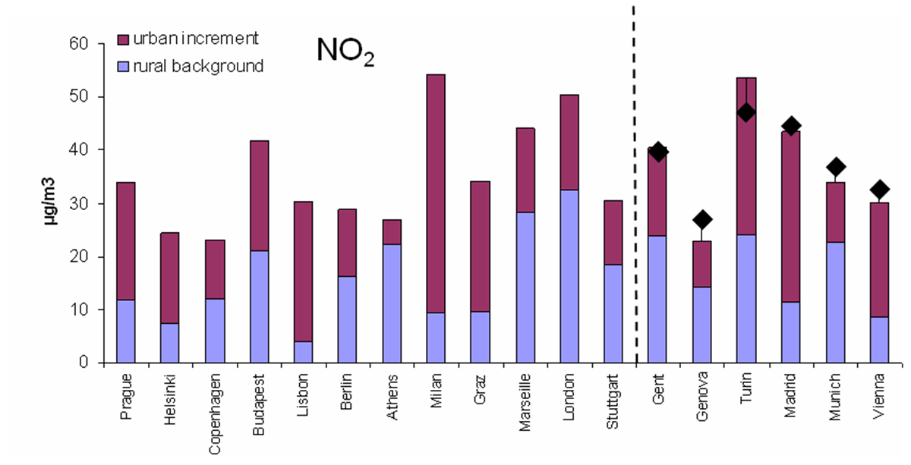
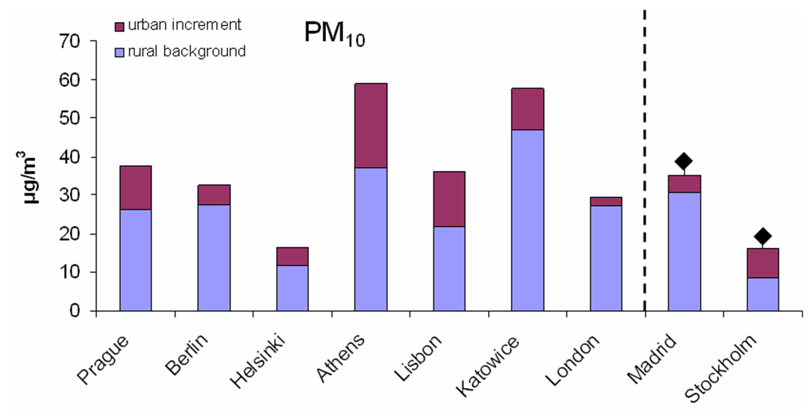
European multi-area application
Bars correspond to measurements (averaged over available data).
Diamonds are concentrations calculated using the urban increment methodology.
The results are for the year 2003.
Notes:
Past applications

Slide 10
Multi-area application based
on mixing height classification
Data from a set of 10 European cities for the year of 2005 were used for the extraction of the relationship. These cities were: Athens, Genoa, Gent, Graz, Helsinki, Copenhagen, Lisbon, Madrid, Marseille and Prague
Validation was performed for the city of London for the same year.
A distinct functional relationship was extracted for each mixing height class.
All measured pollutant concentrations were acquired from the Airbase data base, while data regarding meteorological parameters (mixing height, wind speed) were provided by the SILAM model.

Slide 11
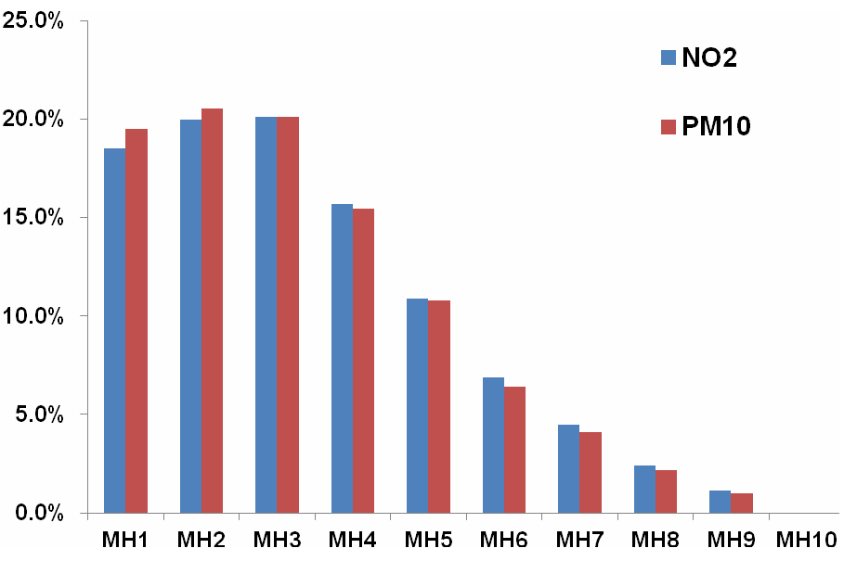
Multi-area application
Mixing height classes and their corresponding frequencies for London for the year 2005.
Class | 1 | 2 | 3 | 4 | 5 | 6 | 7 | 8 | 9 | 10
Range (m) | 0 -210 | 210 -420 | 420 -630 | 630 -840 | 840 -1050 | 1050 -1260 | 1260 -1470 | 1470 -1680 | 1680 -1890 | 1890 -2100
ΝΟ₂ | 1399 | 1509 | 1518 | 1184 | 823 | 520 | 337 | 180 | 87 | 0
ΡΜ₁₀ | 1611 | 1696 | 1662 | 1277 | 892 | 528 | 338 | 181 | 81 | 0
Relative frequency for each mixing height class as a percentage of available ΝΟ₂ and ΡΜ₁₀ measurements.

Slide 12
Multi-area application
Result comparison for the UI methodology regarding NO₂ (left) and PM₁₀ (right) for London for the application year of 2005, for each mixing height class.
In both Figures the blue bars represent the measured rural background concentrations for each pollutant, the red bars represent the measured urban increment and the green triangles stand for the results of the UI methodology.

Slide 13
Interannual application
The methodology was applied for the city of London, taking into account a period of nine years.
Data from a five year period (2000-2004) were utilized for the extraction of the functional relationship, which was subsequently validated on a different set of years (2005-2008).
The measured pollutant concentrations were derived from the Airbase data base.
The required wind speed data originated from observations conducted in the Heathrow airport and data regarding mixing height were derived from calculations of the WRF model (Skamarock et al., 2008).

Slide 14
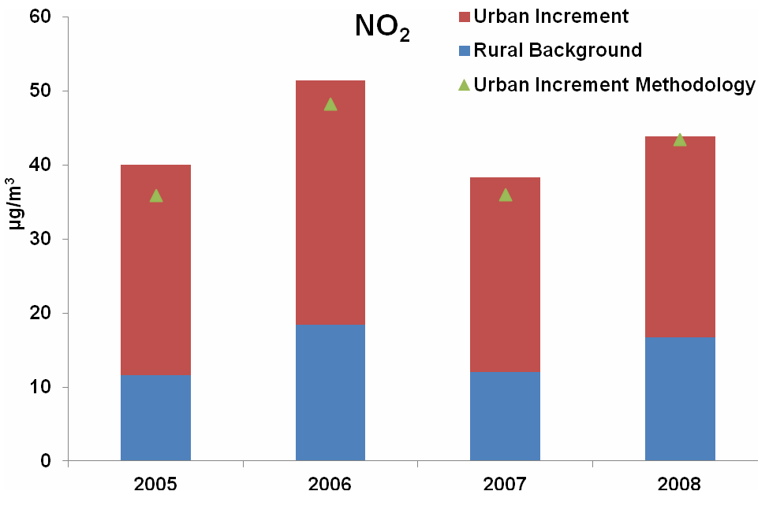
Interannual application
Comparison between the UI methodology results and measurements at a yearly level regarding NO₂ for the years of the application.

Slide 15
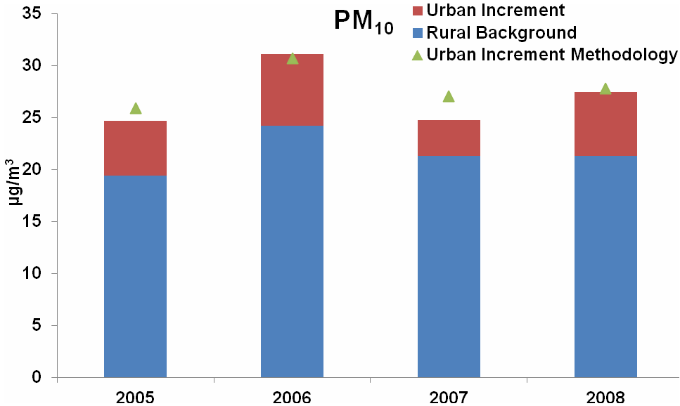
Interannual application
Comparison between the UI methodology results and measurements at a yearly level regarding PM₁₀ for the years of the application.

Slide 16
Interannual application
Comparison between the results of the first (multi-area) and the second (interannual) application of the UI methodology for the year 2005 for each mixing height class.
NO₂ results are shown on the left while PM₁₀ results on the right.

Slide 17
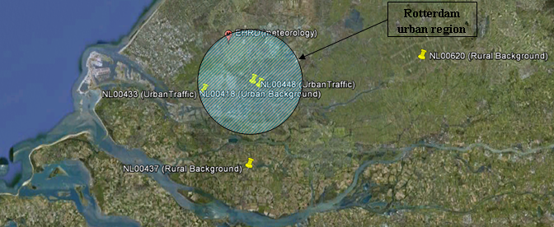
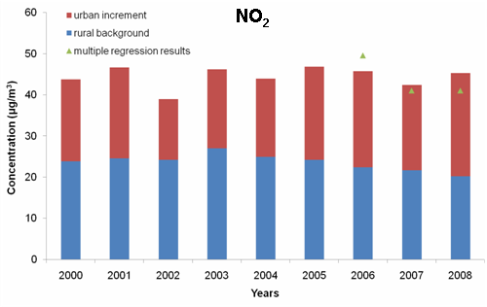
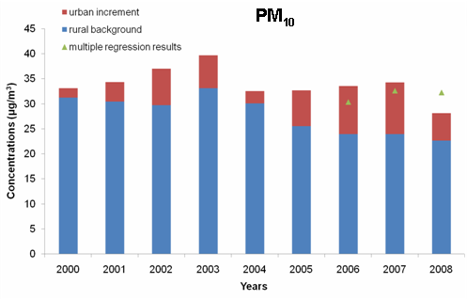
Interannual application (Rotterdam)
Notes:
Past applications

Slide 18
Online models as a source for regional scale estimates
The WRF-chem team participating in AQMEII-2 provided (thanks among other to Renate Forkel and Rahela Zabkar) concentration and meteorological fields over Europe for both coupled and uncoupled WRF-chem model runs.
The investigation was based on the availability of measurement data for year 2010 from a pool of 18 European cities (Athens, Budapest, Copenhagen, Genova, Gent, Graz, Helsinki, Katowice, Lisbon, Madrid, Marseille, Milan, Munich, Prague, Stockholm, Stuttgart, Torino, Vienna).
Two “scenarios” were considered, a “baseline” without any feedbacks and a second one taking into account only the direct aerosol effect.

Slide 19
Multi-area application based on
online model estimates
Mixing height classes used for all cities
Class | 1 | 2 | 3 | 4 | 5 | 6 | 7 | 8 | 9 | 10
Range (m) | 0-300 | 300-600 | 600-900 | 900-1200 | 1200-1500 | 1500-1800 | 1800-2100 | 2100-2400 | 2400-2700 | 2700-3000
Relative frequency for each mixing height class as percentage, for the two scenarios
Notes:
Small difference are

Slide 20
Multi-area application based on
online model estimates
Mean wind speed for each MH class averaged over all cities
Mean NO₂ and PM₁₀ concentrations at near-city rural locations for each MH class averaged over all cities, based on WRF-chem calculations
Notes:
The largest part of PM concentration levels (both of primary and secondary origin) at rural locations is advected over large distances and are thus not sensitive to the diurnal circle or MH which is dependent on the diurnal circle. NO2 is more local in origin and is thus more dependent on local emissions and mixing height variations.

Slide 21
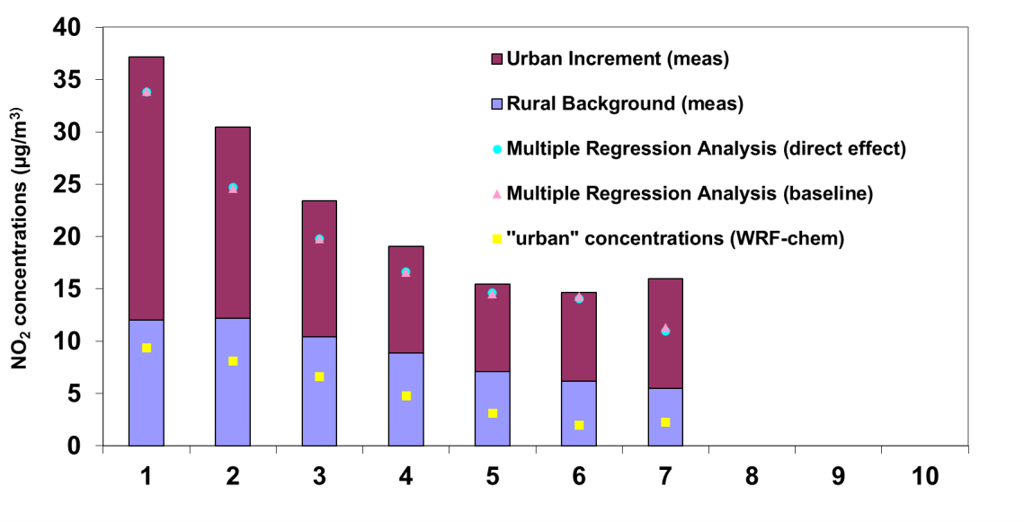
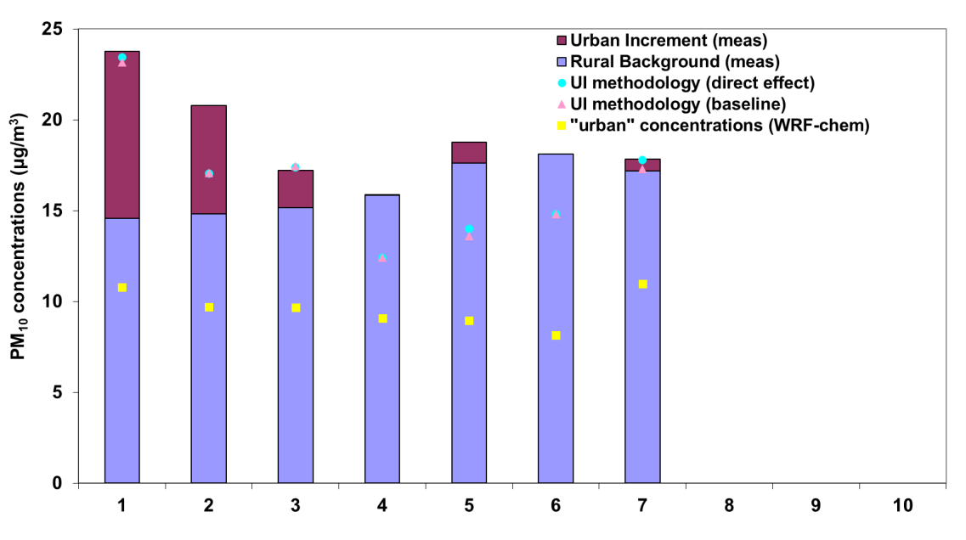
Multi-area application based on
online model estimates
UI methodology results for NO₂ and for each MH class for the city of Prague
UI methodology results for PM₁₀ and for each MH class for the city of Madrid
Notes:
Mixing height classes above 7 do not occur on those 2 cities.

Slide 22
Multi-area application based on
online model estimates
UI methodology results for NO₂
UI methodology results for PM₁₀
Notes:
Yellow squares represent the predictions of the regional scale WRF-chem for a representative urban cell.

Slide 23
Conclusions
Estimates for the urban concentrations using the UI methodology are found to be in good agreement with the observed values both for NO₂ and PM₁₀.
Using WRF-chem results for both the baseline scenario (without any feedbacks) and the one taking into account only the direct aerosol effect, urban concentrations were estimated using the UI methodology. Statistical analysis of the obtained results shows a slights superiority of the second scenario.

Slide 24
References
Airbase, European Air Quality Database. [online] Available at: http://www.eea.europa.eu/themes/air/airbase.
Kukkonen, J., Olsson, T., Schultz, D. M., Baklanov, A., Klein, T., Miranda, A. I., Monteiro, A., Hirtl, M., Tarvainen, V., Boy, M., Peuch, V.-H., Poupkou, A., Kioutsioukis, I., Finardi, S., Sofiev, M., Sokhi, R., Lehtinen, K. E. J., Karatzas, K., San José, R., Astitha, M., Kallos, G., Schaap, M., Reimer, E., Jakobs, H., and Eben, K.: A review of operational, regional-scale, chemical weather forecasting models in Europe, Atmos. Chem. Phys., 12, 1-87, doi:10.5194/acp-12-1-2012, 2012.
Moussiopoulos, N., Douros, J., Tsegas, G., Chourdakis, E. and Ortiz, S.T., 2011. An approach for determining urban concentration increments. 14th Conference on Harmonisation within Atmospheric Dispersion Modelling for Regulatory Purposes – 2-6 October 2011, Kos, Greece.
Skamarock, W. C., J. B. Klemp, J. Dudhia, D. O. Gill, D. M. Barker, M. Duda, X.-Y. Huang, W. Wang and J. G. Powers. A Description of the Advanced Research WRF Version 3, NCAR Technical Note, 2008.

