Slide 1
Institute for Energy and Transport

Slide 2
Estimating the performance of PV-wind hybrid mini-grid systems for rural electrification
T.Huld, I. Pinedo Pascua, M.M. Miglietta, F. Monforti-Ferrario
European Commission, DG-JRC

Slide 3
Overview of presentation
Mini-grids and how to model them
Data for simulation of mini-grid performance
PV-wind mini-grid performance for Africa and South Asia
Conclusions and to-do list

Slide 4
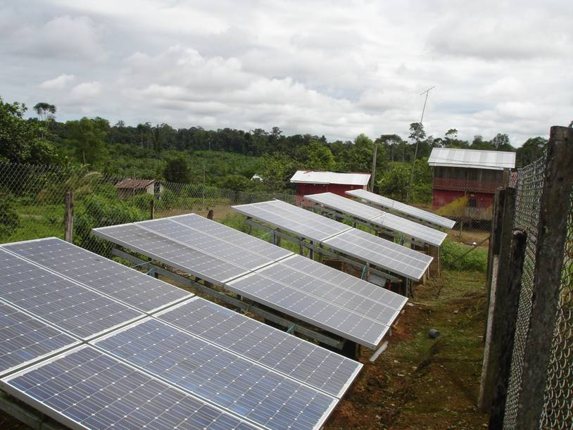
Mini-grids and how to model them
Mini-grids are electricity grids serving a local community but not connected to the national electricity grid. When renewable energy sources are used, energy storage must be employed.

Slide 5
Mini-grids and how to model them
Performance of the mini-grid system is estimated by calculating power production and consumption, as well as power flows into or out of the battery storage
Calculations are performed at hourly time intervals over a period lasting one or more years
Diagnostics of performance include the total energy produced, as well as the reliability, expressed as frequency of downtime due to missing energy

Slide 6
Models for power components
Model for PV array calculates power as a function of in-plane irradiance and air temperature. Model coefficients use a fit to measured data on a crystalline silicon module (measured at the ESTI Laboratory)
Wind power is calculated from published power curve for 100kW turbine (Polaris P-21). Wind energy density is adjusted for air density (local elevation pressure and temperature).
Model for Li-ion battery charge/discharge performance as a function of current and charge state, based on measurements of charge/discharge cycle

Slide 7
Data sources
Irradiance estimated from satellite data by the CM SAF collaboration (www.cmsaf.eu) and JRC Ispra
Hourly time resolution
Spatial resolution 3’ (about 5km)
Temperature and wind speed data from ECMWF (www.ecmwf.int) operational forecast data
Hourly time resolution
Spatial resolution 0.125° latitude/longitude
Wind speed interpolated between 10m and 100m data given by ECMWF
Module power measurements by JRC (ESTI Laboratory)
Li-ion battery performance measurements by JRC

Slide 8
Electricity consumption data
Two different daily consumption patterns, one with ~1/3 consumption during daytime, one with ~2/3 consumption during the day, daily consumption is 400kWh for both

Slide 9
Calculation parameters
PV array size: 60kWp, crystalline silicon modules mounted equator-facing at a slope equal to 1.5 times latitude
Wind turbine size: 40kW, 36m hub height
Li-ion batteries, effective battery size: 720kWh (capacity between full charge and lowest recommended charge)
Daily consumption: 400kWh
Hourly calculation for 2015

Slide 10
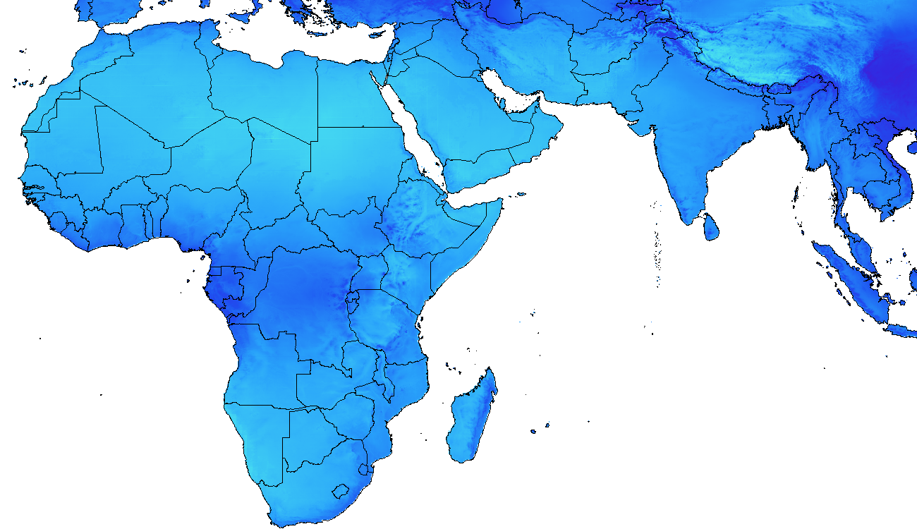
Solar and wind energy resource
Annual average energy output, kWh per kW, no curtailment
PV array
Wind turbine

Slide 11
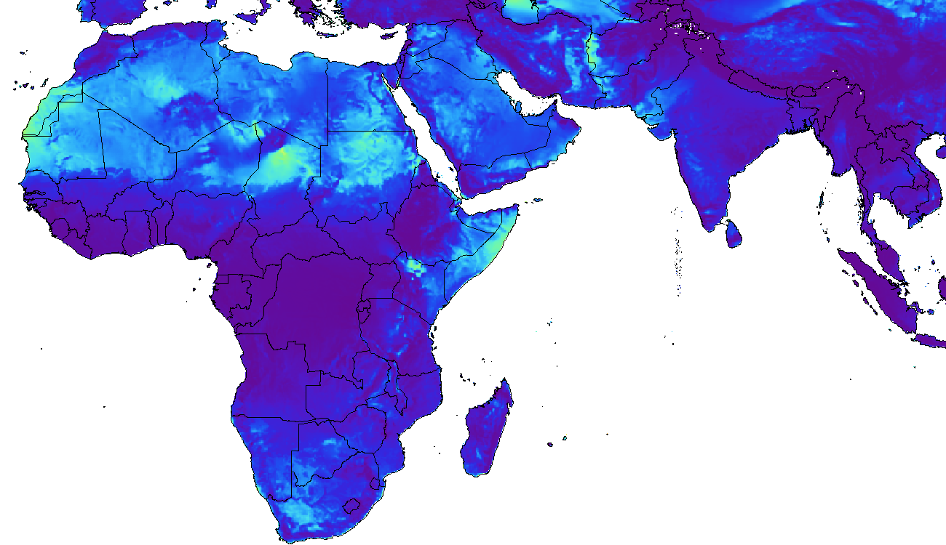
Mini-grid calculation results
Low daytime consumption, daily average energy output, kWh
PV array
Wind turbine

Slide 12
Mini-grid calculation results
Low daytime consumption, daily average energy output, kWh
PV array
+ wind turbine

Slide 13
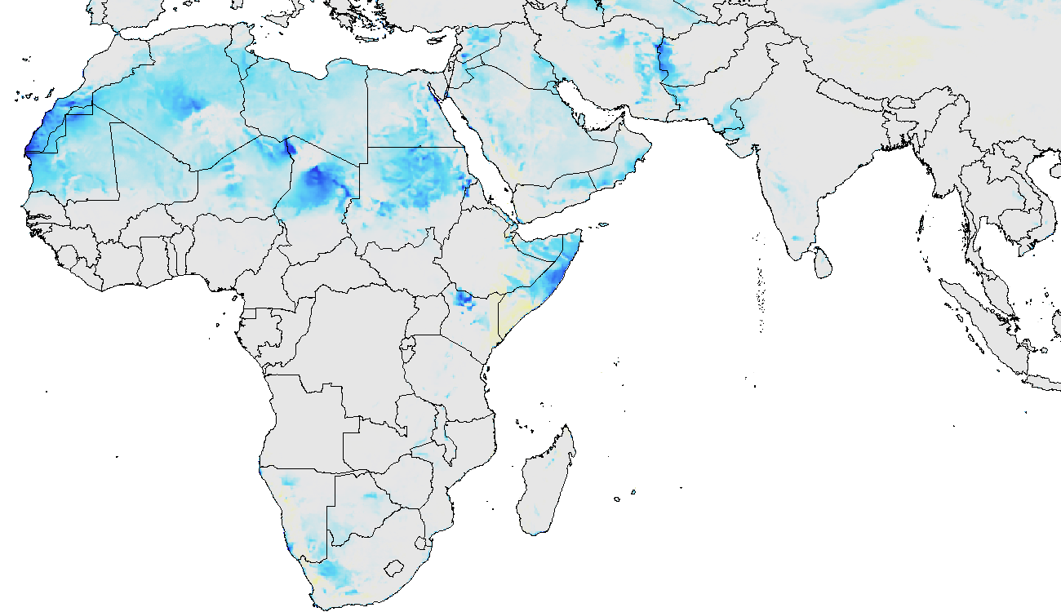
Mini-grid calculation results
Difference between high and low daytime consumption scenarios (kWh/day)
PV array
Wind turbine

Slide 14
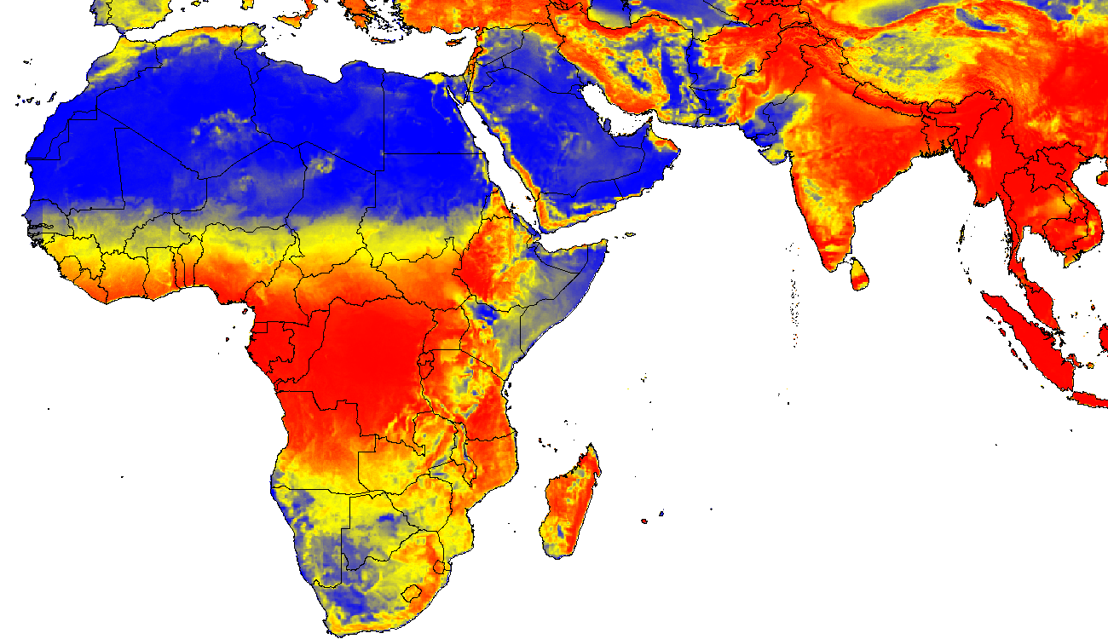
Mini-grid calculation results
System reliability: number of days when energy runs out
Good
Bad
Ugly
System size must be optimized
for each location

Slide 15
Conclusions and to-do list
Mini-grid performance can be modelled using geospatial climatic data sets
Performance fits well with the patterns of solar and wind energy resources
For large parts of the study area, wind turbines are not suitable (but where they are, they may be very competitive)
PV and wind generators must be optimized for each location. We have developed methods for this for PV mini-grids, some issues for adding wind energy are:
Added complexity (3 independent variables instead of 2)
PV and battery size can be varied almost continuously, but wind turbine size cannot
It would be nice to compare with data from actual installations!

Slide 16
Thank you for your patience!

