Slide 1
Quality Control techniques applied to surface data in ERA-CLIM2
Maria Antónia Valente mavalente@fc.ul.pt,
Pedro Gomes pedro_mv_gomes@Hotmail.com,
Maria Clara Ventura mcmventura@fc.ul.pt,
Maria João Rocha mjrocha75@gmail.com
FFCUL
Instituto Dom Luiz
Faculty of Science of the University of Lisbon
11th European Conference on Applied Climatology – 13 September 2016

Slide 2
ERA-CLIM2 is a EU funded FP7/Space project - Contract Nr. 607029
Outline
1 – Introduction
2 – QC tests for surface data
Chapter 6, “Quality Control Procedures”, Suppl. No. 2 (IX.2000) of the Guide of the Global Data-Processing System, from the World Meteorological Organization (WMO) in what regards the treatment and diffusion of SYNOP observations.
3 – Visualisation tool for surface data QC
4 – Break detections using Homogeneity tests – RHTestsV4 and HOMER
5 – QC for metadata (data location)

Slide 3
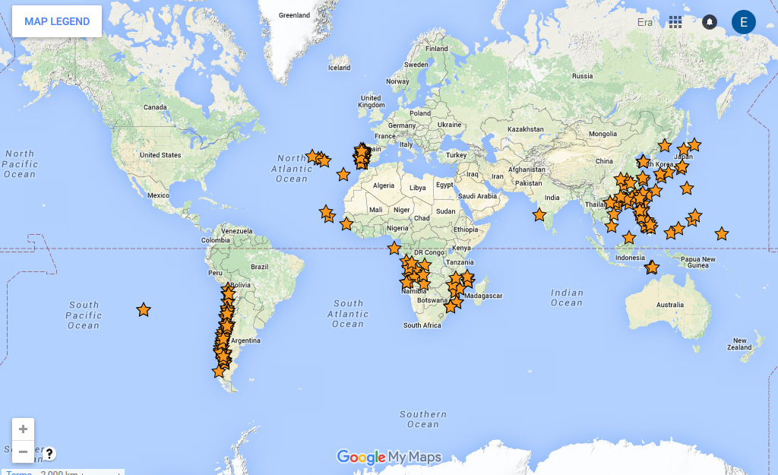
1 – Introduction
FFCUL has been digitising sub-daily land surface data for projects ERA-CLIM/ERA-CLIM2. Besides Mainland Portugal and Isles, data has been recovered for former colonies (Angola, Mozambique, Guiné-Bissau, Cape Verde, São Tomé, Goa, Macau and East Timor – 1915-1946) and Chile (1950-1958), with QC and formatting (only) applied to South China Sea stations.
Quality Control is applied to the digitised data through a series of tests, included in Fortran programs.
The codes have the ability to join the series of monthly tables into long time series, and produce error files, QC flags, formatted data for global databases and statistical data. One of the codes also allows visualisation of the series in GNUplot.
Homogeneity tests (RhTestsV4, HOMER) have been applied to some of the series (pressure, tmax, tmin, temp, prec, rh) in order to detect break points.
We’ve also been developing QC tests for metadata, specifically for stations location through an R program that attributes a country to every pair of (lat,lon).
The main ECVs digitised and QCd are: pressure (mlsp, surface), temperatures (including tmax, tmin, tw, td, soil, grass, radiative), precipitation, precipitation hours, relative humidity, water vapor pressure, wind (speed,dir), could cover, evaporation, sunshine hours, ozone for the 1863-1946 period.

Slide 4
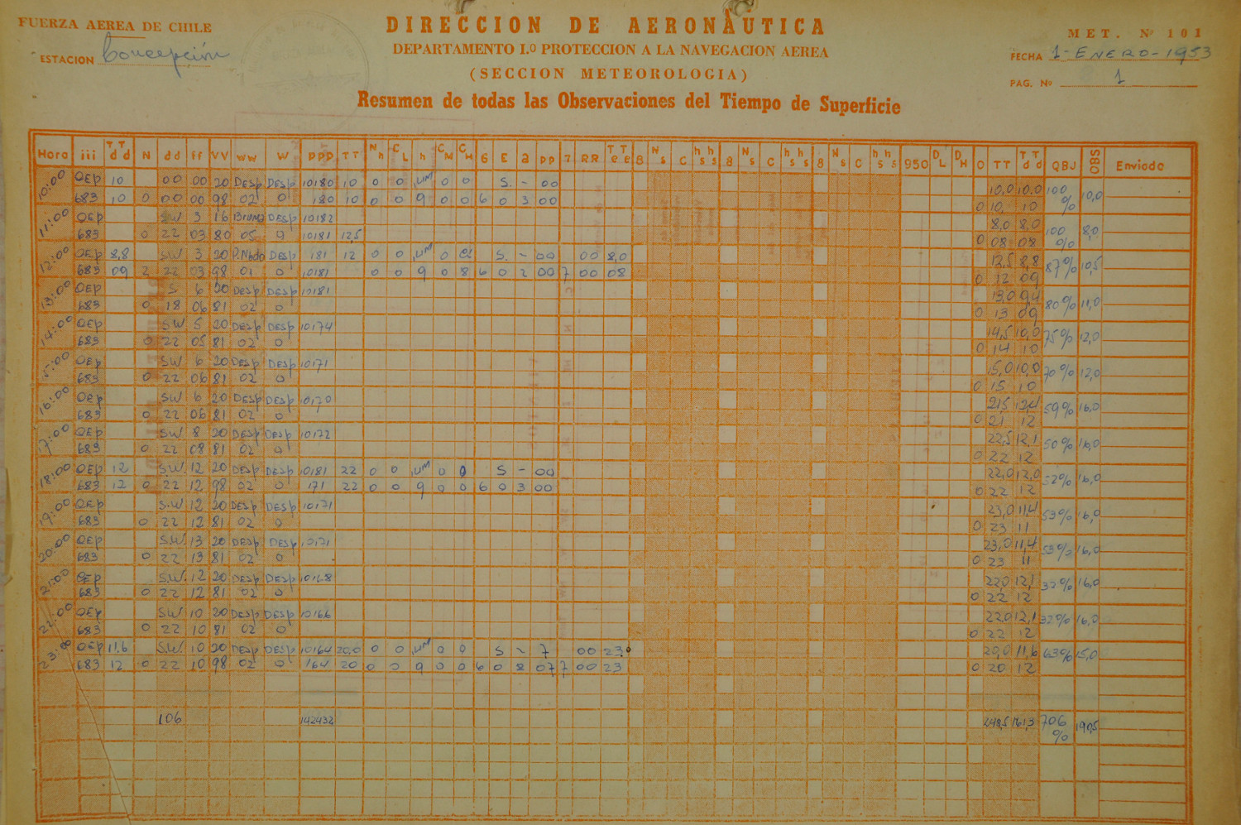
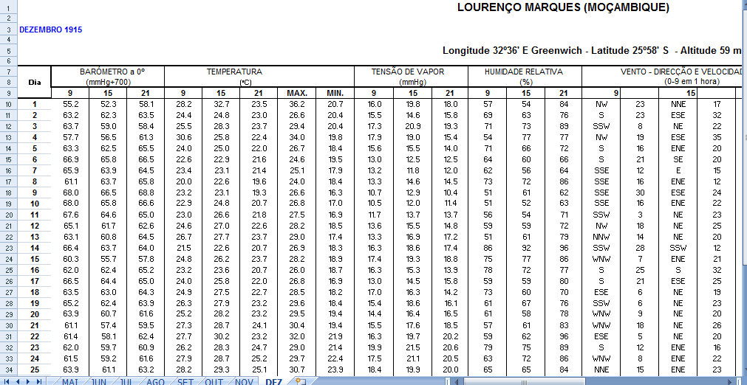

Slide 5
2 - QC tests for surface data
CHECK 1: Gross Error Limit (GEL) – detecting outliers
A set of checks was applied to surface pressure, mslp, wind speed and direction, temperature, cloud cover. relative humidity and precipitation.
Flags used do codify the observations:
0 – Correct
1 – Erroneous
9 – Suspect
M – Missing QC
WIND DIRECTION (dd) and FORCE (ff)
The values were considered correct when
dd ≥ 0º and dd ≤ 360º
ff ≤ 100 (ms⁻¹) = 360 (km/h)
and the values were flagged as wrong when
dd < 0º and dd > 360º
ff < 0 (ms⁻¹) = 0 (km/h)
an ff value above 100 ms⁻¹ earned a suspicious value flag.
MSLPRESSURE : (units=hPa)
A suspected error was flagged when
p ≤ 870.0 or p ≥ 1100.0
TEMPERATURE (T)
Values were considered correct when
T ≥ -50ºC and T ≤ 50ºC
outside this interval, they are considered suspect until more checks are applied
PRECIPITATION (RRR)
If RRR < 0 value is incorrect
RRR ≥ 0 value is correct
Threshold for maximum?
RELATIVE HUMIDITY (RH)
Values are considered correct if
RH > 0% and HR ≤ 100%
If
RH >100% the value is reset to RH = 100%???
CLOUD COVER (N)
Values are considered correct when
N ≥ 0 and N ≤ 8 if cloud cover is in oktas
N=9 clouds are not visible, ex. in the case of fog
Or N ≥ 0 and N ≤ 10 if cloud cover is in tenths

Slide 6
2 - QC tests for surface data
CHECK 2: Gross Error Limit (GEL)
Based on the application of more strict limits to the meteorological fields according to the latitude and time of year of the observation, used to flag wind speed (FF), temperature (T), dew point temperature (Td), Pressure at station level (Pstation), Mean Sea Level pressure (Pmsl), pressure trend (ppp).
Suspect (flag=9) | Error (flag=1)
Max1 < FF < Max2 | FF > Max2
Min2 ≤ ECV < Min1 Max1 < ECV ≤ Max2 | ECV < Min2 ECV > Max2
Latitudes : 45ºS to 45ºN
 | W - Winter |  |  |  | S - Summer |  |  |  | Y - Year
 | Min2 | Min1 | Max1 | Max2 | Min2 | Min1 | Max1 | Max2 | Min2 | Min1 | Max1 | Max2
FF (ms⁻¹) | - | - | 60 | 125 | - | - | 90 | 150 | - | - | - | -
T (ºC) | -40 | -30 | 50 | 55 | -30 | -20 | 50 | 60 | - | - | - | -
Td (ºC) | -45 | -35 | 35 | 40 | -35 | -25 | 35 | 40 | - | - | - | -
Pstation (hPa) | - | - | - | - | - | - | - | - | 300 | 400 | 1080 | 1100
Pmsl (hPa) | 870 | 910 | 1080 | 1100 | 850 | 900 | 1080 | 1100 | - | - | - | -
Pres. trend ppp (hPa) | - | - | - | - | - | - | - | - | - | - | 40 | 50
Latitudes : south of 45ºS and north of 45ºN
 | W - Winter |  |  |  | S – Summer |  |  |  | Y - Year
 | Min2 | Min1 | Max1 | Max2 | Min2 | Min1 | Max1 | Max2 | Min2 | Min1 | Max1 | Max2
FF (ms⁻¹) | - | - | 50 | 100 | - | - | 40 | 75 | - | - | - | -
T (ºC) | -90 | -80 | 35 | 40 | -40 | -30 | 40 | 50 | - | - | - | -
Td (ºC) | -99 | -85 | 30 | 35 | -45 | -35 | 35 | 40 | - | - | - | -
Pstation (hPa) | - | - | - | - | - | - | - | - | 300 | 400 | 1080 | 1100
Pmsl (hPa) | 910 | 940 | 1080 | 1100 | 920 | 950 | 1080 | 1100 | - | - | - | -
Pres. trend ppp (hPa) | - | - | - | - | - | - | - | - | - | - | 40 | 50

Slide 7
5min
2 - QC tests for surface data
CHECK 3: Internal Consistency (IC)
Internal consistency was checked simultaneously on wind speed and direction; Tmax, Tmin,T and Tdew; precipitation (RRR) and number of hours of precipitation (RRRhr); and on T, Tdew and RH.
WIND (dd and ff)
Error (flag=1) if: 1) dd = 0º and ff ≠ 0 ms⁻¹
2) dd ≠ 0º and ff = 0 ms⁻¹
dd = -99.9 and ff = 0 or ff ≤ 5 ms⁻¹
with dd=-99.9 being the default value
TEMPERATURES (T, Tmax, Tmin, Tdew)
Error (flag=1) if: Tmax < T or T < Tmin
or Tmax < Tmin
Suspicious (flag=9) if Tdew > T
PRECIPITATION (RRR) AND NUMBER OF PRECIPITATION HOURS (RRRhr)
In case both precipitation and number of hours of precipitation exist:
Error (flag=1) or Suspect (flag=9) if:
RRR ≠ 0mm and RRRhr = 0 hours (and vice-versa)
Surface Temperature (T), Dew Point (TDEW) and Relative Humidity (RH)
Suspicious (flag=9) if
T=Tdew and RH ≠ 100%
T ≠ Tdew and RH = 100%
T – Tdew < 0.6ºC and RH < 90%

Slide 8
2 - QC tests for surface data
CHECK 4: Time Consistency (TC)
Time consistency checks were implemented for temperatures and pressure.
TEMPERATURES T and Tdew
The difference between values separated by a time dt are considered suspicious (flag=9) if
| T(t) – T(t-dt) | > Ttol(dt) (1)
| Tdew(t) – Tdew(t-dt) | > Tdewtol(dt) (2)
where Ttol(dt) and Tdewtol(dt) are given by
Parameters | dt
 | 1h | 2h | 3h | 6h | 12h
Ttol (ºC) | 4 | 7 | 9 | 15 | 25
Tdewtol (ºC) | 4 | 6 | 8 | 12 | 20
ppptol (hPa) | 3 | 6 | 9 | 18 | 36
Pressure Trend (ppp) and Pressure (P)
Pressure trends are considered suspicious
(flag=9), with ppptol(dt) given by the previous table if
| ppp(t) – ppp(t-dt) | > ppptol(dt)
Moreover pressure values are suspicious (flag=9) if:
| p(t) – p(t-dt) – ppp(t) | > Dtol (for dt = 3h)
| p(t) – p(t-dt) – 0.5*ppp(t-dt) – 1.5*ppp(t) | > Dtol (for dt = 6h)
Dtol (hPa) | For mslp (mean sea level) | For station level pressure
a) | 1.5 | 0.5
b) | 2.5 | 1.5

Slide 9
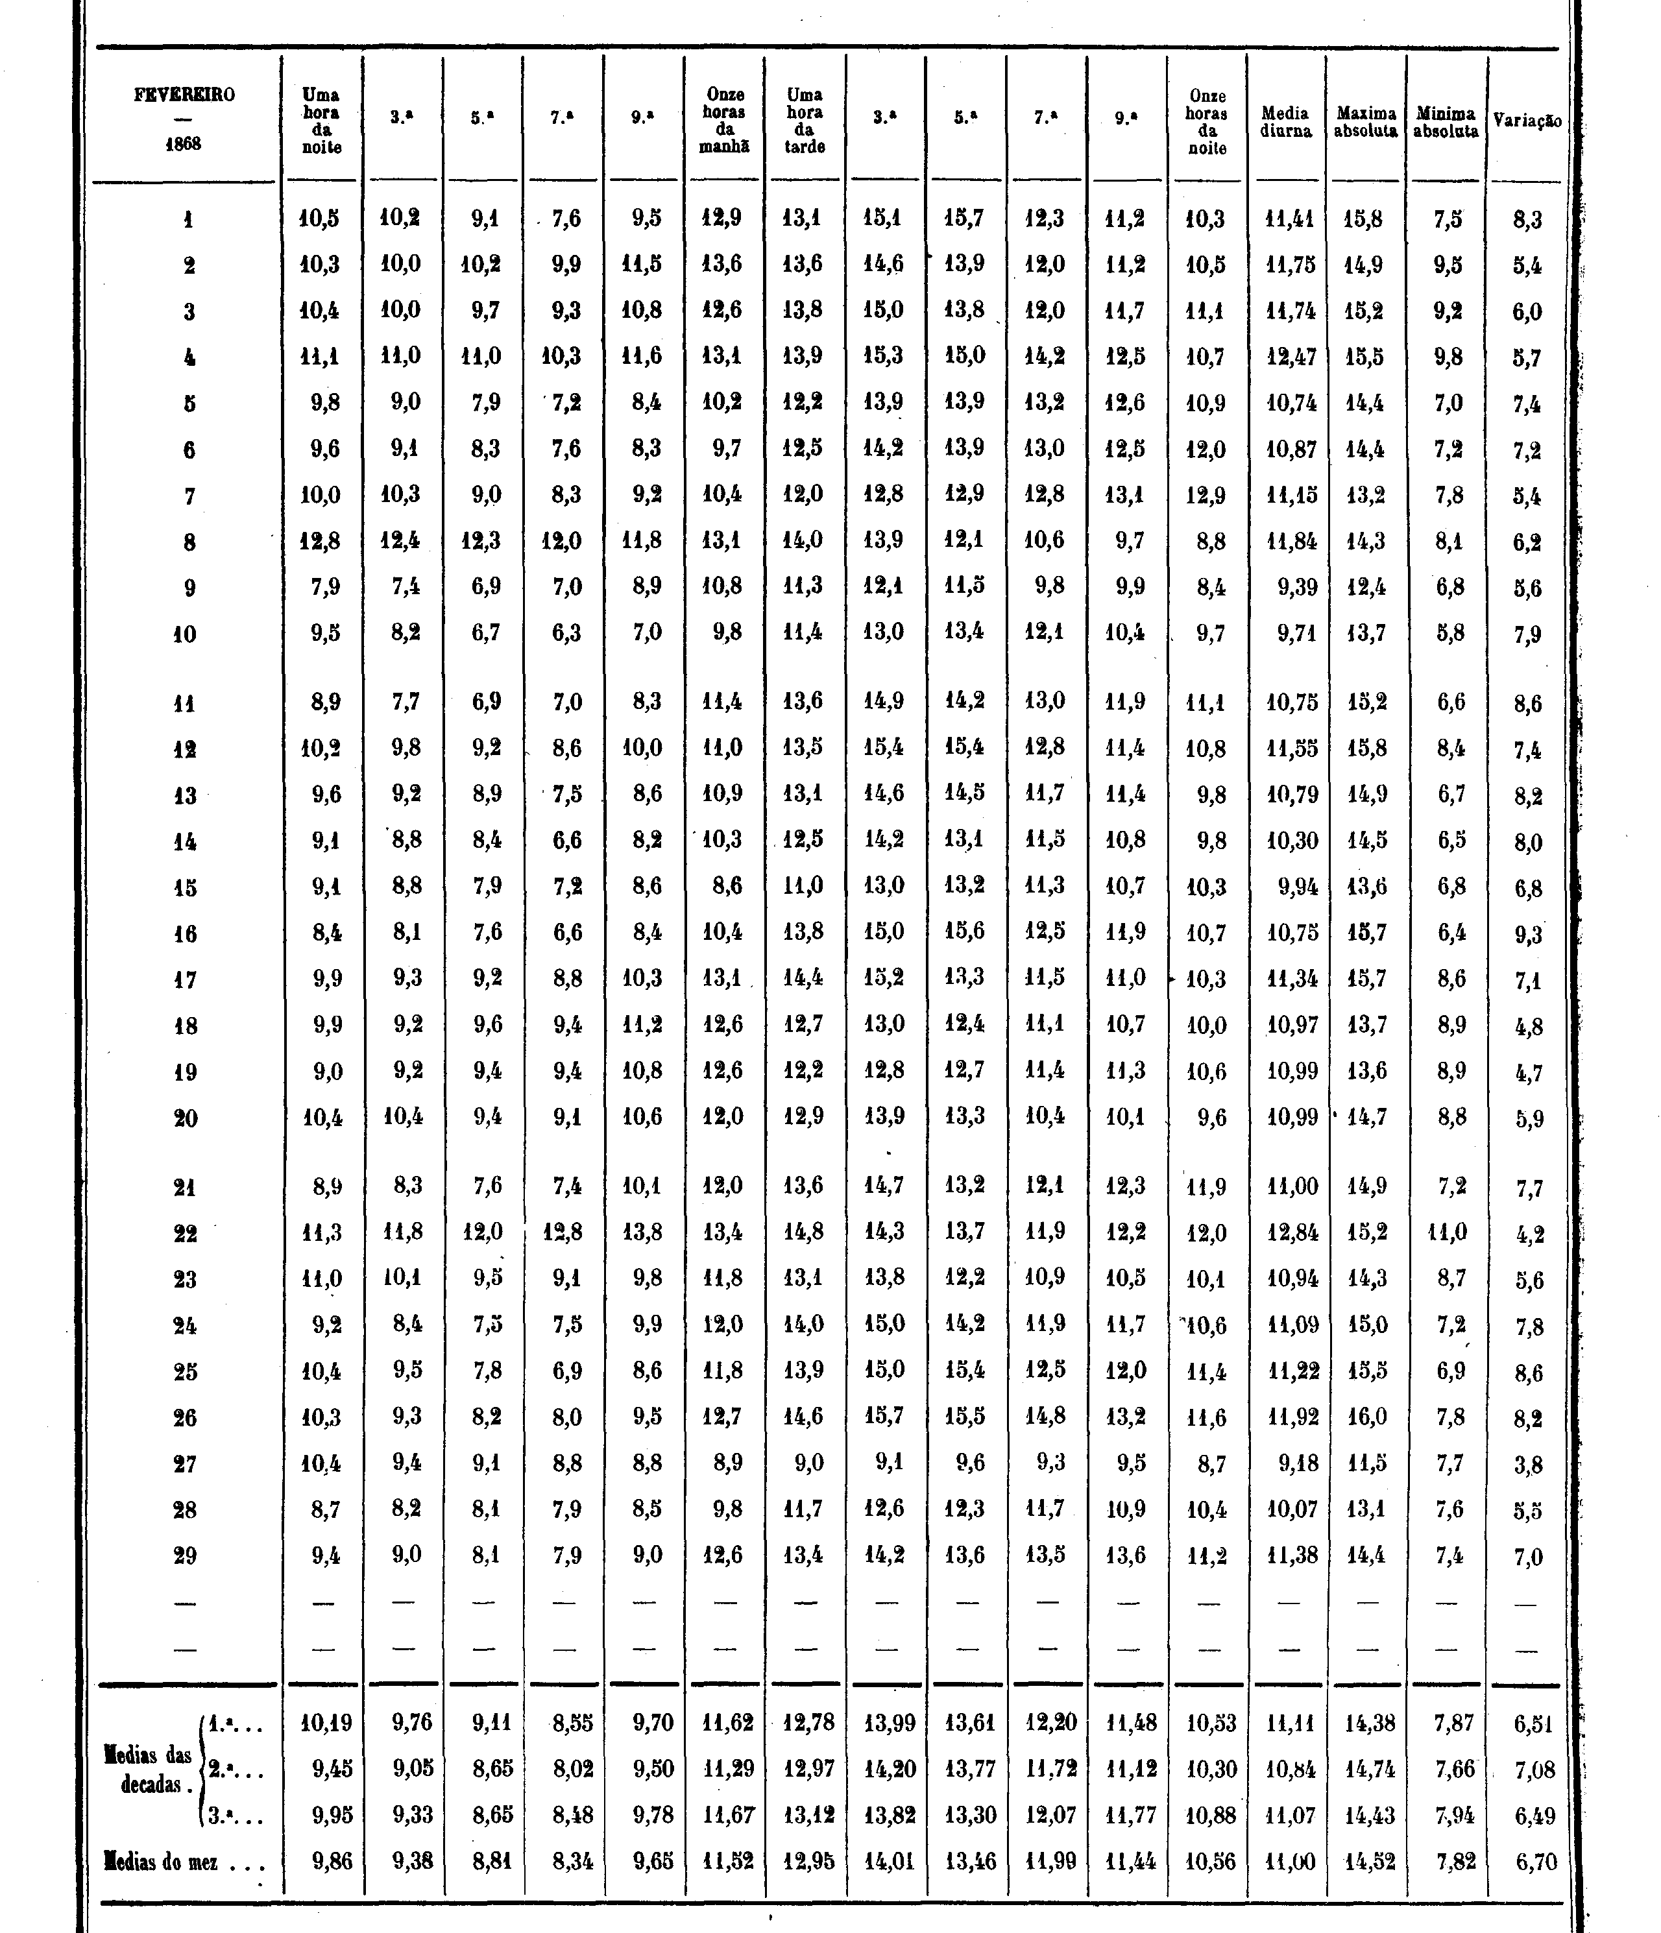
2 - QC tests for surface data
After the application of the previous checks, the program produces an error file identifying the year, month, day and eventually hour of the suspicious observation and the type of check applied.
The operator can then return to the input data and verify if the error comes from mistyping of data, a misinterpretation of hand written data given to the printing company or an error originated by the observation process. If the correction is possible, the erroneous data are replaced by the corrected value. This process requires operational observations practice and must be dealt with carefully, not to add more mistakes to the data. If the correction is not obvious, the suspicious or error flag remains attached to the value.
CHECK 5: Mean Consistency Check
The Mean Consistency check is applied if original data contains the monthly means or sums for each variable. As the data are published in tables, with each column having the daily data for a certain time, the last element of the columns is the monthly mean or monthly sum (in the case of precipitation and evaporation). Columns means or sums calculated are compared with published values.
If for one column these values are different by more than the observational error, a suspicious flag (9) is given to all the data in the column. The whole digitized column is verified with published data and if no digitising mistakes are found the operator can crosscheck values with results from the previous checks. The conjunction of both checks can lead to the conclusion that one value in the column with the error and with a daily error is wrong.
The value is tentatively corrected to eliminate both errors. If the process is successful the new value is considered correct and the suspicious or error flags are substituted by (flag=0). This process requires substantial experience of observations on the part of the operator, to avoid introducing additional errors.

Slide 10
3 - A visualization tool for QC CQ_SURFACE 2.0
CQ_SURFACE is a tool (originally written in Fortran and using GNUPLOT) that
Performs the Quality Control tests described before
Delivers products – Error files, Formatted data, QC flags, stats
Permits Visualization of ECV series (graphics)
Installing the QC tool
Unzip CQ_surface.zip and Install in Windows or Linux and use GNUPLOT version 4.6.6 to run the program CQ_Surface.exe
modify datapaths.nam with adequate file paths
We have included as an example input data for Luanda 1915. There is also the full .DB (output file obtained previously) Luanda database for 1915-1946 so that long time series can be plotted.
Follow instructions in the User Guide provided by FFCUL , to input the data in the correct format.
Pedro Gomes, IGIDL @2016
pmvg1977@gmail.com

Slide 11
3 - A visualization tool for QC CQ_SURFACE 2.0
Running in DOS
Choose the several options given by the program. It is possible to do only graphics from complete .BD (database files). Monthly and Annual graphics, as well as series of several years can be chosen.

Slide 12
3 - A visualization tool for QC CQ_SURFACE 2.0
Products – Error files and formatted data
After running the program, the output is constituted by several ASCII data files and graphics:
Log (.log) file with all details from the tests containing types of errors found and the date, and other verifications
.BD files, data base with all meteorological information in long time series format
Flag file – containing the QC files attibuted by all Checks and the chosen final flag
ERA_CLIM and ISPD formatted files
Statistics files (mean, std, mod, cov, etc.)
Graphics
All ASCII files can be opened as text files, reagardless of the extension.

Slide 13
3 - A visualization tool for QC CQ_SURFACE 2.0
Visualization (graphics)
In this module we use GNUPLOT to build graphics for the different variables. They allow us to check visually for outliers and other problems, comparing with the errors found by QC. They can also indicate possible breakpoints in series, which have to be checked with metadata.
Allows us to track some possible major weather changes, viewing some extremes values and cross-check between different plotted variables.
Usefull to detect suspicious values, that should be verified in the original imaged data, and the behaviour of short or long term series.

Slide 14
10 min
Visualization (graphics)
Luanda 1915 series of daily 15pm Temperature (ºC). Monthly means published are shown in green and computed means by the program in blue.

Slide 15
Visualization (graphics)
Long term series of 9am mslp (hPa) for Luanda 1915-1946 (daily data).
Annual series of mslp (hPa) for Luanda 1915. Daily data for 9am (local time).
QC software is still evolving: We want to improve the look; perform more QC tests, plot different varibles in each graphic and provide directly formatted output for homogeneity tests HOMER, RHtestsV4, AnClim.

Slide 16
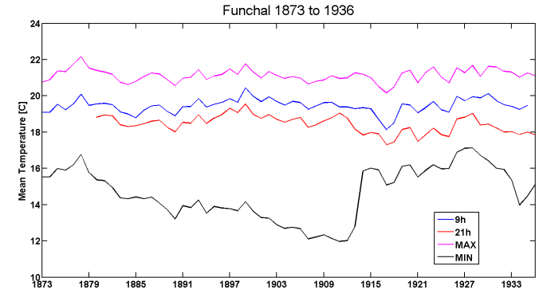
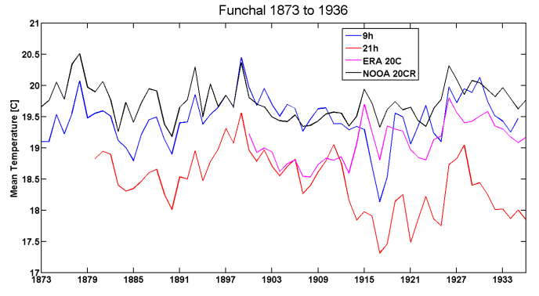
4 – Break detections using Homogeneity tests – RHTestsV4 and HOMER
It is also required that we supply possible breakpoints, usually associated with metadata changes. The QC’d monthly and annual data is subjected to different homogeneity tests (RHTestsV4, HOMER) and the detected breakpoints are compared to metadata records. Most of the breakpoints found are explained by metadata changes, but we have been able to infer possible undocumented metadata changes based on the persistence and magnitude of breakpoints.
All tests performed with reference series (20CR and ERA-20C) detect a breakpoint in 1913 in the Funchal 9h and 21h series.
The 1913 breakpoint appears in the Azores series of Ponta Delgada and Angra when performing relative homogeneity tests.
Hypothesis: In 1913 all thermometers were changed in the Azores and Madeira.
There is possibly a non-documented metadata change in 1913
Surface Temperature series for Funchal, Tmax and Tmin
Just by visual inspection, a very clear breakpoint appears in the Tmin series in 1913 that needs to be corrected.
The thermometers changed their height by 7m in 1920.

Slide 17
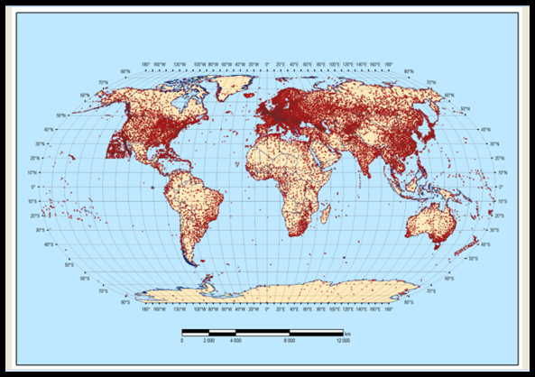
5 – QC for metadata (data location)
Another kind of QC has been applied to the stations metadata, due to the development of the ERA-CLIM2 Global Registry (see poster H58) which includes the ISPDv4 inventory. By determining the station’s country corresponding to each ISPD (longitude, latitude) with an R-scripted tool, we have been able to detect spatial outliers that are due to incorrect conversion, essentially of longitudes, which are easy to correct.
All ISPDv4 stations (80K+) are represented on this map.
Same name, but different country due to wrong latitude or longitude:
Lon=0º ; lack of minus (-) sign in long; number missing on lat or lon; decimal point mistake
Errors detected so far come from ISD stations and if corrected the pressure for these stations can be assimilated in reanalyses.

