Slide 1
Fugitive methane emissions from biogas plants – results of a field experiment
Martin Piringer, Claudia Flandorfer, Sirma Stenzel, Marlies Hrad

Slide 2
Overall aim of the investigation
Reproduce the a priori not known emission rate of a biogas plant by an inverse dispersion technique with the Lagrangian particle dispersion model LASAT
Field experiment: 3 laser teams and one DIAL team involved, but not ZAMG
ZAMG received plant information and measurement data afterwards to back-calculate the methane emission
As the real source configuration was not known, several assumptions have been tested

Slide 3
Outline
Detection of emission rates
Measurement set-up
Meteorological measurements
Laser measurements of methane concentrations
Calculation of emission rates
Summary of findings

Slide 4
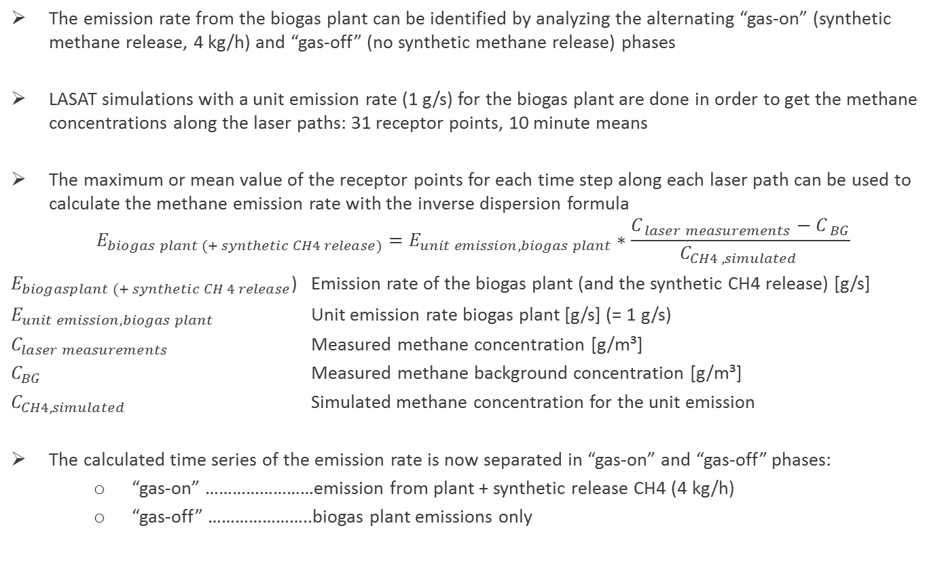
Synthetic methane release experiment
The emission rate from the biogas plant can be identified by analyzing the alternating “gas-on” (synthetic methane release, 4 kg/h) and “gas-off” (no synthetic methane release) phases
LASAT simulations with a unit emission rate (1 g/s) for the biogas plant are done in order to get the methane concentrations along the laser paths: 31 receptor points, 10 minute means
The maximum or mean value of the receptor points for each time step along each laser path can be used to calculate the methane emission rate with the inverse dispersion formula
$$E_{biogas plant (+ synthetic CH4 release)}=E_{unit emission, biogas plant}∗\frac{C_{ laser measurements}−C_{ BG}}{C_{CH4 , simulated }}$$
$E_{biogasplant (+ synthetic CH 4 release}$) Emission rate of the biogas plant (and the synthetic CH4 release) [g/s]
$E_{unit emission, biogas plant}$ Unit emission rate biogas plant [g/s] (= 1 g/s)
$C_{laser measurements}$ Measured methane concentration [g/m³]
$C_{BG}$ Measured methane background concentration [g/m³]
$C_{CH4, simulated}$ Simulated methane concentration for the unit emission
The calculated time series of the emission rate is now separated in “gas-on” and “gas-off” phases:
“gas-on” ……………………emission from plant + synthetic release CH4 (4 kg/h)
“gas-off” …………………..biogas plant emissions only

Slide 5
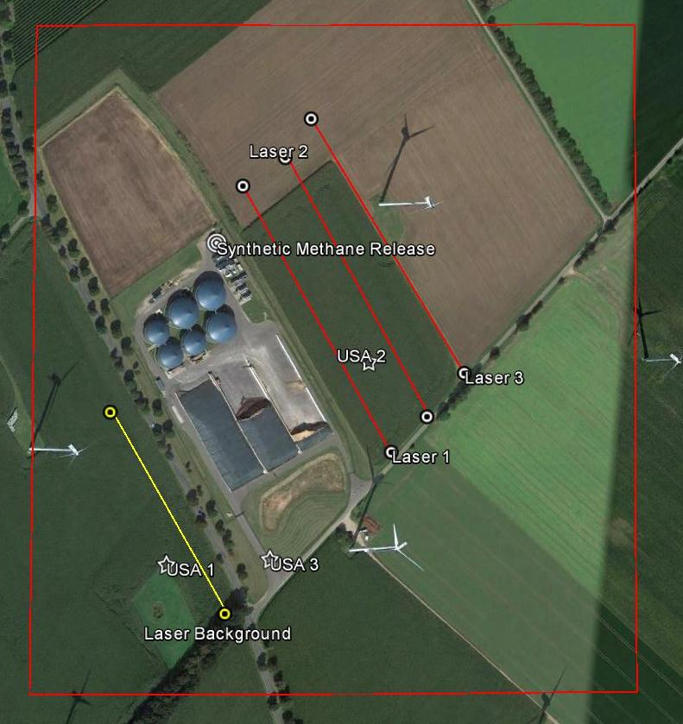
Measurement set-up and model domain
LASAT Domain (630 x 700 m) with synthetic methane release point source (white circle), the background measurement path (yellow straight), the laser paths (red straights) and USA locations (white stars). (Google Earth)

Slide 6
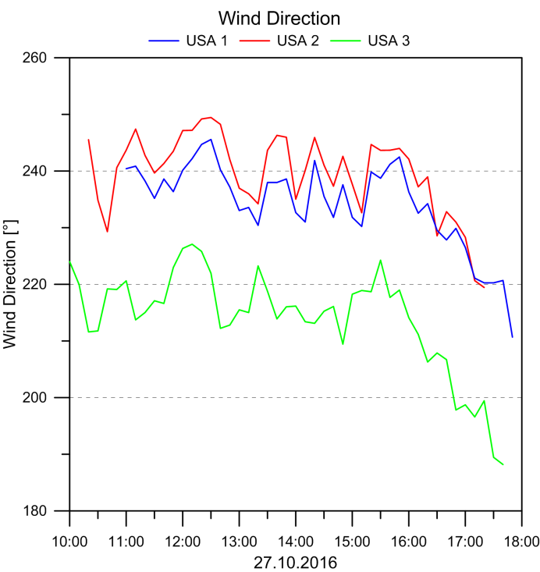
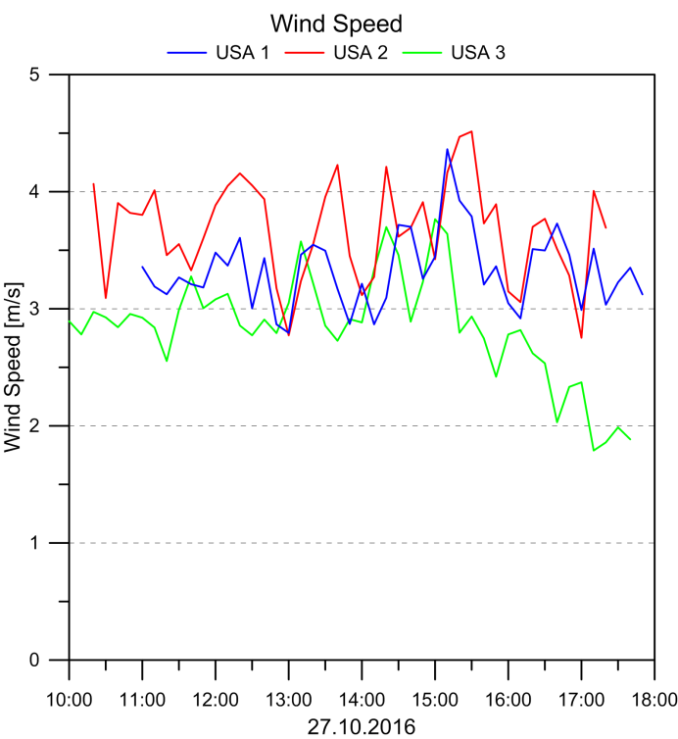
Wind direction and wind speed
3 different measurement heights:
USA 1 at 2.6 m; windward side
USA 2 at 4.6 m; leeward side
USA 3 at 5 m; probably influenced by a tree row and a fence
USA 1 and USA 2 data is used as input to dispersion model

Slide 7
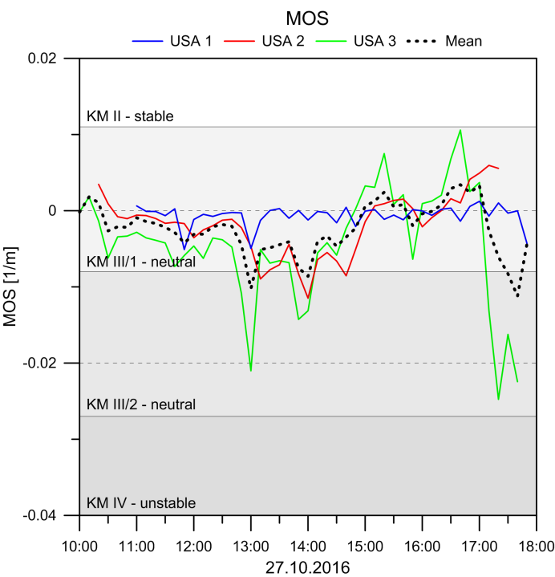
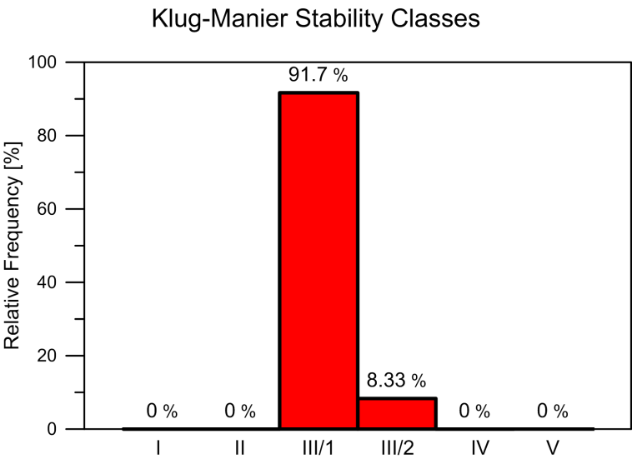
Atmospheric stability
Largest variation in MOS for USA 3 (vicinity of trees and fence)
Neutral conditions are prevalent
Mean value of MOL chosen as input to dispersion model

Slide 8
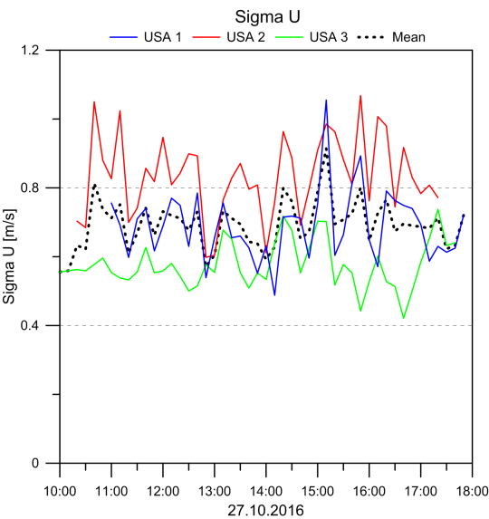
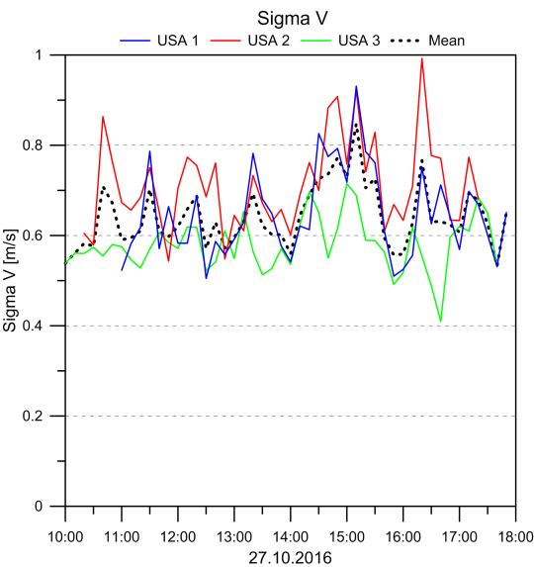
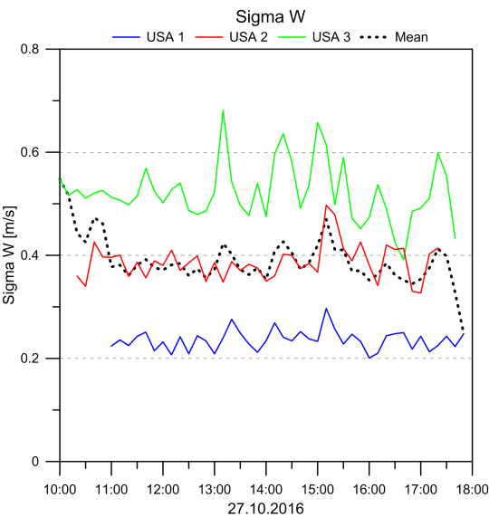
Standard deviations of wind components
Sigma U and Sigma V show similar values.
Larger differences for Sigma W: USA 1 (blue, windward) measured the lowest, USA 3 (trees and fence) the highest values.
Leeward Sigma W (USA 2) larger than windward Sigma W
For the model simulations, averages of Sigma U and Sigma V, but Sigma W from USA 1 and USA 2 only were used.

Slide 9
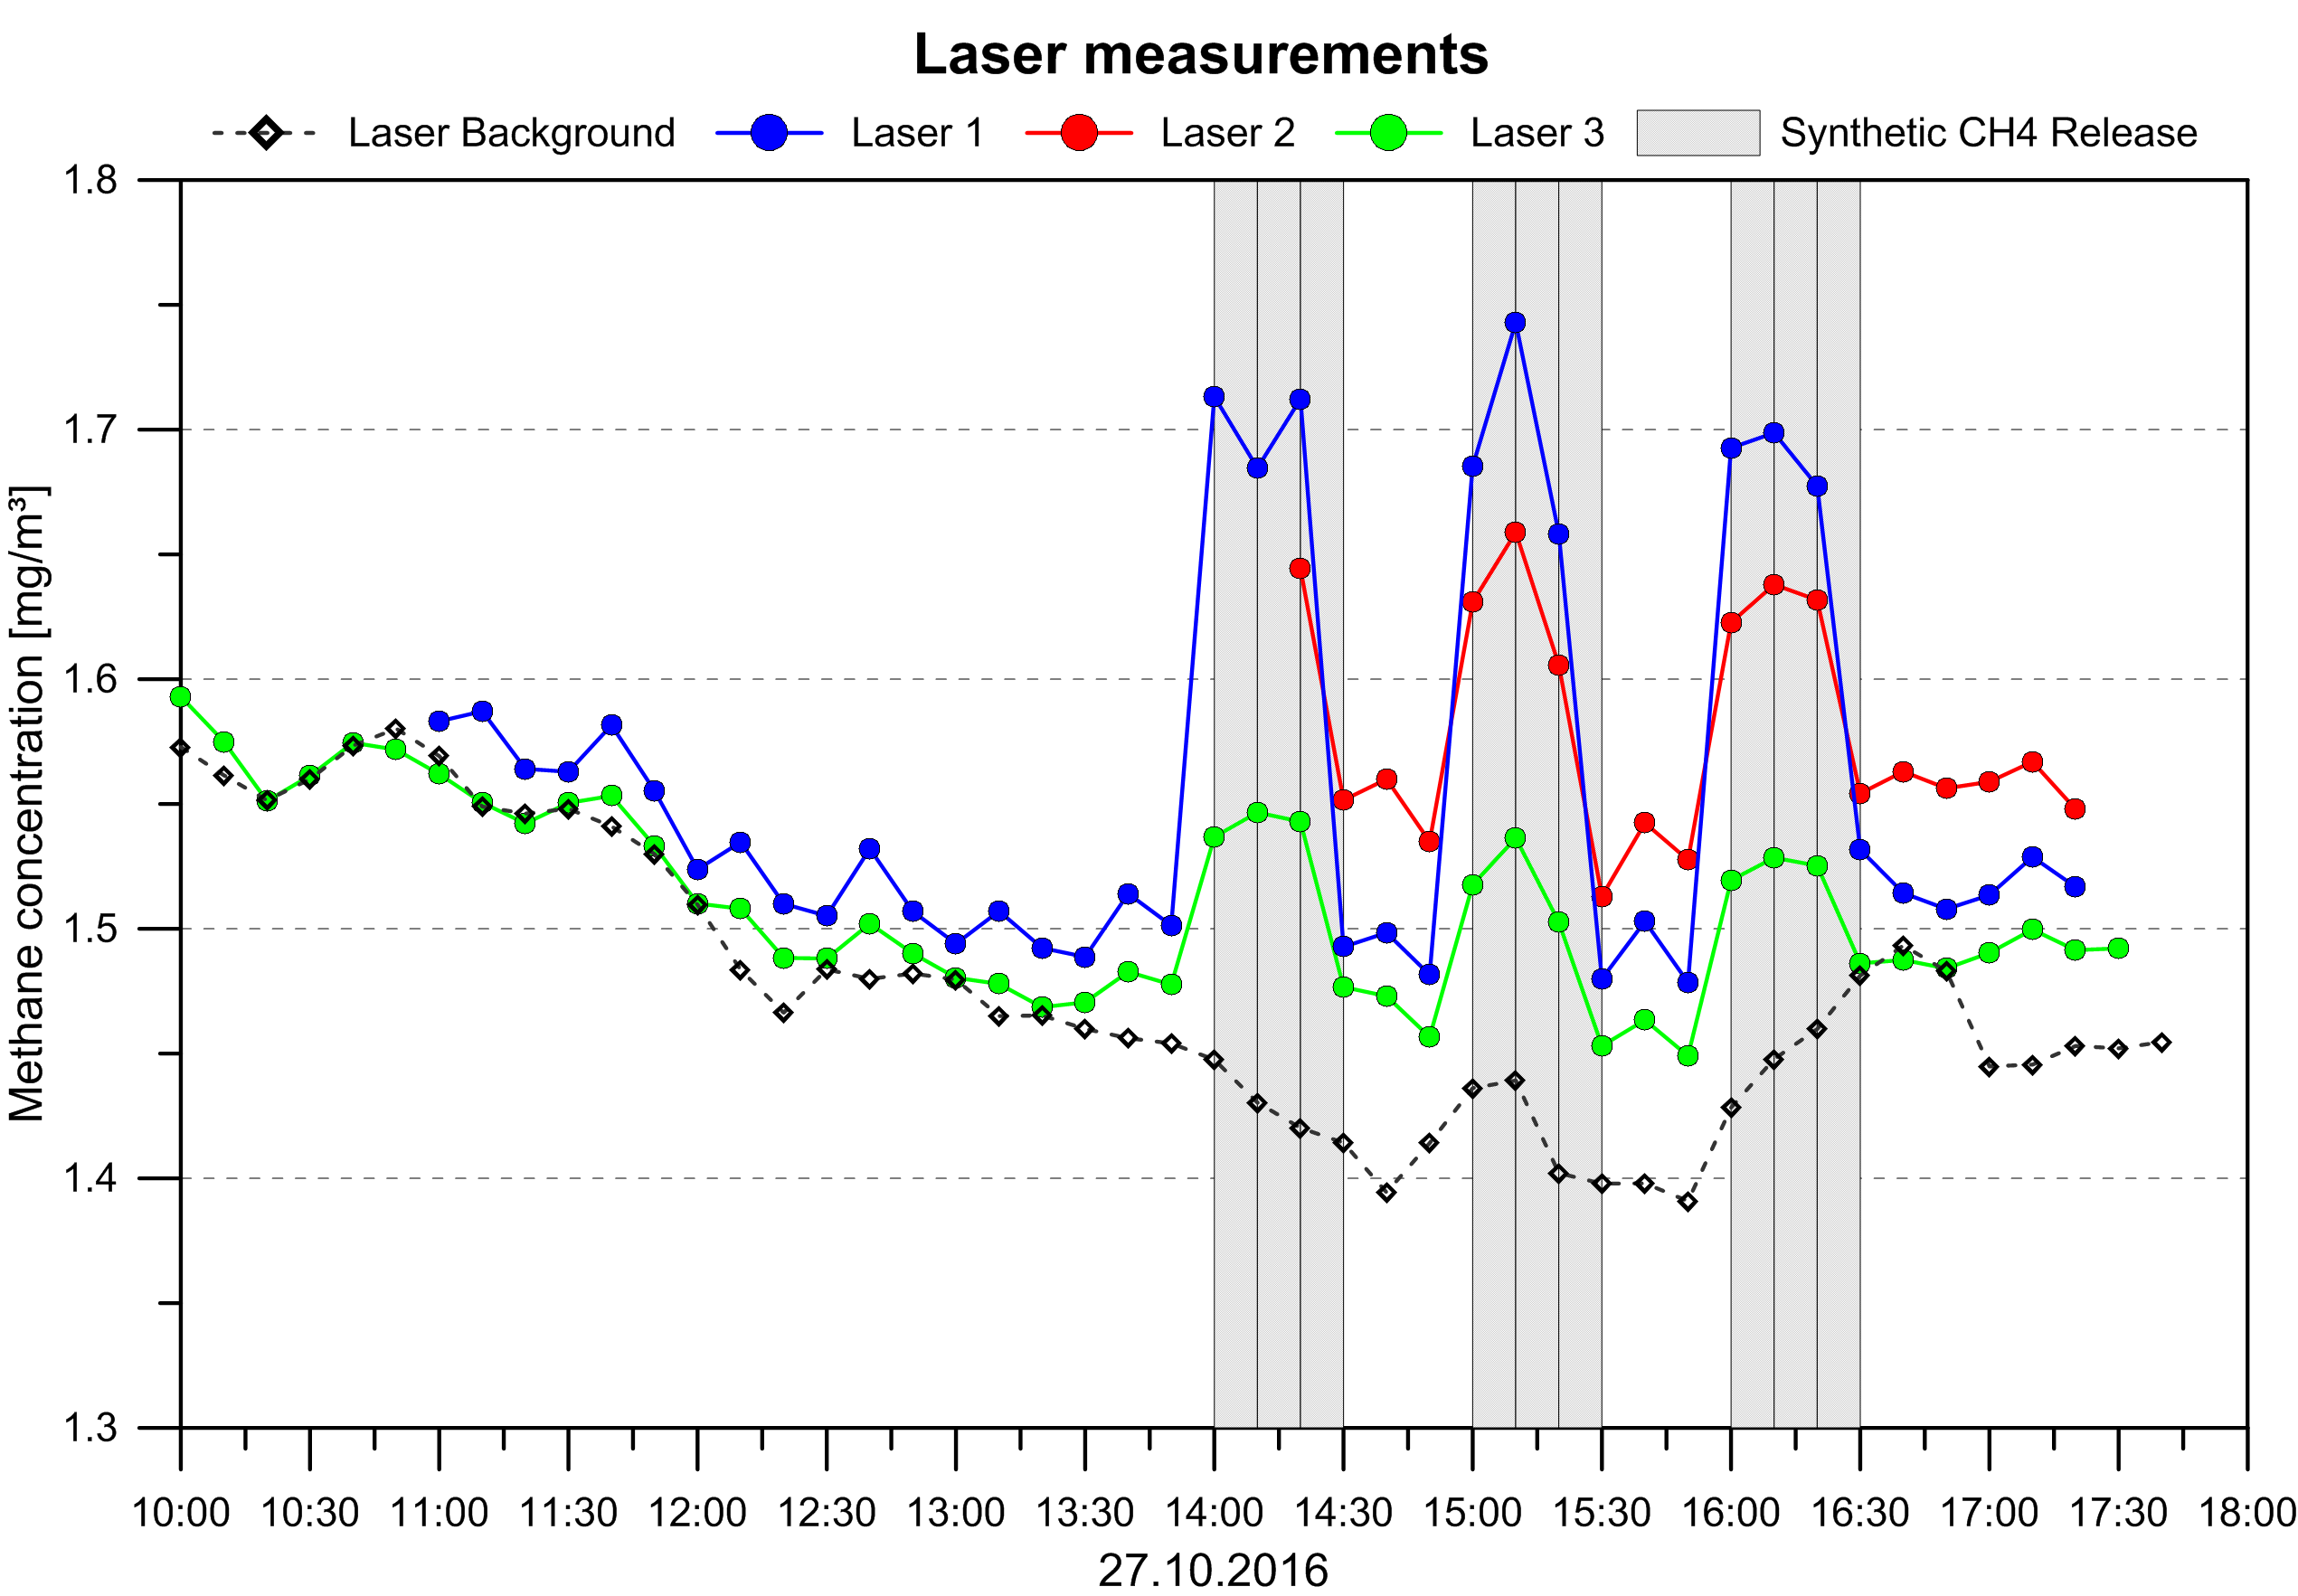
Laser measurements of methane concentrations
In the “gas-on phase”, the measured methane concentrations from the lasers increase. In the “gas-off phase”, the methane concentrations decrease, as expected. Laser 2 shows less reduction in the gas-off phase than the other lasers.

Slide 10
Steps to calculate emission rates
Aims: reproduce the emission rate of the biogas plant (with and without synthetic methane release) and the reference emission rates derived from DIAL (Differential Absorption Lidar) measurements for the gas-on and gas-off phases.
Therefore, concentration fields for a unity emission of 1 g/s (for different source configurations) have been calculated
Maximum or mean value from the receptor points along the laser paths
Wind data from USA 1 and USA 2 have been used
Source configurations tested:
Area source – whole biogas plant (height 0.1 m)
Area source – centered over the fermenters (height 0.1 m)
Point source – located in the middle of the fermenters (height 1 m)
Volume source – whole biogas plant (height 10 m)
Volume source – centered over the fermenters (height 10 m)

Slide 11
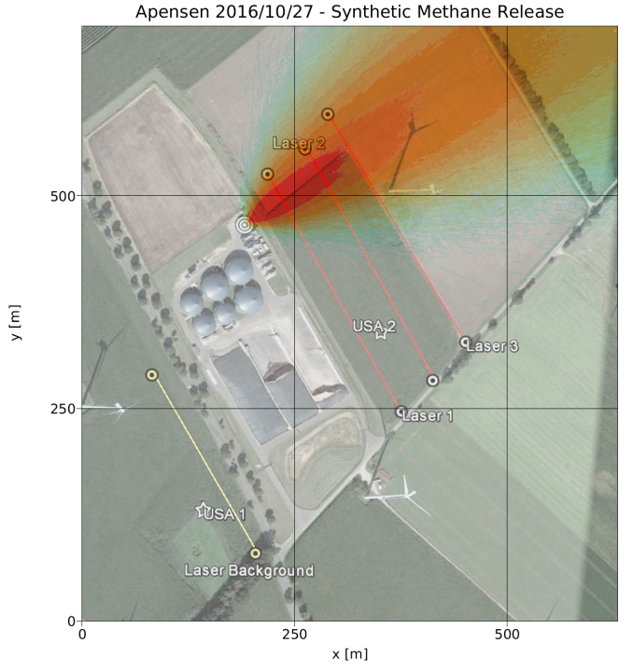
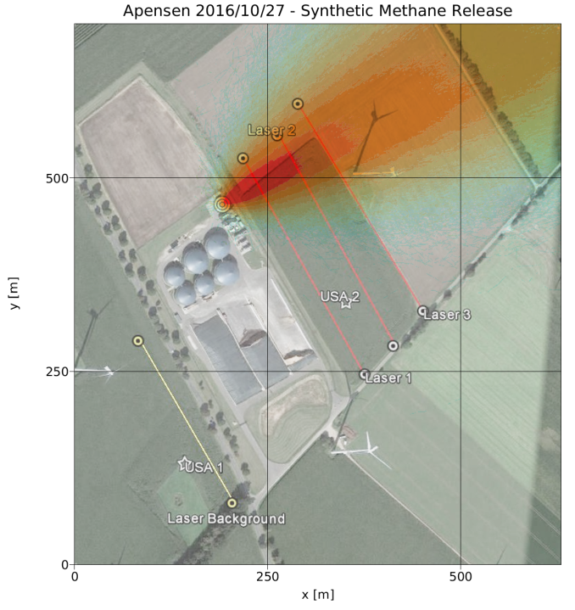
Methane plume of the synthetic release
Maximum 10-min CH4 concentration calculated with LASAT with the wind data from USA 1 (left) and USA 2 (right).
USA 1: Higher concentrations due to lower wind and turbulence
USA 2: Higher wind speed and vertical turbulence cause a faster mixing of methane which results – as expected - in smaller simulated concentrations

Slide 12
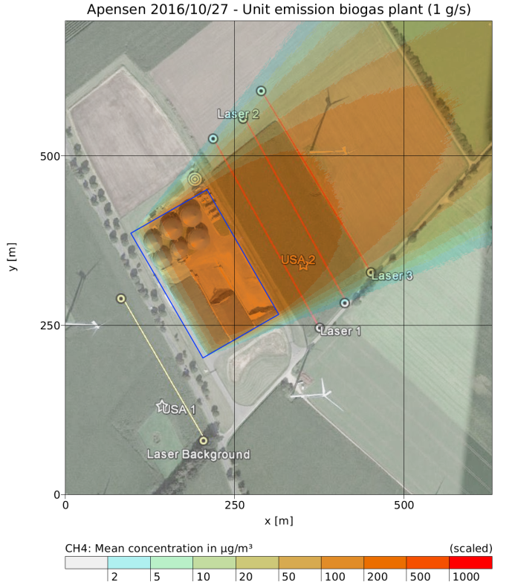
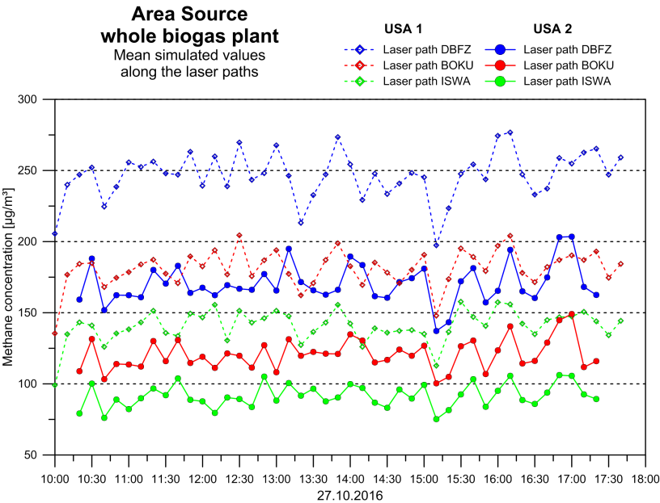
Methane plume of the area source (whole biogas plant)
Simulated 10-min mean values along the laser paths 1-3. Wind data from USA 1 (dashed lines) and USA 2 (solid lines).
Mean CH4 concentrations (LASAT), unit emission. Area source located 0.1 m above surface (blue rectangle). Wind data from USA 1 (left) and USA 2 (right).

Slide 13
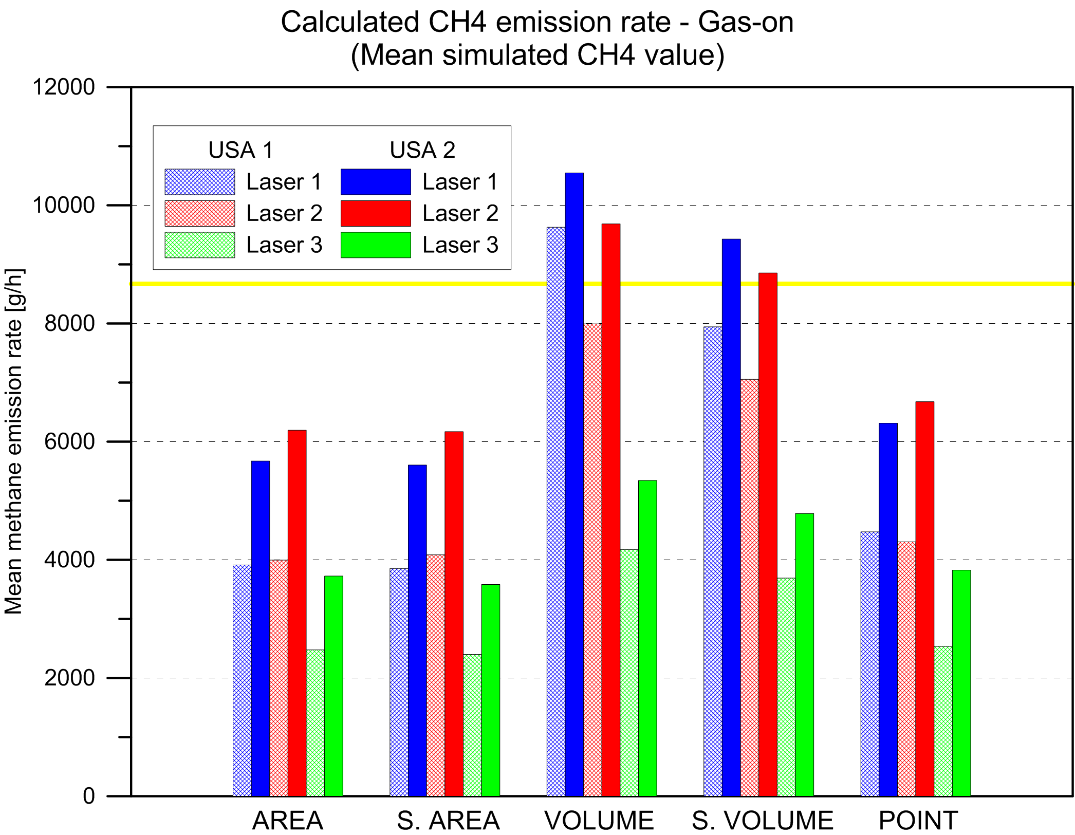
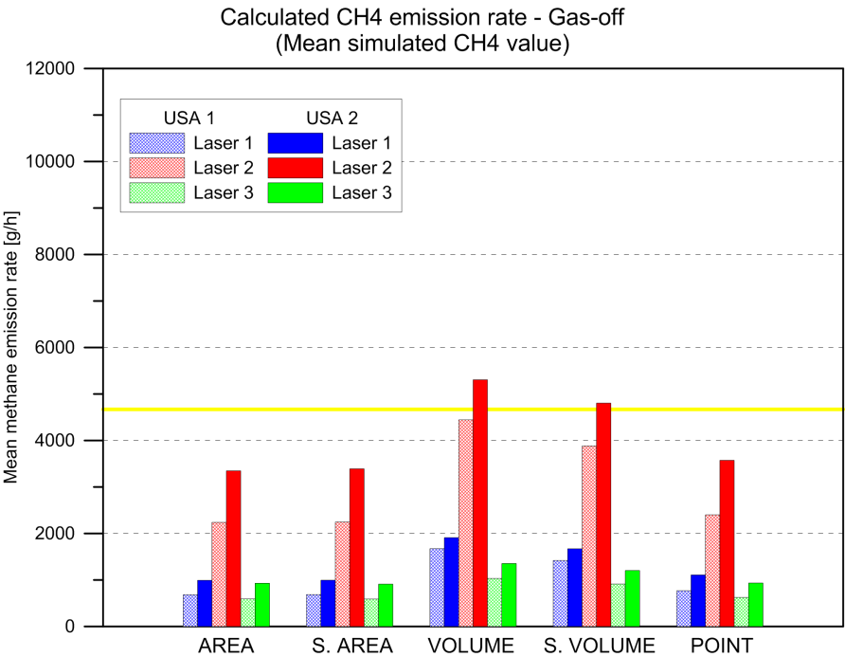
Summary of results („gas-on, gas-off“)
Calculated emission rate for 5 source configurations for the “gas-on” and “gas-off” phases.
Reference emission rates (yellow lines) are derived from the DIAL.
The emission rate is calculated with the 10-minute mean CH4 values along the laser paths 1-3. The cross-line filled bars show the results of the simulations with the meteorology from USA 1, the filled bars show the simulations with meteorology from USA 2.

Slide 14
Interpretation and conclusions
Both the selected source geometry and the meteorological data have an influence on the calculated synthetic emission rate.
Using the mean value along the laser path, the derived emission rate is much closer to the reference emission rate as for the maximum value which often results in a severe under-estimation of emissions.
The calculated emission rate depends on the distance of the laser paths. The highest emission rates are obtained for lasers 1 or 2. Laser 3 is maybe too far away from the source.
The best results were derived from
Mean values along the laser paths
USA 2 (leeward)
Volume source configurations
Lasers not too close or too far away from the plant
The first measurement campaign was seen as an opportunity to optimize the set-up for the following field experiment.

Slide 15
Thank you for your attention!
Questions?

