Slide 1

Radiative transfer in atmospheric models – why do we still have to work on it?
Petri Räisänen
Finnish Meteorological Institute

Slide 2
Outline of the talk
Introduction
Optical properties (atmosphere & surface)
Computational issues (”speed vs. accuracy”)
Some further discussion

Slide 3
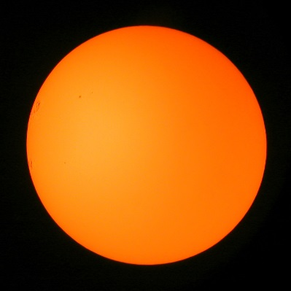
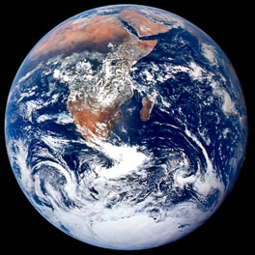
”Radiation is important”
For the climate system as a whole
Energy source
solar (shortwave, SW)
radiation (net = down - up)
Energy sink
outgoing terrestrial
(longwave, LW) radiation
Also in shorter (weather) time-scales
e.g., the diurnal cycle is driven by solar radiation at the surface

Slide 4
Radiation in atmospheric models
(1) Surface energy budget equation
where
(2) Thermodynamic equation
where
(3) Possible other uses: radiances for data assimilation,
photochemistry, solar energy forecasts …

Slide 5
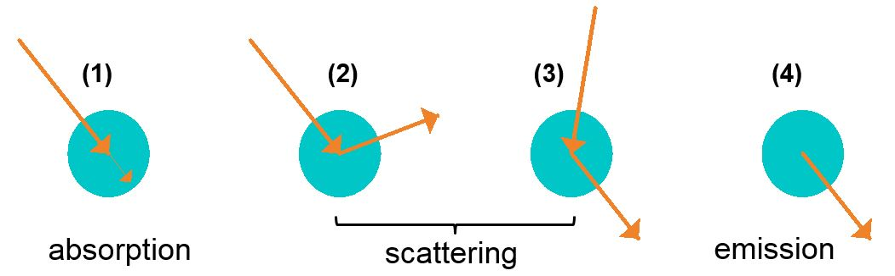
The theoretical backbone: Radiative transfer equation (RTE)
1
2
3
4
Notes:
This is the scalar RTE, with no polarization!

Slide 6
The theoretical basis is well known …
The RTE has been known for many decades, and it has been (later) derived from first principles:
Mishchenko, M.I., 2002. Vector radiative transfer equation for arbitrarily shaped and arbitrarily oriented particles: a microphysical derivation from statistical electromagnetics. Applied Optics, 41, 7114-7134.
… However, some practical issues exist
1) Optical properties of the atmosphere need to be specified:
- Absorption and scattering coefficients (σ_{a,λ}, σ_{s,λ})
- Scattering phase function P_{λ}(θ,φ; θ’,φ’)
As a function of
wavelength (λ) and
location (x,y,z)
- Also the lower boundary conditions: surface reflectivity & emissivity
2) Computational issues

Slide 7
Outline of the talk
Introduction
Optical properties (atmosphere & surface)
Computational issues (”speed vs. accuracy”)
Some further discussion

Slide 8
Optical properties of the atmosphere
1) Gas molecules
Molecular (Rayleigh) scattering:
  a very well-known process
Gaseous absorption (H₂O, CO₂, O₃, O₂, CH₄, N₂O, CFCs, etc.):
  Absorption spectra of major absorbing gases generally very well (but not exactly) known from quantum mechanics and laboratory experiments
  Uncertainties (e.g.) in the water vapour continuum absorption (in particular, in the near-infrared)

Slide 9
Optical properties of the atmosphere (cont’d)
2) Liquid and solid particles
Cloud droplets and ice crystals
Precipitating hydrometeors (rain, snow, graupel, hail …)
aerosol particles
A mature field of research, but work remains to be done
Calculation of single-scattering properties of non-spherical particles (shape, surface roughness etc.)
Refractive index (aerosol particles)
Simulation / diagnosis / assumptions of the relevant particle properties in NWP and climate models!

Slide 10
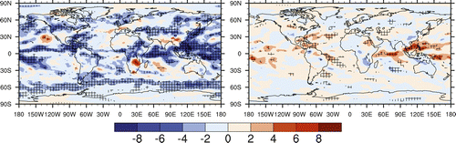
Example: ice crystal roughness
Evidence has accumulated that most ice crystals are not ideal, but have surface roughness, inhomogeneity or other irregularities
flatter phase function, reduced asymmetry parameter
somewhat stronger ice cloud SW radiative effects
CAM5.1 runs (Yi et al. 2013, J. Atmos. Sci., p. 2794-2807):
SWCRE: rough - smooth
LWCRE: rough - smooth
-1.83 Wm⁻²
0.37 Wm⁻²
Notes:
CAM5.1, atmosphere only.

Slide 11
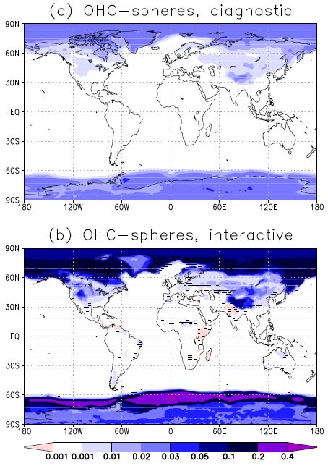
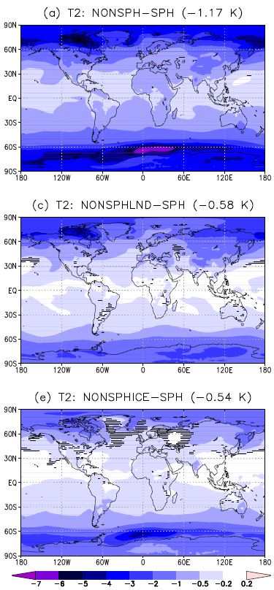
Surface radiative properties (example): snow albedo (Räisänen et al., The Cryosphere Discussions)
Difference in surface albedo:
Non-spherical vs. spherical snow grains, diagnostic calculation in NorESM
max ≈ 0.03
Difference in 2-m temperature:
Non-spherical vs. spherical snow grains applied interactively in the
snow albedo calculation in NorESM
(slab ocean configuration)
min ≈ -7 K
avg = -1.17 K
Notes:
Also important: albedo of forests in the presence of snow.

Slide 12
Outline of the talk
Introduction
Optical properties (atmosphere & surface)
Computational issues (”speed vs. accuracy”)
Some further discussion

Slide 13
Computational issues
The radiative transfer equation can be solved ”exactly”, but rigorous radiative transfer (RT) computations are extremely time-consuming
Especially:
- Spectral integration:
up to millions of wavelengths in line-by-line computations
- Multiple-scattering computations:
e.g.: DISORT (1D), Monte Carlo (3D)
Compromises between speed and accuracy of RT calculations
are / have been / will always be necessary in atmospheric models!

Slide 14
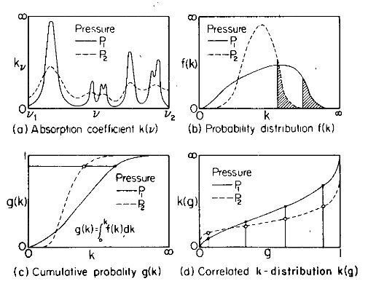
Speed vs. accuracy: spectral integration
Most frequently used solution:
Correlated k-distribution technique (CKD)
The integral over wavelength replaced with an integral over the [inverted]
cumulative probability distribution of gas absorption coefficient
A spiky integrand replaced
with a smooth one!
Sketch from Hansen et al.,
(MWR 1983) ⇔ the CKD
approach is not exactly new!
Notes:
CKD introduced in Lacis et al. (1979) (some conference paper) , see Fu & Liou, JAS 1992, p. 2139

Slide 15
CKD technique: some examples
* not strictly correlated k-distribution code
Reported clear-sky accuracy for RRTMG: LW ≤1 W m⁻²; SW ≤ 3 Wm⁻²
Vast computational savings compared to line-by-line calculations
(where up to millions of wavelengths are considered) …
 | Number of bands / ”g-points”
 | LW | SW
RRTMG (Mlawer et al., several GCMs) | 16 / 140 | 14 / 112
Li & Barker (2005) (Canadian AGCM4) | 5 / 46 | 8 / 35
Sun-Edwards-Slingo scheme, v. 2 (Sun 2011) | 8 / 31 | 9 / 27
FKDM (Fomin 2004, Fomin & de P. Correa 2005)* | 3 / 23 | 6 / 15
… but the CPU time requirement may still be a concern

Slide 16
An alternative approach: single spectral interval schemes
Several have been developed, mainly in the context of mesoscale models and short-range NWP
- Recent (unusually rigorous!) examples:
Mašek et al., 2016: Single interval shortwave radiation scheme with parameterized optical saturation and spectral overlaps. QJRMS, 142, 304-326.
Geleyn et al., 2017: Single interval longwave radiation scheme based on the net exchanged rate decomposition with bracketing. QJRMS, 143, 1313-1335.
Absolute accuracy not as high as for typical (multi-band) CKD schemes
More complicated to develop (& comprehend) than schemes with higher spectral resolution
Benefit: much faster
⇒ the radiation scheme can be invoked more frequently

Slide 17
Speed vs. accuracy: multiple scattering
Typical solution (esp. SW): two-stream approximations
Errors case-dependent. Generally,
atmospheric SW absorption
underestimated and surface
SW absorption overestimated
In the longwave region, scattering often neglected
however, scattering makes a significant contribution to the cloud LW radiative effect at TOA (3 Wm⁻², ~10%) (Costa & Shine, QJRMS 2006)
Surface
Atmosphere
Off-line calculations for GCM data;
δ-Eddington vs. δ-16-stream
(Räisänen, QJRMS 2002)
Fraction of cases (%)
Error (W m⁻²)
Error (W m⁻²)
Notes:
This figure is not directly from the QJRMS paper, but computed from the same data.

Slide 18
Speed vs. accuracy: temporal and spatial resolution of radiation calculations
Radiation time step usually longer than the time step for other physical processes and model dynamics.
In some cases, RT calculations performed at a lower horizontal resolution.
 | Δx | Δx (rad) | Δt | Δt (rad)
NorESM / CESM (1.9° x 2.5°) | ~192 km | ~192 km | 30 min | 2 hours
ECMWF HRES (deterministic) | 9 km | 29 km | 7.5 min | 1 hour
ECMWF ENS | 18 km | 45 km | 12 min | 3 hours
Concern: the reduced temporal/spatial resolution of radiation calculations could compromise the interaction of radiation with other physical processes (e.g., cloud-radiation interaction)

Slide 19
Last but not the least: the plane-parallel horizontally homogeneous (PPH) assumption
In the real world, radiative transfer is a 3D process (x,y,z)
In atmospheric models, it is treated as a 1D process (z)
- each atmospheric column assumed to consist of horizontally uniform
layers; no interaction between columns
- both due to computational costs and lacking information on 3D structure
”model world”
reality?
… although strictly speaking, this is not 100% true …

Slide 20
Treatment of subgrid-scale cloud structure in radiation calculations
Cloud fraction and cloud overlap: ≈ all models
- grid cells divided into cloudy and cloud-free parts
(each of which is homogeneous)
- overlap assumptions (e.g., ”maximum-random”)
define how clouds in different layers are located
wrt. each other
Subgrid-scale variations in cloud optical
depth or water content: many models
- Monte Carlo Independent Column Approximation (McICA)
- TripleClouds
3D radiative transfer: emerging, not in operational use

Slide 21
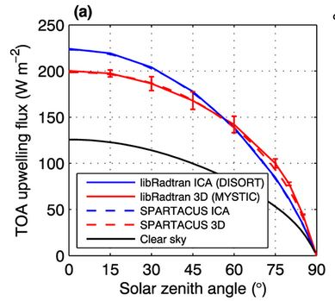
3D radiative transfer? Why bother?
(Hogan et al., JGR 2016)
Systematic impacts on SW RT
- increased cloud reflectance for low sun
- decreased cloud reflectance for high sun
Systematic impacts on LW RT
- emission from cloud sides increases
LW cloud radiative effects
Estimates for global-mean effects on TOA and surface net fluxes
(Sophia Schäfer, Univ. of Reading, Ph.D. thesis)
ICA
CLEAR-SKY
3D
 | SW | LW
TOA (W m⁻²) | 3.0 | 0.9
Surface (W m⁻²) | 2.3 | 2.1
Notes:
The figure is from Hogan et al. (JGR 2016), see next slide. The numerical values in the table
have been picked from the ECRAD report (Hogan & Bozzo 2016, ECMWF Tech. Memo 787). They
are based on off-line radiation calculations for ERA-Interim data with SPARTACUS.

Slide 22
3D RT for climate / NWP models?
Very recently, a couple of approaches have been suggested:
1) SPARTACUS
Schäfer et al. (JGR 2016), Representing 3-D cloud radiation effects in two-stream schemes: 1. Longwave considerations and effective cloud edge length.
Hogan et al. (JGR 2016), Representing 3-D cloud radiation effects in two-stream schemes: 2. Matrix formulation and broadband evaluation.
- Principle: add extra terms to the two-stream equations to represent
lateral transport between clear and cloudy regions
- requires ”effective length of cloud edge” per unit area of gridbox
- implemented in the new ECMWF radiation code (ECRAD)
(Hogan and Bozzo 2016, ECMWF Tech. Memo 787)
- 4.5 x slower than the ECRAD default RT solver (McICA)

Slide 23
3D RT for climate / NWP models?
2) 3D Monte Carlo radiative transfer calculations (SW)
Barker et al. (QJRMS 2015): Application of a Monte Carlo solar radiative transfer model in the McICA framework.
A relatively small numbers of photons per GCM grid cell (~500) sufficient? (radiative flux and heating rate random errors comparable to what has been found ”safe” with McICA).
- Allows the use of a full phase function
⇒ also eliminates errors associated with two-stream approximations
(these errors often reinforce those due to the neglect of 3D effects!)
- Not GCM-ready yet & computational costs to be evaluated
A first algorithm for generating 3-D subgrid-scale cloud structure
Barker et al. (JAMES 2016), A parametrization of 3-D subgrid-scale clouds for conventional GCMs: Assessment using A-Train satellite data and solar radiative transfer characteristics.

Slide 24
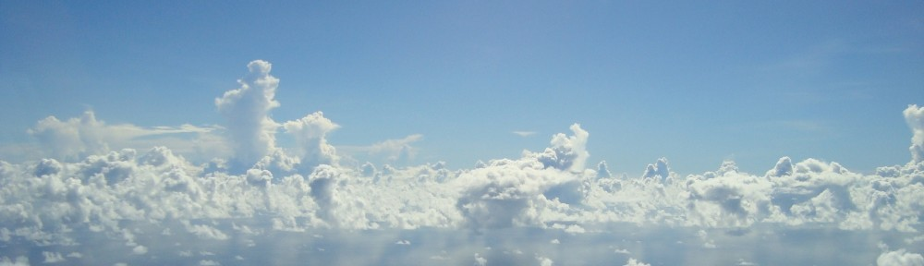
Radiative transfer between model grid columns
Photo from: http://hannahlab.org/category/uncategorized/
~ 50 km?
Neglected in all current radiation schemes. In other words, the net
effect or radiation ”flowing” between grid columns is assumed to be 0.

Slide 25
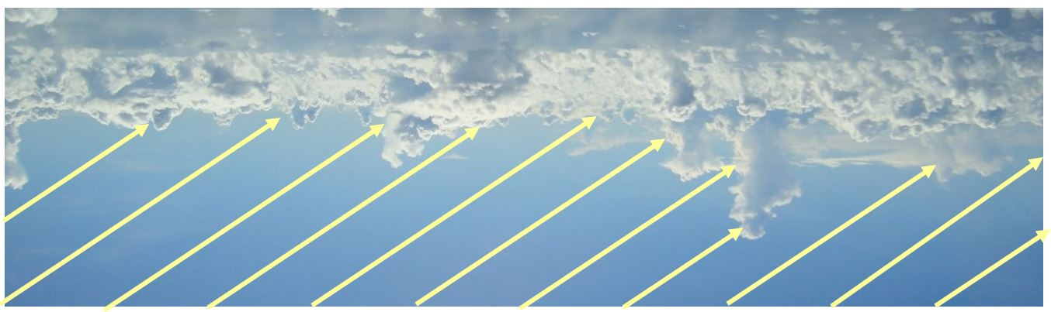
Radiative transfer between model grid columns
Photo from: http://hannahlab.org/category/uncategorized/
~ 50 km?
2.5 km
Neglected in all current radiation schemes. In other words, the net
effect or radiation ”flowing” between grid columns is assumed to be 0.
This becomes increasingly questionable as the horizontal resolution increases. At km-scale resolution, column aspect ratio
!

Slide 26
Outline of the talk
Introduction
Optical properties (atmosphere & surface)
Computational issues (”speed vs. accuracy”)
Some further discussion

Slide 27
Radiative transfer in atmospheric models: the wish list for the ideal world
The radiation calculations should be done accurately
Use a comprehensive CKD approach for gas absorption
4-stream (instead of 2-stream) for multiple scattering
account for cloud inhomogeneity, 3D effects …
…
… and at high temporal and spatial resolution
radiation scheme called at every timestep and gridpoint
Not going to happen. Too costly.

Slide 28
Then what should be prioritized?
The answer might depend on the application
The choices should be based on testing
1) The traditional approach: off-line radiation calculations
Comparison of radiative fluxes and heating rates to reference calculations (or comprehensive, well-calibrated observations)
Limitation: not straightfoward to compare other approximations with the effects of reduced spatial/temporal sampling
On-line tests: how do approximations in radiative transfer impact climate and NWP simulations?
A lot of ”anecdotal evidence” gained especially at NWP centers
Systematic understanding lacking

Slide 29
On-line tests of RT approximations: a ”recipe”
Perform reference simulations with a comprehensive RT
scheme called (ideally) at every time step / grid point
2) Repeat with approximation(s) in the RT scheme, or with
reduced spatial or temporal resolution of RT calculations
3) Evaluate the errors in weather/climate statistics,
considering the reference run as the truth
4) Repeat points 2 and 3 for other approximations
In principle straightforward, but requires human and computer resources
Due to compensating errors, the most accurate treatment of RT
does not always produce best climate simulations / weather forecasts
Notes:
Especially for NWP, it is not enough that the modifications are physically motivated. They should not decrease the forecast scores, or increase (much) the use of computer resources.

Slide 30
Example: McICA’s random errors
Monte Carlo Independent Column Approximation
features random errors in radiative fluxes and
heating rates, which depend on the details of
implementation
RMS errors in radiative
heating rates in ECHAM5
REF (0.08 K/d)
McICA (0.40 K/d)
1COL (1.16 K/d)
1) REF = reference-McICA
(small random errors, very slow)
2) McICA = a reasonable GCM implementation
3) 1COL = a less reasonable implementation
(~maximizes the random errors)
1000 σ
K d⁻¹
How do McICA’s random errors influence climate simulations?
Compare the other two versions (McICA, 1COL) with REF.

Slide 31
Differences in low cloud fraction (%) in ECHAM5
McICA - REF
A reduction of low cloud fraction, especially in marine stratocumulus areas. Very slight for the ordinary version of McICA, but more substantial for the high-noise version (1 COL).
1COL - REF
A very fast (~24-48 h) response,
related to a non-linear response
of precipitation to random errors
in radiative heating
More information:
Räisänen et al., 2008,
QJRMS, 134, 481-495.

Slide 32
Radiative transfer in atmospheric models
– why do still have to work on it?
Optical properties:
gases, (nonspherical) hydrometeors, aerosols
surface radiative properties
Speed vs. accuracy: How to best utilize the computer resources available for radiative transfer?
- accuracy for the 1D world (spectral resolution, multiple scattering)?
- subgrid-scale cloud effects + 3D radiative transfer?
- spatial and temporal resolution of radiation calculations?
A need for more systematic testing of how the various approximations influence climate model or NWP simulations

Slide 33
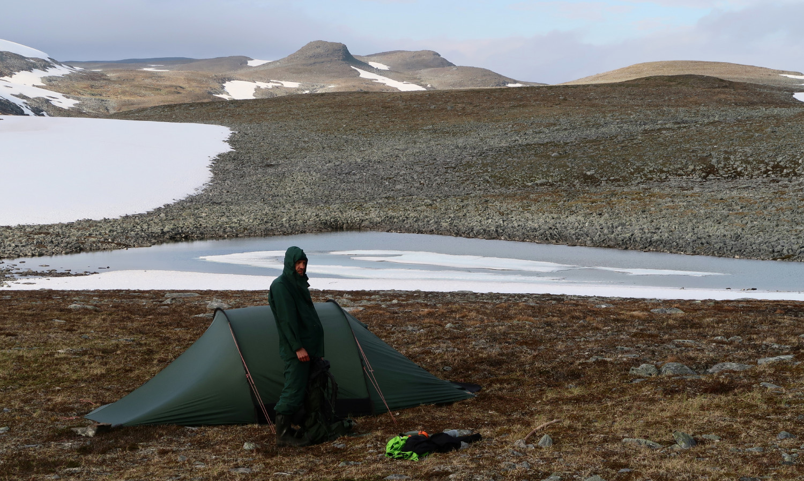
Kiitoksia mielenkiinnosta!

Slide 34
EXTRA SLIDES …

Slide 35
Radiative transfer processes
Consider a ray propagating into an arbitrary direction
, at a wavelength λ (radiance L_{λ}(θ,φ))
Within a distance ds the radiance L_{λ}(θ,φ) is attenuated by
(1) absorption
(2) scattering from direction (θ,φ) to other directions (θ’,φ’)
but it is strengthened by
(3) scattering from other directions (θ’,φ’) to the direction (θ,φ)
(4) radiation emssion by the medium to the direction (θ,φ)
(1)
(2)
(3)
(4)

Slide 36
Subgrid-scale cloud variations in RT
1) Quick and dirty: multiply cloud optical depth or water content by a factor < 1 (e.g., 0.7 in Tiedtke, MWR 1996)
2) Monte Carlo Independent Column Approximation (McICA) (Pincus et al. JGR 2003)
- RT calculations made for subcolumns, which may differ from spectral
band or ”g-point” to each other
- a stochastic method: features random errors in radiative fluxes and
heating rates (the impacts have been found ”mostly harmless”)
3) Tripleclouds (Shonk and Hogan, J. Climate 2010)
- Cloudy part of each layer split into ”thick” and ”thin” parts
Both McICA and Tripleclouds allow for a flexible description of cloud overlap. But they neglect 3D effects (i.e., net effects of horizontal RT).

