Slide 1
COST Action ES1206:
Advanced GNSS tropospheric products for monitoring severe weather events and climate
Jonathan Jones
Met Office, UK
Notes:
Structure of Action and organisation then Scientific findings

Slide 2
Emerging Requirements and Capabilities
ZTD only gives mean from ‘cone of observation’
Obs. providing the location of water vapour in the horizontal and vertical are required by NWP
Hi-res nowcasting NWP and IWV images require improved timeliness and greater spatial and temporal resolution
Climate community becoming aware of high-quality reprocessed GNSS tropospheric products
Advanced products: STDs, gradients, tomography etc
RT raw data streaming (NTRIP) and RT processing
Long-term, homogenised regional and global GNSS tropospheric products now available (e.g. EPN Repro)

Slide 3
ES1206: GNSS4SWEC
‘To enhance existing and develop new, ground-based multi-GNSS tropospheric products, assess their usefulness in severe weather forecasting and climate monitoring, and to improve GNSS accuracy through enhanced atmospheric modelling.’
4yr project (2013-2017)
32 COST Countries
150+ Participants from 60+ institutes
7 NCIs in Canada, USA, Australia and Hong Kong
1 COST NNC (OTC Tunisia)
Notes:
COST Actions do not fund actual research
COST Actions do fund meetings, workshops, training schools, STSMs and dissemination

Slide 4
GNSS4SWEC Structure
Chair: J. Jones (UK Met Office) Vice Chair: G. Guerova (Univ. of Sophia)
WG1 - Advanced GNSS Processing Techniques
Chair: J. Dousa (GOPE) Co-chair: G. Dick (GFZ)
WG2 - GNSS for Severe Weather Monitoring
Chair: S. de Haan (KNMI) Co-chair: E. Pottiaux (ROB)
WG3 - GNSS for Climate Monitoring
Chair: O. Bock (IGN) Co-chair: R. Pacione (e-geos)
WG1
70 participants
25 countries
11 sub-WGs
WG2
44 participants
21 countries
7 sub-WGs
WG3
52 participants
17 countries
5 sub-WGs

Slide 5
COST Funded Meetings
Kick-off meeting | Brussels, Belgium | 2013
Core Team meeting | Potsdam, Germany | 2013
Working Group and MC Meeting | Valencia, Spain | 2013
Core team Meeting | Prague, Czech republic | 2013
Workshop and MC Meeting | Munich, Germany | 2014
Dissemination Meeting | Washington DC | 2014
Core Team meeting | Vienna, Austria | 2014
Summer School, WG and MC | Varna, Bulgaria | 2014
Core Team meeting | Paris, France | 2015
Workshop and MC | Thessaloniki, Greece | 2015
Working Group and MC Meeting | Wroclaw, Poland | 2015
IGS Workshop | Sydney, Australia | 2016
Workshop and MC Meeting | Reykjavik, Iceland | 2016
Homogenisation Workshop | Brussels, Belgium | 2016
Core Team Meeting | Vienna, Austria | 2016
Dissemination Meeting | Beijing, China | 2016
Summer School, WG and MC Meeting | Potsdam, Germany | 2016
Homogenisation Workshop | Warsaw, Poland | 2017
Final Workshop | Noordwijk, Netherlands | 2017
Notes:
19 meetings up until end of Action in start June 2017

Slide 6
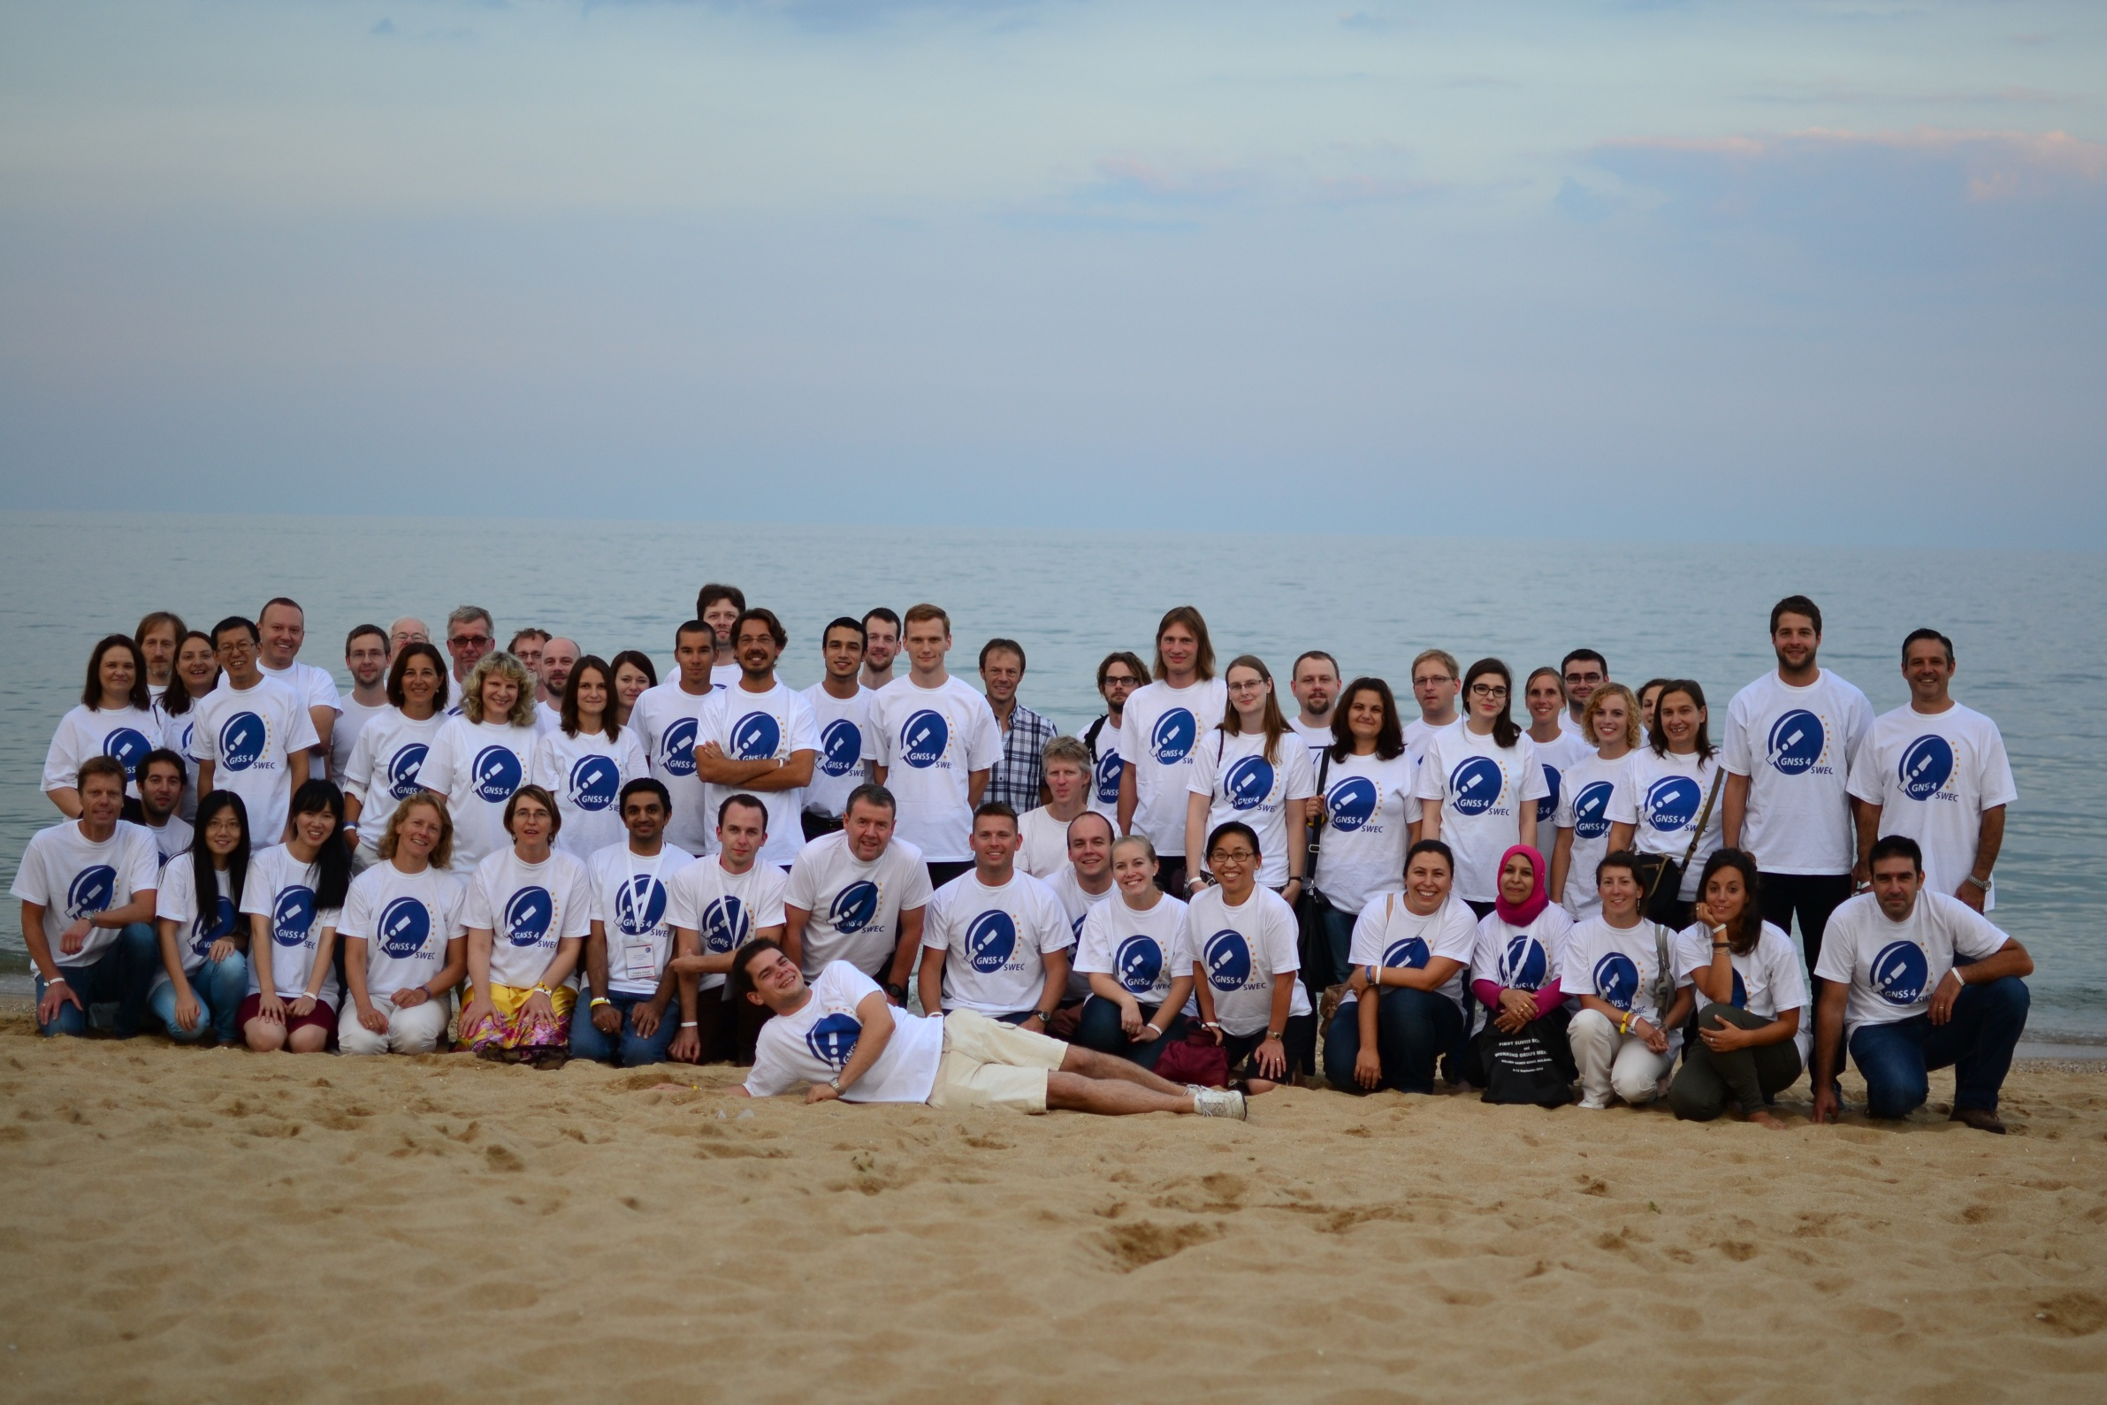
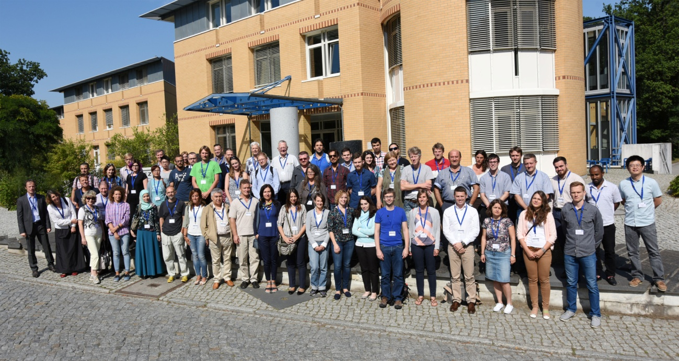
Training Schools
2 Summer Schools
Training next generation of scientists
Talks included basic science, climate, operational meteorology
Sept 2014, Varna, Black Sea Coast
12 Tutors, 33 Students
Aug 2016, GFZ, Potsdam
17 Tutors, 42 Students
Notes:
Originally planned 12, achieved 23. Great success

Slide 7
STSMs
Name | From | To | Title
Furqan Ahmed | Luxenbourg | France | Impact of Assimilating GNSS-derived ZTD from Luxembourg and the Greater Region into NWP model AROME
Kalev Rannat | Estonia | Germany | Improved processing and use of GNSS Zenith Total Delay and Integrated Water Vapour data for Climatology
Tomasz Hadas | Poland | Canada | Neutral atmosphere delay model for Precise Point Positioning
Witold Rohm | Poland | UK | Application of GNSS tomography for severe weather studies
Pavel Vaclavovic | Czech Rep. | ROB | Developing of ultra-fast tropospheric products
Tzvetan Simeonov | Bulgaria | Luxembourg | Tropospheric products processing for Bulgarian ground-based GNSS network
Peter Szabo | Hungary | Bulgaria | Tropospheric products from GNSS and ALADIN-Climate regional climate model for East-Southeast Europe
Jan Dousa | Czech Rep. | Turkey | Installing new analysis centre for near real-time GNSS troposphere monitoring in Turkey
Jan Dousa | Czech Rep. | Greece | Installing new analysis centre for near real-time GNSS troposphere monitoring in Greece
Gokhan Gurbuz | Turkey | Hungary | Develop a near real-time GNSS processing system for the Turkish GNSS stations (Istanbul and Ankara).
Karina Wilgan | Poland | Switzerland | Parameterized refractivity models and GNSS path delays in view of GNSS Severe Weather Monitoring
Riccardo Biondi | Italy | Belgium | GNSS atmospheric water vapour detection for extreme events
Andre Sa | Portugal | Poland | Tomography as a tool for atmospheric studies
Katarzyna Stepniak | Poland | France | Impact of processing parameters on the ZTD estimates and adaptation of ZTD screening methods
Michal Kacmarik | Czech Rep. | GFZ | Validation of GNSS Slant Delays
Rita Nogherotto | Italy | La Reunion | Tropical cyclone intensification, water vapour distribution and GNSS measurements
Tomasz Hadas | Poland | Luxenbourg | Optimization of real-time GNSS troposphere delay estimation algorithms
Katarzyna Stepniak | Poland | France | Improved methods for reprocessing of GNSS data for climate monitoring over Poland
Anna Klos | Poland | Luxenbourg | Analysis of ZTD timeseries from reprocessed GPS solutions
Jan Dousa | Czech Rep. | Iceland | Installing new GNSS analysis centre for troposphere monitoring in Iceland
Kamil Kazmierski | Poland | Canada | Real-time troposphere delay gradient estimation with multi-GNSS PPP
Karina Wilgan | Poland | BIRA | Lookup tables of refractivity coefficients for the conversion from zenith path delays to integrated water vapour
Anna Klos | Poland | Lux | Selected Issues of Homogenisation of Synthetic ZTD Data with Noise Characteristic Derived from Reprocessed GPS Solutions
Anna Klos | Poland | ROB | Homogenisation and characterisation of IWV time series from IGS repro1 and its comparison to ERA-Interim
Notes:
Originally planned 12, achieved 23. Great success

Slide 8
Inter-Journal Special Issue
Advanced Global Navigation Satellite Systems tropospheric products for monitoring severe weather events and climate (GNSS4SWEC)
SI jointly organized between:
Atmospheric Measurement Techniques
Atmospheric Chemistry and Physics
Annales Geophysicae
Running 2012-2018, 23 submissions so far.
For more info see:
https://www.ann-geophys.net/special_issue400_89.html

Slide 9
Non-COST Funded Dissemination
AGU Fall Meeting | San Francisco, USA | 2013
Galileo Symposium | Prague, Czech republic | 2013
IAG Scientific Assembly | Potsdam, Germany | 2013
GRUAN ICM6 | Beltsville, USA | 2014
IGS Workshop | Pasadena, USA | 2014
EUREF Symposium | Vilnius, Lithuania | 2014
EGU General Assembly | Vienna, Austria | 2014
GRUAN ICM7 | Matera, Italy | 2015
EUREF Symposium | Leipzig, Germany | 2015
EGU General Assembly | Vienna, Austria | 2015
EMS Annual Meeting | Sofia, Bulgaria | 2015
Galileo Symposium | Braunschweig, Germany | 2015
EUREF Symposium | San Sebastian, Spain | 2016
AGU Fall Meeting | San Francisco, USA | 2016
EGU General Assembly | Vienna, Austria | 2016
EMS Annual Meeting | Trieste, Italy | 2016
UNAVCO Science Workshop | Boulder, USA | 2016
ECMWF | Reading | 2017
EUREF Symposium | Wroclaw, Poland | 2017
EGU General Assembly | Vienna, Austria | 2017
Notes:
19 non-COST funded dissemination up until end of Action in start June 2017

Slide 10
Action Achievements

Slide 11
Network Coverage
Goal: Support transfer of knowledge, data exchange for improving coverage of tropospheric products in Europe
7 new ACs:
Hungary: Satellite Geodetic Observatory
Turkey: Karadeniz Technical University,
Greece: Aristotle University
Turkey: Bulent Ecevit University
Icelandic: Meteorological Office
Poland: MUT
Bulgaria: Sophia University
8 new GNSS networks:
Italy, Hungary, Greece, Lithuania, Latvia, Slovakia, Turkey, Iceland.
+ others expected: Turkey, Austria, Denmark
+ others revitalised: Norway, Sweden, Finland, Poland
All new data made available to E-GVAP (http://egvap.dmi.dk/)
Notes:
Increase in Poland, Greece, Iceland, Latvia, Lithuania, Slovakia and also Italy. But also increase in density in Spain, France and Nordic countries. Not all down to COST Action, but some e.g. STSMs to establish new ACs in Greece and Iceland for example

Slide 12
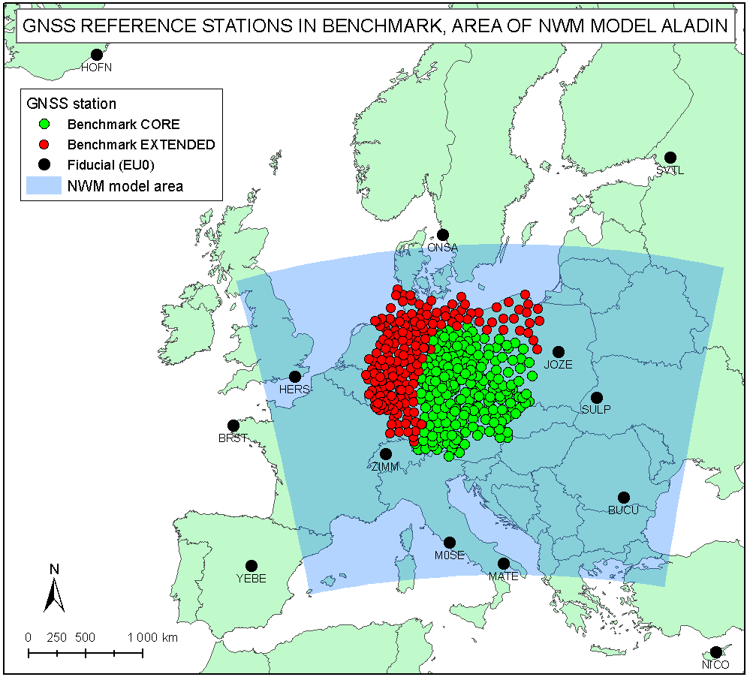
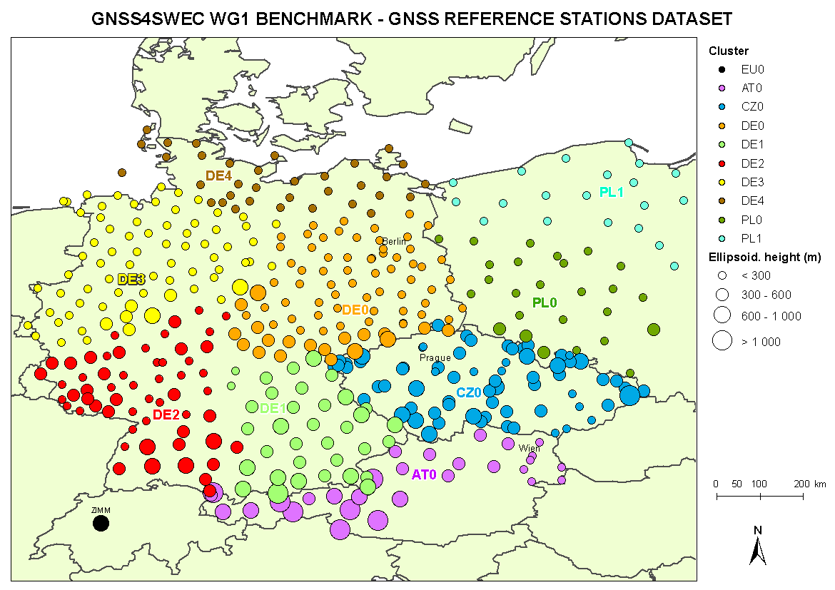
Benchmark Campaign
Goal: Design a common dataset for advanced GNSS tropospheric products, then evaluate the data to try and find the true value of water vapour
Benchmark design & data collection
May-June 2013 floods of Danube/ Moldau/Elbe
GNSS: ~500 stations
SYNOP: ~200 stations
NWM: regional (Aladin-CZ), global (ERA-Interim, NCEP GFS)
RAOBS: 2 high-resolution
WVR: Potsdam, Lindenberg
RADAR images: Brdy, Skalka
Reference products
GNSS: Bernese (GOP), EPOS (GFZ)
NWM: G-Nut/Shu (GOP), DNS (GFZ)

Slide 13
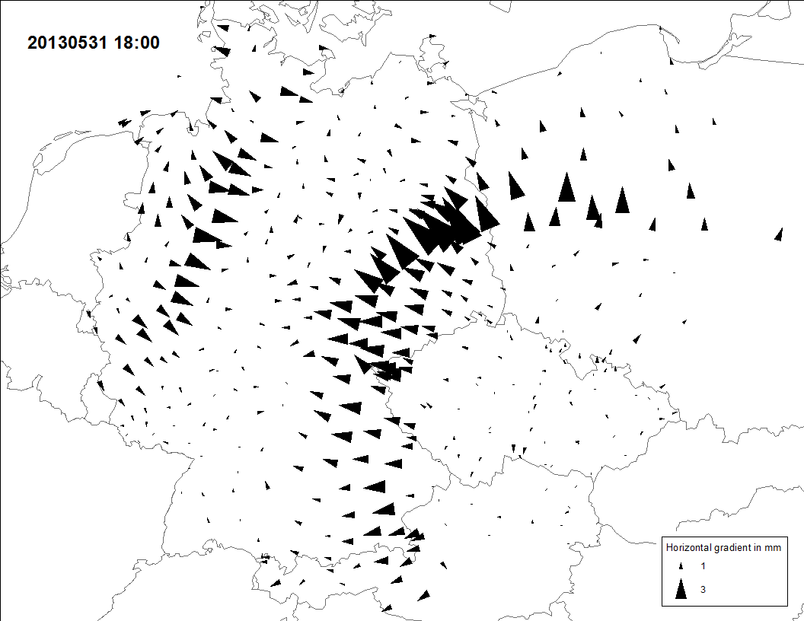
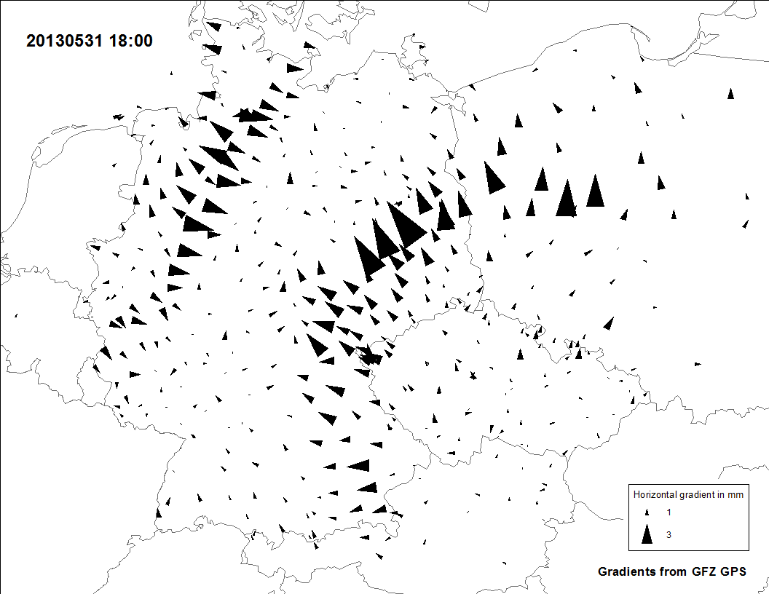
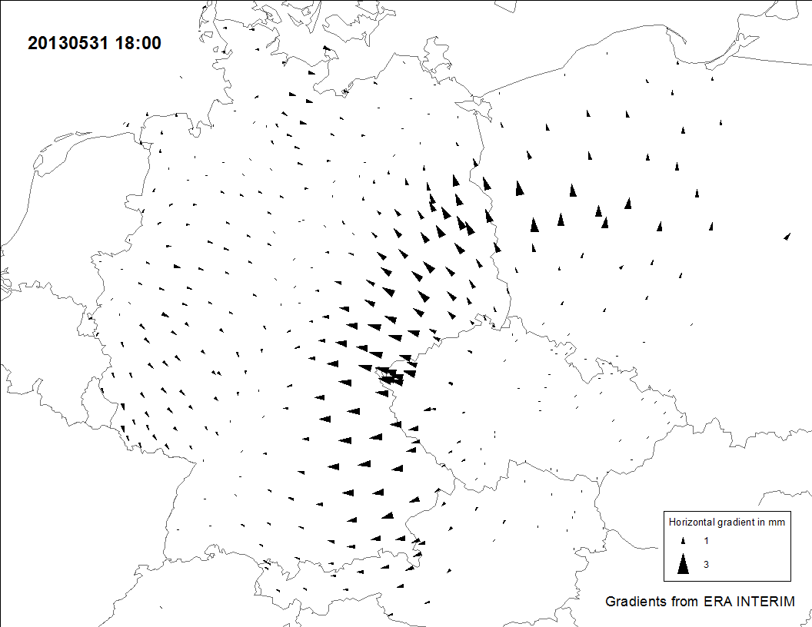
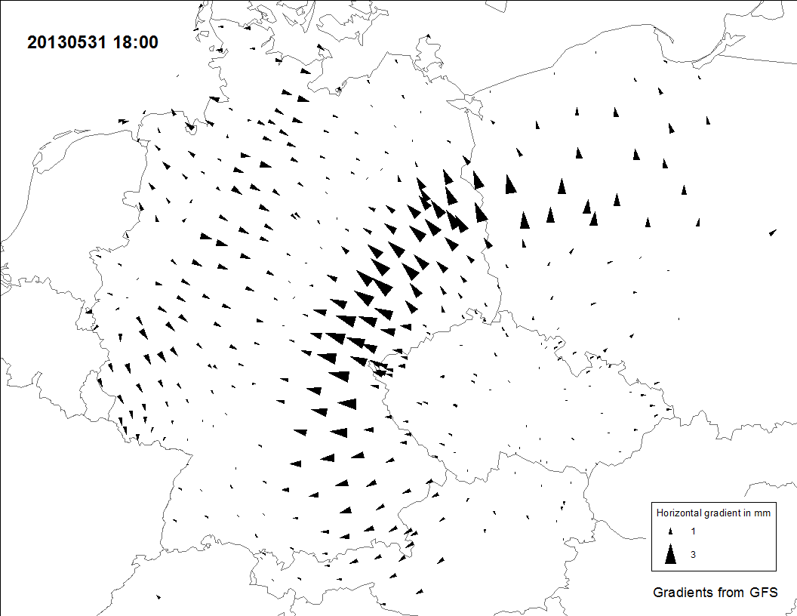
Tropospheric Gradients
Goal: Develop and assess advanced products for tropospheric asymmetry monitoring
GOP GNSS-gradients
ERA-Interim gradients
NCEP RT gradients
GFZ GNSS-gradients
May 31, 2013 (Benchmark) – estimates of (E-W, N-S) tropospheric gradients from GNSS & NWM
Development of NRT/RT high-resolution gradients and slant delays
Derivation of 1st and 2nd order troposphere gradients from NWM
Inter-comparison of gradients and slant delays from GNSS, NWM and WVR
More info see: Kacmarik et al (2016), atmos-meas-tech.net/9/2989/2016/doi:10.5194/amt-9-2989-2016

Slide 14
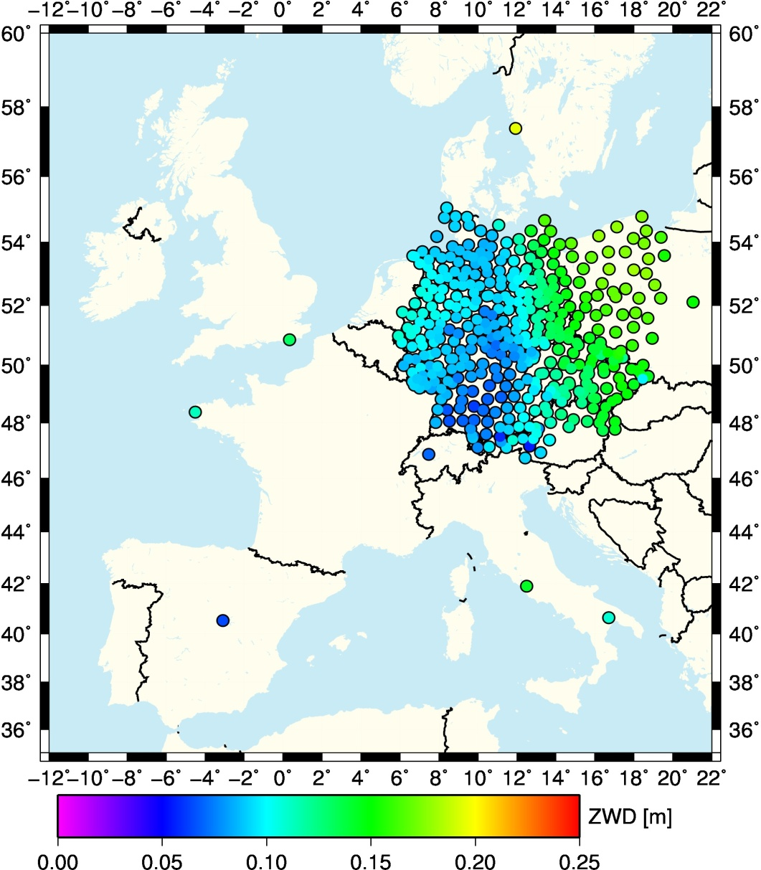
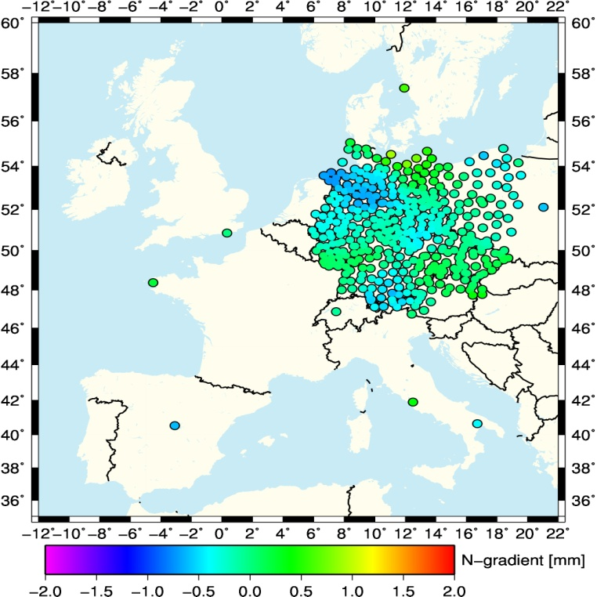
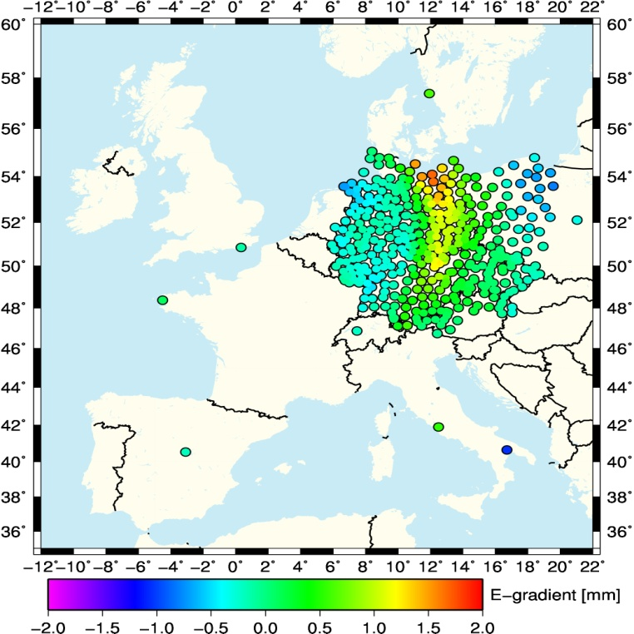
NWP-Derived Tropo. Parameters
Goal: Exploitation of NWP data in GNSS data analysis
Derived to strengthen & accelerate GNSS RT PPP, improve re-analysis solutions, assess quality of NWP and compare against independent data
ESA project ‘Dev. and RT Implementation Feasibility Study of NWP Enhanced Tropospheric Delay Estimation for Next Generation Satellite Positioning’
Good correlation between DD ZTDs and those derived from NWP ray tracing.
Model fields improved convergence time of PPP solution

Slide 15
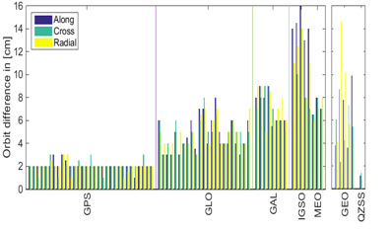
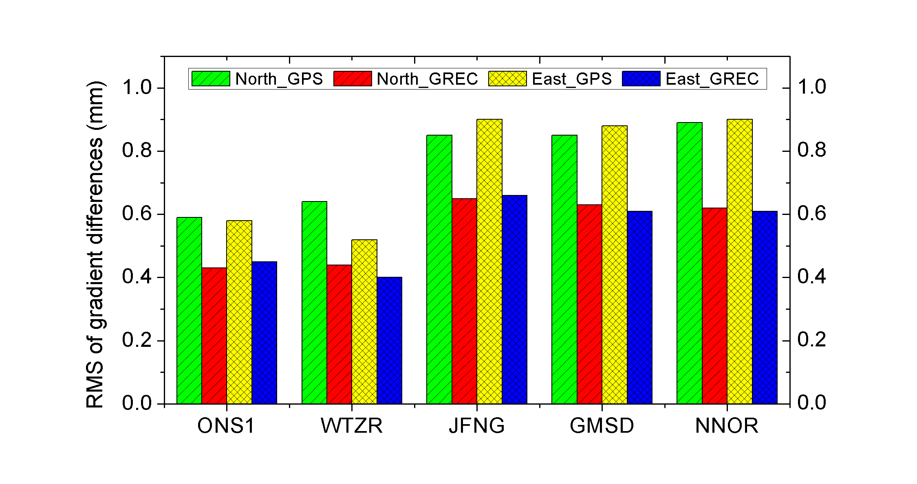
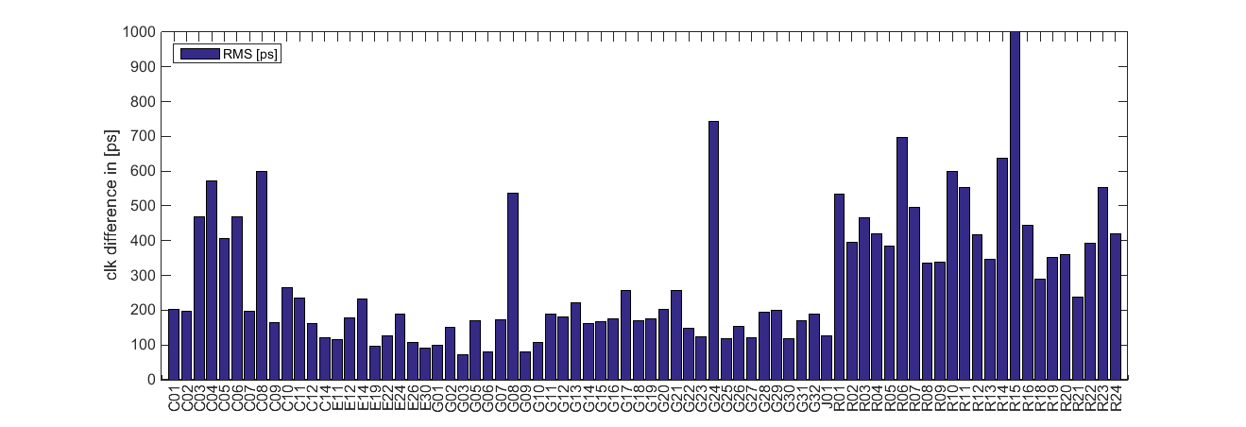
Assessment of Multi-GNSS
Goal: Adapt software for multi-constellation processing and assess its impact on tropospheric products
Several software developed/adapted for multi-GNSS data processing
GLONASS integrated in various NRT & RT-Demo solutions, GLONASS used within Benchmark campaign
Since Nov 2015 GFZ provide ultra-rapid multi-GNSS orbit and clock product every 3 hours
Includes GPS, GLO, GAL, BDS and QZSS
Latency is less than 2 hours

Slide 16
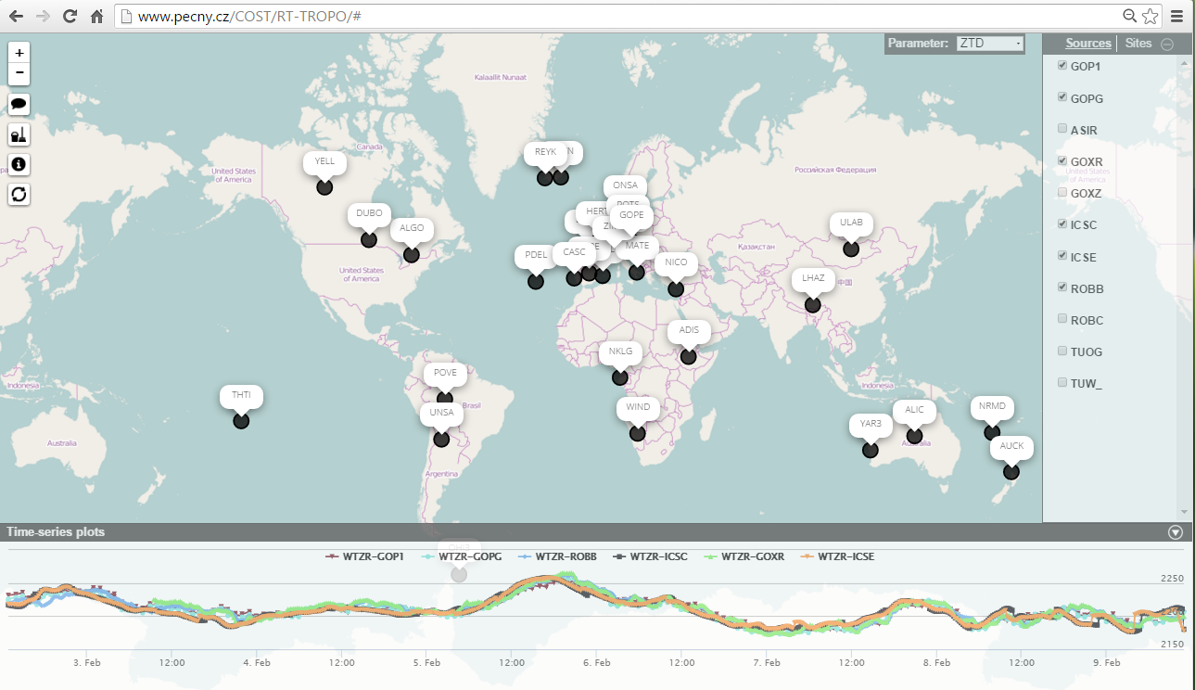
Validation of RT Tropo Estimates
Goal: Develop and assess ultra-fast and real-time tropospheric products for NWP nowcasting
Database of RT products established at GOP
Use IGS RT products for RT PPP
15 European sites
32 Global sites
6 Processing software types
7 ACs (plus WRF Model)
AC | Software | Start | Update | Solutions
GOP | G-Nut/Tefnut | 9.4. 2015 | real-time | GPS, GLO, grad
TUW | TUW software | 15.4. 2015 | real-time | GPS
ROB | G-Nut/Tefnut | 23.4. 2015 | real-time | GPS, GLO, grad
ASI | Gipsy-Oasis | 5.5. 2015 | hourly | GPS, gradients
UL | BNC, PPP-wizard | 15.6. 2015 | real-time | GPS
ICS | G-Nut/Shu | 12.7.2015 | forecast | WRF (EU, CZ)
TUO | RTKLib | 5.11.2015 | real-time | GPS
BKG | BNC | 15.3.2016 | real-time | GPS, GLO
Monitoring at: http://www.pecny.cz/COST/RT-TROPO
F. Ahmed et al. (2016) Comparative analysis of real-time precise point positioning zenith total delay estimates. GPS Solutions, 20 (2). pp. 187-199. ISSN 1521-1886
Notes:
RT solutions noisier (higher RMS) – to be expected, but no inherent bias
Adaptation of NWP schemes to compensate

Slide 17
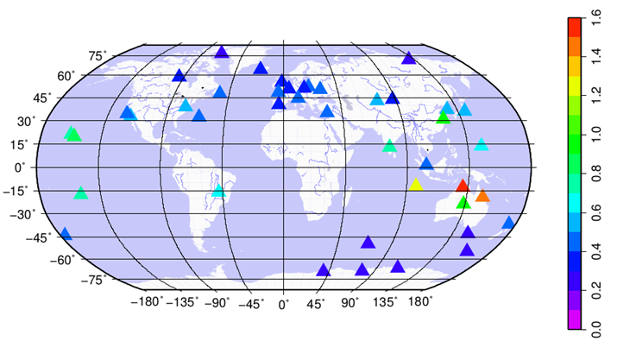
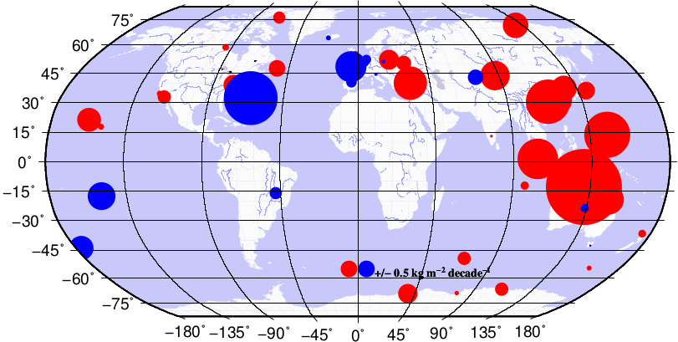
Monitoring Climate with GNSS
Goal: Prepare state-of-the-art homogeneous tropospheric product(s) for climate
Database of climate GNSS solutions established at GOP in conjunction with the IGS
Long term model validation
NCEP model - good seasonal and inter-annual variations but underestimation of IWV of <40% in tropics and <25% in Antarctica
Linear IWV trends
(a) Global trend: -1.65 to +2.32 kg/m² per decade
(b) Global trend uncertainty: 0.21 to +1.52 kg/m² per decade
http://publications.lib.chalmers.se/records/fulltext/157389.pdf
(a)
(b)

Slide 18
European IWV Trends 1995-2009
IPSL (IPCC-AR5)
GPS
IPSL (Med-CORDEX)
ERAI
Notes:
IPSL: Model projection from Institut Pierre Simon Laplace, France
Still a lot of contradiction on smaller scale

Slide 19
Next...
Monitoring H2020 calls and Action Team can coordinate interested parties
Preparation of Action Final Report underway (published Spring 2018)
Special Issue runs until end of 2018
E-GVAP Phase IV (2019-2023)
More of a focus on increased timeliness
Coordination of Global ZTDs
STDs and ZTD gradients are expected to be of benefit to high resolution NWP with STDs considered an operational component in E-GVAP Phase IV
Data formats ready for ZTD gradients and STDs, however, they need to be revised to handle the large amounts of (potentially low elevation) STD data. Work has already begun

Slide 20
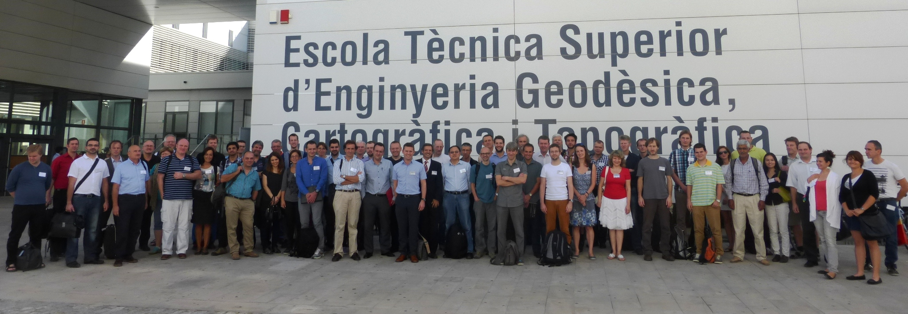
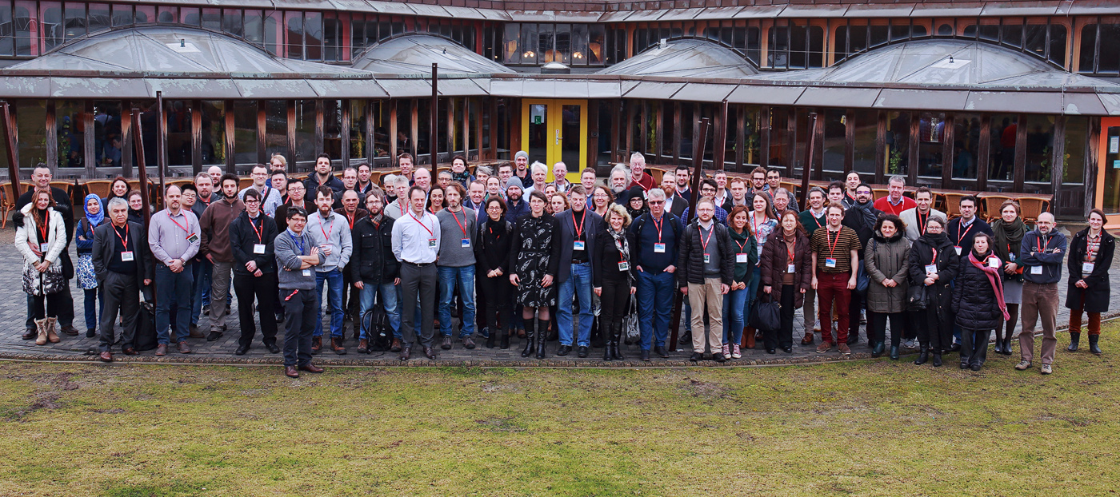
ES1206: Advanced GNSS tropospheric products for monitoring severe weather and climate
Jonathan.jones@metoffice.gov.uk
http://www.cost.eu/COST_Actions/essem/ES1206

