Slide 1

High-resolution daily gridded minimum, mean and maximum temperature datasets for Germany and river catchments
Stefan Krähenmann, Andreas Walter and Simona Höpp
Deutscher Wetterdienst
Zentrales Klimabüro

Slide 2

Overview
Motivation and concept
Data basis
Analysis of 2 m temperature
Results
Evaluation of temperature analysis

Slide 3
Dataset required to bias-correct regional climate projection data
  Both bias-corrected RCM data and observational grids serve as input data for impact modelling and related studies within Network of Experts
  The ultimate goal being the determination and implementation of adaptation measures in order to enhance the resilience of roads
High-resolution grids of minimum and maximum temperature for various applications including technical meteorology, agricultural meteorology
Presentation by S. Hänsel: “Assessing weather related risks to the German transport infrastructure” (EMS2017-606) on Tuesday, 05.09.17 at 15:00–15:15 within session OSA2.2 Spatial Climatology

Slide 4
Requirements on the temperature dataset
High spatial resolution and precision
True histogram and spatial variability
  All available observations fulfilling basic quality requirements used
  Temporal variations in the error structure
  Not applicable to trend analysis
Method for temperature interpolation in complex topography
Frei, 2014: Daily temperature maps for Switzerland; non-linear temperature profile & non-Euclidean distances
Hiebl, and Frei, 2015: Daily minimum and maximum temperature maps for Austria; non-linear temperature profile, non-Euclidean distances & urban heat island effect
Krähenmann et al., 2016: Hourly temperature maps for Germany; non-linear temperature profile, non-Euclidean distance, urban heat island effect and cloudiness

Slide 5
Overview
Motivation and concept
Data basis
Analysis of 2 m temperature
Results
Evaluation of temperature analysis

Slide 6
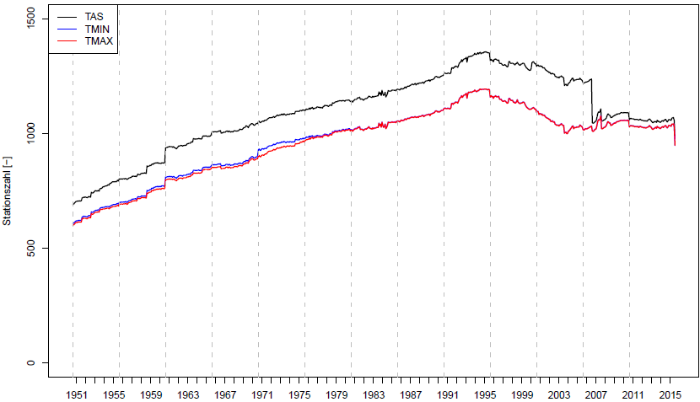

Slide 7
Overview
Motivation and concept
Data basis
Analysis of 2 m temperature
Results
Evaluation of temperature analysis

Slide 8
Configuration and adaptations
Daily temperature extremes
Sub regions of the background field
Urban heat island
Accounting for coastal distance
Simplification of distance measure

Slide 9
Consistency
To ensure consistency between TAS, TMIN and TMAX, TAS is primarily interpolated in two steps
Lapse rates derived in 13 regions
  Background field
Interpolation of residuals
Two-step interpolation of TMIN- and TMAX-deviations to TAS
Lapse rates derived in 13 regions
Interpolation of residuals

Slide 10
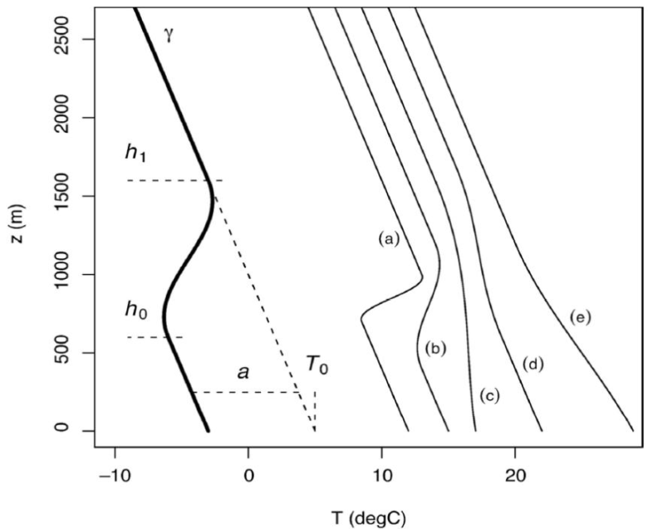
Background field
Non-linear temperature lapse rate
  Representative on macro scale
  Temperature inversions of various depths allowed
*Frei, 2014

Slide 11
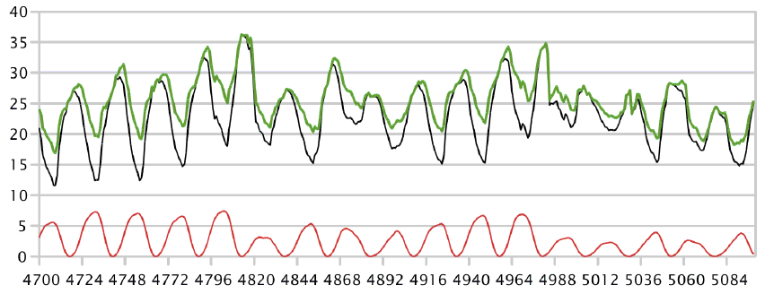
Urban heat island (UHI)
UHI effect spoils urban time series
Distances between grid node and station increased basing on UHI-potential, depending on
  City size and location within an agglomeration
  Time of day and season (alters UHI-based distance penalty)
  Current weather conditions (alters UHI-based distance penalty)
– Berlin
– Potsdam
– UHI-effect
Temperature [°C]
Hour since the begin of year

Slide 12
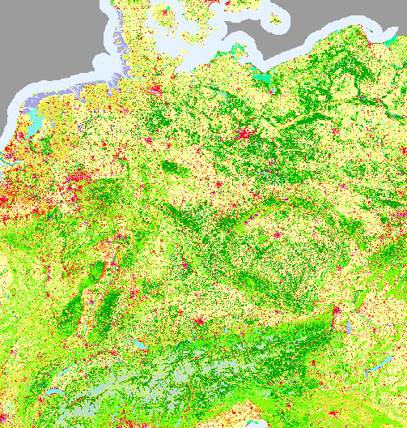
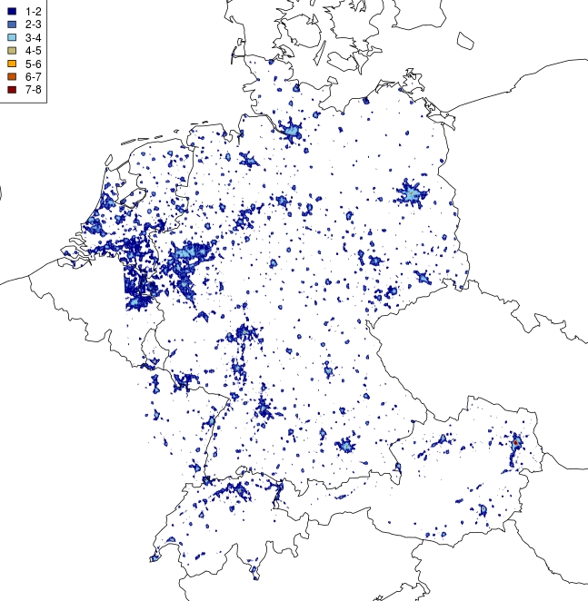
CORINE land use dataset*
Maximum UHI effect [°C]
Derive maximum UHI effect from CORINE land use
*COPERINICUS

Slide 13
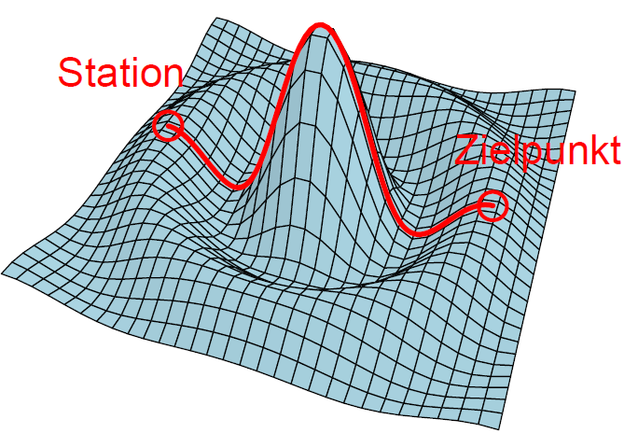
Euclidean distance (λ = 0)
Cross the mountain
Target
Down to the valley

Slide 14
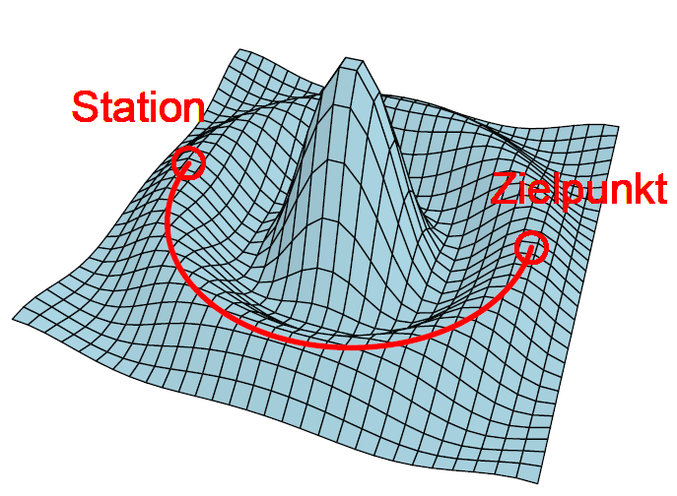
Non-Euclidean distance (λ >> 0)
Here:
Only account for elevation difference
Go around the mountain
Target
Stay on
elevation line

Slide 15
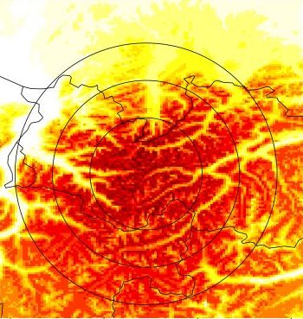
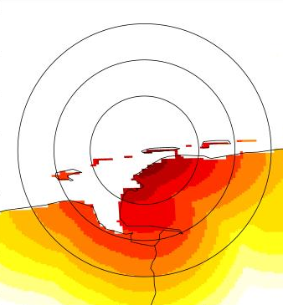
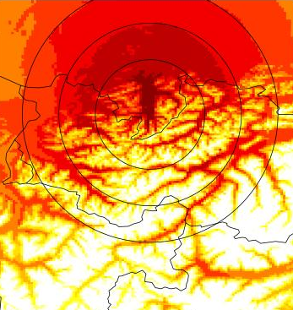
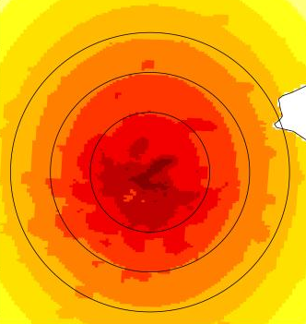
Peak z.pen=150
Coast c.pen=2
Residual field
Models local structures not captured by the lapse-rate
Cold pools, Foehn effect
Weighting scheme derived from modified distances:
Distance ~ Δlat, Δlon, z.pen*Δheight, c.pen*Δdist_to_coast, uhi.pen*ΔUHImax
  z.pen: relative weighting of vertical distance
  c.pen: relative weighting of distance to coastline
  uhi.pen: relative weighting of difference in UHImax
  z.pen/k.pen/uhi.pen = 0 => Euclidian distance
Valley z.pen=150
Berlin uhi.pen=0.25

Slide 16
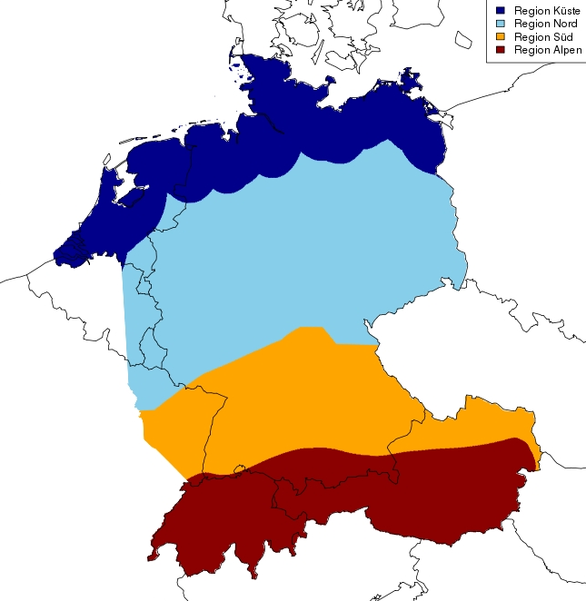
Derivation of distance penalties
Independently chosen in four regions
Unequal complexity of terrain & proximity to the coast requires definition of sub regions
  penalty depends on weather conditions
  penalty depends on difference between air and sea temperature

Slide 17
Overview
Motivation and concept
Data basis
Analysis of 2 m temperature
Results
Evaluation of temperature analysis

Slide 18
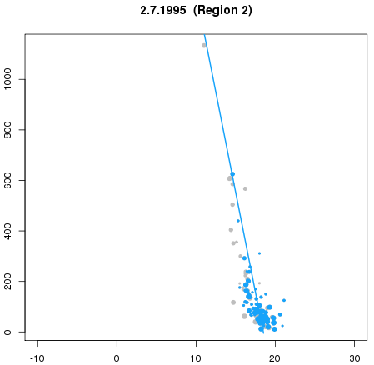
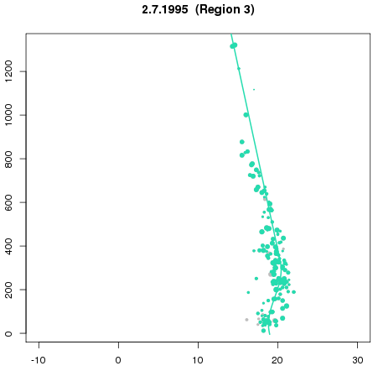
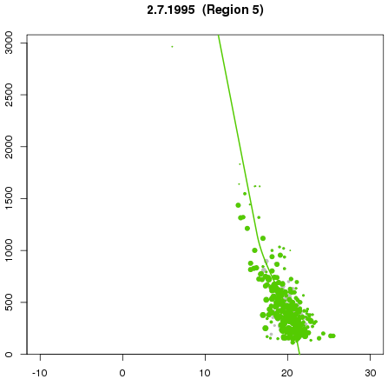
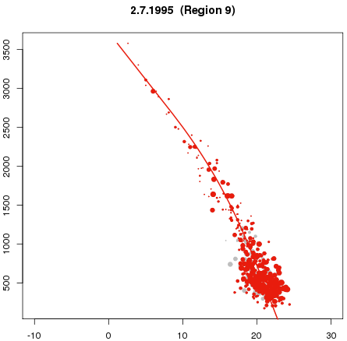
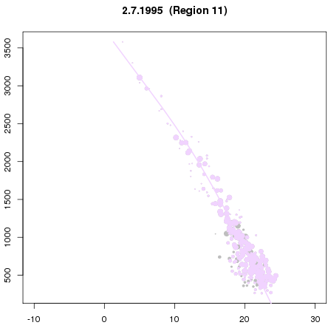
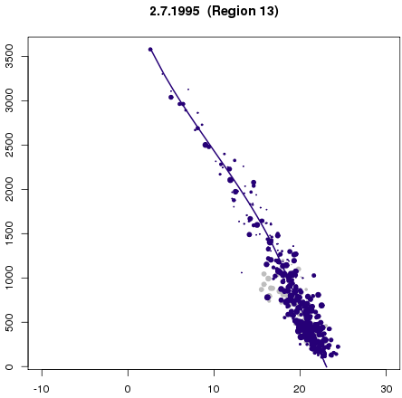
Profiles for daily mean temperature (2.7.1995)
UHI- and cold pool -
station

Slide 19
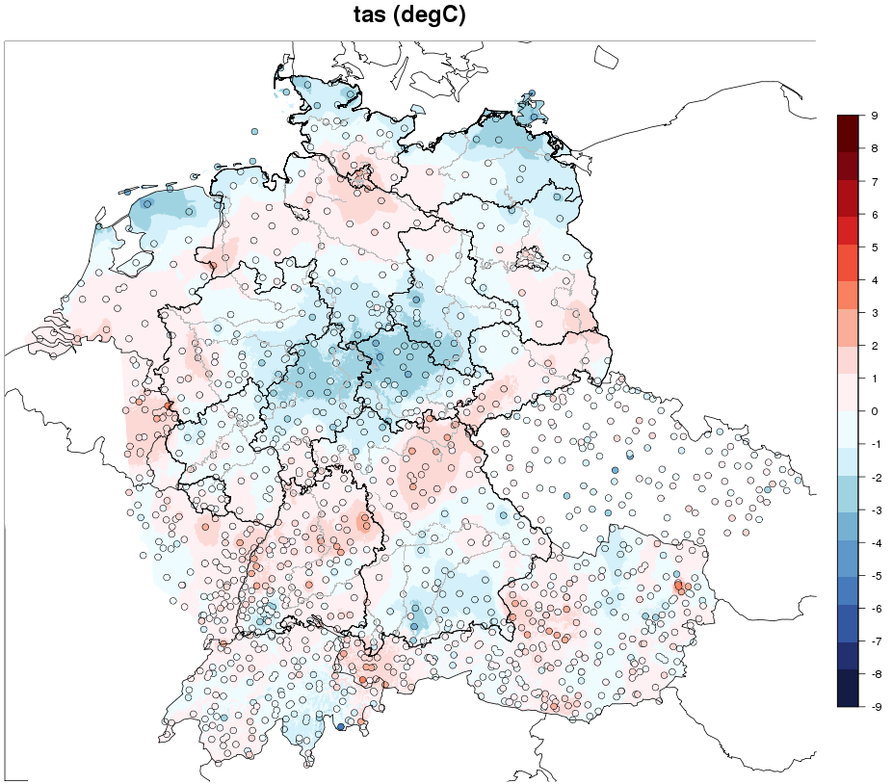
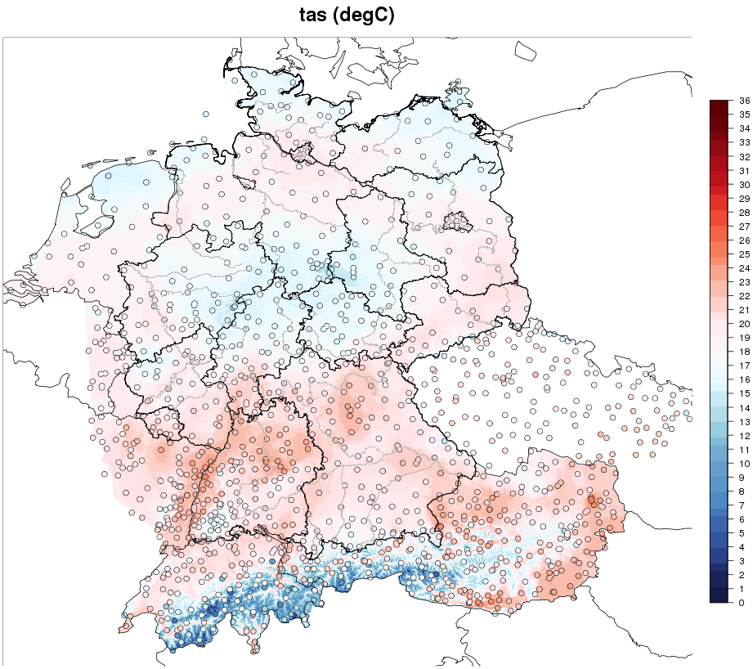
Residuals & analysis 2.7.1995 TAS
Results
Temperature analysis [°C]

Slide 20
Overview
Motivation and concept
Data basis
Analysis of 2 m temperature
Results
Evaluation of temperature analysis

Slide 21
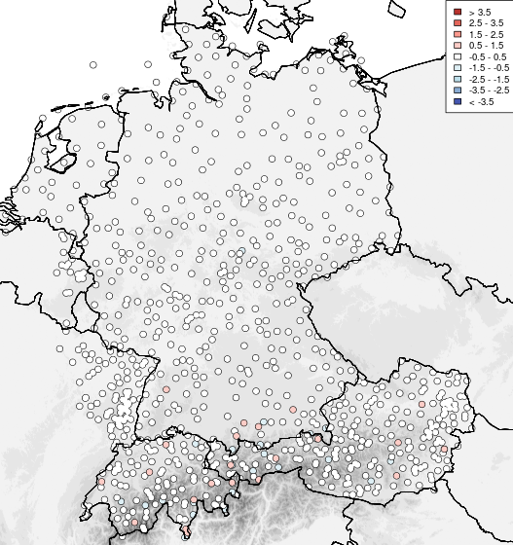
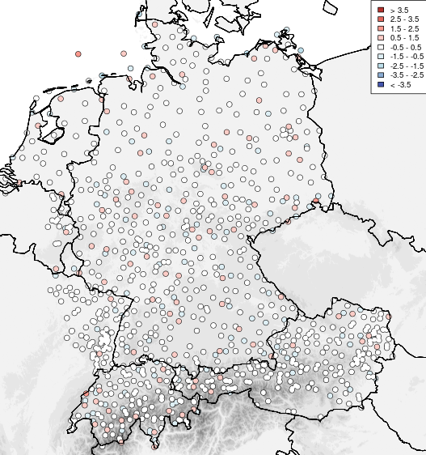
Leave-one-out cross validation (1951-2015)
Bias TAS (DJF)
Bias TAS (JJA)
[°C] | BIAS | MAE
TAS | -0.01 | 0.57
TMIN | -0.02 | 0.66
TMAX | 0.02 | 0.61

Slide 22
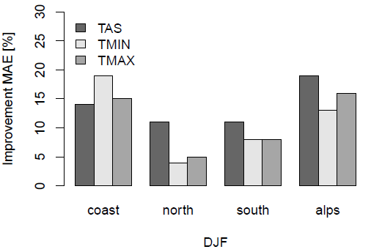
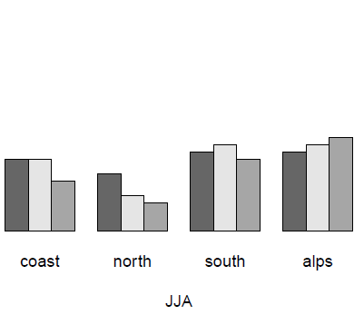
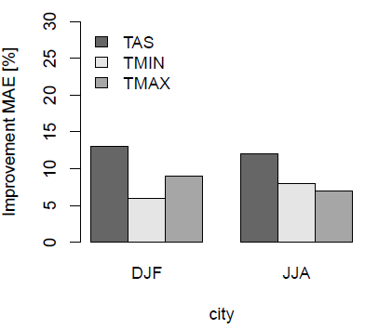
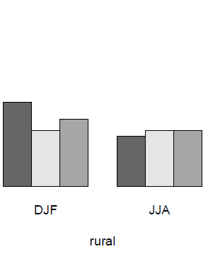
Evaluation
MAE-Improvement [%] due to modified distances vs. eucl. distances (1995-2012)
MAE-Improvement [%] when accounting for UHI (1995 – 2012)

Slide 23
Conclusions
Temperature dataset
Daily mean and extremes
Spatial resolution 1 km² and 25 km²
1.Jan.1951 – 31.Dec.2015
Interpolation method suitable for regions with variable topography
Methodological adaptations: UHI-effect, distance to coast
UHI-correction improved temperature estimates in urban areas
MAE 0.6°C for mean temperature and 0.7°C for extremes
Consistency of mean temperature and extremes

Slide 24
Literature
http://www.bmvi-expertennetzwerk.de/DE/Home/home_node.html
Frei, 2014: Interpolation of temperature in a mountainous region using non-linear profiles and non-Euclidian distances. Int. J. Climatol. 24, 1585-1505.
Hiebl, and Frei, 2015: Daily temperature grids for Austria since 1961 – concept, creation and applicability. Theor. Appl. Climatol. Doi: 10.1007/s00704-015-1411-4.
Krähenmann et al., 2016: High-resolution grids of hourly meteorological variables for Germany. Theor. Appl. Climatol. Doi:10.1007/s00704-016-2003-7.
Wienert, U., F. Kreienkamp, A. Spekat, and W. Enke, 2013: A simple method to estimate the urban heat island intensity in data sets used for the simulation of the thermal behavior of buildings. Met. Z., 22(2), 179-185.

Slide 25
Appendix

Slide 26
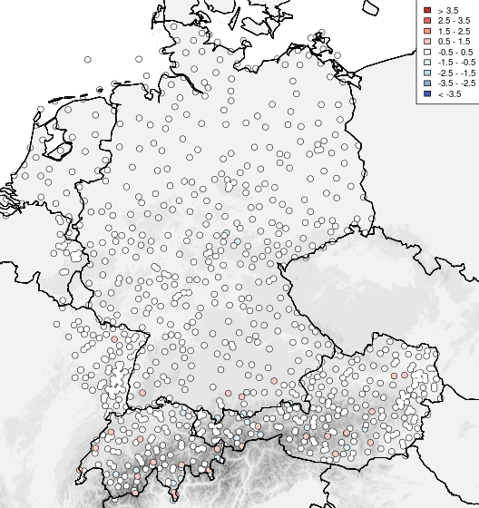
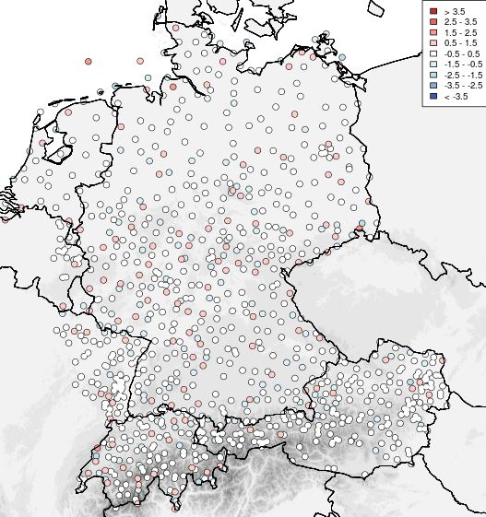
Evaluation (1995-2015)
Bias TMIN (DJF)
Bias TMIN (JJA)

Slide 27


Evaluation (1995-2015)
Bias TMAX (DJF)
Bias TMAX (JJA)

Slide 28
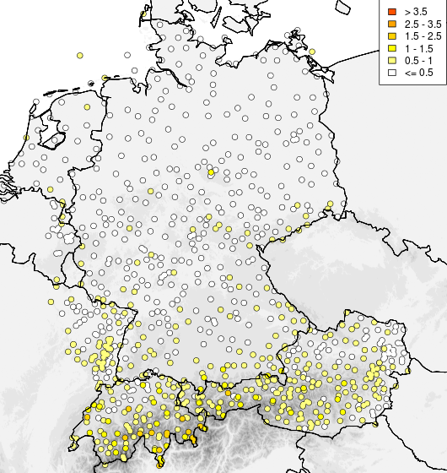
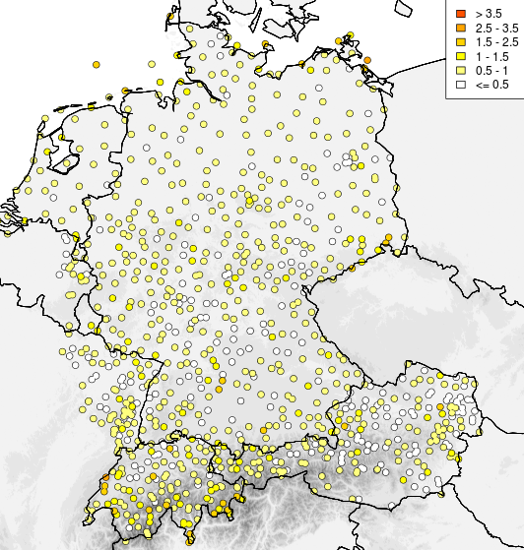
Evaluation (1995-2015)
MAE TAS (DJF)
MAE TAS (JJA)

Slide 29
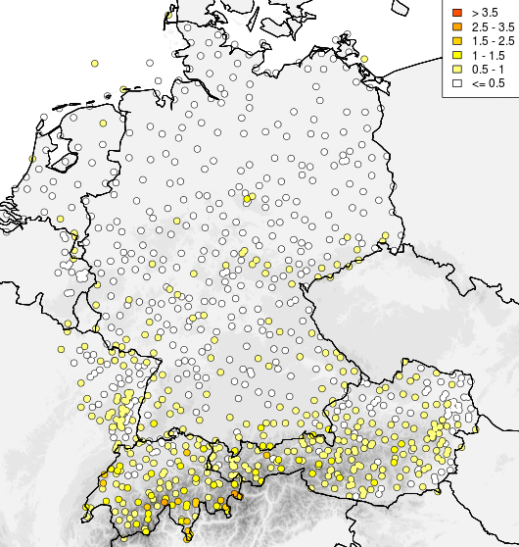
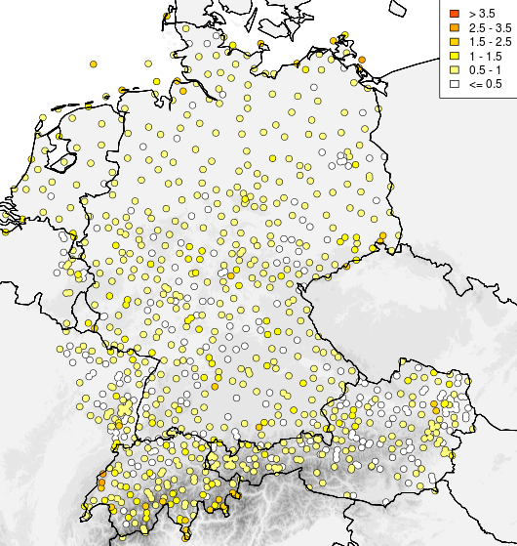
Evaluation (1995-2015)
MAE TMIN (DJF)
MAE TMIN (JJA)

Slide 30
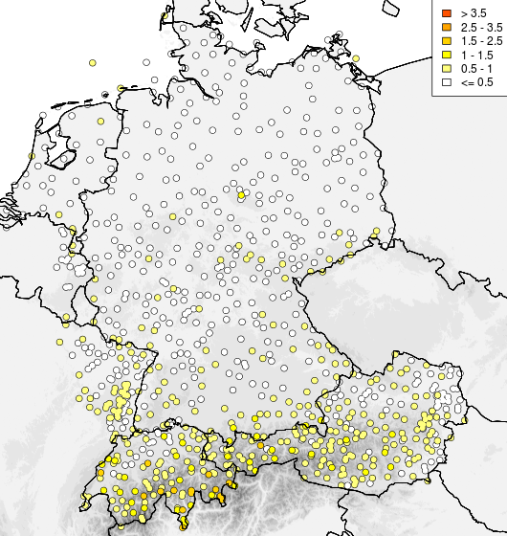
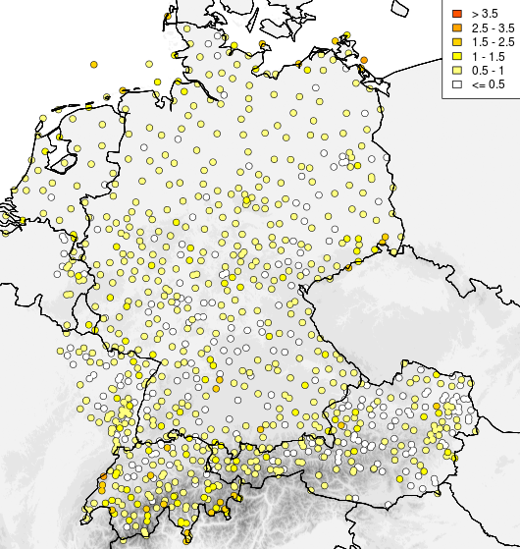
Evaluation (1995-2015)
MAE TMAX (DJF)
MAE TMAX (JJA)

Slide 31
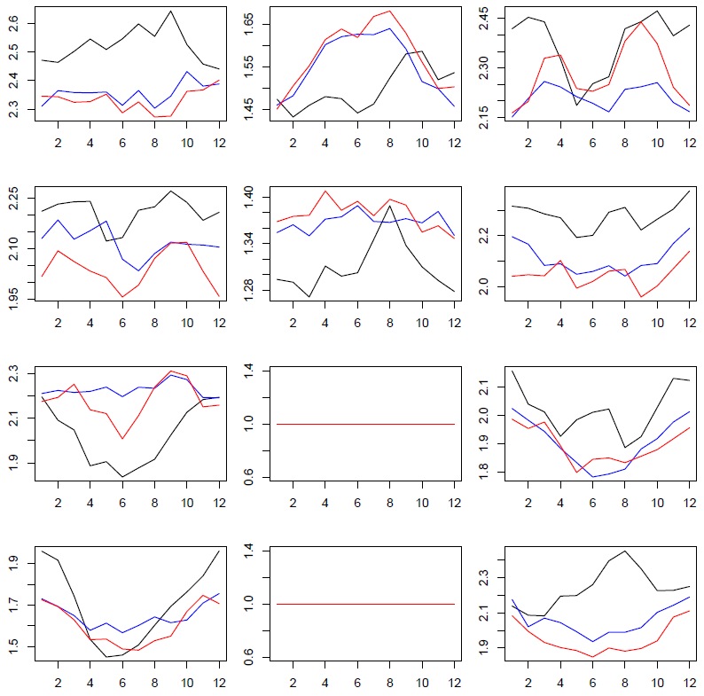
Annual cycle of distance penalties
elevation
Dist. to coast
UHI
coast
north
south
alpine

Slide 32
Overlay of the urban heat island effect (I)
Estimation of maximal UHI effect basing on city population
Population | UHI_{max} [K]
10.000 | 4,0
100.000 | 6,0
500.000 | 7,4
1.000.000 | 8,0
3.000.000 | 9,0
UHI_{max}: maximal UHI effect [K] pop: City population
UHI_{max} occurs in low-wind, cloudless weather conditions.

Slide 33
Overlay of the urban heat island effect (II)
The current UHI depends on the weather condition (wind speed, cloudiness).
UHI(t): UHI [K] at t
t: time (hour)
cf(v₂₄): correction factor due to wind speed (average over 24 h before t)
cf(N₂₄): correction factor due to cloudiness (average over 24 h before t )
cf(t): correction factor of UHImax due to its daily cycle

Slide 34
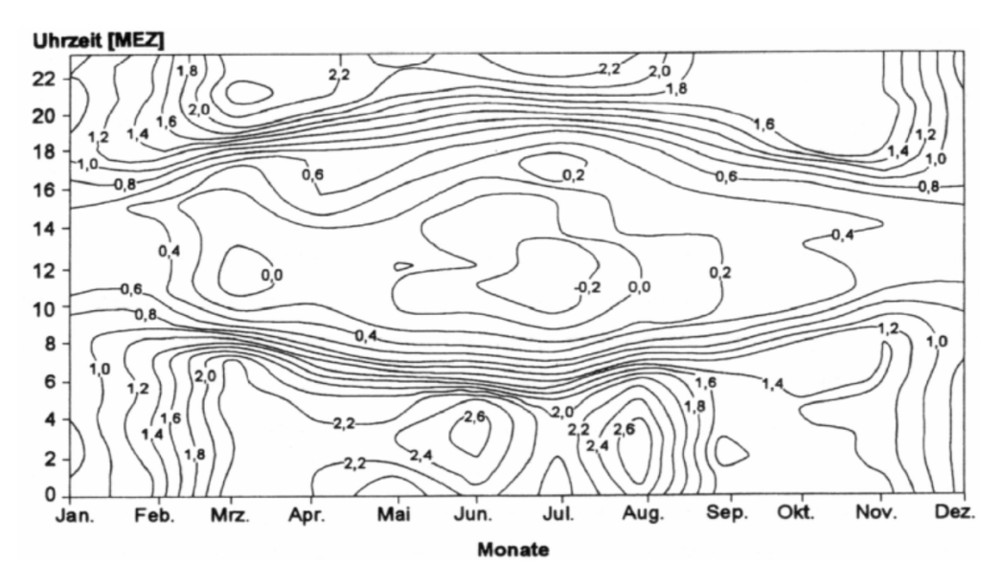
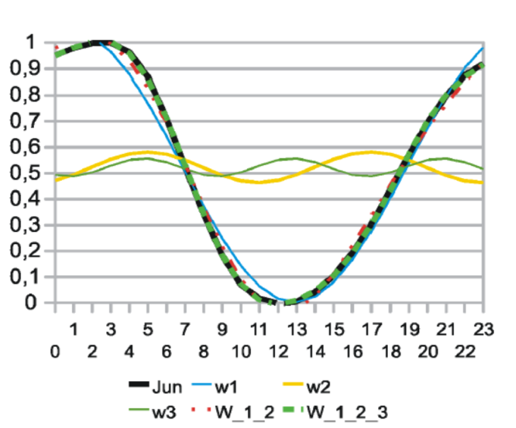
Overlay of the urban heat island effect (III)
Approximation of the UHI cycle bases on published observations
cf(t)
Quelle: CEC
Diurnal UHI cycle as observed for Düsseldorf (KUTTLER, 1997)
Correction factor cf(t) for June
Development of the correction factor cf(t) for daily cycle using a Fourier series:

Slide 35
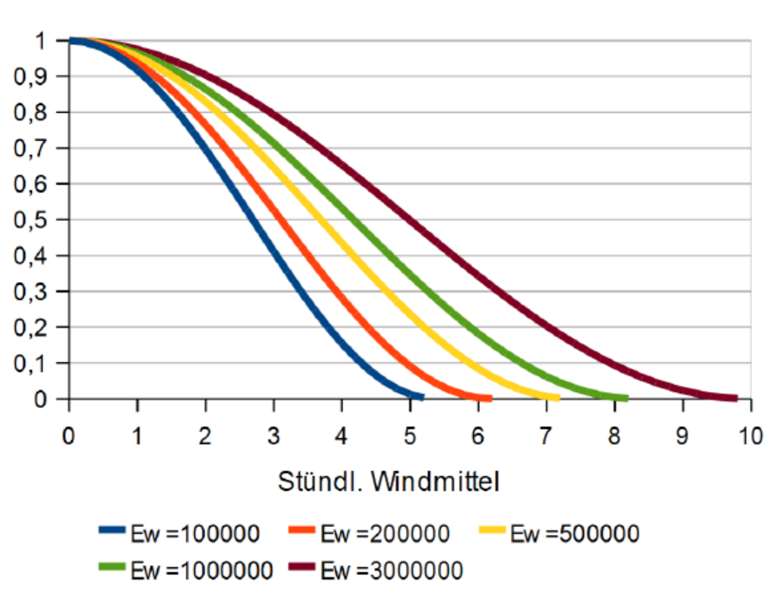
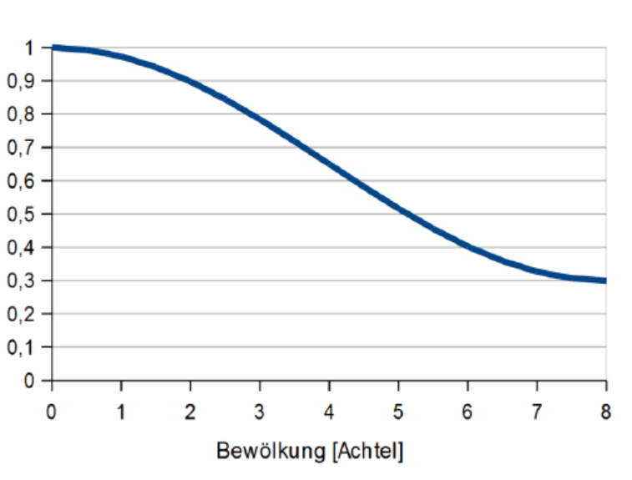
Overlay of the urban heat island effect (IV)
Estimation of the weather influence (cloudiness, wind speed) on UHI
Correction factor (cf) depending on wind (24 h average) and city population (Ew)
Correction factor (cf) depending on cloudiness (24 h average)
cf(v₂₄)
cf(N₂₄)
Quelle: CEC

Slide 36
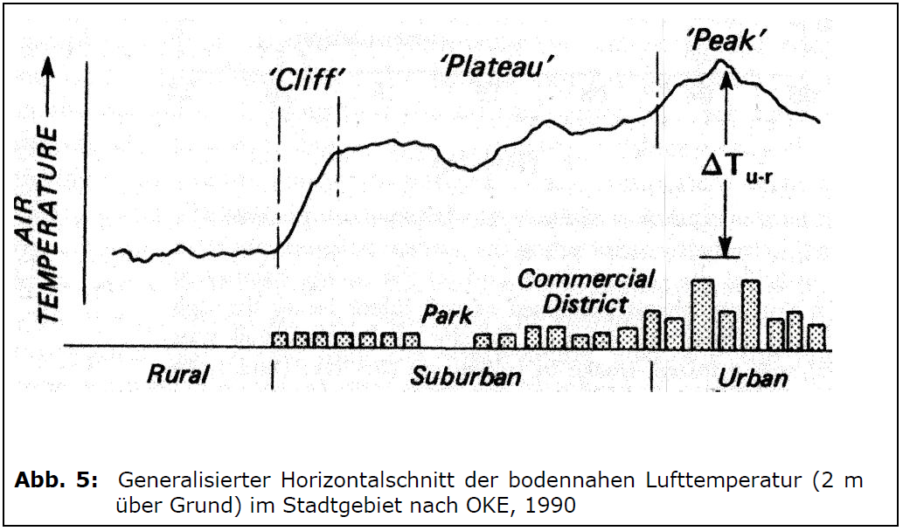
Overlay of the urban heat island effect (V)
The UHI is modified by the local building structure.
0
0,5
0,7
1

Slide 37
Estimation of the UHI effect at the stations
Assignment of an UHI potential (0-1) depends on land use data
  CORINE land use data of 100 m spatial resolution (50 classes)

Slide 38
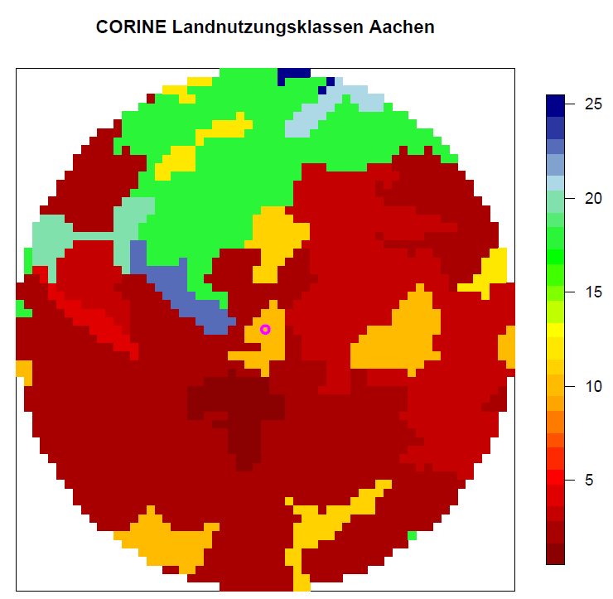
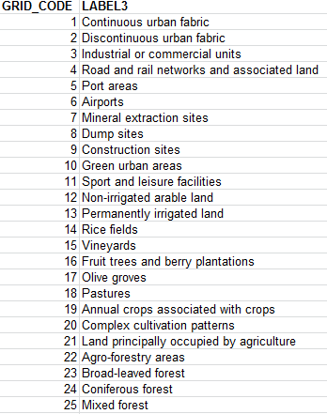
CORINE land use classes for Aachen
1 km

Slide 39
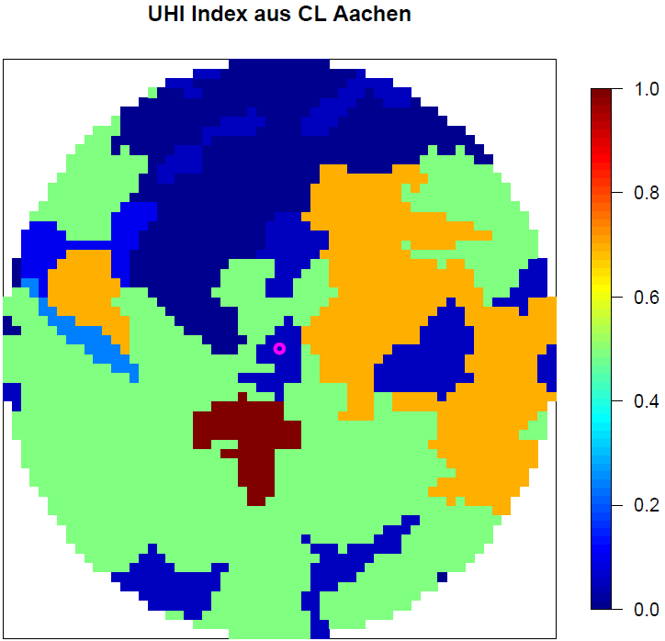
Assignment of UHI potential to CORINE land use classes: Aachen
UHI Potential
Assignment to land use classes:
Continuous urban fabric: 1, discontinuous urban fabric: 0.5, industrial areas: 0.7, green urban areas: 0.05, …
1 km

Slide 40
Virtual city population & location within an agglomeration
Virtual city population (Ew):
Location within an agglomeration:
      UHI potential > 0.5 => city center
      UHI potential 0.2 – 0.5 => transitional area
      UHI potential 0 – 0.2 => outskirts
      UHI potential 0 => rural

Slide 41
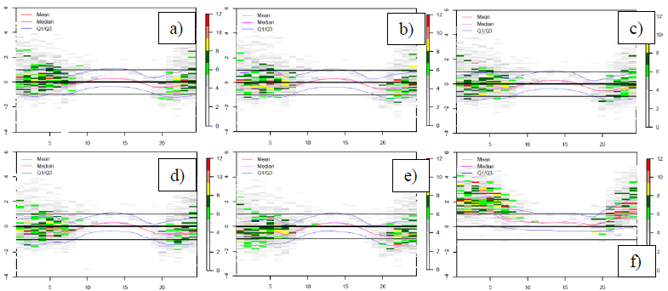
Ideal averaging radius for UHI potential (Munich)
UHI potential –> virtual population density -> UHI-effect
100m
400m
1000m
2500m
5000m
Largest differences at night
T-differences between Munich city & Munich airport
a-e) UHI-effect removed from temperature series, f) no UHI-removal

Slide 42
Ideal averaging radius for UHI potential (Munich)
UHI potential –> virtual population density -> UHI-effect
100m
400m
1000m
2500m
5000m
Differences much smaller
T-differences between Munich city & Munich airport
a-e) UHI-effect removed from temperature series, f) no UHI-removal

Slide 43
Motivation and concept
  In Germany the adaptation of the impacts of climate change is framed by the German Strategy for Adaptation to Climate Change (DAS)
  The Federal Ministry of Transport and Digital Infrastructure (BMVI) – being responsible for the transport infra structure in Germany – funded a comprehensive national research program on safe and sustainable transport in Germany
  One column of this project is the “Adapting transport and infra structure to climate change and extreme weather events”

Slide 44
Evaluation
Leave-one-out cross validation
1951 – 2015
1995 – 2015
[°C] | BIAS | MAE | RMSE
TAS | -0.01 | 0.57 | 0.72
TMIN | -0.02 | 0.66 | 0.85
TMAX | 0.02 | 0.61 | 0.78
[°C] | BIAS | MAE | RMSE
TAS | 0.00 | 0.54 | 0.79
TMIN | -0.02 | 0.65 | 0.92
TMAX | 0.02 | 0.60 | 0.85

Slide 45
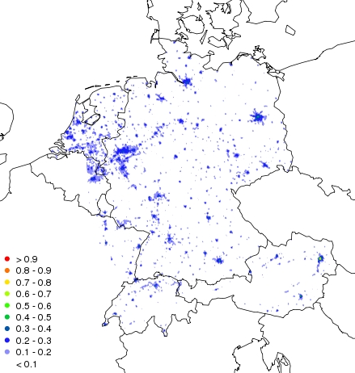
Residuals & analysis 2.7.1995 TAS
UHI potential 25 km² (=> Pop)
Assignment for grid nodes:
Continuous urban fabric: 1, discontinuous urban fabric: 0.5, green urban areas: 0.05, …
UHI potential averaged over 25 grid nodes (2500 values)
Required to derive virtual city population

Slide 46
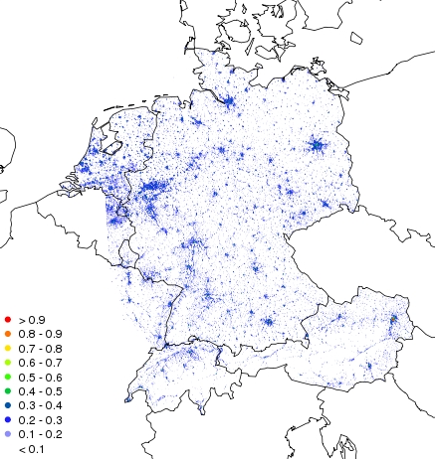
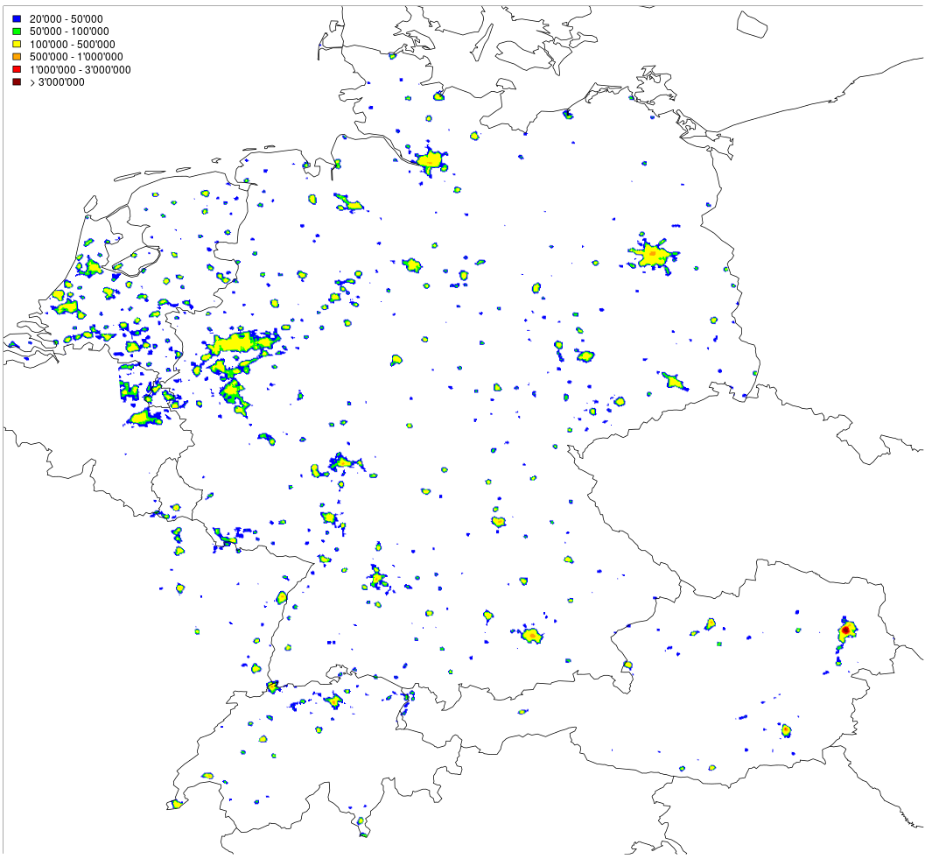
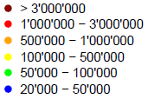
Residuals & analysis 2.7.1995 TAS
Results
Virtual city population
UHI potential 1 km² (=> location)
Assignment for grid nodes:
Continuous urban fabric: 1, discontinuous urban fabric: 0.5, green urban areas: 0.05, …
UHI potential averaged over one grid node (100 values)
Required to derive the location within an agglomeration

Slide 47
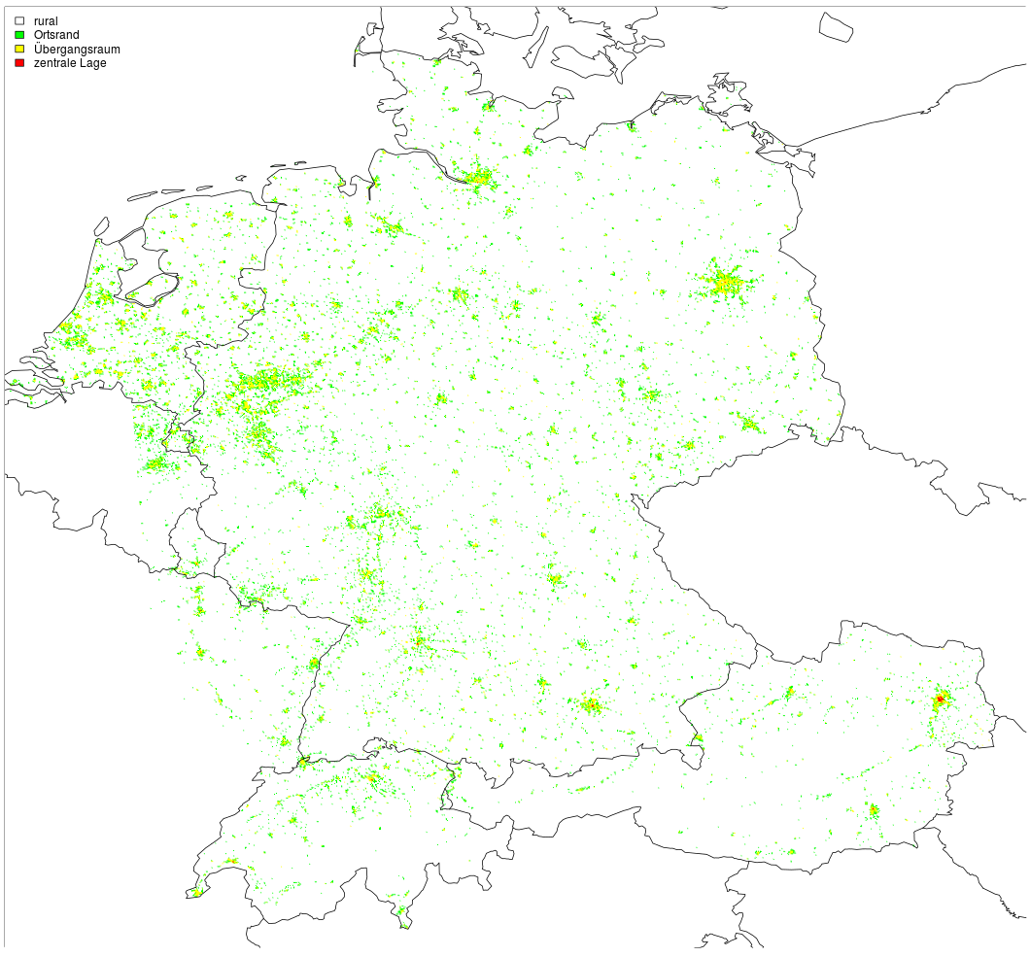
Residuals & analysis 2.7.1995 TAS
Results
Location within agglomeration
City center
Transitional area
outskirts
rural

Slide 48
Evaluation
Leave-one-out cross validation (1995 – 2012)
Pseudo-non-Euclidean
Non-Euclidean
[°C] | 20 - 04 UTC | 10 - 16 UTC | Tmax – Tmin
Bias | 0.0 | 0.1 | -0.1
MAE | 0.8 | 0.7 | 1.1
RMSE | 1.1 | 0.9 | 1.4
[°C] | 20 - 04 UTC | 10 - 16 UTC | Tmax – Tmin
Bias | 0 | 0.1 | -0.2
MAE | 0.8 | 0.7 | 1.1
RMSE | 1.0 | 0.9 | 1.4

Slide 49
Evaluation
Leave-one-out cross validation
Bias [°C] with / without UHI-effect
1995 – 2012
Bias [°C] | Not accounted for UHI-effect | Accounted for UHI-effect
Urban | -0.2 | 0
Rural | 0.1 | 0

Slide 50
Evaluation
Leave-one-out cross validation
1951 – 2015
Improvement due to modified distances:
[°C] | BIAS | MAE | RMSE
TAS | -0.01 | 0.57 | 0.72
TMIN | -0.02 | 0.66 | 0.85
TMAX | 0.02 | 0.61 | 0.78
Impr. RMSE [%] | coast |  | north |  | south |  | alps
 | DJF | JJA | DJF | JJA | DJF | JJA | DJF | JJA
TAS | -3 | -3 | -7 | -5 | -11 | -6 | -18 | -12
TMIN | -2 | -4 | -4 | -3 | -9 | -7 | -12 | -14
TMAX | -3 | -5 | -5 | -3 | -10 | -7 | -14 | -15

