Slide 1
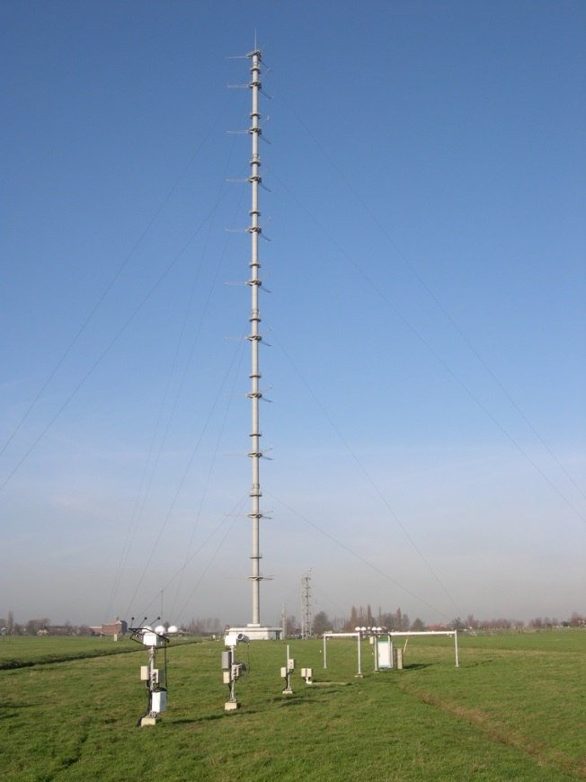
The Nocturnal Surface Energy Budget (SEB) at Cabauw Fred C. Bosveld (KNMI)
Content
Why bother about SEB closure?
How to measure SEB?
What drives the vegetation heat content?
Rough grassland
A freezing case
A dry summer case

Slide 2
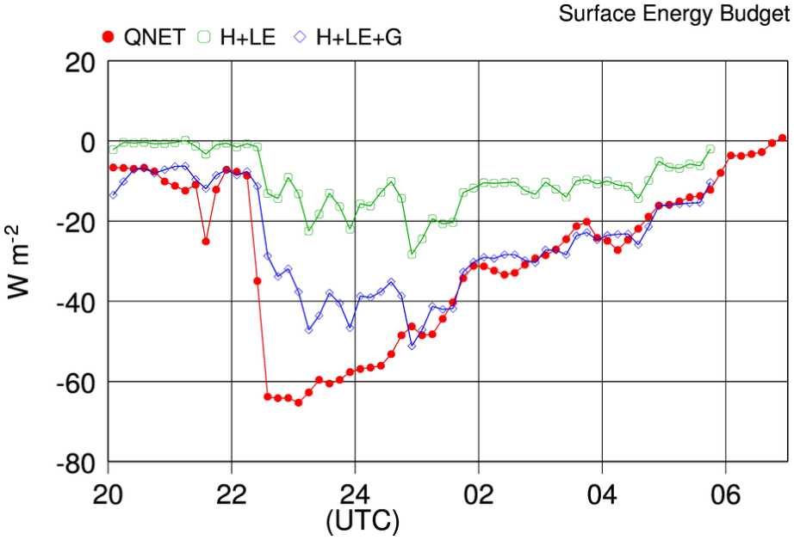
Why bother about Nocturnal SEB closure
A rigorous test on measurement principles
A rigorous test on instrument performance
Day- and night time SEB imbalance may have different causes
Trust in matter and stress flux observations by the EC-method
Improve relevance for model evaluation

Slide 3
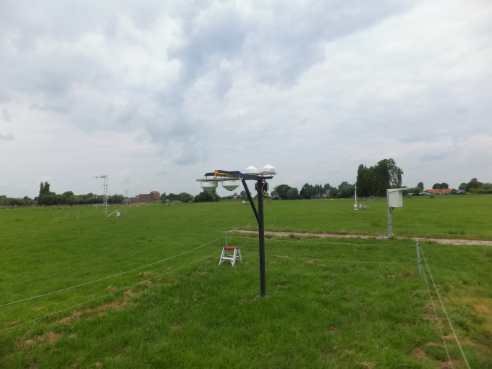
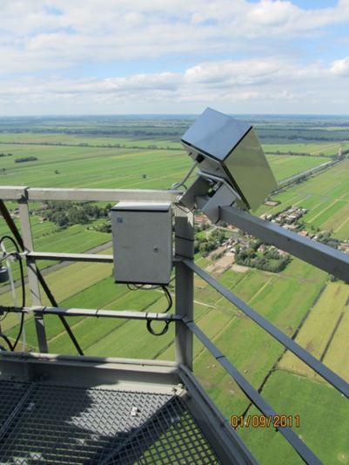
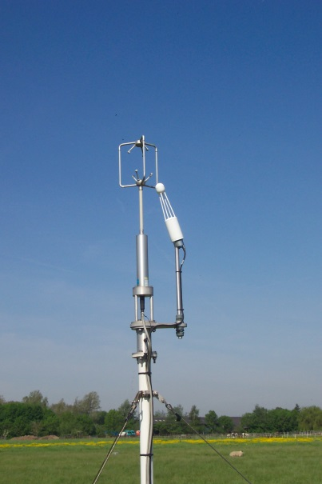
How to measure the SEB (1 of 3)
⬅ Net Radiation (QNET)
Measure the four individual components with
State of the art pyrano- and pyrgeo meters
Ventilated and heated
Radiative Surface temperature ➔
Pyrometer from top of 200 m tower
“Sees” footprint of EC-observations
⬅ Sensible- and latent heat (H+LE)
State of the art sonic anemometer/thermometer
State of the art open path water vapor sensor

Slide 4
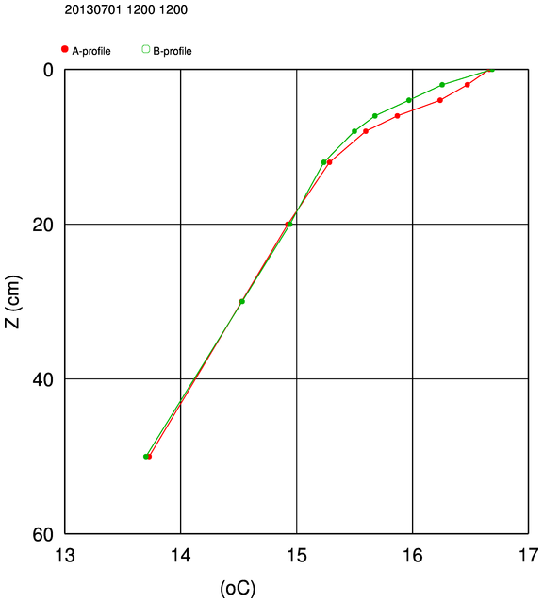
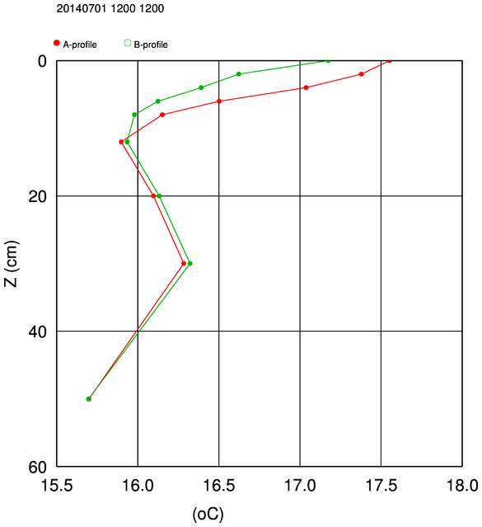
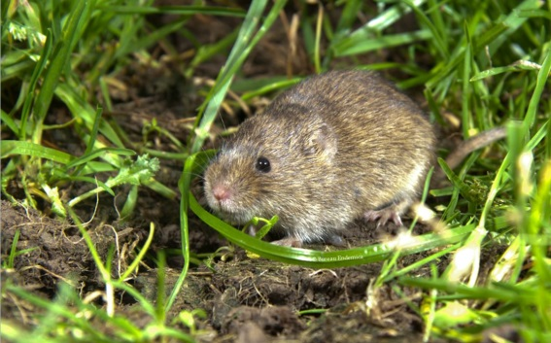
How to measure the SEB (2 of 3)
Self calibrating soil heat flux plates (Hukseflux) 3x2 at 5 and 10 cm
High accuracy temperature profile (KNMI) to extrapolate to surface.
Surface is top of the mineral soil.
Methods: 1) Soil heat flux extrapolated to surface; 2) Soil heat budget
Midday 01 July 2013
Midday 01 July 2014

Slide 5
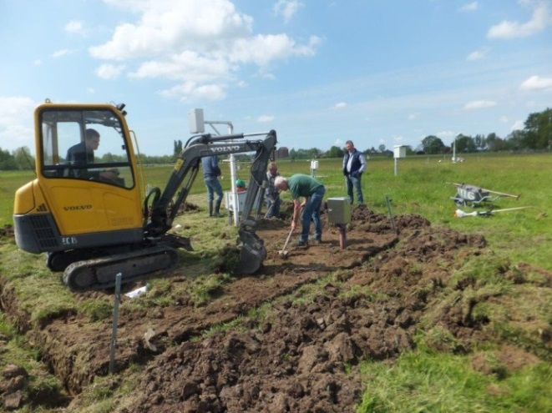
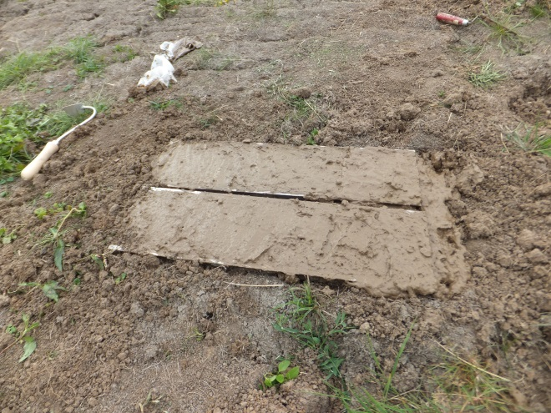
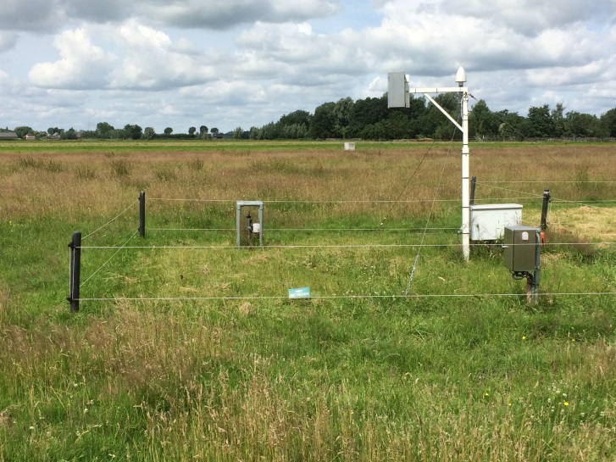
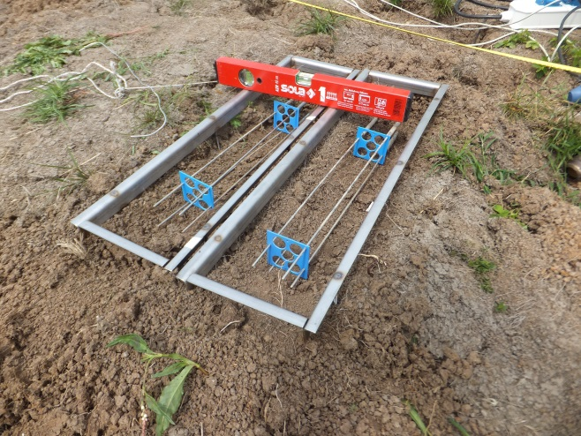
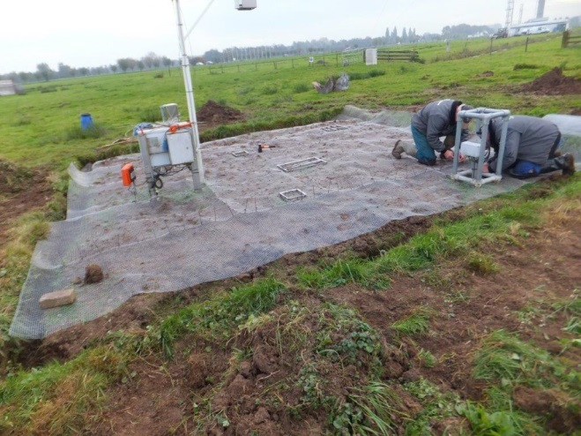
How to measure the SEB (3 of 3)
Wait for spring 2016
Summer 2015

Slide 6
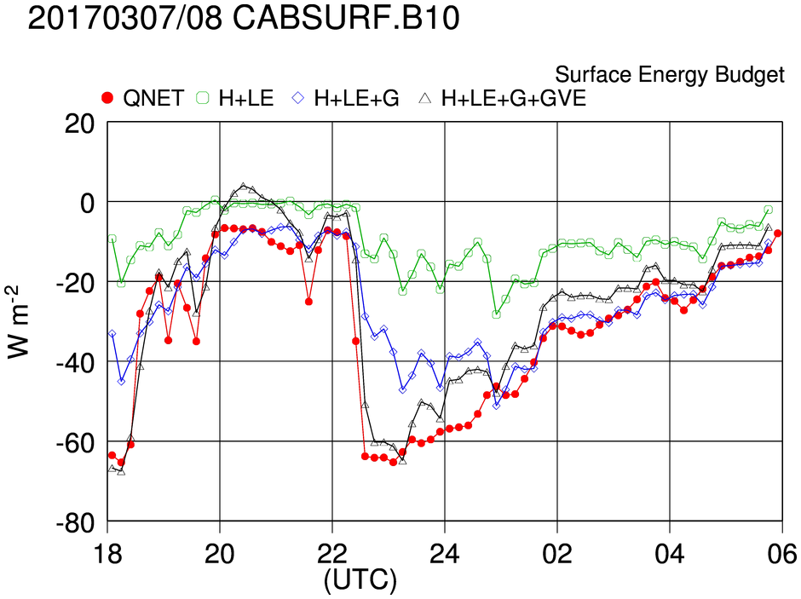
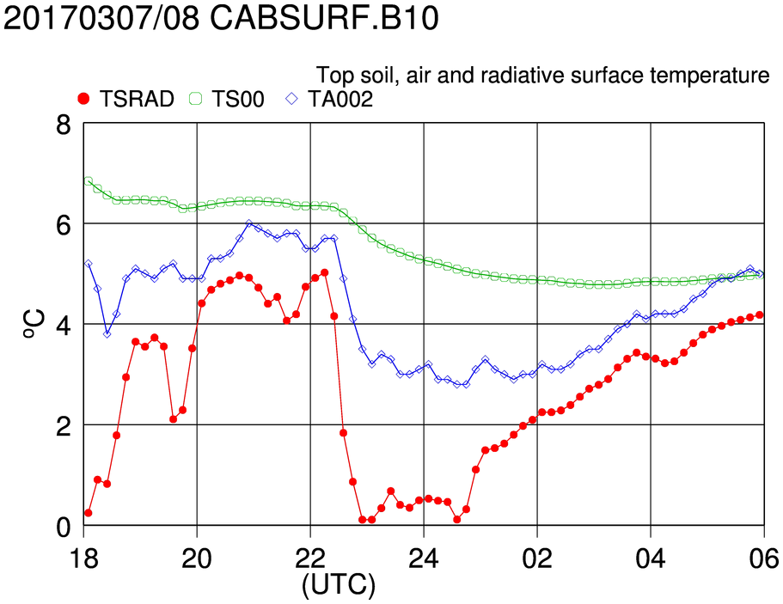
Surface Radiation temperature driving the biomass layer
SEB closure with additional heat storage of:
30 kJ/m²/K (7 mm water) and 1 hour response time.

Slide 7
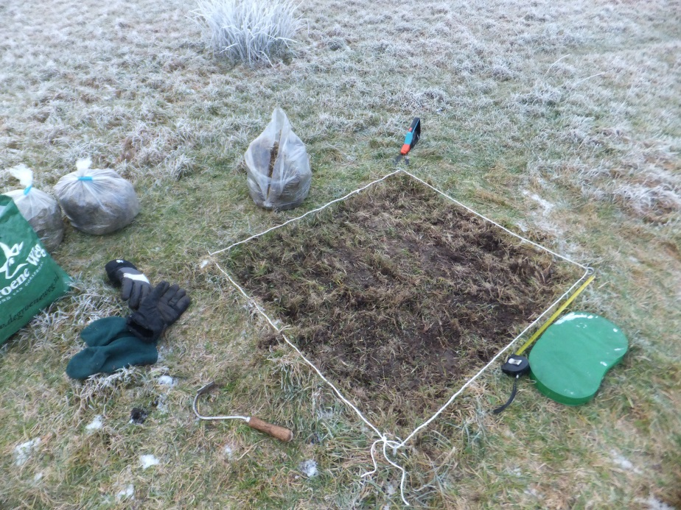
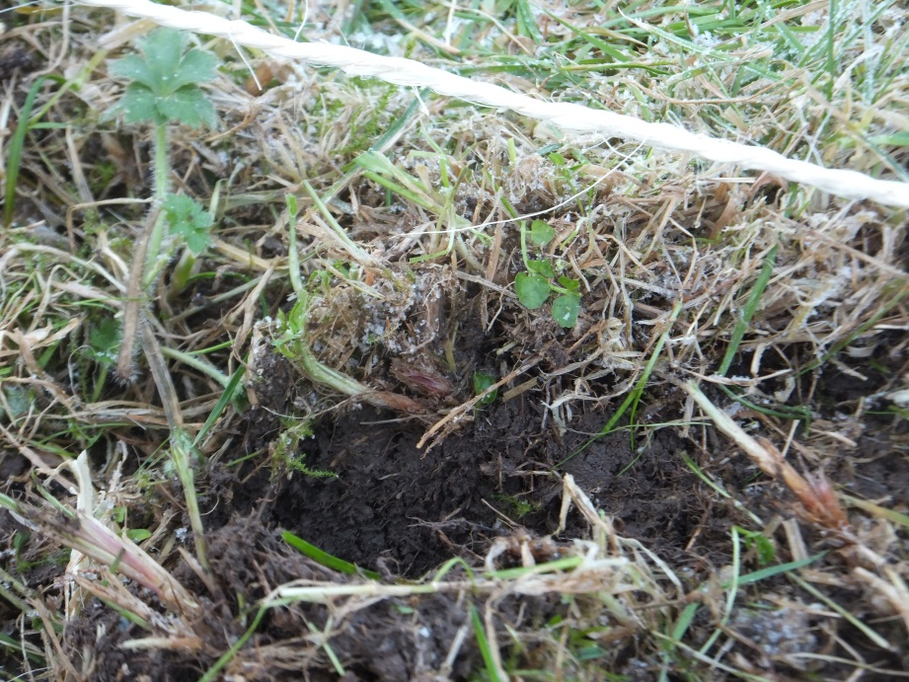
Rough grassland
Layer where bio material dominates
In wet winter periods (winter half year)
Amounts to 7 mm of water
 | Weight | Water content
Grass leaves | 0.90 kg | 87%
Underlayer | 8.60 kg | 70 %

Slide 8
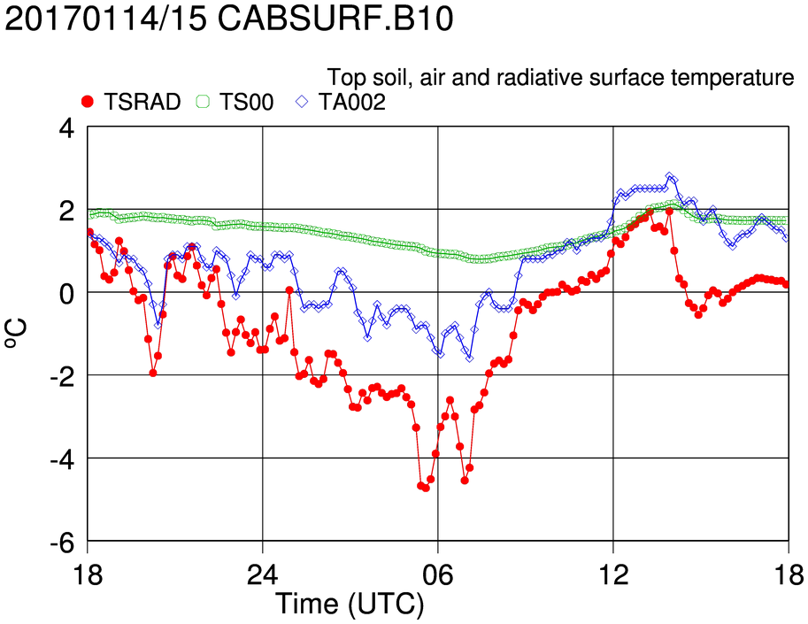
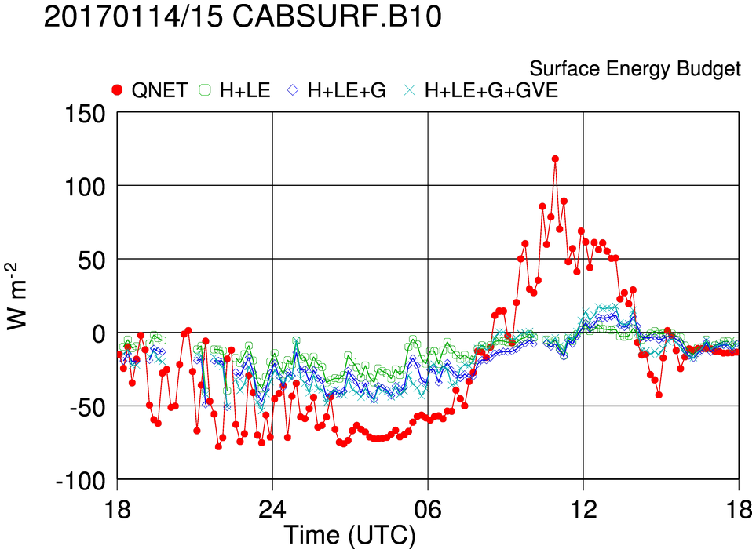
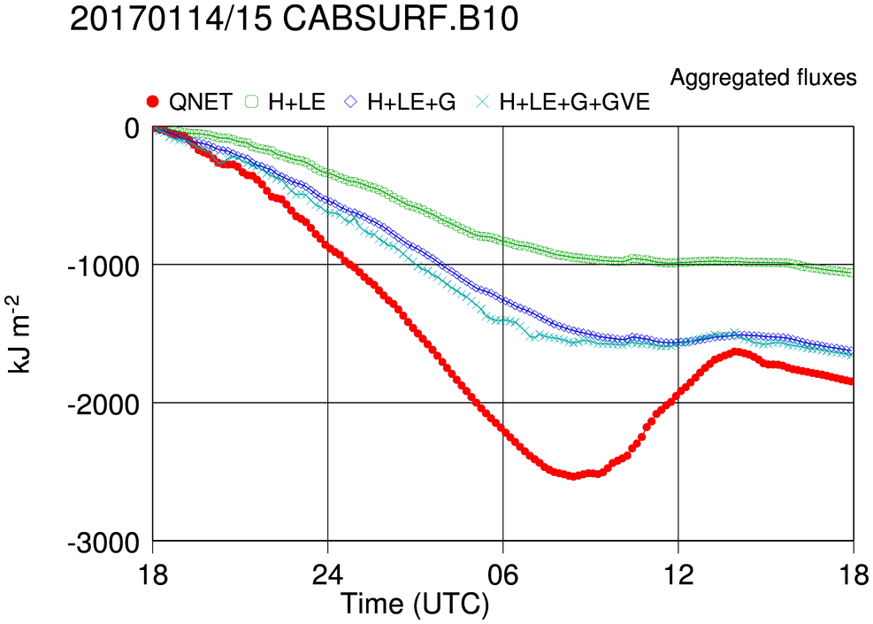
A freezing case
1000 kJ/m2 ( equivalent to 3mm ice formation ) heat released over 12 h period, consumed by ice melting in the next 6 day time hours
Tsoil above freezing
Tair little freezing
Tsrad sign. freezing
In another case where top Tsoil goes just below freezing we find 6 mm of ice formation.

Slide 9
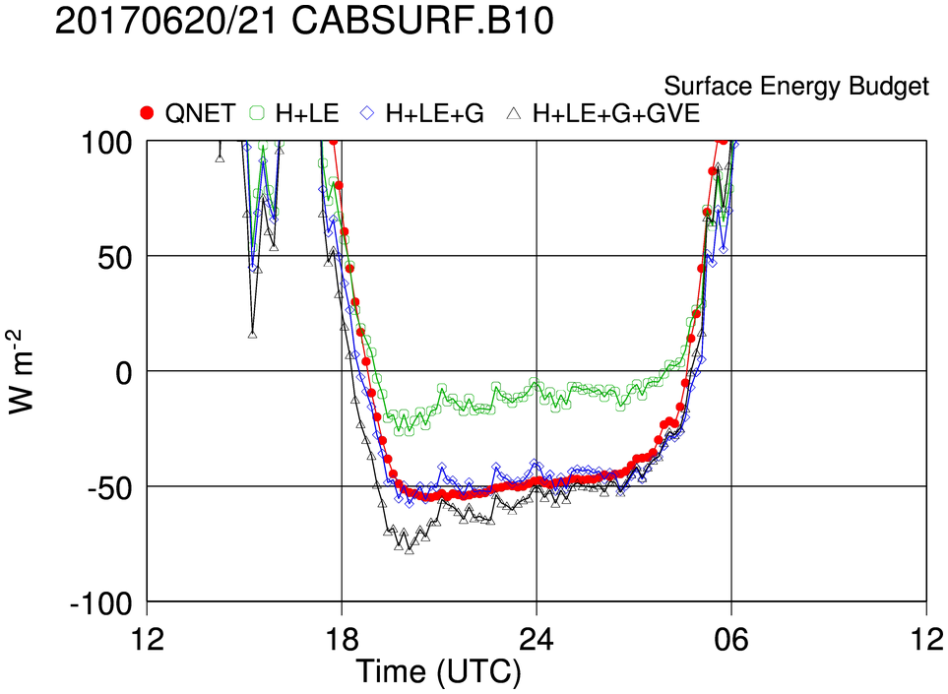
A dry summer case
Night time SEB closure occurs without additional heat storage
Top soil has dried and dead biomass has almost disappeared.

Slide 10
Conclusions
SEB closure is problematic during both night and day
Before studying the physics of SEB imbalance all sorts of observational issues have to be addressed. (corrections, homogeneity,..)
The night time imbalance can be explained by assuming a 7 mm water equivalent heat storage capacity with a response time of 1 hour.
This 7 mm water equiv. is in line with the results of weighing and drying of 1m² of grass and top soil.
This 7mm water equiv. is also in line with a freezing case where the top soil temperature goes just below freezing.
During dry periods in summer the top layer dries out and dead biomass almost disappears. Indeed we find that much of the night time SEB imbalance disappears under these conditions.
This storage term also explains part of the day time SEB imbalance
This may help to better understand the physics behind SEB imbalance during daytime

