Slide 1
Reference Crop Evapotranspiration:
a new LSA SAF product
Henk A.R. de Bruin¹, Isabel F. Trigo^{2,3} and Fred C. Bosveld⁴
¹) Meteorology and Air Quality Wageningen University, Wageningen, The Netherlands (retired)
²) Instituto Dom Luiz, University of Lisbon, 1749-016 Lisbon, Portugal,
³) Instituto Português do Mar e da Atmosfera, IPMA, 1749-077 Lisbon, Portugal
⁴) Royal Netherlands Meteorological Institute (KNMI), de Bilt, The Netherlands

Slide 2
FAO Irr. & dr. paper 56
Concept of Reference Crop Evapotranspiration (E_{ref})
The rate of evapotranspiration from an extensive surface of 8 to 15 cm tall, green grass cover of uniform height, actively growing, completely shading the ground and not short of water”.
Next step: crop water requirement calculated with E_{crop}
crop factors for different agricultural crops available in tables
Rick Allen

Slide 3










The Land SAF Consortium
Instituto Português do Mar e da Atmosfera (IPMA), Portugal
Météo-France (MF), France
Royal Meteorological Institute (RMI), Belgium
Karlsruhe Institute of Technology, Germany
IDL, University of Lisbon, Portugal
UV, University of Valencia, Spain
King College London (KCL), UK
VITO, Belgium
ARSO, Slovenia
NIMH, Bulgaria
Organisation principles
  Algorithms developed and validated by one of the partners
  Algorithms handed over to IPMA for integration and production
  Operational chain in Lisbon (IPMA)
A consortium of 10 Institutions in 8 countries

Slide 4
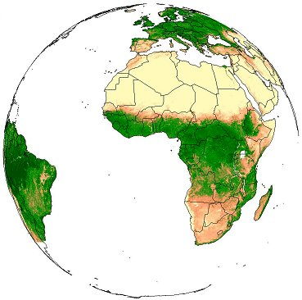
Family of LSA SAF Products:
Surface Radiation
LST
↓LongWave Flux
↓ShortWave Flux
Albedo
Vegetation
State
Water stres
Wild fires
Fraction Veg Cover
Evapotranspiration
Fire Detection
LAI
Reference Evap
Fire Radiative Power
fAPAR
Fire Risk (Europe)
NDVI
MSG
Metop
SEVIRI/Meteosat
Increased level of maturity

Slide 5
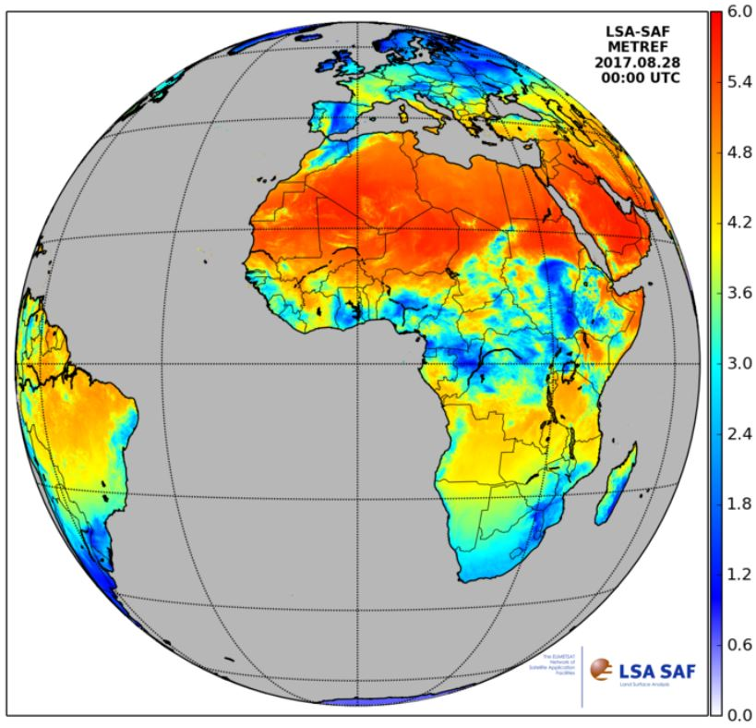
LSA SAF ET_{ref} product operational since February 2017
Daily values for each MSG pixel
archiving from 2005 onwards in progress
Future: Extension to other satellites possible
[mm/day]

Slide 6
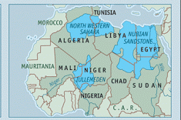
Examples of Application of ET_{ref}
Water Foot Print Calculations, e.g.
How much water is used to produce 1 kg of meat
Climate studies, estimation future water use/scarcity
Drought index
Exploration 'virginal' water aquifers

Slide 7
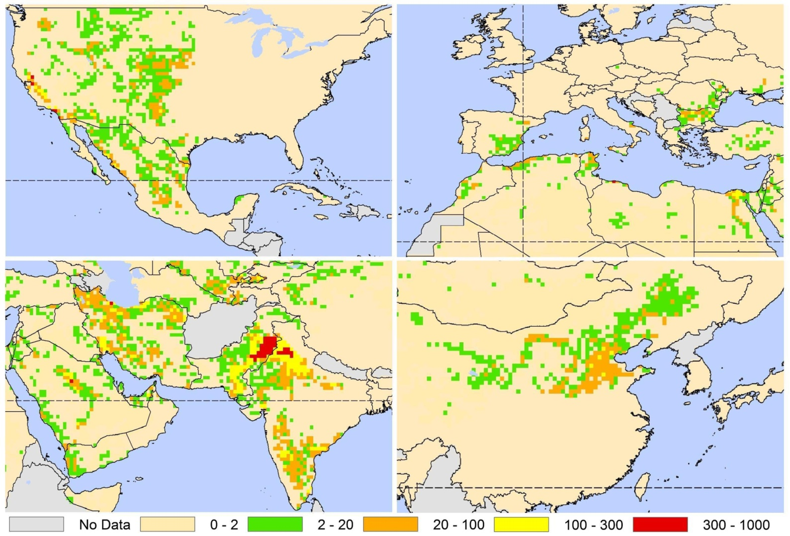
Regions with severe groundwater depletion (more pumping than rainfall) mm/year

Slide 8
LSA SAF estimate of ET_{ref} , see de Bruin et al. (2016), Trigo et al. (in prep.)
meso-scale advection
PBL physics
Thermodynamics
R_{sMSG} = global radiation
R_{ext} is
extraterrestrial
radiation
SEVERI-MSG
This leads to final formula

Slide 9
Schematic picture well-mixed atmospheric boundary layer (daytime)
Free atmosfeer, warm en dry
After sunrise ABL growth
and at the top
warm, dry air is entrained
Into the ABL, causing
'meso-scale advection of
heat
This explains heuristically
the additional 20 W/m2
and why RH < 100%
over well-watered
grass
z
h
Atmospheric
Boundary Layer
q
θ
Specific
humidity
Potential temp.
Surface Layer

Slide 10
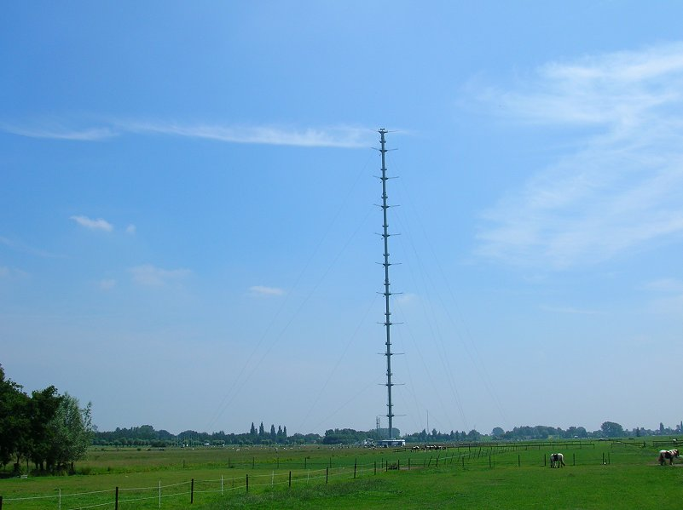
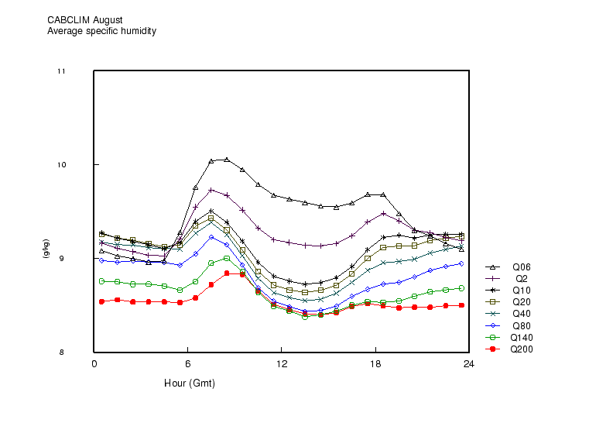
Cabauw tower climatology 10 years
specific humidity
August

Slide 11
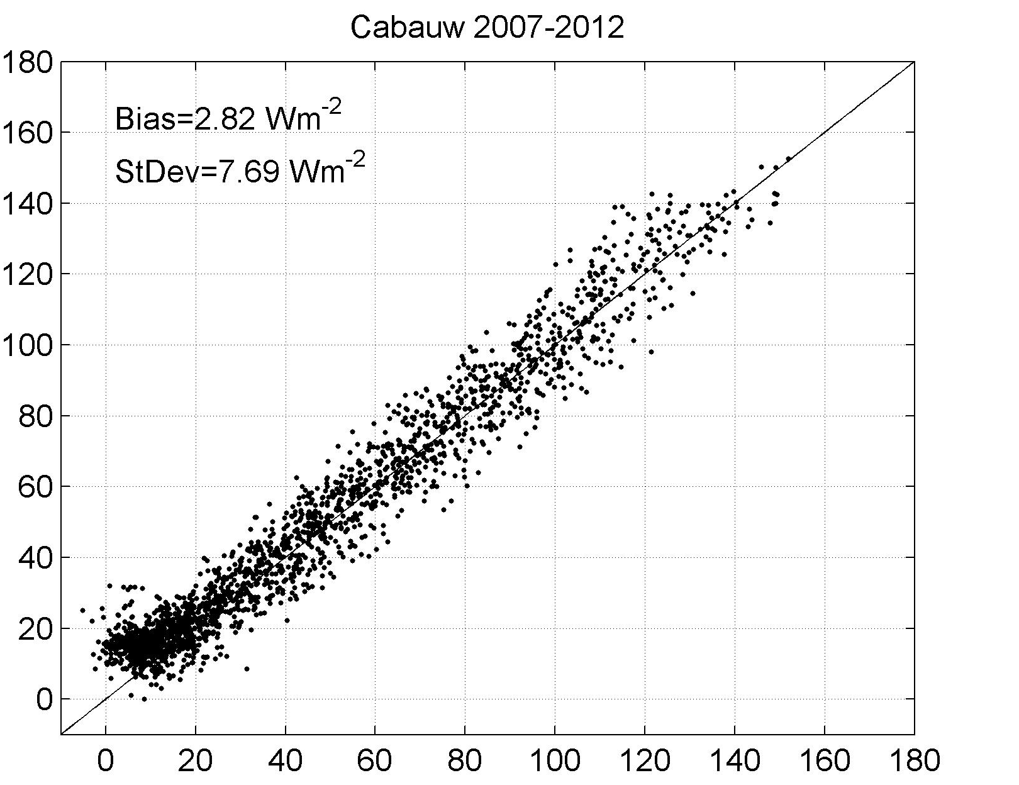
Validation Report
SAF_LAND_IPMA_VR_ETREF_v1.1.pdf
Estimated from MSG Wm⁻²
test R_{net}
Measured with EC –EB method Wm⁻²)

Slide 12
Thanks for your attention
Further information at:
http://lsa-saf.eumetsat.int

