Slide 1
Satellite-based climate data records of the surface solar radiation Jörg Trentmann, Uwe Pfeifroth, Steffen Kothe, Vivien Priemer

Slide 2
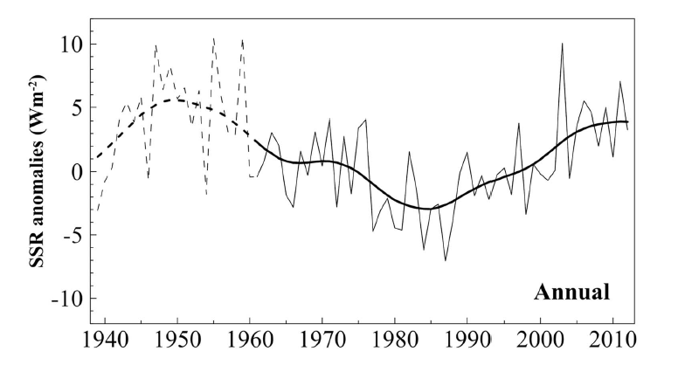
Surface Irradiance / Sunshine Duration
Surface Solar Irradiance / Sunshine duration highly relevant, e.g. climate monitoring, solar energy assessments
Most studies rely on surface observations, e.g., BSRN, GEBA, national networks
Spatial and temporal information of surface radiation can accurately be derived from satellite observations….
Sanchez-Lorenzo et al., JGR, 2015

Slide 3
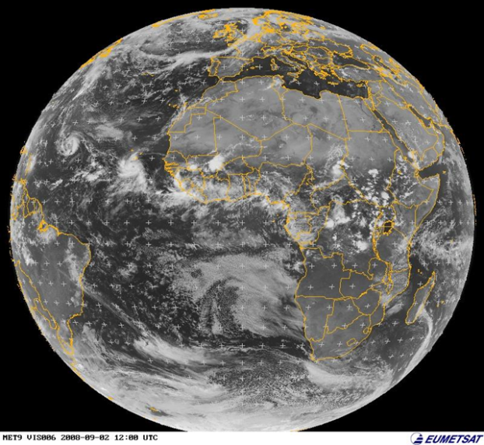
Surface Irradiance / Sunshine Duration
Spatial and temporal information of surface radiation can accurately be derived from satellite observations, because…
… satellites can well detect clouds (= bright) during daytime
… clear-sky solar radiative transfer is well simulated assuming auxiliary data (e.g., water vapor, aerosol) is available

Slide 4
CM SAF Surface Solar Radiation Data Records
Global radiation (SIS), Direct irradiance (SID, DNI), Sunshine Duration (SDU)
CLARA (Clouds, Albedo, Radiation based on AVHRR)
Surface Solar Radiation Dataset – Heliosat (SARAH)
SARAH and CLARA are freely available from the CM SAF:
www.cmsaf.eu
More information: Poster P.112, Thursday
Resolution
Spatial: 0.25° × 0.25°
Temporal: daily, monthly means
Coverage
Spatial: global
Temporal: 1982 to 2015
Accuracy
SIS: 9 W/m² (mm) / 19 W/m² (dm)
Resolution
Spatial: 0.05° × 0.05°
Temporal: 30-min, daily, monthly
Coverage
Spatial: Meteosat full disk
Temporal: 1983 to 2017
Accuracy
SIS: 5 W/m² (mm) / 12 W/m² (dm)
Notes:
Data freely available, without restrictions

Slide 5
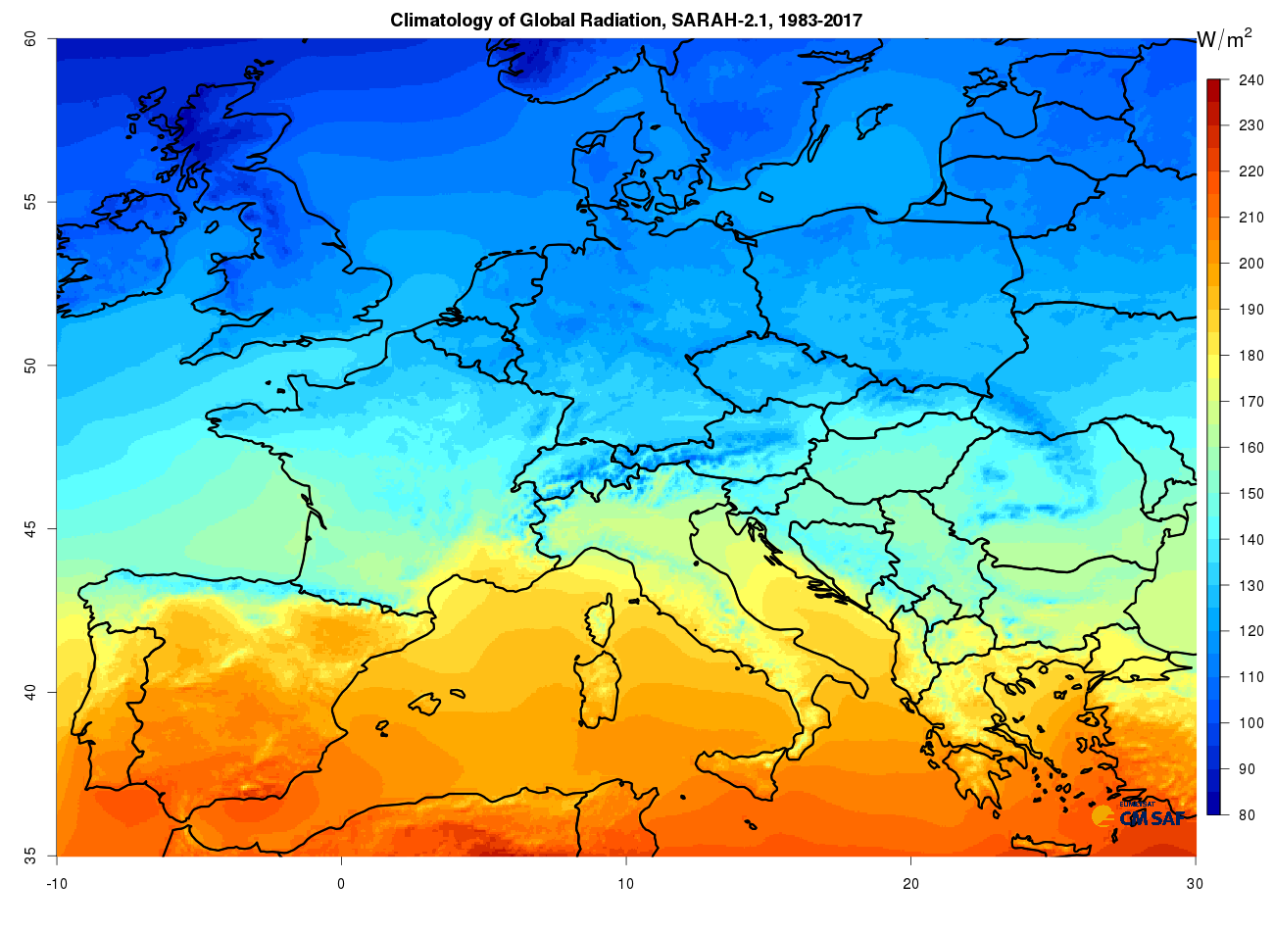
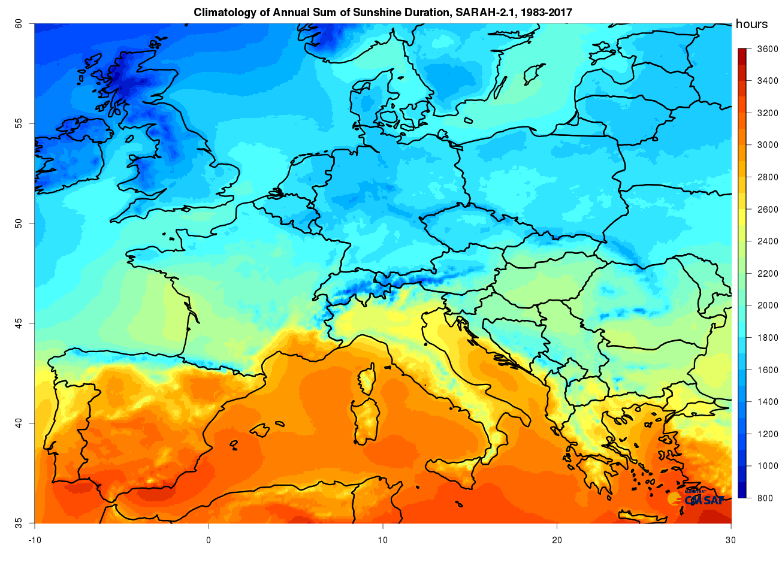
Global radiation (SIS)
Sunshine Duration (SDU)
Accuracy: 17 h (ms) / 1 h (ds)
Stability: ~ 1 hr / dec
Accuracy: 5 W/m² (mm) / 12 W/m² (dm)
Stability: ~ 1 W/m²/dec

Slide 6
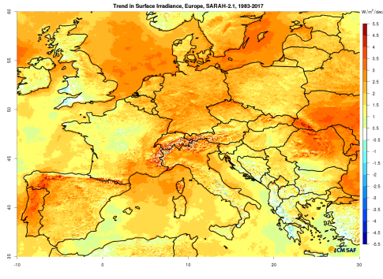
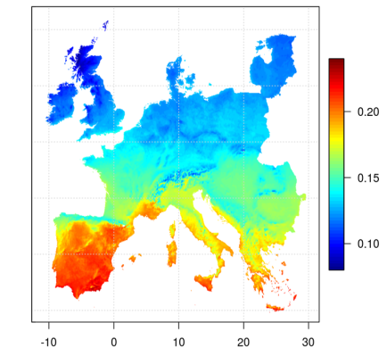
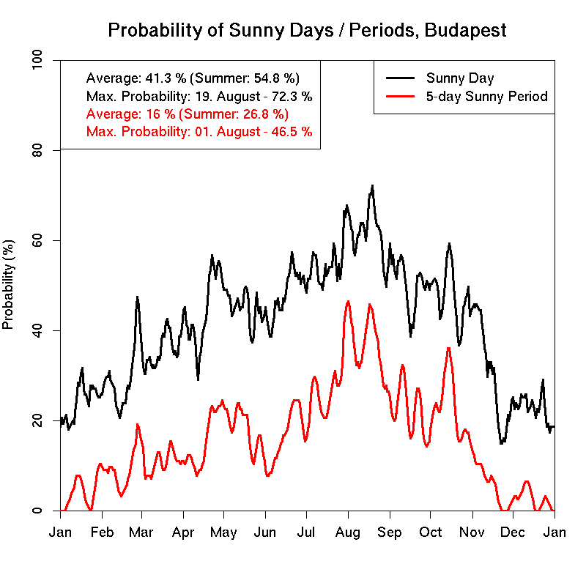
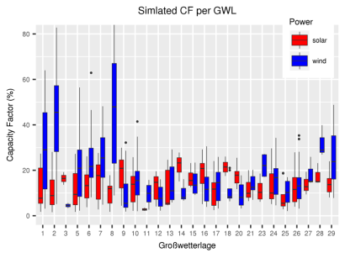
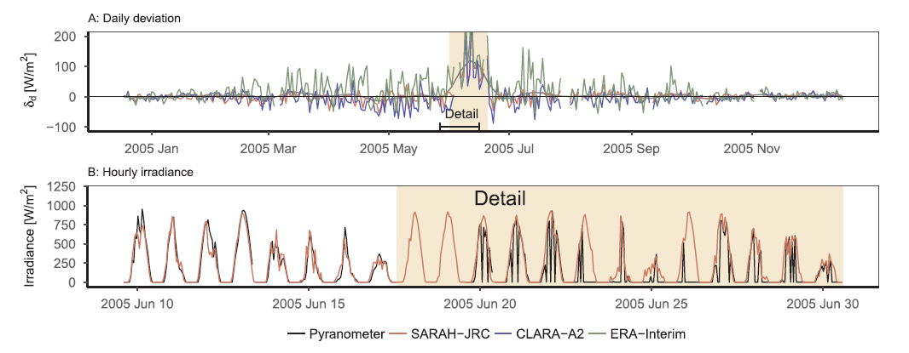
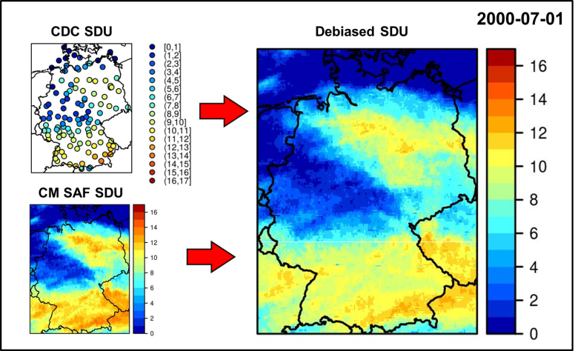
Climate Analysis, Trend Analysis
Solar Energy Modeling
e.g., PV GIS (JRC); Poster P.76; Friday
„Sunny Days“, Budapest
Pfeifroth et al (2018), J. Geophys. Res., 123, 1735-1754, doi:10.1002/2017JD027418.
Quality control of surface measurements
Merging of surface and satellite data
Urraca, et al., (2017), Solar Energy, 158, 49-62, doi:10.1016/j.solener.2017.09.032.
Walawender, J (2018) CM SAF Visiting Scientist Report

Slide 7
ICDR
+
TCDR

Slide 8
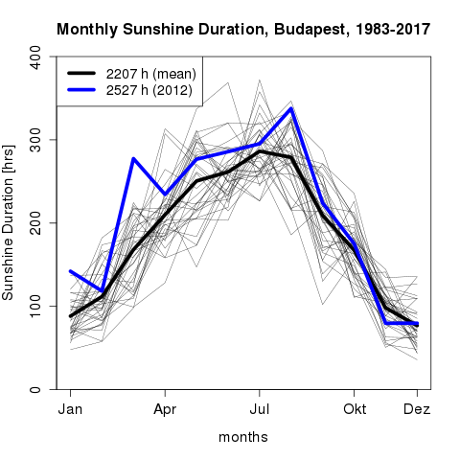
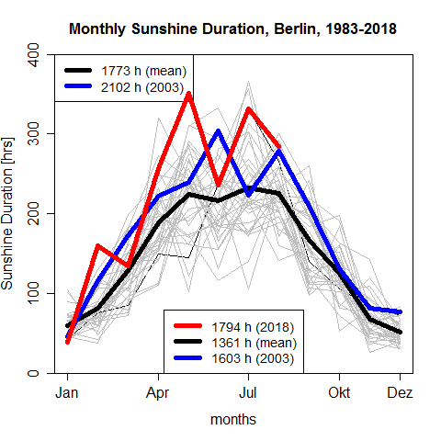
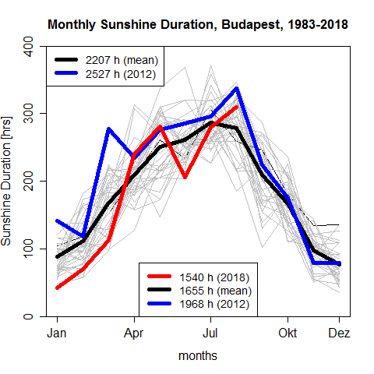
Climate Monitoring: Climatology + recent data
CM SAF provides (almost) near-realtime data for SARAH-2 (dt ~ 3 days)

Slide 9
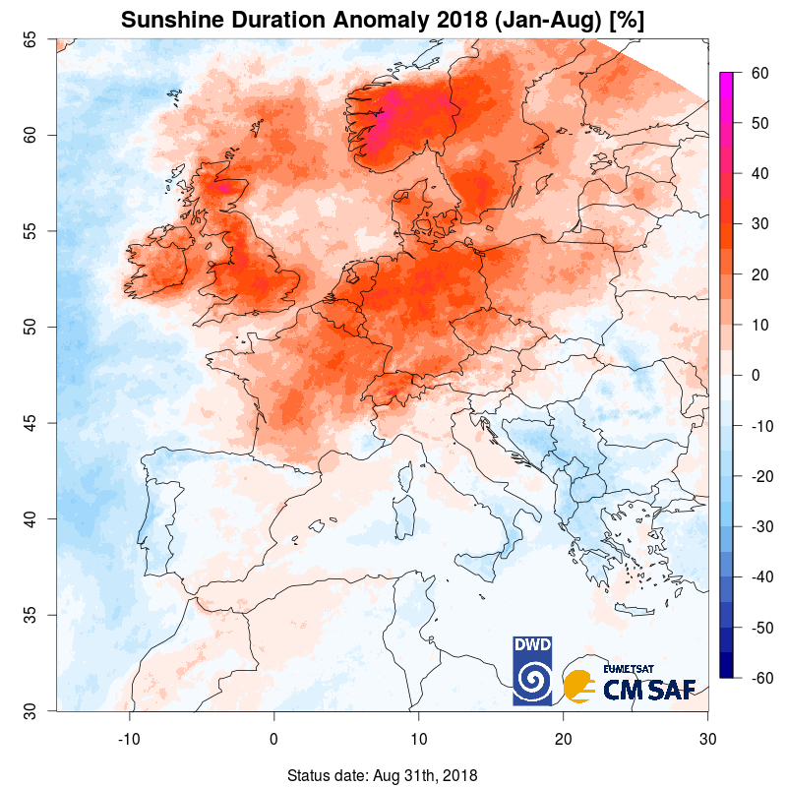
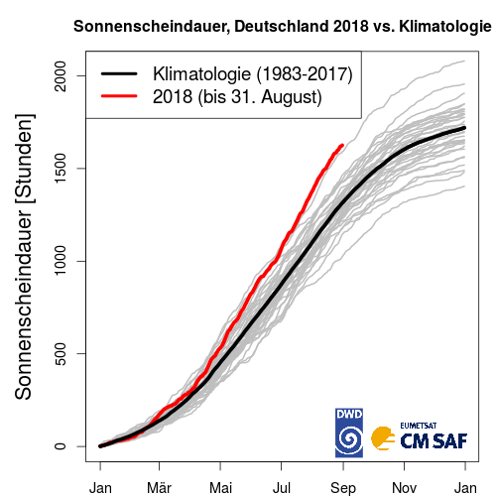
Positive anomaly of sunshine duration in 2018 in Western / Northern Europe
Normal sunshine duration in Southern and Eastern Europe
Germany: 2018 close to the all-time record (2003)

Slide 10
Positive anomaly of sunshine duration in 2018 in Western / Northern Europe
Normal sunshine duration in Southern and Eastern Europe
Germany: 2018 close to the all-time record (2003)

Slide 11
CM SAF Surface Solar Radiation Data Records
What’s next in SARAH-3 (available in 2021)
Improved retrieval over snow-covered surfaces
Improved surface albedo (aerosol?) input
Use of (daily!) ERA-5 water vapor information

Slide 12
Daily Global Radiation
Evaluation with surface measurements (Germany)
Good agreement with surface measurements

Slide 13
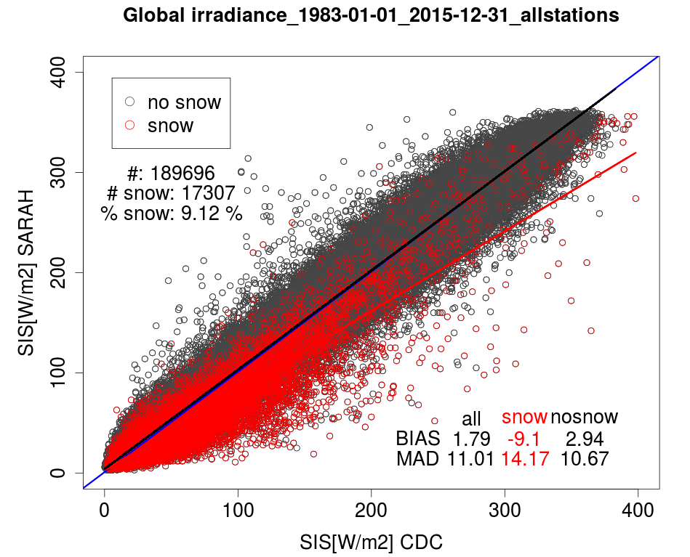
Daily Global Radiation
Systematic under-estimation of surface radiation in snow-covered situations
e.g., March:
bias: -21 W/m²
abs. bias: 26 W/m²
Problem: Snow is classified as cloud
Notes:
CDC snowmask is used for the snowdays
1983-2015 every month
SARAH underestimates in cases of snow, because due to the Heliosat method the snow is often deteced as clouds -> radiation is reflected back and will not reach the surface -> radiation smaller as in reality
This effect ist larger at days with less clouds (higher values) due to the higher incoming radiation
Heliosat is only able to detect snow , if there is the whole month snow. -> the clear sky value includes the snow
Largest difference betweenn snow and no snow days in March
higher global irradiance (SIS) than in the other winter months and more snow than in the other spring and autumn months
Less constant snow regions -> Snow vanishes in more regions, less regions with completly snow

Slide 14
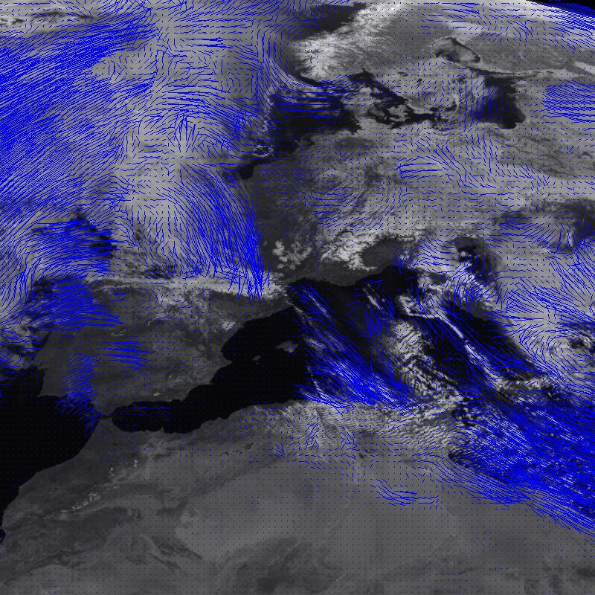
Snow Detection
HelSnow
Status quo: Separation between cloud and snow problematic (only 3 spectral channels available from historic satellites)
Approach: Separation between Cloud and Snow based on ‚motion‘
Intelligent / modern / efficient programming (OpenCV: ‚optical flow‘) allows the processing of long time series
18 March 2006, 1200 + 1230 UTC

Slide 15
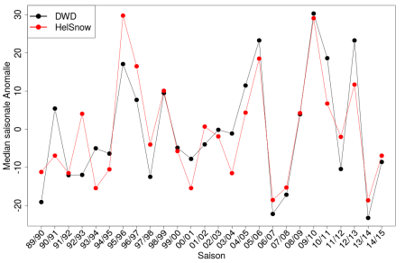
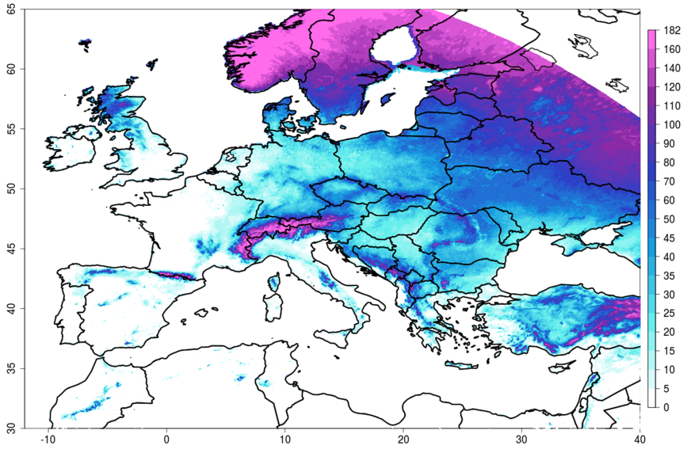
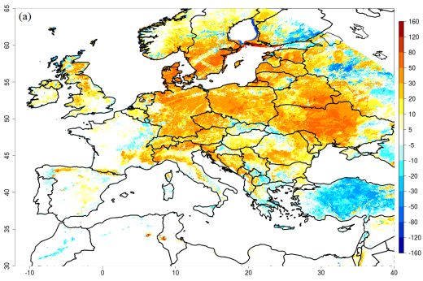
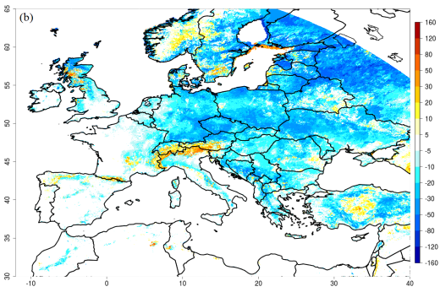
Snow Mask (based on HelSnow)
Resolution
Spatial: 0.05° × 0.05°
Temporal: daily
Coverage
Spatial: Meteosat full disk
Temporal: 1989 to 2015 (1983 - 2017)
Accuracy
Moderate quality
bias: 0.46
POD: 0.36
ETS: 0.23
Realistic spatial distribution and temporal variability of snow coverage, but not meant for climate analysis
Mean Number of Snowdays, NDJFMA, 1989 - 2015
2009/2010
2013/2014

Slide 16
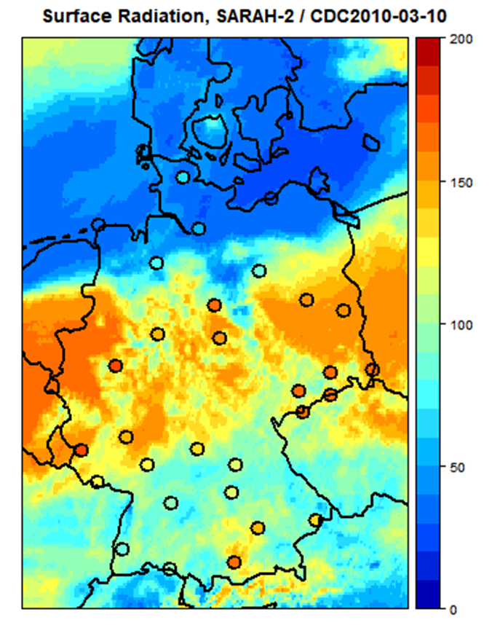
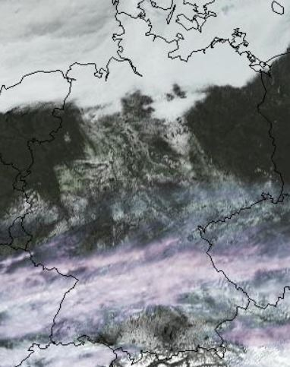
Surface Radiation (SARAH-2)
10 March 2010

Slide 17
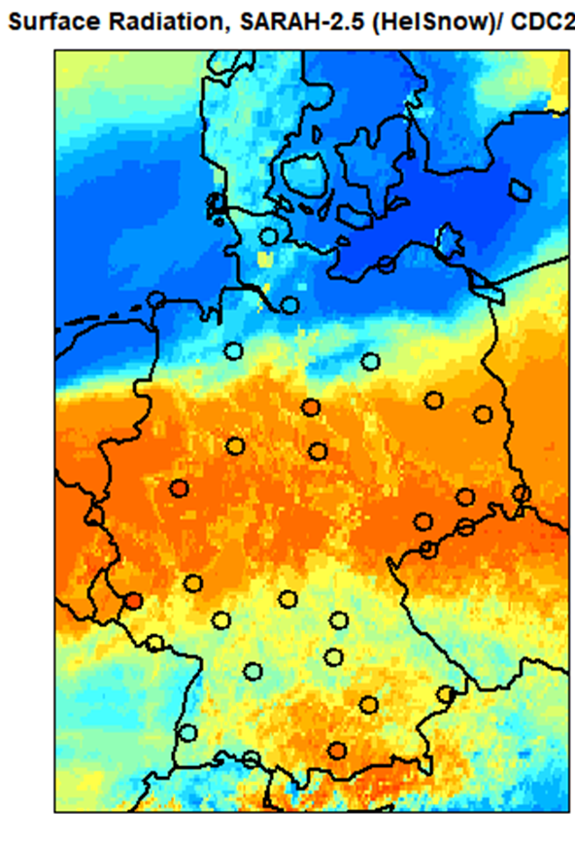
Surface Radiation (SARAH-2.5)
10 March 2010

Slide 18
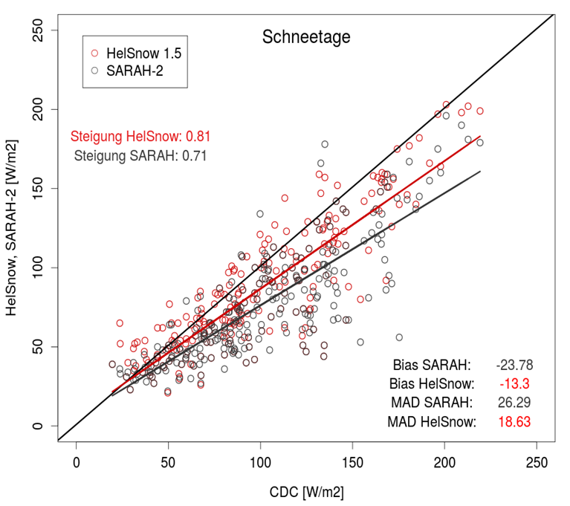
Surface Radiation (SARAH-2.5)
March 2006
Substantial improvement of data quality over snow (March 2006, Germany):
bias: -13.3 W/m² (SARAH-2: -23.8 W/m²)
abs. bias 18.6 W/m² (SARAH-2: 26.3 W/m²)
Accuracy of satellite-derived surface solar radiation still below average under snow-covered conditions

Slide 19
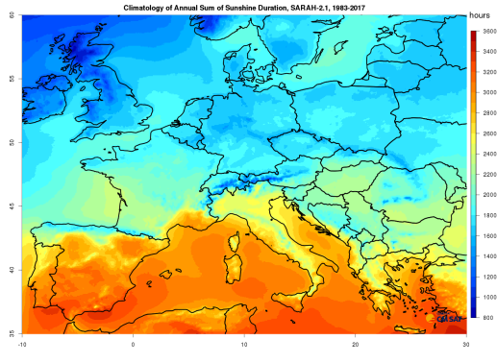
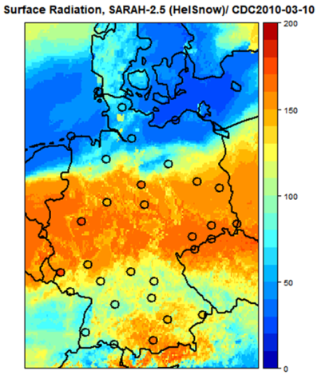
Summary
CM SAF provides surface radiation climate data records (SARAH / CLARA) with high accuracy and stability as well as corresponding near-realtime data (SARAH-ICDR)
For Europe / Africa, we provide high resolution (temporal / spatial) data of surface radiation and sunshine duration
Combined use of TCDR / ICDR allows local / regional climate monitoring
Reduced quality of surface radiation data under snow-covered conditions; new snow detection scheme allows improved retrieval of surface radiation
5th CM SAF User Workshop (3–5 June 2019) & EUMETSAT Advanced Climate Training Course (5–7 June 2019), Mainz, Germany

