Slide 1

Great Forecast
Poor Outcome
Haleh Kootval
EMS-18

Slide 2
Outline
Why we need to change the way forecasts and warnings are produced and communicated
impact-based forecast and warning services
Case of developing countries
Case of developed countries
Engaging the society
Great forecasts, Poor outcomes Great forecasts, Good outcomes

Slide 3
Why Impact-based Forecasts and Warnings?
Despite good forecasts, people still die and economic losses continue to rise…
We need to know how hazards will impact lives, livelihoods, property and the economy and take action to mitigate the impact
What the hazard will BE
→
What the hazard will DO
Notes:
Need to spend some time to get this concept across...
note that is about all hazards - weather, hydro, seismic.
Often people complain about the weather forecast, but the forecast is usually correct, so what is the problem?

Slide 4
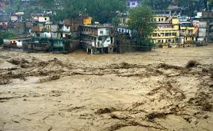
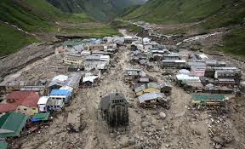
Case studies: Good Forecasts, Poor Outcomes
Event: Flooding
Place: Uttarakhand, India
Date: 15-17 June 2013
Synopsis:
June 2013, a multi-day convective storm caused
devastating floods and landslides.
375% of normal monsoon rainfall fell between
14 and 17 June.
Outcome:
Over 5700 fatalities
4,200 villages were affected
Courtesy: David Rogers

Slide 5
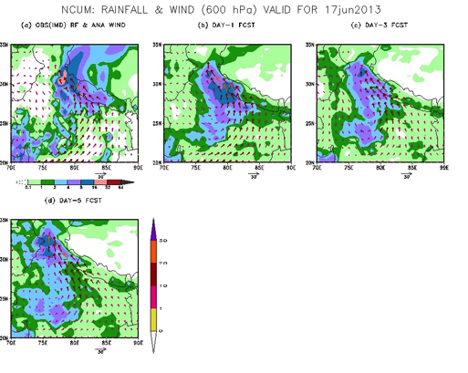
What worked, what didn’t?
Good Weather forecasts of heavy rainfall three days ahead of event
Weather warnings issued by India Met Department
Media coverage of threat
Satellite remote sensing information available
Notes:
forecasts were published in the local newspapers

Slide 6
What worked, what didn’t?
Good Weather forecasts of heavy rainfall three days ahead of event
Weather warnings issued by Indian Met Department
Media coverage of threat
Satellite remote sensing information available
Warning information was not fully understood – DM unable to interpret “heavy rainfall for entire state” into effective impacts
Local preparedness for this magnitude of hazard inadequate
Late response resulting in additional hazards to responders during rescue operations
Poor communication between central government IMD and State DM
“We get a copy of the IMD bulletin but action has to be taken by state government only. They put out bulletin (this time) and said “very heavy rain”. What does “heavy rain” mean? “Very heavy rain” means very heavy rain. But it doesn’t mean so much rain in such a short time” – Vice Chair, NDMA, India

Slide 7
What worked, what didn’t?
Good Weather forecasts of heavy rainfall three days ahead of event
Weather warnings issued by Indian Met Depart.
Media coverage of threat
Satellite remote sensing information available
Weather and hydrological models not coupled
Lack of scientific and technical capacity to translate hazard information into impacts – therefore, impacts underestimated
Inadequate communication channels, which failed during the event
Lack of appreciation and utilization of available hazard maps at local level
Inadequate observations to forecast events on scale required by Gov. of Uttarakhand
Notes:
Note: July 2016 more flooding, landslides and loss of life

Slide 8
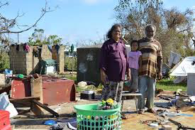
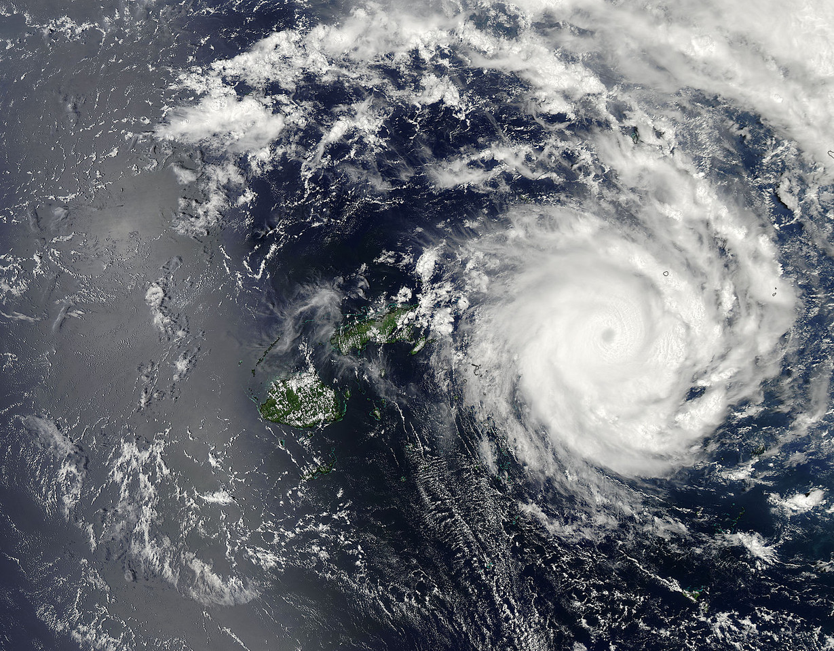
Case Study: Good Forecasts, Poor Outcomes
Event: TC Ian
Place: Ha’apai, Tonga
Date: 2-12 January 2014
Synopsis:
January 2014, Category. 5 TC Ian
(max sustained winds 220 km/h)
Outcome:
Loss of 90% power lines, 80-90% water supply. 50% of all buildings were destroyed.
2,300 people were made homeless.
Loss of Communication with all islands.
Courtesy: David Rogers

Slide 9
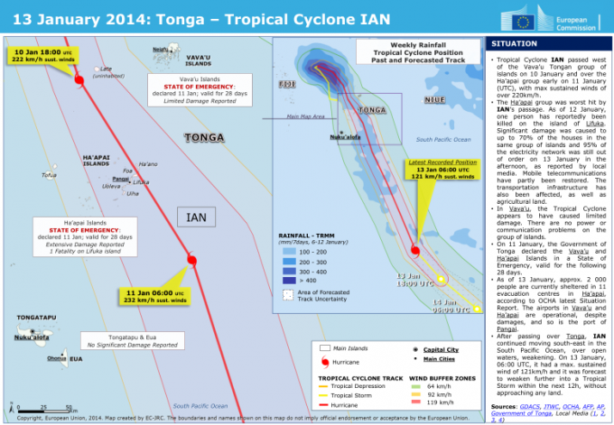
What worked, what didn’t?
Good track and intensity forecasts
Weather warnings issued by Tonga Met Department
Warnings received by those likely to be impacted
Shelters available

Slide 10
What worked, what didn’t?
Good track and intensity forecasts
Weather warnings issued by Tonga Met Department
Warnings received by those likely to be impacted
Shelters available
Warning information was not understood by the public. Unable to interpret “high winds” into effective impacts
Local preparedness for this magnitude of hazard inadequate
Resilience of infrastructure low – electricity, water, communications and shelters.
After the event, when asked by the Tonga Met Department “When did you evacuate?”
The response from the residents of Ha’apai was “When my house fell down”

Slide 11
Case Study: Good Forecasts, Poor Outcomes
Event: Snow, blizzards and low temperatures
Place: UK
Date: 26 February-3 March 2018
Synopsis:
High pressure over Scandinavia and northern Europe, bitterly cold easterly airflow across the UK,
wind-chill below -10 °C. (Major Sudden Stratospheric warming and blocking the Jet Stream: polar-vortex deformation, led to very wintry weather).
A MO Red Warning was issued for Scotland for 28 February.
1 March, a low pressure system in the Bay of Biscay (Storm Emma) brought mild, moist air into the colder air resulting in heavy snow, particularly across southern and south-west England and south Wales.
MO Red Warning:1 March snow SW England-South Wales

Slide 12
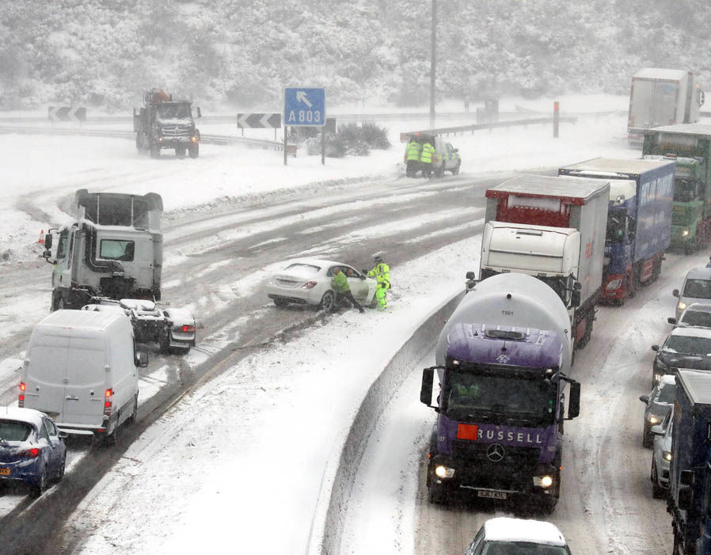
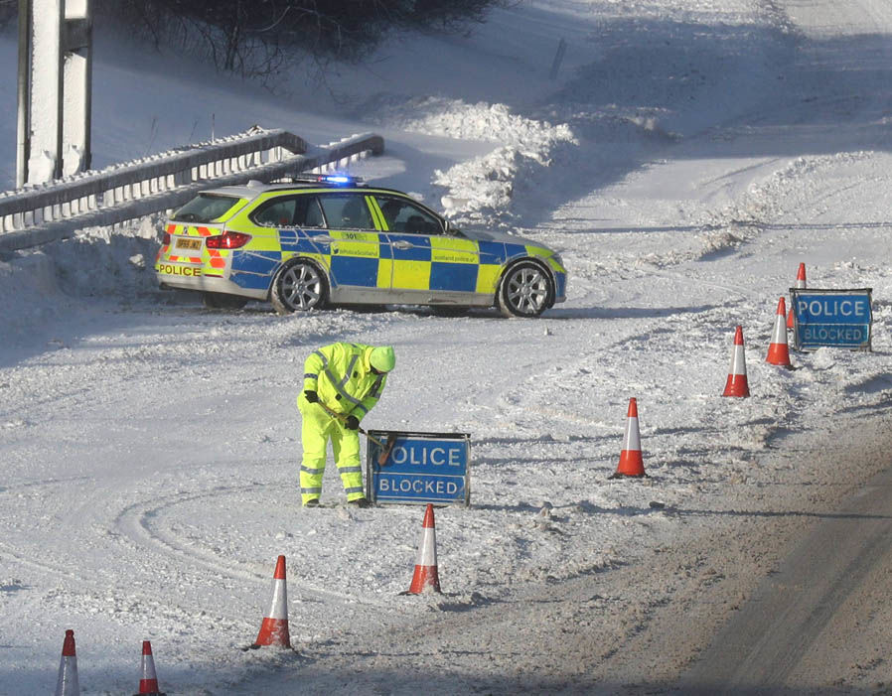
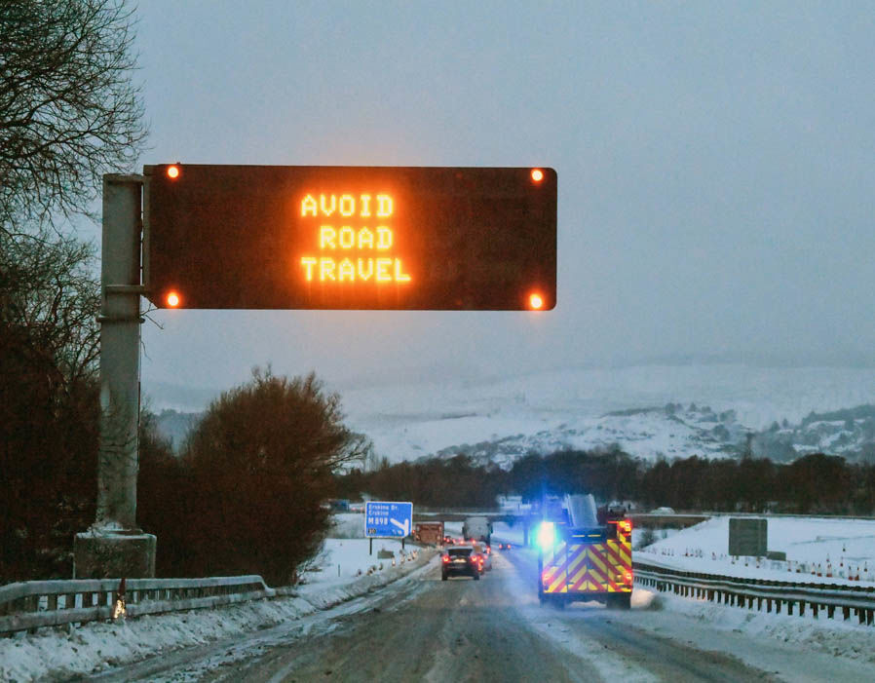
Case Study: Good Forecasts, Poor Outcomes
Outcome:
The weather-related death toll reached 10
Severe disruption to rail, road and air transport; cars stranded overnight on many roads
Around 100 passengers trapped on a train on 1 March and forced to spend the night with no heating, no power, no light and no food
Thousands of schools were closed, power and water cuts in many areas.

Slide 13
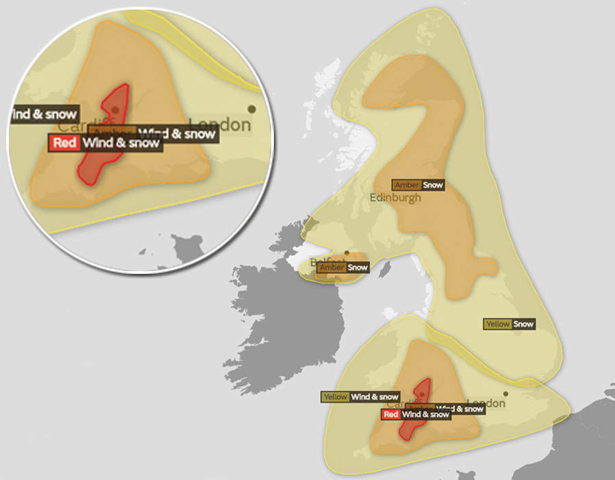
Case studies: Good Forecasts, Poor Outcomes
Red warnings: issued when it is highly likely that the weather will cause a high level of impact and is not issued often.
“The last time we had the red snow warning was in 2013 for South Wales -
a red warning for snow has never before been issued for Scotland, England or Northern Ireland”.
Yellow and Amber Warnings remained in place across the UK for Friday 2 March and into the weekend

Slide 14
What worked, what didn’t?
Good weather forecasts of the exceptional events
Highly developed warning system by MO
Close collaboration between MO and road, rail, air transport and emergency services
Well prepared emergency management and first responders
Good public communication using multiple channels
Motorists were advised not to travel unless absolutely necessary
Many employers allowed staff to go home early or work from home.

Slide 15
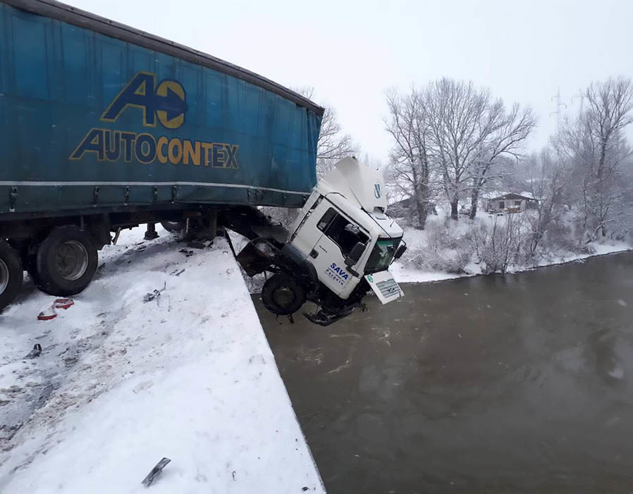
What worked, what didn’t?
Good weather forecasts of the exceptional events
Highly developed warning system by MO
Close collaboration between MO and road, rail, air transport and emergency services
Well prepared emergency management and first responders
Good public communication using multiple channels
Many people trapped on roads
Transport Minister: “people had heeded warnings not to travel "to an extent”, but I have seen HGVs that are carrying home furniture, stationery and piping. I am not convinced that is necessary, and a lot of the incidents we have seen have been caused by a loss of traction by HGVs, so not everybody has been listening or heeding that advice."
Defense minister criticized emergency planners for not asking for military assistance until a late stage.

Slide 16
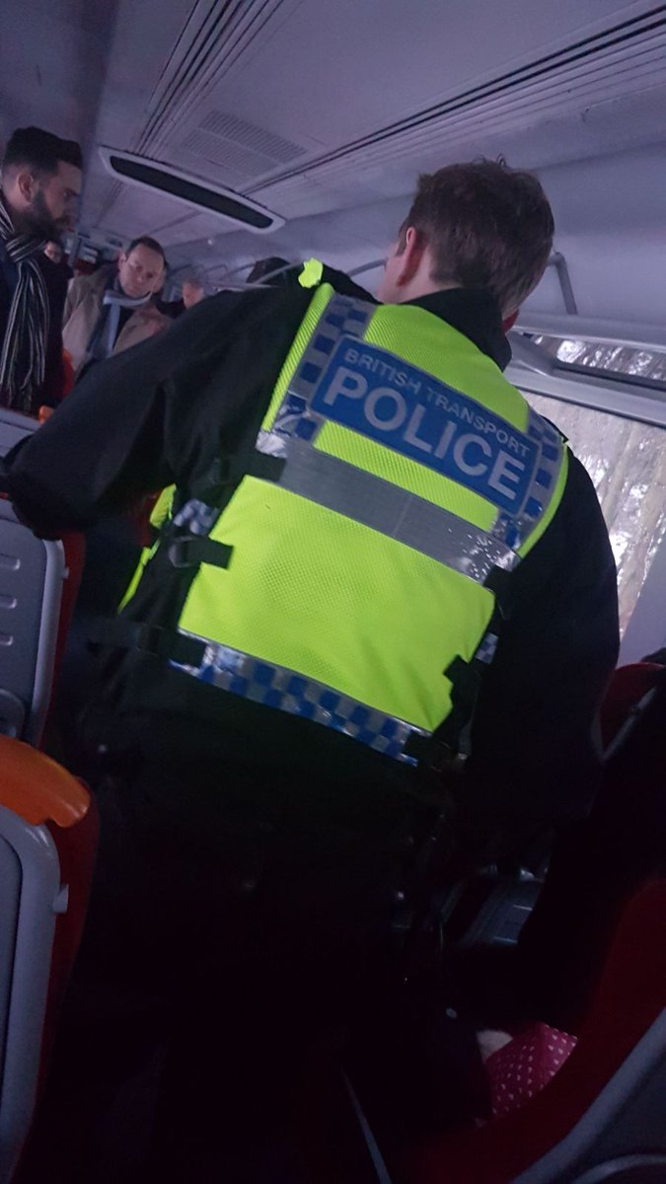
What worked, what didn’t?
Good weather forecasts of the exceptional events
Highly developed warning system by MO
Close collaboration between MO and road, rail, air transport and emergency services
Well prepared emergency management and first responders
Good public communication using multiple channels
Train companies allowed operations without adequate preparations
The SW railway company : “Because of the severe weather conditions multiple trains have broken down between Weymouth and Bournemouth. All lines between these stations are currently blocked”
6. Roads were gridlocked when people tried to get bottles of water from supermarkets
7. The water industry regulator “a number of water companies had fallen well short on their forward planning. They have been warned to better plan ahead to deal with these sorts of situations.”

Slide 17
Case Study: Good Forecasts, Poor Outcomes
Event: Snow, and low temperatures
Place: Switzerland
Date: 26 Feb-1 March 2018
Synopsis:
Major Sudden Stratospheric warming and blocking the Jet Stream; bitterly cold easterly airflow from Siberia across Switzerland; the coldest winter temperature (-28° C), wind-chill of -10° to -20° C.
1 March almost all Switzerland was covered by fresh snow (10-15 cm in the west). The snowfall continued on 2 March.

Slide 18
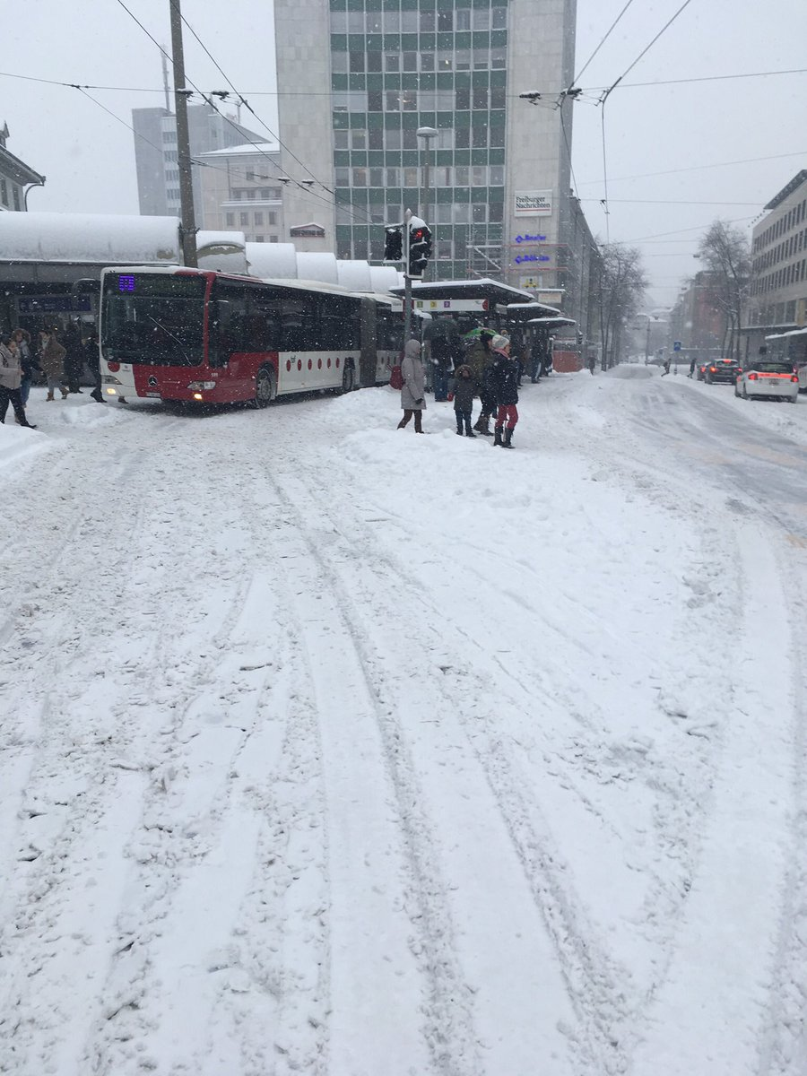
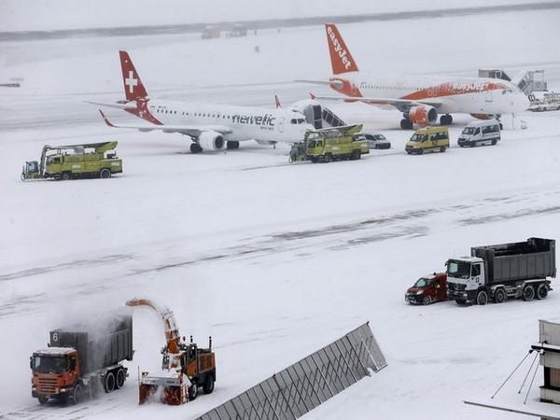
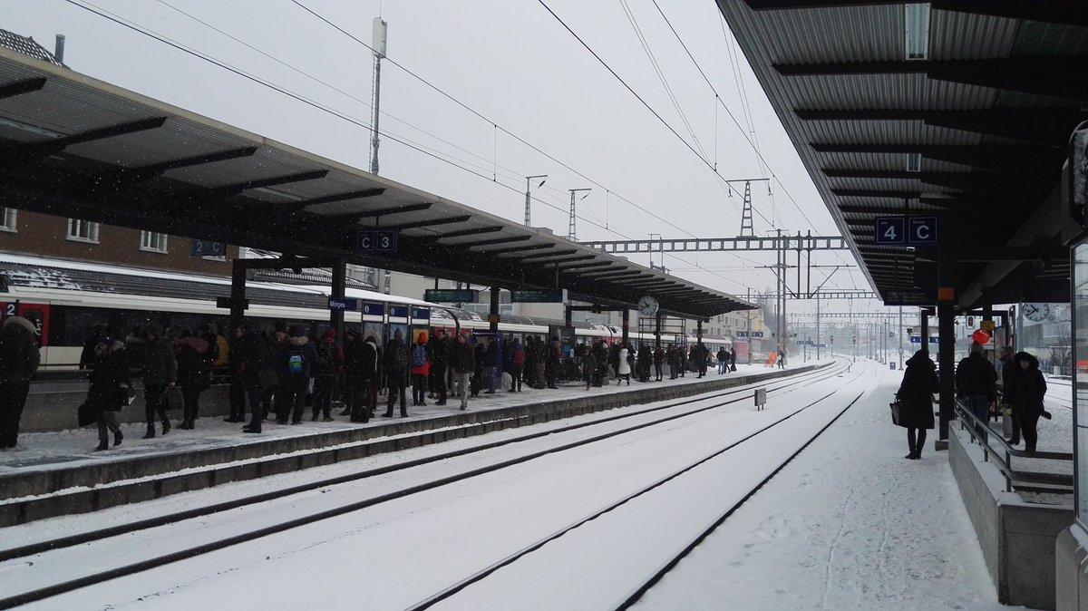
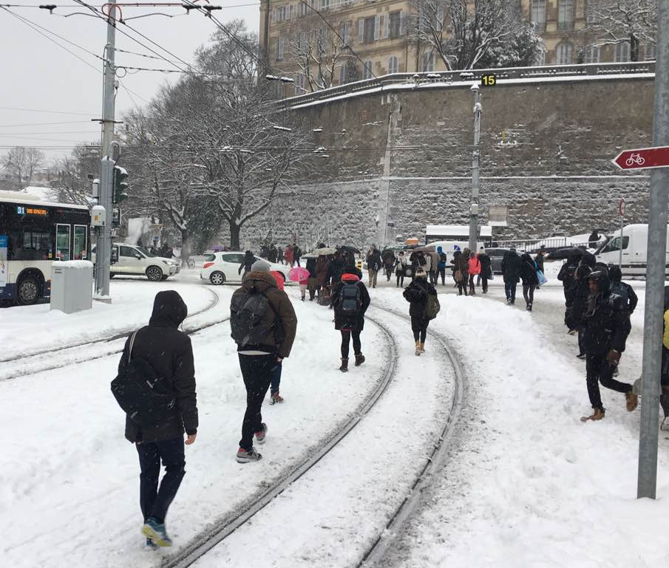
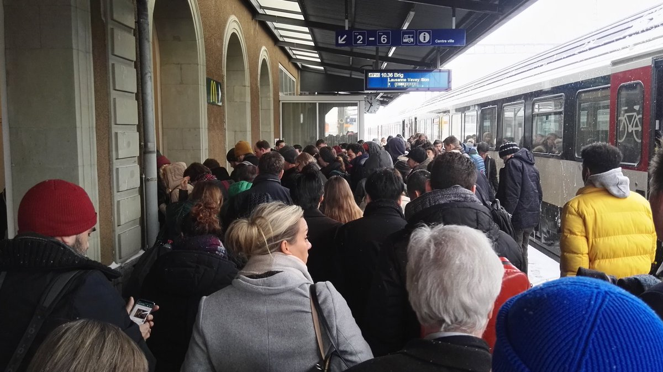
Case Study: Good Forecasts, Poor Outcomes
Outcome:
Massive disruption to road and rail transport
Geneva airport temporarily closed (1 and 2 March)
Many accidents and tailbacks on roads

Slide 19
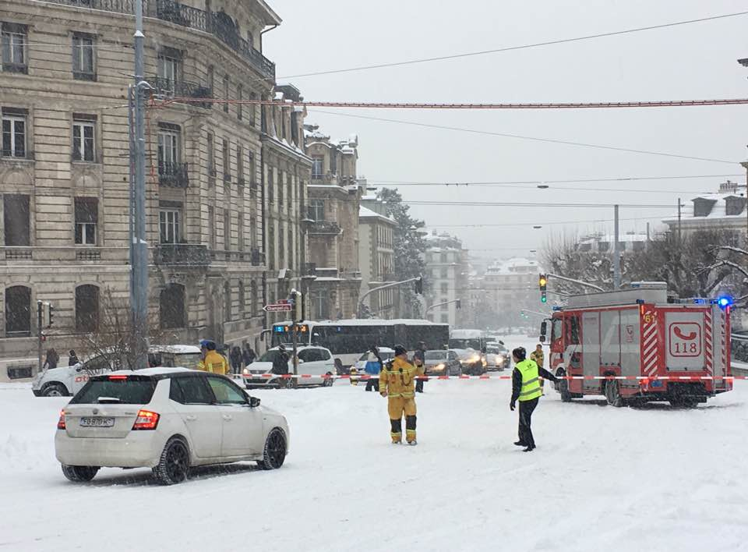

What worked, what didn’t?
Good weather forecasts of the heavy snowfall at least 5 days ahead
Well prepared emergency management and first responders
Close collaboration between Meteoswiss and road maintenance authorities, rail, and airport authorities: proactive briefings and contacts
Good public communication using multiple channels
Advisories issued by the police about road conditions urging people to take care
A country for the most part used to and prepared for winter and unusual amounts of snow but ….
Web TV
26 février 2018 08:26; Act: 26.02.2018 14:21Print
La Suisse a connu sa nuit la plus froide de l'hiver
Après trois journées glaciales, la neige entrera dans la danse à partir de jeudi, avec des flocons jusqu'en plaine.

Slide 20
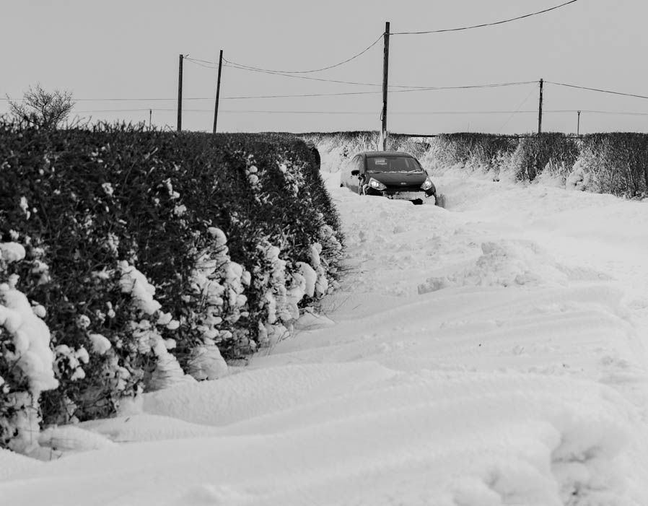
What worked, what didn’t?
Models had difficulty in adequate simulation of the warm humid air riding over the cold surface over the Swiss Plateau
Warm air advection aloft was stronger than forecast by the models
Models were underestimating the potential snowfall accumulation
Eventually the "winter storm watch/warning" for extreme Western Switzerland was issued where the strongest warm air advection was forecast aloft
The winter storm warning could have been extended further east where significant snowfall accumulation occurred as well
Snow falling on cold ground stuck immediately. Certain communes not allowed to pre-salt the roads too much ahead of a forecasted snow event (political decisions), leading to complications in the snow removal process once the snow starts falling on cold ground
Good weather forecasts of the heavy snowfall at least 5 days ahead
Well prepared emergency management and first responders
Good public communication using multiple channels
Advisories issued by the police about road conditions urging people to take care
A country used to and prepared for winter, mountain towns and ski resorts handled the unusual amounts of snow better than most cities but ….

Slide 21
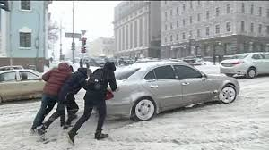
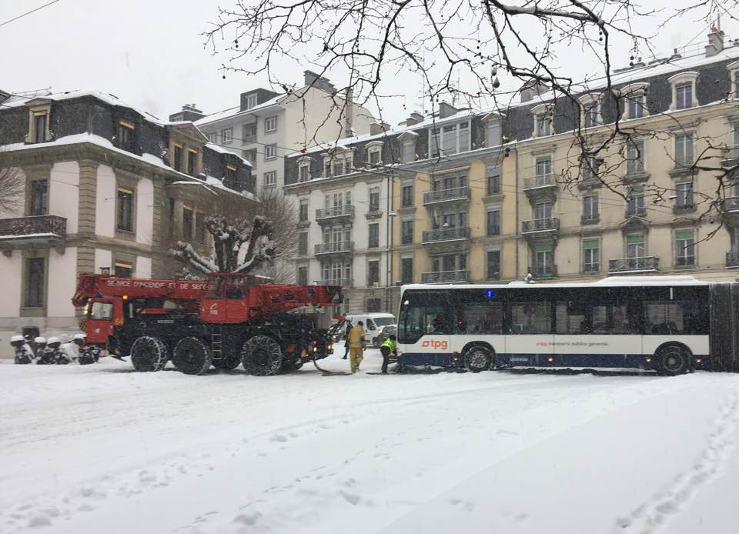
What worked, what didn’t?
Good weather forecasts of the heavy snowfall at least 5 days ahead
Well prepared emergency management and first responders
Good public communication using multiple channels
Advisories issued by the police about road conditions urging people to take care
A country used to and prepared for winter, mountain towns and ski resorts handled the unusual amounts of snow better than most cities but ….
7. 2012 the last time in the past decade that so much snow fell in a single day (public’s memory). Many mountain areas were on high alert for avalanches, and several towns were cut off from transport networks
8. Some public and many private vehicles in towns such as Geneva not equipped for snow, causing accidents and road blockages trapped on roads
9. The heavy snow on Thursday 1 March caught many people by surprise, including the meteorologists at Swiss public television, SRF “we’re also surprised about all the snow. The warm front is much more active than expected. We wish you a lot of patience on the roads”

Slide 22
Impacts
Forecasts in general were all about meteorological hazards (cm of snow, rain, or wind speed)
Some issues particular to each case why there was a poor outcome from a good forecast
One common thread: impacts were not articulated clearly for people to make the right decisions
The “Heavy” snowfall was not translated into clear impacts on road and rail transport and possibilities of delays (snow tyres are essential, arrange to work from home, school closures ahead of time)
“Heavy” rain was not translated into the possibility of roads being washed away, landslides, city drains being overwhelmed and not able to cope
“Strong” wind was not translated into immediate need to leave relatively weak infrastructures and seeking shelter in stronger buildings

Slide 23
Main Issues
Wealth of accurate data and information
    Can and should be used to mitigate and prevent adverse impacts of many weather, climate and water-related events
What prevents the effective use of this information?
How can we as a community of providers and of users of information do better?
How to engage everyone who has a role in providing information, interpreting it, getting it out and getting it to those who need it?

Slide 24
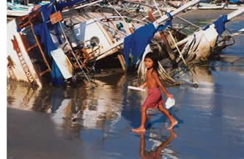
Effective Waring Service
A warning service is successful when recipients:
    Receive the warning (dissemination);
    Understand the information presented (language);
    Believe the information (credibility);
    Personalize the risk;
    Make correct decisions; and,
    Respond in an adequate manner,
    Feedback, lessons learnt.

Slide 25

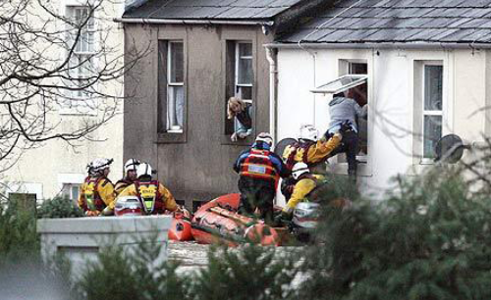
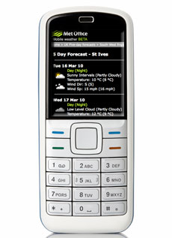



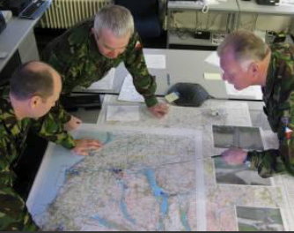
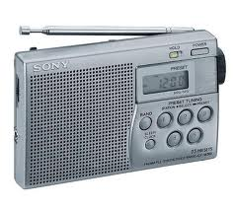
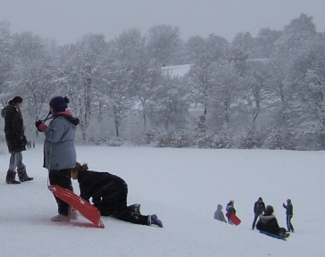

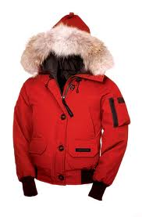
Developing effective warnings
Essential Elements
easy to understand
easy to access
change behavior
help people decide what to do
variety of access points
help emergency responders plan
help emergency responders respond

Slide 26
Why do good forecasts still result in a poor outcome?
Lack of recognition of both technical and human elements in good information delivery
Technical factors
  Forecast accuracy: miscalculating onset time, intensity or impacts
  Lack of timeliness of warnings and updates
  Contradictory information from different sources
  Communication and/or dissemination inadequacies
  Weather models not coupled to other hazards models (hydrological, storm surge, landslides)
  Weather forecast is too technical: not interpreted into common language
  Forecasters lack knowledge on potential impact of the hazard

Slide 27
Why do good forecasts still result in a poor outcome?
Disaster Managers and responders lack of scientific and technical capacity to translate hazard information into impacts – therefore impacts underestimated
Often resulting in endangering the lives of responders
Lack of a disaster preparedness plan: SOP
Lack of appreciation and utilization of available vulnerability information at local level; not shared, not routinely updated and not digital
Ineffective decision support systems
Notes:
Summary of case studies

Slide 28
Why do good forecasts still result in a poor outcome?
Human factors:
  Poor communication, ineffective and ad-hoc coordination among forecasters, disaster managers, first-responders, and the media
  Low credibility of NMHS: Many people do not fully trust the warnings and associated information (both developed and developing countries)
      Lack of engagement with decision makers who despite interest in the weather do not appreciate the potential harm of the hazard: public transport, road maintenance
      The public do not personalize the risk: many people think they can get through the flood, snow etc. (UK, Switzerland)
          Poor decision making and response

Slide 29
What to do?
Institutional strengthening and forecast improvements are a necessary, but not sufficient step
Need to understand why people don’t take action: social scientists
Communicating impact-based forecasts is more important than communicating weather forecasts only
Forecasters need access to vulnerability and exposure information
Closer operational ties among meteorologists, hydrologists, disaster managers, other experts needed to provide impact forecast and warnings
New types of staff in NMHSs – “Civil Contingencies” Advisors; Sectorial Advisors; Public Weather Service Advisors
Collocation is the best solution; at least create a joint activity or unit that brings together the expertise
Impact-based forecasting has become an integral part of the World Bank projects on modernization of NMHSs with considerable resource allocation
Notes:
Main points:
Still need to improve forecasts
People's behaviour --- this is an issue for social scientists.
NMHSs have to make some fundamental changes in the way they perceive their responsibilities --there is often a lot of resistance to change
Changing working relations with other agencies is very difficult --
collocation is the best solution; if not then create a joint activity or unit that brings together the expertise needed.

Slide 30
Engagement with society
Public education and outreach very good and necessary, but….
Need to go beyond: engage people
Role of authorities (road transport authorities, company owners and managers) extremely important;
Public authorities and businesses should allow people to stay home without fear of losing job or wages, should not send HGV onto roads, should close schools ahead of the event, should stop trains running when high alerts are issued
Crowdsourcing: public participation is a possible approach
Benefits:
feedback to the forecaster on ”ground truth”, forecast quality and impacts
verification of weather warnings
the establishment of a climatology of severe or unusual weather events
case studies or damage reports
strengthening relations between NMHSs and the citizens
Modern communication technologies and social networking: allow big unstructured data (real time pictures and videos)

Slide 31
Engagement with society
Issue: degree of reliability and quality of reports
European collaboration between NMHSs and voluntary weather observers or storm spotters (ZAMG survey) and expected to increase
A number of European NMHSs provide advice, education and training of spotters
Training of storm spotters linked to quality control of their reports leading to quicker acceptance of their reports

Slide 32
Final Thoughts….
Overall good forecasts……getting better
Absolute importance: from hazard to impact
Disaster Management: closer collaboration with Met/Hydro Service Providers
Social responsibility: authorities in public and private sector
Road transport: more strict rules for providers and users similar to those for aviation
Great Forecasts Good Outcomes

Slide 33
Thank You

