Slide 1
A Statistical/Dynamical Hybrid Model Approach to Atlantic Basin Seasonal Hurricane Prediction
Phil Klotzbach
Department of Atmospheric Science
Colorado State University
Louis-Philippe Caron
Barcelona Supercomputing Centre
European Meteorological Society Annual Meeting
11 September 2019

Slide 2
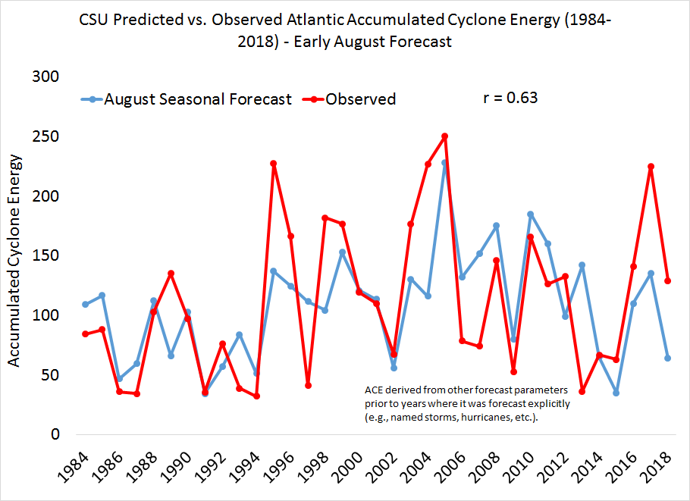

Slide 3
Fundamental Research Questions
Can we improve our forecast models to better predict Atlantic hurricane seasons?
Can a dynamical model be used to forecast large-scale atmospheric regions known to impact Atlantic hurricane activity?

Slide 4
Data Sources
Atlantic Hurricanes: HURDAT2 (1982-2018)
Large-Scale Atmospheric/Oceanic Fields: ERA-Interim and NOAA OI SST (1982-2018)
Dynamical Model Output: SEAS5 (1982-2018) Ensemble Mean

Slide 5
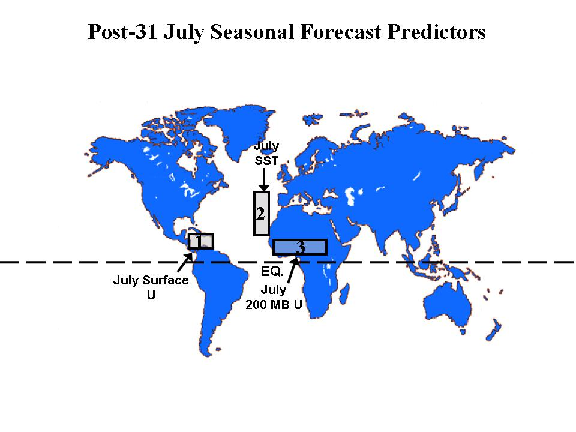

Slide 7
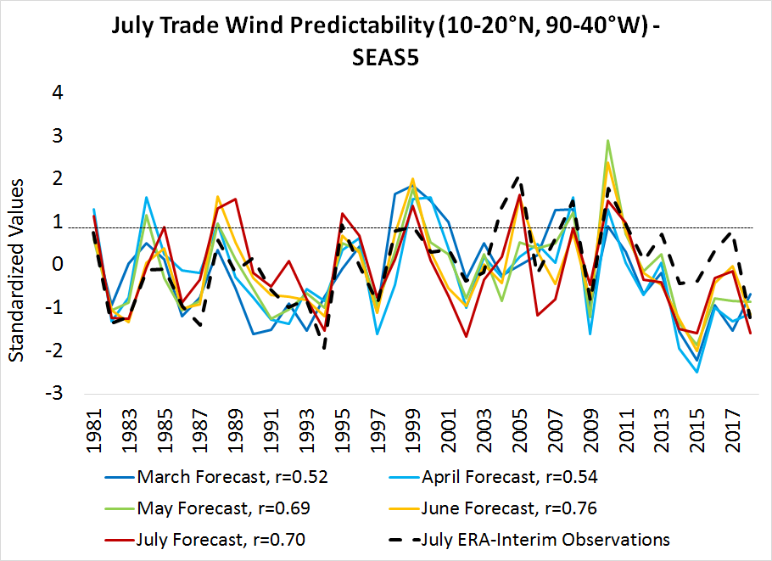

Slide 8
Early April Forecast

Slide 9
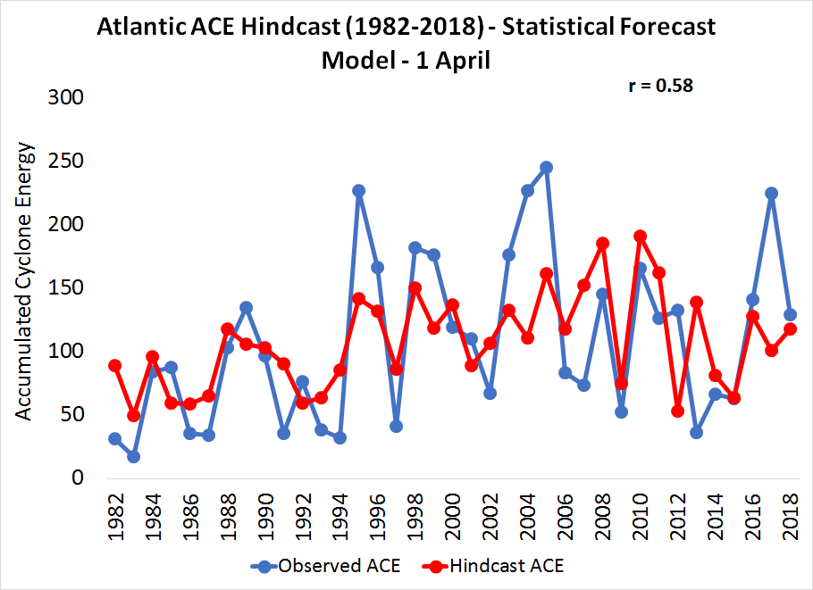

Slide 10
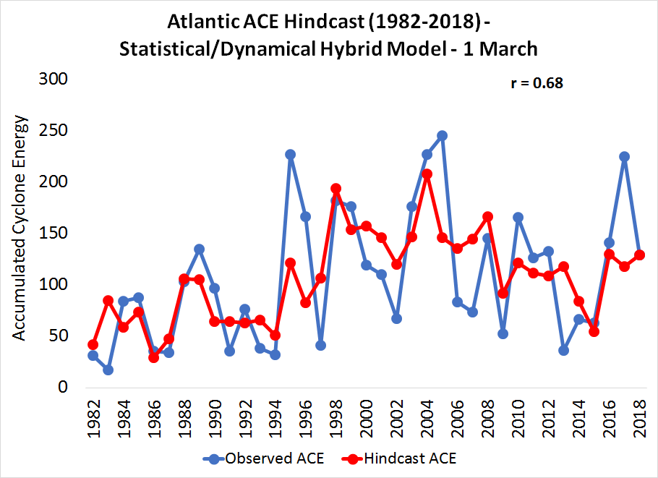

Slide 11
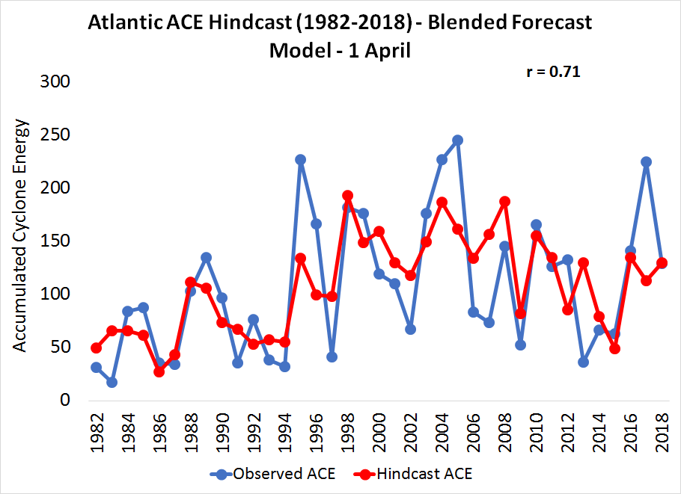

Slide 12
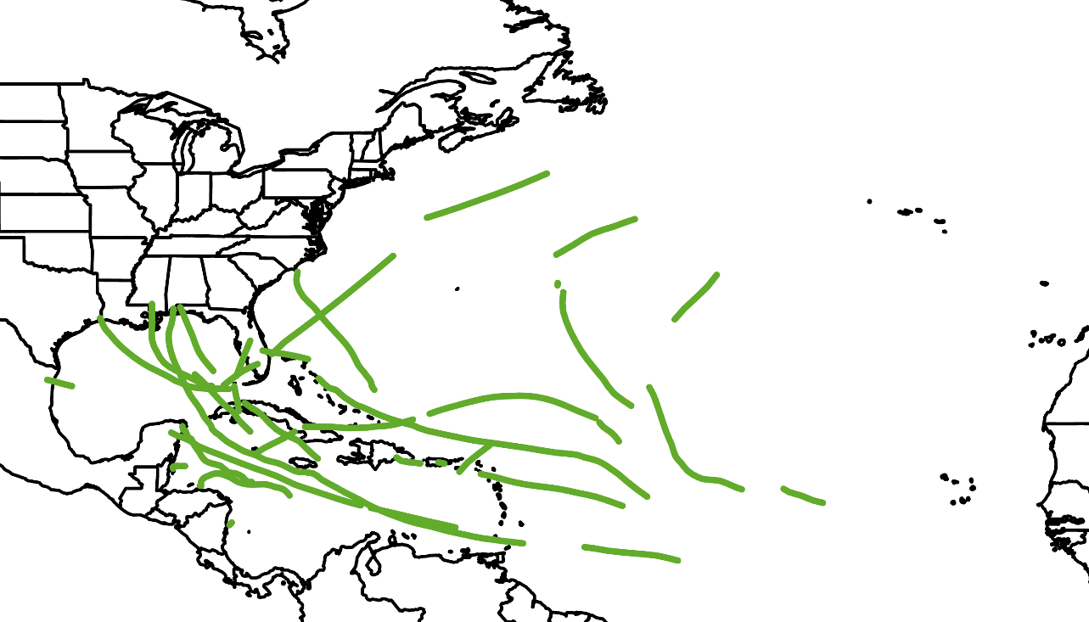
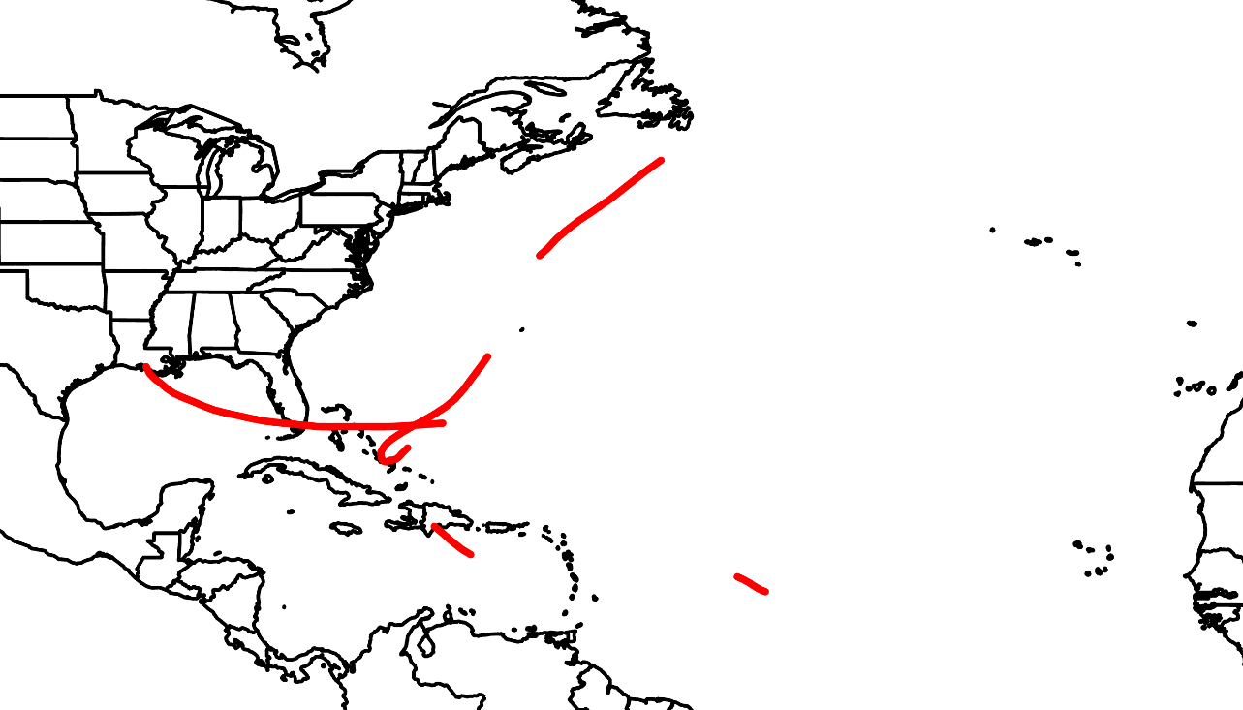
Observed Major Hurricane Tracks in 5 Most Active Hindcast Seasons
24 Major Hurricanes
61.75 Major Hurricane Days
7 CONUS Landfalling MH
Observed Major Hurricane Tracks in 5 Least Active Hindcast Seasons
5 Major Hurricanes
9.25 Major Hurricane Days
2 CONUS Landfalling MH

Slide 13
Early June Forecast

Slide 14
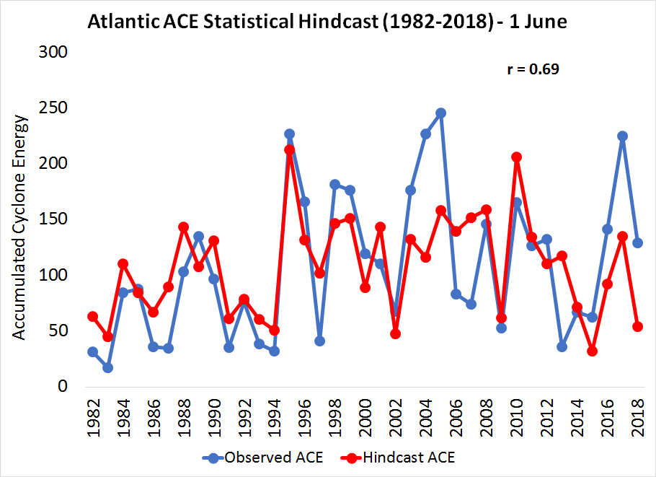

Slide 15
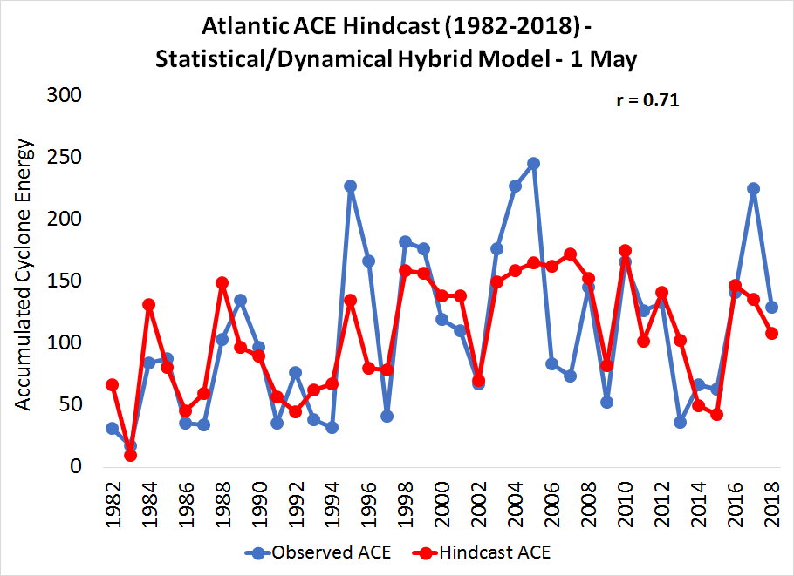

Slide 16
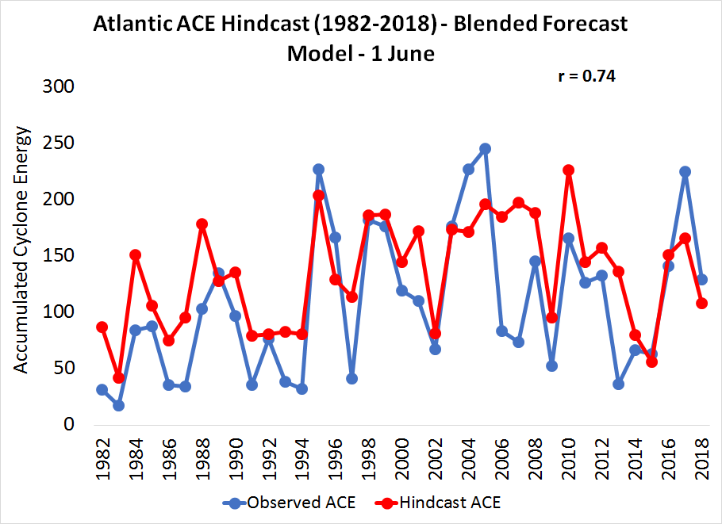

Slide 17
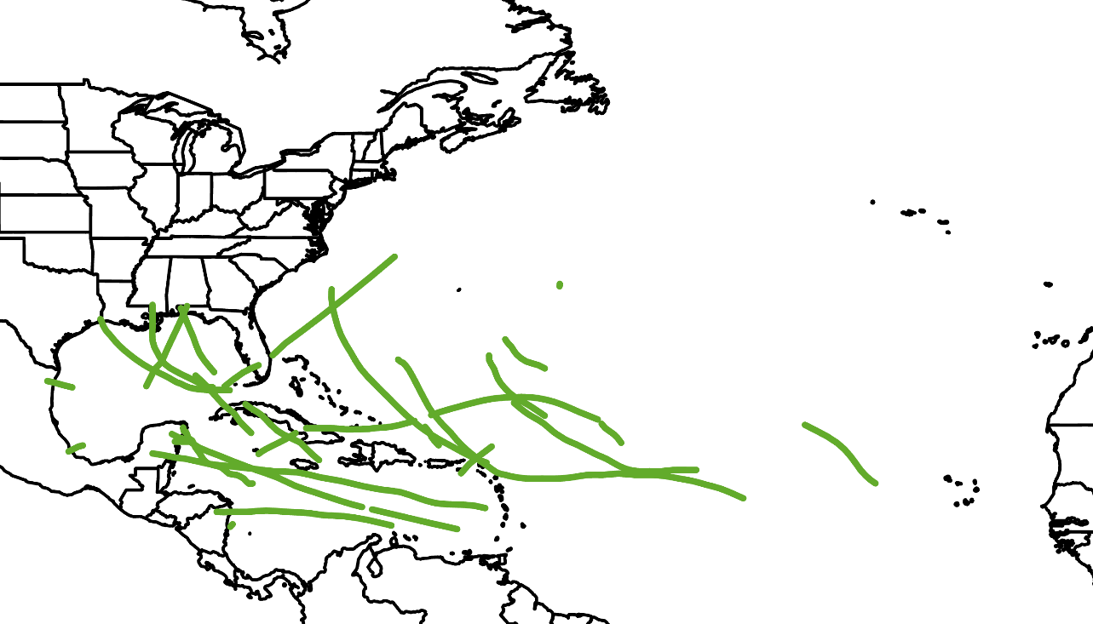
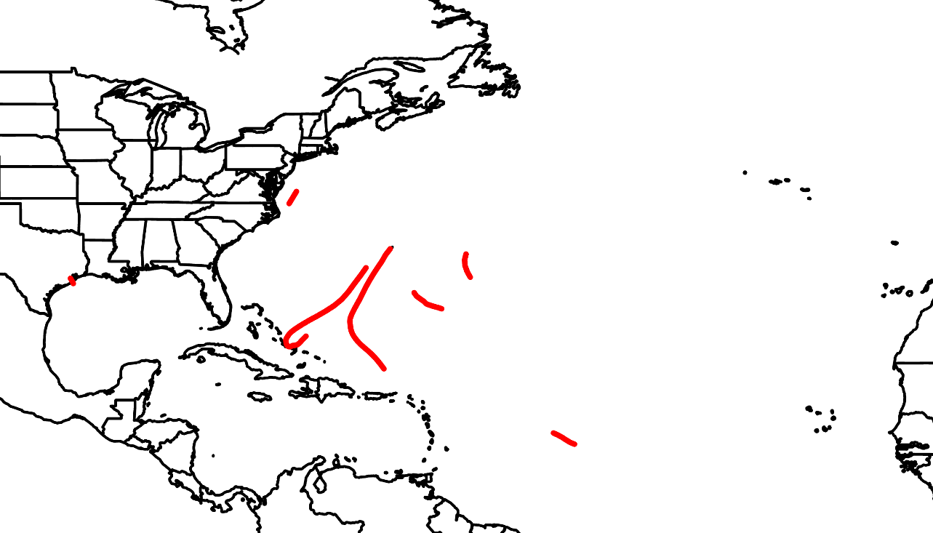
Observed Major Hurricane Tracks in 5 Most Active Hindcast Seasons
24 Major Hurricanes
53.5 Major Hurricane Days
5 CONUS Landfalling MH
Observed Major Hurricane Tracks in 5 Least Active Hindcast Seasons
7 Major Hurricanes
9.50 Major Hurricane Days
1 CONUS Landfalling MH

Slide 18
Correlation Improvement Summary
Month | Statistical | Statistical/Dynamical | Combined
April | 0.58 | 0.68 | 0.71
June | 0.69 | 0.71 | 0.74
July | 0.80 | 0.76 | 0.81

Slide 19
Summary
Statistical/dynamical hybrid model forecast shows improved skill relative to statistical model for April and June forecasts
Combining statistical and statistical/dynamical hybrid model shows improved skill to either scheme individually

Slide 20
Future Work
Include the GloSea5 dynamical model to arrive at ensemble statistical/dynamical hybrid model forecast
Forecast peak of Atlantic hurricane season large-scale conditions (August-September) with dynamical models
Incorporate dynamical model forecasts of steering flow to determine likelihood of hurricane landfalls

