Slide 1


EMS Annual Meeting 2019, Copenhagen, Demark, 9-13 September 2019
Sea-Land-Breeze Circulation over
the Seoul Metropolitan Area
Moo-Soo Park ∙ Jung-Hoon Chae
Research Center for Atmospheric Environment
Hankuk University of Foreign Studies, Korea

Slide 2

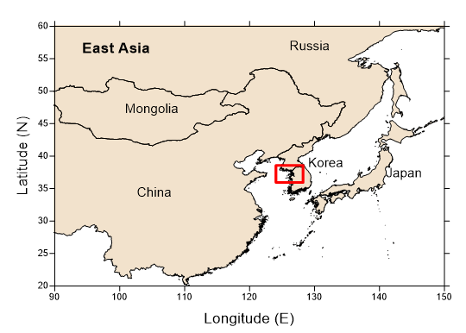
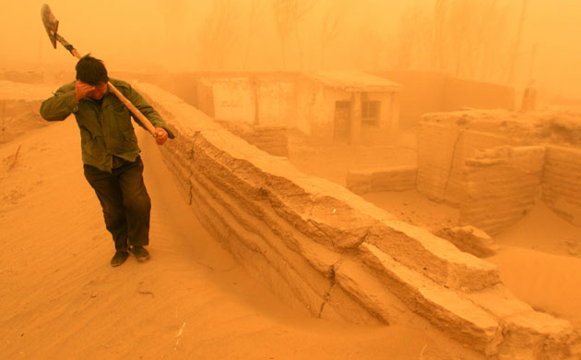
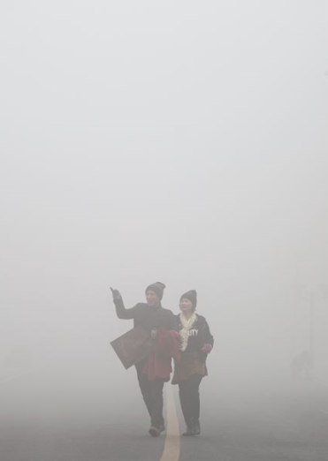
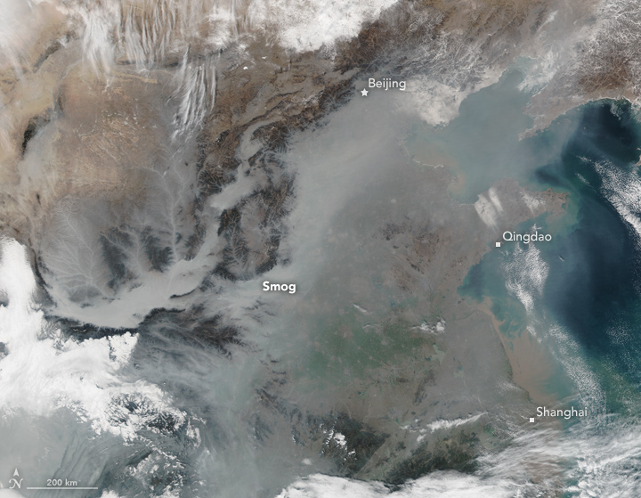



01
Motivation
Local circulation, especially sea-land breeze circulation, plays an important role in providing high-resolution meteorological and air quality information in peninsula countries with high mountains such as in Korea.
Due to the Asian Smog in 2010s, Korea suffers very severe natural dust as well as anthropogenic smog events every year.
Main cause of smog in Korea: long-range-transported, domestic originated, and mixed with the two
Credit: NASA
25 Jan 2017

Slide 3
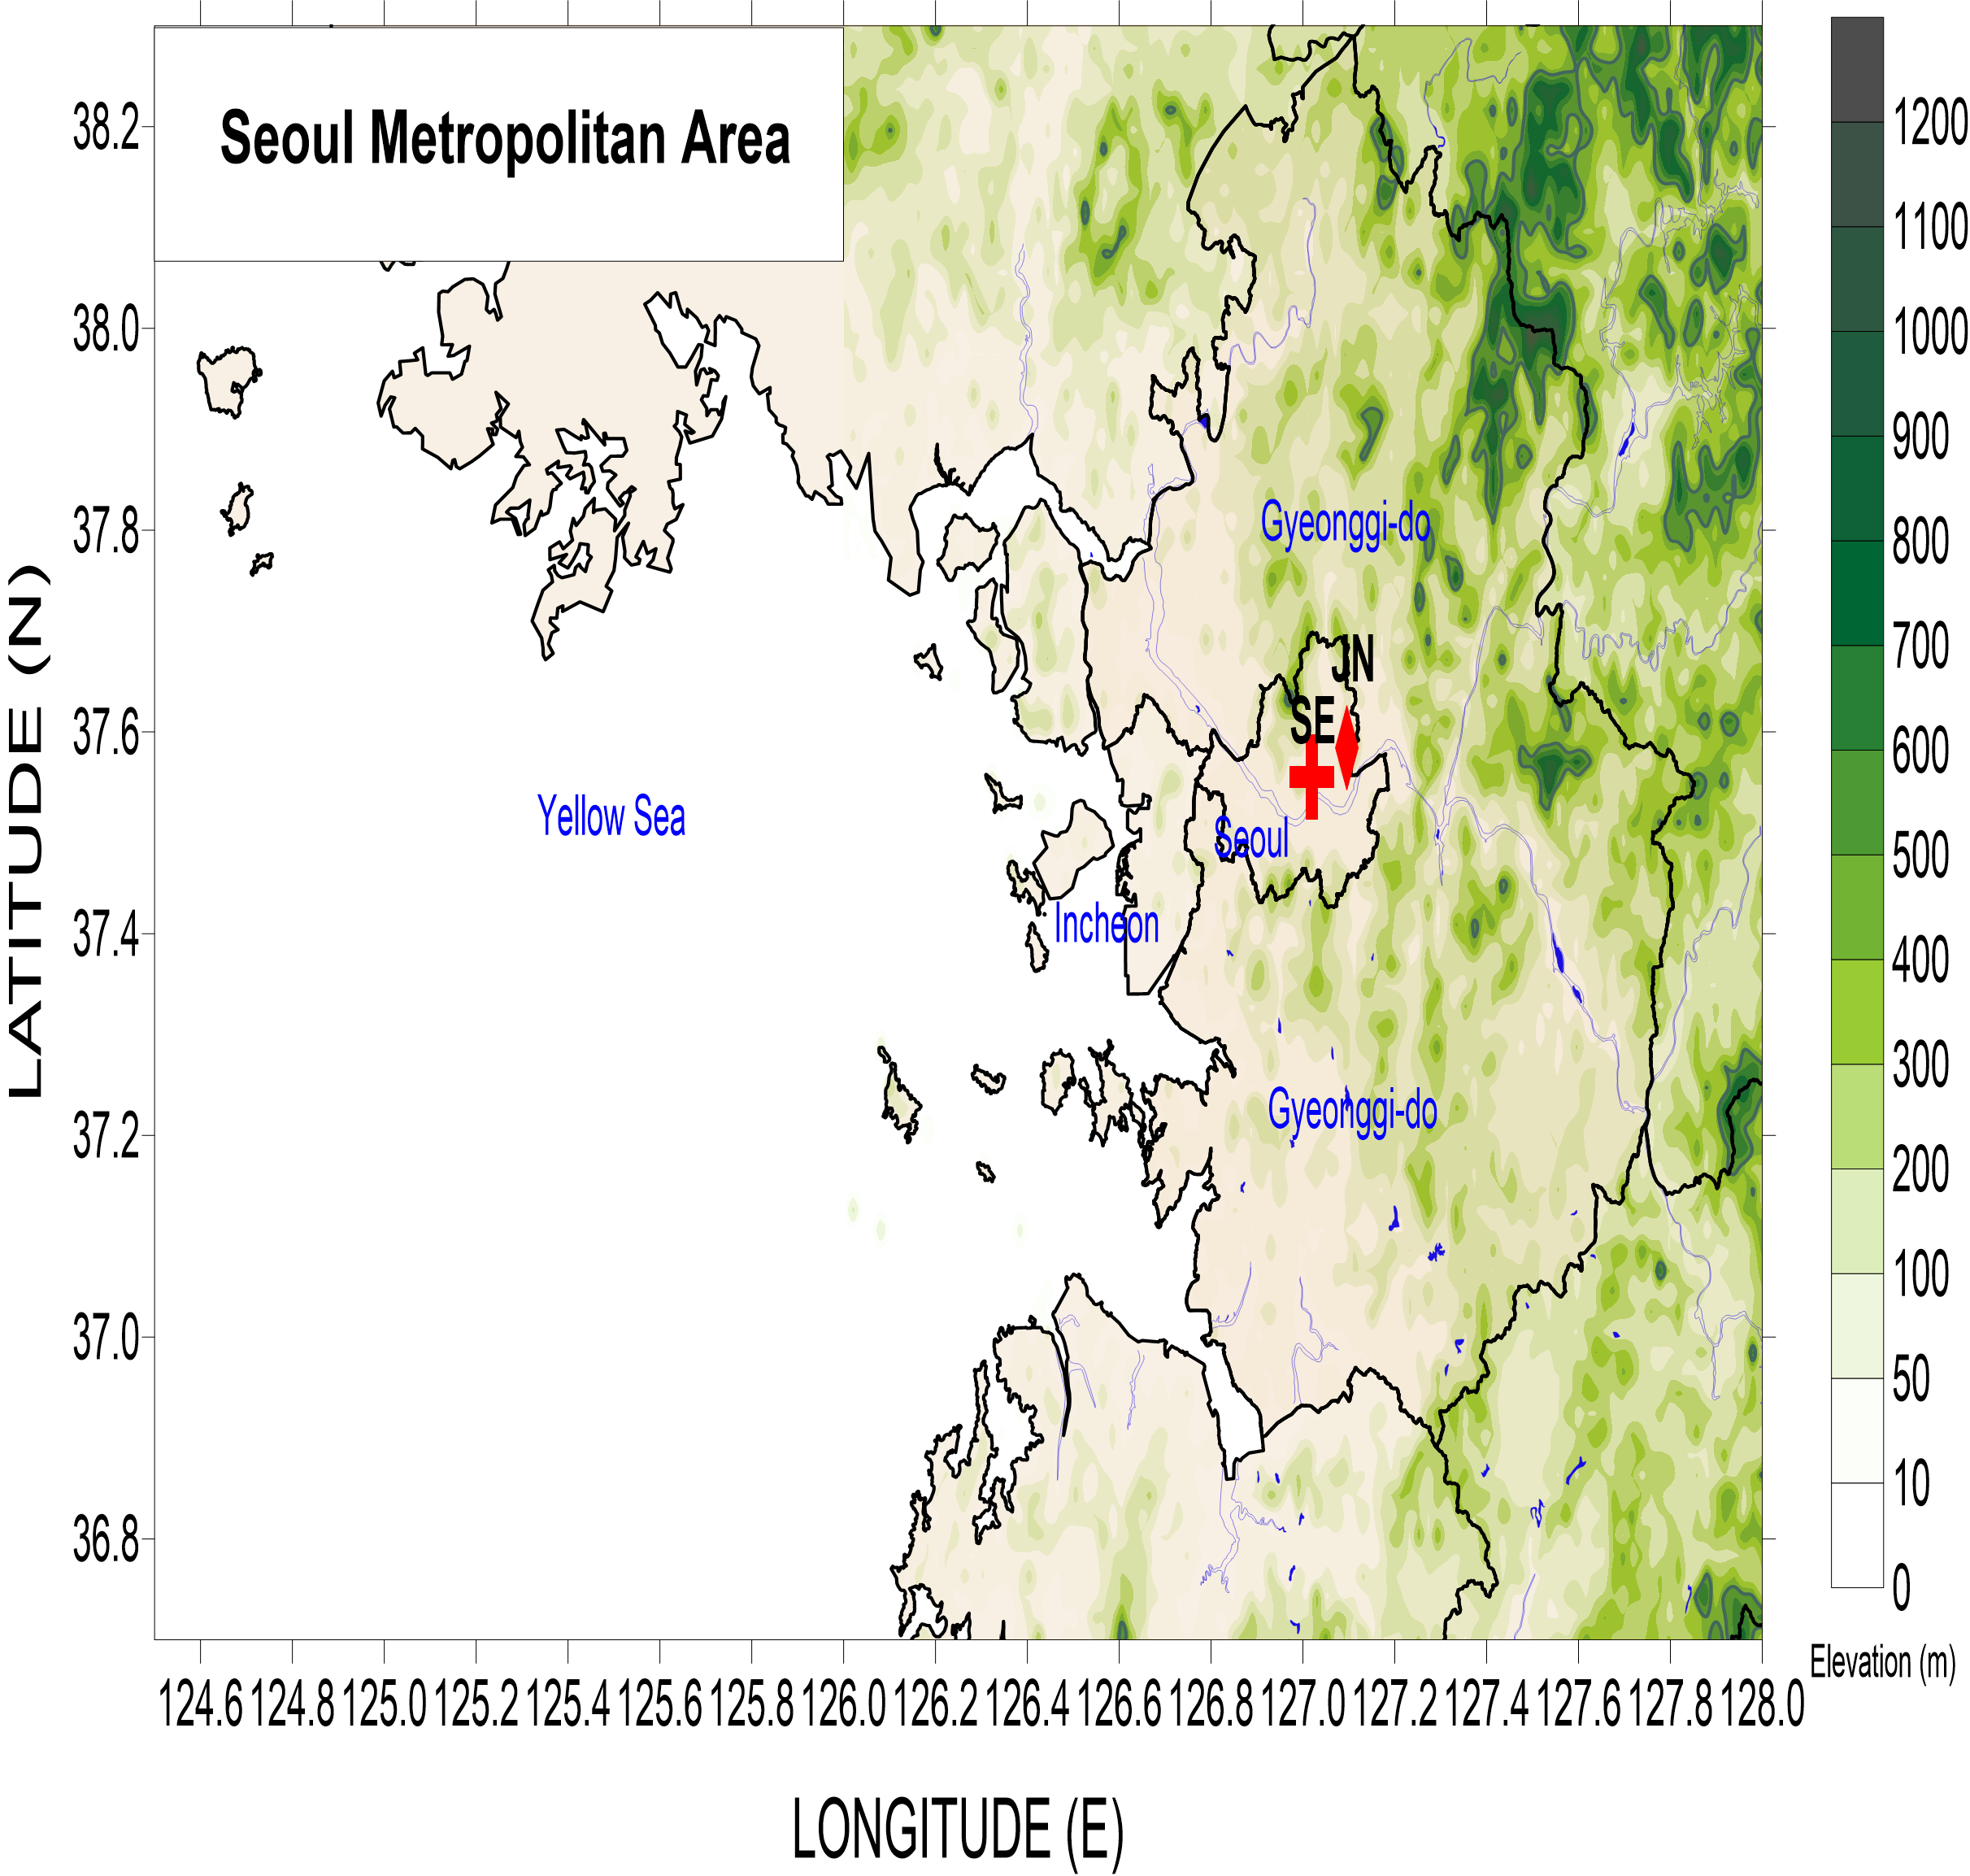
01
Background
The Seoul Metropolitan Area (SMA) has very complex geography, topography, and land covers.
➔ SMA could be easily affected by the local circulation.

Slide 4
01
Purpose
Recently, high-resolution surface meteorological observation data and surface-based remote sensing data (UMS-Seoul) are available in the SMA (Park et al., 2017).
Purpose
Observation-based sea-land-breeze circulation features in the SMA
Starting and ending times and advancing speed of sea-breeze and land-breeze
Features of land-breeze circulation
Vertical structure of sea-land-breeze circulations

Slide 5
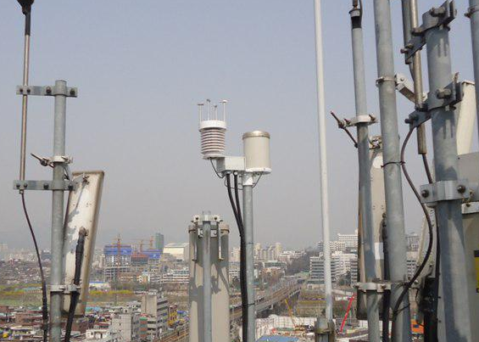
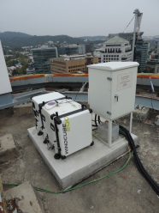
02
Station and Instrumentation
SKTechX
Data: Temperature, Humidity, Wind speed and direction (Sonic), Pressure, Precipitation
Stations: 381
Data sampling: 1 min
Doppler-Pulsed Wind Lidar

Slide 6
03
Experimental period
Wind speed at 850 hPa : 2 – 5 m/s (Osan Upper Air Measurement)
Daily mean wind speed: 1.6 – 2.0 m/s (monthly mean of 2.4 m/s)
Daily mean cloud cover: 0 – 30 % (monthly mean of 46%)
Low synoptic wind
clear days
17-22 May 2016
(6 consecutive Days)

Slide 7
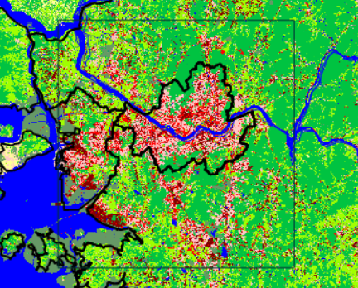
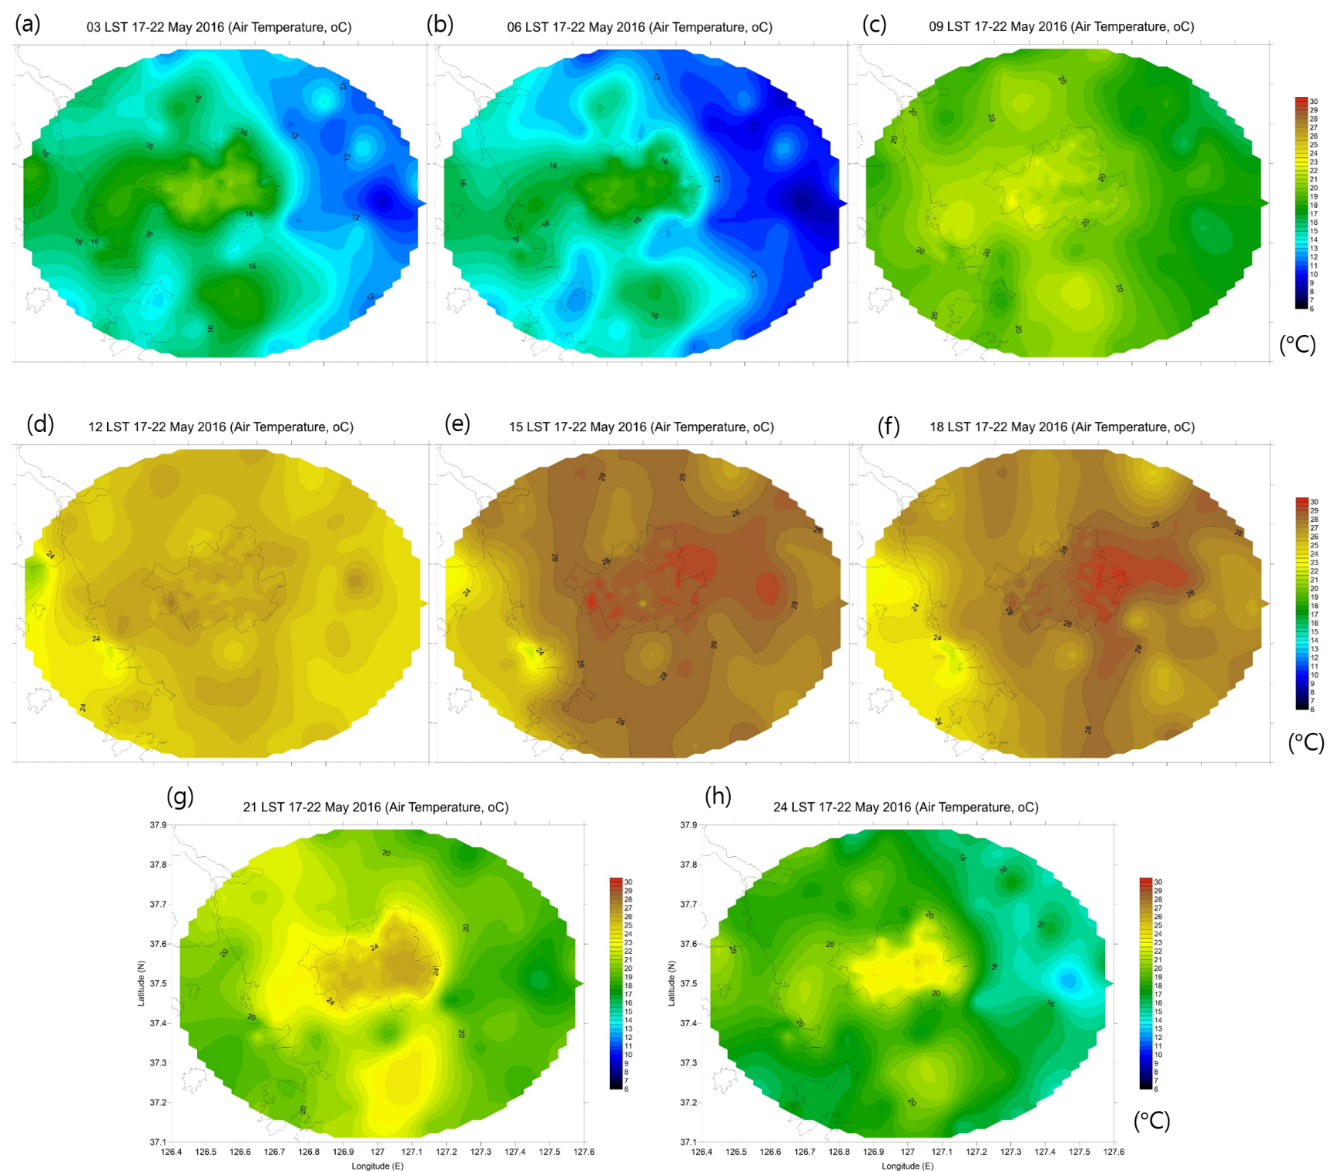
03
Results
temperature
03 LST 06 LST 09 LST
12 LST 15 LST 18 LST
06 LST
12 LST
18 LST
24 LST
21 LST 24 LST

Slide 8
03
Results
Daily temperature range is less than 10 ℃ in the sea area, increases with distance from the shoreline. Maximum range is above 20 ℃ in eastern land region.
Urban shows the smaller daily temperature range than the surrounding rural regions.

Slide 9
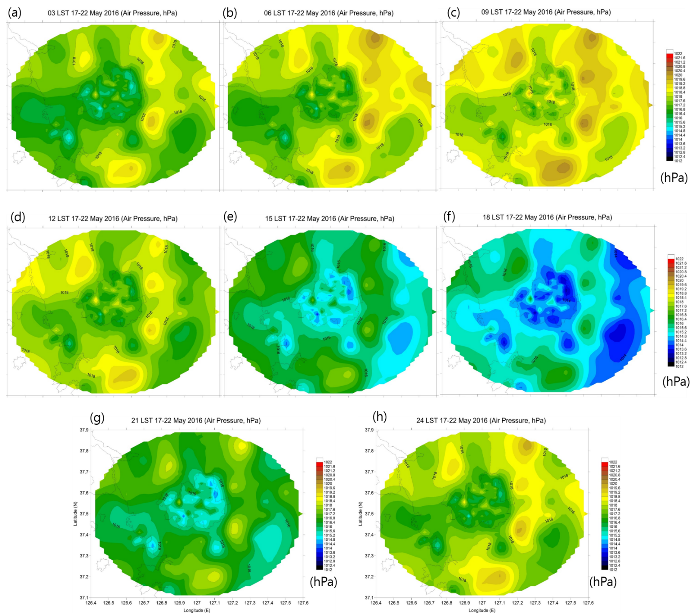
03
Results
Pressure
03 LST 06 LST 09 LST
12 LST 15 LST 18 LST
Daily pressure difference increases with distance from the shoreline in land. Minimum (Maximum) difference was 2.5 (5.1) hPa in sea (eastern land) region.
Urban does not show any distinct daily pressure difference patterns.
21 LST 24 LST

Slide 10
03
Results
6
7
3
4
5
2
1
Temperature differences between the sea and the land
Pressure anomaly difference between the sea and the land
Positive PA Diff induces land breeze
Negative PA Diff induces sea breeze

Slide 11
03
Results
6
7
2
3
4
5
1
Sea Breeze
Start at shoreline at 12 LST, reach 60 km inland at 18 LST.
Moving speed of about 10 km h⁻¹.
Land Breeze
Land breeze occurs within 50 km inland.
Land breeze starts at 23 (04) LST, lasts until 13 (11) LST at Station 5 (1).
1 2 3 4 5 6 7

Slide 12
03
Results
1700 LST
3.6 ºC
1730 LST
7.8 hPa
3.1 m/s
1800 LST

Slide 13
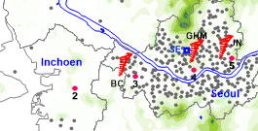
03
Results
BC: Bucheon
GHM: Gwanghwamun
JN: Jungnang
Sea Breeze
 | BC | GHM | JN
Start | 1500 | 1530 | 1700
End | 2200 | 2100 | 2030
Height | 1.5km | 1.3km | 1.3km
 | 2 cells | 1 cell | 1 cell
Land Breeze circulation
 | BC | GHM | JN
Start | 0300 | 0200 | 0200
End | 1100 | 1100 | 1130
Height | 0.7km | 0.8km | 0.8km
Max Speed | 250m (0600 LST) | 350m (0630 LST) | 400m (0700 LST)

Slide 14
04
Summary
The detailed surface meteorological and vertical profile features of the sea-land breeze circulations over SMA were investigated using the data obtained from UMS-Seoul high-resolution surface meteorological and 3 wind lidar stations.
The distinct temperature differences exist not only between land and sea regions, but also between urban and rural regions. It implies the possibility of sea-land breeze as well as urban-rural breeze in SMA. Daily temperature differences in urban areas were much smaller than those in the surrounding rural areas because of higher temperature during the nighttime.
Temperature differences between the land and the sea could induce the pressure difference between the two. Amplitude difference and phase shift of the sea-level pressure anomaly with respect to the distance from the shoreline produces the sea-breeze-circulation.

Slide 15
04
Summary
The sea-breeze front started at the shoreline at 12 LST, moved landward at a rate of about 10 km h⁻¹, and reached 60 km inland at 18 LST. The land breeze occurred at areas within 50 km of the shoreline with a maximum in the early morning.
The top of sea breeze reached to 1.5 km height with maximum winds at 0.4 km in the late afternoon. The top of land breeze reached to 0.8 km with a maximum winds at 0.3-0.4 km in the early morning. The returning easterly winds were clearly observed over the land-breeze cell at 1.5-1.6 km height. Minor local circulation was also observed between the land-breeze and the sea-breeze period.
Park and Chae, 2018
Doi:// 10.1186/s40562-018-0127-6

Slide 16




Thank you!

