Slide 1


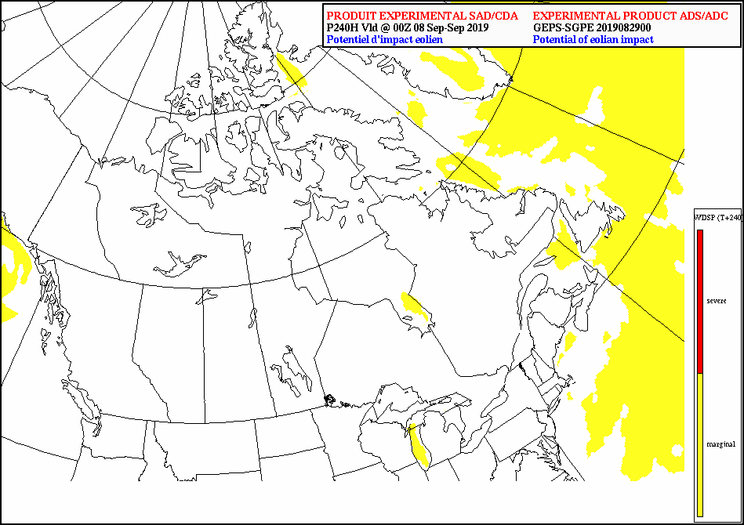
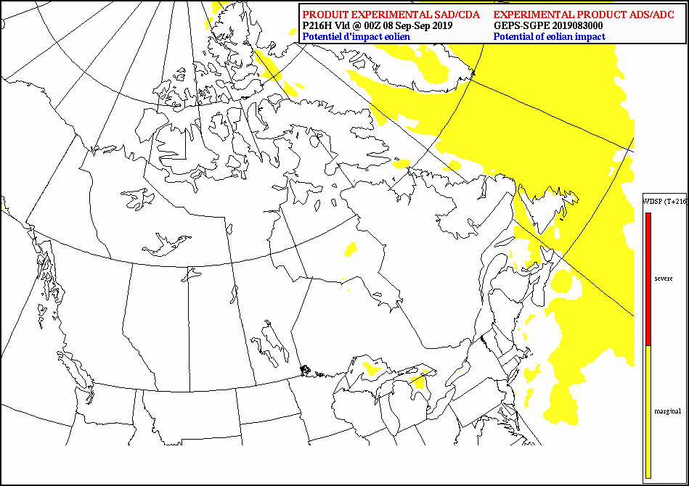
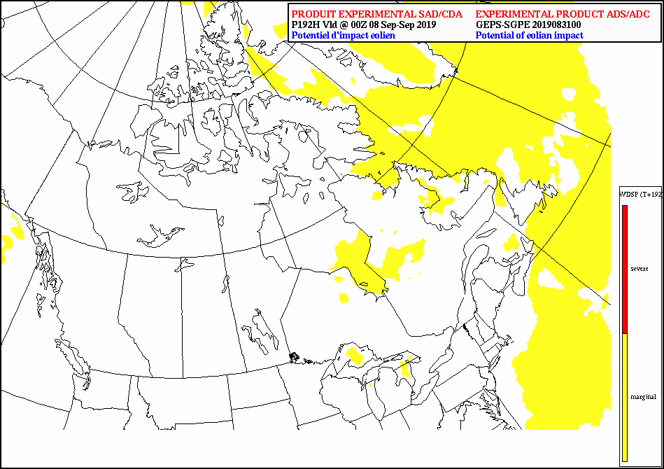
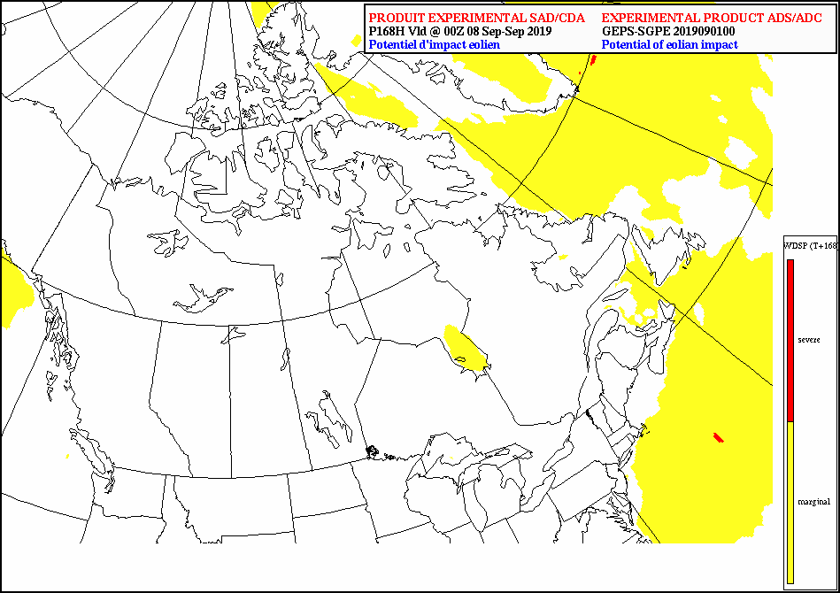
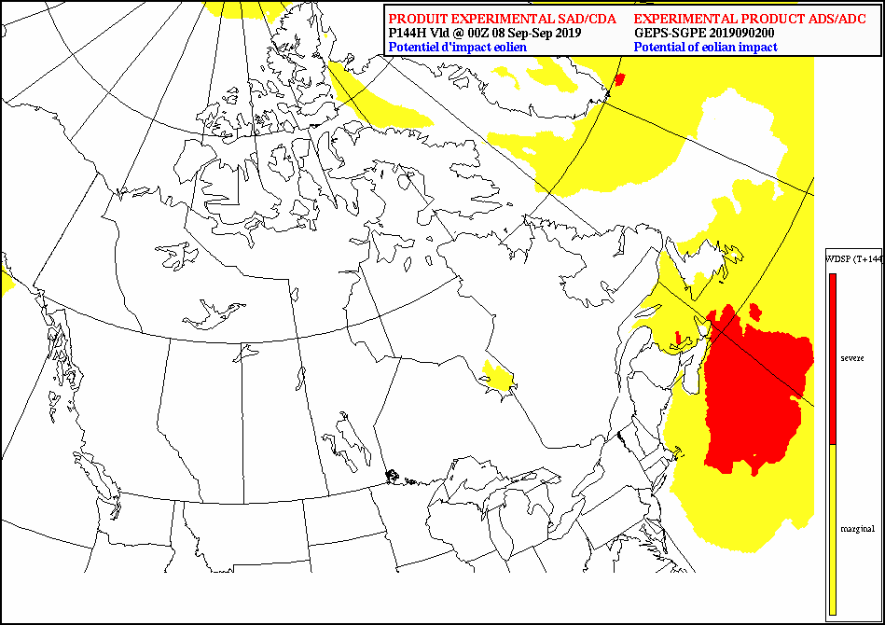
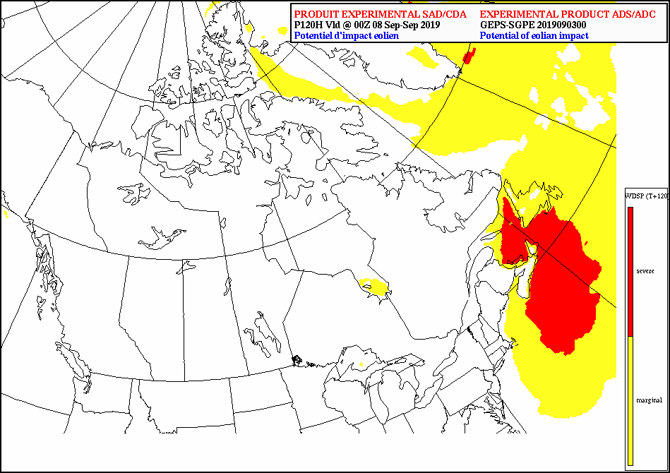
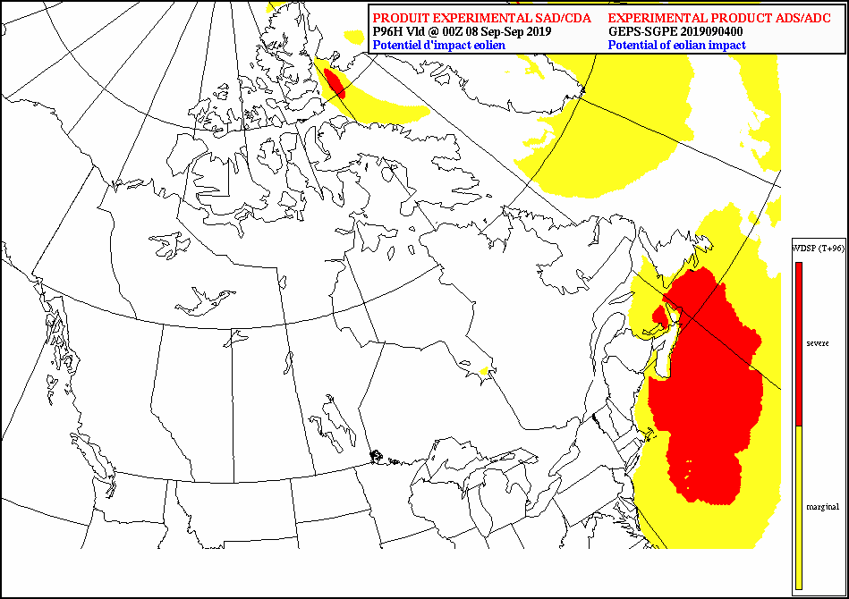
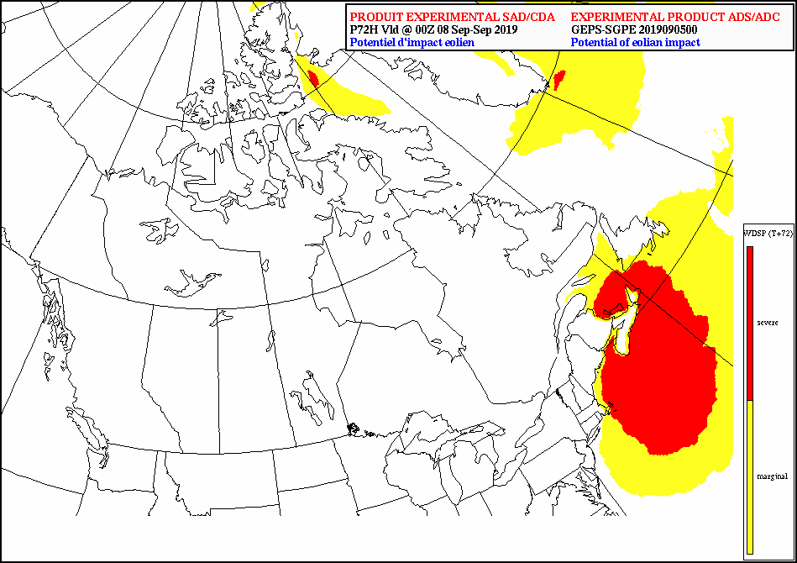
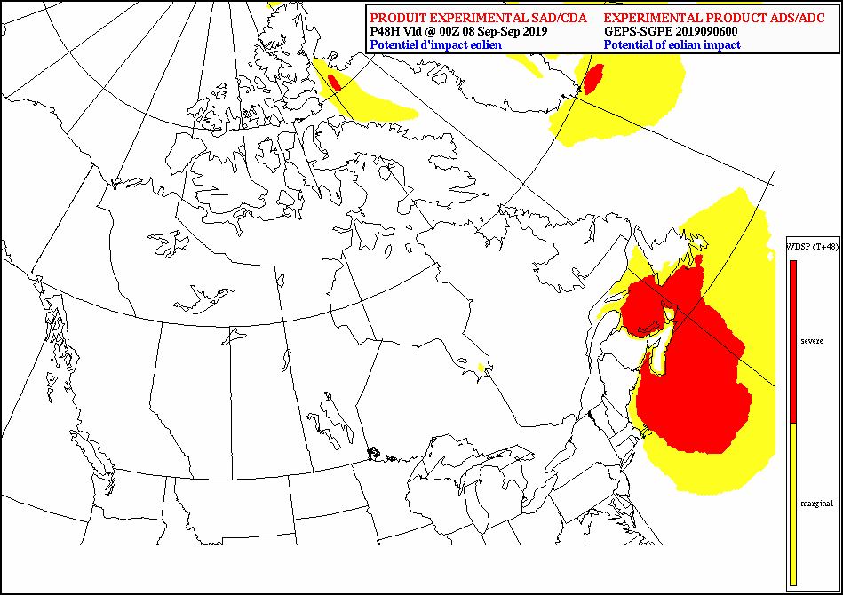

Impact Based Forecast for the Canadian Armed Forces
From a deterministic to a probabilistic approach
T+240
T+216
T+192
T+168
T+144
T+120
T+96
T+72
T+48
EMS 2019
September 9th-13th, 2019
Copenhagen, Denmark
David Dégardin
Marie-France Turcotte
Applied Development Cell (ADC),
Joint Meteorological Center (JMC),
Aviation and Defence Services (ADS),
Notes:
MSC, ADS Employee
Belong to the Applied Development Cell. An entity of the Aviation and defence Services.
Working for a very specific client : The Department of National Defence.
ADC’s mandate : By understanding Existing and new military requirements and MSC emerging capabilities. The Applied Development Cell (ADC) undertakes projects to move Canadian Forces (CF) weather support forward technically and scientifically.
Located on the 5th Canadian Division Support Base, Gagetown, NB (green cross close to the Fundy bay).
The map shows the evolution from day 10 to day 2 of the forecasted sustained (Yellow: 50 kmh, red: 70 kmh) wind impacts, by the Canadian GEPS, due to Dorian on the Maritimes provinces. Dorian hit Nova scotia close to Halifax around 7pm.

Slide 2



Agenda
THE SITUATIONAL AWARENESS PROJECT
Project’s framework
Rationale
Consolidated Weather Impact Chart
  Objectives
  Principles
Current state (deterministic)
  In house web-site
  WMS/WCS/WFS capability
Looking ahead (probabilistic)
  CAF Matrix
  Vigilance-in-Context Matrix
“Holly cow …
There's a lot of cows
… !!!...”
Notes:
After presenting the framework of the project and its rational.
Performing a quick overview on the CWIC and the current state in order to dive into the probabilistic aspect of the project.
Feel free to take pictures.

Slide 3
Project’s framework
THE SITUATIONAL AWARENESS PROJECT
  DND/DMETOC “Data centric approach”
  The « Modernization of MetOc data Services » Document (SOCD, sept 2015) suggests a significant update of CFWOS website to incorporate OGC-compliant web services to allow for interoperability with other applications and services, and to provide timely and cost efficient transmission of data to deployed assets.
  ECCC/MSC Vision
  “Prediction system will evolve towards a greater automation of forecast production while allowing the expertise of the operational meteorologist to be focused where the risk of hydrometeorological impacts is highest”. The evolution will take into account where meteorologist value is added to validate automation of data streams
Notes:
The framework of our situational awareness project is driven by both mother organization's visions (SMC and DND), which state:
Data centric approach
The « Modernization of MetOc data Services » Document (SOCD, sept 2015) suggests a significant update of CFWOS website to incorporate OGC-compliant web services to allow for interoperability with other applications and services, and to provide timely and cost efficient transmission of data to deployed assets.
MSC Vision
“Prediction system will evolve towards a greater automation of forecast production while allowing the expertise of the operational meteorologist to be focused where the risk of hydrometeorological impacts is highest”. The evolution will take into account where meteorologist value is added to validate automation of data streams

Slide 4
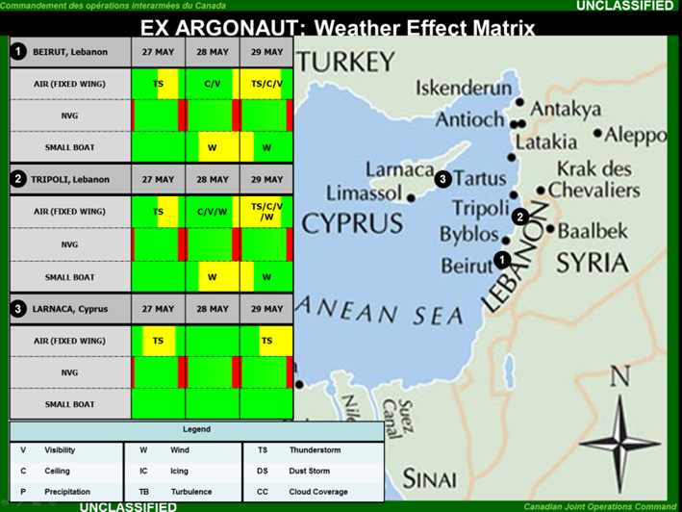
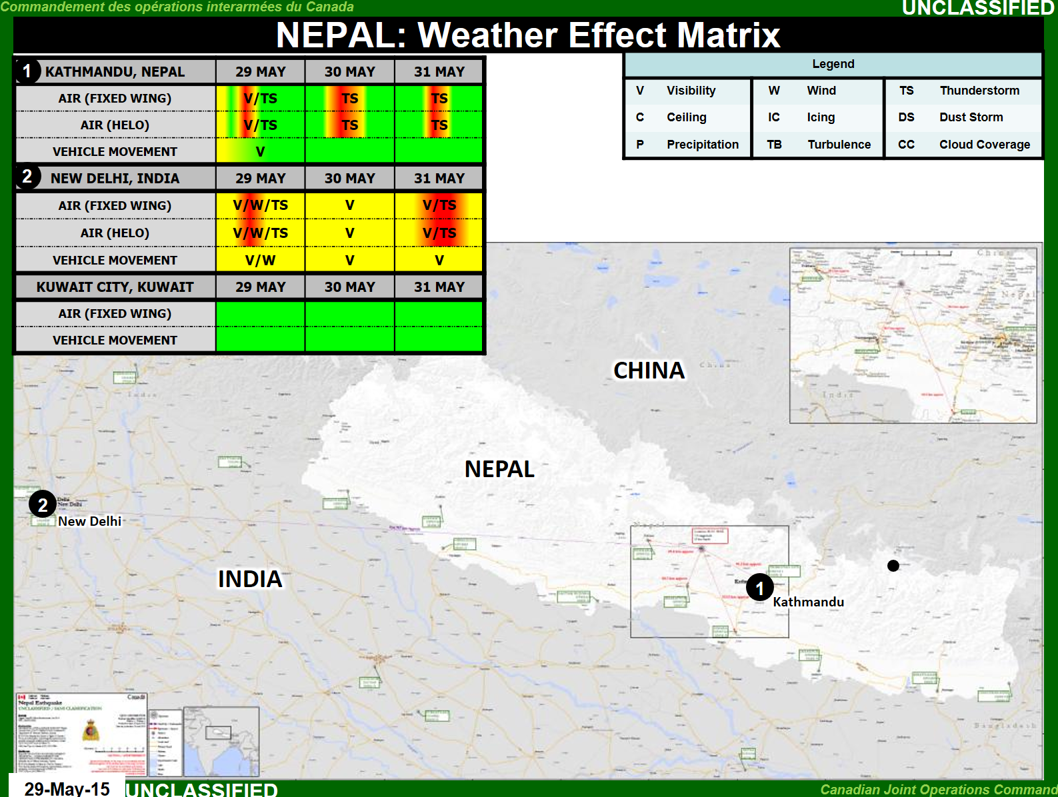
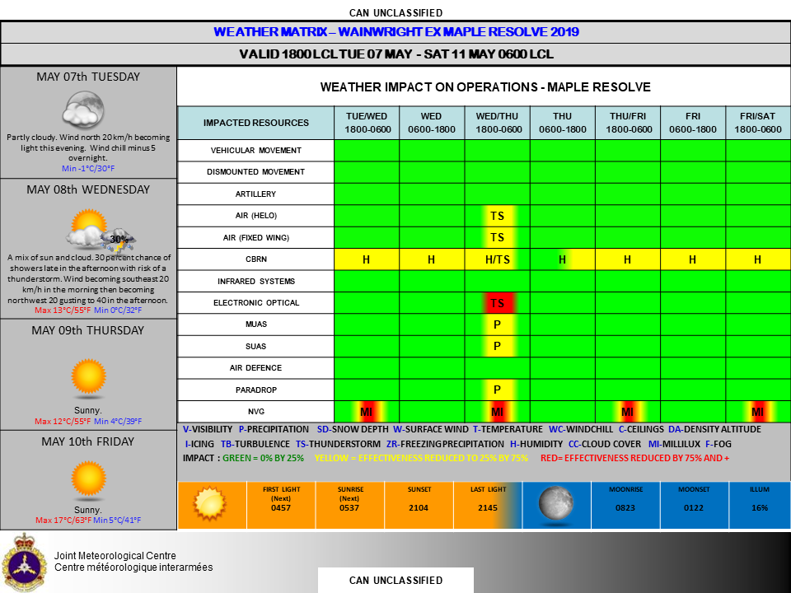
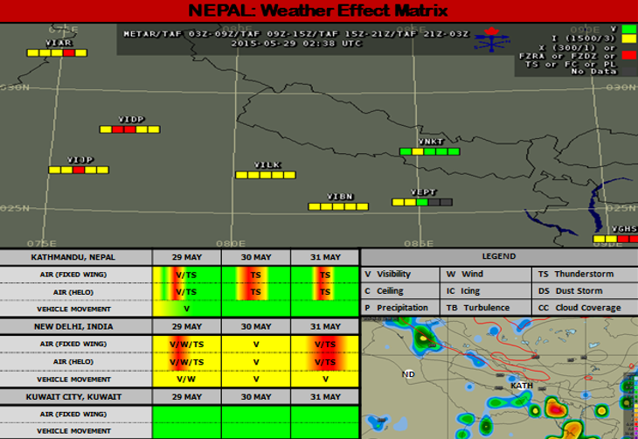
Rational
Currently, these types of products do not benefit from NWP's capabilities:
  data set on grid,
  ensemble forecasts,
  automation
DMETOC Data centric approach / MSC Vision:
  Going away from manual production of weather impact matrix (time consuming),
  Allowing flexibility in delivery information (data, product, GIS, Web Service etc)
  Focusing « met » expertise where impacts are highest
Notes:
To complement significant weather information, decision makers systematically request key information of weather impacts on their operations.
Operations, which can either be at tactical, operational or strategic levels, may involve potential participation of either RCAF, RCN, CAF corps.
Impact Matrices (using traffic lights code) are manually built from weather forecasts (expertized and automated) in order to support decision making processes.
On the other hand, these products do not benefit from NWP’s capabilities.
From the morther organizations visions, ADC undertook the situational awareness project in order to :
Go away from manual production of weather impact matrix (time consuming),
Allow flexibility in delivery information (data, product, GIS, Web Service etc)
Focus « met » expertise where impacts are highest

Slide 5
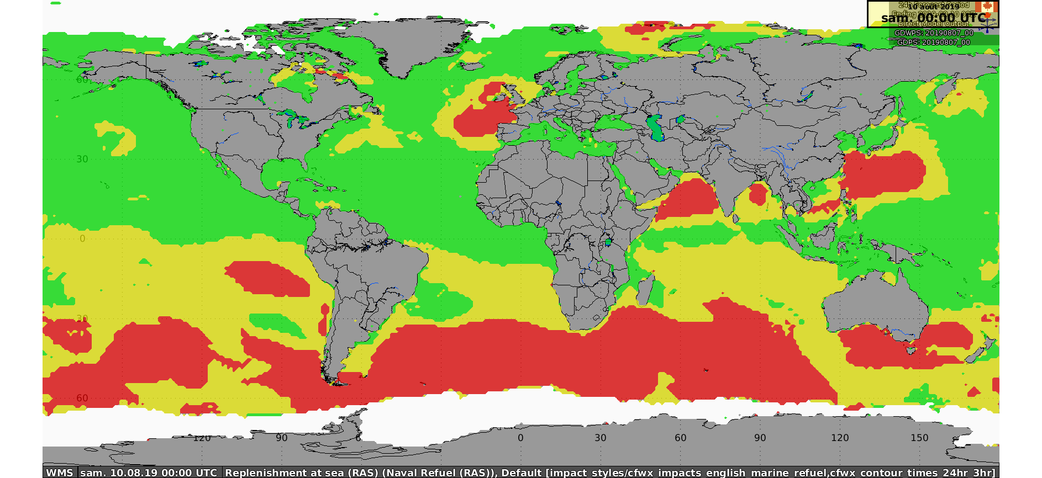






Consolidated Weather Impact Chart (CWIC) - Objectives
Relevant Environmental data base
Mission planing
Canadian Forces
Intelligence
Command
Assets
Royal Canadian
Air Force
Royal Canadian
Navy
Canadian
Army
Notes:
From a relevant Environmental database, user selects appropriate meteorological fields, defines and applies his own operational limits on the selected fields in order to produce a consolidated field representing an operational impact forecast based on forecasted weather conditions

Slide 6
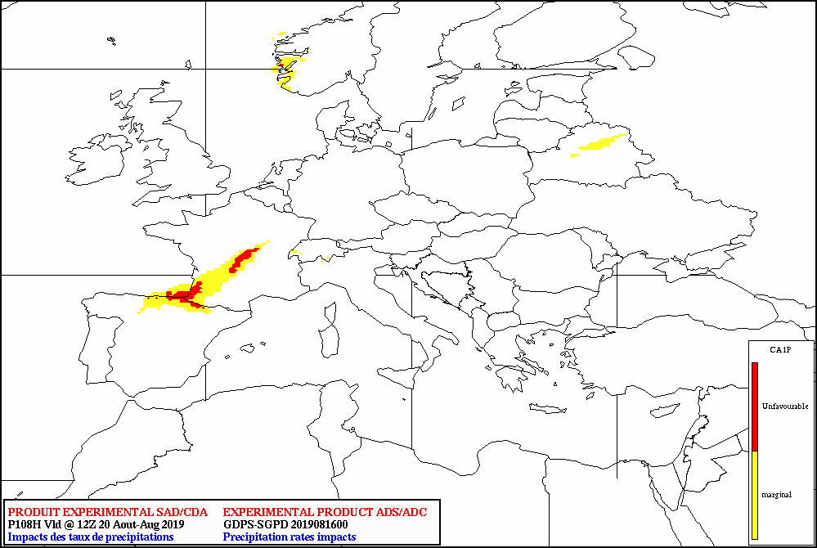
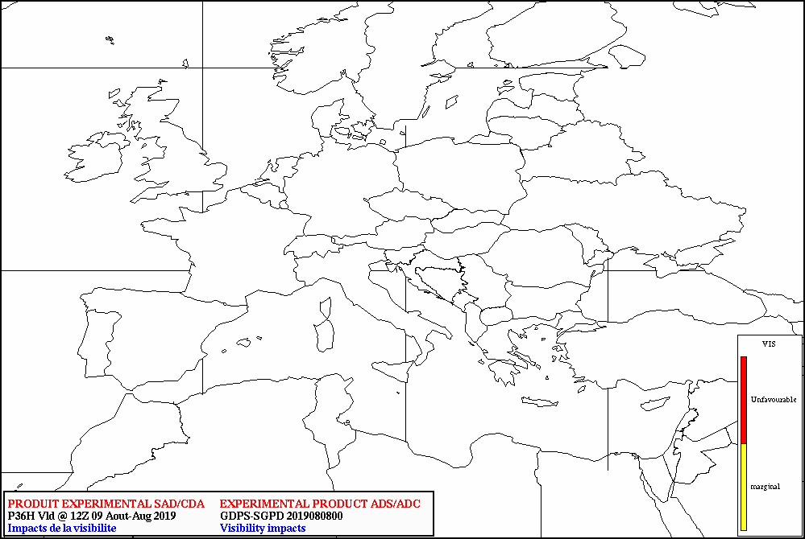
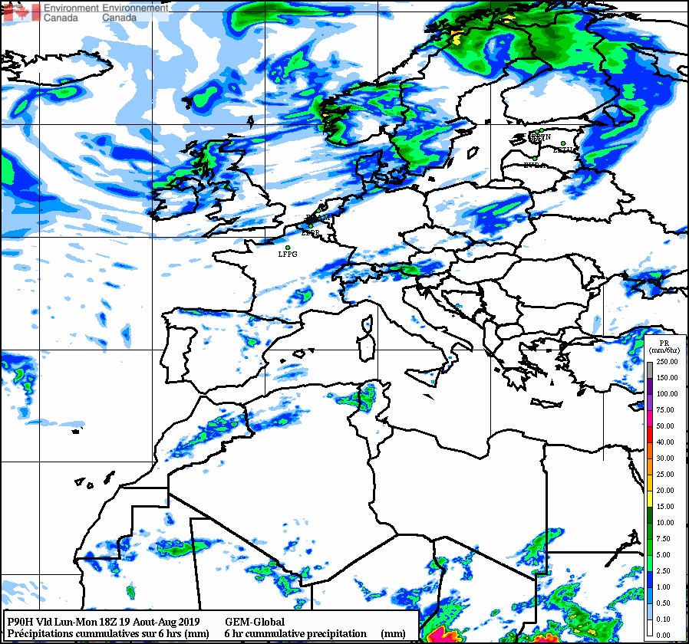
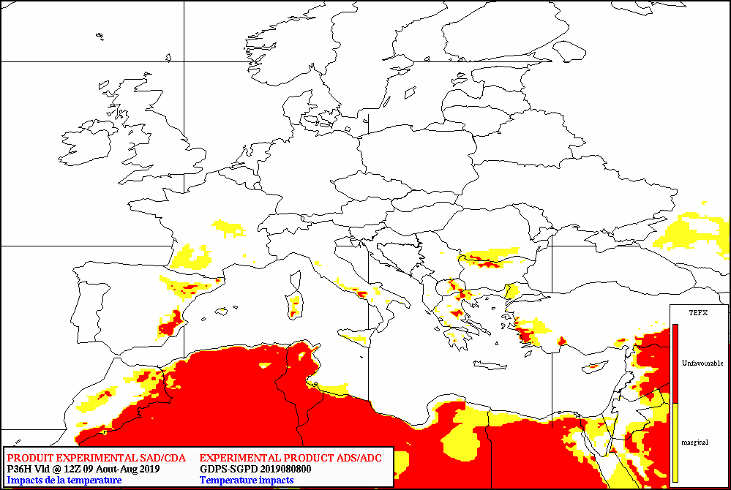
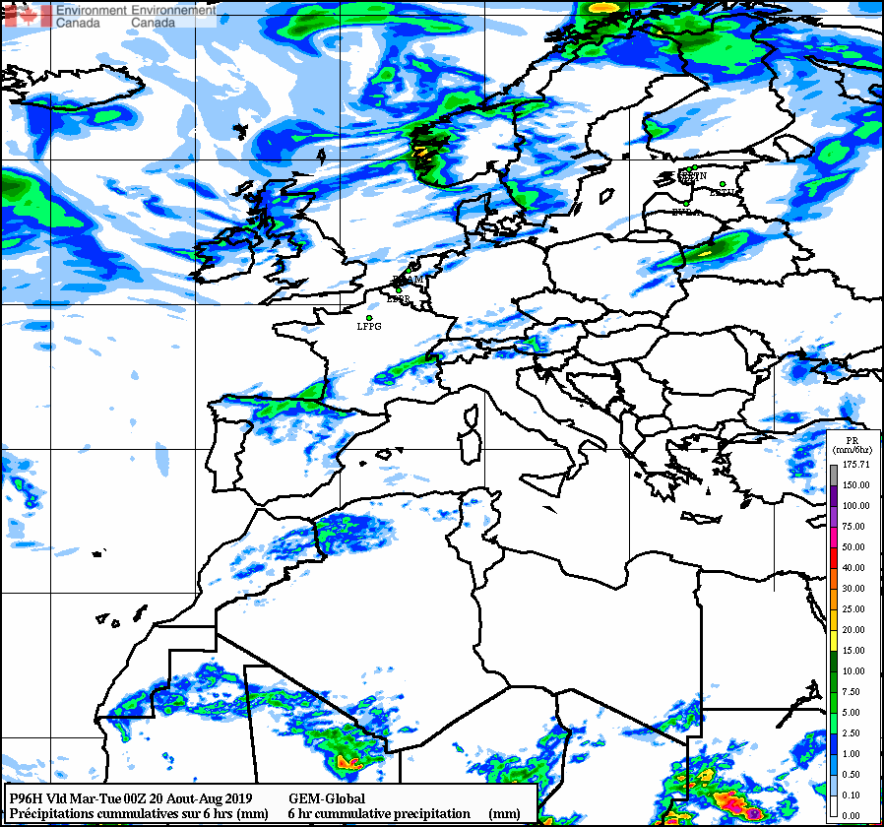
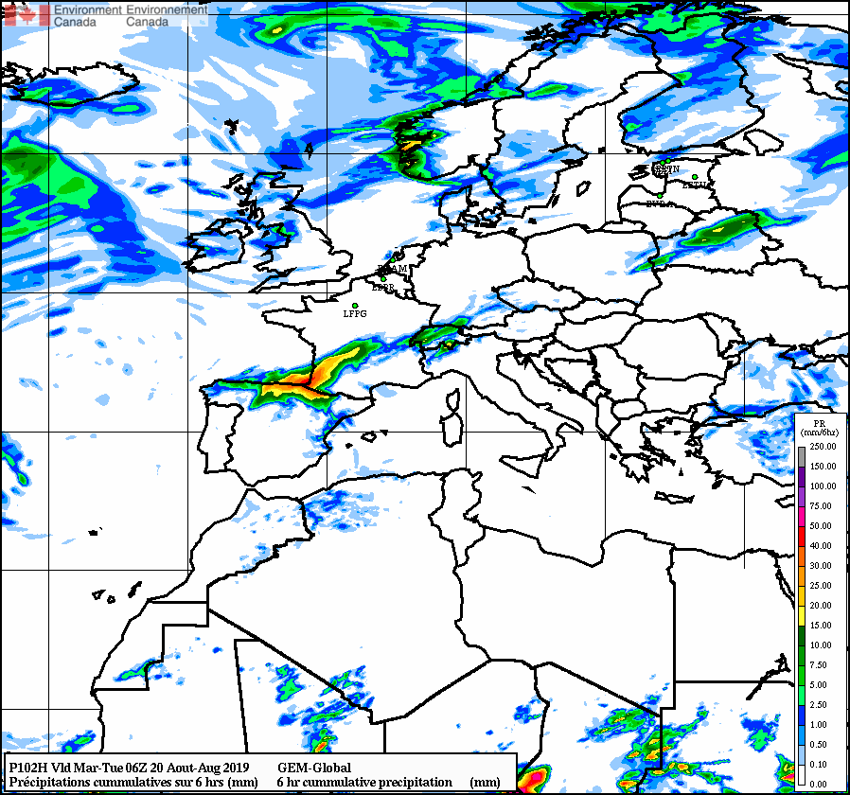
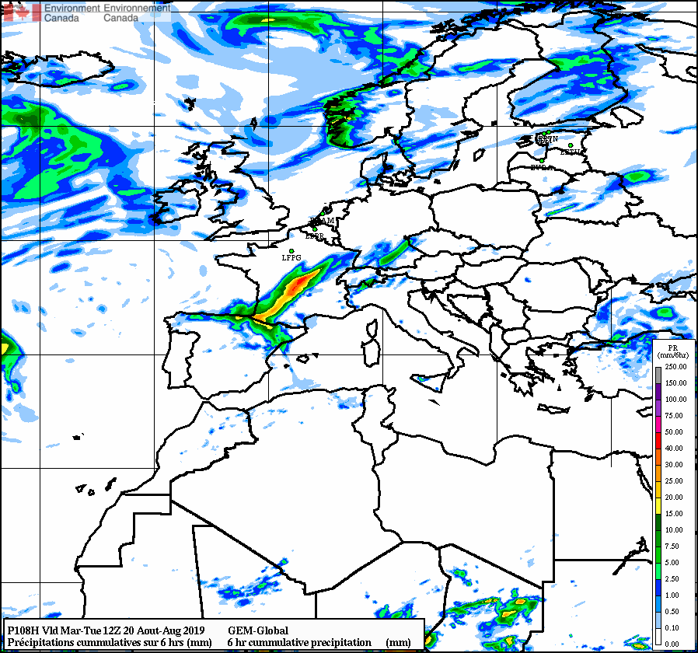
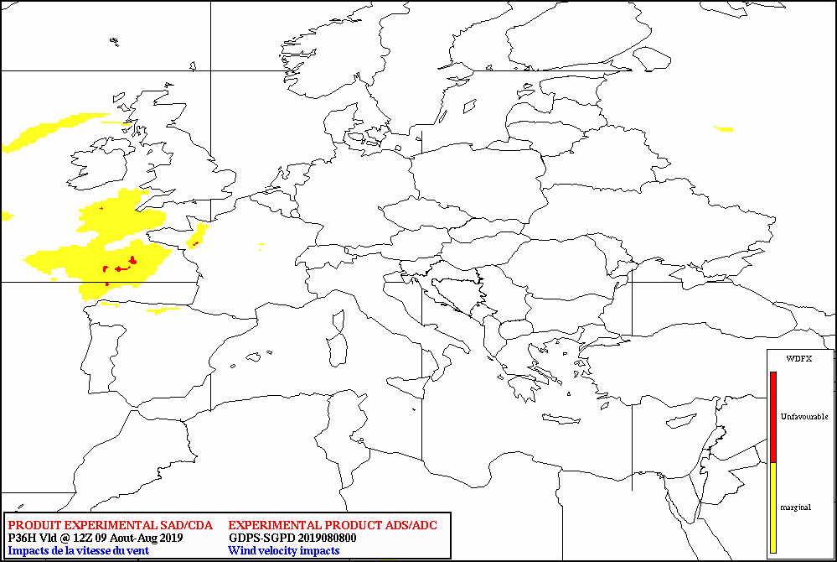
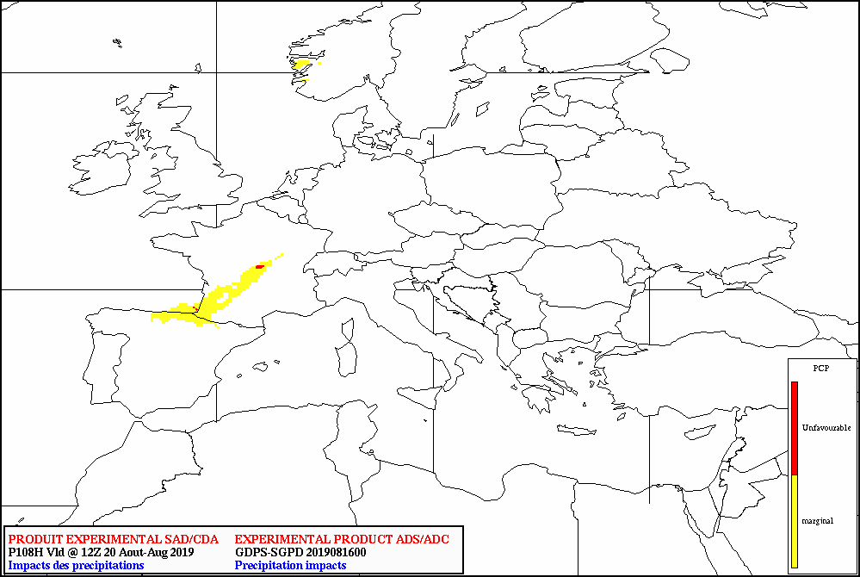
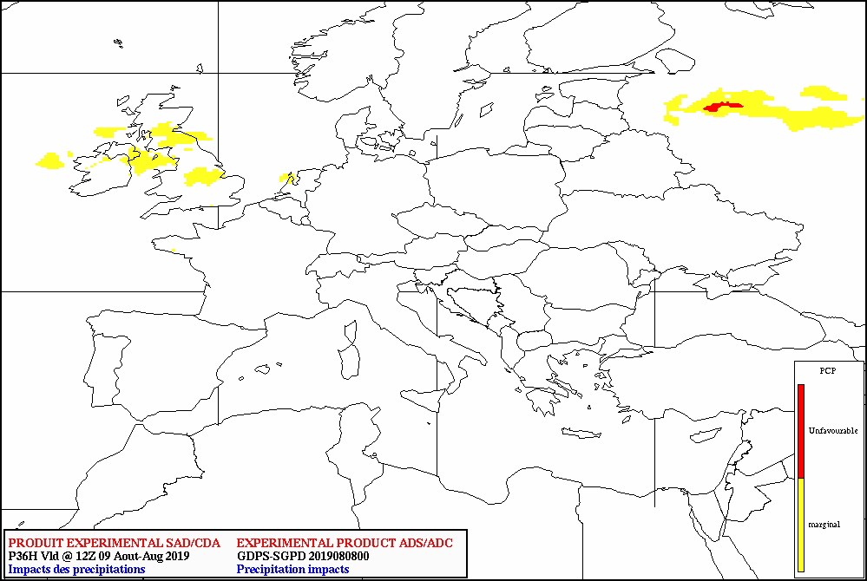
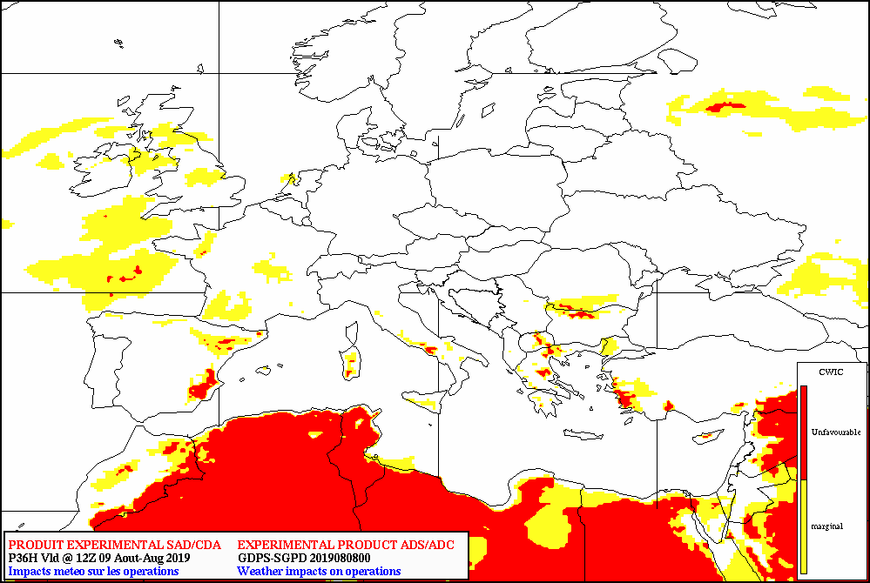
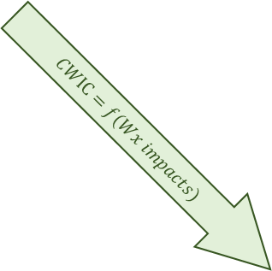
Consolidated Weather Impact Chart (CWIC) - Principles
Impacts characterization
Consolidation rule
$$CWIC=Max (Max \left(WxEl1\right),Max \left(WxEl2\right),…,Max \left(WxEln\right))$$
Precipitation rain impacts for user #1
24hrs (4x6hrs) rain accumulation
Visibility impact
Temperature impact
$$CWIC=f(Wx impacts)$$
Precipitation rain impacts for user #2
Wind impact
Precipitation rate impact
CWIC
Adjustable thresholds

Slide 7
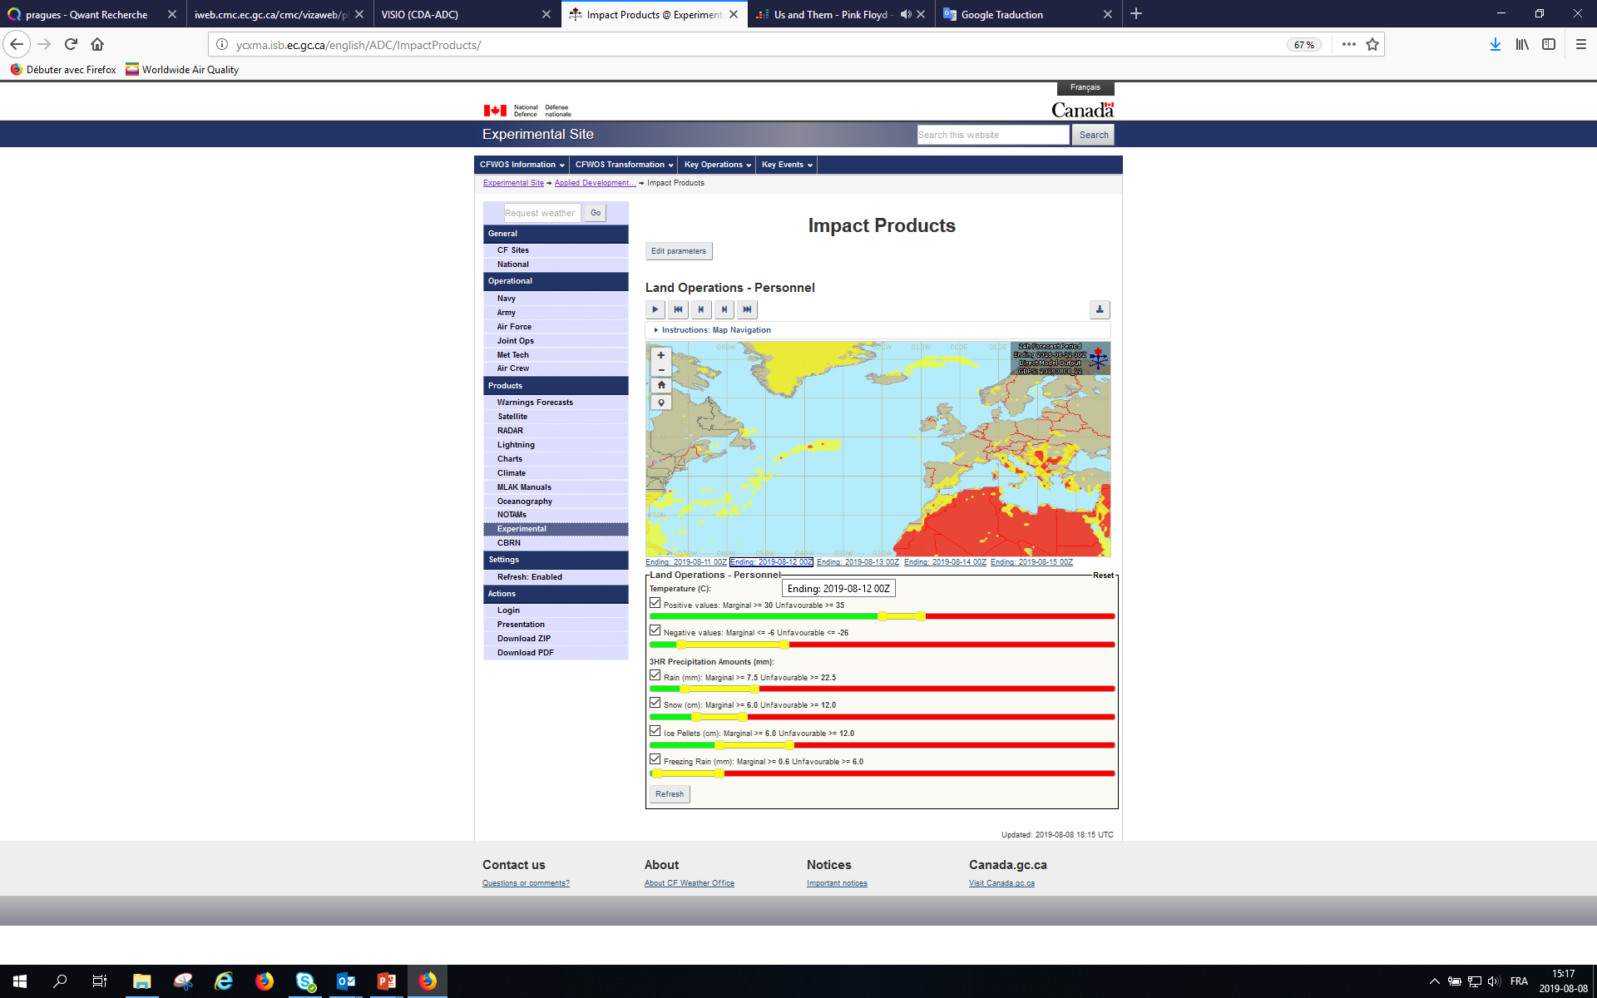
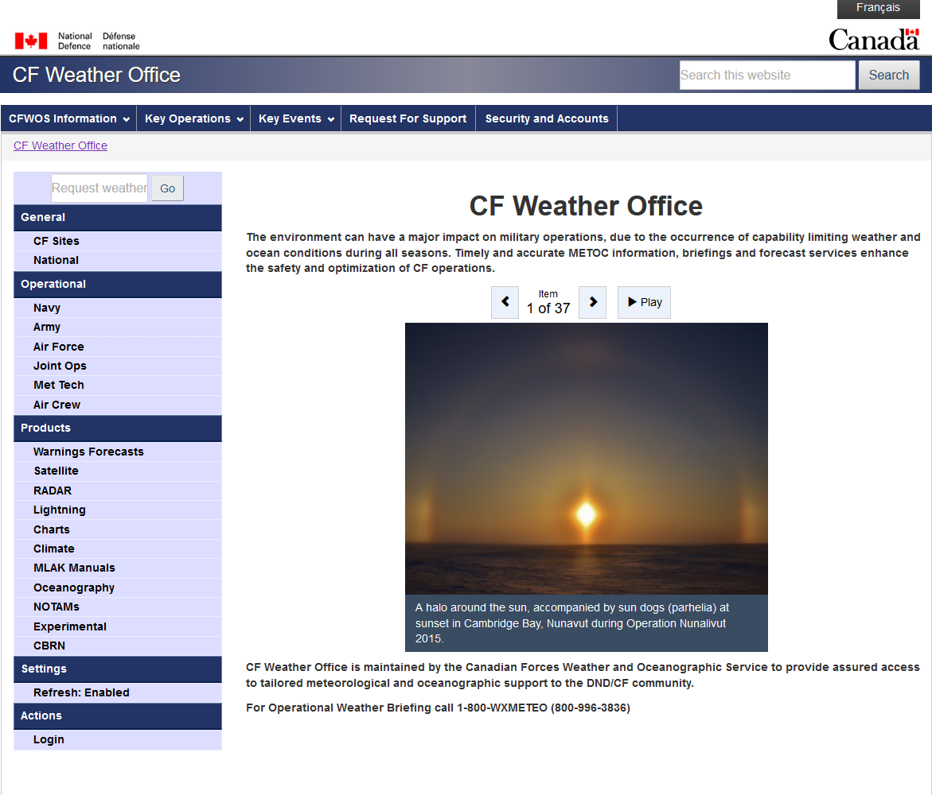
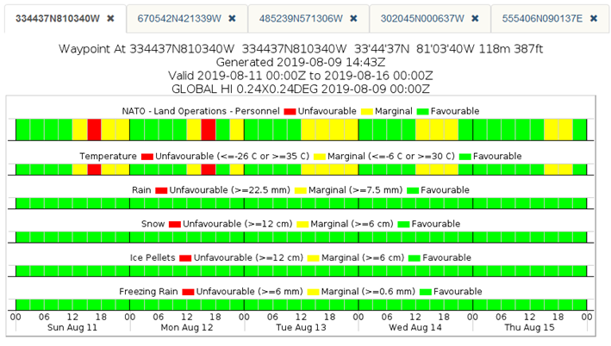
Current state (deterministic modeling) - CFWOS
Canadian Forces Weather and Oceanographic Service

Slide 8
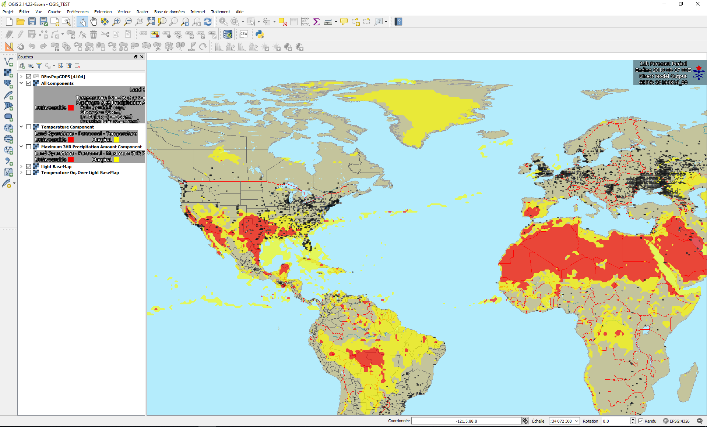
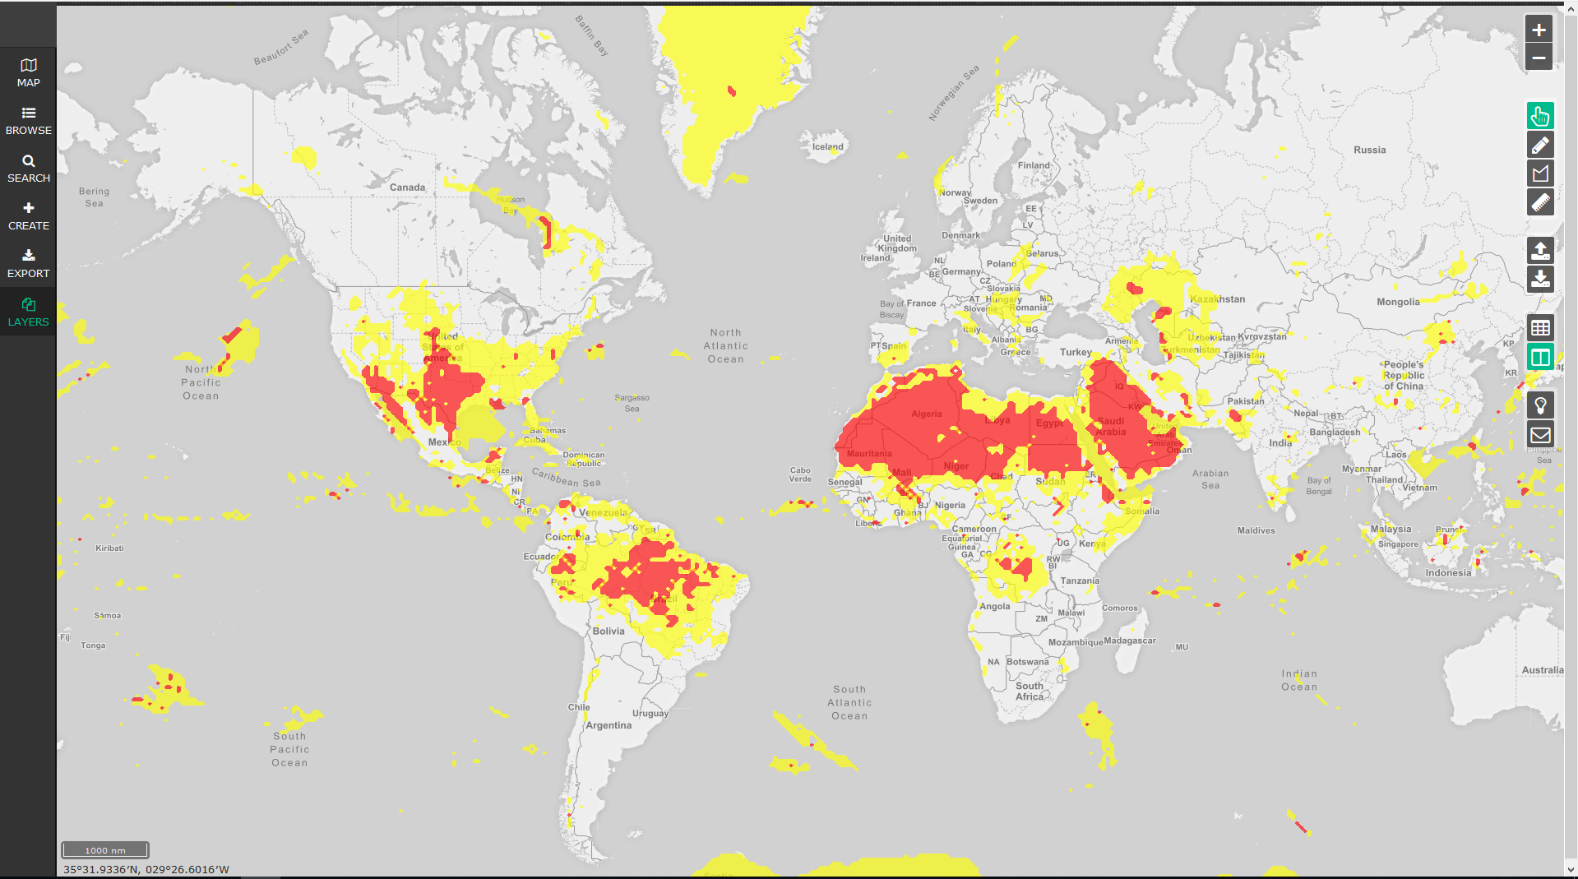
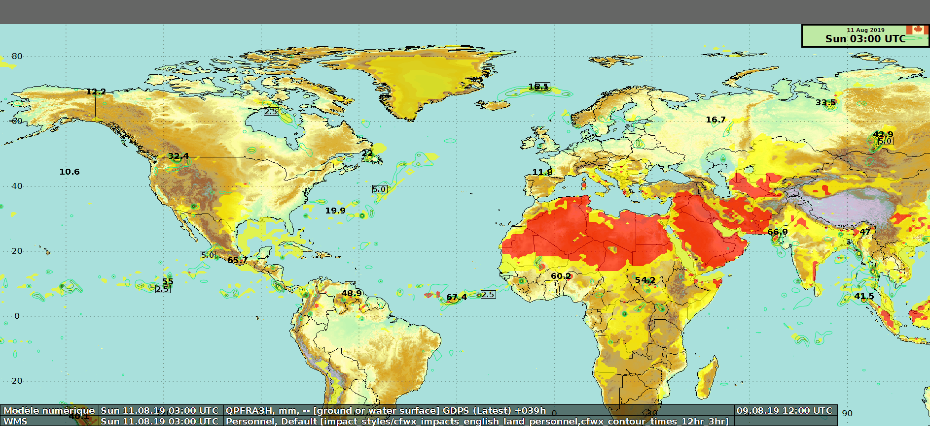
Current state (deterministic modeling) – GIS Capability
GIS capability of the Canadian Forces Weather and Oceanographic Service
QGIS
NinJo (SMC's forecasters visualisation & production tool)
GCIView

Slide 9
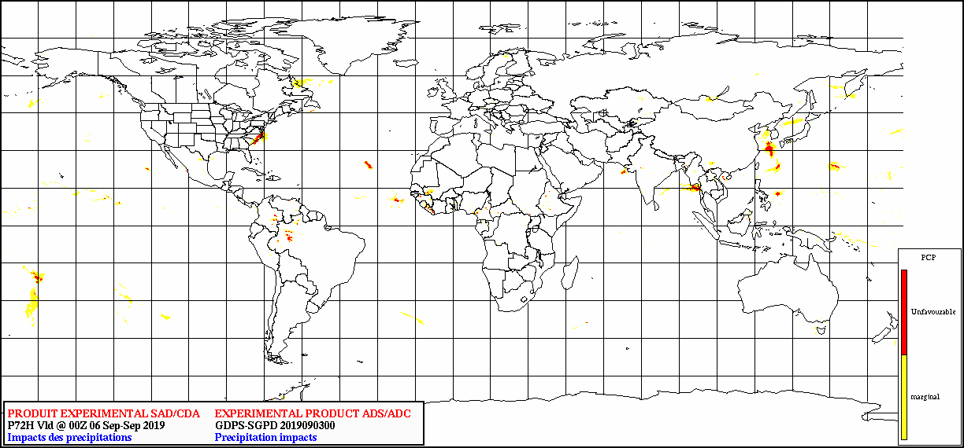
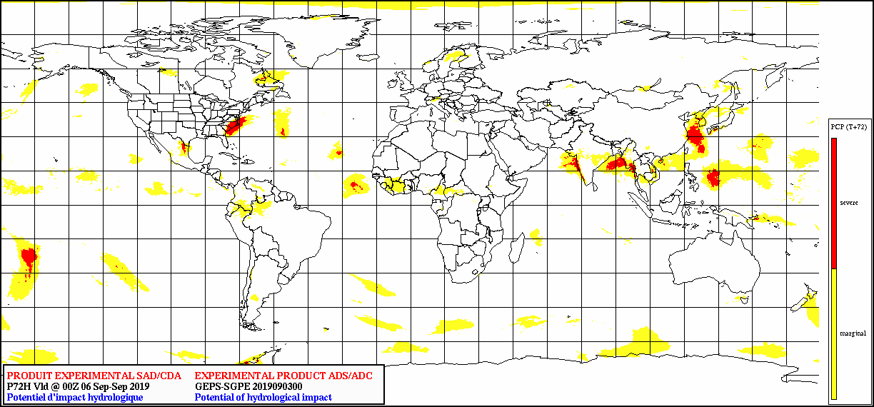
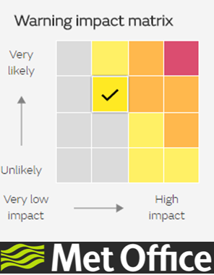
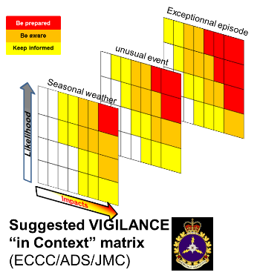
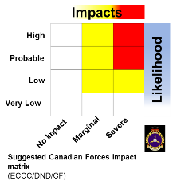
Looking ahead (probabilistic modeling)
Question: How to keep the info consistency while moving from deterministic to probabilistic NWP?
  Deterministic
  Probabilistic
  Vigilance-in-context
CAF Matrix
Answer: The matrix approach
Notes:
In our review on weather impact based forecast, the UK MetOffice caught our attention for the following reasons:
The association of a category that identifies the intensity of the impact regardless of the nature of the weather hazard and its probability of occurrence.
The standardization of the message that affects the population and the public authorities.
The preservation of a homogeneous and consistent message that allows, on one hand, the forecaster to select the impact category that best matches the forecast of the day and, on the other hand, to integrate the ensemble forecasts to characterize the risk of impact of meteorological hazards (experience meteocentre.com) for longer deadlines.
The objective of the last months was to adapt this solution to the specificities of the Canadian Armed Forces.
The collaboration between the applied development cell and the ST&L team allowed to define this matrix which allows to associate the impacts of the meteorological hazards on the operations to their probabilities to happen.

Slide 10

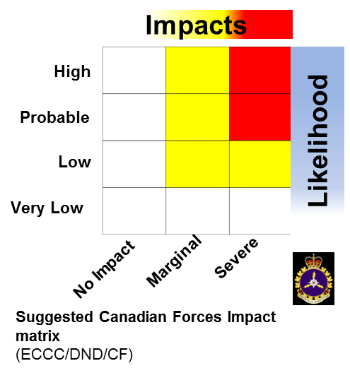
In a Nutshell
The British Matrix Table Concept which combines the level of impacts the weather may cause and the likelihood of those impacts occurring.
The European EFI concept, computed from the GEPS, provides signals of anomalous weather relative to the model climatology.
Percentile's computations which allow the capability to choose any adapted thresholds for specific needs/issues for all sensitivity types.
are pillars upon which a MetOc impact database, relying on forecasted weather elements, will be developed in order to :
Assist with the flexibility of the CAF in their decision making processes and
Help our forecasters to identify regions where their expertize will be required

Slide 11
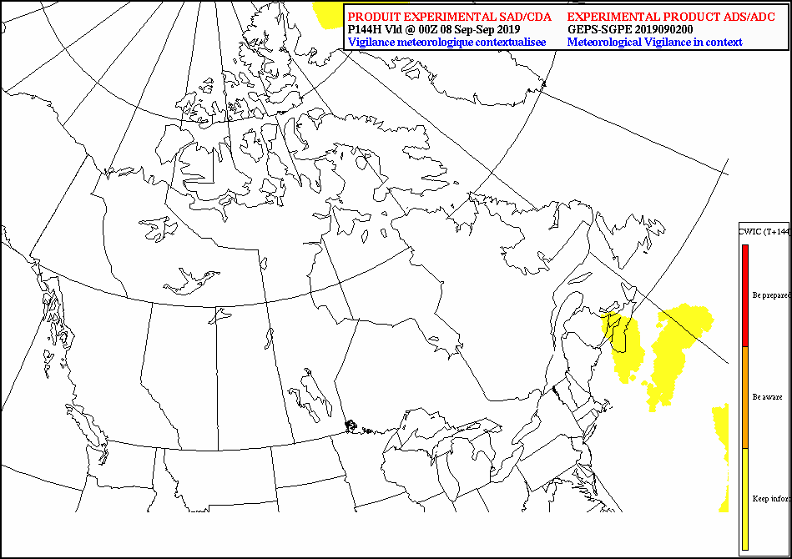
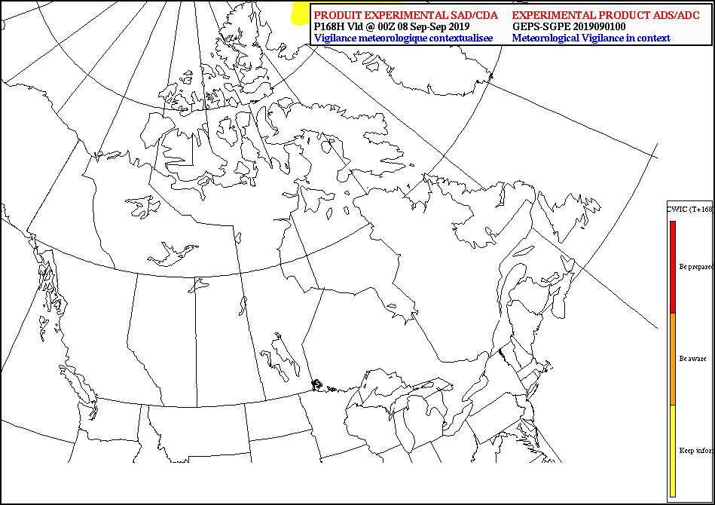
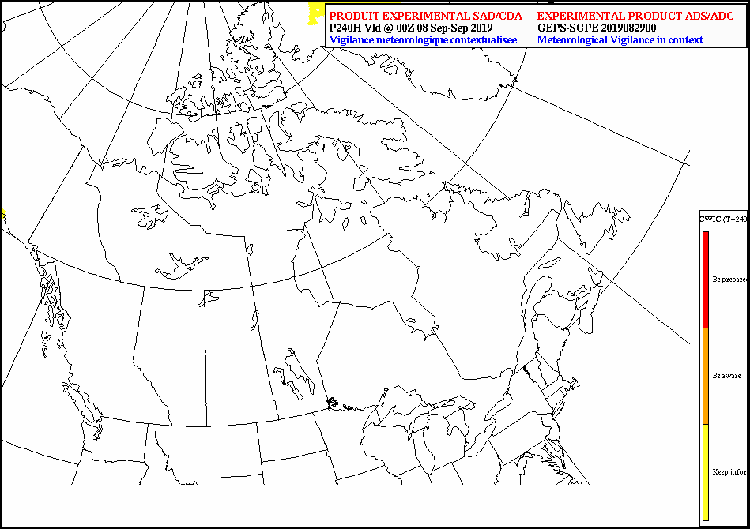

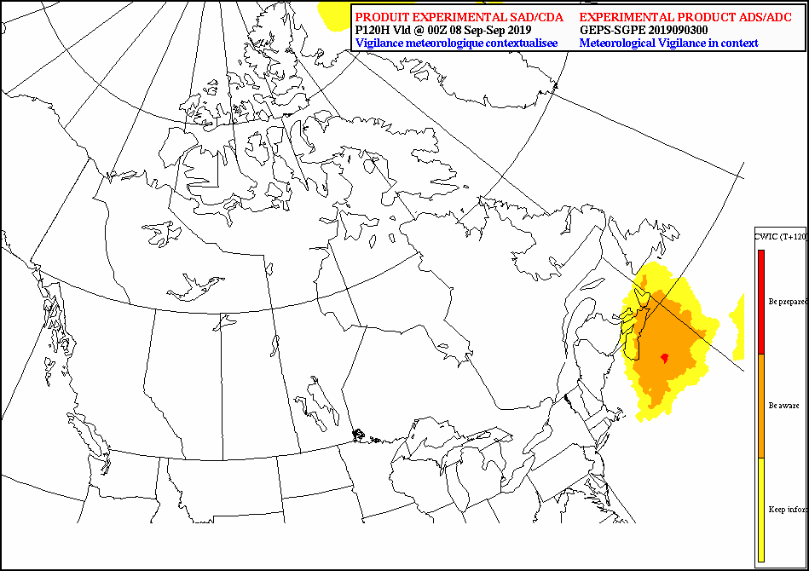
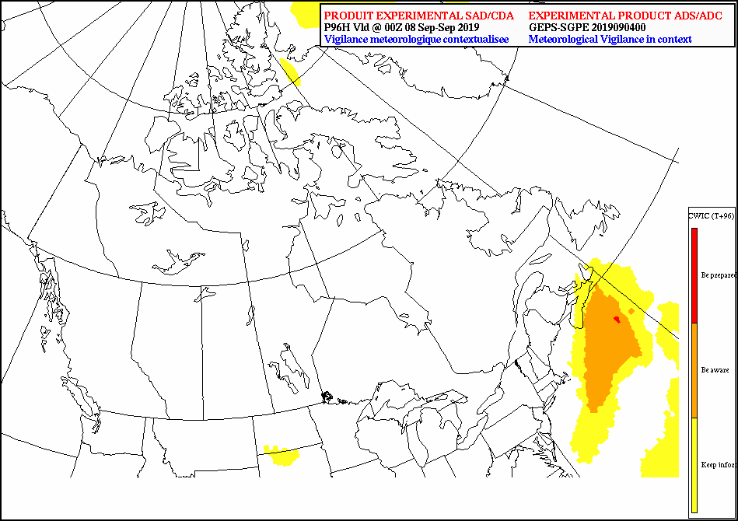
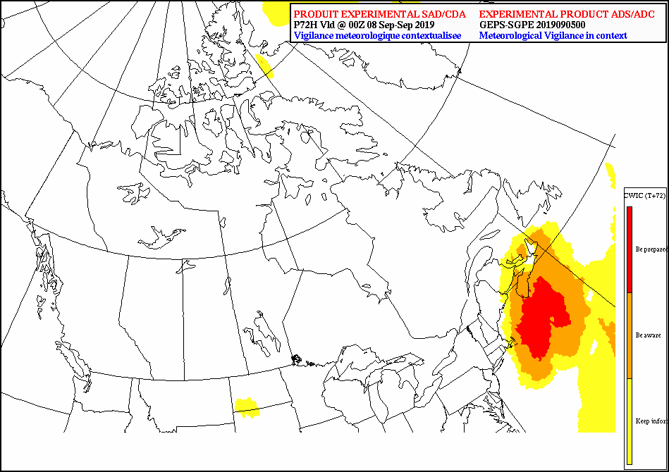
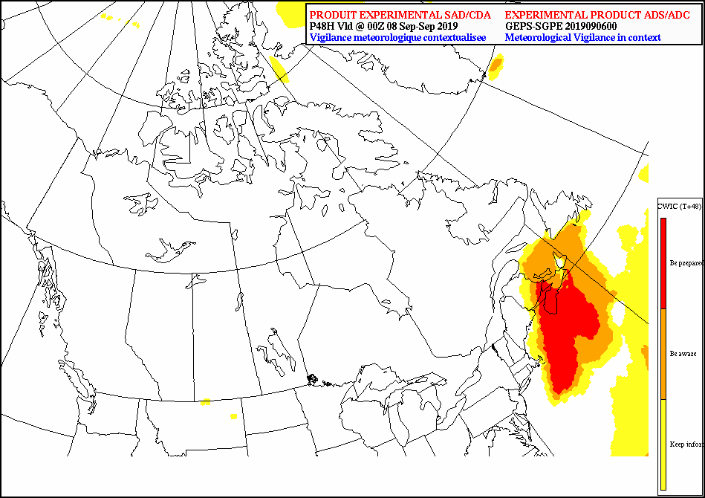

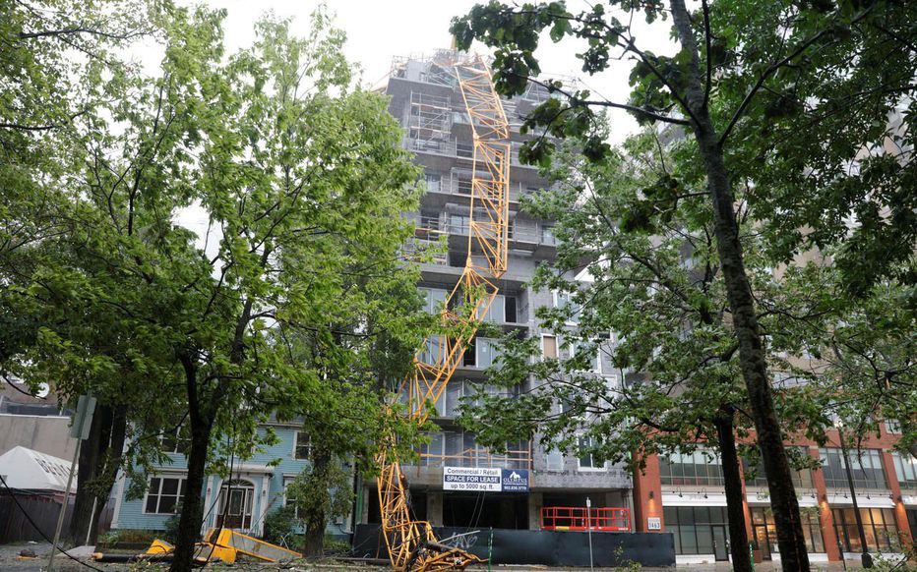
Thank you
Merci
T+240
T+216
T+192
T+168
T+144
T+120
T+96
T+72
T+48
Impact Based Forecast for the
Canadian Armed Forces
From a deterministic to a probabilistic approach
david.degardin@canada.ca
Joint Meteorological Center
Aviation and Defence Services, Environment Canada

Slide 13
Consolidated Weather Impact Chart (CWIC) – Seamless suite of systems
Spanning Weather and Climate
Years
Forecast Uncertainty
Outlook
Seasons
Months
Guidance
Canadian Seasonal to Inter-annual Prediction System (CanSIPS)
Threats Assessments
2 Week
Global Ensemble Prediction System - Extended (GEPS-Ex)
North American Ensemble Forecast System (NAEFS)
Forecast Lead Time
1 Week
Global Ensemble Prediction System (GEPS & GEWPS)
Forecasts
Global Deterministic Prediction system (GDPS & GDWPS)
Days
Global Ice and Oceanic Prediction System (GIOPS)
Watches
Regional Ensemble Prediction system (REPS & REWPS)
Hours
Regional Deterministic Prediction system (RDPS & RDWPS)
Regional Ice and Oceanic Prediction System (RIOPS)
Warnings & Alert Coordination
High Resolution Deterministic Prediction System (HRDPS)
Minutes
Integrated NowCasting System (INCS)
Levels of Military Intelligence
Benefits
Tactical
Strategic
Operational
Largely inspired by NESPC

Slide 14
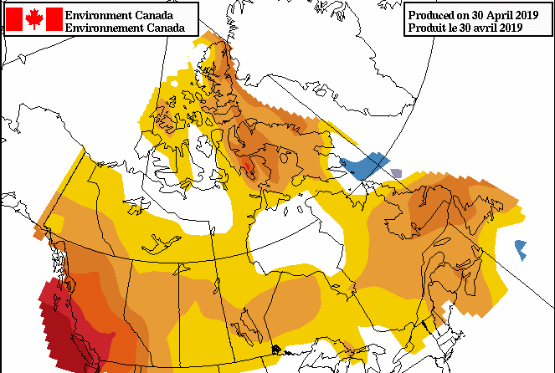
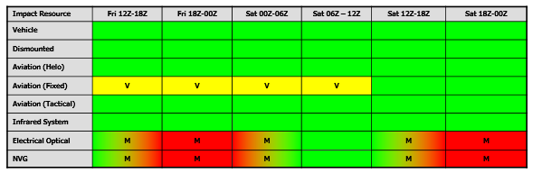
Consolidated Weather Impact Chart (CWIC) – Seamless suite of products
Spanning Weather and Climate
Years
Forecast Uncertainty
Outlook
Seasons
Months
Guidance
Threats Assessments
2 Week
Forecast Lead Time
1 Week
Forecasts
Days
Watches
The appropriate model, for a given domain and a given timeframe, for a specific need
Hours
Warnings & Alert Coordination
Minutes
Levels of Military Intelligence
Benefits
Tactical
Strategic
Operational
Largely inspired by NESPC

Slide 15
Consolidated Weather Impact Chart (CWIC) – A relevant database
Main
A relevant database will be constituted by environmental elements (MetOc) with at least one the following features:
  Highest temporal and spatial resolutions available.
  Representativeness of MetOc's impact on considered mission:
    Highest/lowest intensity,
    Accumulation over periods
    Exposition to a potential MetOc's impact,
    Duration of MetOc's impact.
  MetOc elements relevant for either Aviation, Navy, Land or Intelligence activities,
  Known vulnerabilities,
  …
Big data and bandwidth issues imply compromises and restrictions on the database elaboration

Slide 16
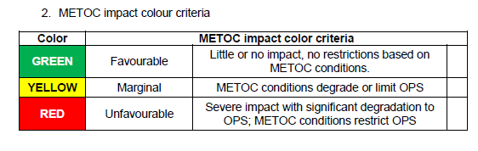
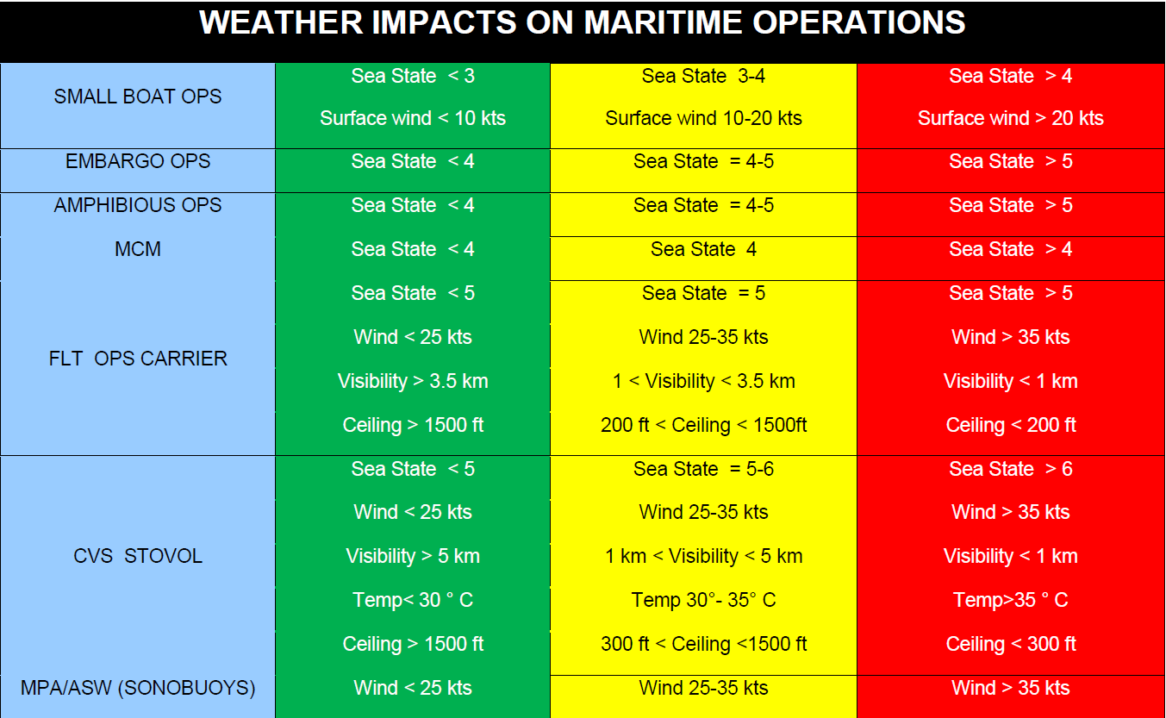
Consolidated Weather Impact Chart (CWIC) – Impacts characterization
Missions/Assets Definition
The traffic lights code is widely (NATO) used to express the potential risk related to meteorological impacts on troops and materials.
METOC_IMPACT_NATO_AMC 13_5b_SHAPE
For each operation type, operational limits have been defined for every weather element which can interfere with the considered operation.
Due to a wide range of assets, missions or operations, preset formats production is not an efficient solution when only some of them are considered and when further adjustment to impacts are needed.

Slide 17



Consolidated Weather Impact Chart (CWIC) – Adjustable thresholds
One tool to support the decision process

Slide 18




Consolidated Weather Impact Chart (CWIC) – Consolidation rule
Main
The worst index make the index (worst case scenario)
Waves
Precipitation
Temperature
Temperature
Waves
Precipitation
$$CWIC=Max (Max \left(WxEl1\right),Max \left(WxEl2\right),…,Max \left(WxEln\right))$$

Slide 19


Current state (deterministic modeling) – Configuration page
NATO’s missions Catalog
Capability of deselection of environmental elements
Adjustable thresholds
Temporal windows (12/24hr)
Area-of-interest's definition capability

Slide 20
Current state (deterministic modeling) – Impacts products page
Update “on-the-fly”,
Animation from D3 to D7,
Capability of deselection of environmental elements,
Adjustable thresholds,
Area-of-interests refinement capability,
Product dissemination: numerical and graphical formats depending on client's bandwidth capabilities.
Temporal series for 5 locations: impact-grams

Slide 21


Current state (deterministic modeling) – Impact-grams
Main
Up-to 5 locations
Adustable “on-the-fly”
Light and full versions

Slide 22
Current state (deterministic modeling) – GIS on operational visualisation tool
  NinJo WMS layer

Slide 23

Current state (deterministic modeling) – GIS – external WMS client interface
  Partner WFS client interface (GCI view)
DND initiative: to gather and share maritime information among federal departments

Slide 24
Current state (deterministic modeling) – GIS – ESRI application
Main
  QGIS

Slide 25







Looking ahead (probabilistic modeling) – Impacts on operations
How does the concept work?
Forecasted
weather
parameters (GEPS)
Temperature
Wind speed
Precipitation
Global Ensemble Prediction System
Potential Impacts due to forecasted weather parameters
T impact
Potential of meteorological impact
VV impact
PCP impact
Consolidation
Notes:
How does it work ?
Each meteorological element, having a repercussion potential on a mission type, is transcribed in the impact field, thanks to the impact matrix, according to its intensity and probability of occurrence. When all fields have been transcribed into impact fields, a generic impact field is generated. In this phase the method "the worst index makes the index". This first method does not take into account potential interactions between weather elements (blowing snow, flash freeze, etc.)
Comment cela fonctionne t’il ?
Chaque élément météorologique, ayant un potentiel de répercussion sur un type de mission, est retranscrit en champ d’impact, grâce à la matrice, selon son intensité et sa probabilité d’occurrence. Quand tous les champs ont été retranscrit en champs d’impact, un champ d’impact générique est produit. Dans cette phase la méthode « l’indice le plus mauvais fait l’indice ». Cette première méthode ne tient pas compte d’interactions potentielles entre les éléments météorologiques (poudrerie, gel soudain, …)

Slide 26


Looking ahead (probabilistic modeling) – Percentiles
How do we use the Ensemble?
    90th Perc represents 10%,
    75th Perc represents 25%,
    50th Perc represents 50%,
    25th Perc represents 75%,
    10th Perc represents 90%
    of chance of occurrence to be above a threshold
    Values of
    Usage of percentiles gives more flexibility than the existing calculations on probability of occurrence to be above given thresholds.
    More percentiles ranks available would:
      add more flexibility when dealing with the client’s sensitivity;
      allow to skim the output files since probabilities of being greater than thresholds would become redundant.
Probability of occurrence

Slide 27

Looking ahead (probabilistic modeling) – CAF Proof of concept
Main
What does the proof of concept look like?
For a prototype CAF operation purpose.
Thresholds based on the CAF mission type « Personnel »
10%, 25% and 75% probability of occurrence characterize the « sensitivity » of the client.
Notes:
This map shows how the weather component can be crucial in their decision making process.
The very pessimistic aspect of this map highlights the fact that weather fields have to be well defined in order to deliver a relevant information.
Here, because the current set of data offers only extremums over a 24 hour period for temperature, humidex, windchill or over 12 hour period for the maximum windspeed. Wide bands of marginal/severe imact above the poles and the equator are due do the selected fields respectively maximum and minimum over a 24 hour period for humidex and windchill. Using fileds such as maximum/minimum over a 12 hour period for humidex/windchill would show a swing of them between nights and days.
An enrichment of the current data set by complementary fields such as extremums over 6/12 hours for the first 72 hours and over 12 hours beyond 72 hours or such as running means over 6/8 hours period in order to express the exposition to the weather would make the product more relevant.

Slide 28




Looking ahead (probabilistic modeling) – Impacts on population/environment
How does the concept work?
Forecasted
weather
parameters (GEPS)
Temperature
Wind speed
Precipitation
Global Ensemble Prediction System
Extreme Forecast Index
(TT, VV, PCP)
Potential Impacts due to forecasted weather parameters w.r.t. the M-climate
T impact
Potential of meteorological impact
VV impact
PCP impact
Consolidation

Slide 29



Looking ahead (probabilistic modeling) – “Vigilance-in-context” matrix
Vigilance inspired by the UK warning impact matrix
« Maple flavoured »
Snow acc: 15 cm/12hrs
Tmax < [-38°C, -30°C]
Canadian Joint operations
Command (CJOC)

Slide 30

Looking ahead (probabilistic modeling) – “Vigilance-in-context” matrix
Contextualization w.r.t. M-Climate (EFI Precipitation field)
« a pinch of salt »
White: Seasonal Reddish: Unusual Red: Exceptional
Notes:
The EFI fields highlight areas where forecasted weather events are

Slide 31


Looking ahead (probabilistic modeling) – “Vigilance-in-context” matrix
For the Canadian Joint operations Command (CJOC)
RAIN (mm) | Sea | Un | Exc
Y | 25 | 15 | 10
O | 50 | 40 | 25
R | 100 | 75 | 50
Notes:
Why did we develop this product?
CJOC works on a global scale and use all available information source.
Meteoalarm and SWIC 2.0 is frequently used to globally identify potential weather impact for the next 48 hours.
We wanted to offer them a similar product extending beyond 48 hours and based on the most appropriate prediction system (GEPS).

Slide 32



Looking ahead (probabilistic modeling) – Example: Rainfall Dec 15th, 2018
  Casualties and significant damages in several regions of Albania
T+120h
T+24h

Slide 33






Looking ahead (probabilistic modeling) – Ways of improvements
Main
Additional layer to take into account ‘’vulnerabilities’’ to METOC hazards:
  Population density
  Urbanization rate
  Land use cover (soil type)
  Climatology
  Latest hazard assessment

