Slide 1
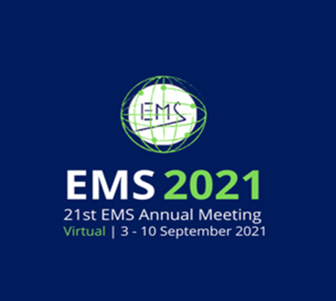

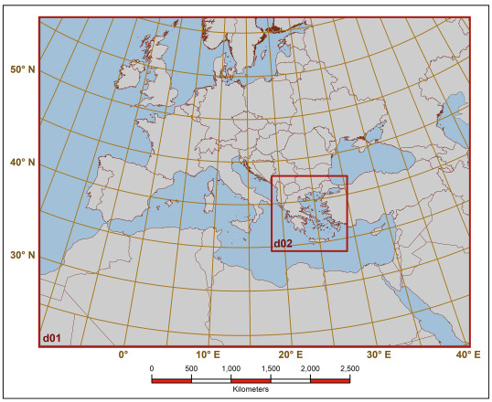
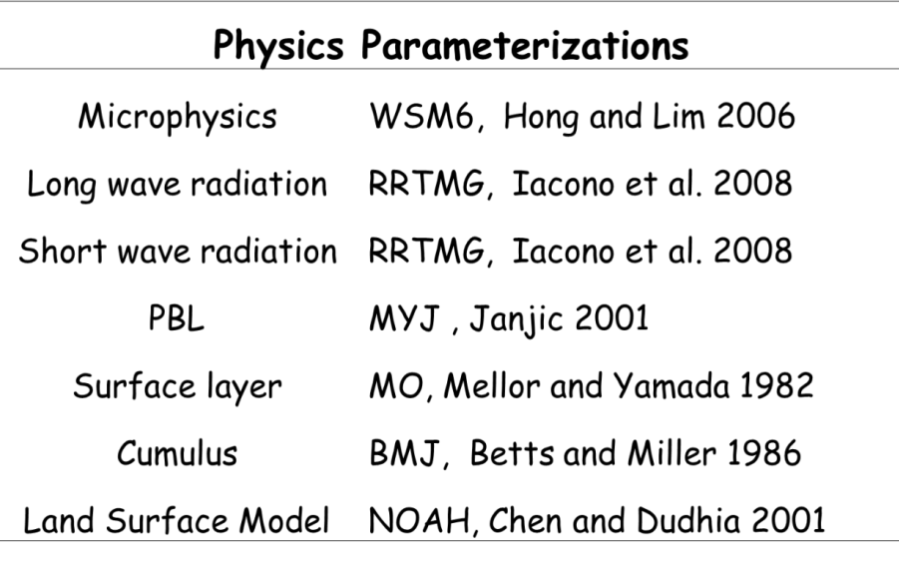
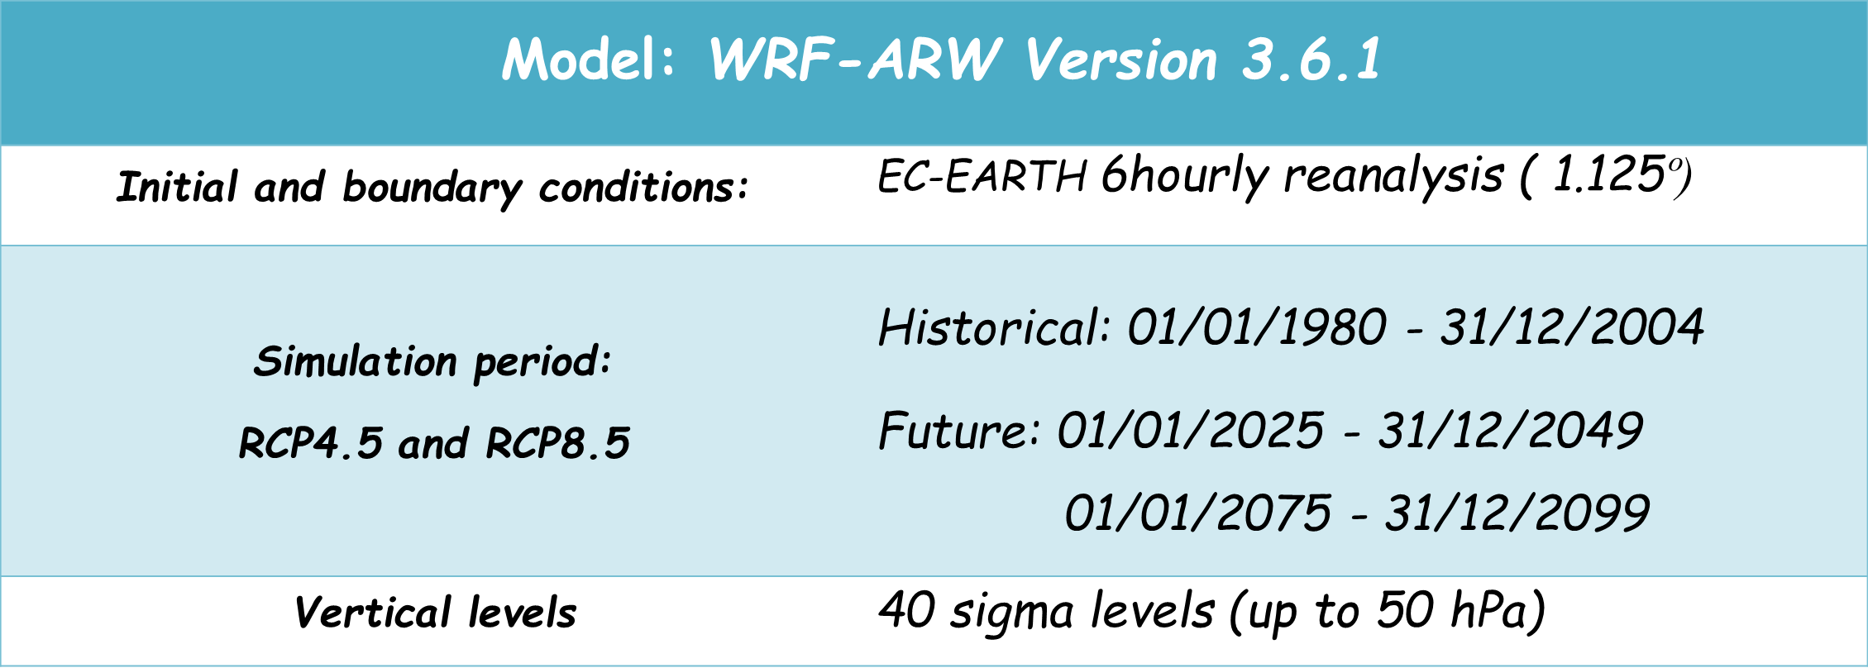
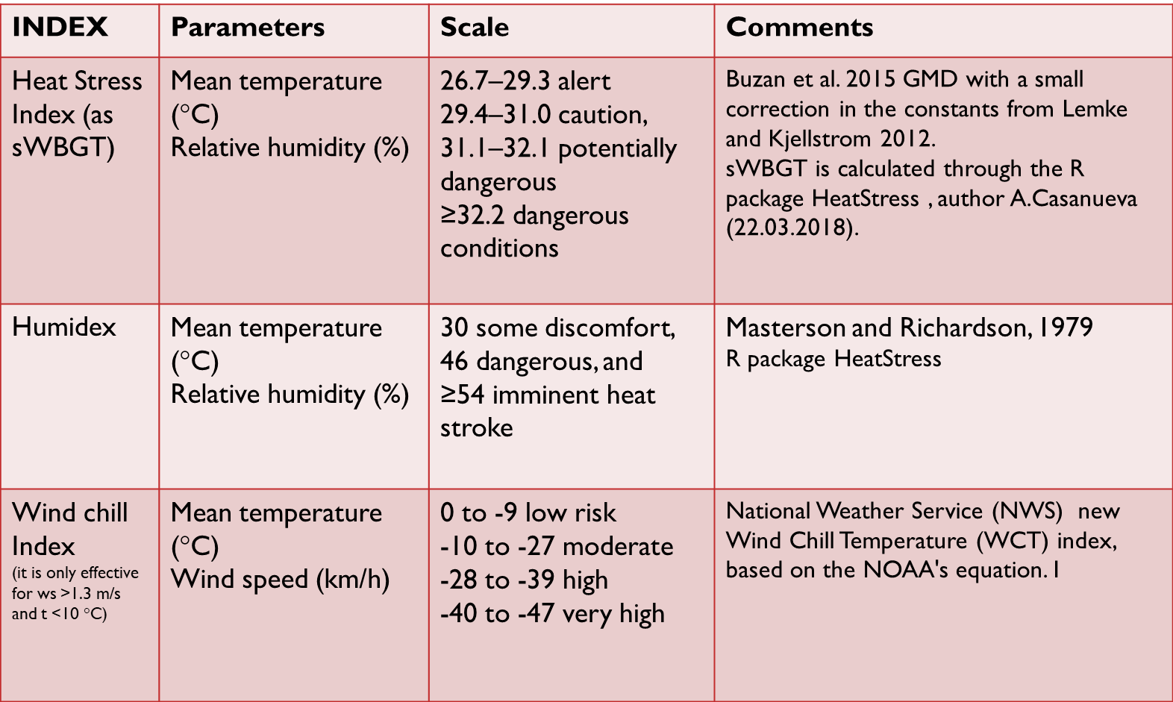
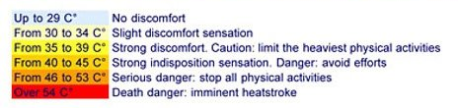
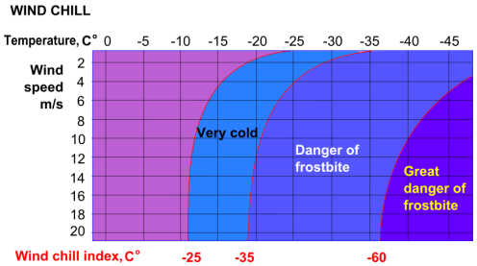

Future Projections of heat and cold stress based on two RCP
Scenarios over Greece
Nadia Politi, Diamando Vlachogiannis, Athanasios Sfetsos, and Iasonas Markantonis
NCSR Demokritos, Environmental Research Laboratory, INRaSTES, Athens, Greece (nadiapol@ipta.demokritos.gr)
The scope of this study is to investigate climate change projections for indices that express human‐perceived temperature extremes such as the Humidity index (Humidex), Wind Chill index (WCI) and Heat stress index (HI) in order to evaluate the potential impact on human health. These indices use different meteorological variables or a combination of them such as temperature, relative humidity and wind speed. The computation of these indices is based on daily simulated data, under two different scenarios (RCP4.5 and RCP 8.5) compared to present climate conditions (1980-2004). Downscaled WRF results are derived from the global EC-EARTH model dataset, with a high spatial resolution of 5 km for the area of Greece. Our findings contribute to the quantification of future changes as well as on the identification of potential areas that might become prone to different degrees of heat/cold stress over the area of Greece.
Model setup
5 x 5 km$²$
Extensively evaluated: Politi et al., 2017, 2020, 2021,
Katopodis et al., 2021
Heat and cold stress indices
In order to account for the highest daily indices we used daily maximum and minimum temperatures for heat and cold stress respectively

Slide 2
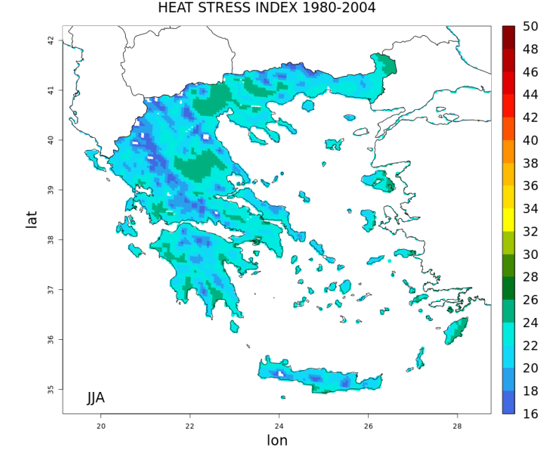
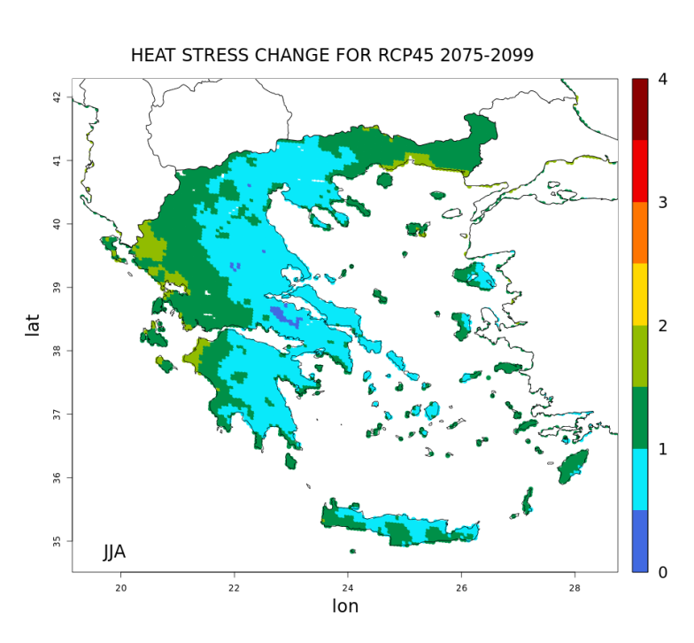
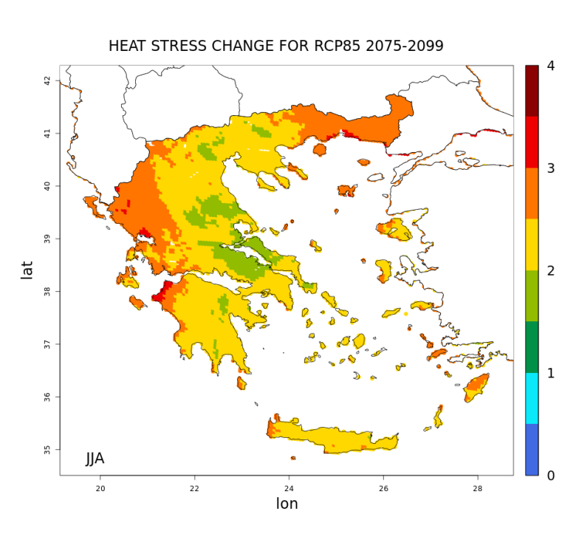
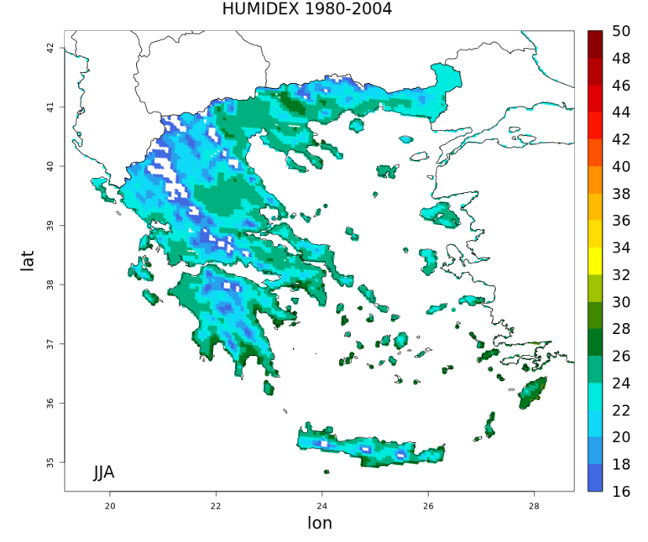
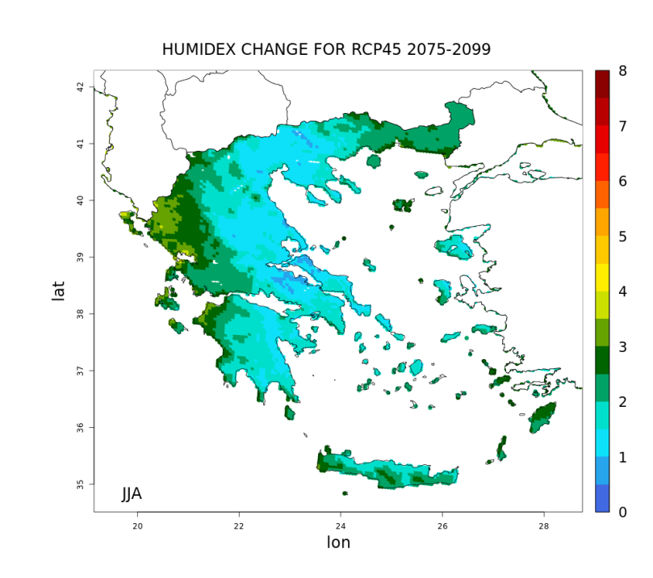
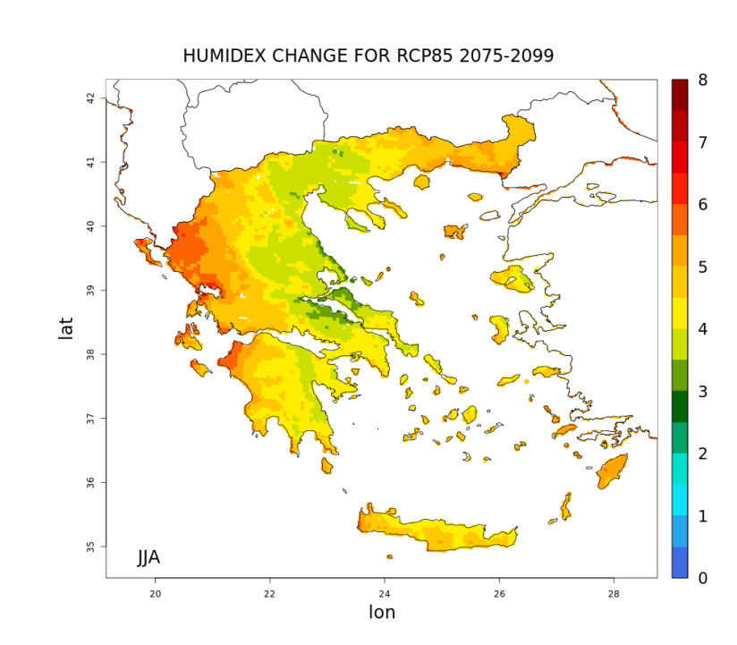
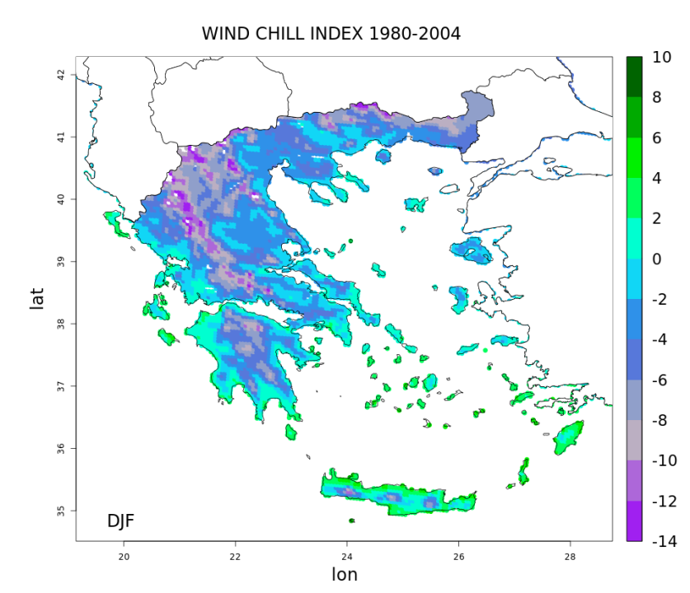
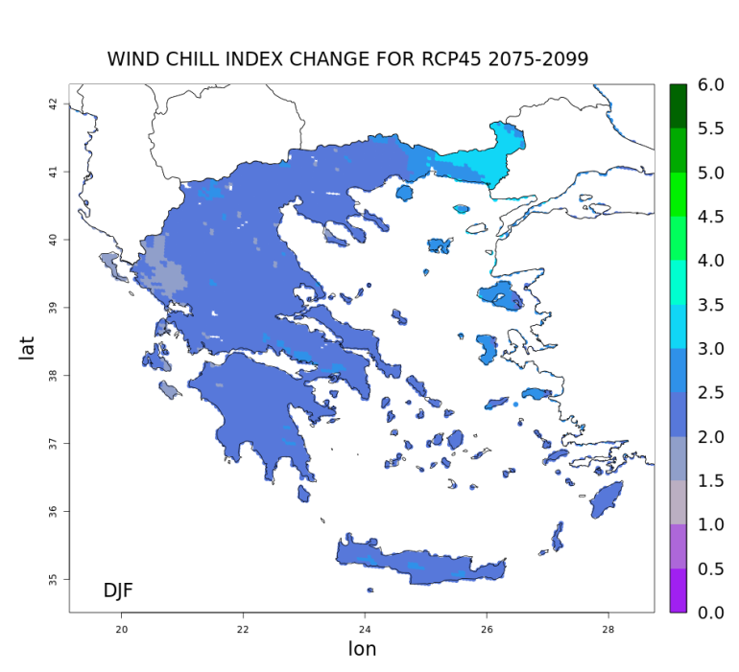
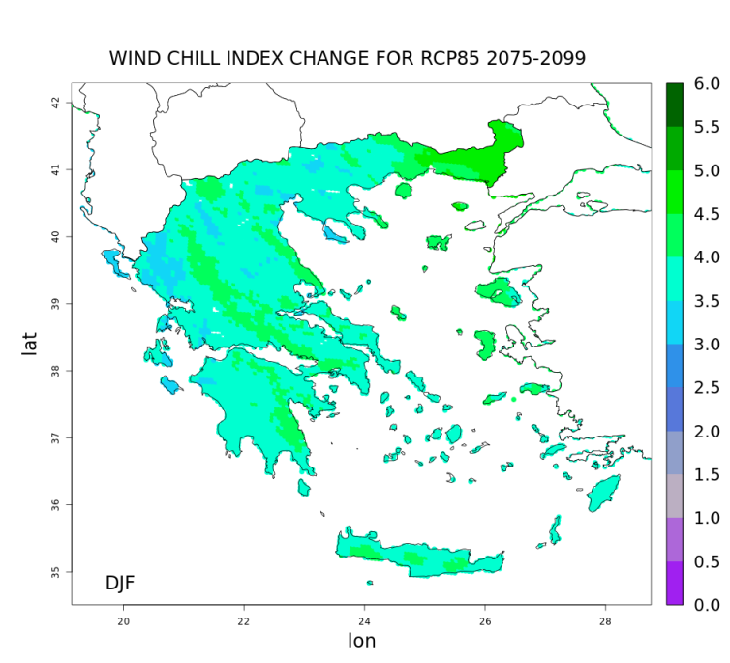
Climate change signal of Heat stress during summer (JJA) period
Historical
RCP4.5
RCP8.5
Climate change signal of Humidex during summer (JJA) period
Historical
RCP4.5
RCP8.5
Climate change signal of Wind chill during winter (DJF) period
Historical
RCP4.5
RCP8.5
Our results are consistent with A.Casanueva et al., 2019, where summer heat stress indices are projected to increase by the end of the 21st century especially under RCP8.5, with more detailed presentation of high resolution study area which is characterized by complex topography.
Most important increases in the ranges 0.5 to 2 under RCP4.5 and 2 to 4 under RCP8.5 with a east-west gradient for Heat stress.
Increase of 4.5 to 6 for Humidex under RCP8.5 in the region of East Macedonia and Thrace (northern Greece), Aegean Islands, Crete, western Greece and Ionian Islands.
Western Greece is more prone to climate change signal.
Positive differences between future and past period, so the impact for Wind Chill factor is foreseen to reduce particularly over mountainous areas and northern Greece under RCP8.5 .
Acknowledgements
This work was supported by computational time granted from the Greek Research & Technology Network (GRNET) in the National HPC facility - ARIS - under projects ID HRCOG (pr004020) and HRPOG (pr006028).

