Slide 1

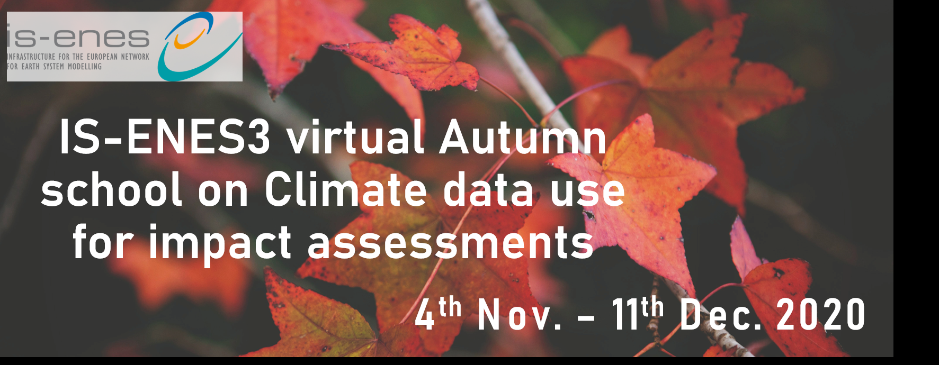
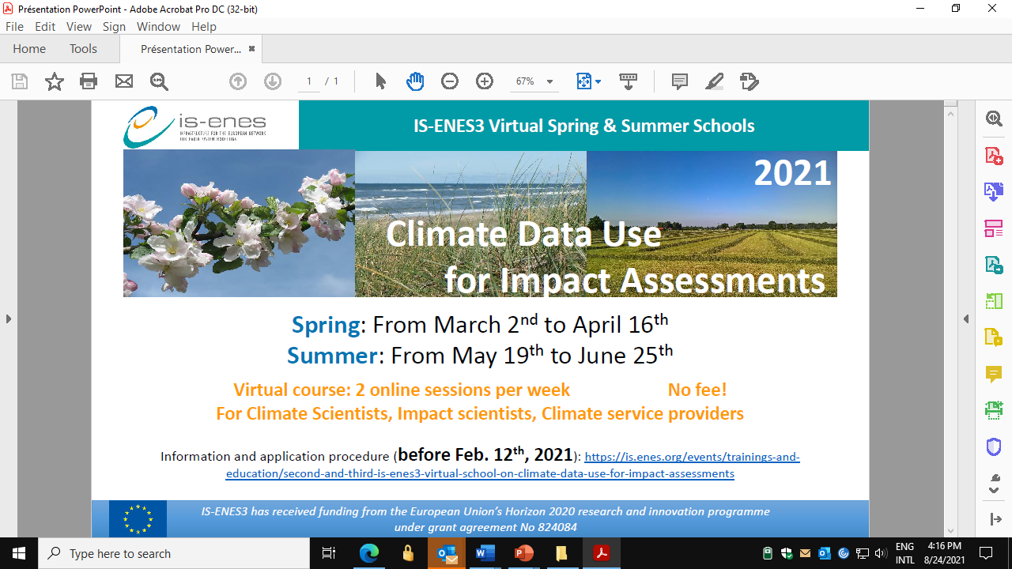

Experiences with virtual schools on
“Climate data for impact assessments”
Three online courses with interaction between climate and impact researchers
Learning objectives
Climate data sources, advantages and disadvantages
Climate models – basic knowledge
Impact model approaches
Challenges in climate impact studies
Challenges in inter/transdisciplinary work
Climate services and the information needs of users
Learning to understand each other for future cooperation
The IS-ENES3 project has received funding from the European Union’s Horizon 2020
research and innovation programme under grant agreement No 824084

Slide 2

Experiences with virtual schools on “Climate data for impact assessments”
Lessons learnt, experiences and recommendations
Conversion from face to face to virtual schools has disadvantages but also advantages
Large differences in background knowledge can be compensated
Interaction between climate scientists and impact researchers is needed
Impact studies are more than analysing data
Important to explain the connection between the various subjects in the programme to the participants
One school is not enough to learn how to use climate data
The IS-ENES3 project has received funding from the European Union’s Horizon 2020
research and innovation programme under grant agreement No 824084

Slide 3
Experiences with virtual schools on “Climate data for impact assessments”
Janette Bessembinder, Judith Klostermann, Rutger Dankers, Vladimir Djurdjevic and Tomáš Halenka
September 9th 2021
The IS-ENES3 project has received funding from the European Union’s Horizon 2020
research and innovation programme under grant agreement No 824084

Slide 4
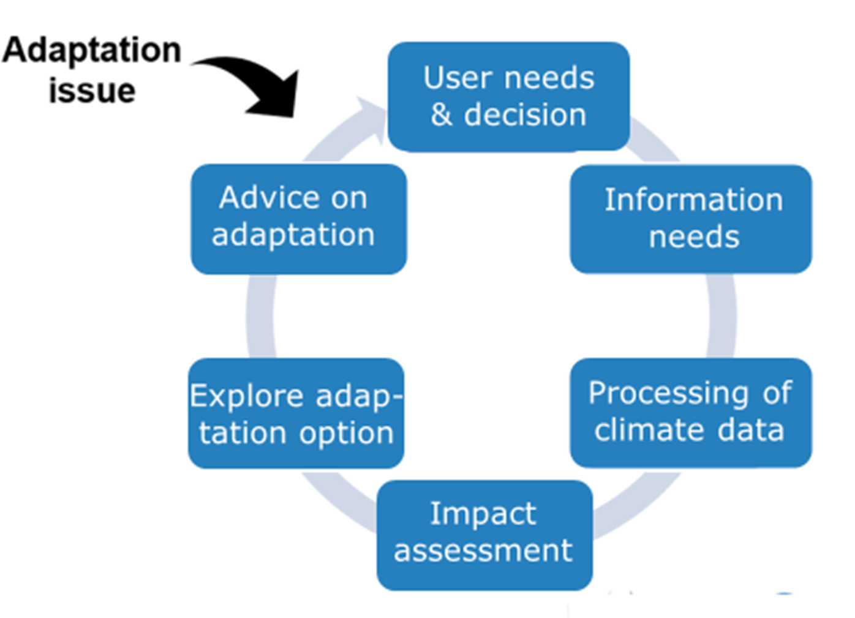



Aim of the schools on Climate data for
impact assessments
Support exploitation of climate (model) data by Earth system science, climate change impact and climate service communities

Slide 5
Learning objectives
Climate data sources, advantages and disadvantages
Climate models – basic knowledge
Impact model approaches
Challenges in climate impact studies
Challenges in inter/transdisciplinary work
Climate services and the information needs of users
Learning to understand each other for future cooperation

Slide 6
Programme overview
Due to COVID-19 face-to-face schools were converted to virtual
3 virtual schools with 20 persons each
2 meetings/webinars per week for 6 weeks
Week 1 | Week2 | Week 3 | Week 4-6
Climate models, CMIP, downscaling Climate data sources Climate indices Uncertainties, ensembles ESMValTool | Impact modeling Examples of impact studies in agriculture, forestry, water Climate services Climate data portals | Case study method Climate4Impact portal Bias correction methods | Case studies: 1 climate scientist+1 impact scientist Questions Interactive sessions ongoing work Case study presentations Evaluation

Slide 7
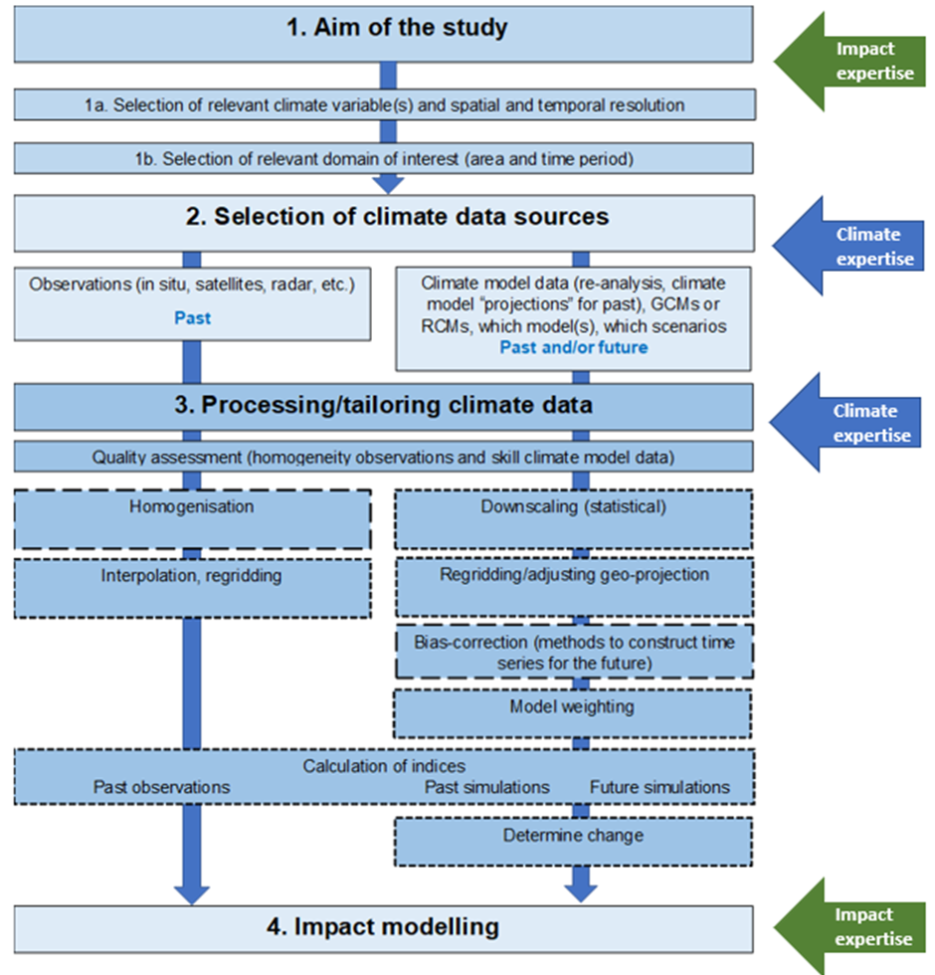
Webinar 5, week 3
Steps required for climate impact case studies and challenges in multi/transdisciplinary work
Lessons ULS on climate data sources
Webinar 1, week 1 Climate models and the international landscape of climate research and modelling and current developments; Climate model evaluation and the ESMValTool)
Webinar 2, week 1: Downscaling techniques and regional modelling, and bias-adjustment; Standards for climate data, CMIP experiments; Climate indices and standards, uncertainties/ensembles, challenges in use of climate data
Webinar 4, week 2: Climate services; landscape of portals, tools with climate data and other data
Webinar 6, week 3: Climate4Impact portal and some examples on possible analyses
Lessons ULS on sectoral impacts
Webinar 3, week 2: Approaches used in impact modelling + examples of impact studies

Slide 8
Examples of case studies
Water stress for citrus fruits in Spain
Impact of anomalous temperatures and rainfall on potato yield in Ireland
Impact of temperature change on grapes for Balkan region
Drought impact on maize production in Kenya
Impact of hot temperature on people in Po plain, Italy
Extreme precipitation and flash floods and impact on Prague and Venice
Flooding of coastal areas in France in the long term
Surface runoff in Norway and impact on hydropower
Sea level and flooding in Bangladesh
Growing season on long term for Beach forests in the Balkan region
Norway spruce and summer drought in Northern Europe

Slide 9
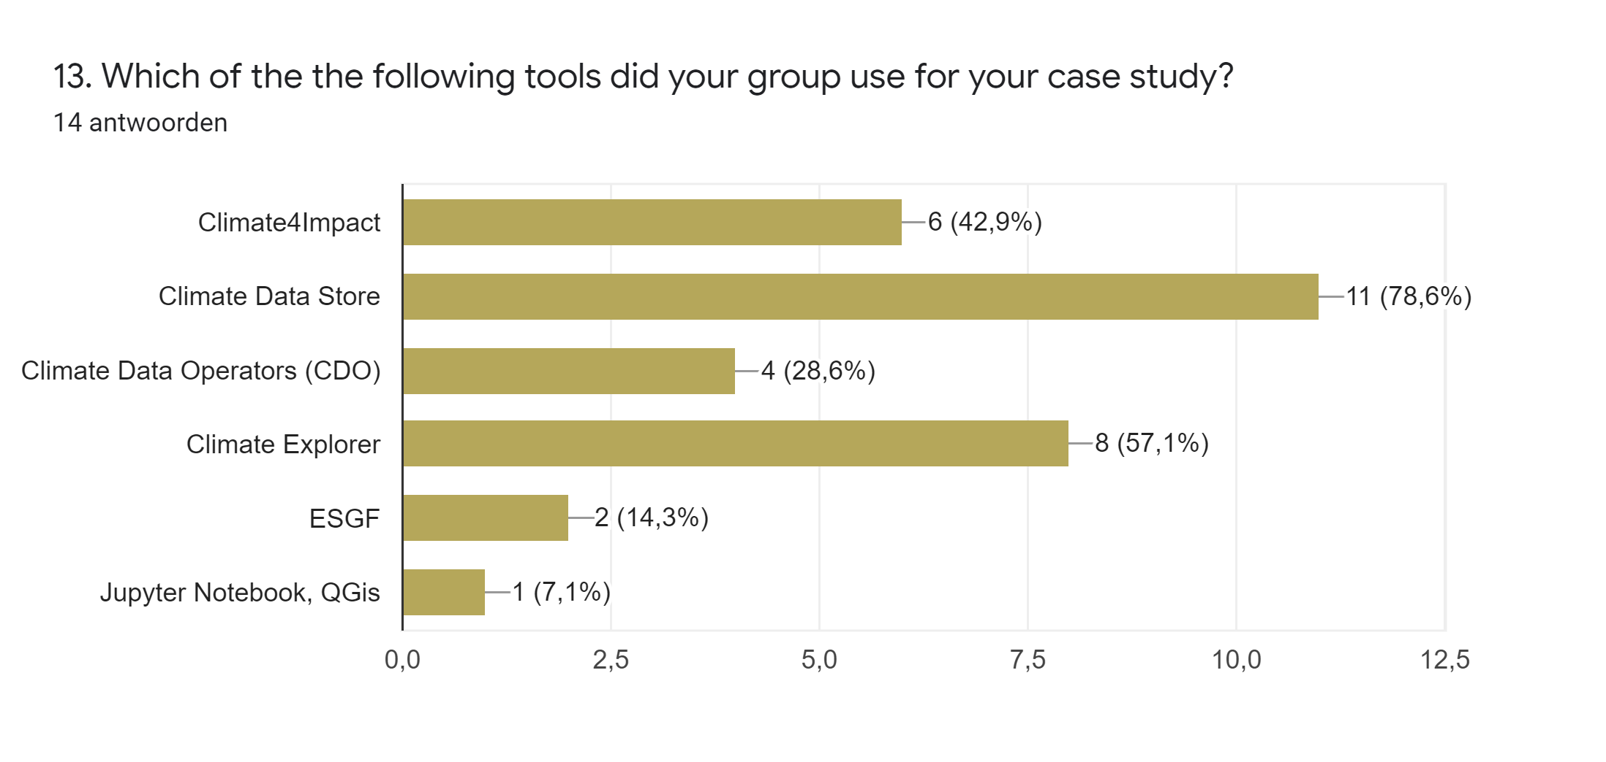
Data platforms and tools

Slide 10
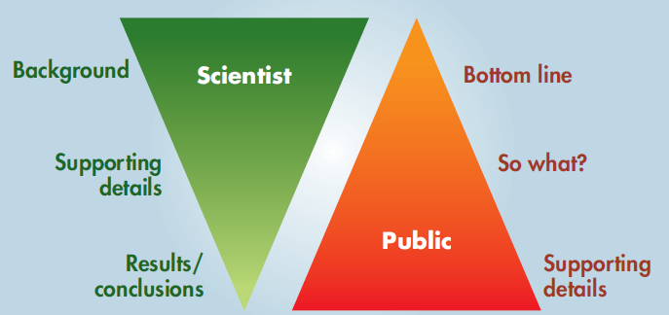
Communication and visualisation
Keep your audience in mind, translate the info to their world and the media that they use
Check your information with your audience
Don’t overload your audience with information and keep the main message in mind
Present information in several different ways
Two-way interaction with users
Sommerville & Hassol, 2011

Slide 11
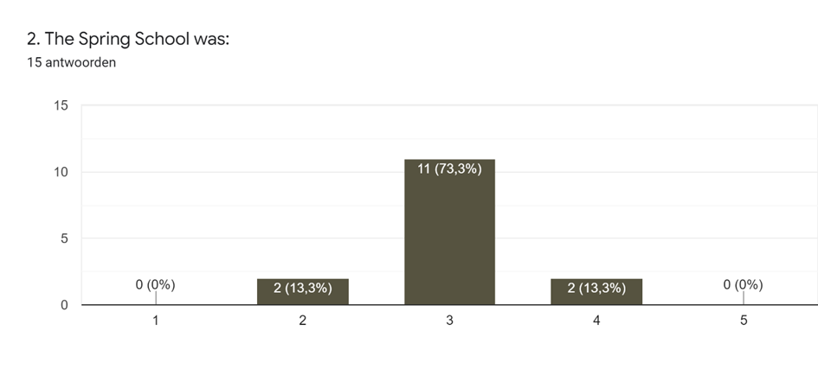
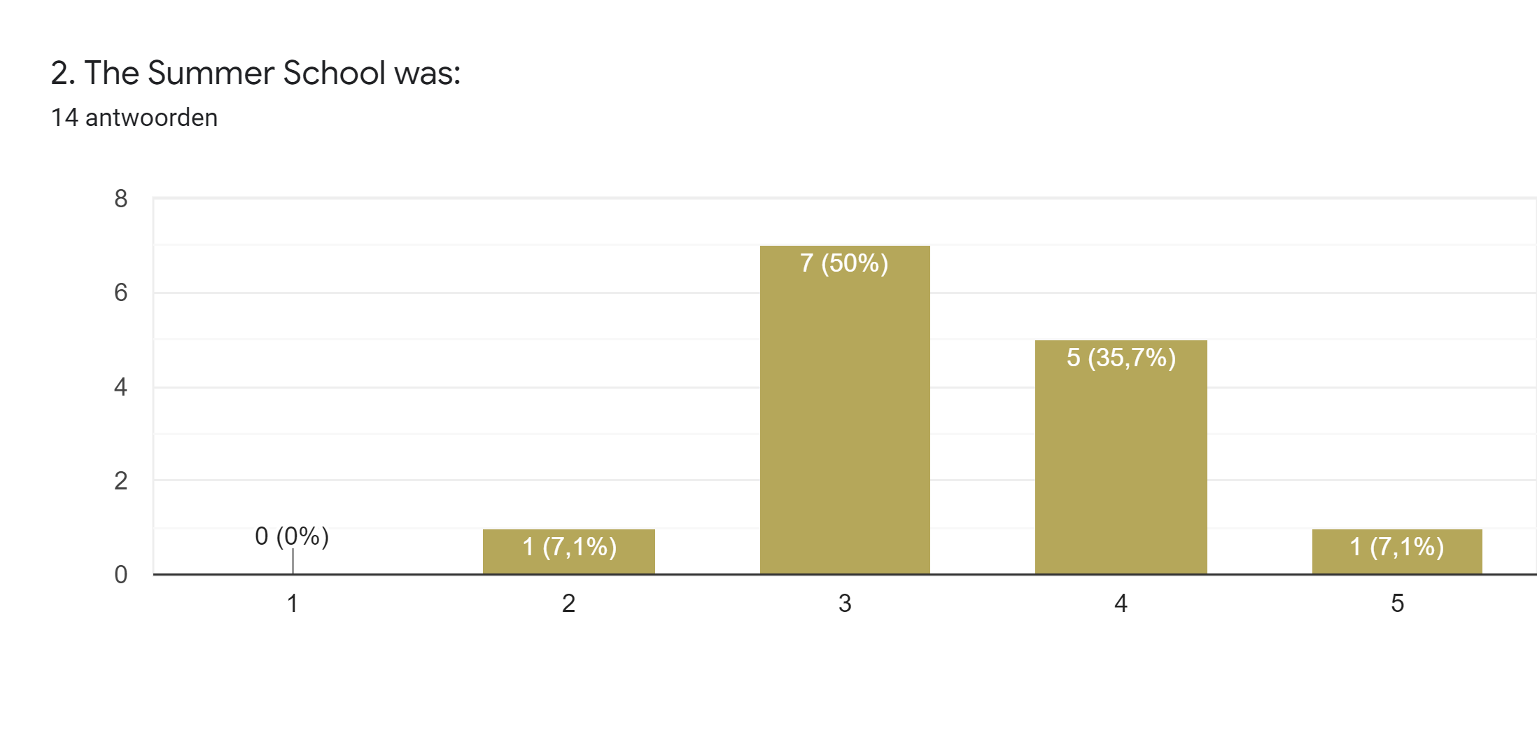
Evaluation
Was the school too easy (1), just about right (3), or too difficult (5) ?
Nov-dec 2020
March-April 2021
Overall positive evaluation, but also with good suggestions

Slide 12
Challenges and recommendations
Conversion from face-to-face schools to virtual schools has disadvantages but also advantages
          more limited interaction between participants and with the lecturers, less networking
          limited number of participants per school
          potentially more difficult to ask for support for the case studies
easy to make recordings, which can be reused
easier to combine with other work
longer period with more time to work on case studies
No CO₂ emissions for traveling
Large differences in background knowledge can be compensated
Use of lessons from the C3S User Learning Services
Links to additional background material
Put climate researcher and impact researcher together for case study

Slide 13
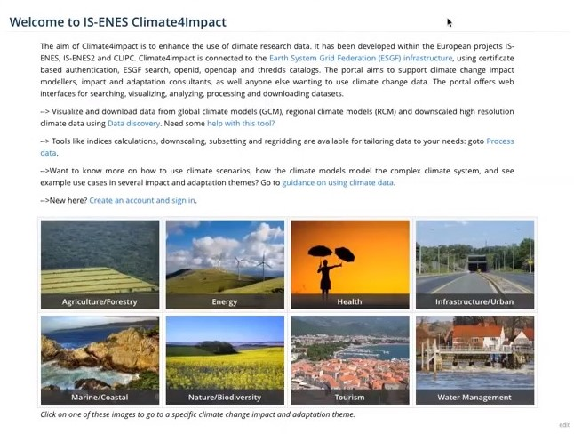
Challenges and recommendations
Interaction between climate scientists and impact researchers is needed
Use several networks/channels to get sufficient applications from the various disciplines
Participants experience the real problems that can occur during impact/adaptation studies
Discuss challenges in case studies with the whole group
Impact studies are more than analysing data
Also attention for user requirements, communication issues and how results may be used
Also learn about data needs for user products and reflect on the future of climate science

Slide 14
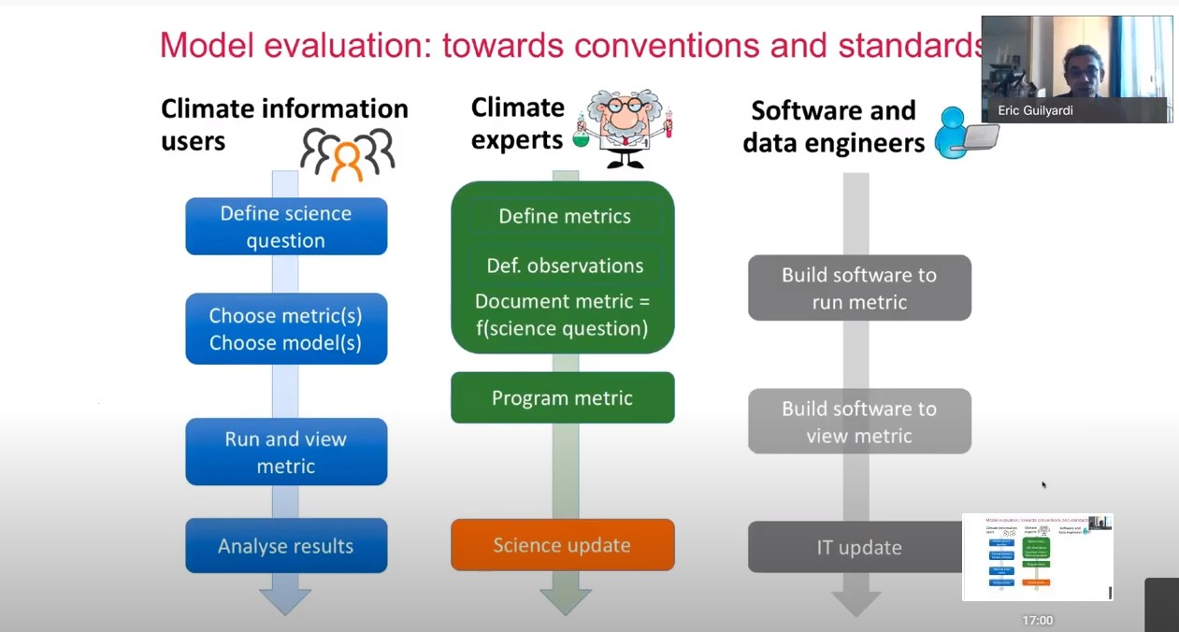
Challenges and recommendations
Important to explain the connection between the various subjects in the programme to the participants
Additional attention for e.g. the importance of standards and the interconnection of the subjects during the programme
Explain clearly what is expected from the case study (being not too ambitious, but learn about different steps)
One school is not enough to learn how to use climate data
Follow-up meeting
Linked-In group
Continued support by members of the IS-ENES3 project
Further short webinars or workshops

Slide 15
Available material
Programme, presentations and videos Autumn School: First IS-ENES3 virtual Autumn School on Climate data use for impact assessments — IS-ENES 3
(will be replaced by the presentations of the Summer school May-June 2021)
For more material, contact
Judith Klostermann, judith.klostermann@wur.nl
Janette Bessembinder, bessembi@knmi.nl

