Slide 1
LAI sensitivity testing in HARMONIE-AROME for NWP forecasting for Ireland
Geoffrey Bessardon and Emily Gleeson

Slide 2
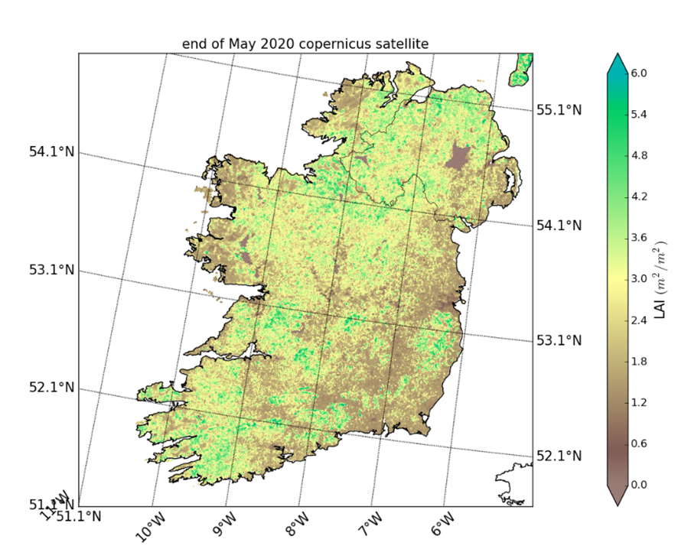
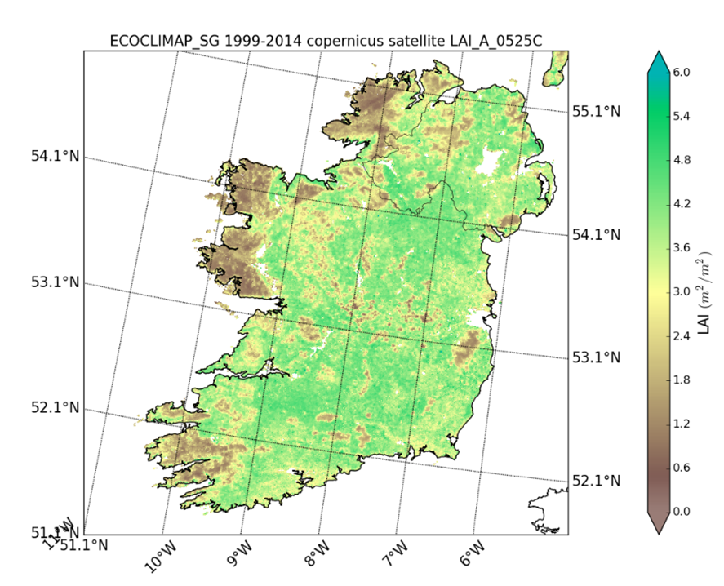
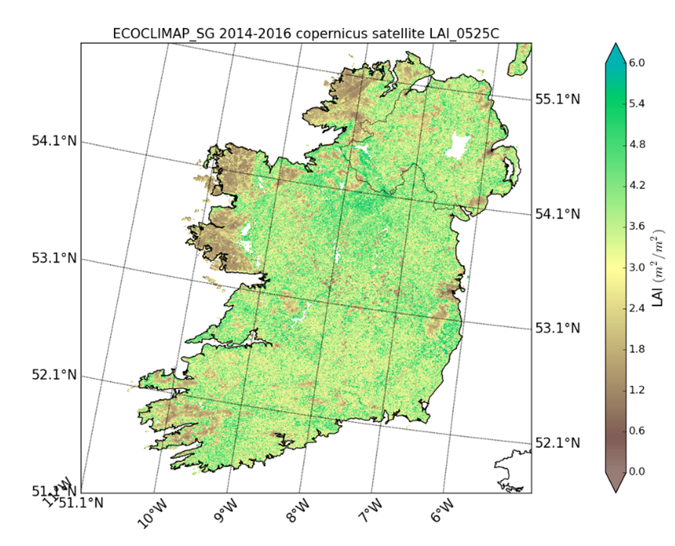
What LAI data should we use?
In ECOCLIMAP-SG the land cover map used in HARMONIE-AROME cycle 43 LAI data are an “add-on” to the land cover itself
Meteo France suggests 2 climatologies which can significantely differ from the near-real time data
25-May
2014-2016 Climatology ECOCLIMAP-SG
25-May
1999-2014 Climatology ECOCLIMAP-SG
25-May
2020 Copernicus

Slide 3
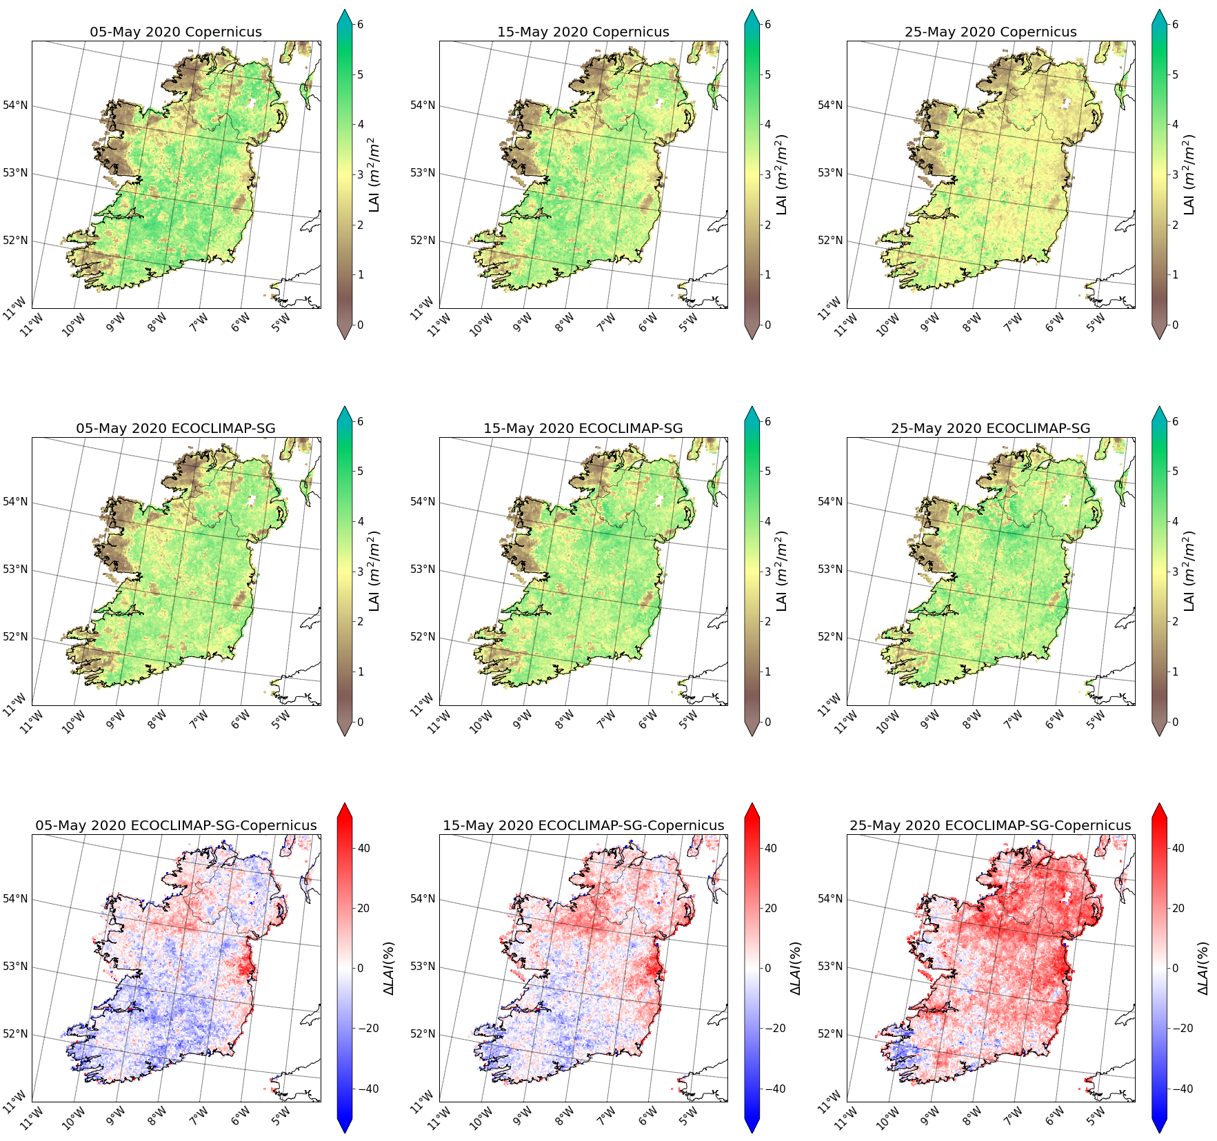
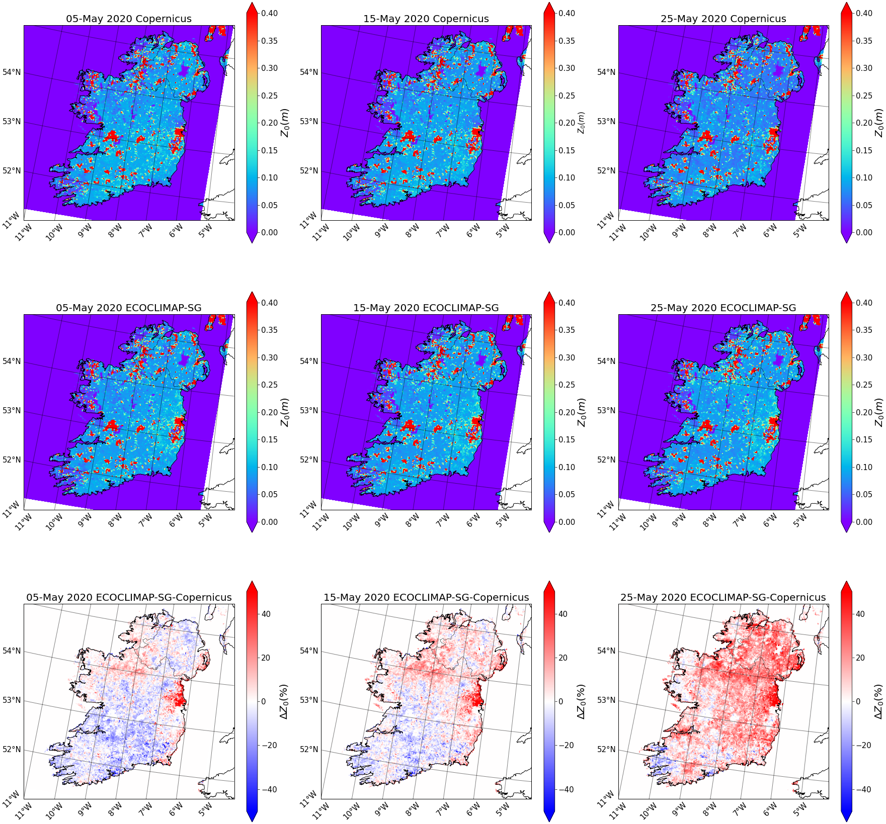
Offline Surfex LAI sensitivity test
LAI
Surface roughness Z₀
05-May
15-May
25-May
05-May
15-May
25-May
2020 Copernicus
The Δ LAI between inputs reflects in significant
Δ Z₀
2014-2016 Climatology
ECOCLIMAP-SG
Δ 2014-2016 Climatology
ECOCLIMAP-SG - 2020 Copernicus

Slide 4
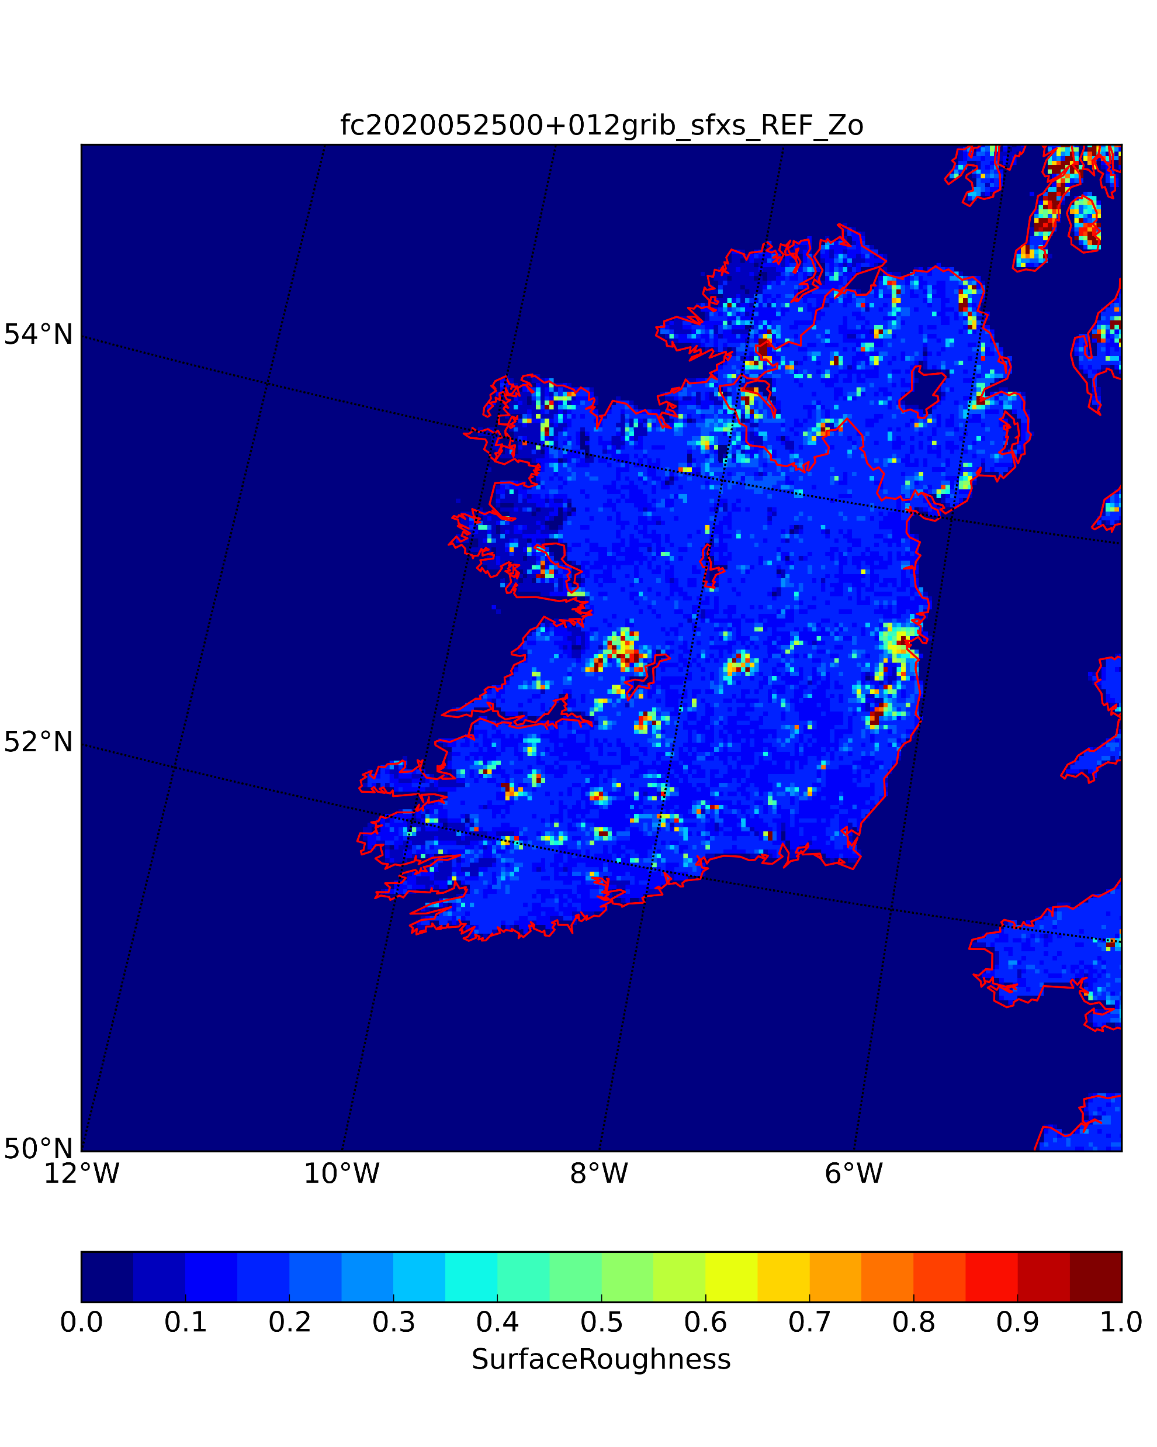
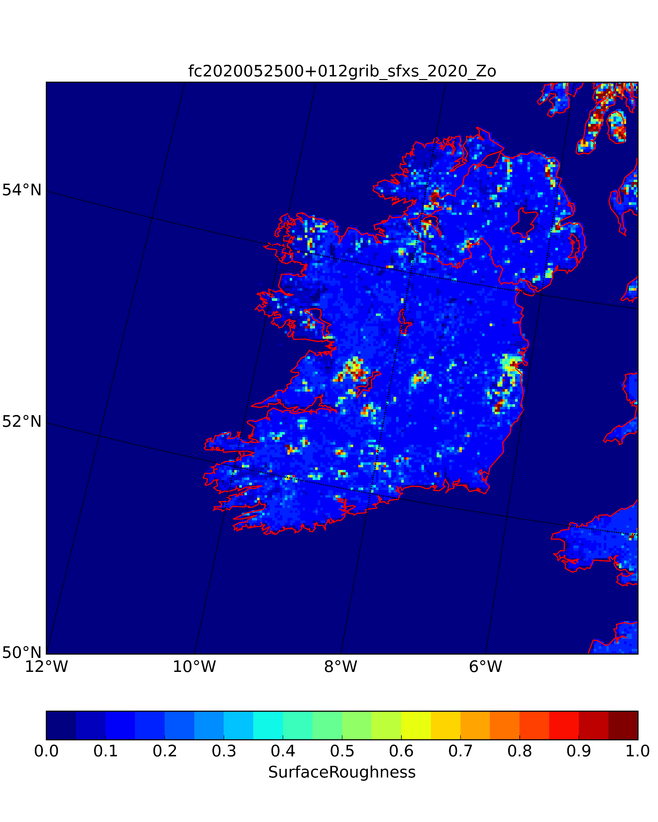
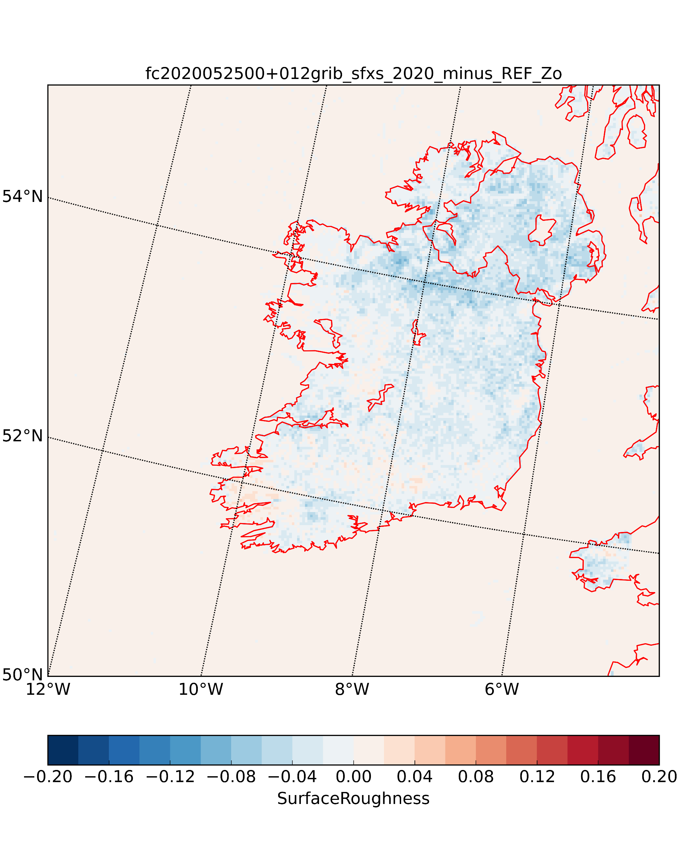
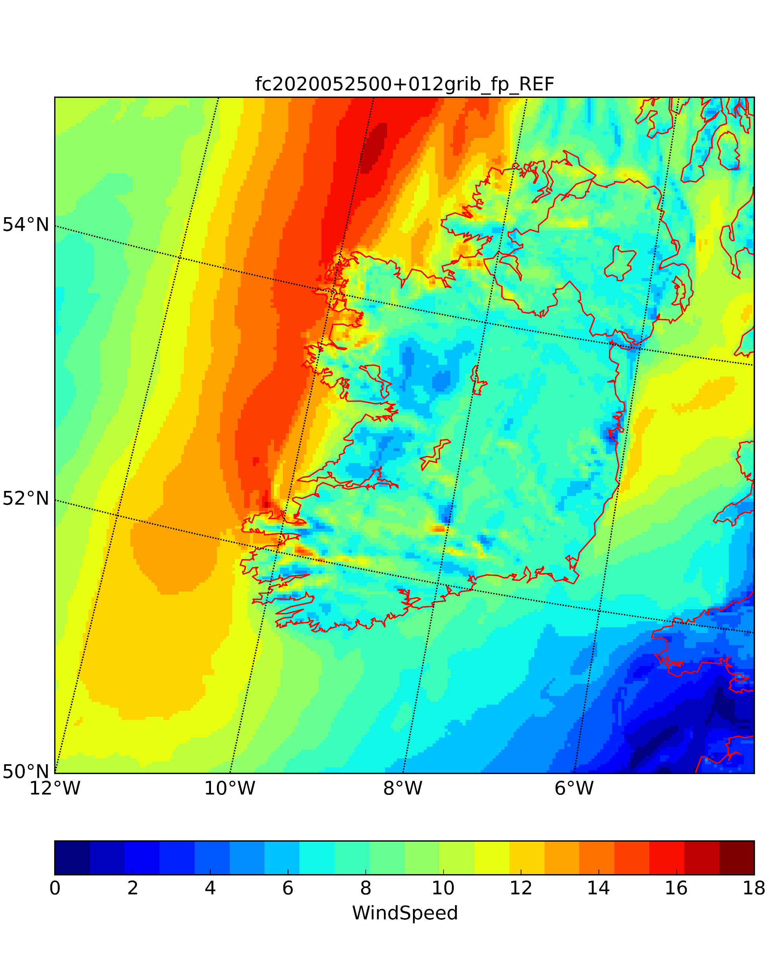
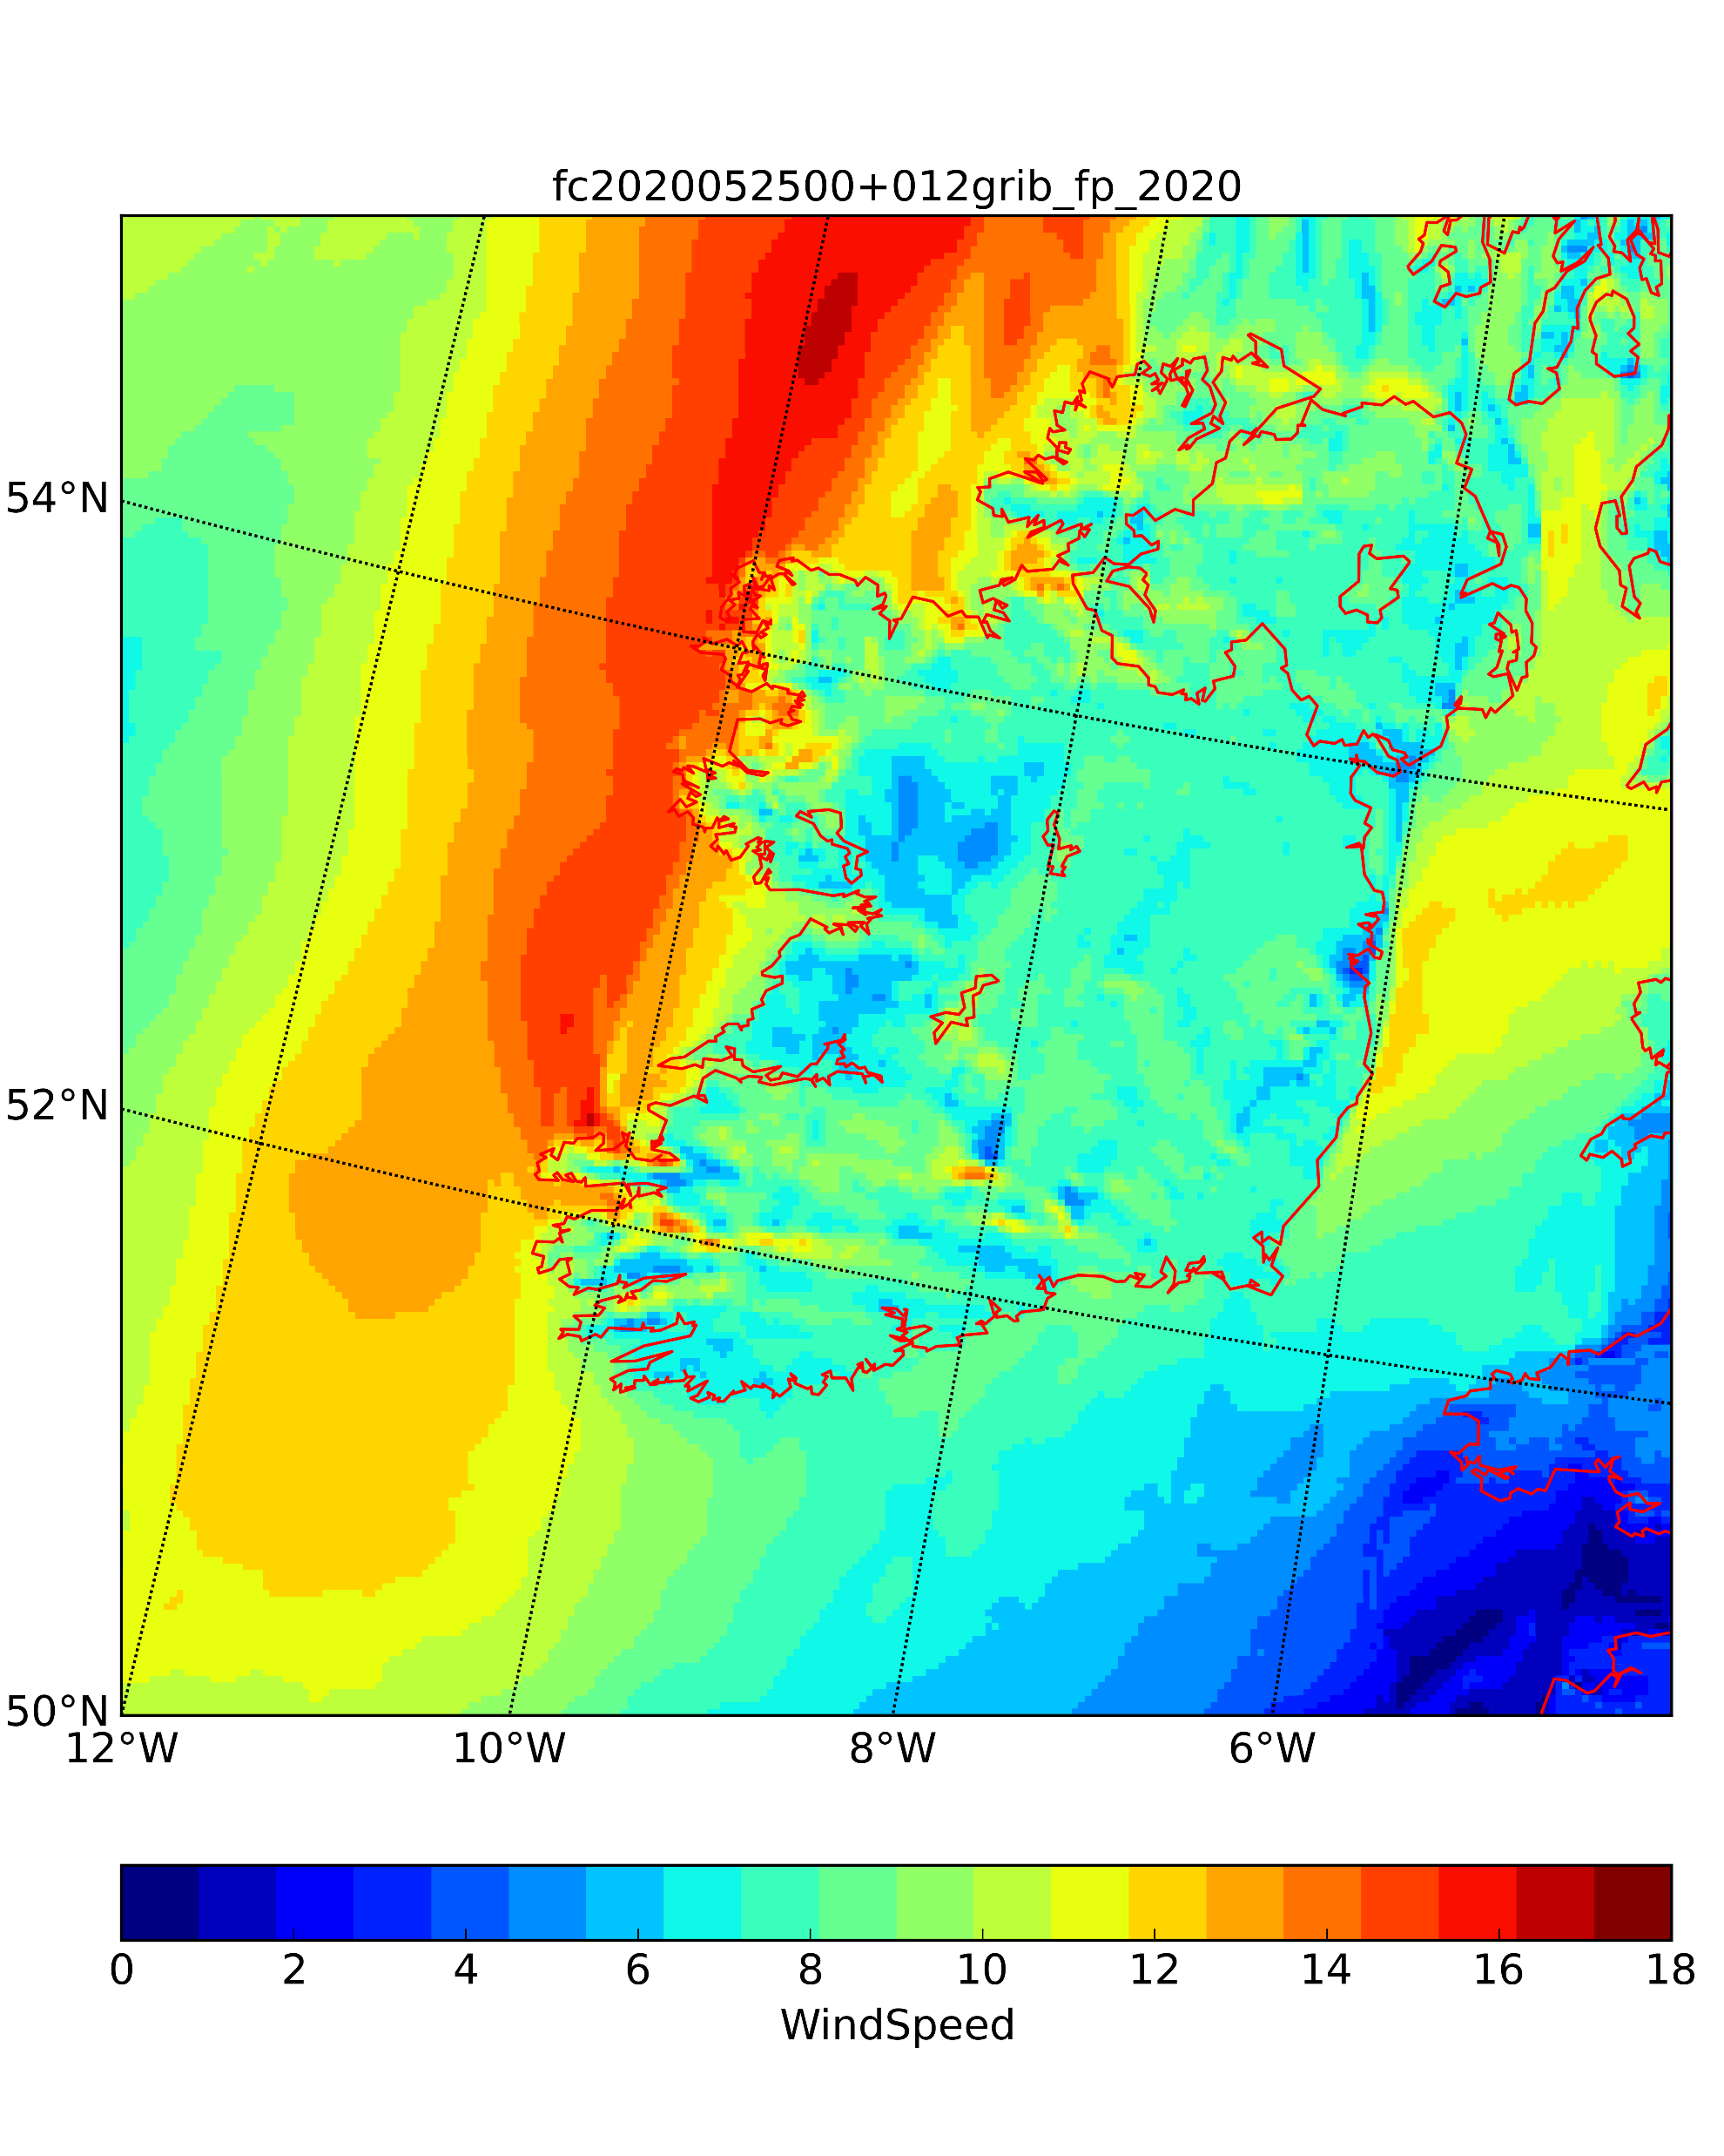
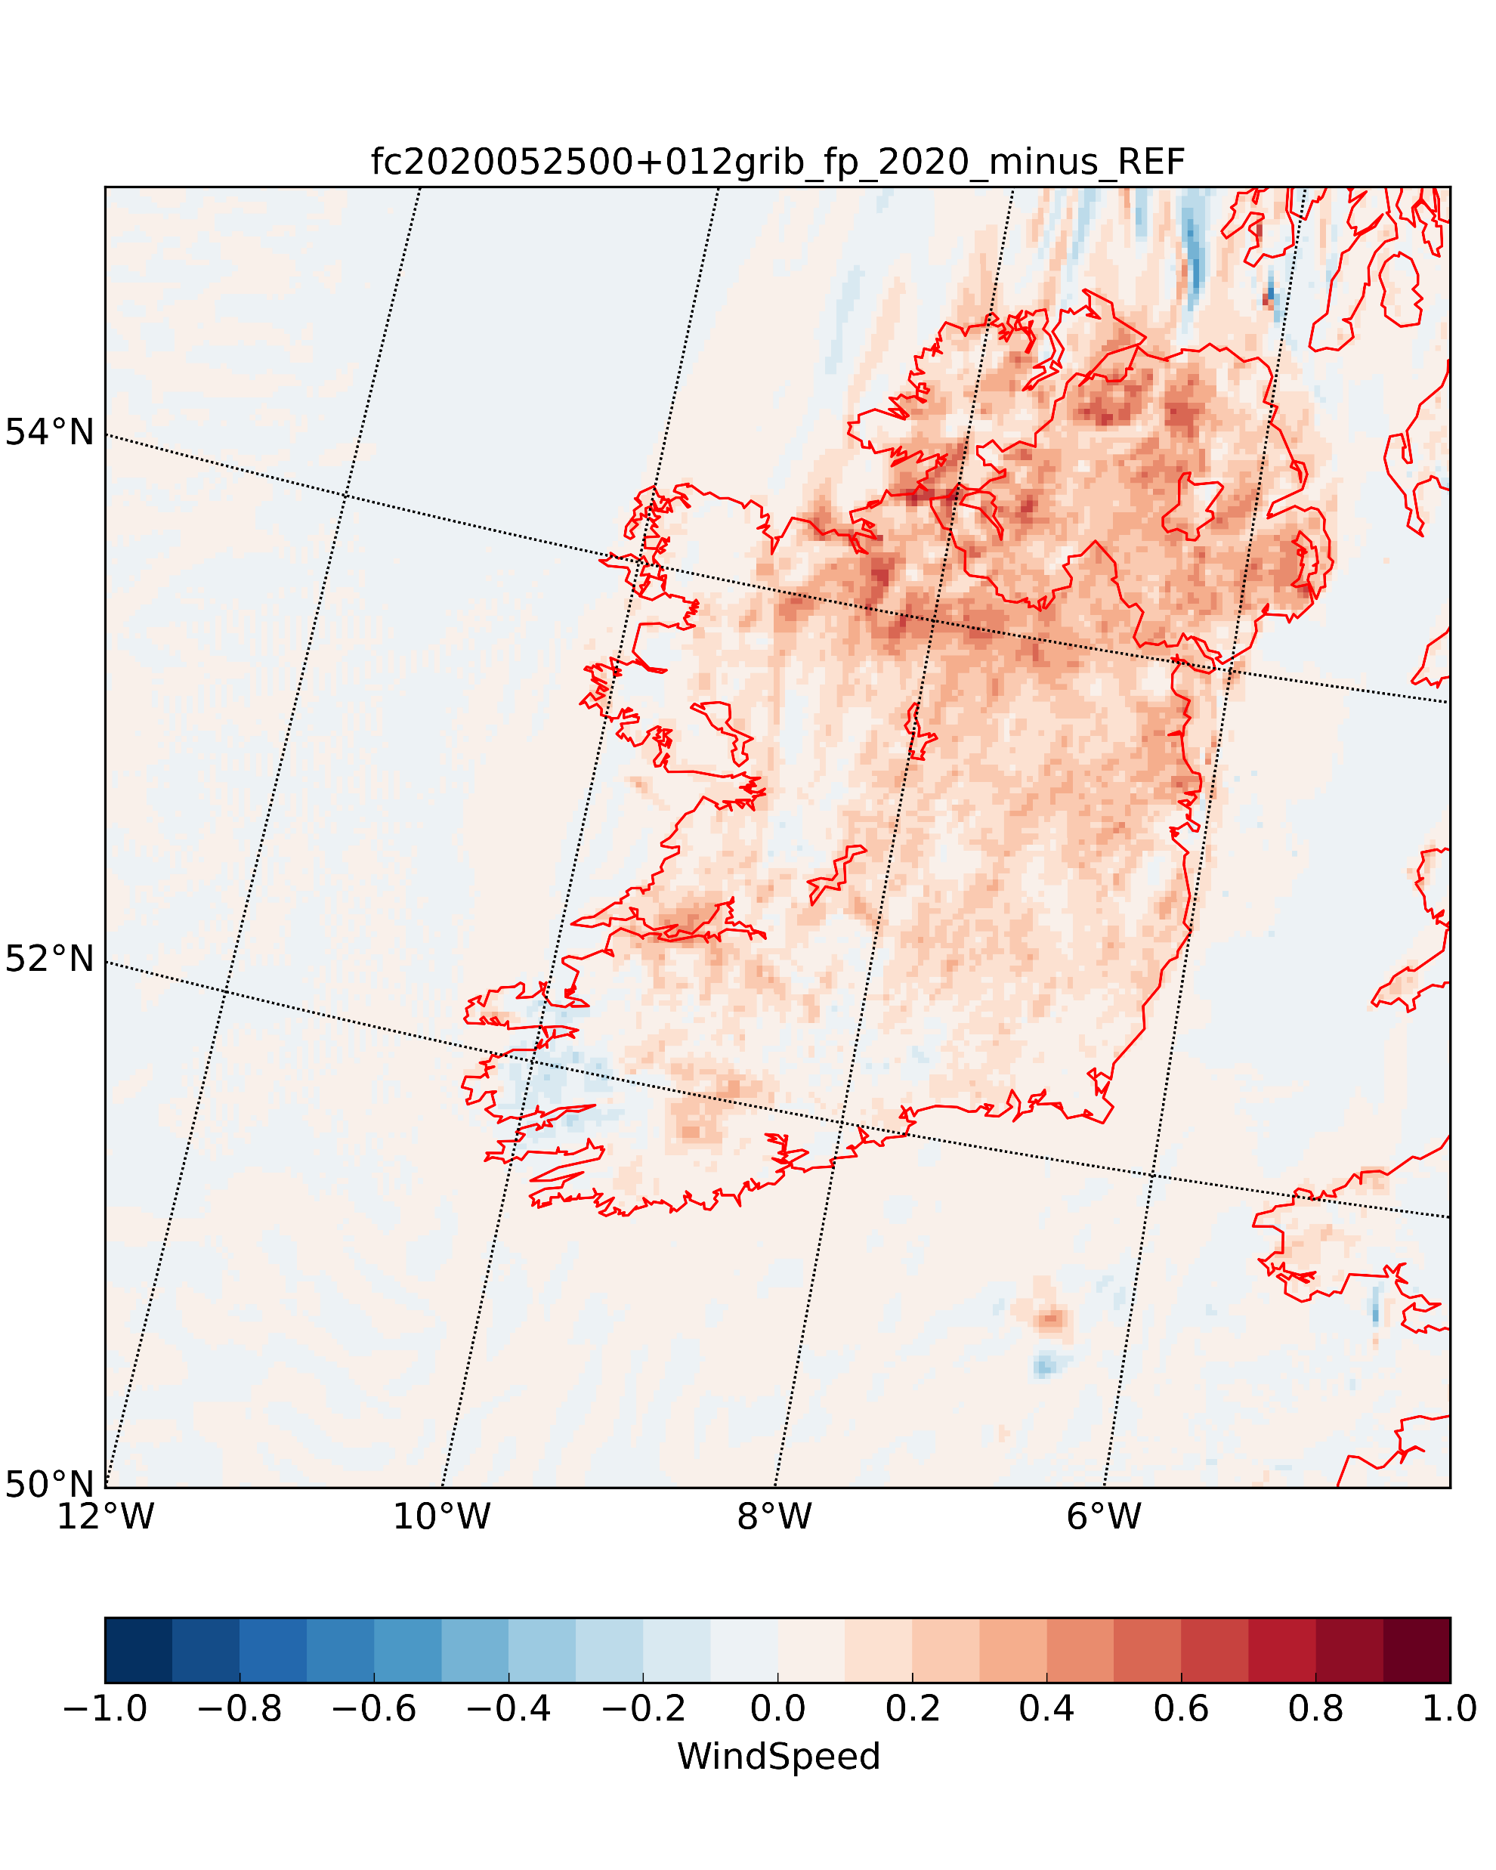
3D testing end of May 2020
2014-2016 Climatology
ECOCLIMAP-SG (REF)
2020 Copernicus
Δ 2020 Copernicus - REF
The 2020lower LAI leads to smaller surface roughnees leading to larger wind speed in the wind forecast
Surface roughness Z₀
Wind speed

Slide 5
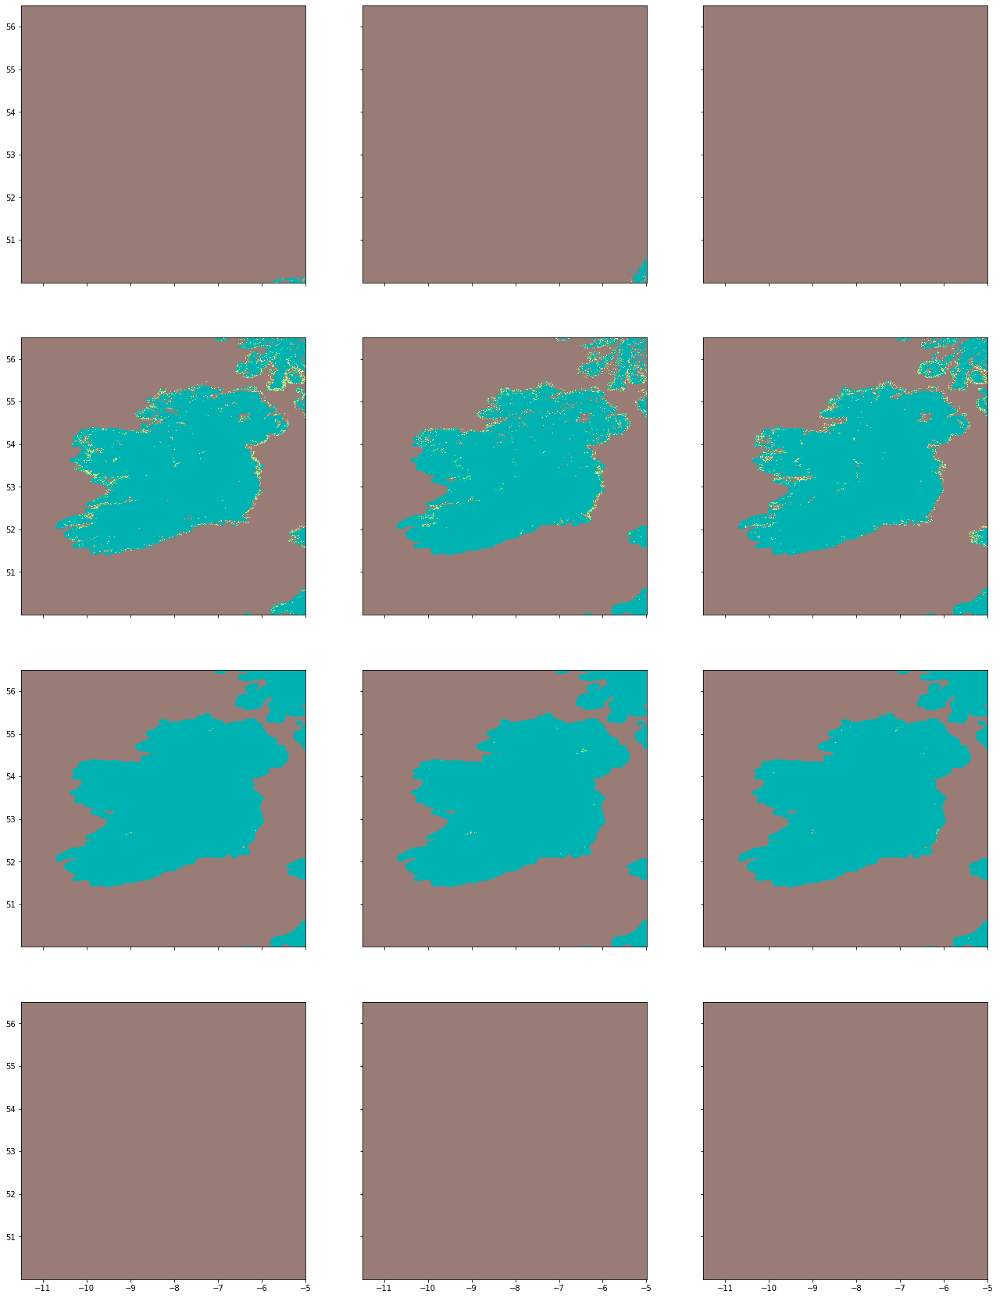
Ongoing work
2014
2015
2016
Month selectionwere LAI are fully available
  Multiple month missing data due to cloud cover certainly
  Dry months will consequently prevail
Validation against observation
05-January
05-February
05-July
05-December

