Slide 1
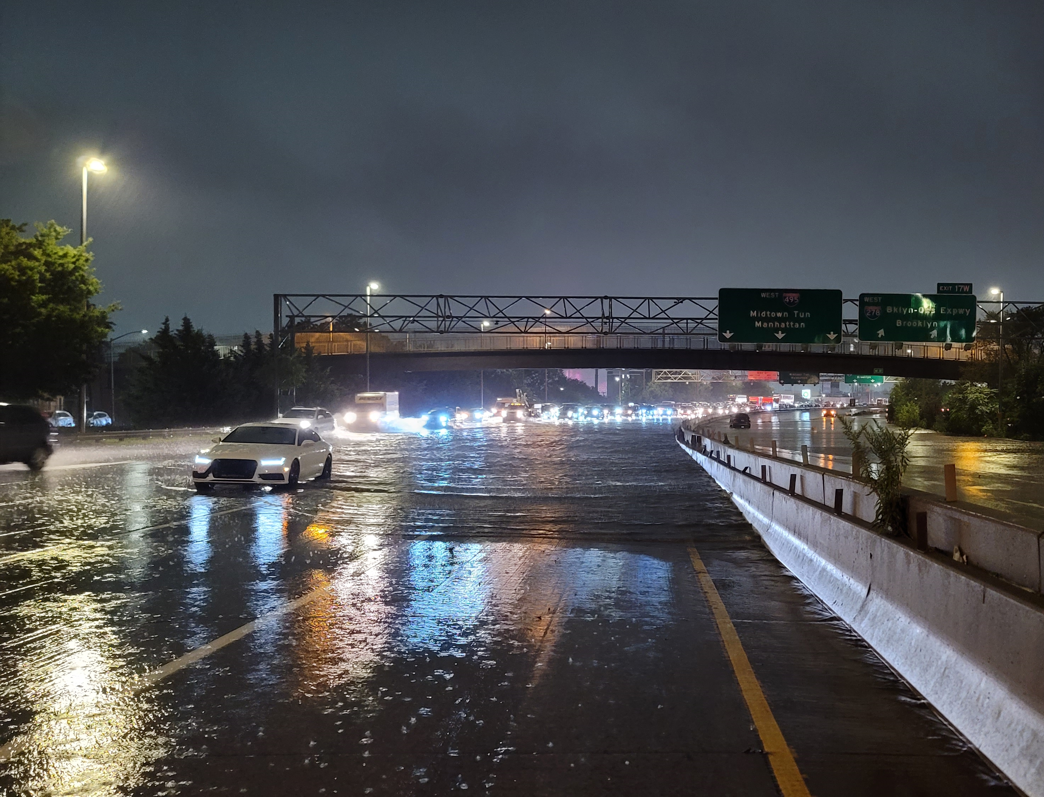
Implementing Integrated Urban Services
Gerald Mills and Oksana Tarasova
On behalf of WMO study group on Integrated Urban Services.
Tommy Gao Long Island Expressway shut down during Ida.
Cc:4.0. Source: Wikipedia

Slide 2
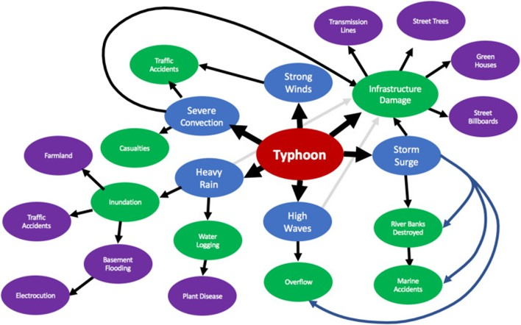
The need for an integrated system at urban scales.
The ‘domino effect’ partially shown for a typhoon or hurricane event, which produces multiple hydro-meteorological hazards (blue) that have immediate effects (green) and follow-on impacts (purple) that can be both short- and long-term. Source: Grimmond et al. 2020)

Slide 3
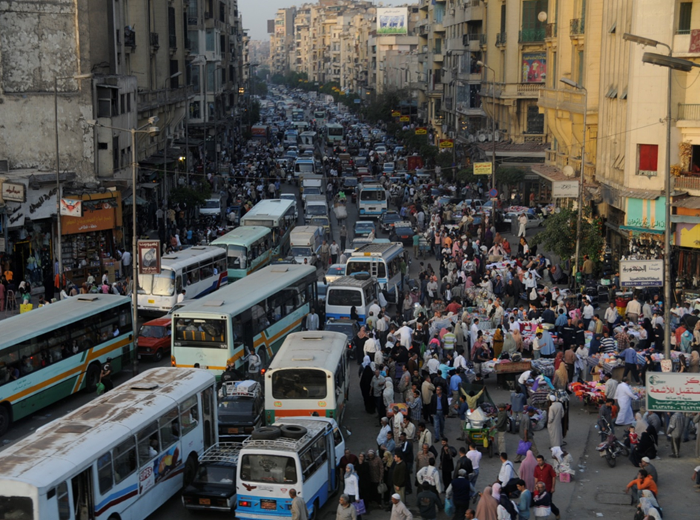
Cities are the home for the majority of humankind.
They contribute to climate change at the local, regional and global scales.
They are at risk from the consequences of these changes because:
Of their common topographic setting
Concentration of infrastructure and humans

Slide 4
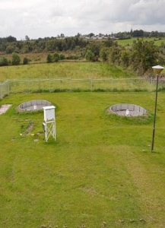
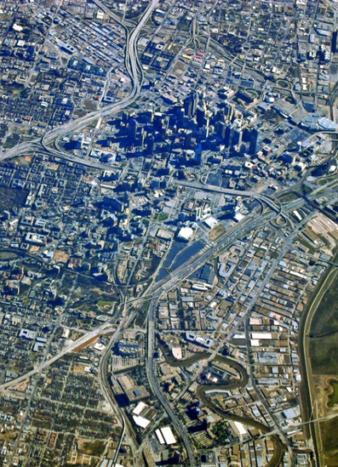
Maturing urban climate science
Where we apply
Where we measure
Urban climate science is sufficiently developed to predict many urban outcomes.

Slide 5
WMO and the new Urban Agenda
WMO is promoting safe, health and resilient cities through the development of specially tailored integrated urban weather, climate and environmental services. The aim is to build urban services that meet the special needs of cities and their growing population.
These services are needed by
Emergency managers to map out risks and provide early warnings.
Transport departments to minimize emissions and disruptions from extreme weather,
Health providers to prepare heat-action plans and responses to severe pollution
Energy managers to optimize production.
Water departments to manage the impact of floods and water shortages
Urban planners to reduce vulnerability of buildings and infrastructure to sea-level rise and natural hazards
Implementation
Concept and methodology
Demonstration cities
Implementation

Slide 6
Integrated Urban Services
WMO
Service user
Citizen
Government
Public health
Sector
Energy
Water
Transport
Commercial
Industrial
Residential
Service provider
National Meteorological &
Hydrological Services (NMHS)
Hazard
Meteorological
Climatological
Hydrological
Air quality
Information
Communication
Services have developed historically to support certain services, such as air transport and have neglected other potential users. Moreover, these services have developed in isolation with their own scientific infrastructure (models and data) and organizational structures.

Slide 7
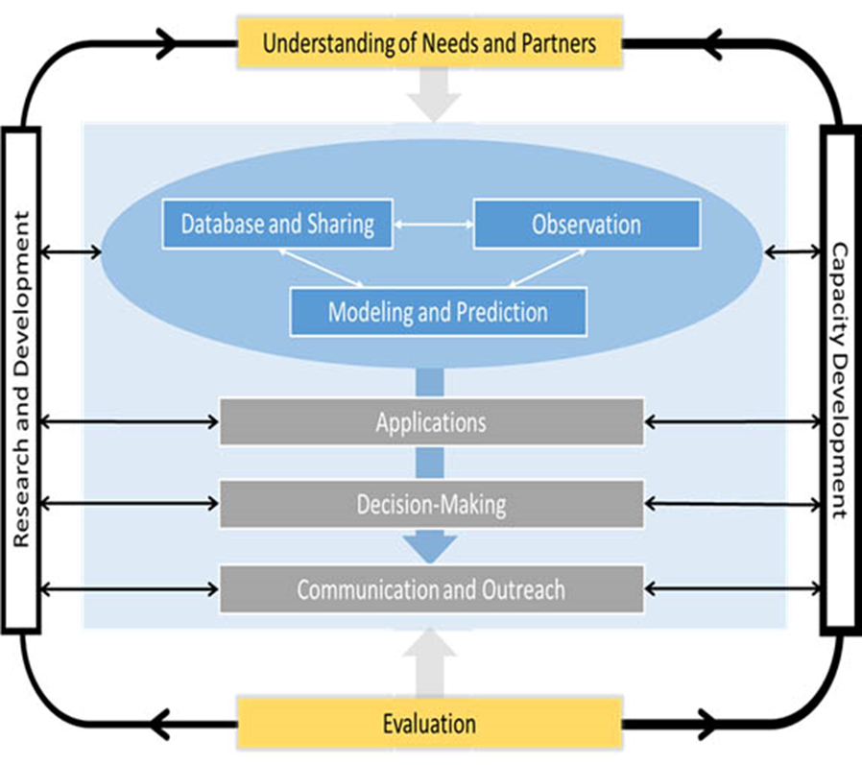
IUS conceptual model
https://community.wmo.int/activity-areas/urban

Slide 8
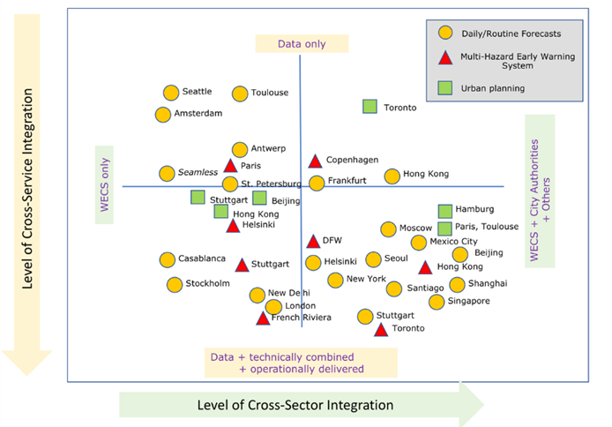
Urban services and the level of integration.
Axes of service integration: cross-service and cross-sector

Slide 9
NMHS survey results.
 | Weather | Climate | Hydrology | Air quality
Number of NMHS | 79 | 55 | 47 | 36
By Hazard | % | % | % | %
Heavy rainfall | 77 | 55 | 46 | 36
Flooding | 67 | 48 | 41 | 30
Tropical storms | 29 | 23 | 20 | 9
Coastal inundation | 34 | 25 | 22 | 15
Wind storms | 56 | 38 | 32 | 26
Heatwaves | 52 | 34 | 31 | 28
Air pollution | 51 | 34 | 31 | 25
Thunderstorm | 66 | 46 | 39 | 29
Services and level of development

Slide 10
Implementation Tasks
Survey of service users:
This presentation
Cost benefit analysis of IUS:
Ongoing
Recommendations (test city):
Ongoing

Slide 11
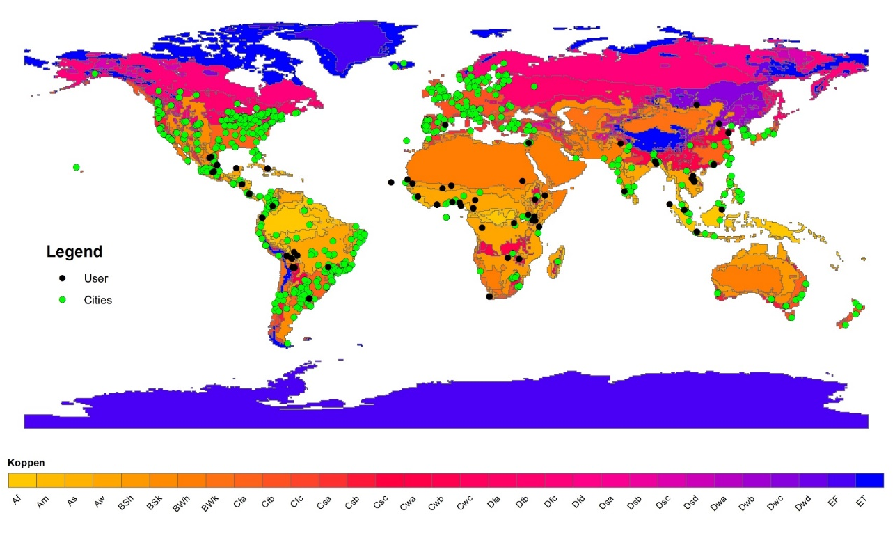
Survey data
WMO survey data of users (n=79)
Sent to UN networks and focused on city hazards and the sources of information.
ICLEI annual city reporting (n=762)
Completed annually by city officials to monitor sustainable development goals.

Slide 12
WMO user survey
ICLEI survey
 | Low income | Lower middle income | Upper middle income | High income | Total
Sub-Saharan Africa | 5 | 19 | 1 | 0 | 25
Europe & Central Asia | 0 | 0 | 0 | 2 | 2
Latin America & Caribbean | 0 | 9 | 20 | 0 | 29
East Asia & Pacific | 0 | 5 | 12 | 1 | 18
Middle East & North Africa | 0 | 0 | 0 | 1 | 1
South Asia | 0 | 4 | 0 | 0 | 4
Total | 5 | 37 | 33 | 4 | 79
 | Low income | Lower middle income | Upper middle income | High income | Total
Sub-Saharan Africa | 6 | 13 | 10 | 0 | 29
Europe & Central Asia | 0 | 0 | 14 | 145 | 159
Latin America & Caribbean | 0 | 5 | 262 | 15 | 282
North America | 0 | 0 | 0 | 183 | 183
East Asia & Pacific | 0 | 13 | 28 | 31 | 72
Middle East & North Africa | 0 | 2 | 1 | 13 | 16
South Asia | 0 | 21 | 0 | 0 | 21
Total | 6 | 54 | 315 | 387 | 762
Distribution of responses by income and region (World Bank classification).

Slide 13
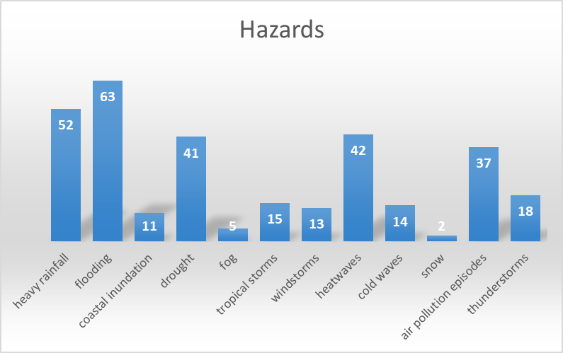
WMO user survey
What are the hazards your city faces?

Slide 14
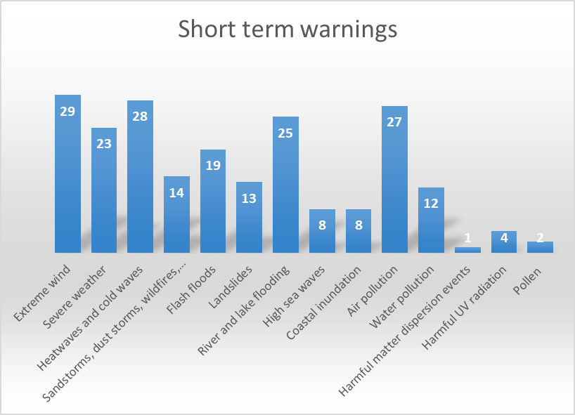
Organisation | N | %
National Meteorological and Hydrological Services (1) | 46 | 58.2
government agencies (2) | 41 | 51.9
universities/research networks (3) | 22 | 27.8
private sector (4) | 4 | 5.1
I don’t receive any information/predictions (5) | 16 | 20.3
other (6) | 0 | 0.0
Table 8. Who is providing the information for long-term planning (predictions)?

Slide 15
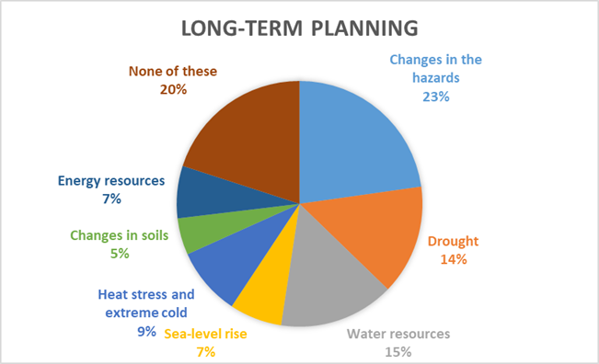
Aspects | N | %
Content (1) | 37 | 47
Frequency (2) | 31 | 39
Spatial resolution/accuracy (3) | 35 | 44
other (4) | 0 | 0.0
What aspects of the information you receive do you expect to be improved?

Slide 16
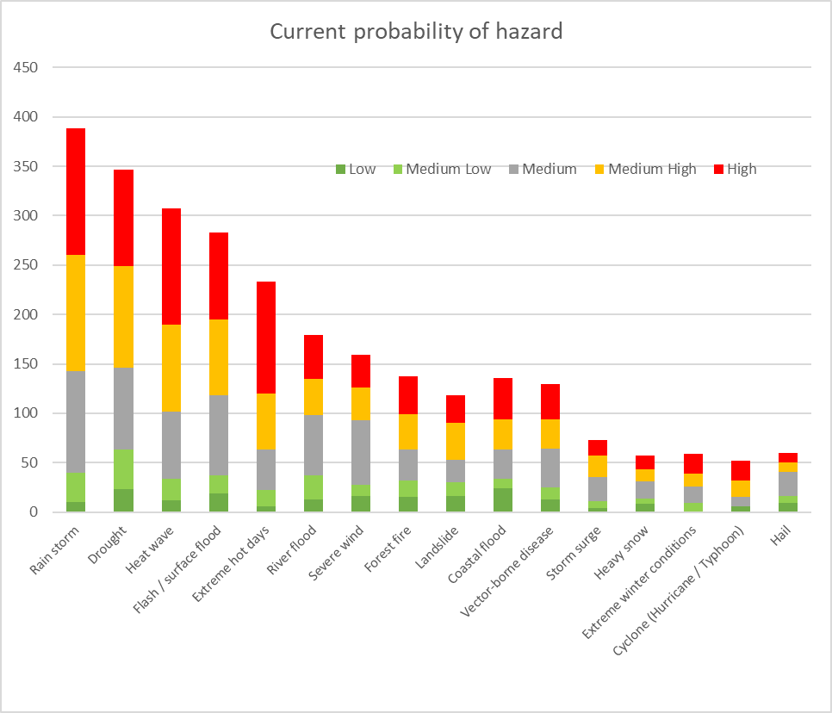
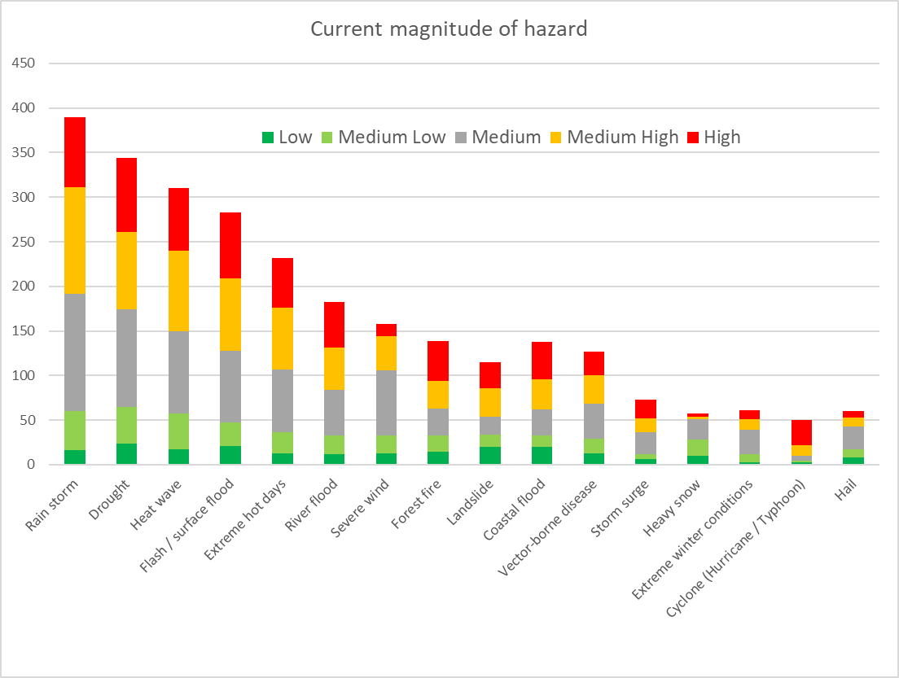
CDP Survey

Slide 18
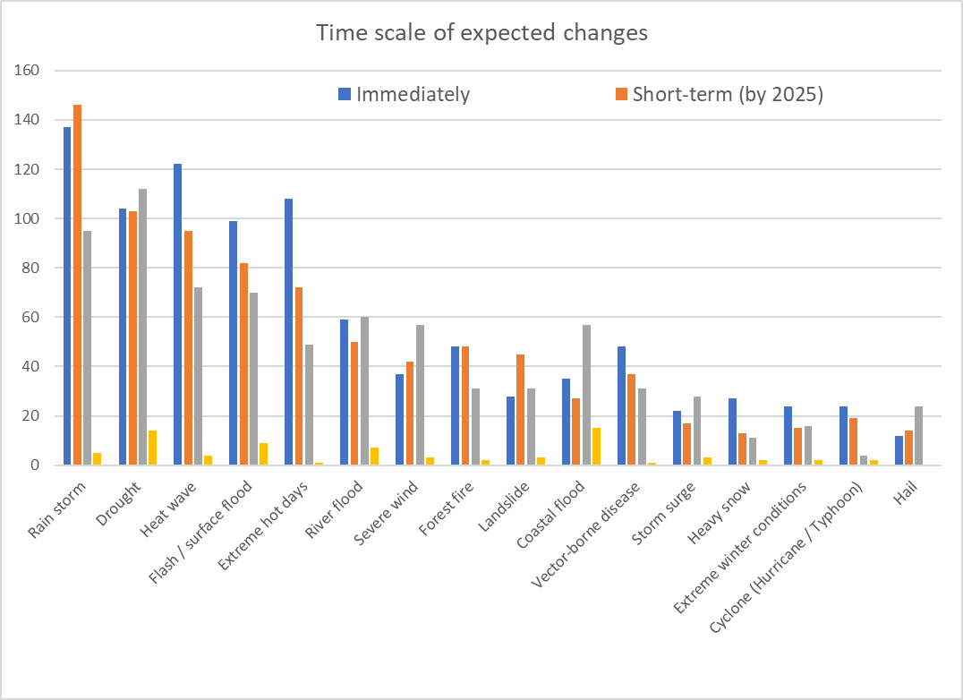

Slide 19
Results, so far
Based on the combined information from the WMO and CDP survey:
There is broad provider-user agreement on the most significant hazards
Flooding and extreme rainfall issues are paramount for city managers.
There needs to be a greater focus on water shortages and drought.
The commercial and emergency services are key stakeholders.
There needs to be a far greater emphasis on communicating information.
Next steps:
Develop partnership with ICLEI to gather data on cities and their use of hazard information.
Complete the cost-benefit analysis.

Slide 20
References
Baklanov, A., Grimmond, C.S.B., Carlson, D., Terblanche, D., Tang, X., Bouchet, V., Lee, B., Langendijk, G., Kolli, R.K. and Hovsepyan, A., 2018. From urban meteorology, climate and environment research to integrated city services. Urban Climate, 23, pp.330-341.
Grimmond, S., Bouchet, V., Molina, L.T., Baklanov, A., Tan, J., Schlünzen, K.H., Mills, G., Golding, B., Masson, V., Ren, C. and Voogt, J., 2020. Integrated urban hydrometeorological, climate and environmental services: Concept, methodology and key messages. Urban climate, 33, p.100623
Baklanov, A., Cárdenas, B., Lee, T.C., Leroyer, S., Masson, V., Molina, L.T., Müller, T., Ren, C., Vogel, F.R. and Voogt, J.A., 2020. Integrated urban services: Experience from four cities on different continents. Urban Climate, 32, p.100610.

