Slide 1
Using machine learning to produce a very high-resolution land-cover map for Ireland and beyond
Geoffrey Bessardon, Emily Gleeson, Eoin Walsh, Odhrán Dooley

Slide 2
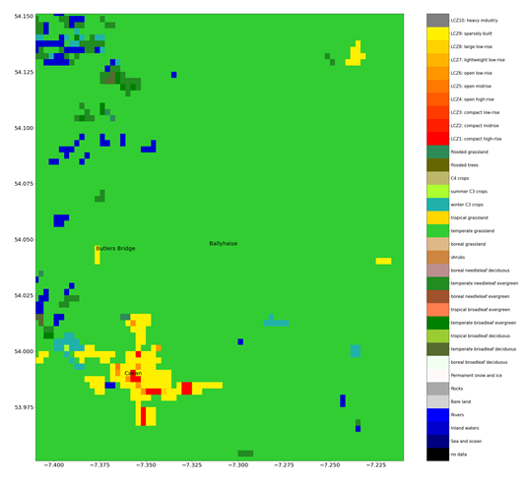
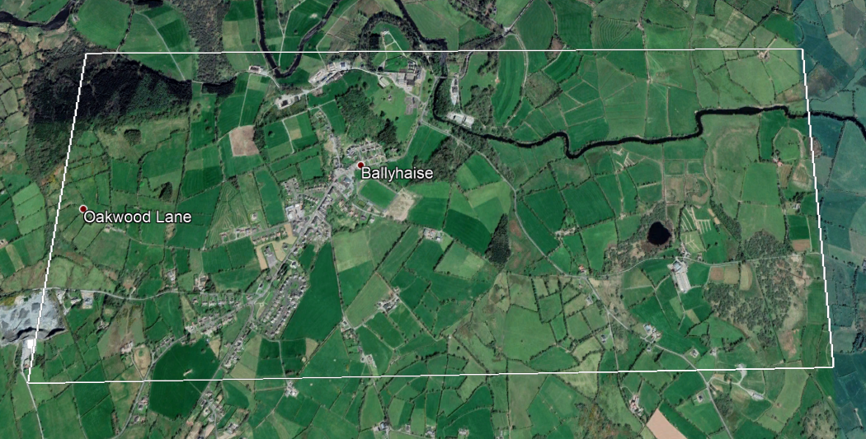
Context
ECOCLIMAP-SG used in HARMONIE-AROME overestimates grassland over Ireland
2020 work: Segmentation of Sentinel-2 imagery over Ireland Creation Ulmas-Walsh map
Walsh et al. 2021
Using machine learning to produce a very high resolution land-cover map for Ireland https://doi.org/10.5194/asr-18-65-2021

Slide 3
Ulmas-Walsh has promising results
Sentinel-2
Ulmas-Walsh
ECOCLIMAP-SG
Bog in county Galway
Bog shape is looks better
Forests are captured in Country Tipperary
Differences in Phoenix Park are due to label definition
ECO-SG misses lake in Galway
County Tipperary
Phoenix Park (Dublin)
Lake in county Galway

Slide 4
Extension to other countries: example Faroe
The prediction counts most of the country as grassland
Issue: not enough bareland and lakes in the training dataset
Ongoing work with continental dataset

Slide 5
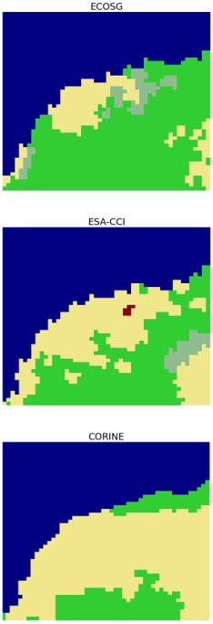
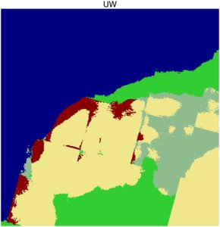
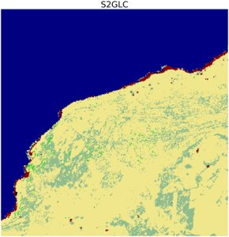
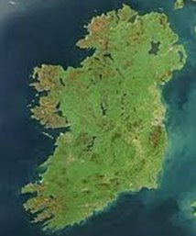
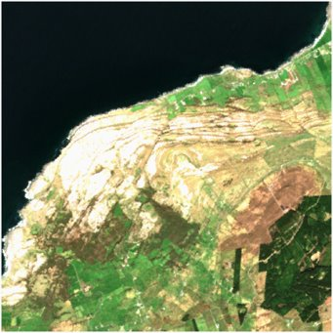
Comparison with other maps
The Burren
Agricultural Areas
Artificial Areas
Forest & Semi-Natural Areas
Wetlands​
S2GLC (produced by ES) using machine learning is good at representing roads
Ulmas-Walsh has a sporadic “checkered effect”
CORINE (Copernicus) does a decent work
Water​
The Burren, north of Doolin, Co. Clare​
5km x 5km

Slide 6
Conclusions
Machine learning techniques are promising but work needs still to be done
Any expension of the UW map needs correction of the checkered issue an a well thought training dataset (on-going)
Each map has pro and cons between label definition and accuracy
ECOCLIMAP-SG urban labels implicitly includes building heights
Leveraging machine learning to produce a cost-effective national building height map of Ireland EMS2021-48 | Lightning talks | OSA1.5 Wed, 08 Sep, 09:30–09:35

