Slide 1



Redefining the climate regions of Romania through objective methods
EMS Annual Meeting
10 of September 2021
1,2
1 2
Vlad-Alexandru AMIHĂESEI Lucian SFÎCĂ , Alexandru DUMITRESCU
1
Faculty of Geography and Geology, Alexandru Ioan Cuza University, Iași, Romania
National Meteorological Administration, Bucharest, Romania
2

Slide 2
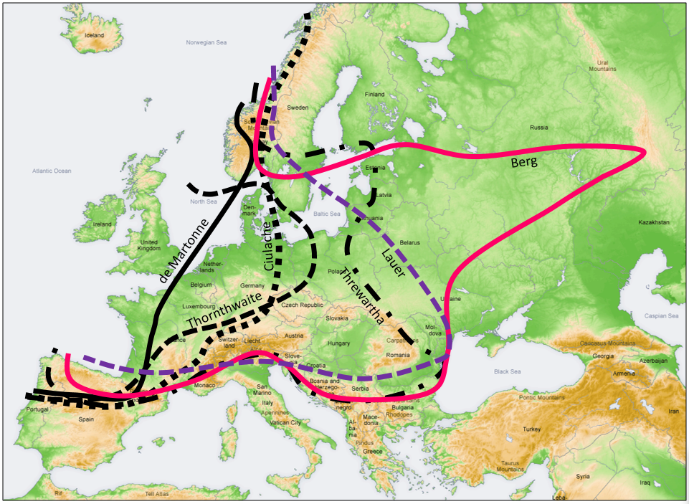
INTRODUCTION
CONTINENTALITY VS. OCEANITY
South-East of Europe represents a so-called Earth's Climate Problem region at global scale

Slide 3
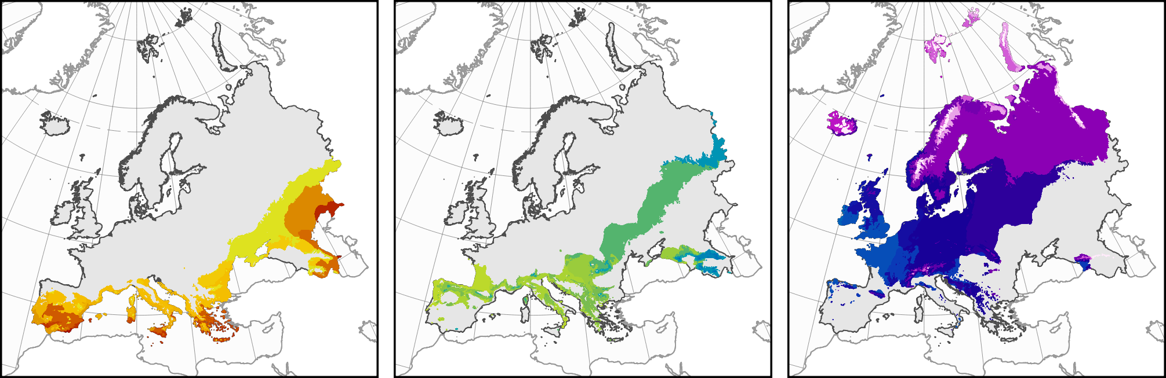
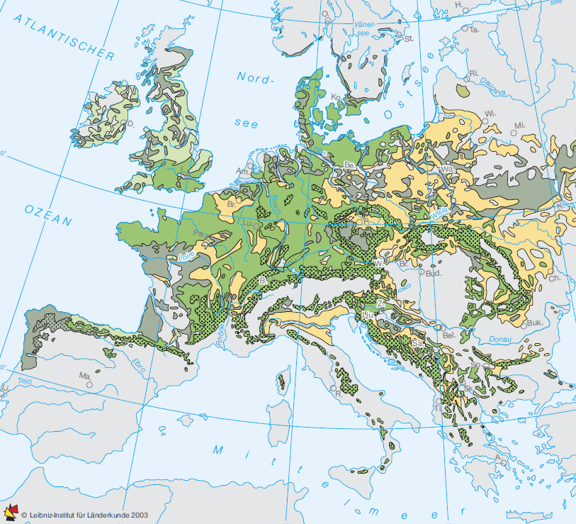
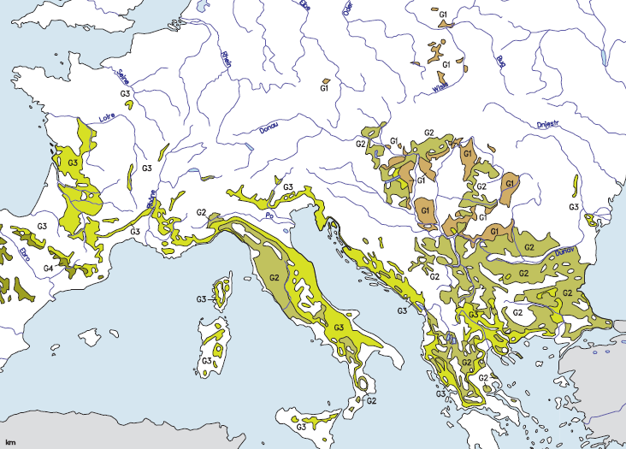
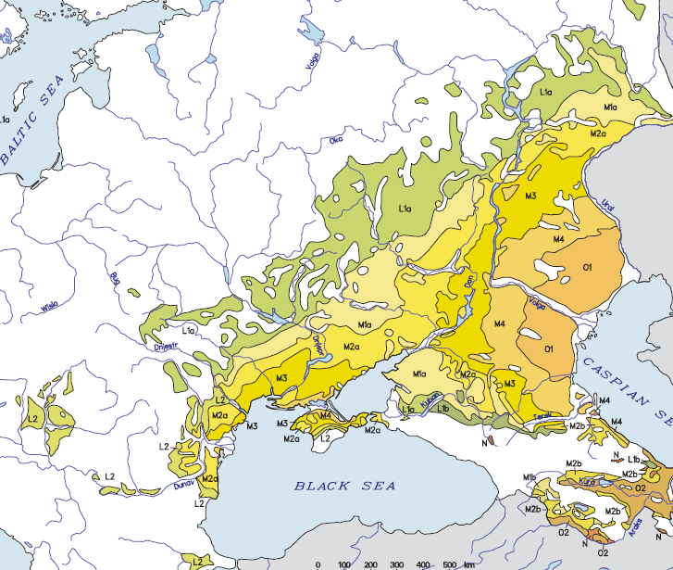
INTRODUCTION
Botti et al., 2018
AXERIC REGIONS
SUBXERIC REGIONS
XERIC REGIONS
Mesophilic decidous forests: Fagus sp.
Thermophilious decidous forests: Quercus sp.
Steppe and forest steppe
Bohn et al., 2004

Slide 4
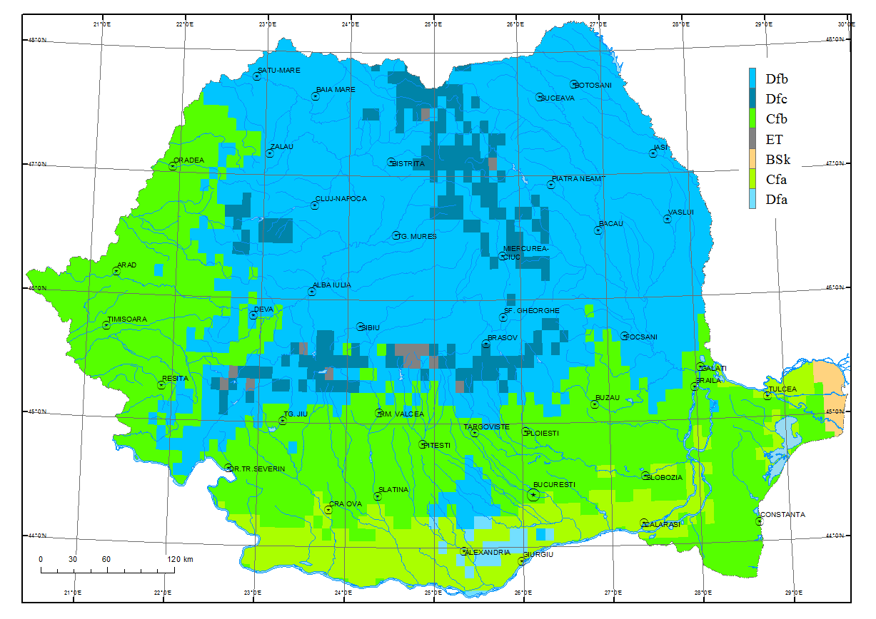
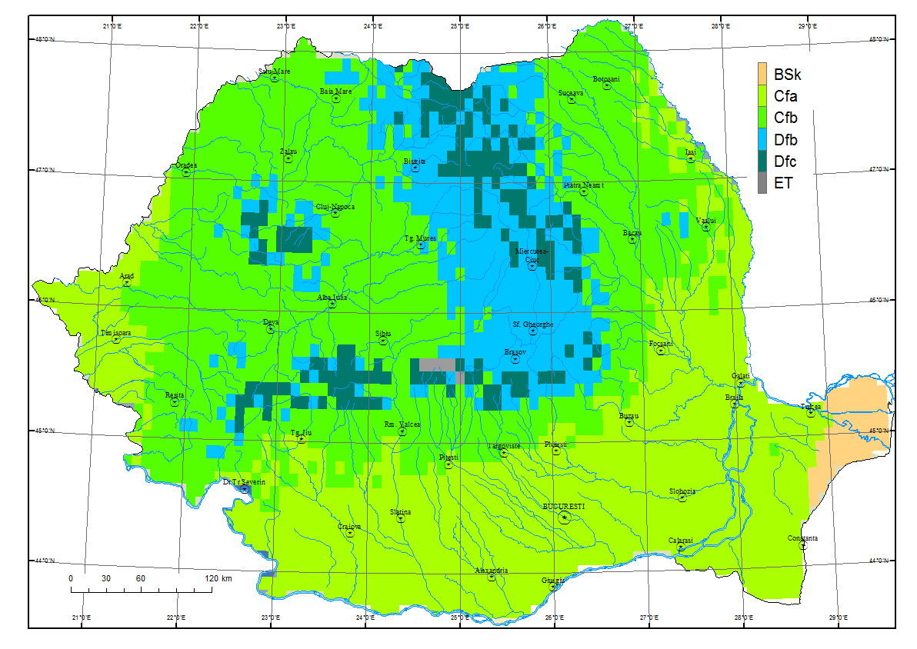
INTRODUCTION
KÖPPEN CLASSIFICATION
Köppen classification map for Romania (1961-1980)
Köppen classification map for Romania (1981-2013)

Slide 5
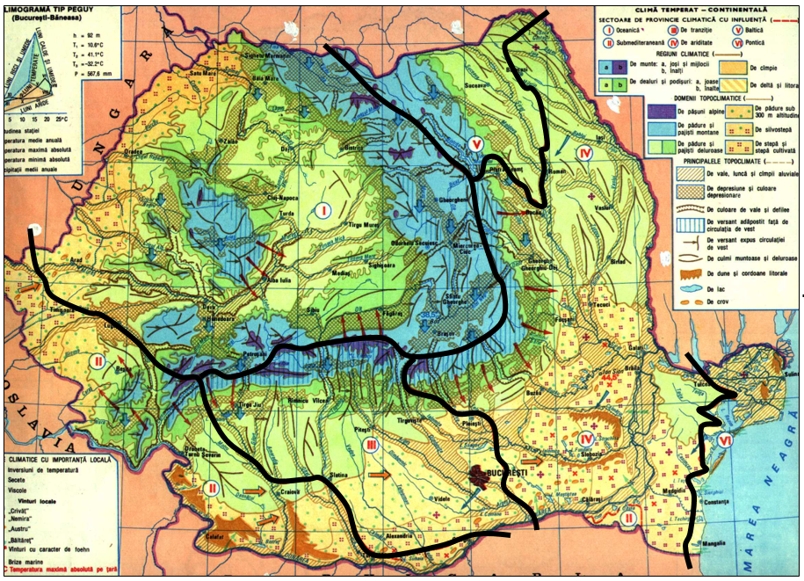
INTRODUCTION
Climate regions of Romania,
Bogdan, 1983
Climate of Romania considered
as temperate-continental with
6 climate subregions:
Oceanic
Submediteranean
Transitional (inside Romania)
Arid
Baltic
Pontic
Weak points:
- no clear methodology displayed;
- no correspondence with the climate
of the neighbors countries;
- no clear thresholds regarding the
climate elements;
- subjective interpretation of the
vegetation aspects;

Slide 6
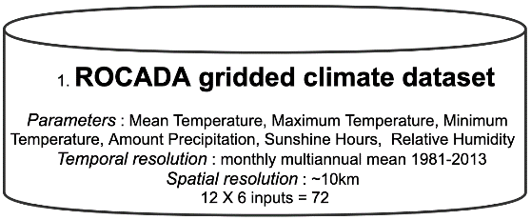
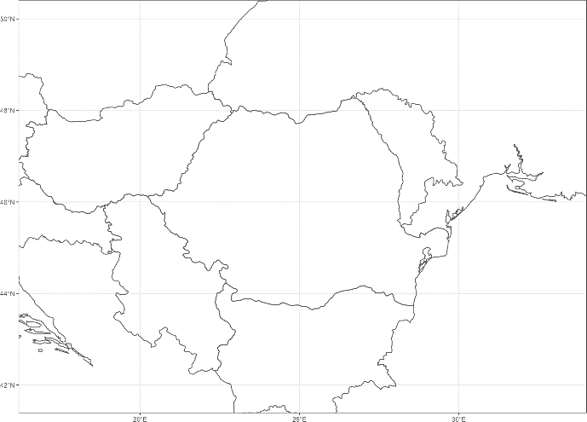
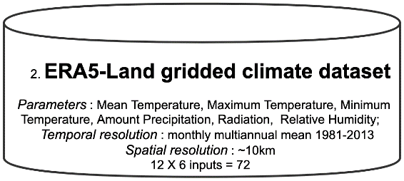
DATA AND METHODS
DATA BASES (DB)
INPUT DATA (ID)
METHOD
MONTHLY CLIMATE PARAMETERS:
Maximum temperature
Minimum temperature
Mean temperature
Precipitation amount
Relative humidity
Solar radiation (ERA 5 land)/
Sunshine duration (ROCADA)
1. Factor analysis
Factor scores methods(FSM):
Alpha
GLS
Minchi
Mminrank
Minres
ML
Old.min
ULS
WLS
Factoring method(FM):
Anderson
Bartlett
Regression
ten Berge
KÖPPEN PARAMETERS:
July mean air temperature
January mean air temperature
Annual mean air temperature
Annual precipitation amount
October-March precipitation amount
Precipitation amount in April
Precipitation amount in February
Precipitation amount in September
Precipitation amount in July
Precipitation amount in November
June-September mean air temperature
2. K-means clustering (6-14 clusters)
SOFTWARE
R libraries:
library(psych)
library(factors)
library(cluster)
library (ggplot2)

Slide 7
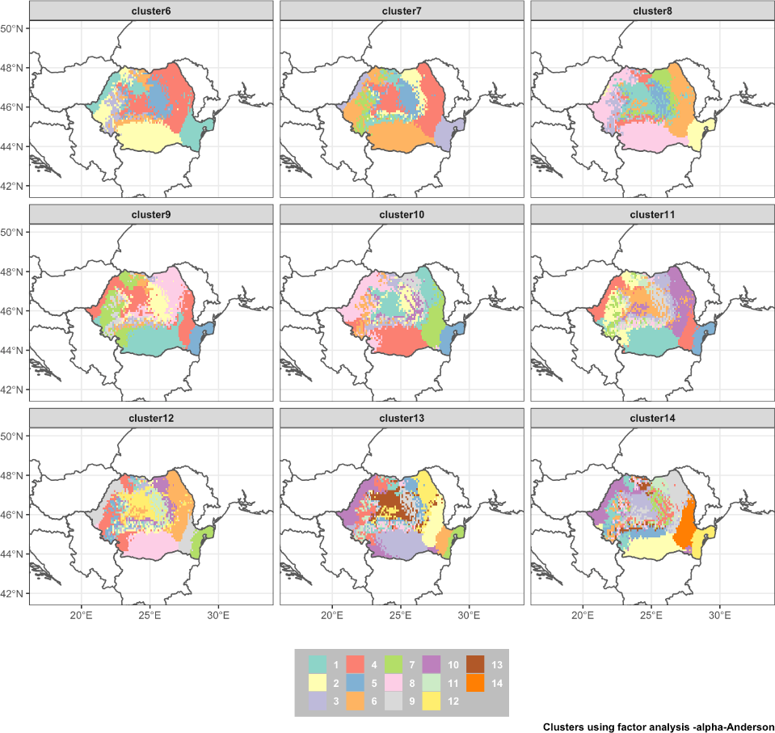
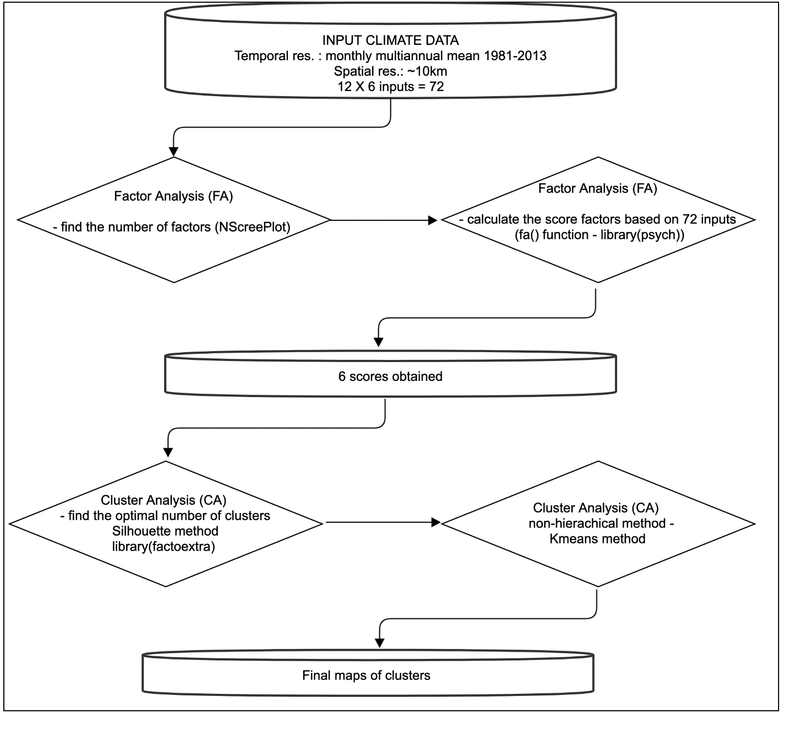
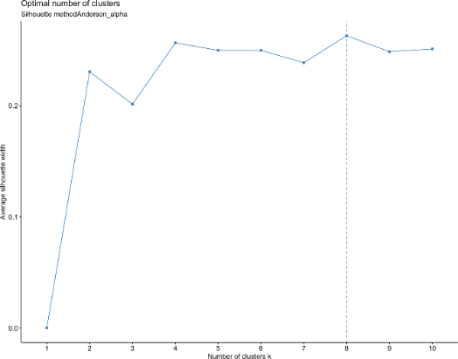
DATA AND METHODS
Number of clusters obtained
Methodological workflow
2 DB * 2 ID * 4 FM * 9 FSM * 9 CT = 1296 maps
Silhouette method used to map selection
2 DB * 2 ID * 4 FM * 9 FSM = 144 maps

Slide 8
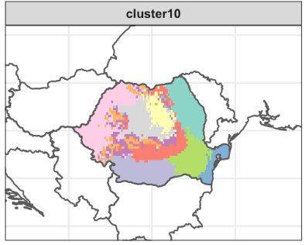
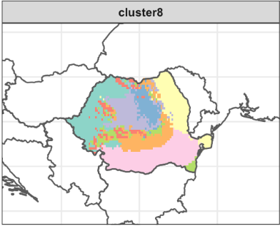
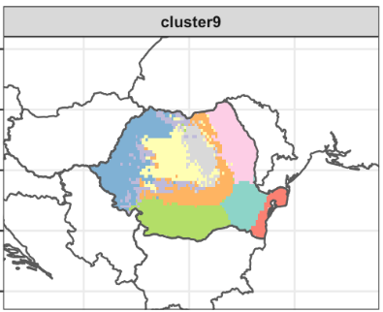
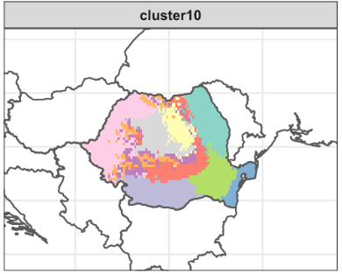
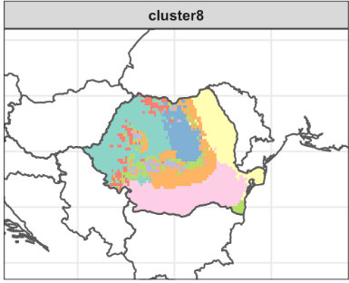
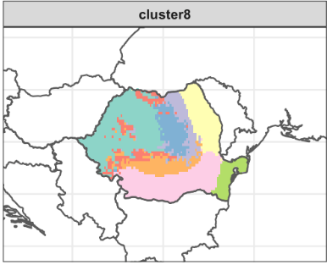
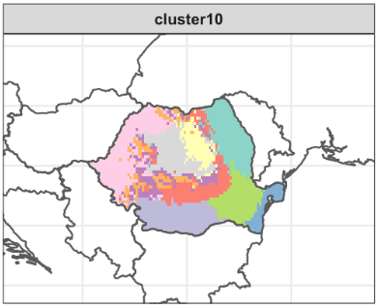
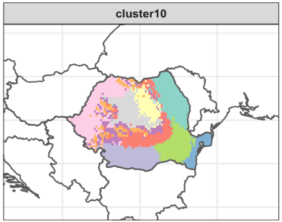

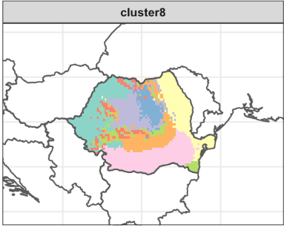
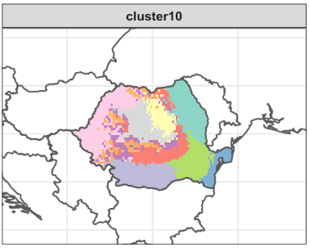
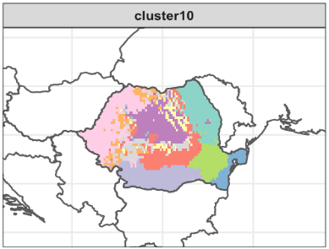
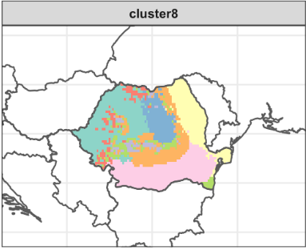
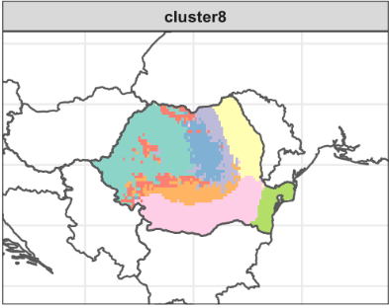
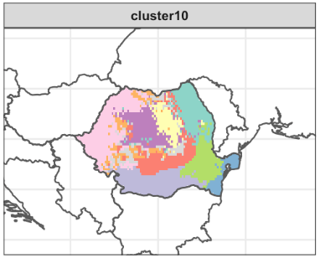
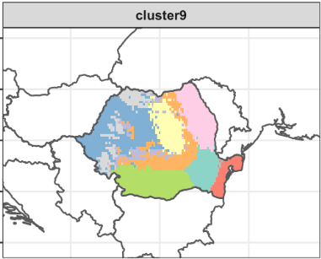
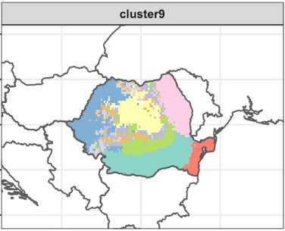
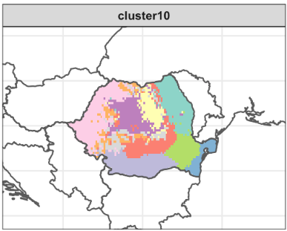
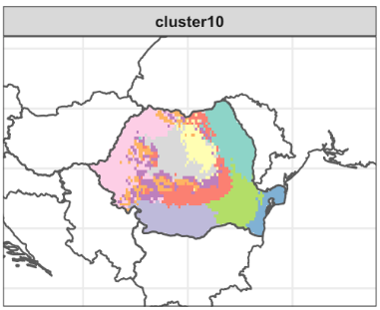
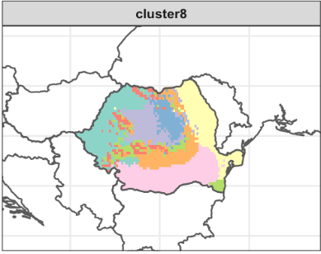
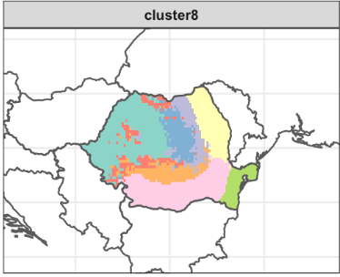


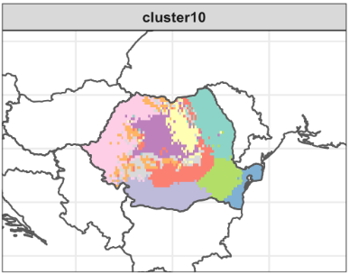
DATA AND METHODS
Selecting major types of climate regions delimitation based on k-means clustering
Factor scores method
Alpha
GLS
Min.chi
Min.rank
ML
WLS
Anderson
Bartlett
Factor analysis method
Regression
tenBerge

Slide 9
RESULTS
1. ROCADA: k-mean clustering based on 6 monthly parameters and filtered with Silhouette method
Major patterns

Slide 10

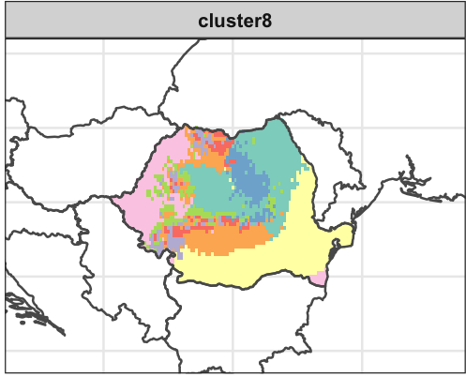
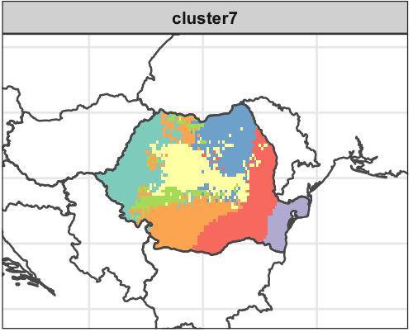
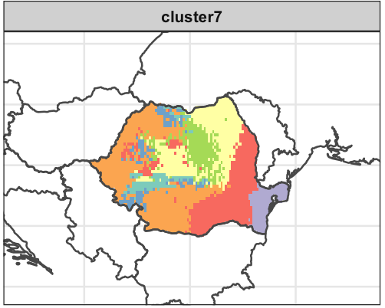
RESULTS
2. ROCADA: k-mean clustering based on 20 Köppen monthly/seasonal parameters and filtered with Silhouette method
Major patterns

Slide 11
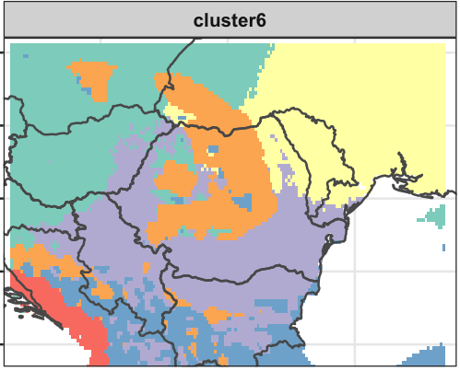
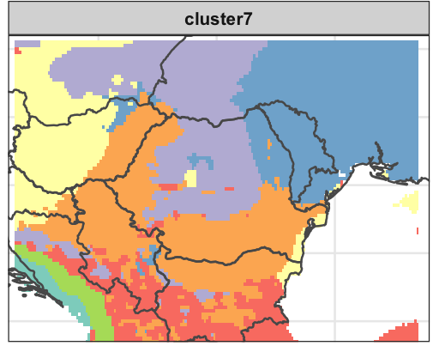
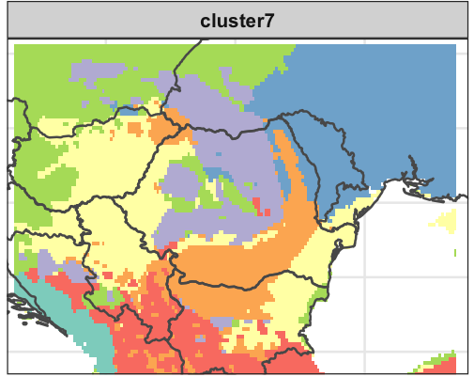
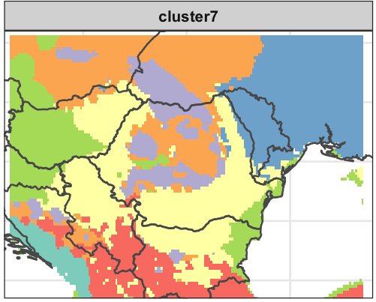
RESULTS
3. ERA5 LAND: k-mean clustering based on 20 Köppen monthly/seasonal parameters and filtered with Silhouette method
Major patterns

Slide 12
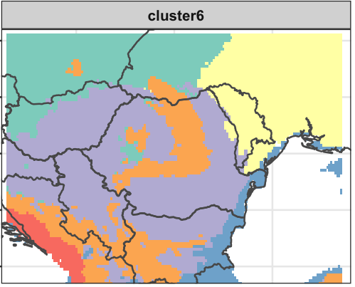
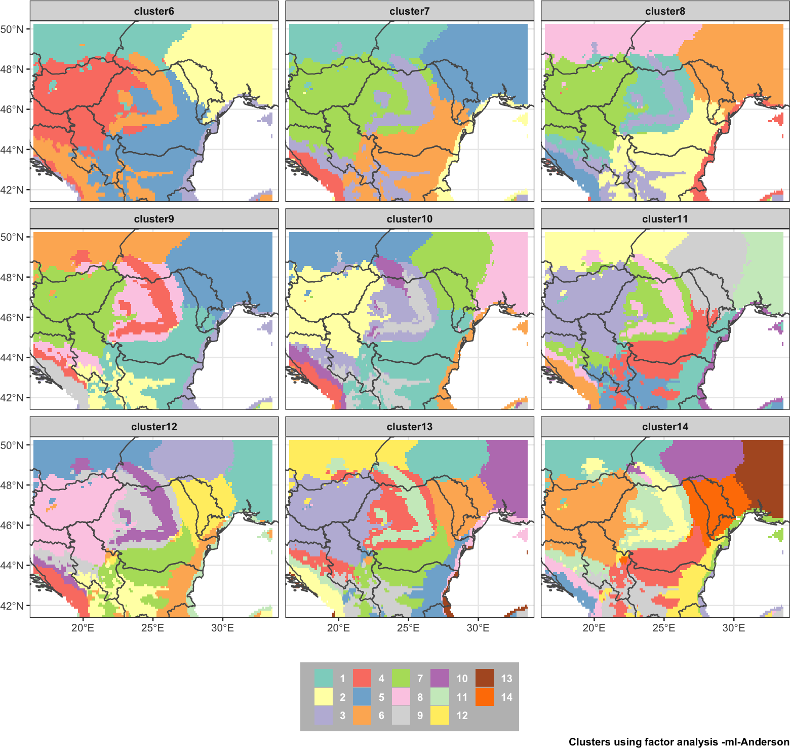
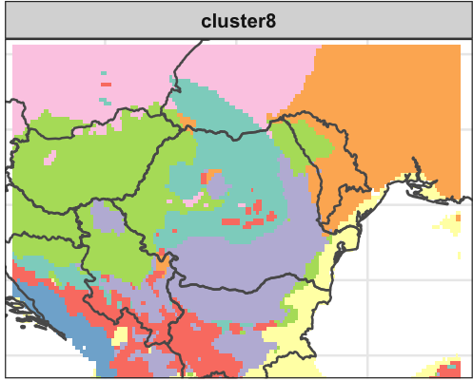
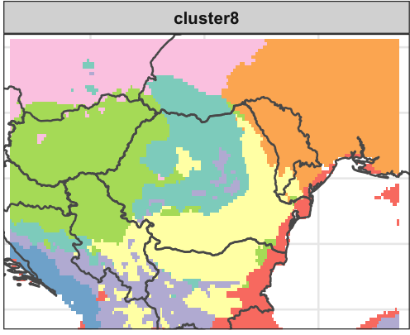
RESULTS
4. ERA5 LAND: k-mean clustering based on 6 monthly parameters and filtered with Silhouette method
Major patterns

Slide 13
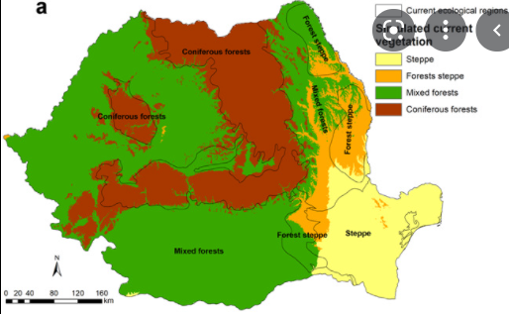
RESULTS
ROCADA_6parameters
ERA 5 LAND_6parameters
Vegetation map of Romania

Slide 14
RESULTS
Steppe
Forest

